Slide 2
Today’s class
Fibonacci numbers
Search algorithms
Linear, Binary
Towers of Hanoi

Slide 3
Fibonacci numbers

Slide 4


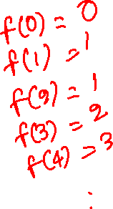
Fibonacci numbers
Recursive definition of Fibonacci numbers
$f\left(n\right)= \begin{matrix}\begin{aligned}0 \\ 1\end{aligned} & \begin{aligned}n=0 \\ n=1\end{aligned} \\ f\left(n−1\right)+f(n−2) & n≥2\end{matrix}$

Slide 5
Fibonacci numbers
Recursive definition of Fibonacci numbers
$f\left(n\right)= \begin{matrix}\begin{aligned}0 \\ 1\end{aligned} & \begin{aligned}n=0 \\ n=1\end{aligned} \\ f\left(n−1\right)+f(n−2) & n≥2\end{matrix}$
int fib(int n) {
if (n == 0 || n == 1)
return n;
return fib(n-1) + fib(n-2);
}

Slide 6
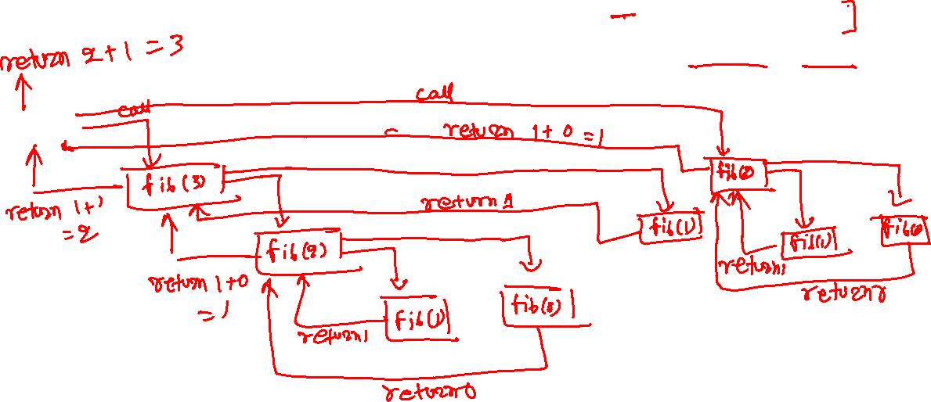
Fibonacci numbers
int fib(int n) {
if (n == 0 || n == 1)
return n;
return fib(n-1) + fib(n-2);
}
fib(4)

Slide 7
Fibonacci numbers
int fib(int n) {
if (n == 0 || n == 1)
return n;
return fib(n-1) + fib(n-2);
}
fib(4)

Slide 8
Fibonacci numbers
int fib(int n) {
if (n == 0 || n == 1)
return n;
return fib(n-1) + fib(n-2);
}
fib(4)
calls
fib(3)

Slide 9
Fibonacci numbers
int fib(int n) {
if (n == 0 || n == 1)
return n;
return fib(n-1) + fib(n-2);
}
fib(4)
calls
fib(3)
calls
fib(2)

Slide 10
Fibonacci numbers
int fib(int n) {
if (n == 0 || n == 1)
return n;
return fib(n-1) + fib(n-2);
}
fib(4)
calls
fib(3)
calls
fib(2)
calls
fib(1)

Slide 11
Fibonacci numbers
int fib(int n) {
if (n == 0 || n == 1)
return n;
return fib(n-1) + fib(n-2);
}
fib(4)
calls
fib(3)
calls
fib(2)
calls
returns 1
fib(1)

Slide 12
Fibonacci numbers
int fib(int n) {
if (n == 0 || n == 1)
return n;
return fib(n-1) + fib(n-2);
}
fib(4)
calls
fib(3)
calls
fib(2)
calls
calls
returns 1
fib(1)
fib(0)

Slide 13
Fibonacci numbers
int fib(int n) {
if (n == 0 || n == 1)
return n;
return fib(n-1) + fib(n-2);
}
fib(4)
calls
fib(3)
calls
fib(2)
calls
calls
returns 1
fib(1)
fib(0)
returns 0

Slide 14
Fibonacci numbers
int fib(int n) {
if (n == 0 || n == 1)
return n;
return fib(n-1) + fib(n-2);
}
fib(4)
calls
fib(3)
calls
fib(2)
returns 1 + 0 = 1
calls
calls
returns 1
fib(1)
fib(0)
returns 0

Slide 15
Fibonacci numbers
int fib(int n) {
if (n == 0 || n == 1)
return n;
return fib(n-1) + fib(n-2);
}
fib(4)
calls
calls
fib(3)
calls
fib(2)
fib(1)
returns 1 + 0 = 1
calls
calls
returns 1
fib(1)
fib(0)
returns 0

Slide 16
Fibonacci numbers
int fib(int n) {
if (n == 0 || n == 1)
return n;
return fib(n-1) + fib(n-2);
}
fib(4)
calls
calls
fib(3)
calls
returns 1
fib(2)
fib(1)
returns 1 + 0 = 1
calls
calls
returns 1
fib(1)
fib(0)
returns 0

Slide 17
Fibonacci numbers
int fib(int n) {
if (n == 0 || n == 1)
return n;
return fib(n-1) + fib(n-2);
}
fib(4)
calls
calls
fib(3)
returns 1 + 1 = 2
calls
returns 1
fib(2)
fib(1)
returns 1 + 0 = 1
calls
calls
returns 1
fib(1)
fib(0)
returns 0

Slide 18
Fibonacci numbers
int fib(int n) {
if (n == 0 || n == 1)
return n;
return fib(n-1) + fib(n-2);
}
calls
fib(4)
calls
calls
fib(3)
fib(2)
returns 1 + 1 = 2
calls
returns 1
fib(2)
fib(1)
returns 1 + 0 = 1
calls
calls
returns 1
fib(1)
fib(0)
returns 0

Slide 19
Fibonacci numbers
int fib(int n) {
if (n == 0 || n == 1)
return n;
return fib(n-1) + fib(n-2);
}
calls
fib(4)
calls
calls
fib(3)
fib(2)
returns 1 + 1 = 2
calls
calls
returns 1
fib(2)
fib(1)
fib(1)
returns 1 + 0 = 1
calls
calls
returns 1
fib(1)
fib(0)
returns 0

Slide 20
Fibonacci numbers
int fib(int n) {
if (n == 0 || n == 1)
return n;
return fib(n-1) + fib(n-2);
}
calls
fib(4)
calls
calls
fib(3)
fib(2)
returns 1 + 1 = 2
calls
calls
returns 1
fib(2)
fib(1)
fib(1)
returns 1 + 0 = 1
returns 1
calls
calls
returns 1
fib(1)
fib(0)
returns 0

Slide 21
Fibonacci numbers
int fib(int n) {
if (n == 0 || n == 1)
return n;
return fib(n-1) + fib(n-2);
}
calls
fib(4)
calls
calls
calls
fib(3)
fib(2)
returns 1 + 1 = 2
calls
calls
returns 1
fib(2)
fib(1)
fib(1)
fib(0)
returns 1 + 0 = 1
returns 1
calls
calls
returns 1
fib(1)
fib(0)
returns 0

Slide 22
Fibonacci numbers
int fib(int n) {
if (n == 0 || n == 1)
return n;
return fib(n-1) + fib(n-2);
}
calls
fib(4)
calls
calls
calls
fib(3)
fib(2)
returns 1 + 1 = 2
calls
calls
returns 1
fib(2)
fib(1)
fib(1)
fib(0)
returns 1 + 0 = 1
returns 1
calls
calls
returns 0
returns 1
fib(1)
fib(0)
returns 0

Slide 23
Fibonacci numbers
int fib(int n) {
if (n == 0 || n == 1)
return n;
return fib(n-1) + fib(n-2);
}
calls
fib(4)
calls
returns 1 + 0 = 1
calls
calls
fib(3)
fib(2)
returns 1 + 1 = 2
calls
calls
returns 1
fib(2)
fib(1)
fib(1)
fib(0)
returns 1 + 0 = 1
returns 1
calls
calls
returns 0
returns 1
fib(1)
fib(0)
returns 0

Slide 24
Fibonacci numbers
int fib(int n) {
if (n == 0 || n == 1)
return n;
return fib(n-1) + fib(n-2);
}
returns 2 + 1 = 3
calls
fib(4)
calls
returns 1 + 0 = 1
calls
calls
fib(3)
fib(2)
returns 1 + 1 = 2
calls
calls
returns 1
fib(2)
fib(1)
fib(1)
fib(0)
returns 1 + 0 = 1
returns 1
calls
calls
returns 0
returns 1
fib(1)
fib(0)
returns 0

Slide 25

f(6)
f(5)
f(4)
f(4)
f(3)
f(3)
f(2)
f(3)
f(2)
f(2)
f(1)
f(2)
f(1)
f(1)
f(0)
f(0)
f(1)
f(0)
f(1)
f(0)
f(2)
f(1)
f(1)
f(1)
f(0)
f(6) makes 24 function calls.

Slide 26
Faster solution

Slide 27
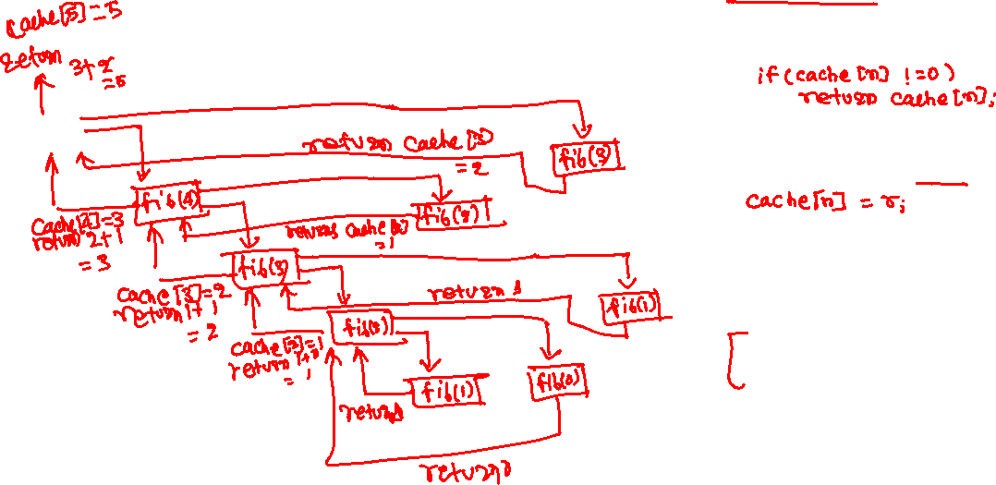
Fibonacci numbers
int cache[1000];
int fib(int n) {
int r;
if (n == 0 || n == 1)
return n;
r = fib(n-1) + fib(n-2);
return r;
}
int main() {
int n, r, i;
for (i = 0; i < 1000; i++) {
cache[i] = 0;
}
printf(“enter the value of n\n”);
scanf(“%d”, &n);
assert(n < 1000);
r = fib(n);
printf(“nth fib number is %d\n”, r);
return 0;
}
fib(5)
Notes:
A cache can be used to reduce the number of repeating computations. We can save the result of a computation that might be used later in a cache (can be implemented using array / other data structures) and retrieve the result from the cache when needed, thus eliminating the need to recompute the result. However, such an approach may take more memory than the algorithm that doesn’t use a cache.

Slide 28
Fibonacci numbers
int cache[1000];
int fib(int n) {
int r;
if (cache[n] != 0)
return cache[n];
if (n == 0 || n == 1)
return n;
r = fib(n-1) + fib(n-2);
cache[n] = r;
return r;
}
int main() {
int n, r, i;
for (i = 0; i < 1000; i++) {
cache[i] = 0;
}
printf(“enter the value of n\n”);
scanf(“%d”, &n);
assert(n < 1000);
r = fib(n);
printf(“nth fib number is %d\n”, r);
return 0;
}
fib(5)

Slide 29
Fibonacci numbers
int cache[1000];
int fib(int n) {
int r;
if (cache[n] != 0)
return cache[n];
if (n == 0 || n == 1)
return n;
r = fib(n-1) + fib(n-2);
cache[n] = r;
return r;
}
int main() {
int n, r, i;
for (i = 0; i < 1000; i++) {
cache[i] = 0;
}
printf(“enter the value of n\n”);
scanf(“%d”, &n);
assert(n < 1000);
r = fib(n);
printf(“nth fib number is %d\n”, r);
return 0;
}
fib(5)
calls
fib(4)

Slide 30
Fibonacci numbers
int cache[1000];
int fib(int n) {
int r;
if (cache[n] != 0)
return cache[n];
if (n == 0 || n == 1)
return n;
r = fib(n-1) + fib(n-2);
cache[n] = r;
return r;
}
int main() {
int n, r, i;
for (i = 0; i < 1000; i++) {
cache[i] = 0;
}
printf(“enter the value of n\n”);
scanf(“%d”, &n);
assert(n < 1000);
r = fib(n);
printf(“nth fib number is %d\n”, r);
return 0;
}
fib(5)
calls
fib(4)
calls
fib(3)

Slide 31
Fibonacci numbers
int cache[1000];
int fib(int n) {
int r;
if (cache[n] != 0)
return cache[n];
if (n == 0 || n == 1)
return n;
r = fib(n-1) + fib(n-2);
cache[n] = r;
return r;
}
int main() {
int n, r, i;
for (i = 0; i < 1000; i++) {
cache[i] = 0;
}
printf(“enter the value of n\n”);
scanf(“%d”, &n);
assert(n < 1000);
r = fib(n);
printf(“nth fib number is %d\n”, r);
return 0;
}
fib(5)
calls
fib(4)
calls
fib(3)
calls
fib(2)

Slide 32
Fibonacci numbers
int cache[1000];
int fib(int n) {
int r;
if (cache[n] != 0)
return cache[n];
if (n == 0 || n == 1)
return n;
r = fib(n-1) + fib(n-2);
cache[n] = r;
return r;
}
int main() {
int n, r, i;
for (i = 0; i < 1000; i++) {
cache[i] = 0;
}
printf(“enter the value of n\n”);
scanf(“%d”, &n);
assert(n < 1000);
r = fib(n);
printf(“nth fib number is %d\n”, r);
return 0;
}
fib(5)
calls
fib(4)
calls
fib(3)
calls
fib(2)
calls
fib(1)

Slide 33
Fibonacci numbers
int cache[1000];
int fib(int n) {
int r;
if (cache[n] != 0)
return cache[n];
if (n == 0 || n == 1)
return n;
r = fib(n-1) + fib(n-2);
cache[n] = r;
return r;
}
int main() {
int n, r, i;
for (i = 0; i < 1000; i++) {
cache[i] = 0;
}
printf(“enter the value of n\n”);
scanf(“%d”, &n);
assert(n < 1000);
r = fib(n);
printf(“nth fib number is %d\n”, r);
return 0;
}
fib(5)
calls
fib(4)
calls
fib(3)
calls
fib(2)
calls
returns 1
fib(1)

Slide 34
Fibonacci numbers
int cache[1000];
int fib(int n) {
int r;
if (cache[n] != 0)
return cache[n];
if (n == 0 || n == 1)
return n;
r = fib(n-1) + fib(n-2);
cache[n] = r;
return r;
}
int main() {
int n, r, i;
for (i = 0; i < 1000; i++) {
cache[i] = 0;
}
printf(“enter the value of n\n”);
scanf(“%d”, &n);
assert(n < 1000);
r = fib(n);
printf(“nth fib number is %d\n”, r);
return 0;
}
fib(5)
calls
fib(4)
calls
fib(3)
calls
fib(2)
calls
calls
returns 1
fib(1)
fib(0)

Slide 35
Fibonacci numbers
int cache[1000];
int fib(int n) {
int r;
if (cache[n] != 0)
return cache[n];
if (n == 0 || n == 1)
return n;
r = fib(n-1) + fib(n-2);
cache[n] = r;
return r;
}
int main() {
int n, r, i;
for (i = 0; i < 1000; i++) {
cache[i] = 0;
}
printf(“enter the value of n\n”);
scanf(“%d”, &n);
assert(n < 1000);
r = fib(n);
printf(“nth fib number is %d\n”, r);
return 0;
}
fib(5)
calls
fib(4)
calls
fib(3)
calls
fib(2)
calls
calls
returns 1
fib(1)
fib(0)
returns 0

Slide 36
Fibonacci numbers
int cache[1000];
int fib(int n) {
int r;
if (cache[n] != 0)
return cache[n];
if (n == 0 || n == 1)
return n;
r = fib(n-1) + fib(n-2);
cache[n] = r;
return r;
}
int main() {
int n, r, i;
for (i = 0; i < 1000; i++) {
cache[i] = 0;
}
printf(“enter the value of n\n”);
scanf(“%d”, &n);
assert(n < 1000);
r = fib(n);
printf(“nth fib number is %d\n”, r);
return 0;
}
fib(5)
calls
fib(4)
calls
fib(3)
calls
fib(2)
calls
r = 1 + 0
cache[2] = 1
returns 1
calls
returns 1
fib(1)
fib(0)
returns 0

Slide 37
Fibonacci numbers
int cache[1000];
int fib(int n) {
int r;
if (cache[n] != 0)
return cache[n];
if (n == 0 || n == 1)
return n;
r = fib(n-1) + fib(n-2);
cache[n] = r;
return r;
}
int main() {
int n, r, i;
for (i = 0; i < 1000; i++) {
cache[i] = 0;
}
printf(“enter the value of n\n”);
scanf(“%d”, &n);
assert(n < 1000);
r = fib(n);
printf(“nth fib number is %d\n”, r);
return 0;
}
fib(5)
calls
fib(4)
calls
fib(3)
calls
calls
fib(2)
calls
fib(1)
r = 1 + 0
cache[2] = 1
returns 1
calls
returns 1
fib(1)
fib(0)
returns 0

Slide 38
Fibonacci numbers
int cache[1000];
int fib(int n) {
int r;
if (cache[n] != 0)
return cache[n];
if (n == 0 || n == 1)
return n;
r = fib(n-1) + fib(n-2);
cache[n] = r;
return r;
}
int main() {
int n, r, i;
for (i = 0; i < 1000; i++) {
cache[i] = 0;
}
printf(“enter the value of n\n”);
scanf(“%d”, &n);
assert(n < 1000);
r = fib(n);
printf(“nth fib number is %d\n”, r);
return 0;
}
fib(5)
calls
fib(4)
calls
fib(3)
calls
calls
returns 1
fib(2)
calls
fib(1)
r = 1 + 0
cache[2] = 1
returns 1
calls
returns 1
fib(1)
fib(0)
returns 0

Slide 39
Fibonacci numbers
int cache[1000];
int fib(int n) {
int r;
if (cache[n] != 0)
return cache[n];
if (n == 0 || n == 1)
return n;
r = fib(n-1) + fib(n-2);
cache[n] = r;
return r;
}
int main() {
int n, r, i;
for (i = 0; i < 1000; i++) {
cache[i] = 0;
}
printf(“enter the value of n\n”);
scanf(“%d”, &n);
assert(n < 1000);
r = fib(n);
printf(“nth fib number is %d\n”, r);
return 0;
}
fib(5)
calls
fib(4)
calls
fib(3)
calls
r = 1 + 1
cache[3] = 2
returns 2
calls
returns 1
fib(2)
calls
fib(1)
r = 1 + 0
cache[2] = 1
returns 1
calls
returns 1
fib(1)
fib(0)
returns 0

Slide 40
Fibonacci numbers
int cache[1000];
int fib(int n) {
int r;
if (cache[n] != 0)
return cache[n];
if (n == 0 || n == 1)
return n;
r = fib(n-1) + fib(n-2);
cache[n] = r;
return r;
}
int main() {
int n, r, i;
for (i = 0; i < 1000; i++) {
cache[i] = 0;
}
printf(“enter the value of n\n”);
scanf(“%d”, &n);
assert(n < 1000);
r = fib(n);
printf(“nth fib number is %d\n”, r);
return 0;
}
fib(5)
calls
fib(4)
calls
calls
fib(3)
calls
fib(2)
r = 1 + 1
cache[3] = 2
returns 2
calls
returns 1
fib(2)
calls
fib(1)
r = 1 + 0
cache[2] = 1
returns 1
calls
returns 1
fib(1)
fib(0)
returns 0

Slide 41
Fibonacci numbers
int cache[1000];
int fib(int n) {
int r;
if (cache[n] != 0)
return cache[n];
if (n == 0 || n == 1)
return n;
r = fib(n-1) + fib(n-2);
cache[n] = r;
return r;
}
int main() {
int n, r, i;
for (i = 0; i < 1000; i++) {
cache[i] = 0;
}
printf(“enter the value of n\n”);
scanf(“%d”, &n);
assert(n < 1000);
r = fib(n);
printf(“nth fib number is %d\n”, r);
return 0;
}
fib(5)
calls
fib(4)
calls
calls
returns cache[2] = 1
fib(3)
calls
fib(2)
r = 1 + 1
cache[3] = 2
returns 2
calls
returns 1
fib(2)
calls
fib(1)
r = 1 + 0
cache[2] = 1
returns 1
calls
returns 1
fib(1)
fib(0)
returns 0

Slide 42
Fibonacci numbers
int cache[1000];
int fib(int n) {
int r;
if (cache[n] != 0)
return cache[n];
if (n == 0 || n == 1)
return n;
r = fib(n-1) + fib(n-2);
cache[n] = r;
return r;
}
int main() {
int n, r, i;
for (i = 0; i < 1000; i++) {
cache[i] = 0;
}
printf(“enter the value of n\n”);
scanf(“%d”, &n);
assert(n < 1000);
r = fib(n);
printf(“nth fib number is %d\n”, r);
return 0;
}
fib(5)
calls
fib(4)
calls
r = 2 + 1
cache[4] = 3
returns 3
calls
returns cache[2] = 1
fib(3)
calls
fib(2)
r = 1 + 1
cache[3] = 2
returns 2
calls
returns 1
fib(2)
calls
fib(1)
r = 1 + 0
cache[2] = 1
returns 1
calls
returns 1
fib(1)
fib(0)
returns 0

Slide 43
Fibonacci numbers
int cache[1000];
int fib(int n) {
int r;
if (cache[n] != 0)
return cache[n];
if (n == 0 || n == 1)
return n;
r = fib(n-1) + fib(n-2);
cache[n] = r;
return r;
}
int main() {
int n, r, i;
for (i = 0; i < 1000; i++) {
cache[i] = 0;
}
printf(“enter the value of n\n”);
scanf(“%d”, &n);
assert(n < 1000);
r = fib(n);
printf(“nth fib number is %d\n”, r);
return 0;
}
calls
fib(5)
calls
fib(4)
calls
fib(3)
r = 2 + 1
cache[4] = 3
returns 3
calls
returns cache[2] = 1
fib(3)
calls
fib(2)
r = 1 + 1
cache[3] = 2
returns 2
calls
returns 1
fib(2)
calls
fib(1)
r = 1 + 0
cache[2] = 1
returns 1
calls
returns 1
fib(1)
fib(0)
returns 0

Slide 44
Fibonacci numbers
int cache[1000];
int fib(int n) {
int r;
if (cache[n] != 0)
return cache[n];
if (n == 0 || n == 1)
return n;
r = fib(n-1) + fib(n-2);
cache[n] = r;
return r;
}
int main() {
int n, r, i;
for (i = 0; i < 1000; i++) {
cache[i] = 0;
}
printf(“enter the value of n\n”);
scanf(“%d”, &n);
assert(n < 1000);
r = fib(n);
printf(“nth fib number is %d\n”, r);
return 0;
}
calls
fib(5)
calls
returns cache[3] = 2
fib(4)
calls
fib(3)
r = 2 + 1
cache[4] = 3
returns 3
calls
returns cache[2] = 1
fib(3)
calls
fib(2)
r = 1 + 1
cache[3] = 2
returns 2
calls
returns 1
fib(2)
calls
fib(1)
r = 1 + 0
cache[2] = 1
returns 1
calls
returns 1
fib(1)
fib(0)
returns 0

Slide 45
Fibonacci numbers
int cache[1000];
int fib(int n) {
int r;
if (cache[n] != 0)
return cache[n];
if (n == 0 || n == 1)
return n;
r = fib(n-1) + fib(n-2);
cache[n] = r;
return r;
}
int main() {
int n, r, i;
for (i = 0; i < 1000; i++) {
cache[i] = 0;
}
printf(“enter the value of n\n”);
scanf(“%d”, &n);
assert(n < 1000);
r = fib(n);
printf(“nth fib number is %d\n”, r);
return 0;
}
calls
fib(5)
calls
returns cache[3] = 2
fib(4)
calls
fib(3)
r = 2 + 1
cache[4] = 3
returns 3
calls
returns cache[2] = 1
fib(3)
calls
fib(2)
r = 1 + 1
cache[3] = 2
returns 2
calls
returns 1
fib(2)
calls
fib(1)
r = 1 + 0
cache[2] = 1
returns 1
calls
r = 3 + 2
cache[5] = 5
returns 5
returns 1
fib(1)
fib(0)
returns 0

Slide 46
Faster recursive solution without caching

Slide 47

Faster recursive solution
Let’s say fib(n) returns two values: fib(n) and fib(n-1), i.e.,
fib(5) returns fib(5) and fib(4)
fib(4) returns fib(4) and fib(3)
fib(3) returns fib(3) and fib(2)
fib(2) returns fib(2) and fib(1)
fib(1) returns 1 and 0
How many function calls are needed to compute fib(6)?
The previous solution without caching requires 24 calls

Slide 48
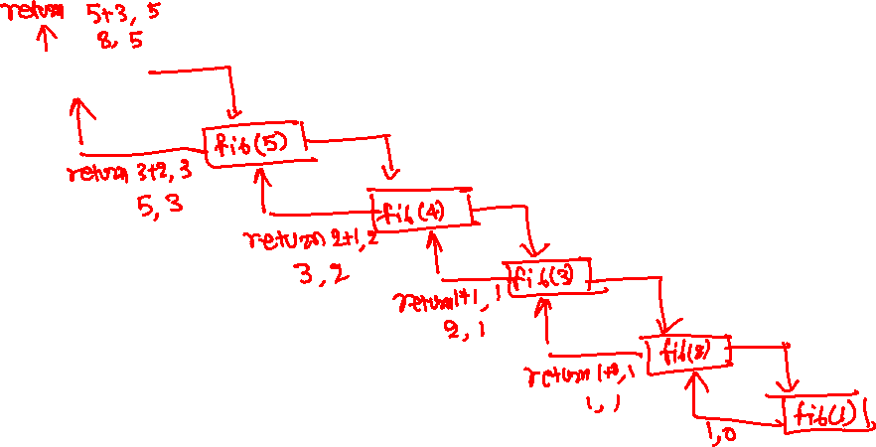
Faster recursive solution
fib(6)

Slide 49
Faster recursive solution
fib(6)

Slide 50
Faster recursive solution
fib(6)
calls
fib(5)

Slide 51
Faster recursive solution
fib(6)
calls
fib(5)
calls
fib(4)

Slide 52
Faster recursive solution
fib(6)
calls
fib(5)
calls
calls
fib(4)
fib(3)

Slide 53
Faster recursive solution
fib(6)
calls
fib(5)
calls
calls
fib(4)
calls
fib(3)
fib(2)

Slide 54
Faster recursive solution
fib(6)
calls
fib(5)
calls
calls
fib(4)
calls
fib(3)
calls
fib(2)
fib(1)

Slide 55
Faster recursive solution
fib(6)
calls
fib(5)
calls
calls
fib(4)
calls
fib(3)
calls
fib(2)
fib(1)
returns 1, 0

Slide 56
Faster recursive solution
fib(6)
calls
fib(5)
calls
calls
fib(4)
calls
fib(3)
calls
fib(2)
returns 1 + 0, 1
= 1, 1
fib(1)
returns 1, 0

Slide 57
Faster recursive solution
fib(6)
calls
fib(5)
calls
calls
fib(4)
calls
returns 1 + 1, 1
= 2, 1
fib(3)
calls
fib(2)
returns 1 + 0, 1
= 1, 1
fib(1)
returns 1, 0

Slide 58
Faster recursive solution
fib(6)
calls
fib(5)
calls
calls
fib(4)
returns 2 + 1, 2
= 3, 2
calls
returns 1 + 1, 1
= 2, 1
fib(3)
calls
fib(2)
returns 1 + 0, 1
= 1, 1
fib(1)
returns 1, 0

Slide 59
Faster recursive solution
fib(6)
calls
fib(5)
calls
returns 3 + 2, 3
= 5, 3
calls
fib(4)
returns 2 + 1, 2
= 3, 2
calls
returns 1 + 1, 1
= 2, 1
fib(3)
calls
fib(2)
returns 1 + 0, 1
= 1, 1
fib(1)
returns 1, 0

Slide 60
Faster recursive solution
fib(6)
calls
fib(5)
calls
returns 3 + 2, 3
= 5, 3
calls
fib(4)
returns 2 + 1, 2
= 3, 2
calls
returns 1 + 1, 1
= 2, 1
fib(3)
calls
fib(2)
returns 1 + 0, 1
= 1, 1
returns 5 + 3, 5
= 8, 5
fib(1)
returns 1, 0

Slide 61
Faster recursive solution
Base case
if (n == 1) return (1, 0)
Recursive step
Recursively call for n-1 to obtain (x, y) = (fib(n-1), fib(n-2))
return (x+y, x)
Notes:
In this recursive algorithm, instead of just returning fib(n), the fib function returns two values: fib(n) and fib(n-1), resulting in an efficient algorithm that doesn’t require multiple recursive calls or caches.

Slide 62
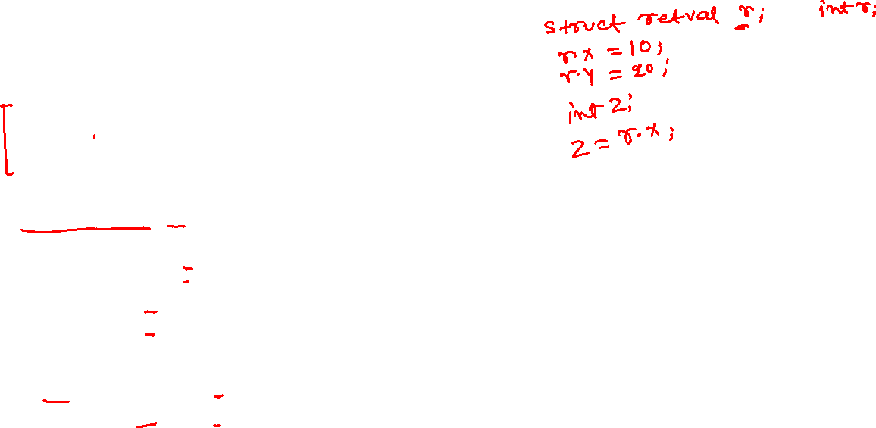
Fibonacci numbers
struct retval {
int x;
int y;
};
struct retval fib(int n) {
struct retval ret;
struct retval r;
if (n == 1) {
r.x = 1;
r.y = 0;
return r;
}
ret = fib(n - 1);
r.x = ret.x + ret.y;
r.y = ret.x;
return r;
}
Notes:
In C, “struct” is a way to define a new data type. A struct may contain multiple fields of possibly different types, including the struct type.

Slide 63
Iterative solution

Slide 64
Iterative solution for Fibonacci numbers

Slide 65
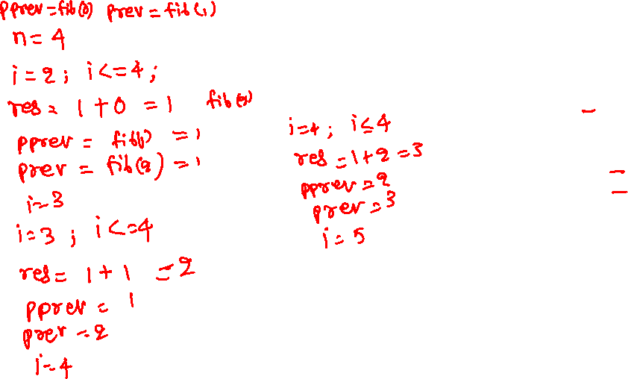
Iterative solution for Fibonacci numbers
int fib(int n) {
if (n == 0 || n == 1) {
return n;
}
int prev = 1;
int pprev = 0;
int res, i;
for (i = 2; i <= n; i++) {
res = prev + pprev;
pprev = prev;
prev = res;
}
return res;
}

Slide 66
Iterative solution for Fibonacci numbers
compute fib(5):
prev = 1
pprev = 0
iteration 1 : i = 2; i <= 5
res = 1 + 0 = 1
pprev = 1
prev = 1
i = 3
iteartion2: i = 3; i <= 5
res = 1 + 1 = 2
pprev = 1
prev = 2
i = 4
iteration 3 : i = 4; i <= 5
res = 2 + 1 = 3
pprev = 2
prev = 3
i = 5
iteartion4: i = 5; i <= 5
res = 3 + 2 = 5
pprev = 3
prev = 5
i = 6
return res = 5
int fib(int n) {
if (n == 0 || n == 1) {
return n;
}
int prev = 1;
int pprev = 0;
int res, i;
for (i = 2; i <= n; i++) {
res = prev + pprev;
pprev = prev;
prev = res;
}
return res;
}
Notes:
The iterative algorithm computes fib(2), fib(3), fib(4), …, fib(n) in an iterative manner. It keeps track of the last two Fibonacci numbers needed to compute the next Fibonacci number.

Slide 67
Can we do better?

Slide 68

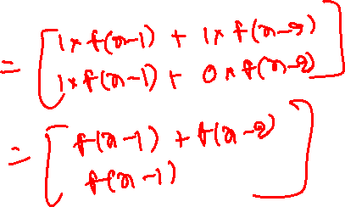
Fibonacci numbers
A better solution
$\left[\begin{aligned}f(n) \\ f(n−1)\end{aligned}\right]= \left[\begin{matrix}1 & 1 \\ 1 & 0\end{matrix}\right]\left[\begin{aligned}f(n−1) \\ f(n−2)\end{aligned}\right]$

Slide 69

Fibonacci numbers
A better solution
$$\left[\begin{aligned}f(n) \\ f(n−1)\end{aligned}\right]= \left[\begin{matrix}1 & 1 \\ 1 & 0\end{matrix}\right]\left[\begin{aligned}f(n−1) \\ f(n−2)\end{aligned}\right]={\left[\begin{matrix}1 & 1 \\ 1 & 0\end{matrix}\right]}^{2}\left[\begin{aligned}f(n−2) \\ f(n−3)\end{aligned}\right]$$

Slide 70
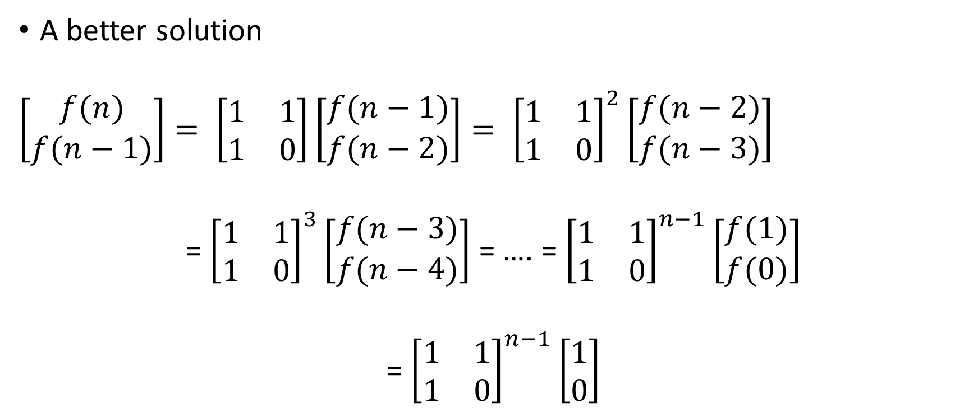
Fibonacci numbers
A better solution
$$\left[\begin{aligned}f(n) \\ f(n−1)\end{aligned}\right]= \left[\begin{matrix}1 & 1 \\ 1 & 0\end{matrix}\right]\left[\begin{aligned}f(n−1) \\ f(n−2)\end{aligned}\right]= {\left[\begin{matrix}1 & 1 \\ 1 & 0\end{matrix}\right]}^{2}\left[\begin{aligned}f(n−2) \\ f(n−3)\end{aligned}\right]$$
= ${\left[\begin{matrix}1 & 1 \\ 1 & 0\end{matrix}\right]}^{3}\left[\begin{aligned}f(n−3) \\ f(n−4)\end{aligned}\right]$ = …. = ${\left[\begin{matrix}1 & 1 \\ 1 & 0\end{matrix}\right]}^{n−1}\left[\begin{aligned}f(1) \\ f(0)\end{aligned}\right]$
= ${\left[\begin{matrix}1 & 1 \\ 1 & 0\end{matrix}\right]}^{n−1}\left[\begin{aligned}1 \\ 0\end{aligned}\right]$

Slide 71

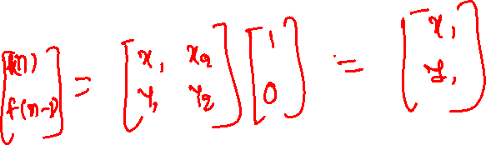
Fibonacci numbers
Let $A= \left[\begin{matrix}1 & 1 \\ 1 & 0\end{matrix}\right]$
$$\left[\begin{matrix}f\left(n\right) \\ f\left(n−1\right)\end{matrix}\right]=A^{n−1}∗\left[\begin{aligned}1 \\ 0\end{aligned}\right]$$
How to compute $A^{n−1}$ fast?

Slide 72
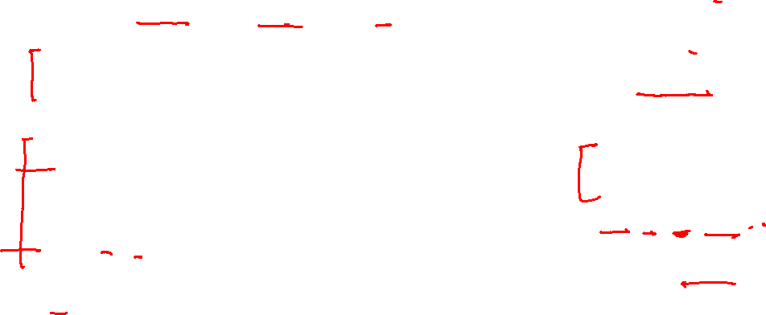
Fibonacci numbers
// mul takes a matrix A and R as input
// returns the result of A^{n} in R
void mul(int A[2][2], int R[2][2], int n) {
if (n == 1) {
R[0][0] = A[0][0]; R[0][1] = A[0][1];
R[1][0] = A[1][0]; R[1][1] = R[1][1];
return;
}
if (n % 2 == 0) {
mul(A, R, n/2);
// mul2 takes two 2x2 matrices as input and
// returns the multiplication in the first
// matrix
mul2(R, R); // R <- R * R
}
else {
mul(A, R, (n-1)/2);
mul2(R, R); // R <- R * R
mul2(R, A); // R <- R * A
}
}
int fib(int n) {
if (n <= 1) {
return n;
}
int A[2][2];
int R[2][2];
A[0][0] = 1; A[0][1] = 1;
A[1][0] = 1; A[1][1] = 0;
mul(A, R, n-1);
// R contains A^{n-1}
return R[0][0];
}
Notes:
The fib routine initializes A (a 2x2 matrix) with the value discussed in the previous slide. The mul routine takes two 2x2 matrices, A and R; the value of n; and returns A^(n-1) in R. The mul2 routine takes two 2x2 matrices, P and Q; computes P x Q; and stores them in P before returning. The recursive algorithm to compute A^n is similar to the faster algorithm we discussed for computing x^n.

Slide 73
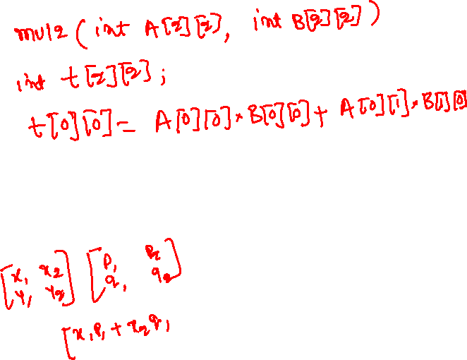
Fibonacci numbers
// mul takes a matrix A and R as input
// returns the result of A^{n} in R
void mul(int A[2][2], int R[2][2], int n) {
if (n == 1) {
R[0][0] = A[0][0]; R[0][1] = A[0][1];
R[1][0] = A[1][0]; R[1][1] = R[1][1];
return;
}
if (n % 2 == 0) {
mul(A, R, n/2);
// mul2 takes two 2x2 matrices as input and
// returns the multiplication in the first
// matrix
mul2(R, R); // R <- R * R
}
else {
mul(A, R, (n-1)/2);
mul2(R, R); // R <- R * R
mul2(R, A); // R <- R * A
}
}
mul2 implementation?

Slide 74
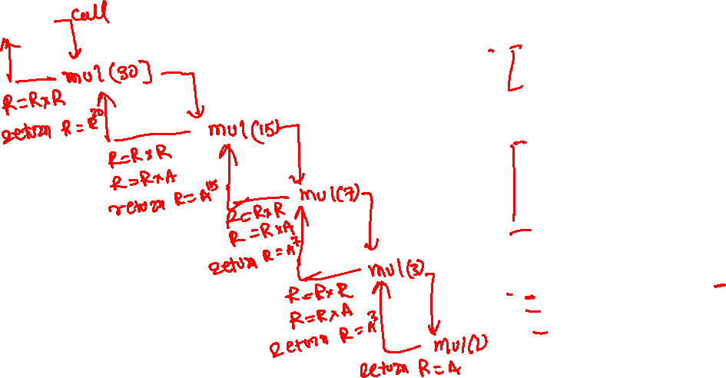
Fibonacci numbers
// mul takes a matrix A and R as input
// returns the result of A^{n} in R
void mul(int A[2][2], int R[2][2], int n) {
if (n == 1) {
R[0][0] = A[0][0]; R[0][1] = A[0][1];
R[1][0] = A[1][0]; R[1][1] = R[1][1];
return;
}
if (n % 2 == 0) {
mul(A, R, n/2);
// mul2 takes two 2x2 matrices as input and
// returns the multiplication in the first
// matrix
mul2(R, R); // R <- R * R
}
else {
mul(A, R, (n-1)/2);
mul2(R, R); // R <- R * R
mul2(R, A); // R <- R * A
}
}
fib(31)

Slide 75
Fibonacci numbers
// mul takes a matrix A and R as input
// returns the result of A^{n} in R
void mul(int A[2][2], int R[2][2], int n) {
if (n == 1) {
R[0][0] = A[0][0]; R[0][1] = A[0][1];
R[1][0] = A[1][0]; R[1][1] = R[1][1];
return;
}
if (n % 2 == 0) {
mul(A, R, n/2);
// mul2 takes two 2x2 matrices as input and
// returns the multiplication in the first
// matrix
mul2(R, R); // R <- R * R
}
else {
mul(A, R, (n-1)/2);
mul2(R, R); // R <- R * R
mul2(R, A); // R <- R * A
}
}
fib(31)

Slide 76
Fibonacci numbers
// mul takes a matrix A and R as input
// returns the result of A^{n} in R
void mul(int A[2][2], int R[2][2], int n) {
if (n == 1) {
R[0][0] = A[0][0]; R[0][1] = A[0][1];
R[1][0] = A[1][0]; R[1][1] = R[1][1];
return;
}
if (n % 2 == 0) {
mul(A, R, n/2);
// mul2 takes two 2x2 matrices as input and
// returns the multiplication in the first
// matrix
mul2(R, R); // R <- R * R
}
else {
mul(A, R, (n-1)/2);
mul2(R, R); // R <- R * R
mul2(R, A); // R <- R * A
}
}
fib(31)
calls
mul(A, R, 30)

Slide 77
Fibonacci numbers
// mul takes a matrix A and R as input
// returns the result of A^{n} in R
void mul(int A[2][2], int R[2][2], int n) {
if (n == 1) {
R[0][0] = A[0][0]; R[0][1] = A[0][1];
R[1][0] = A[1][0]; R[1][1] = R[1][1];
return;
}
if (n % 2 == 0) {
mul(A, R, n/2);
// mul2 takes two 2x2 matrices as input and
// returns the multiplication in the first
// matrix
mul2(R, R); // R <- R * R
}
else {
mul(A, R, (n-1)/2);
mul2(R, R); // R <- R * R
mul2(R, A); // R <- R * A
}
}
fib(31)
calls
mul(A, R, 30)
calls
mul(A, R, 15)

Slide 78
Fibonacci numbers
// mul takes a matrix A and R as input
// returns the result of A^{n} in R
void mul(int A[2][2], int R[2][2], int n) {
if (n == 1) {
R[0][0] = A[0][0]; R[0][1] = A[0][1];
R[1][0] = A[1][0]; R[1][1] = R[1][1];
return;
}
if (n % 2 == 0) {
mul(A, R, n/2);
// mul2 takes two 2x2 matrices as input and
// returns the multiplication in the first
// matrix
mul2(R, R); // R <- R * R
}
else {
mul(A, R, (n-1)/2);
mul2(R, R); // R <- R * R
mul2(R, A); // R <- R * A
}
}
fib(31)
calls
mul(A, R, 30)
calls
mul(A, R, 15)
calls
mul(A, R, 7)

Slide 79
Fibonacci numbers
// mul takes a matrix A and R as input
// returns the result of A^{n} in R
void mul(int A[2][2], int R[2][2], int n) {
if (n == 1) {
R[0][0] = A[0][0]; R[0][1] = A[0][1];
R[1][0] = A[1][0]; R[1][1] = R[1][1];
return;
}
if (n % 2 == 0) {
mul(A, R, n/2);
// mul2 takes two 2x2 matrices as input and
// returns the multiplication in the first
// matrix
mul2(R, R); // R <- R * R
}
else {
mul(A, R, (n-1)/2);
mul2(R, R); // R <- R * R
mul2(R, A); // R <- R * A
}
}
fib(31)
calls
mul(A, R, 30)
calls
mul(A, R, 15)
calls
mul(A, R, 7)
calls
mul(A, R, 3)

Slide 80
Fibonacci numbers
// mul takes a matrix A and R as input
// returns the result of A^{n} in R
void mul(int A[2][2], int R[2][2], int n) {
if (n == 1) {
R[0][0] = A[0][0]; R[0][1] = A[0][1];
R[1][0] = A[1][0]; R[1][1] = R[1][1];
return;
}
if (n % 2 == 0) {
mul(A, R, n/2);
// mul2 takes two 2x2 matrices as input and
// returns the multiplication in the first
// matrix
mul2(R, R); // R <- R * R
}
else {
mul(A, R, (n-1)/2);
mul2(R, R); // R <- R * R
mul2(R, A); // R <- R * A
}
}
fib(31)
calls
mul(A, R, 30)
calls
mul(A, R, 15)
calls
mul(A, R, 7)
calls
mul(A, R, 3)
calls
mul(A, R, 1)

Slide 81
Fibonacci numbers
// mul takes a matrix A and R as input
// returns the result of A^{n} in R
void mul(int A[2][2], int R[2][2], int n) {
if (n == 1) {
R[0][0] = A[0][0]; R[0][1] = A[0][1];
R[1][0] = A[1][0]; R[1][1] = R[1][1];
return;
}
if (n % 2 == 0) {
mul(A, R, n/2);
// mul2 takes two 2x2 matrices as input and
// returns the multiplication in the first
// matrix
mul2(R, R); // R <- R * R
}
else {
mul(A, R, (n-1)/2);
mul2(R, R); // R <- R * R
mul2(R, A); // R <- R * A
}
}
fib(31)
calls
mul(A, R, 30)
calls
mul(A, R, 15)
calls
mul(A, R, 7)
calls
mul(A, R, 3)
calls
mul(A, R, 1)
R = A
returns R = A

Slide 82
Fibonacci numbers
// mul takes a matrix A and R as input
// returns the result of A^{n} in R
void mul(int A[2][2], int R[2][2], int n) {
if (n == 1) {
R[0][0] = A[0][0]; R[0][1] = A[0][1];
R[1][0] = A[1][0]; R[1][1] = R[1][1];
return;
}
if (n % 2 == 0) {
mul(A, R, n/2);
// mul2 takes two 2x2 matrices as input and
// returns the multiplication in the first
// matrix
mul2(R, R); // R <- R * R
}
else {
mul(A, R, (n-1)/2);
mul2(R, R); // R <- R * R
mul2(R, A); // R <- R * A
}
}
fib(31)
calls
mul(A, R, 30)
calls
mul(A, R, 15)
calls
mul(A, R, 7)
calls
mul(A, R, 3)
calls
R = R * R
R = R * A
return R = A^3
mul(A, R, 1)
R = A
returns R = A

Slide 83
Fibonacci numbers
// mul takes a matrix A and R as input
// returns the result of A^{n} in R
void mul(int A[2][2], int R[2][2], int n) {
if (n == 1) {
R[0][0] = A[0][0]; R[0][1] = A[0][1];
R[1][0] = A[1][0]; R[1][1] = R[1][1];
return;
}
if (n % 2 == 0) {
mul(A, R, n/2);
// mul2 takes two 2x2 matrices as input and
// returns the multiplication in the first
// matrix
mul2(R, R); // R <- R * R
}
else {
mul(A, R, (n-1)/2);
mul2(R, R); // R <- R * R
mul2(R, A); // R <- R * A
}
}
fib(31)
calls
mul(A, R, 30)
calls
mul(A, R, 15)
calls
R = R * R
R = R * A
return R = A^7
calls
mul(A, R, 7)
mul(A, R, 3)
calls
R = R * R
R = R * A
return R = A^3
mul(A, R, 1)
R = A
returns R = A

Slide 84
Fibonacci numbers
// mul takes a matrix A and R as input
// returns the result of A^{n} in R
void mul(int A[2][2], int R[2][2], int n) {
if (n == 1) {
R[0][0] = A[0][0]; R[0][1] = A[0][1];
R[1][0] = A[1][0]; R[1][1] = R[1][1];
return;
}
if (n % 2 == 0) {
mul(A, R, n/2);
// mul2 takes two 2x2 matrices as input and
// returns the multiplication in the first
// matrix
mul2(R, R); // R <- R * R
}
else {
mul(A, R, (n-1)/2);
mul2(R, R); // R <- R * R
mul2(R, A); // R <- R * A
}
}
fib(31)
calls
mul(A, R, 30)
calls
R = R * R
R = R * A
return R = A^15
mul(A, R, 15)
calls
R = R * R
R = R * A
return R = A^7
calls
mul(A, R, 7)
mul(A, R, 3)
calls
R = R * R
R = R * A
return R = A^3
mul(A, R, 1)
R = A
returns R = A

Slide 85
Fibonacci numbers
// mul takes a matrix A and R as input
// returns the result of A^{n} in R
void mul(int A[2][2], int R[2][2], int n) {
if (n == 1) {
R[0][0] = A[0][0]; R[0][1] = A[0][1];
R[1][0] = A[1][0]; R[1][1] = R[1][1];
return;
}
if (n % 2 == 0) {
mul(A, R, n/2);
// mul2 takes two 2x2 matrices as input and
// returns the multiplication in the first
// matrix
mul2(R, R); // R <- R * R
}
else {
mul(A, R, (n-1)/2);
mul2(R, R); // R <- R * R
mul2(R, A); // R <- R * A
}
}
fib(31)
calls
mul(A, R, 30)
calls
R = R * R
R = R * A
return R = A^15
mul(A, R, 15)
calls
R = R * R
R = R * A
return R = A^7
calls
mul(A, R, 7)
mul(A, R, 3)
calls
R = R * R
R = R * A
return R = A^3
mul(A, R, 1)
R = A
returns R = A
R = R * R
return R = A^30
Notes:
Notice that this algorithm only makes five recursive calls to compute f(31) in contrast to the previous recursive algorithm that makes around 30 calls.

Slide 86
Homework
Modify the fib(n) routines (matrix mul and iterative) discussed in the class to return “nth Fibonacci number % 1000” instead of “nth Fibonacci number”
Compare the runtimes of matrix mul vs. iterative algorithms for various inputs

Slide 87
Search algorithms

Slide 88
Linear search

Slide 89
Linear search
Let arr be an input array of length n. Given a value x, we want to find an index i (0 <= i < n), such that arr[i] == x. If no such index exists, then the algorithm returns -1.

Slide 90
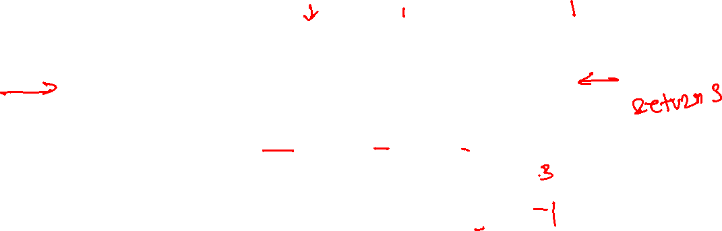
Linear search
12 | 11 | 23 | 13 | 41 | 19 | 25
0
1
2
3
4
5
6
int lsearch(int arr[], int len, int val);
What is the output of lsearch(arr, 7, 13)?
What is the output of lsearch(arr, 7, 30)?

Slide 91
Iterative linear search
int lsearch(int arr[], int val, int len) {
int i;
for (i = len-1; i >= 0; i--) {
if (arr[i] == val)
return i;
}
return -1;
}
Notes:
This linear search algorithm iterates all the elements in the array, starting from the last index to the start index. If the value of an array element is equals to val, it returns the corresponding index; otherwise, if val is not present in the array, lsearch returns -1.

Slide 92
Recursive linear search
int lsearch(int arr[], int val, int len);
Initially, len is the length of the input arr
val is the value being searched

Slide 93
Recursive linear search
int lsearch(int arr[], int val, int len);
Initially, len is the length of the input arr
val is the value being searched
Base cases
if (len == 0) return -1
if (arr[len-1] == val) return len-1
Recursive step
Decrement the length of the array and recursively call search

Slide 94
Recursive linear search
int lsearch(int arr[], int val, int len) {
if (len == 0)
return -1;
if (arr[len-1] == val)
return len-1;
return lsearch(arr, val, len-1);
}

Slide 95
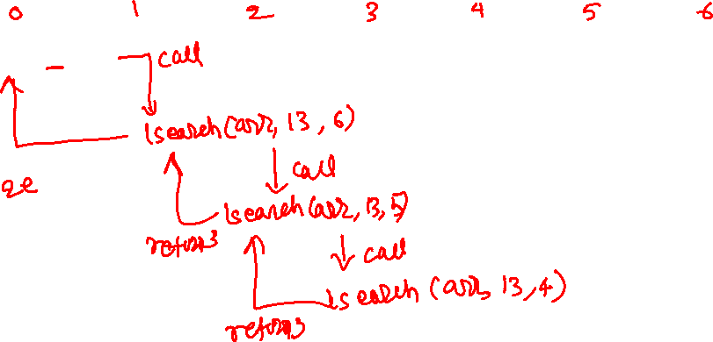
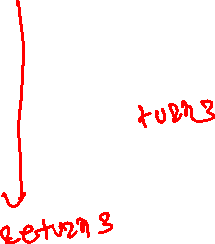
Recursive linear search
12 | 11 | 23 | 13 | 41 | 19 | 25
int lsearch(int arr[], int val, int len) {
if (len == 0)
return -1;
if (arr[len-1] == val)
return len-1;
return lsearch(arr, val, len-1);
}
lsearch(arr, 13, 7)

Slide 96
Recursive linear search
12 | 11 | 23 | 13 | 41 | 19 | 25
int lsearch(int arr[], int val, int len) {
if (len == 0)
return -1;
if (arr[len-1] == val)
return len-1;
return lsearch(arr, val, len-1);
}
lsearch(arr, 13, 7)

Slide 97
Recursive linear search
12 | 11 | 23 | 13 | 41 | 19 | 25
int lsearch(int arr[], int val, int len) {
if (len == 0)
return -1;
if (arr[len-1] == val)
return len-1;
return lsearch(arr, val, len-1);
}
lsearch(arr, 13, 7)
calls
lsearch(arr, 13, 6)

Slide 98
Recursive linear search
12 | 11 | 23 | 13 | 41 | 19 | 25
int lsearch(int arr[], int val, int len) {
if (len == 0)
return -1;
if (arr[len-1] == val)
return len-1;
return lsearch(arr, val, len-1);
}
lsearch(arr, 13, 7)
calls
lsearch(arr, 13, 6)
calls
lsearch(arr, 13, 5)

Slide 99
Recursive linear search
12 | 11 | 23 | 13 | 41 | 19 | 25
int lsearch(int arr[], int val, int len) {
if (len == 0)
return -1;
if (arr[len-1] == val)
return len-1;
return lsearch(arr, val, len-1);
}
lsearch(arr, 13, 7)
calls
lsearch(arr, 13, 6)
calls
lsearch(arr, 13, 5)
calls
lsearch(arr, 13, 4)

Slide 100
Recursive linear search
12 | 11 | 23 | 13 | 41 | 19 | 25
int lsearch(int arr[], int val, int len) {
if (len == 0)
return -1;
if (arr[len-1] == val)
return len-1;
return lsearch(arr, val, len-1);
}
lsearch(arr, 13, 7)
calls
lsearch(arr, 13, 6)
calls
lsearch(arr, 13, 5)
calls
lsearch(arr, 13, 4)
returns 3
Notes:
lsearch(arr, 13, 4) returns 3 because arr[len-1], i.e., arr[3] is equal to the value we are searching for, i.e., 13.

Slide 101
Recursive linear search
12 | 11 | 23 | 13 | 41 | 19 | 25
int lsearch(int arr[], int val, int len) {
if (len == 0)
return -1;
if (arr[len-1] == val)
return len-1;
return lsearch(arr, val, len-1);
}
lsearch(arr, 13, 7)
calls
lsearch(arr, 13, 6)
calls
lsearch(arr, 13, 5)
returns 3
calls
lsearch(arr, 13, 4)
returns 3
Notes:
lsearch(arr, 13, 5) returns the return value of lsearch(arr, 13, 4), which is 3.

Slide 102
Recursive linear search
12 | 11 | 23 | 13 | 41 | 19 | 25
int lsearch(int arr[], int val, int len) {
if (len == 0)
return -1;
if (arr[len-1] == val)
return len-1;
return lsearch(arr, val, len-1);
}
lsearch(arr, 13, 7)
calls
lsearch(arr, 13, 6)
returns 3
calls
lsearch(arr, 13, 5)
returns 3
calls
lsearch(arr, 13, 4)
returns 3
Notes:
lsearch(arr, 13, 6) returns the return value of lsearch(arr, 13, 5), which is 3.

Slide 103
Recursive linear search
12 | 11 | 23 | 13 | 41 | 19 | 25
int lsearch(int arr[], int val, int len) {
if (len == 0)
return -1;
if (arr[len-1] == val)
return len-1;
return lsearch(arr, val, len-1);
}
lsearch(arr, 13, 7)
calls
lsearch(arr, 13, 6)
returns 3
calls
lsearch(arr, 13, 5)
returns 3
calls
lsearch(arr, 13, 4)
returns 3
returns 3
Notes:
lsearch(arr, 13, 7) returns the return value of lsearch(arr, 13, 6), which is 3.

Slide 104
Binary search

Slide 105
Binary search
Let arr be an input sorted array (in ascending order) of length n. Given a value x, we want to find an index i (0 <= i < n), such that arr[i] == x. If no such index exists, then the algorithm returns -1.

Slide 106

Binary search
11 | 15 | 19 | 23 | 41 | 59 | 65 | 75 | 79 | 81 | 87
0
1
2
3
4
5
6
7
8
9
10
int bsearch(int arr[], int len, int val);
search 15
Notes:
The binary search algorithm works on a sorted array. The algorithm first computes the middle index (mid), which is equal to (start+end)/2, where start and end are the first and last index of the array. In this case, initially, mid is 5. If the val == arr[mid], then the algorithm simply returns mid; otherwise, if val > arr[mid], then the searching is performed in the subarray starting from mid+1 to end, else we search the element in the subarray starting from start to mid-1. If the element is not present in the array, the start index will eventually become lesser than the end index, and in that case, the algorithm returns -1.

Slide 107
Binary search
11 | 15 | 19 | 23 | 41 | 59 | 65 | 75 | 79 | 81 | 87
0
1
2
3
4
5
6
7
8
9
10
int bsearch(int arr[], int len, int val);
search 15

Slide 108
Binary search
11 | 15 | 19 | 23 | 41 | 59 | 65 | 75 | 79 | 81 | 87
0
1
2
3
4
5
6
7
8
9
10
int bsearch(int arr[], int len, int val);
search 15
Notes:
Searching 15 in the range (0,10). mid = (0+10)/2 = 5. 15 < arr[5], search in the range (0, 4).

Slide 109
Binary search
11 | 15 | 19 | 23 | 41 | 59 | 65 | 75 | 79 | 81 | 87
0
1
2
3
4
5
6
7
8
9
10
int bsearch(int arr[], int len, int val);
search 15
Notes:
Searching 15 in the range (0,4). mid = (0+4)/2 = 2. 15 < arr[2], search in the range (0, 1).

Slide 110
Binary search
11 | 15 | 19 | 23 | 41 | 59 | 65 | 75 | 79 | 81 | 87
0
1
2
3
4
5
6
7
8
9
10
int bsearch(int arr[], int len, int val);
search 15
Notes:
Searching 15 in the range (0,1). mid = (0+1)/2 = 0. 15 > arr[0], search in the range (1, 1).

Slide 111
Binary search
11 | 15 | 19 | 23 | 41 | 59 | 65 | 75 | 79 | 81 | 87
0
1
2
3
4
5
6
7
8
9
10
int bsearch(int arr[], int len, int val);
search 15
Notes:
Searching 15 in the range (1,1). mid = (1+1)/2 = 1. 15 == arr[1], returns 1.

Slide 112

Binary search
11 | 15 | 19 | 23 | 41 | 59 | 65 | 75 | 79 | 81 | 87
0
1
2
3
4
5
6
7
8
9
10
int bsearch(int arr[], int len, int val);
search 74

Slide 113
Binary search
11 | 15 | 19 | 23 | 41 | 59 | 65 | 75 | 79 | 81 | 87
0
1
2
3
4
5
6
7
8
9
10
int bsearch(int arr[], int len, int val);
search 74

Slide 114
Binary search
11 | 15 | 19 | 23 | 41 | 59 | 65 | 75 | 79 | 81 | 87
0
1
2
3
4
5
6
7
8
9
10
int bsearch(int arr[], int len, int val);
search 74
Notes:
Searching 74 in the range (0,10). mid = (0+10)/2 = 5. 74 > arr[5], search in the range (6, 10).

Slide 115
Binary search
11 | 15 | 19 | 23 | 41 | 59 | 65 | 75 | 79 | 81 | 87
0
1
2
3
4
5
6
7
8
9
10
int bsearch(int arr[], int len, int val);
search 74
Notes:
Searching 74 in the range (6,10). mid = (6+10)/2 = 8. 74 < arr[8], search in the range (6, 7).

Slide 116
Binary search
11 | 15 | 19 | 23 | 41 | 59 | 65 | 75 | 79 | 81 | 87
0
1
2
3
4
5
6
7
8
9
10
int bsearch(int arr[], int len, int val);
search 74
Notes:
Searching 74 in the range (6,7). mid = (6+7)/2 = 6. 74 > arr[6], search in the range (7, 7).

Slide 117
Binary search
11 | 15 | 19 | 23 | 41 | 59 | 65 | 75 | 79 | 81 | 87
0
1
2
3
4
5
6
7
8
9
10
int bsearch(int arr[], int len, int val);
search 74
Notes:
Searching 74 in the range (7,7). mid = (7+7)/2 = 7. 74 < arr[7], search in the range (7, 6).

Slide 118
Binary search
11 | 15 | 19 | 23 | 41 | 59 | 65 | 75 | 79 | 81 | 87
0
1
2
3
4
5
6
7
8
9
10
int bsearch(int arr[], int len, int val);
search 74
Notes:
Searching 74 in the range (7,6). start > end. The value is not present. Returns -1.

Slide 119

Recursive solution
int bsearch(int arr[], int val, int lo, int hi);
Initially, lo = 0 and hi = length(arr) - 1
val is the value being searched
Base cases
if (lo > hi) return -1
mid = (lo + hi)/2
if (arr[mid] == val) return mid
Recursive step
If val > arr[mid], search the second half (mid+1, lo), recursively
Otherwise, search the first half (lo, mid-1)

Slide 120
Recursive solution
int bsearch(int arr[], int val, int lo, int hi) {
if (hi < lo)
return -1;
int mid = (lo + hi) / 2;
if (arr[mid] == val)
return mid;
if (arr[mid] > val)
return bsearch(arr, val, lo, mid-1);
else
return bsearch(arr, val, mid+1, hi);
}

