Slide 2
Today’s class
Towers of Hanoi
Selection sort
Analysis of algorithms

Slide 3
Homework
Implement bsearch for strings
int bsearch(char dict[][8], char word[], int lo, int hi)
Initially
lo is the index of the first row = 0
hi is the index of the last row = number of rows - 1

Slide 4

Comparing two strings
D | O | G | ‘\0’
d | O | G | A | ‘\0’
Ignore the case
ASCII of A-Z = 65-90
ASCII of a-z = 97-122

Slide 5
Towers of Hanoi

Slide 6
Towers of Hanoi
Three towers: source, middle (or temporary), destination
n discs of different sizes are stacked on the source tower
The discs are ordered from largest (bottom) to smallest (top)
The goal is to move all discs from source to destination
Rules for movement
You can move only one disc at a time from one tower to another
A larger disc can’t be placed over a smaller disc

Slide 7
Towers of Hanoi
TOWER-2
TOWER-3
TOWER-1

Slide 8
Towers of Hanoi
TOWER-2
TOWER-3
TOWER-1

Slide 9
Towers of Hanoi
TOWER-2
TOWER-3
TOWER-1

Slide 10
Towers of Hanoi
TOWER-2
TOWER-3
TOWER-1

Slide 11
Towers of Hanoi
TOWER-2
TOWER-3
TOWER-1

Slide 12
Towers of Hanoi
TOWER-2
TOWER-3
TOWER-1

Slide 13
Towers of Hanoi
TOWER-2
TOWER-3
TOWER-1

Slide 14
Towers of Hanoi
TOWER-2
TOWER-3
TOWER-1

Slide 15
Towers of Hanoi
TOWER-2
TOWER-3
TOWER-1

Slide 16
Towers of Hanoi
TOWER-2
TOWER-3
TOWER-1

Slide 17
Towers of Hanoi
TOWER-2
TOWER-3
TOWER-1

Slide 18
Towers of Hanoi
TOWER-2
TOWER-3
TOWER-1

Slide 19
Towers of Hanoi
TOWER-2
TOWER-3
TOWER-1

Slide 20
Towers of Hanoi
TOWER-2
TOWER-3
TOWER-1

Slide 21
Towers of Hanoi
TOWER-2
TOWER-3
TOWER-1

Slide 22
Towers of Hanoi
TOWER-2
TOWER-3
TOWER-1

Slide 23

Initial state
Goal: move n discs from source to destination
TOWER-2
TOWER-3
TOWER-1
SOURCE
MIDDLE
DESTINATION
Notes:
The algorithm work as follows. Suppose there exists a move routine that takes four parameters: 1> the number of discs, 2> the name of the source tower, 3> the name of the destination tower, and 4> the name of the temporary tower. The move routine prints all the moves needed to move n discs from the source tower to the destination tower. Because move is a recursive procedure, we need to find a way to divide the original problem into subproblems and then combine the results of the subproblems to solve the actual problem. Because move works for an arbitrary value of n, we can first call the move routine to move top n-1 discs from the source tower to the temporary tower using the destination tower as temporary. This recursive call will print all the moves required to move top n-1 discs to the temporary tower from the source tower. The resulting state is shown on the next slide.

Slide 24
Intermediate state
After moving n-1 discs from the source tower to the middle tower using the destination tower as temporary
TOWER-2
TOWER-3
TOWER-1
SOURCE
MIDDLE
DESTINATION
Notes:
After moving the top n-1 discs to the temporary tower, we need to move the disc at the bottom of the source tower to the destination tower. The resulting state is shown on the next slide.

Slide 25
Move bottom disc from source to destination
TOWER-2
TOWER-3
TOWER-1
SOURCE
MIDDLE
DESTINATION
Notes:
After this step, we need to move n-1 discs stacked at the temporary tower to the destination tower, using the source as the temporary tower. We can use the move procedure to do this task, which will print all the moves needed to move n-1 discs from the temporary tower to the destination tower. The resulting state is shown on the next slide.

Slide 26
Final state
After moving n-1 discs from the middle tower to the destination tower using the source tower as temporary
TOWER-2
TOWER-3
TOWER-1
SOURCE
MIDDLE
DESTINATION
Notes:
Our objective has been completed, as all the discs have been moved to the destination tower. No further action is required.

Slide 27

Tower of Hanoi
void move(int n, char src_t[], char dst_t[], char tmp_t[]) {
if (n == 1) {
printf(“moving from %s to %s\n”, src_t, dst_t);
}
else {
move(n-1, src_t, tmp_t, dst_t);
printf(“moving from %s to %s\n”, src_t, dst_t);
move(n-1, tmp_t, dst_t, src_t);
}
}
int main() {
move(4, “Tower1”, “Tower3”, “Tower2”);
return 0;
}
Notes:
This is the corresponding C code. Notice that the arguments of move at line-1 are 1> number of discs (n), 2> the name of the source tower (src_t), 3> the name of the destination tower (dst_t), and 4> the name of the temporary tower (tmp_t). At line-6, we are calling the move routine to move top n-1 discs from the src tower to the temporary tower using the destination tower as temporary. Look at the arguments passed to move at line-6. At line-8, we are invoking the move routine again to move n-1 discs from the temporary tower to the destination tower using the source as the temporary tower.

Slide 28
n = 1

Slide 29
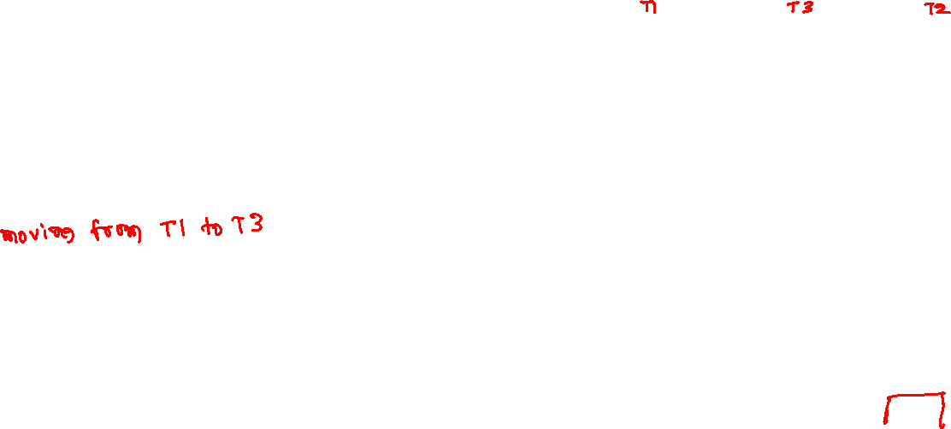
Towers of Hanoi
void move(int n, char src_t[], char dst_t[], char tmp_t[]) {
if (n == 1) {
printf(“moving from %s to %s\n”, src_t, dst_t);
}
else {
move(n-1, src_t, tmp_t, dst_t);
printf(“moving from %s to %s\n”, src_t, dst_t);
move(n-1, tmp_t, dst_t, src_t);
}
}
move(1, “T1”, “T3”, “T2”)
TOWER-2
TOWER-3
TOWER-1

Slide 30
Towers of Hanoi
void move(int n, char src_t[], char dst_t[], char tmp_t[]) {
if (n == 1) {
printf(“moving from %s to %s\n”, src_t, dst_t);
}
else {
move(n-1, src_t, tmp_t, dst_t);
printf(“moving from %s to %s\n”, src_t, dst_t);
move(n-1, tmp_t, dst_t, src_t);
}
}
move(1, “T1”, “T3”, “T2”)
moving from T1 to T3
TOWER-2
TOWER-3
TOWER-1

Slide 31
Towers of Hanoi
void move(int n, char src_t[], char dst_t[], char tmp_t[]) {
if (n == 1) {
printf(“moving from %s to %s\n”, src_t, dst_t);
}
else {
move(n-1, src_t, tmp_t, dst_t);
printf(“moving from %s to %s\n”, src_t, dst_t);
move(n-1, tmp_t, dst_t, src_t);
}
}
move(1, “T1”, “T3”, “T2”)
moving from T1 to T3
TOWER-2
TOWER-3
TOWER-1

Slide 32
n = 2

Slide 33
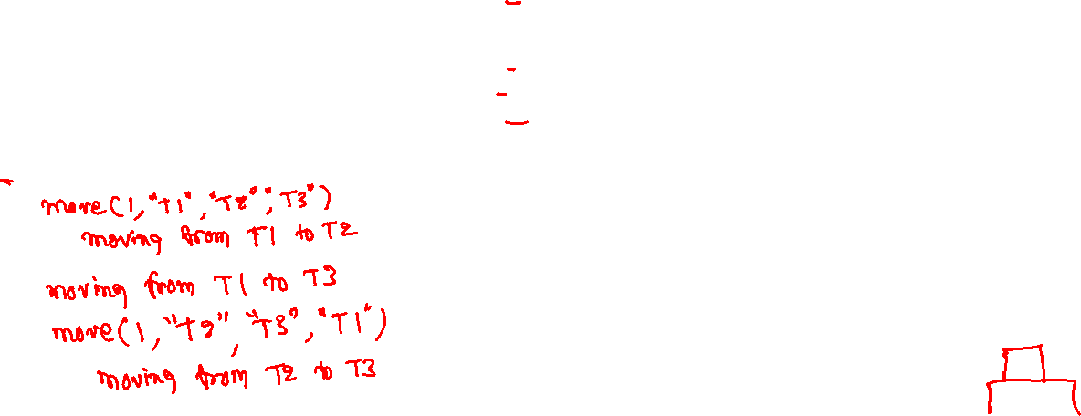
Towers of Hanoi
void move(int n, char src_t[], char dst_t[], char tmp_t[]) {
if (n == 1) {
printf(“moving from %s to %s\n”, src_t, dst_t);
}
else {
move(n-1, src_t, tmp_t, dst_t);
printf(“moving from %s to %s\n”, src_t, dst_t);
move(n-1, tmp_t, dst_t, src_t);
}
}
move(2, “T1”, “T3”, “T2”)
TOWER-2
TOWER-3
TOWER-1

Slide 34
Towers of Hanoi
void move(int n, char src_t[], char dst_t[], char tmp_t[]) {
if (n == 1) {
printf(“moving from %s to %s\n”, src_t, dst_t);
}
else {
move(n-1, src_t, tmp_t, dst_t);
printf(“moving from %s to %s\n”, src_t, dst_t);
move(n-1, tmp_t, dst_t, src_t);
}
}
move(2, “T1”, “T3”, “T2”)
move(1, “T1”, “T2”, “T3”)
moving from T1 to T2
TOWER-2
TOWER-3
TOWER-1

Slide 35
Towers of Hanoi
void move(int n, char src_t[], char dst_t[], char tmp_t[]) {
if (n == 1) {
printf(“moving from %s to %s\n”, src_t, dst_t);
}
else {
move(n-1, src_t, tmp_t, dst_t);
printf(“moving from %s to %s\n”, src_t, dst_t);
move(n-1, tmp_t, dst_t, src_t);
}
}
move(2, “T1”, “T3”, “T2”)
move(1, “T1”, “T2”, “T3”)
moving from T1 to T2
TOWER-2
TOWER-3
TOWER-1

Slide 36
Towers of Hanoi
void move(int n, char src_t[], char dst_t[], char tmp_t[]) {
if (n == 1) {
printf(“moving from %s to %s\n”, src_t, dst_t);
}
else {
move(n-1, src_t, tmp_t, dst_t);
printf(“moving from %s to %s\n”, src_t, dst_t);
move(n-1, tmp_t, dst_t, src_t);
}
}
move(2, “T1”, “T3”, “T2”)
move(1, “T1”, “T2”, “T3”)
moving from T1 to T2
moving from T1 to T3
TOWER-2
TOWER-3
TOWER-1

Slide 37
Towers of Hanoi
void move(int n, char src_t[], char dst_t[], char tmp_t[]) {
if (n == 1) {
printf(“moving from %s to %s\n”, src_t, dst_t);
}
else {
move(n-1, src_t, tmp_t, dst_t);
printf(“moving from %s to %s\n”, src_t, dst_t);
move(n-1, tmp_t, dst_t, src_t);
}
}
move(2, “T1”, “T3”, “T2”)
move(1, “T1”, “T2”, “T3”)
moving from T1 to T2
moving from T1 to T3
TOWER-2
TOWER-3
TOWER-1

Slide 38
Towers of Hanoi
void move(int n, char src_t[], char dst_t[], char tmp_t[]) {
if (n == 1) {
printf(“moving from %s to %s\n”, src_t, dst_t);
}
else {
move(n-1, src_t, tmp_t, dst_t);
printf(“moving from %s to %s\n”, src_t, dst_t);
move(n-1, tmp_t, dst_t, src_t);
}
}
move(2, “T1”, “T3”, “T2”)
move(1, “T1”, “T2”, “T3”)
moving from T1 to T2
moving from T1 to T3
move(1, “T2”, “T3”, “T1”)
moving from T2 to T3
TOWER-2
TOWER-3
TOWER-1

Slide 39
Towers of Hanoi
void move(int n, char src_t[], char dst_t[], char tmp_t[]) {
if (n == 1) {
printf(“moving from %s to %s\n”, src_t, dst_t);
}
else {
move(n-1, src_t, tmp_t, dst_t);
printf(“moving from %s to %s\n”, src_t, dst_t);
move(n-1, tmp_t, dst_t, src_t);
}
}
move(2, “T1”, “T3”, “T2”)
move(1, “T1”, “T2”, “T3”)
moving from T1 to T2
moving from T1 to T3
move(1, “T2”, “T3”, “T1”)
moving from T2 to T3
TOWER-2
TOWER-3
TOWER-1

Slide 40
n = 3

Slide 41
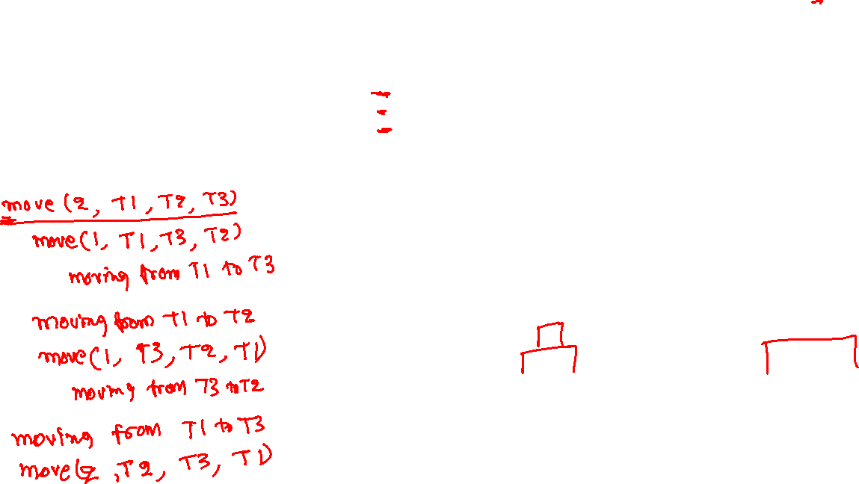
Towers of Hanoi
void move(int n, char src_t[], char dst_t[], char tmp_t[]) {
if (n == 1) {
printf(“moving from %s to %s\n”, src_t, dst_t);
}
else {
move(n-1, src_t, tmp_t, dst_t);
printf(“moving from %s to %s\n”, src_t, dst_t);
move(n-1, tmp_t, dst_t, src_t);
}
}
move(3, “T1”, “T3”, “T2”)
TOWER-2
TOWER-3
TOWER-1

Slide 42
Towers of Hanoi
void move(int n, char src_t[], char dst_t[], char tmp_t[]) {
if (n == 1) {
printf(“moving from %s to %s\n”, src_t, dst_t);
}
else {
move(n-1, src_t, tmp_t, dst_t);
printf(“moving from %s to %s\n”, src_t, dst_t);
move(n-1, tmp_t, dst_t, src_t);
}
}
move(3, “T1”, “T3”, “T2”)
move(2, “T1”, “T2”, “T3”)
move(1, “T1”, “T3”, “T2”)
moving from T1 to T3
TOWER-2
TOWER-3
TOWER-1

Slide 43
Towers of Hanoi
void move(int n, char src_t[], char dst_t[], char tmp_t[]) {
if (n == 1) {
printf(“moving from %s to %s\n”, src_t, dst_t);
}
else {
move(n-1, src_t, tmp_t, dst_t);
printf(“moving from %s to %s\n”, src_t, dst_t);
move(n-1, tmp_t, dst_t, src_t);
}
}
move(3, “T1”, “T3”, “T2”)
move(2, “T1”, “T2”, “T3”)
move(1, “T1”, “T3”, “T2”)
moving from T1 to T3
TOWER-2
TOWER-3
TOWER-1

Slide 44
Towers of Hanoi
void move(int n, char src_t[], char dst_t[], char tmp_t[]) {
if (n == 1) {
printf(“moving from %s to %s\n”, src_t, dst_t);
}
else {
move(n-1, src_t, tmp_t, dst_t);
printf(“moving from %s to %s\n”, src_t, dst_t);
move(n-1, tmp_t, dst_t, src_t);
}
}
move(3, “T1”, “T3”, “T2”)
move(2, “T1”, “T2”, “T3”)
move(1, “T1”, “T3”, “T2”)
moving from T1 to T3
moving from T1 to T2
TOWER-2
TOWER-3
TOWER-1

Slide 45
Towers of Hanoi
void move(int n, char src_t[], char dst_t[], char tmp_t[]) {
if (n == 1) {
printf(“moving from %s to %s\n”, src_t, dst_t);
}
else {
move(n-1, src_t, tmp_t, dst_t);
printf(“moving from %s to %s\n”, src_t, dst_t);
move(n-1, tmp_t, dst_t, src_t);
}
}
move(3, “T1”, “T3”, “T2”)
move(2, “T1”, “T2”, “T3”)
move(1, “T1”, “T3”, “T2”)
moving from T1 to T3
moving from T1 to T2
TOWER-2
TOWER-3
TOWER-1

Slide 46
Towers of Hanoi
void move(int n, char src_t[], char dst_t[], char tmp_t[]) {
if (n == 1) {
printf(“moving from %s to %s\n”, src_t, dst_t);
}
else {
move(n-1, src_t, tmp_t, dst_t);
printf(“moving from %s to %s\n”, src_t, dst_t);
move(n-1, tmp_t, dst_t, src_t);
}
}
move(3, “T1”, “T3”, “T2”)
move(2, “T1”, “T2”, “T3”)
move(1, “T1”, “T3”, “T2”)
moving from T1 to T3
moving from T1 to T2
move(1, “T3”, “T2”, “T1”)
moving from T3 to T2
TOWER-2
TOWER-3
TOWER-1

Slide 47
Towers of Hanoi
void move(int n, char src_t[], char dst_t[], char tmp_t[]) {
if (n == 1) {
printf(“moving from %s to %s\n”, src_t, dst_t);
}
else {
move(n-1, src_t, tmp_t, dst_t);
printf(“moving from %s to %s\n”, src_t, dst_t);
move(n-1, tmp_t, dst_t, src_t);
}
}
move(3, “T1”, “T3”, “T2”)
move(2, “T1”, “T2”, “T3”)
move(1, “T1”, “T3”, “T2”)
moving from T1 to T3
moving from T1 to T2
move(1, “T3”, “T2”, “T1”)
moving from T3 to T2
TOWER-2
TOWER-3
TOWER-1

Slide 48
Towers of Hanoi
void move(int n, char src_t[], char dst_t[], char tmp_t[]) {
if (n == 1) {
printf(“moving from %s to %s\n”, src_t, dst_t);
}
else {
move(n-1, src_t, tmp_t, dst_t);
printf(“moving from %s to %s\n”, src_t, dst_t);
move(n-1, tmp_t, dst_t, src_t);
}
}
move(3, “T1”, “T3”, “T2”)
move(2, “T1”, “T2”, “T3”)
move(1, “T1”, “T3”, “T2”)
moving from T1 to T3
moving from T1 to T2
move(1, “T3”, “T2”, “T1”)
moving from T3 to T2
moving from T1 to T3
TOWER-2
TOWER-3
TOWER-1

Slide 49
Towers of Hanoi
void move(int n, char src_t[], char dst_t[], char tmp_t[]) {
if (n == 1) {
printf(“moving from %s to %s\n”, src_t, dst_t);
}
else {
move(n-1, src_t, tmp_t, dst_t);
printf(“moving from %s to %s\n”, src_t, dst_t);
move(n-1, tmp_t, dst_t, src_t);
}
}
move(3, “T1”, “T3”, “T2”)
move(2, “T1”, “T2”, “T3”)
move(1, “T1”, “T3”, “T2”)
moving from T1 to T3
moving from T1 to T2
move(1, “T3”, “T2”, “T1”)
moving from T3 to T2
moving from T1 to T3
TOWER-2
TOWER-3
TOWER-1

Slide 50
Towers of Hanoi
void move(int n, char src_t[], char dst_t[], char tmp_t[]) {
if (n == 1) {
printf(“moving from %s to %s\n”, src_t, dst_t);
}
else {
move(n-1, src_t, tmp_t, dst_t);
printf(“moving from %s to %s\n”, src_t, dst_t);
move(n-1, tmp_t, dst_t, src_t);
}
}
move(3, “T1”, “T3”, “T2”)
move(2, “T1”, “T2”, “T3”)
move(1, “T1”, “T3”, “T2”)
moving from T1 to T3
moving from T1 to T2
move(1, “T3”, “T2”, “T1”)
moving from T3 to T2
moving from T1 to T3
move(2, “T2”, “T3”, “T1”)
move(1, “T2”, “T1”, “T3”)
moving from T2 to T1
TOWER-2
TOWER-3
TOWER-1

Slide 51
Towers of Hanoi
void move(int n, char src_t[], char dst_t[], char tmp_t[]) {
if (n == 1) {
printf(“moving from %s to %s\n”, src_t, dst_t);
}
else {
move(n-1, src_t, tmp_t, dst_t);
printf(“moving from %s to %s\n”, src_t, dst_t);
move(n-1, tmp_t, dst_t, src_t);
}
}
move(3, “T1”, “T3”, “T2”)
move(2, “T1”, “T2”, “T3”)
move(1, “T1”, “T3”, “T2”)
moving from T1 to T3
moving from T1 to T2
move(1, “T3”, “T2”, “T1”)
moving from T3 to T2
moving from T1 to T3
move(2, “T2”, “T3”, “T1”)
move(1, “T2”, “T1”, “T3”)
moving from T2 to T1
TOWER-2
TOWER-3
TOWER-1

Slide 52
Towers of Hanoi
void move(int n, char src_t[], char dst_t[], char tmp_t[]) {
if (n == 1) {
printf(“moving from %s to %s\n”, src_t, dst_t);
}
else {
move(n-1, src_t, tmp_t, dst_t);
printf(“moving from %s to %s\n”, src_t, dst_t);
move(n-1, tmp_t, dst_t, src_t);
}
}
move(3, “T1”, “T3”, “T2”)
move(2, “T1”, “T2”, “T3”)
move(1, “T1”, “T3”, “T2”)
moving from T1 to T3
moving from T1 to T2
move(1, “T3”, “T2”, “T1”)
moving from T3 to T2
moving from T1 to T3
move(2, “T2”, “T3”, “T1”)
move(1, “T2”, “T1”, “T3”)
moving from T2 to T1
moving from T2 to T3
TOWER-2
TOWER-3
TOWER-1

Slide 53
Towers of Hanoi
void move(int n, char src_t[], char dst_t[], char tmp_t[]) {
if (n == 1) {
printf(“moving from %s to %s\n”, src_t, dst_t);
}
else {
move(n-1, src_t, tmp_t, dst_t);
printf(“moving from %s to %s\n”, src_t, dst_t);
move(n-1, tmp_t, dst_t, src_t);
}
}
move(3, “T1”, “T3”, “T2”)
move(2, “T1”, “T2”, “T3”)
move(1, “T1”, “T3”, “T2”)
moving from T1 to T3
moving from T1 to T2
move(1, “T3”, “T2”, “T1”)
moving from T3 to T2
moving from T1 to T3
move(2, “T2”, “T3”, “T1”)
move(1, “T2”, “T1”, “T3”)
moving from T2 to T1
moving from T2 to T3
TOWER-2
TOWER-3
TOWER-1

Slide 54
Towers of Hanoi
void move(int n, char src_t[], char dst_t[], char tmp_t[]) {
if (n == 1) {
printf(“moving from %s to %s\n”, src_t, dst_t);
}
else {
move(n-1, src_t, tmp_t, dst_t);
printf(“moving from %s to %s\n”, src_t, dst_t);
move(n-1, tmp_t, dst_t, src_t);
}
}
move(3, “T1”, “T3”, “T2”)
move(2, “T1”, “T2”, “T3”)
move(1, “T1”, “T3”, “T2”)
moving from T1 to T3
moving from T1 to T2
move(1, “T3”, “T2”, “T1”)
moving from T3 to T2
moving from T1 to T3
move(2, “T2”, “T3”, “T1”)
move(1, “T2”, “T1”, “T3”)
moving from T2 to T1
moving from T2 to T3
move(1, “T1”, “T3”, “T2”)
moving from T1 to T3
TOWER-2
TOWER-3
TOWER-1

Slide 55
Towers of Hanoi
void move(int n, char src_t[], char dst_t[], char tmp_t[]) {
if (n == 1) {
printf(“moving from %s to %s\n”, src_t, dst_t);
}
else {
move(n-1, src_t, tmp_t, dst_t);
printf(“moving from %s to %s\n”, src_t, dst_t);
move(n-1, tmp_t, dst_t, src_t);
}
}
move(3, “T1”, “T3”, “T2”)
move(2, “T1”, “T2”, “T3”)
move(1, “T1”, “T3”, “T2”)
moving from T1 to T3
moving from T1 to T2
move(1, “T3”, “T2”, “T1”)
moving from T3 to T2
moving from T1 to T3
move(2, “T2”, “T3”, “T1”)
move(1, “T2”, “T1”, “T3”)
moving from T2 to T1
moving from T2 to T3
move(1, “T1”, “T3”, “T2”)
moving from T1 to T3
TOWER-2
TOWER-3
TOWER-1

Slide 56
Homework
Extend the Towers of Hanoi solution to use four towers
Two temporaries instead of one
Compare the number of moves in both approaches for a given number of discs

Slide 57
Selection sort

Slide 58

Sorting
Input: a sequence of n numbers $<a_{1}, a_{2}, …,a_{n}>$
Output: a permutation of input sequence $<a_{1}^{′}, a_{2}^{′}, …, a_{n}^{′}>$ such that $a_{1}^{′}≤a_{2}^{′}≤ …≤a_{n}^{′}$

Slide 59
Selection sort
Find the minimum element and swap it with the first element
Find the second minimum and swap it with the second element
Find the third minimum and swap it with the third element
and so on.
Find the $\left(n−1\right)th$ minimum and swap it with the $\left(n−1\right)th$ element

Slide 60
Selection sort
83 | 86 | 77 | 15 | 93 | 35 | 86 | 92 | 49 | 21

Slide 61
Selection sort
83 | 86 | 77 | 15 | 93 | 35 | 86 | 92 | 49 | 21
15 | 86 | 77 | 83 | 93 | 35 | 86 | 92 | 49 | 21

Slide 62
Selection sort
83 | 86 | 77 | 15 | 93 | 35 | 86 | 92 | 49 | 21
15 | 86 | 77 | 83 | 93 | 35 | 86 | 92 | 49 | 21
15 | 21 | 77 | 83 | 93 | 35 | 86 | 92 | 49 | 86

Slide 63
Selection sort
83 | 86 | 77 | 15 | 93 | 35 | 86 | 92 | 49 | 21
15 | 86 | 77 | 83 | 93 | 35 | 86 | 92 | 49 | 21
15 | 21 | 77 | 83 | 93 | 35 | 86 | 92 | 49 | 86
15 | 21 | 35 | 83 | 93 | 77 | 86 | 92 | 49 | 86

Slide 64
Selection sort
15 | 21 | 35 | 83 | 93 | 77 | 86 | 92 | 49 | 86
15 | 21 | 35 | 49 | 93 | 77 | 86 | 92 | 83 | 86
15 | 21 | 35 | 49 | 77 | 93 | 86 | 92 | 83 | 86
15 | 21 | 35 | 49 | 77 | 83 | 86 | 92 | 93 | 86

Slide 65
Selection sort
15 | 21 | 35 | 49 | 77 | 83 | 86 | 92 | 93 | 86
15 | 21 | 35 | 49 | 77 | 83 | 86 | 92 | 93 | 86
15 | 21 | 35 | 49 | 77 | 83 | 86 | 86 | 93 | 92
15 | 21 | 35 | 49 | 77 | 83 | 86 | 86 | 92 | 93

Slide 66

Selection sort
int find_min(int arr[], int start, int end)
{
int i, min, idx;
min = arr[start];
idx = start;
for (i = start + 1; i < end; i++) {
if (arr[i] < min) {
min = arr[i];
idx = i;
}
}
return idx;
}
void swap(int arr[], int i, int j)
{
int tmp = arr[i];
arr[i] = arr[j];
arr[j] = tmp;
}
void selection_sort(int arr[], int n)
{
int i, idx;
for (i = 0; i < n - 1; i++) {
idx = find_min(arr, i, n);
if (idx != i) {
swap(arr, i, idx);
}
}
}

Slide 67
Selection sort recursion
int find_min(int arr[], int start, int end)
{
int i, min, idx;
min = arr[start];
idx = start;
for (i = start + 1; i < end; i++) {
if (arr[i] < min) {
min = arr[i];
idx = i;
}
}
return idx;
}
void swap(int arr[], int i, int j)
{
int tmp = arr[i];
arr[i] = arr[j];
arr[j] = tmp;
}
void selection_sort_r(int arr[], int pos, int n)
{
int idx;
if (pos >= n - 1) {
return;
}
idx = find_min(arr, pos, n);
if (idx != pos) {
swap(arr, pos, idx);
}
selection_sort(arr, pos+1, n);
}
Notes:
We can also write selection sort in a recursive manner. Initially, pos is zero, which is also the start index. The recursive procedure sorts the elements in the range pos to n, where n is the number of elements in the array.

Slide 68
Tail recursion

Slide 69

Tail recursion
12 | 11 | 23 | 13 | 41 | 19 | 25
int lsearch(int arr[], int val, int len) {
if (len == 0)
return -1;
if (arr[len-1] == val)
return len-1;
return lsearch(arr, val, len-1);
}
lsearch(arr, 13, 7)
calls
lsearch(arr, 13, 6)
returns 3
calls
lsearch(arr, 13, 5)
returns 3
calls
lsearch(arr, 13, 4)
returns 3
returns 3
Notes:
Look at the recursive definition of the lsearch routine. To search an element, we might need to execute a chain function calls before we reach an index at which the value we are searching is stored. After the value is found, we need to return through the chain of function calls until we reach the outermost function. Notice that during a function call, the compiler needs to allocate the space for all local variables and the parameters at function entry and deallocate all the space before returning to the caller. In contrast, none of this is needed in the corresponding iterative algorithm. There is just one function that iterates through the array elements in a loop. Does this mean that the iterative algorithm will always be better than the recursive algorithm?

Slide 70
Function arguments and local variables
Space for function arguments and local variables are automatically allocated by the compiler
The allocation strategy may differ across compilers
Most compilers use a runtime stack to store a part of local variables, function arguments, and the caller info
The caller info is required to return to the caller

Slide 71

Tail recursion
int lsearch(int arr[], int val, int len) {
if (len == 0)
return -1;
if (arr[len-1] == val)
return len-1;
return lsearch(arr, val, len-1);
}
arr: 13, 79, 87, 32, 65, 23, 11
search : 20

Slide 72

Tail recursion
lsearch(arr, 20, 7)
24 BYTES
int lsearch(int arr[], int val, int len) {
if (len == 0)
return -1;
if (arr[len-1] == val)
return len-1;
return lsearch(arr, val, len-1);
}
arr: 13, 79, 87, 32, 65, 23, 11
search : 20
Notes:
In this case, 24 bytes are required to store the parameters and the caller info (needed to return to the caller) when lsearch is called. This memory is automatically allocated and deallocated by the compiler. The compiler deallocates the memory just before lsearch returns.

Slide 73
Tail recursion
lsearch(arr, 20, 7)
lsearch(arr, 20, 6)
24 BYTES
24 BYTES
int lsearch(int arr[], int val, int len) {
if (len == 0)
return -1;
if (arr[len-1] == val)
return len-1;
return lsearch(arr, val, len-1);
}
arr: 13, 79, 87, 32, 65, 23, 11
search : 20

Slide 74
Tail recursion
lsearch(arr, 20, 7)
lsearch(arr, 20, 6)
lsearch(arr, 20, 5)
24 BYTES
24 BYTES
int lsearch(int arr[], int val, int len) {
if (len == 0)
return -1;
if (arr[len-1] == val)
return len-1;
return lsearch(arr, val, len-1);
}
24 BYTES
arr: 13, 79, 87, 32, 65, 23, 11
search : 20

Slide 75
Tail recursion
lsearch(arr, 20, 7)
lsearch(arr, 20, 6)
lsearch(arr, 20, 5)
lsearch(arr, 20, 4)
24 BYTES
24 BYTES
int lsearch(int arr[], int val, int len) {
if (len == 0)
return -1;
if (arr[len-1] == val)
return len-1;
return lsearch(arr, val, len-1);
}
24 BYTES
24 BYTES
arr: 13, 79, 87, 32, 65, 23, 11
search : 20

Slide 76
Tail recursion
lsearch(arr, 20, 7)
lsearch(arr, 20, 6)
lsearch(arr, 20, 5)
lsearch(arr, 20, 4)
lsearch(arr, 20, 3)
24 BYTES
24 BYTES
int lsearch(int arr[], int val, int len) {
if (len == 0)
return -1;
if (arr[len-1] == val)
return len-1;
return lsearch(arr, val, len-1);
}
24 BYTES
24 BYTES
24 BYTES
arr: 13, 79, 87, 32, 65, 23, 11
search : 20

Slide 77
Tail recursion
lsearch(arr, 20, 7)
lsearch(arr, 20, 6)
lsearch(arr, 20, 5)
lsearch(arr, 20, 4)
lsearch(arr, 20, 3)
lsearch(arr, 20, 2)
24 BYTES
24 BYTES
int lsearch(int arr[], int val, int len) {
if (len == 0)
return -1;
if (arr[len-1] == val)
return len-1;
return lsearch(arr, val, len-1);
}
24 BYTES
24 BYTES
24 BYTES
24 BYTES
arr: 13, 79, 87, 32, 65, 23, 11
search : 20

Slide 78
Tail recursion
lsearch(arr, 20, 7)
lsearch(arr, 20, 6)
lsearch(arr, 20, 5)
lsearch(arr, 20, 4)
lsearch(arr, 20, 3)
lsearch(arr, 20, 2)
lsearch(arr, 20, 1)
24 BYTES
24 BYTES
int lsearch(int arr[], int val, int len) {
if (len == 0)
return -1;
if (arr[len-1] == val)
return len-1;
return lsearch(arr, val, len-1);
}
24 BYTES
24 BYTES
24 BYTES
24 BYTES
24 BYTES
arr: 13, 79, 87, 32, 65, 23, 11
search : 20

Slide 79

Tail recursion
lsearch(arr, 20, 7)
lsearch(arr, 20, 6)
lsearch(arr, 20, 5)
lsearch(arr, 20, 4)
lsearch(arr, 20, 3)
lsearch(arr, 20, 2)
lsearch(arr, 20, 1)
lsearch(arr, 20, 0)
24 BYTES
24 BYTES
int lsearch(int arr[], int val, int len) {
if (len == 0)
return -1;
if (arr[len-1] == val)
return len-1;
return lsearch(arr, val, len-1);
}
24 BYTES
24 BYTES
24 BYTES
24 BYTES
24 BYTES
arr: 13, 79, 87, 32, 65, 23, 11
search : 20
24 BYTES

Slide 80
Tail recursion
lsearch(arr, 20, 7)
lsearch(arr, 20, 6)
lsearch(arr, 20, 5)
lsearch(arr, 20, 4)
lsearch(arr, 20, 3)
lsearch(arr, 20, 2)
lsearch(arr, 20, 1)
lsearch(arr, 20, 0)
24 BYTES
24 BYTES
int lsearch(int arr[], int val, int len) {
if (len == 0)
return -1;
if (arr[len-1] == val)
return len-1;
return lsearch(arr, val, len-1);
}
24 BYTES
24 BYTES
24 BYTES
24 BYTES
24 BYTES
arr: 13, 79, 87, 32, 65, 23, 11
search : 20

Slide 81
Tail recursion
lsearch(arr, 20, 7)
lsearch(arr, 20, 6)
lsearch(arr, 20, 5)
lsearch(arr, 20, 4)
lsearch(arr, 20, 3)
lsearch(arr, 20, 2)
lsearch(arr, 20, 1)
lsearch(arr, 20, 0)
24 BYTES
24 BYTES
int lsearch(int arr[], int val, int len) {
if (len == 0)
return -1;
if (arr[len-1] == val)
return len-1;
return lsearch(arr, val, len-1);
}
24 BYTES
24 BYTES
24 BYTES
24 BYTES
arr: 13, 79, 87, 32, 65, 23, 11
search : 20

Slide 82
Tail recursion
lsearch(arr, 20, 7)
lsearch(arr, 20, 6)
lsearch(arr, 20, 5)
lsearch(arr, 20, 4)
lsearch(arr, 20, 3)
lsearch(arr, 20, 2)
lsearch(arr, 20, 1)
lsearch(arr, 20, 0)
24 BYTES
24 BYTES
int lsearch(int arr[], int val, int len) {
if (len == 0)
return -1;
if (arr[len-1] == val)
return len-1;
return lsearch(arr, val, len-1);
}
24 BYTES
24 BYTES
24 BYTES
arr: 13, 79, 87, 32, 65, 23, 11
search : 20

Slide 83
Tail recursion
lsearch(arr, 20, 7)
lsearch(arr, 20, 6)
lsearch(arr, 20, 5)
lsearch(arr, 20, 4)
lsearch(arr, 20, 3)
lsearch(arr, 20, 2)
lsearch(arr, 20, 1)
lsearch(arr, 20, 0)
24 BYTES
24 BYTES
int lsearch(int arr[], int val, int len) {
if (len == 0)
return -1;
if (arr[len-1] == val)
return len-1;
return lsearch(arr, val, len-1);
}
24 BYTES
24 BYTES
arr: 13, 79, 87, 32, 65, 23, 11
search : 20

Slide 84
Tail recursion
lsearch(arr, 20, 7)
lsearch(arr, 20, 6)
lsearch(arr, 20, 5)
lsearch(arr, 20, 4)
lsearch(arr, 20, 3)
lsearch(arr, 20, 2)
lsearch(arr, 20, 1)
lsearch(arr, 20, 0)
24 BYTES
24 BYTES
int lsearch(int arr[], int val, int len) {
if (len == 0)
return -1;
if (arr[len-1] == val)
return len-1;
return lsearch(arr, val, len-1);
}
24 BYTES
arr: 13, 79, 87, 32, 65, 23, 11
search : 20

Slide 85
Tail recursion
lsearch(arr, 20, 7)
lsearch(arr, 20, 6)
lsearch(arr, 20, 5)
lsearch(arr, 20, 4)
lsearch(arr, 20, 3)
lsearch(arr, 20, 2)
lsearch(arr, 20, 1)
lsearch(arr, 20, 0)
24 BYTES
24 BYTES
int lsearch(int arr[], int val, int len) {
if (len == 0)
return -1;
if (arr[len-1] == val)
return len-1;
return lsearch(arr, val, len-1);
}
arr: 13, 79, 87, 32, 65, 23, 11
search : 20

Slide 86
Tail recursion
lsearch(arr, 20, 7)
lsearch(arr, 20, 6)
lsearch(arr, 20, 5)
lsearch(arr, 20, 4)
lsearch(arr, 20, 3)
lsearch(arr, 20, 2)
lsearch(arr, 20, 1)
lsearch(arr, 20, 0)
24 BYTES
int lsearch(int arr[], int val, int len) {
if (len == 0)
return -1;
if (arr[len-1] == val)
return len-1;
return lsearch(arr, val, len-1);
}
arr: 13, 79, 87, 32, 65, 23, 11
search : 20

Slide 87
Tail recursion
lsearch(arr, 20, 7)
lsearch(arr, 20, 6)
lsearch(arr, 20, 5)
lsearch(arr, 20, 4)
lsearch(arr, 20, 3)
lsearch(arr, 20, 2)
lsearch(arr, 20, 1)
lsearch(arr, 20, 0)
int lsearch(int arr[], int val, int len) {
if (len == 0)
return -1;
if (arr[len-1] == val)
return len-1;
return lsearch(arr, val, len-1);
}
arr: 13, 79, 87, 32, 65, 23, 11
search : 20

Slide 88
Tail recursion
lsearch(arr, 20, 7)
lsearch(arr, 20, 6)
lsearch(arr, 20, 5)
lsearch(arr, 20, 4)
lsearch(arr, 20, 3)
lsearch(arr, 20, 2)
lsearch(arr, 20, 1)
lsearch(arr, 20, 0)
int lsearch(int arr[], int val, int len) {
if (len == 0)
return -1;
if (arr[len-1] == val)
return len-1;
return lsearch(arr, val, len-1);
}
The caller simply returns after the recursive call.
arr: 13, 79, 87, 32, 65, 23, 11
search : 20

Slide 89
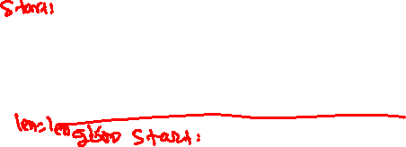
Tail recursion
int lsearch(int arr[], int val, int len) {
if (len == 0)
return -1;
if (arr[len-1] == val)
return len-1;
return lsearch(arr, val, len-1);
}
Can we remove the recursive call?
The caller simply returns after the recursive call.
arr: 13, 79, 87, 32, 65, 23, 11
search : 20

Slide 90
Tail recursion
int lsearch(int arr[], int val, int len) {
if (len == 0)
return -1;
if (arr[len-1] == val)
return len-1;
return lsearch(arr, val, len-1);
}
int lsearch(int arr[], int val, int len) {
start:
if (len == 0)
return -1;
if (arr[len-1] == val)
return len-1;
len = len – 1;
goto start;
}
After eliminating recursive call.
The caller simply returns after the recursive call.
arr: 13, 79, 87, 32, 65, 23, 11
search : 20
Notes:
We can remove the function call and simply add a goto statement if we are just returning the return value of the target function. This can be done automatically by the compiler. The resulting code is as efficient as its iterative counterpart. The tail recursion enables programmers to write concise and elegant recursive routines without worrying about performance.

Slide 91
Tail recursion
An algorithm uses tail recursion if it simply returns after recursive calls without doing additional computation
The compiler can automatically transform such algorithms into iterative algorithms
Therefore, the tail-recursive algorithms are equally efficient as their iterative counterparts

Slide 92
Recursion vs iteration
Recursive programs usually turn out to be concise and elegant
Recursive solutions can get extremely slow if not designed carefully
e.g., fib(n) = fib(n-1) + fib(n-2) solution
Iterative solution is generally faster than the recursive counterpart
However, for many problems, iterative solutions are not obvious
e.g., the Towers of Hanoi problem
Tail recursion can eliminate the overhead of additional calls
However, tail-recursive solutions do not exist for all problems

Slide 93
Analysis of algorithms

Slide 94
Algorithm-1
int fib(int n) {
if (n == 0 || n == 1)
return n;
return fib(n-1) + fib(n-2);
}
returns 2 + 1 = 3
calls
fib(4)
calls
returns 1 + 0 = 1
calls
calls
fib(3)
fib(2)
returns 1 + 1 = 2
calls
calls
returns 1
fib(2)
fib(1)
fib(1)
fib(0)
returns 1 + 0 = 1
returns 1
calls
calls
returns 0
returns 1
fib(1)
fib(0)
returns 0
Notes:
This algorithm is inefficient for computing the nth Fibonacci number, as discussed in the last class.

Slide 95
Algorithm-2
compute fib(5):
prev = 1
pprev = 0
iteration 1 : i = 2; i <= 5
res = 1 + 0 = 1
pprev = 1
prev = 1
i = 3
iteartion2: i = 3; i <= 5
res = 1 + 1 = 2
pprev = 1
prev = 2
i = 4
iteration 3 : i = 4; i <= 5
res = 2 + 1 = 3
pprev = 2
prev = 3
i = 5
iteartion4: i = 5; i <= 5
res = 3 + 2 = 5
pprev = 3
prev = 5
i = 6
return res = 5
int fib(int n) {
if (n == 0 || n == 1) {
return n;
}
int prev = 1;
int pprev = 0;
int res, i;
for (i = 2; i <= n; i++) {
res = prev + pprev;
pprev = prev;
prev = res;
}
return res;
}
Notes:
This is an iterative algorithm to compute the nth Fibonacci. This algorithm is reasonably fast.

Slide 96
Algorithm-3
// mul takes a matrix A and R as input
// returns the result of A^{n} in R
void mul(int A[2][2], int R[2][2], int n) {
if (n == 1) {
R[0][0] = A[0][0]; R[0][1] = A[0][1];
R[1][0] = A[1][0]; R[1][1] = R[1][1];
return;
}
if (n % 2 == 0) {
mul(A, R, n/2);
// mul2 takes two 2x2 matrices as input and
// returns the multiplication in the first
// matrix
mul2(R, R); // R <- R * R
}
else {
mul(A, R, (n-1)/2);
mul2(R, R); // R <- R * R
mul2(R, A); // R <- R * A
}
}
fib(31)
calls
mul(A, R, 30)
calls
R = R * R
R = R * A
return R = A^15
mul(A, R, 15)
calls
R = R * R
R = R * A
return R = A^7
calls
mul(A, R, 7)
mul(A, R, 3)
calls
R = R * R
R = R * A
return R = A^3
mul(A, R, 1)
R = A
returns R = A
R = R * R
return R = A^30
Notes:
This is the fastest algorithm to compute the nth Fibonacci number. It takes only five function calls to compute the value of fib(31), whereas the iterative algorithm will take around 30 iterations.

Slide 97
Runtime statistics
For various number of n
Notes:
Even for a small value of n, e.g., 42, the first algorithm takes around 450 ms. On the other hand, the other two algorithms hardly take any time from such a small n.

Slide 98
Runtime statistics
For various number of n
Notes:
For very large values of n, e.g., 50 million to 1000 million, the third algorithm takes very little time compared to the second algorithm.

Slide 99
Analysis of algorithms
How do we say that one algorithm is better than the other?
Possible strategy

Slide 100
Analysis of algorithms
How do we say that one algorithm is better than the other?
Possible strategy
Implement both algorithms
Run both algorithms for various inputs
Analyse the runtime and memory usage of both implementations
What is the drawback of this approach?

Slide 101
Analysis of algorithms
Experiments are performed on a set of test inputs that may not include all possible behaviors
The algorithm may perform differently on different platforms
Some CPUs are faster than others, e.g., Intel i7 vs Intel i3
The algorithm needs to be fully implemented before the runtime analysis

Slide 102
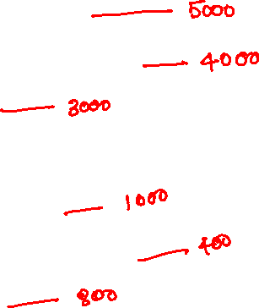
An example
int example(int arr[], int n) {
int ret = -1;
if (n > 1000) {
if (n > 5000) {
ret = sort(arr, n);
} else if (n > 3000) {
ret = set_zero(arr, n);
} else {
ret = search_zero(arr, n);
}
} else {
if (n > 900) {
ret = sum(arr, n);
} else if (n < 700) {
ret = reverse(arr, n);
} else {
ret = sum_all(arr, n, 2);
}
}
return ret;
}
Generate a set of test inputs needed to cover all the paths in the example routine at runtime.
Notes:
One possible strategy to test our program is ensuring all program paths execute at runtime. If we test our program when the values of n are 5000, 4000, 3000, 1000, 400, and 800, it will cover all program paths.

Slide 103
Analysis of algorithms
Even though we are successful in generating a set of test inputs that cover all program paths at runtime, the runtime when the program takes a given path may vary depending on the input, e.g.,
Some sorting algorithms are fast for small-size arrays but not for large arrays
Some sorting algorithms work faster if the input array is mostly sorted
It’s very hard to test for all possible kinds of inputs
Think about all possible inputs for a sorting algorithm

Slide 104
Analysis of algorithms
Another strategy is to count the total number of CPU instructions that may execute for the worst input (i.e., the input for which the algorithm is expected to behave very badly)
What is a CPU instruction?

Slide 105
CPU instructions
d = a + b + c;
movl -4(%rbp), %eax
movl -8(%rbp), %ebx
movl -12(%rbp), %ecx
mov %eax, %edx
add %ebx, %edx
add %ecx, %edx
mov %edx, -16(%rbp)
A program statement is eventually converted to a sequence of CPU instructions that actually executes when you run an application.

Slide 106
CPU instructions
d = a + b + c;
movl -4(%rbp), %eax
movl -8(%rbp), %ebx
movl -12(%rbp), %ecx
mov %eax, %edx
add %ebx, %edx
add %ecx, %edx
mov %edx, -16(%rbp)
Analyzing the assembly is hard because high-level operations like loops that take most of the time are not intuitive in assembly.
Notes:
Assembly, code is the actual code that is going to execute at runtime. However, it is hard to analyze the assembly code than a C program. Therefore, instead of counting the number of CPU instructions, our focus would be on counting the high-level operations.

