Slide 2
Today’s class
Analysis of algorithms
Asymptotic notation

Slide 3
Analysis of algorithms

Slide 4
References
Read Chapter-2 from Mark Allen Weiss
Read Chapter-2,3 from CLRS
CLRS => CORMEN, LEISERSON, RIVEST, STEIN
Read Chapter-1 from Narasimha Karumanchi

Slide 5
Analysis of algorithms
How do we say that one algorithm is better than the other?
Possible strategy
Implement both algorithms
Run both algorithms for various inputs
Analyse the runtime and memory usage of both implementations
What is the drawback of this approach?

Slide 6
Drawbacks
Experiments are performed on a set of test inputs that may not include all possible behaviors
It’s very hard to test for all possible kinds of inputs
Think about all possible inputs for a sorting algorithm
The algorithm may perform differently on different platforms
Some CPUs are faster than others, e.g., Intel i7 vs. Intel i3
The algorithm needs to be fully implemented before the runtime analysis

Slide 7
Analysis of algorithms
Another strategy is to count the total number of CPU instructions that may execute for the worst input (i.e., the input for which the algorithm is expected to behave very badly)
What is a CPU instruction?

Slide 8
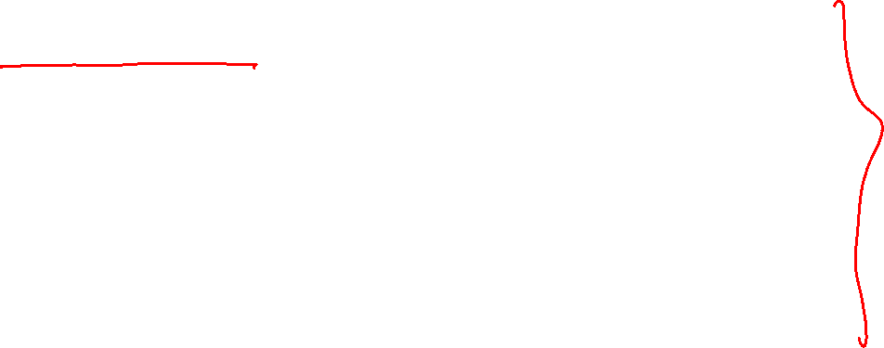
CPU instructions
d = a + b + c;
movl -4(%rbp), %eax
movl -8(%rbp), %ebx
movl -12(%rbp), %ecx
mov %eax, %edx
add %ebx, %edx
add %ecx, %edx
mov %edx, -16(%rbp)
A program statement is eventually converted to a sequence of CPU instructions that actually executes when you run an application.

Slide 9
CPU instructions
d = a + b + c;
movl -4(%rbp), %eax
movl -8(%rbp), %ebx
movl -12(%rbp), %ecx
mov %eax, %edx
add %ebx, %edx
add %ecx, %edx
mov %edx, -16(%rbp)
Analyzing the assembly is hard because high-level operations like loops that take most of the time are not intuitive in assembly.
Notes:
Assembly code is the actual code that is going to execute at runtime. However, it is hard to analyze the assembly code than a C program. Therefore, instead of counting the number of CPU instructions, we focus on counting the high-level operations.

Slide 10
Analysis of algorithms
Time taken by an algorithm is directly proportional to the sum of the costs of CPU instructions executed at runtime
Counting the number of CPU instructions may be a tedious job
Alternatively, counting the number of high-level (primitive) operations is a good approximation

Slide 11
Primitive operations
Assigning a value to a variable: a = b
Calling a method: foo(a, b)
Performing an arithmetic operation: a + b
Comparing two numbers: a <= b
Indexing into an array: a[b]
Returning from a method: return a

Slide 12

Fibonacci numbers (algorithm-1)
Recursive solution
int fib(int n) {
if (n <= 1)
return n;
return fib(n-1) + fib(n-2);
}
n | Num operations
<=1 | 2
>1 | 7
Notes:
If n <= 1, the comparison operator at line-2 and the return statement at line-3 take place, so the total number of operations is two. When n > 1, then the compare at line-2 is counted as one operation, computing n-1 and n-2 at line-4 are two operations, calling fib(n-1) and fib(n-2) are two operations, adding fib(n-1) and fib(n-2) is one operation and finally returning the sum at line-4 is one operation. Therefore the total number of operations, in this case, is 7.

Slide 13
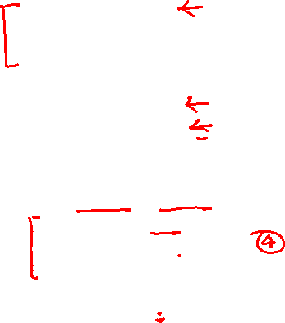
Fibonacci numbers (algorithm-2)
int fib(int n) {
if (n <= 1) {
return n;
}
int prev = 1;
int pprev = 0;
int res, i;
for (i = 2; i <= n; i++) {
res = prev + pprev;
pprev = prev;
prev = res;
}
return res;
}
Iterative solution
n | Num operations
<=1 | 2
>1 | 4 + (n-1)*6 + 1
Notes:
In this algorithm, if n <= 1, the comparison and return operations at lines-2 and 3 execute. Otherwise, the total number of operations includes comparison at line-2; initializations at lines-5 and 6; one-time initialization of i in the for-loop at lines-8; "n-1" times execution of, 1> the compare and increment operations at line-8, 2> addition at line-9, and 3> assignments at lines-9, 10, 11; and finally the return operation at line-13.

Slide 14
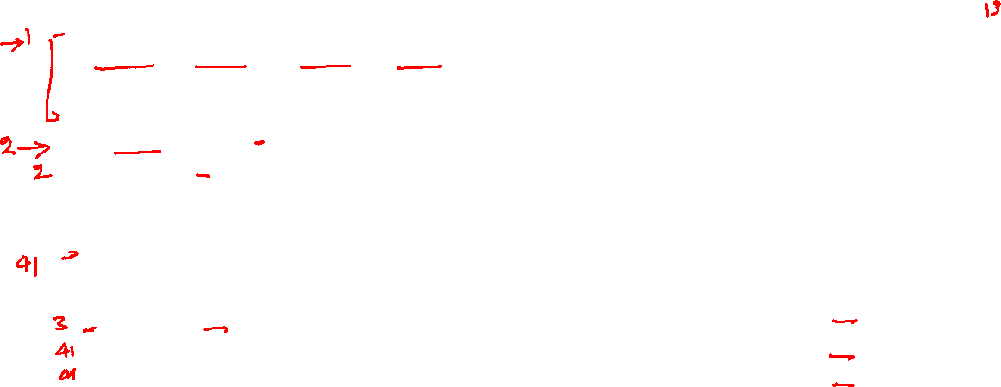
Fibonacci numbers (algorithm-3)
// mul takes a matrix A and R as input
// returns the result of A^{n} in R
void mul(int A[2][2], int R[2][2], int n) {
if (n == 1) {
R[0][0] = A[0][0]; R[0][1] = A[0][1];
R[1][0] = A[1][0]; R[1][1] = R[1][1];
return;
}
if (n % 2 == 0) {
mul(A, R, n/2);
// mul2 takes two 2x2 matrices as input and
// returns the multiplication in the first
// matrix
mul2(R, R); // R <- R * R
}
else {
mul(A, R, (n-1)/2);
mul2(R, R); // R <- R * R
mul2(R, A); // R <- R * A
}
}
int fib(int n) {
if (n <= 1) {
return n;
}
int A[2][2];
int R[2][2];
A[0][0] = 1; A[0][1] = 1;
A[1][0] = 1; A[1][1] = 0;
mul(A, R, n-1);
return R[0][0];
}
n | Num operations
=1 | 14
mul2 | 41
n%2 = 0 | 46
n%2 = 1 | 88
fib | 13
Notes:
In mul, if n=1, the total number of operations include the comparison at line-2, computation of the address of the array elements R[0][0], A[0][0], etc. at lines-3, 4, four assignments at lines-3,4, and finally the return operation at line-5. Otherwise, if n is even, the comparison at line-2 executes, followed by the computation of n%2 and the comparison operation at line-7, computation of n/2 and calling mul at line-8, and 41 operations corresponding to mul2. Else if n is odd, then in addition to the operations at lines-2,7, subtraction, divide, and call operations are performed at line-15, and calls to mul2 at lines-16,17 take 41 operations each.

Slide 15
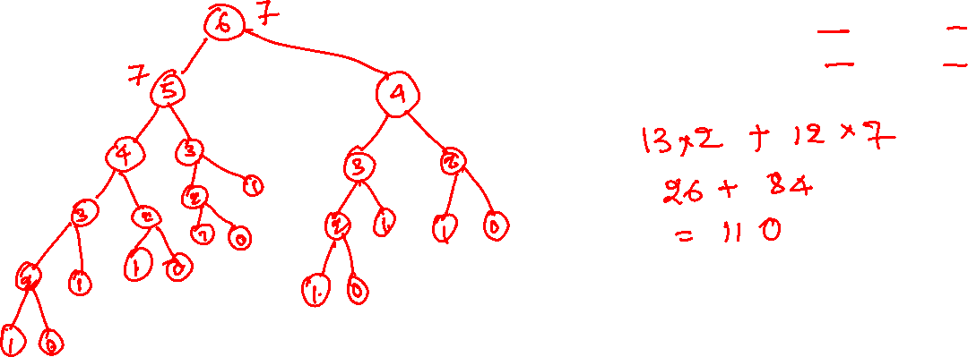
Fibonacci numbers
Algorithm-1 : n = 6
n | Num operations
<=1 | 2
>1 | 7
Notes:
For the first algorithm, many recursive calls will take place. Since we have already computed the number of operations taken by the fib routine, it is easy to compute the total number of operations that will take place during the computation of fib(6), which is 110.

Slide 16
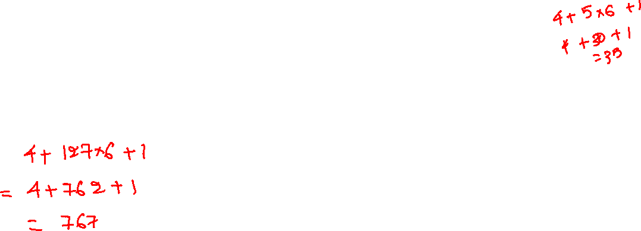
Fibonacci numbers
Algorithm-2: n = 128
n | Num operations
<=1 | 2
>1 | 4 + (n-1)*6 + 1
Notes:
For the second algorithm, computing the number of operations is very easy because everything is done within the function. For n = 6, it does around 35 operations which is better than the previous one. For n=128, this algorithm performs 767 operations.

Slide 17
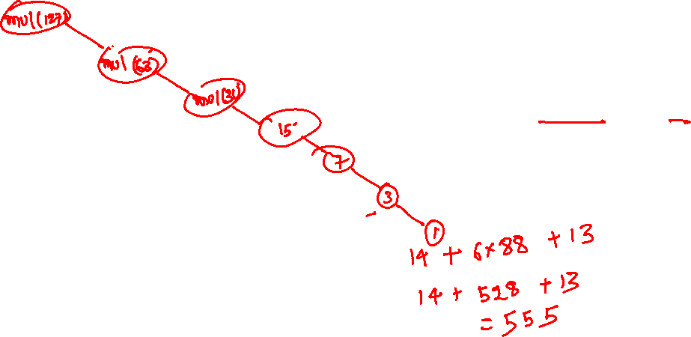
Fibonacci numbers
Algorithm-3 : n = 128
n | Num operations
=1 | 14
mul2 | 41
n%2 = 0 | 46
n%2 = 1 | 88
fib | 13
Notes:
Let’s look at the third algorithm. As we already know that for n = 128, mul(127) is invoked. mul(127) does seven recursive calls until mul(1) is reached. Since we have already computed the number of operations required for the mul routine, we can compute the total number of operations performed by this algorithm to compute fib(128), which is 555. The total number of operations in this algorithm is less than the iterative algorithm, as computed on the previous slide. This algorithm is better than the iterative one because, at every recursive call, it reduces the problem to half of the size. For example, if the value is 100000, the first recursive call brings it down to 50000, the second makes it 25000, and so on. Therefore, we can reach the base case (which is one) in very few recursive calls. Whereas for 100000, the iterative algorithm iterates from 2 to 100000, computing every intermediate Fibonacci number; thus, it does more operations.

Slide 18
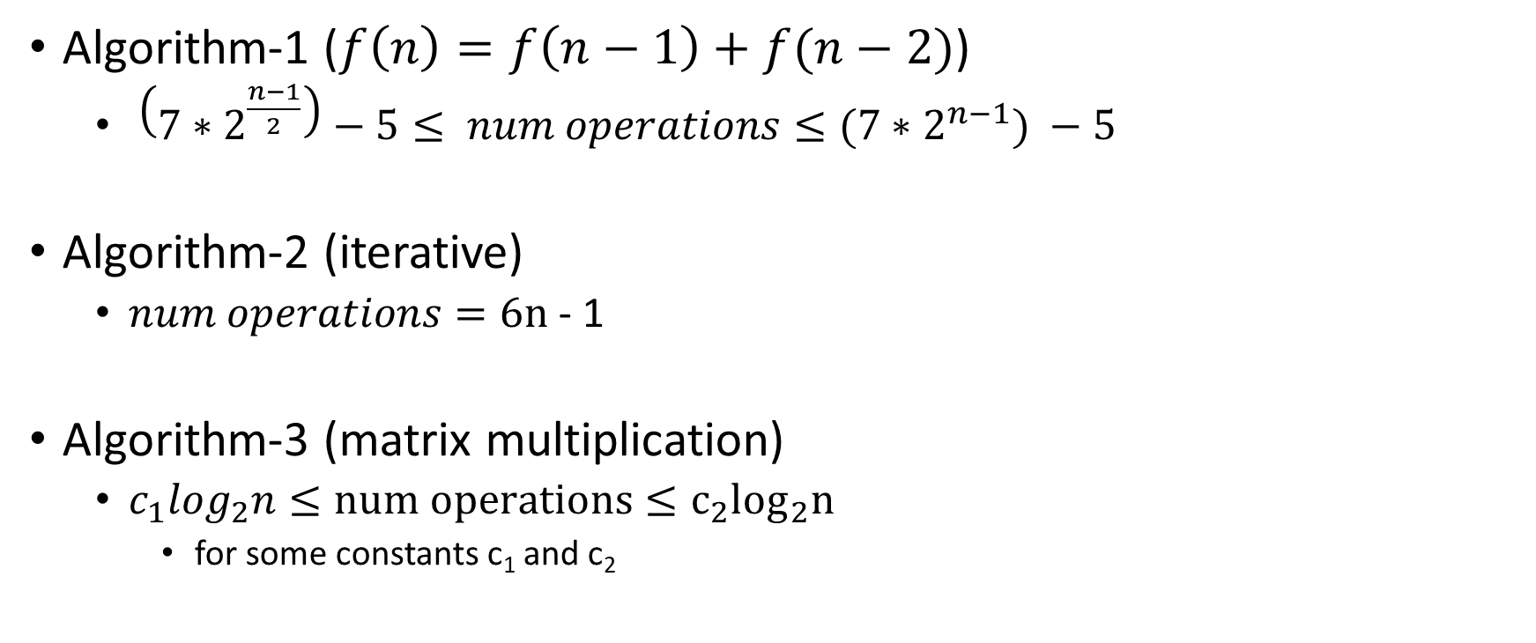

Number of operations
Algorithm-1 ($f\left(n\right)=f\left(n−1\right)+f(n−2)$)
$\left({7∗2}^{\frac{n−1}{2}}\right)−5≤ num operations≤{(7∗2}^{n−1}) −5$
Algorithm-2 (iterative)
$num operations=6n$ - 1
Algorithm-3 (matrix multiplication)
$c_{1}log_{2}n≤num operations≤c_{2}\log_{2}n$
for some constants c₁ and c₂
Notes:
We can represent the total number of operations as a function of input size n. We will discuss later in this course how to compute these bounds.

Slide 19
Time complexity
The number of primitive operations in the worst case as a function of input size
e.g., the time complexity of the iterative algorithm for Fibonacci is 6n - 2

Slide 20
Time complexity
Does counting the number of primitive operations give us the actual time complexity?

Slide 21
Time complexity
Does counting the number of primitive operations give us the actual time complexity?
Does calling a function is same as a variable assignment?
Can we simplify the analysis further?

Slide 22
Time complexity
Does counting the number of primitive operations give us the actual time complexity?
Does calling a function is same as a variable assignment?
Can we simplify the analysis further?
Instead of finding the real complexity, we try to find the lower and upper bounds on the total number of operations
We try to make lower and upper bounds close to the actual complexity

Slide 23
Time complexity
We will discuss a general method to compute time complexity, which
Considers all possible inputs
Can be used to compare two algorithms in a way that is independent of underline hardware and software platform
Can be performed on the pseudo-code of an algorithm

Slide 24
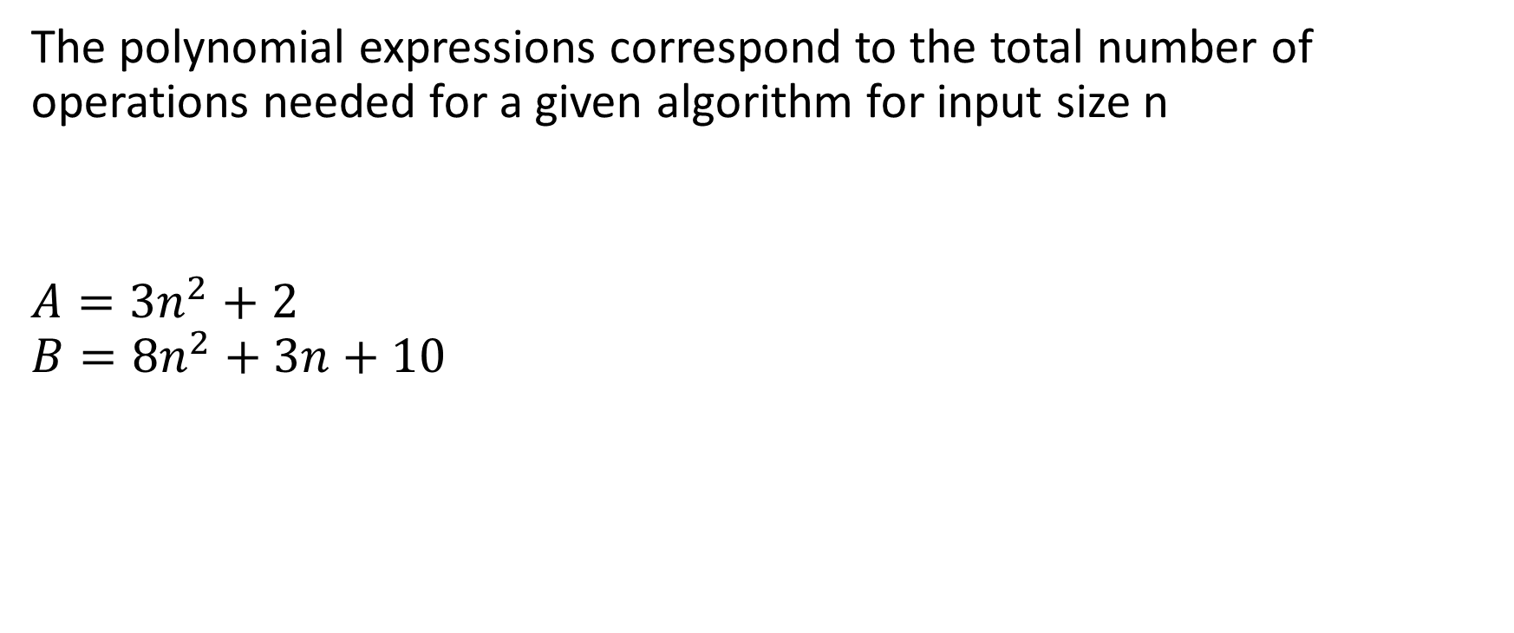
Which algorithm is better?
The polynomial expressions correspond to the total number of operations needed for a given algorithm for input size n
$$A={3n}^{2}+2$$
$$B=8n^{2}+3n+10$$
Notes:
Algorithm A is better because it performs fewer operations than algorithm B for all n >= 1.

Slide 25
Which algorithm is better?
$$A=n^{2}$$
$$B=10n+1$$

Slide 26
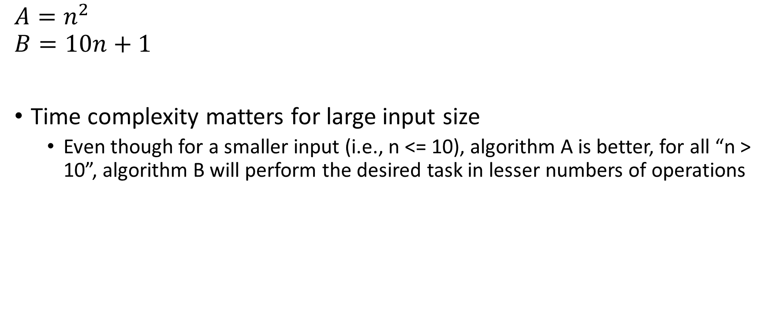
Which algorithm is better?
$$A=n^{2}$$
$$B=10n+1$$
Time complexity matters for large input size
Even though for a smaller input (i.e., n <= 10), algorithm A is better, for all “n > 10”, algorithm B will perform the desired task in lesser numbers of operations

Slide 27
Which algorithm is better?
$$A=n^{2}+1$$
$$B=n^{2}+1000n+10000$$
Notes:
The first algorithm is faster than the second.

Slide 28

Which algorithm is better?
$$A=n^{2}+1$$
$$B=n^{2}+1000n+10000$$
n | A = n² + 1 | B = n² + 1000n + 10000 | A/B
1000 | 1000001 | 2010000 | 0.497513
10000 | 100000001 | 1.1E+08 | 0.909008
100000 | 1E+10 | 1.01E+10 | 0.990098
1000000 | 1E+12 | 1E+12 | 0.999001
10000000 | 1E+14 | 1E+14 | 0.9999
For large n, only the highest order term in the time complexity matters.
Notes:
Even though the first algorithm is faster than the second, the ratio of the number of operations performed by the first and second algorithms remains close to 1 for large values on n. From this observation, we can conclude that only the highest-order term in the time complexity matters.

Slide 29

Which algorithm is better?
$$A={3n}^{2}+1$$
$$B={7n}^{2}+1000n+10000$$
$$C=100n^{1.5}+2000n+20000$$
n | A = ${3n}^{2}+1$ | B = ${7n}^{2}+1000n+10000$ | C = $100n^{1.5}+2000n+20000$ | A/B | C/A
1000 | 3000001 | 8010000 | 5182277.7 | 0.374532 | 1.727425
10000 | 3E+08 | 7.1E+08 | 120020000 | 0.422529 | 0.400067
100000 | 3E+10 | 7.01E+10 | 3.362E+09 | 0.42796 | 0.112077
1000000 | 3E+12 | 7E+12 | 1.02E+11 | 0.42851 | 0.034
10000000 | 3E+14 | 7E+14 | 3.182E+12 | 0.428565 | 0.010608
100000000 | 3E+16 | 7E+16 | 1.002E+14 | 0.428571 | 0.00334
Notes:
Let’s compare these algorithms. The degree of polynomials A and B is 2, which is larger than C (1.5). Therefore, if we take the ratio of the total number of operations for algorithms C and A, it goes close to zero as the n increases. In this case, we can say that algorithm C is a huge improvement over algorithm A. However, if we compare the number of operations for A and B, the ratio remains close to 0.42, even for large values of n. In this case, even though algorithm A is a good improvement over B, it’s not huge. In our analysis, we will focus on the huge improvement aspects and disregard the constant factors in the time complexity.

Slide 30
Which algorithm is better?
$$A={3n}^{2}+1$$
$$B={7n}^{2}+1000n+10000$$
$$C=100n^{1.5}+2000n+20000$$
n | A = ${3n}^{2}+1$ | B = ${7n}^{2}+1000n+10000$ | C = $100n^{1.5}+2000n+20000$ | A/B | C/A
1000 | 3000001 | 8010000 | 5182277.7 | 0.374532 | 1.727425
10000 | 3E+08 | 7.1E+08 | 120020000 | 0.422529 | 0.400067
100000 | 3E+10 | 7.01E+10 | 3.362E+09 | 0.42796 | 0.112077
1000000 | 3E+12 | 7E+12 | 1.02E+11 | 0.42851 | 0.034
10000000 | 3E+14 | 7E+14 | 3.182E+12 | 0.428565 | 0.010608
100000000 | 3E+16 | 7E+16 | 1.002E+14 | 0.428571 | 0.00334
Algorithm A is better than B. However, the improvement factor remains constant for large input sizes. In contrast, algorithm C is a huge improvement over algorithm A.

Slide 31
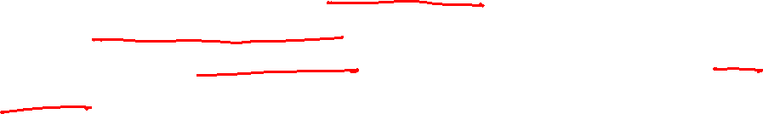
Efficiency of algorithms
Observations so far
We analyze the algorithms for large input size
Only the highest degree term in the time complexity matters
We disregard the constant factors in the formula and focus on the huge-improvement aspects of the algorithm

Slide 32

What is huge improvement?
An algorithm A is a huge improvement over algorithm B, if
$\lim_{n→∞}{\frac{time complexity of A (n)}{time complexity of B (n)} =0}$

Slide 33
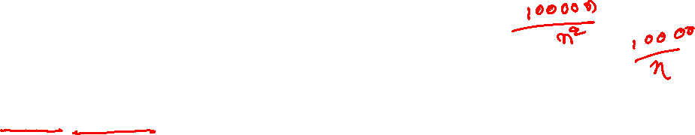
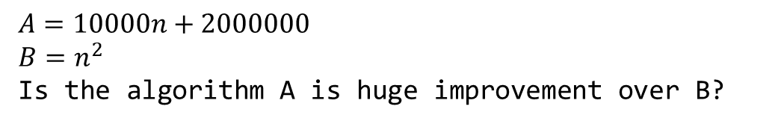
What is huge improvement?
An algorithm A is a huge improvement over algorithm B, if
$\lim_{n→∞}{\frac{time complexity of A (n)}{time complexity of B (n)} =0}$
$$A=10000n+2000000$$
$$B=n^{2}$$
Is the algorithm A is huge improvement over B?
Notes:
Yes, because for large n, the ratio of A and B is close to zero.

Slide 34
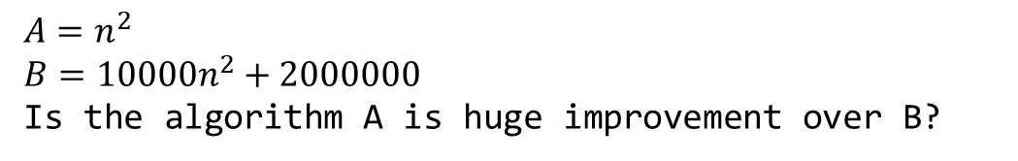
What is huge improvement?
An algorithm A is a huge improvement over algorithm B, if
$\lim_{n→∞}{\frac{time complexity of A (n)}{time complexity of B (n)} =0}$
$$A=n^{2}$$
$$B={10000n}^{2}+2000000$$
Is the algorithm A is huge improvement over B?
Notes:
No, because the ratio of A and B remains almost the same even for large values of n.

Slide 35
Asymptotic notation
(Captures the observations we have made so far)

Slide 36

Big-Oh notation
Let $f(n)$ and $g(n)$ are increasing functions of n
$f\left(n\right) is O\left(g\left(n\right)\right)$ (pronounced as order of)
if for some constants $c>0$ and $n_{0}≥1$
$$f\left(n\right)≤cg\left(n\right), for all n>n_{0}$$

Slide 37




Big-Oh notation
$$c ∗g(n)$$
$$f(n)$$
$$n_{0}$$
c * g(n) is an asymptotic upper bound for f(n)

Slide 38
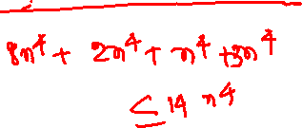
Example
$$8n^{4}+2n^{3}+n^{2}+3 is O(n^{4})$$
Notes:
Because the value of "$8n^{4}+2n^{3}+n^{2}+3$" is less than "$8n^{4}+2n^{4}+n^{4}+3n^{4}$", i.e., $14n^{4}$, therefore the order is $n^{4}$.

Slide 39
Example
$$a_{0}+a_{1}n+a_{2}n^{2}+a_{3}n^{3}+…+a_{k}n^{k} is O\left(n^{k}\right) if a_{k}>0$$

Slide 40
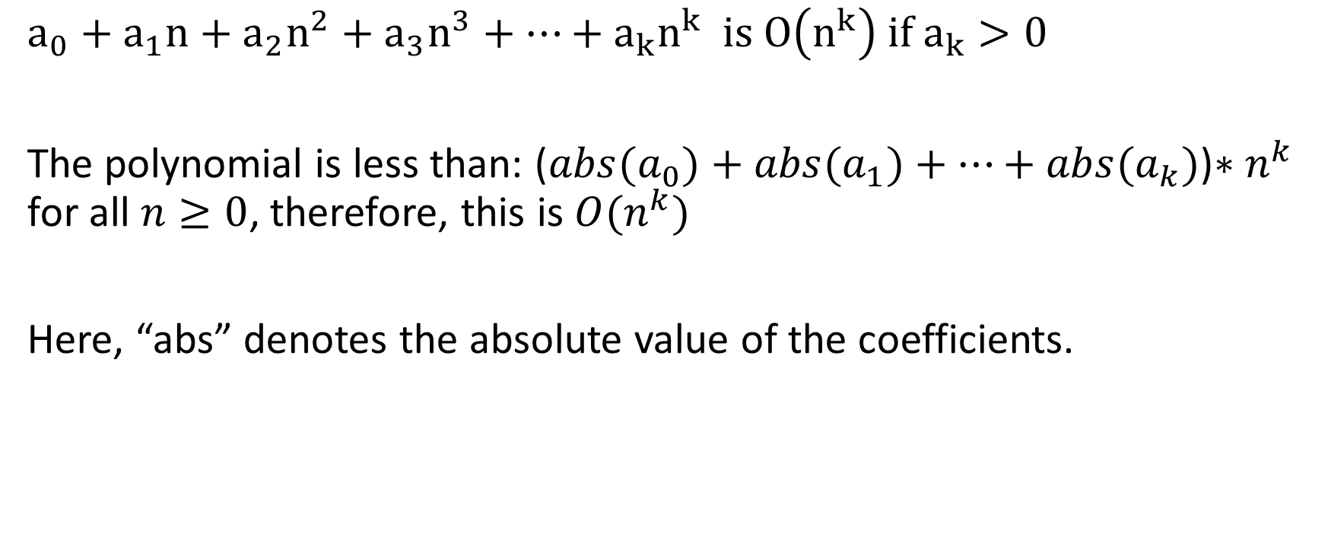
Example
$$a_{0}+a_{1}n+a_{2}n^{2}+a_{3}n^{3}+…+a_{k}n^{k} is O\left(n^{k}\right) if a_{k}>0$$
The polynomial is less than: (${abs(a}_{0})+{abs(a}_{1})+…+{abs(a}_{k})$)$∗n^{k}$ for all $n≥0$, therefore, this is $O(n^{k})$
Here, “abs” denotes the absolute value of the coefficients.

Slide 41
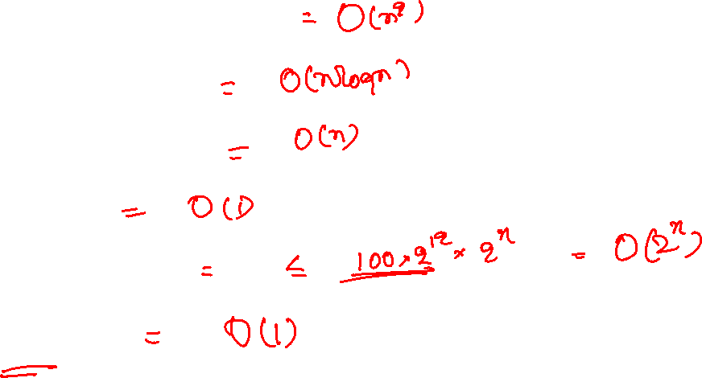
Example
$$5n^{2}+8nlog_{2}n+3$$
$$3nlog_{2}n+n$$
$$10n+3\log_{2}{n}$$
$$100$$
$${100 ∗ 2}^{n+12}$$
$$2^{1000}$$

Slide 42

Example
$$5n^{2}+8nlog_{2}n+3 =O(n^{2})$$
$$3nlog_{2}n+n =O(n\log{ n})$$
$$10n+3\log_{2}{n =O(n)}$$
$$100 =O(1)$$
$${100 ∗ 2}^{n+12} =O(2^{n})$$
$$2^{1000} =O(1)$$

Slide 43
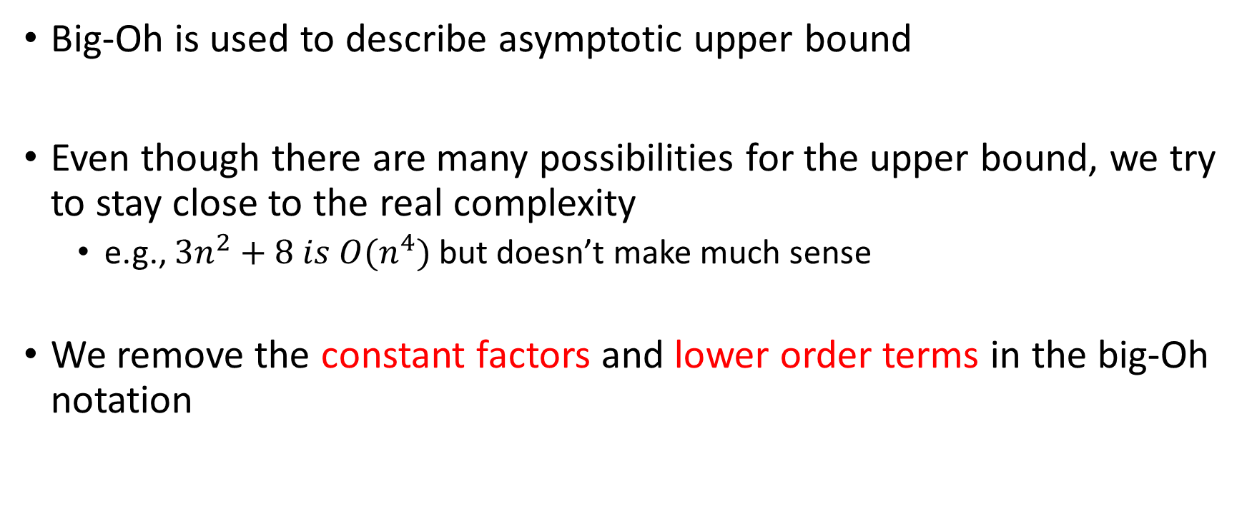
Big-Oh notation
Big-Oh is used to describe asymptotic upper bound
Even though there are many possibilities for the upper bound, we try to stay close to the real complexity
e.g., $3n^{2}+8 is O(n^{4})$ but doesn’t make much sense
We remove the constant factors and lower order terms in the big-Oh notation

Slide 44
Space complexity
Similar to the time complexity, we can also measure space complexity
The space complexity tells us about the memory utilization of the program in the worst case as a function of input size
For most algorithms, space complexity is not a big concern

Slide 45
Analysis of algorithm
Time complexity
Predict how much time an algorithm will take for a given input size
Space complexity
Predict how much space an algorithm will take for a given input size

Slide 46

Linear search
int lsearch(int arr[], int val, int n) {
int i;
for (i = n-1; i >= 0; i--) {
if (arr[i] == val)
return i;
}
return -1;
}
Time complexity:

Slide 47
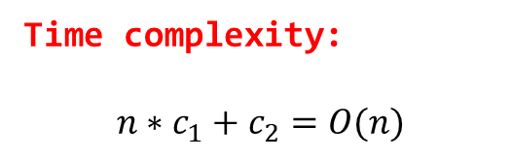
Linear search
int lsearch(int arr[], int val, int n) {
int i;
for (i = n-1; i >= 0; i--) {
if (arr[i] == val)
return i;
}
return -1;
}
Time complexity:
$$n∗c_{1}+c_{2}=O(n)$$
Notes:
This slide computes the number of operations performed by the lsearch routine. As discussed before, we are going to ignore the constant factors and compute the number of operations in the worst case. Let’s assume that the body of the for loop does c₁ number of operations and the code outside the loop does c₂ number of operations. In the worst case, this loop may execute n number of times (e.g., when val is not present in the array). Therefore, the total number of operations in the worst case would be $n∗c_{1}+c_{2}$, which is O(n). So, in the worst case, this program may execute O(n) operations.

Slide 48
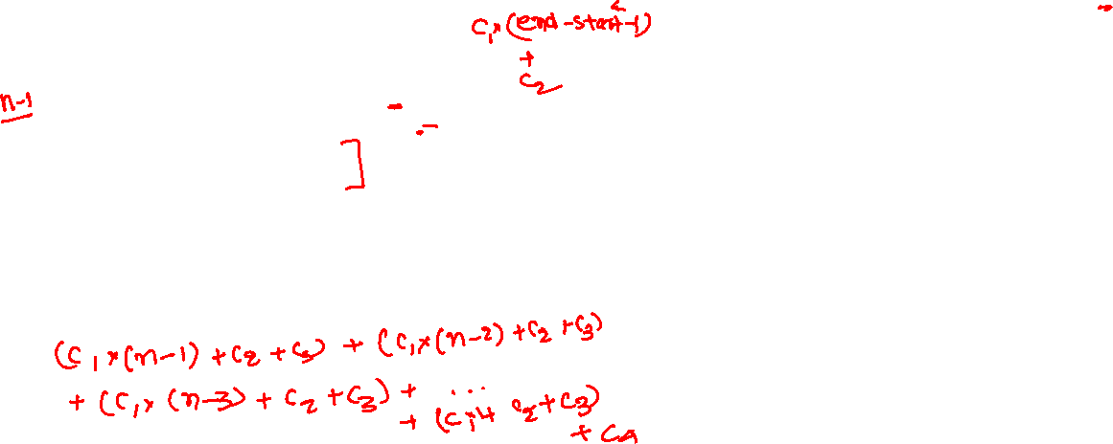
Selection sort
int find_min(int arr[], int start, int end)
{
int i, min, idx;
min = arr[start];
idx = start;
for (i = start + 1; i < end; i++) {
if (arr[i] < min) {
min = arr[i];
idx = i;
}
}
return idx;
}
void swap(int arr[], int i, int j)
{
int tmp = arr[i];
arr[i] = arr[j];
arr[j] = tmp;
}
void selection_sort(int arr[], int n)
{
int i, idx;
for (i = 0; i < n - 1; i++) {
idx = find_min(arr, i, n);
if (idx != i) {
swap(arr, i, idx);
}
}
}
Time complexity:
Notes:
Let's look at the find_min procedure. The for loop executes "end – start – 1" times. If the number of operations inside this loop is c₁, the for loop in the find_min will perform (start - end -1 ) * c₁ number of operations. Because, outside the for loop, find_min perform only a constant number of operations, say c₂. So the total number of operations performed by find_min is "c₁ * (start - end - 1) + c₂". The first time we call find_min from the selection sort, the value of (start, end) is (0, n). So, the first invocation of find_min performs "c₁ * (n - 1) + c₂" operations. The second time find_min is called with (start, end) as (1, n), so the number of operations in this step is "c₁ * (n - 2) + c₂". find_min is called until the value of (start, end) reaches (n-2, n), in which case, it performs "c₁ + c₂" operations. The rest of the for loop body in the selection_sort algorithm does a constant number of operations, say c₃. Because the for loop in selection sort executes n-1 number of times; therefore, in addition to the number of operations performed in find_min, it additionally performs "(n - 1) * c₃" operations. Outside the for loop, seclection_sort performs a constant number of operations, say c₄. Considering all of this, the number of operations performed by selection_sort is listed on this slide.

Slide 49
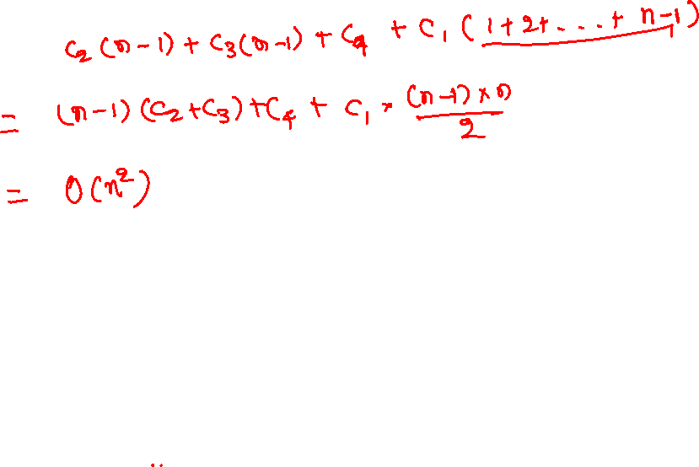
Time complexity

Slide 50

Time complexity
$$T\left(n\right)= {(c}_{1}(n−1)+c_{2})+$$
$\left(c_{1}\left(n−2\right)+c_{2}\right)+\left(c_{1}\left(n−3\right)+c_{2}\right)+ …+\left(c_{1}∗1+c_{2}\right)+$
$c_{3}\left(n−1\right)+c_{4}$
$=c_{1}\left(1+2+3+ …+(n−1)\right)+c_{2}\left(n−1\right)+c_{3}\left(n−1\right)+c_{4}$
$=c_{1}\left(\frac{\left(n−1\right)n }{2}\right)+c_{2}\left(n−1\right)+c_{3}\left(n−1\right)+c_{4}$
$=O(n^{2})$

Slide 51

Fibonacci numbers
int fib(int n) {
if (n <= 1) {
return n;
}
int prev = 1;
int pprev = 0;
int res, i;
for (i = 2; i <= n; i++) {
res = prev + pprev;
pprev = prev;
prev = res;
}
return res;
}
Time complexity:

Slide 52
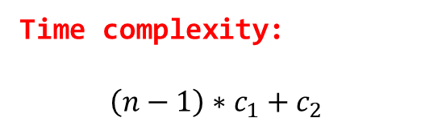
Fibonacci numbers
int fib(int n) {
if (n <= 1) {
return n;
}
int prev = 1;
int pprev = 0;
int res, i;
for (i = 2; i <= n; i++) {
res = prev + pprev;
pprev = prev;
prev = res;
}
return res;
}
Time complexity:
$$\left(n−1\right)∗c_{1}+c_{2}$$

Slide 53
Big-Omega notation
Let $f(n)$ and $g(n)$ are increasing functions of n
$f\left(n\right) is Ω\left(g\left(n\right)\right)$ (pronounced as big-Omega of)
if for some constants $c>0$ and $n_{0}≥1$
$$f\left(n\right)≥cg\left(n\right), for all n>n_{0}$$

Slide 54


Big-Omega notation
$$f(n)$$
$$c ∗g(n)$$
$$n_{0}$$
c * g(n) is an asymptotic lower bound for f(n)

Slide 55
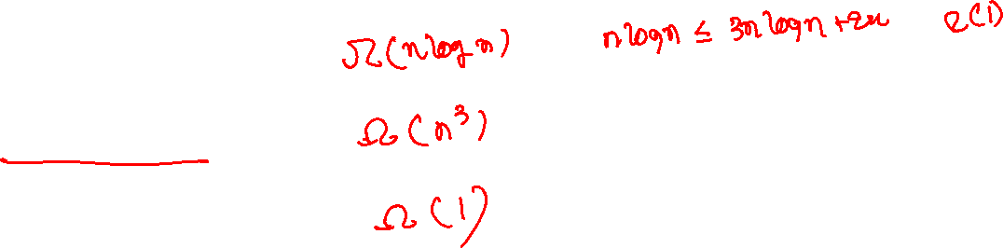
Big-Omega
$$3nlogn+2n$$
$$3n^{3}+2n^{2}+10$$
$$1000$$

Slide 56

Big-Omega
$$3nlogn+2n =Ω(nlogn)$$
$$3n^{3}+2n^{2}+10 =Ω(n^{3})$$
$$1000 =Ω(1)$$

Slide 57

Big-Theta notation
Let $f(n)$ and $g(n)$ are increasing functions of n
$f\left(n\right) is θ\left(g\left(n\right)\right)$ (pronounced as big-Theta of)
if $f\left(n\right) is both O\left(g\left(n\right)\right)$ and $Ω(g(n))$

Slide 58





Big-Theta notation
$$c_{2} ∗g(n)$$
$$f(n)$$
$$c_{1} ∗g(n)$$
$$n_{0}$$
$$n_{1}$$

Slide 59

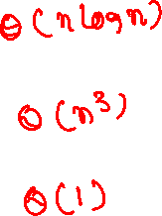
Big-Theta
$$3nlogn+2n$$
$$3n^{3}+2n^{2}+10$$
$$1000$$

Slide 60

Big-Theta
$$3nlogn+2n =θ(nlogn)$$
$$3n^{3}+2n^{2}+10 =θ(n^{3})$$
$$1000 =θ(1)$$

