Slide 2
Today’s class
Analysis of algorithms
Asymptotic notation
Recurrence relation

Slide 3
Analysis of algorithms

Slide 4
Asymptotic notation

Slide 5

Big-Oh notation
Let $f(n)$ and $g(n)$ are increasing functions of n
$f\left(n\right) is O\left(g\left(n\right)\right)$ (pronounced as order of)
if for some constants $c>0$ and $n_{0}≥1$
$$f\left(n\right)≤cg\left(n\right), for all n>n_{0}$$

Slide 6




Big-Oh notation
$$c ∗g(n)$$
$$f(n)$$
$$n_{0}$$
c * g(n) is an asymptotic upper bound for f(n)

Slide 7
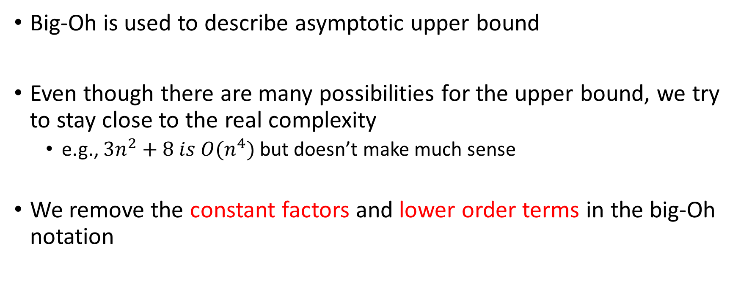
Big-Oh notation
Big-Oh is used to describe asymptotic upper bound
Even though there are many possibilities for the upper bound, we try to stay close to the real complexity
e.g., $3n^{2}+8 is O(n^{4})$ but doesn’t make much sense
We remove the constant factors and lower order terms in the big-Oh notation

Slide 8
Big-Omega notation
Let $f(n)$ and $g(n)$ are increasing functions of n
$f\left(n\right) is Ω\left(g\left(n\right)\right)$ (pronounced as big-Omega of)
if for some constants $c>0$ and $n_{0}≥1$
$$f\left(n\right)≥cg\left(n\right), for all n>n_{0}$$

Slide 9


Big-Omega notation
$$f(n)$$
$$c ∗g(n)$$
$$n_{0}$$
c * g(n) is an asymptotic lower bound for f(n)

Slide 10

Big-Theta notation
Let $f(n)$ and $g(n)$ are increasing functions of n
$f\left(n\right) is θ\left(g\left(n\right)\right)$ (pronounced as big-Theta of)
if $f\left(n\right) is both O\left(g\left(n\right)\right)$ and $Ω(g(n))$

Slide 11





Big-Theta notation
$$c_{2} ∗g(n)$$
$$f(n)$$
$$c_{1} ∗g(n)$$
$$n_{0}$$
$$n_{1}$$

Slide 12
Asymptotic notations
Big-Oh gives us an upper bound on the number of operations
Most of the time, we are interested in Big-Oh complexity
Big-Omega gives us the lower bound on the number of operations
Lower bound is useful in cases when some approximation is needed to compute the upper bound
If both lower and upper bounds are the same, we use Big-Theta notation
Big-theta gives us the precise complexity that can’t be further reduced

Slide 13





Growth of functions
$$n^{3}$$
$$n^{2}$$
$$n ∗ logn$$
$$n$$
$$\log{n}$$
Notes:
For n = 128, an algorithm with time complexity O(n) does around a multiple of 128 operations, whereas the same problem can be solved using an O(log n) algorithm in a multiple of 7 operations. If the complexity is O(n³), it takes around a multiple of 2097152 operations to solve the problem. Therefore, reducing the complexity of an algorithm is a much better optimization than improving the hardware, for example. Improving the hardware may make your program 2x or 4x faster; however, reducing the complexity from n² to "n * log n" may make your program 10000 times better for a large input.

Slide 14






Growth of functions
$$2^{n}$$
$$n^{3}$$
$$n^{2}$$
$$n ∗ logn$$
$$n$$
$$\log{n}$$
Notes:
For n=128, an O(2^{n}) algorithm performs around (3.4 * 10³⁸) operations, which may take a very long time. Therefore, O(2^{n}) algorithms are not an acceptable solution for many problems.

Slide 15

Problem size (n) vs Time complexity
Complexity | 1 second | 1 minute | 1 hour
n | 60M | 360M | 21,600M
n * log n | 2M | 113M | 5,740M
n² | 7,746 | 60,000 | 4,64,758
n³ | 392 | 1534 | 6000
2^{n} | 26 | 32 | 38

Slide 16
Common complexities
Complexity | Common name
O(1) | Constant
O(log(n)) | Logarithmic
O(n) | Linear
O(nlog(n)) | n-log-n
O(n²) | Quadratic
O(n³) | Cubic
O(2^{n}) | Exponential
Best
Worst

Slide 17
Recurrence relation

Slide 18
Recurrence relation
A recurrence relation is an equation or inequality that expresses the n^{th} term of a sequence as a function of the k preceding terms
k is called the order of the recurrence relation
e.g., f(n) = f(n-1) + f(n-2) is a recurrence relation
Source: Wikipedia

Slide 19
Solving recurrence relation
Expansion method
Also look at recursion tree method
Intelligent guesses
Read from CLRS and Narasimha book
Elimination of history
Full-history recurrence relation
Depends on all preceding terms instead of a few
We will discuss later in this course

Slide 20
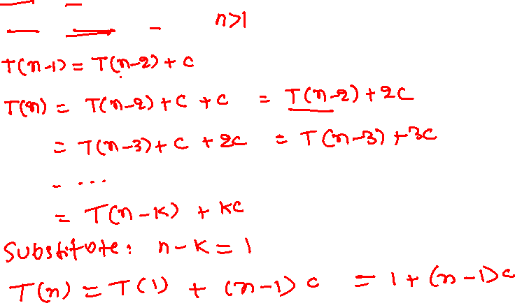
Expansion method
T(1) = 1
T(n) = T(n-1) + c
Notes:
The expansion method has four steps: 1> expand and simplify the recurrence a few times until you see a pattern, 2> compute the recurrence relation after k number of expansions, 3> substitute k with a value such that the RHS can be expressed in terms of base cases (i.e., T(1) in this example), and 4> simplify the equation to compute the final result. These steps are shown in more detail in the following slides.

Slide 21
Expansion method
STEP-1 : Expand and simplify the recurrence
T(1) = 1
T(n) = T(n-1) + c
T(n-1) = T(n-2) + c

Slide 22
Expansion method
STEP-1 : Expand and simplify the recurrence
T(1) = 1
T(n) = T(n-1) + c
T(n-1) = T(n-2) + c
Expand T(n) substituting the value of T(n-1)
T(n) = (T(n-2) + c) + c

Slide 23
Expansion method
STEP-1 : Expand and simplify the recurrence
T(1) = 1
T(n) = T(n-1) + c
T(n-1) = T(n-2) + c
Expand T(n) substituting the value of T(n-1)
T(n) = (T(n-2) + c) + c
= T(n-2) + 2c // simplify

Slide 24
Expansion method
STEP-1 : Expand and simplify the recurrence
T(1) = 1
T(n) = T(n-1) + c
T(n-1) = T(n-2) + c
Expand T(n) substituting the value of T(n-1)
T(n) = (T(n-2) + c) + c
= T(n-2) + 2c // simplify
Expand T(n) substituting the value of T(n-2)
T(n) = (T(n-3) + c) + 2c

Slide 25
Expansion method
STEP-1 : Expand and simplify the recurrence
T(1) = 1
T(n) = T(n-1) + c
T(n-1) = T(n-2) + c
Expand T(n) substituting the value of T(n-1)
T(n) = (T(n-2) + c) + c
= T(n-2) + 2c // simplify
Expand T(n) substituting the value of T(n-2)
T(n) = (T(n-3) + c) + 2c
= T(n-3) + 3c // simplify

Slide 26

Expansion method
STEP-2: Identify a pattern after the $k^{th}$ iteration
T(1) = 1
T(n) = T(n-1) + c
T(n-1) = T(n-2) + c
Expand T(n) substituting the value of T(n-1)
T(n) = (T(n-2) + c) + c
= T(n-2) + 2c // simplify
Expand T(n) substituting the value of T(n-2)
T(n) = (T(n-3) + c) + 2c
= T(n-3) + 3c // simplify
. . . .
After expanding and simplifying k times
T(n) = T(n-k) + kc

Slide 27
Expansion method
STEP-3: Substitute k to express T(n) as a function of base cases
T(1) = 1
T(n) = T(n-1) + c
After expanding and simplifying k times
T(n) = T(n-k) + kc
Substitute n-k = 1
T(n) = T(1) + c(n-1)

Slide 28
Expansion method
STEP-4: Simplify the equation
T(1) = 1
T(n) = T(n-1) + c
After expanding and simplifying k times
T(n) = T(n-k) + kc
Substitute n-k = 1
T(n) = T(1) + c(n-1)
= 1 + cn – c

Slide 29
Time complexity of recursive programs

Slide 30
Time complexity
For recursive programs, time complexities can be expressed as recurrence relations

Slide 31
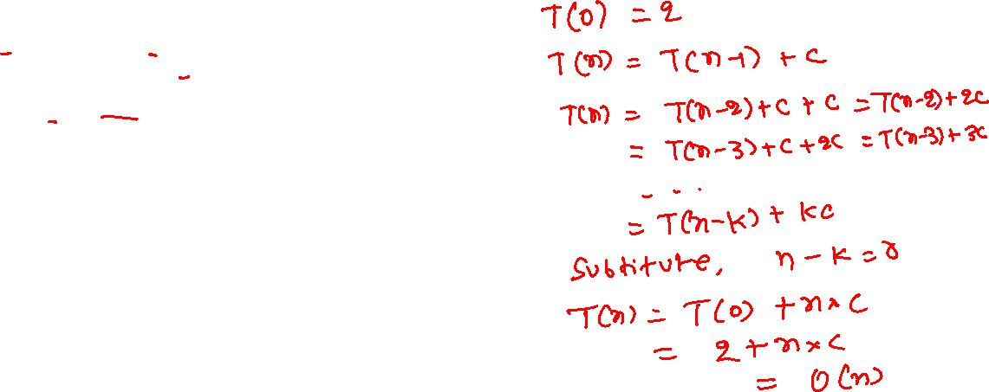
Factorial
Time complexity:
int factorial(int n) {
if (n == 0)
return 1;
return n * factorial(n-1);
}
Notes:
If n=0, the factorial function executes two operations. You can also consider it some constant “c” as it won’t change the complexity. Now factorial(n) calls factorial(n-1) at line-4. Because factorial(n) performs T(n) operations, factorial(n-1) will perform T(n-1) operations. Apart from the T(n-1) operations corresponding to the recursive call at line-4, factorial(n) additionally performs a constant number of operations, say c. Therefore, the total number of operations performed by factorial(n). i.e., T(n), is T(n-1) + c. Solving this recurrence relation will give us the desired time complexity.

Slide 32
Time complexity
$$T\left(0\right)=2$$
$$T\left(n\right)=T\left(n−1\right)+c$$
$=\left(T\left(n−2\right)+c\right)+c=T\left(n−2\right)+2c$
$=\left(T\left(n−3\right)+c\right)+2c=T\left(n−3\right)+3c$
$=…$
$=T\left(n −k\right)+ck$
Substitute, k = n
$=T\left(0\right)+cn=2+cn$
$=O(n)$

Slide 33
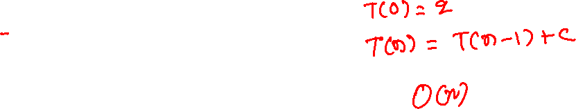
Linear search
Time complexity:
int lsearch(int arr[], int val, int n) {
if (n == 0)
return -1;
if (arr[n-1] == val)
return n-1;
return lsearch(arr, val, n-1);
}
Notes:
If n=0, lsearch performs 2 (or some constant) operations. Because we are interested in worst-case time complexity, let’s say the comparison at line-4 never holds. Let’s assume for n > 0, lsearch(arr, val, n) does T(n) operations, where n is the input size. Therefore, lsearch(arr, val, n-1) will execute T(n-1) operations because the input size is n-1. Apart from calling lsearch(arr, val, n-1), lsearch(arr, val, n) also does some constant number of operations, say c. Therefore, the total number of operations performed by lsearch, i.e., T(n), is T(n-1) + c, when n > 0. Solving this recurrence relation gives us the desired time complexity.

Slide 34
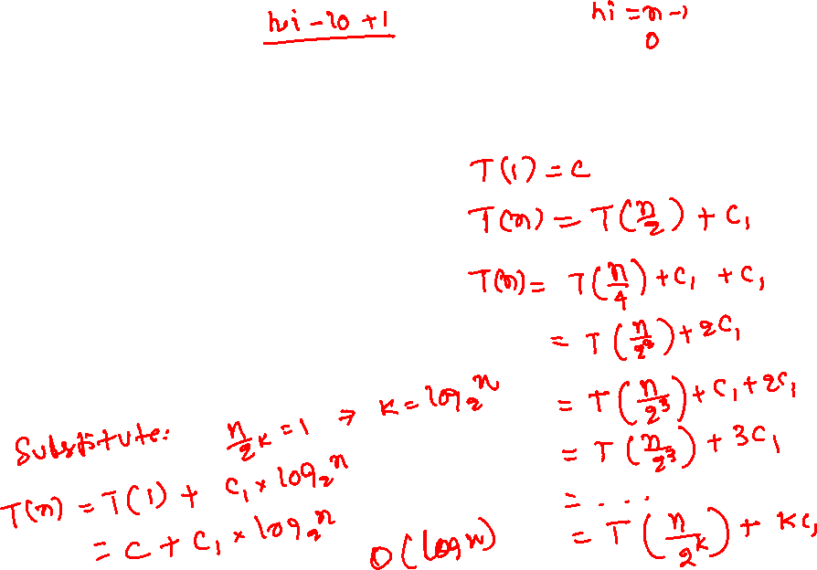
Binary search
Time complexity:
int bsearch(int arr[], int val, int lo, int hi) {
if (hi < lo)
return -1;
int mid = (lo + hi) / 2;
if (arr[mid] == val)
return mid;
if (arr[mid] > val)
return bsearch(arr, val, lo, mid-1);
else
return bsearch(arr, val, mid+1, hi);
}
Notes:
Let’s analyze the bsearch algorithm. Here, lo is the index of the first element, hi is the index of the last element, and the number of elements or the input size is (hi – lo + 1). If the input size is 1, then this algorithm is going to execute a constant number of operations (try to compute the number of operations using the method we discussed in class if you are not convinced). Otherwise, if the “if-branch” is taken bsearch is called at line-8 with input size (mid -lo) = n/2, else in the “else-branch” bsearch is called at line-10 with the input size (hi-mid) = n/2. Both of these recursive calls will execute T(n/2) operations each if bsearch with input n performs T(n) operations. Because, at a given time, either the if or the else branch is taken, and the cost of both the branches are the same, the recurrence relation corresponding to the time-complexity of the bsearch algorithm is T(n) = T(n-1) + c₁, where c₁ is the additional constant number of operations performed by the bsearch algorithm apart from calling the bsearch routines at lines-8,10. When we use the expansion method to solve the recurrence relation, after the k-th expansion, T(n) is equal to T(n/2^{k}) + (k * c₁). Substituting n = 2^{k} gives us the time complexity O(log n).

Slide 35

Time complexity
$$T\left(1\right)=c_{}$$
$$T\left(n\right)=T\left(\frac{n}{2}\right)+c_{1}$$
$=(T\left(\frac{n}{2^{2}}\right)+c_{1})+c_{1}=T\left(\frac{n}{2^{2}}\right)+2c_{1}$
$=\left(T\left(\frac{n}{2^{3}}\right)+c_{1}\right)+2c_{1}=T\left(\frac{n}{2^{3}}\right)+3c_{1}$
$= …$
$=T\left(\frac{n}{2^{k}}\right)+kc_{1}$
Substitute $n=2^{k}$
$T\left(n\right)=T\left(1\right)+(log_{2} n)∗c_{1}=O(log⁡(n))$

Slide 36
O(log n) vs O(n)

Slide 37
O(log n) vs O(n)
An algorithm is O(log n) if it takes constant time to cut the problem size by a fraction
Usually 1/2 as in the binary search algorithm or the fast algorithm for power
The power algorithm that divides the problem into 1/3 is also O(log n)
An algorithm is O(n) if it takes constant time to reduce the problem size by a constant amount
E.g., linear search reduces the problem size by one in a constant number of steps

Slide 38
gcd

Slide 39
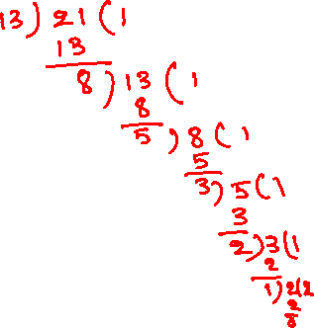
gcd
gcd(21, 13)
int gcd(int m, int n) {
int rem;
while (n > 0) {
rem = m % n;
m = n;
n = rem;
}
return m;
}

Slide 40

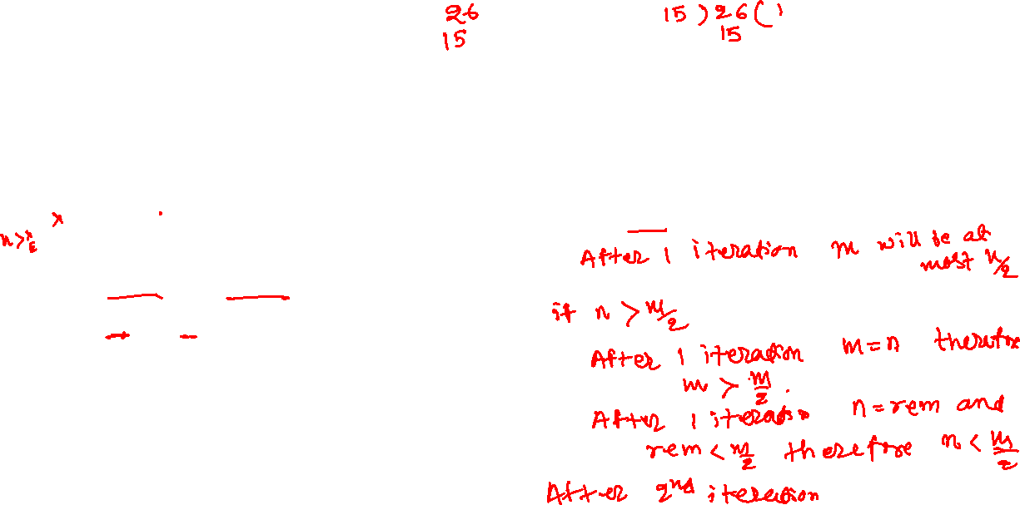
gcd
How many iterations are needed to break the problem into 1/2
if n <= m/2
int gcd(int m, int n) {
int rem;
while (n > 0) {
rem = m % n;
m = n;
n = rem;
}
return m;
}
Notes:
If we look at this algorithm closely, if n <= m/2 after the first iteration, the value of m will be <= m/2, because of the assignment m = n, at line-5. On the other hand, if n > m/2, the value of n after the first iteration would be < m/2. Because the remainder computed at line-4, m % n will be less than m/2, when n > m/2 (rem will be m – n, which is less than m/2). During the second iteration, the value of n from the first iteration is assigned to m at line-5. Therefore, after the second iteration, the value of m will be less than half of the value of m before the first iteration. From this, we can conclude that in two iterations, the value of m will definitely be reduced by half of its original value.

Slide 41
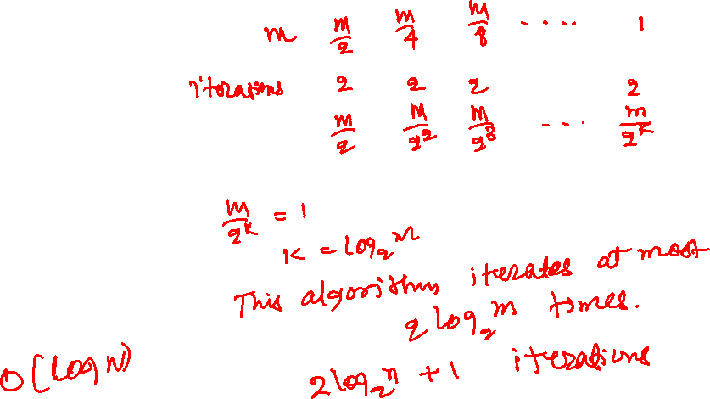
gcd
Time complexity
int gcd(int m, int n) {
int rem;
while (n > 0) {
rem = m % n;
m = n;
n = rem;
}
return m;
}
Notes:
Notice, in the worst case, the loop runs until "m" reaches one. So, the value of "m" will be m/2 after two iterations, m/2² after four iterations, m/2³ after six iterations, and so on. Therefore after 2k iterations, the value of m will be m/2^{k}. Let's say 2k is the number of iterations in the worst case; so, the value of m after 2k iterations, i.e., m/2^{k}, will be equal to 1. This gives the worst-case number of iterations as (2 * log₂ m). The number of iterations in terms of n will be (2 * log₂ n + 1) because, after the first iteration, m becomes n. Since every iteration does a constant number of operations, the worst-case time complexity of the gcd algorithm is O(log n).

Slide 42
gcd
How many iterations are needed to break the problem into 1/2
if n <= m/2
first iteration
rem < m/2 // at line-4
m <= m/2 // at line-5
n < m/2 // at line-6
if n > m/2
first iteration
rem < m/2 // at line-4
m > m/2 // at line-5
n < m/2 // at line-6
second iteration
rem < m/2 (because n < m/2) // at line-4
m < m/2 (because n < m/2) // at line-5
n < m/2 // at line-6
int gcd(int m, int n) {
int rem;
while (n > 0) {
rem = m % n;
m = n;
n = rem;
}
return m;
}

Slide 43

gcd
Problem size: m m/2 m/4 m/8 … 1
Num iterations: 2 4 6 2k
After 2k iterations m becomes $m/2^{k}$
If the total number of iterations in the worst case is 2k:
$$\frac{m}{2^{k}}=1$$
$$k=\log_{2}{m}$$
Therefore, number of iterations in the worst case is: 2 * $\log_{2}{m}$
or 1 + 2 * $\log_{2}{n}$
because after the first iteration m becomes n
Time complexity: O(log n)
int gcd(int m, int n) {
int rem;
while (n > 0) {
rem = m % n;
m = n;
n = rem;
}
return m;
}

Slide 44
Selection sort
int find_min(int arr[], int start, int end)
{
int i, min, idx;
min = arr[start];
idx = start;
for (i = start + 1; i < end; i++) {
if (arr[i] < min) {
min = arr[i];
idx = i;
}
}
return idx;
}
void swap(int arr[], int i, int j)
{
int tmp = arr[i];
arr[i] = arr[j];
arr[j] = tmp;
}
void selection_sort(int arr[], int pos, int n)
{
int idx;
if (pos >= n - 1) {
return;
}
idx = find_min(arr, pos, n);
if (idx != pos) {
swap(arr, pos, idx);
}
selection_sort(arr, pos+1, n);
}
Time complexity:
Notes:
Let’s look at the selection sort algorithm. Initially, the value of pos is zero, and n is the total number of elements. The input size is n – pos. At line-11, selection_sort is called with the input size “n – pos – 1”, which is one less than the current input size. If the selection_sort performs T(n) operations, the recursive call at line-11 will perform T(n-1) operations. Besides the recursive call, find_min iterates (end-start-1) times, i.e., (n-pos-1) times, roughly equal to the input size. If n is the input size, find_min performs roughly c₁*n + c₃ operations. In addition to the number of operations in find_min and the recursive call, selection_sort also executes a constant number of operations, say c₄. So, the total number of operations by selection sort can be expressed as T(n) = T(n-1) +c₁*n + c₂, where c₂ = c₃+c₄.

Slide 45
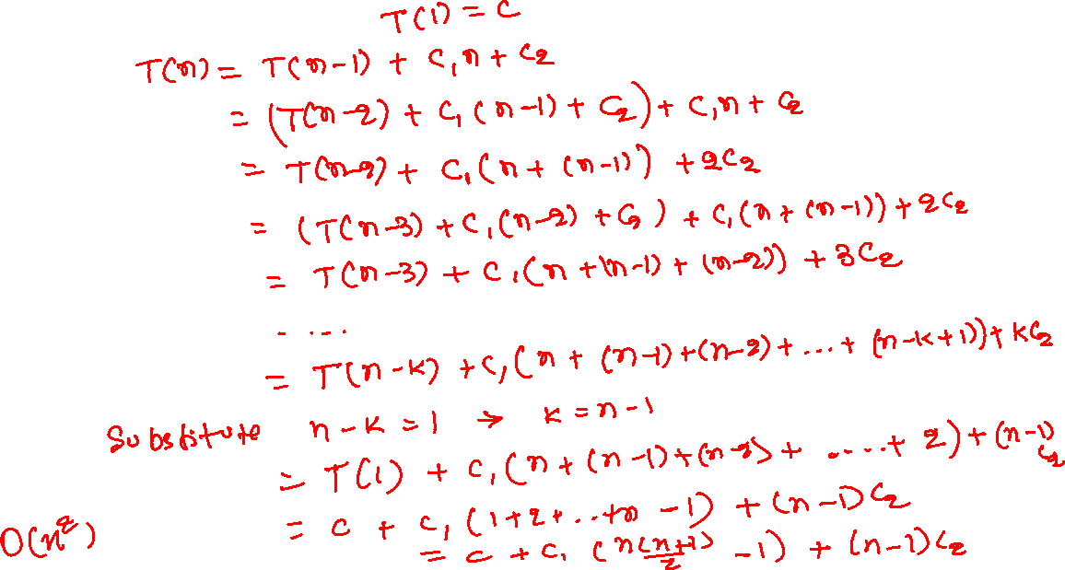
Time complexity
Notes:
After solving this recurrence relation using the expansion method, we obtain the time complexity of selection_sort as O(n²).

Slide 46
Time complexity
$$T\left(1\right)=c$$
$$T\left(n\right)=T\left(n−1\right)+c_{1}n+c_{2}$$
$=(T\left(n−2\right)+c_{1}\left(n−1\right)+c_{2})+c_{1}n+c_{2}$
$=T\left(n−2\right)+c_{1}\left(n−1\right)+c_{1}n+2c_{2}$
$=\left(T\left(n−3\right)+c_{1}\left(n−2\right)+c_{2}\right)+c_{1}\left(n−1\right)+c_{1}n+2c_{2}$
$=T\left(n−3\right)+c_{1}\left(n−2\right)+c_{1}\left(n−1\right)+c_{1}n+3c_{2}$
$= …$
$=T\left(n−k\right)+c_{1}\left(n−k+1\right)+…+c_{1}\left(n−2\right)+c_{1}\left(n−1\right)+c_{1}n+kc_{2}$
Substitute, k = n-1
$=T\left(1\right)+2c_{1}+ …+c_{1}\left(n−2\right)+c_{1}\left(n−1\right)+c_{1}n+c_{2}(n−1)$
$=c+c_{1}\left(2+3+…+n\right)+c_{2}\left(n−1\right)$
$=c+c_{1}\left(\frac{n\left(n+1\right)}{2}−1\right)+c_{2}\left(n−1\right)$
$=O(n^{2})$

Slide 47

Towers of Hanoi
void move(int n, char src_t[], char dst_t[], char tmp_t[]) {
if (n == 1) {
printf(“moving from %s to %s\n”, src_t, dst_t);
}
else {
move(n-1, src_t, tmp_t, dst_t);
printf(“moving from %s to %s\n”, src_t, dst_t);
move(n-1, tmp_t, dst_t, src_t);
}
}
int main() {
move(4, “Tower1”, “Tower3”, “Tower2”);
return 0;
}
Time complexity:
Notes:
Let’s look at the Towers of Hanoi problem. In this case, if the move routine executes T(n) operations, the recursive calls at lines-6,7 will execute T(n-1) operations each. The move routine additionally executes a constant number of operations (say c₁) besides the recursive calls. In this case, the recurrence relation for the time complexity is T(n) = 2T(n-1) + c₁.

Slide 48
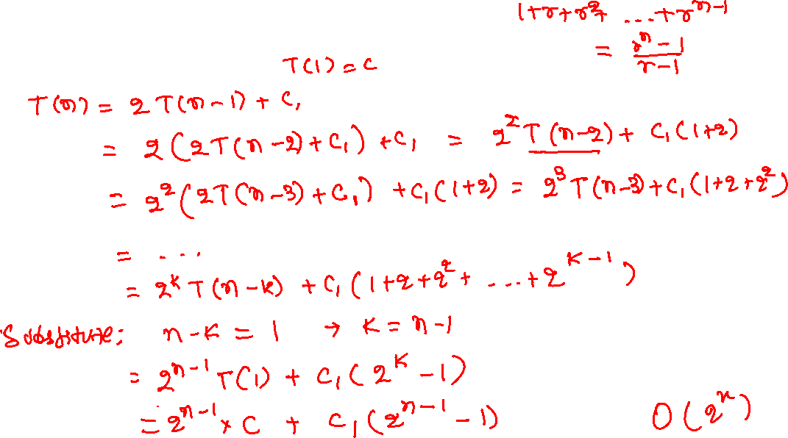
Time complexity
Notes:
If we solve this recurrence relation using the expansion method, we obtain the time complexity as O(2^{n}). It means that the time taken by this function grows exponentially, and it might take a lot of time for large inputs.

Slide 49

Time complexity
$$T\left(1\right)=c$$
$$T\left(n\right)=2T\left(n−1\right)+c_{1}$$
$=2\left(2T\left(n−2\right)+c_{1}\right)+c_{1}$
$=2^{2}T\left(n−2\right)+2c_{1}+c_{1}$
$=2^{2}\left(2T\left(n−3\right)+c_{1}\right)+2c_{1}+c_{1}$
$=2^{3}T\left(n−3\right)+2^{2}c_{1}+2c_{1}+c_{1}$
$= …$
$=2^{k}T\left(n−k\right)+2^{k−1}c_{1}+ …+2^{2}c_{1}+2c_{1}+c_{1}$
Substitute n - k = 1
$=2^{n−1}T\left(1\right)+2^{n−2}c_{1}+ …+2^{2}c_{1}+2c_{1}+c_{1}$
$={c∗ 2}^{n−1}+c_{1}\left(1+2+…+2^{n−2}\right)$
$={c∗ 2}^{n−1}+c_{1}\left(2^{n−1}−1\right)$
$=O(2^{n})$

Slide 50
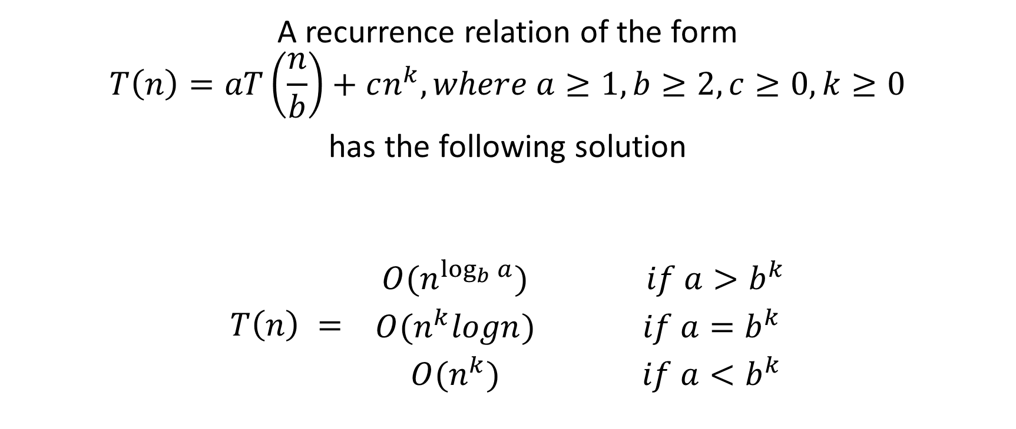
Master theorem
A recurrence relation of the form
$$T\left(n\right)=aT\left(\frac{n}{b}\right)+cn^{k}, where a≥1, b≥2, c≥0, k≥0$$
has the following solution
$$T\left(n\right) = \begin{matrix}O(n^{\log_{b}{a}}) & if a>b^{k} \\ O(n^{k}logn) & if a=b^{k} \\ O(n^{k}) & if a<b^{k}\end{matrix}$$
Notes:
We can also use the master theorem to solve a subset of recurrence relations of the form shown on this slide.

Slide 51

Useful formulae
$$1+2+3+ …+n=\frac{n\left(n+1\right)}{2}$$
$1+r+r^{2}+ …+r^{n−1}=\frac{r^{n}−1}{r −1}$ $if r ≠1$
$$1^{2}+2^{2}+3^{2}+ …+n^{2}=\frac{n(n+1)(2n+1)}{6}$$
$$1+\frac{1}{2}+\frac{1}{3}+ …+\frac{1}{n} ≈\ln{x}$$

Slide 52

Useful formulae
$$\log_{b}{a}=\frac{1}{\log_{a}{b}}$$
$$\log_{a}{x}=\frac{\log_{b}{x}}{\log_{b}{a}}$$
$$b^{\log_{b}{x}}=x$$
$$b^{\log_{a}{x}}=x^{\log_{a}{b}}$$

Slide 53

Useful formulae
$$f\left(x\right)=ax^{2}+bx+c where a, b,c∈R and a ≠0$$
The roots of the above quadratic equation are:
$α=\frac{−b+\sqrt{b^{2}−4ac}}{2a}$ $β=\frac{−b−\sqrt{b^{2}−4ac}}{2a}$

Slide 54
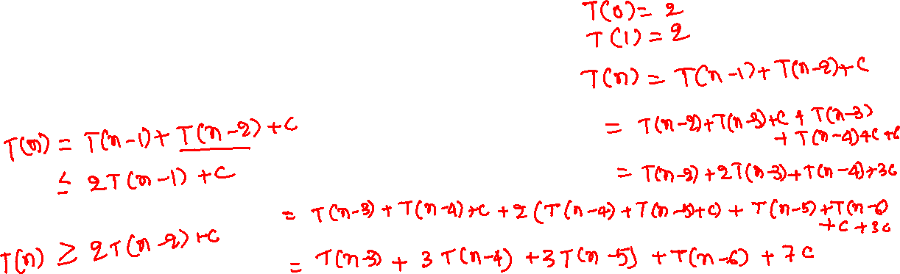
Fibonacci numbers
Time complexity:
int fib(int n) {
if (n <= 1)
return n;
return fib(n-1) + fib(n-2);
}
Notes:
Let’s return to the Fibonacci numbers we have been chasing since the beginning. Notice that if we use the expansion method, it’s not going to work in this case because there is no pattern. For such problems, we can make some approximation to convert this into a recurrence relation that is solvable using the expansion method. For the upper bound, we can over-approximate the number of operations required to compute the result. An over-approximation that works, in this case, is to replace fib(n-2) with fib(n-1), which gives us the recurrence relation, fib(n) <= 2 * fib(n-1) + c. For the lower bound, we can under-approximate the total number of operations. An under-approximation that works, in this case, is to replace fib(n-1) with fib(n-2), yielding a relation, fib(n) >= 2 * fib(n-2) + c. The upper bound gives us the Big-Oh complexity, and the lower bound gives us the Big-Omega complexity; both are needed in this case because finding the actual complexity is slightly more complicated and requires more sophisticated analysis.

Slide 55
Fibonacci numbers
Time complexity:
Upper Bound:
T(1) = 2
T(0) = 2
T(n) <= 2T(n-1) + c
int fib(int n) {
if (n <= 1)
return n;
return fib(n-1) + fib(n-2);
}

Slide 56
Fibonacci numbers
Time complexity:
Lower Bound:
T(1) = 2
T(0) = 2
T(n) >= 2T(n-2) + c
int fib(int n) {
if (n <= 1)
return n;
return fib(n-1) + fib(n-2);
}

