Slide 2
Today’s class
Merge sort
Quick sort
Dynamic arrays

Slide 3
Merge sort

Slide 4
References
Read section-2.3.1 from CLRS

Slide 5
Merging two sorted arrays
3 | 13 | 28 | 49
6 | 23 | 29 | 61
ARRAY- A
ARRAY- B
After merge
3 | 6 | 13 | 23
28 | 29 | 49 | 61
ARRAY- A
ARRAY- B
Notes:
The goal here is to merge two sorted arrays, A and B, in such a way that the combined array (considering arrays A and B as a whole) is sorted.

Slide 6
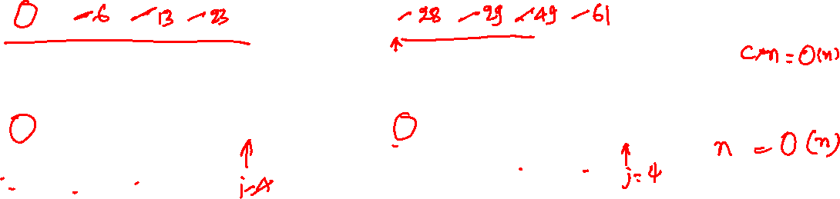
Merging two sorted arrays
3 | 13 | 28 | 49
6 | 23 | 29 | 61
Time complexity:
Additional space complexity:
ARRAY- A
ARRAY- B
3 | 13 | 28 | 49
6 | 23 | 29 | 61
ARRAY- T1
ARRAY- T2
Notes:
This algorithm creates copies of arrays A and B, compares the values in the temporary arrays, copies the smaller value into the original array, and skips the copied value in the temporary array. If the sum of the number of elements in arrays T1 and T2 is n, then this procedure makes n comparisons in the worst case. In addition, it performs 2 * n copy operations (copying from the original to temporary and vice versa). The time complexity of this algorithm is O(n). The following slides demonstrate the algorithm in detail.

Slide 7
Merging two sorted arrays
k = 0
3 | 13 | 28 | 49
6 | 23 | 29 | 61
ARRAY- A
ARRAY- B
3 | 13 | 28 | 49
6 | 23 | 29 | 61
ARRAY- T1
ARRAY- T2
i = 0
j = 0

Slide 8
Merging two sorted arrays
k = 0
3 | 13 | 28 | 49
6 | 23 | 29 | 61
ARRAY- A
ARRAY- B
3 | 13 | 28 | 49
6 | 23 | 29 | 61
ARRAY- T1
ARRAY- T2
i = 0
j = 0
if (T1[i] < T2[j]) { A[k] = T1[i]; i++; }
else { A[k] = T2[j]; j++; }
k++;

Slide 9
Merging two sorted arrays
k = 1
3 | 13 | 28 | 49
6 | 23 | 29 | 61
ARRAY- A
ARRAY- B
3 | 13 | 28 | 49
6 | 23 | 29 | 61
ARRAY- T1
ARRAY- T2
i = 1
j = 0
if (T1[i] < T2[j]) { A[k] = T1[i]; i++; }
else { A[k] = T2[j]; j++; }
k++;

Slide 10
Merging two sorted arrays
k = 2
3 | 6 | 28 | 49
6 | 23 | 29 | 61
ARRAY- A
ARRAY- B
3 | 13 | 28 | 49
6 | 23 | 29 | 61
ARRAY- T1
ARRAY- T2
i = 1
j = 1
if (T1[i] < T2[j]) { A[k] = T1[i]; i++; }
else { A[k] = T2[j]; j++; }
k++;

Slide 11
Merging two sorted arrays
k = 3
3 | 6 | 13 | 49
6 | 23 | 29 | 61
ARRAY- A
ARRAY- B
3 | 13 | 28 | 49
6 | 23 | 29 | 61
ARRAY- T1
ARRAY- T2
i = 2
j = 1
if (T1[i] < T2[j]) { A[k] = T1[i]; i++; }
else { A[k] = T2[j]; j++; }
k++;

Slide 12
Merging two sorted arrays
k = 0
3 | 6 | 13 | 23
6 | 23 | 29 | 61
ARRAY- A
ARRAY- B
3 | 13 | 28 | 49
6 | 23 | 29 | 61
ARRAY- T1
ARRAY- T2
i = 2
j = 2
if (T1[i] < T2[j]) { A[k] = T1[i]; i++; }
else { A[k] = T2[j]; j++; }
k++;

Slide 13
Merging two sorted arrays
k = 1
3 | 6 | 13 | 23
28 | 23 | 29 | 61
ARRAY- A
ARRAY- B
3 | 13 | 28 | 49
6 | 23 | 29 | 61
ARRAY- T1
ARRAY- T2
i = 3
j = 2
if (T1[i] < T2[j]) { A[k] = T1[i]; i++; }
else { A[k] = T2[j]; j++; }
k++;

Slide 14
Merging two sorted arrays
k = 2
3 | 6 | 13 | 23
28 | 29 | 29 | 61
ARRAY- A
ARRAY- B
3 | 13 | 28 | 49
6 | 23 | 29 | 61
ARRAY- T1
ARRAY- T2
i = 3
j = 3
if (T1[i] < T2[j]) { A[k] = T1[i]; i++; }
else { A[k] = T2[j]; j++; }
k++;

Slide 15
Merging two sorted arrays
k = 3
3 | 6 | 13 | 23
28 | 29 | 49 | 61
ARRAY- A
ARRAY- B
3 | 13 | 28 | 49
6 | 23 | 29 | 61
ARRAY- T1
ARRAY- T2
i = 4
j = 3
if (T1[i] < T2[j]) { A[k] = T1[i]; i++; }
else { A[k] = T2[j]; j++; }
k++;

Slide 16
Merging two sorted arrays
k = 4
3 | 6 | 13 | 23
28 | 29 | 49 | 61
ARRAY- A
ARRAY- B
3 | 13 | 28 | 49
6 | 23 | 29 | 61
ARRAY- T1
ARRAY- T2
i = 4
j = 4
if (T1[i] < T2[j]) { A[k] = T1[i]; i++; }
else { A[k] = T2[j]; j++; }
k++;

Slide 17
Merging two sorted arrays
k = 4
3 | 6 | 13 | 23
28 | 29 | 49 | 61
Time complexity:
c * n
Additional space complexity:
n
ARRAY- A
ARRAY- B
3 | 13 | 28 | 49
6 | 23 | 29 | 61
ARRAY- T1
ARRAY- T2
i = 4
j = 4
if (T1[i] < T2[j]) { A[k] = T1[i]; i++; }
else { A[k] = T2[j]; j++; }
k++;

Slide 18
Merge sort
Merge sort is a recursive algorithm
Base condition:
if the input array has one or zero elements, the array is already sorted; return the array
Recursive step
Divide the array into two sub-arrays, A₁ and A₂
A₁ contains the first half, A₂ contains the second half
Recursively sort A₁ and A₂
Merge sorted A₁ and A₂ into a single sorted array

Slide 19
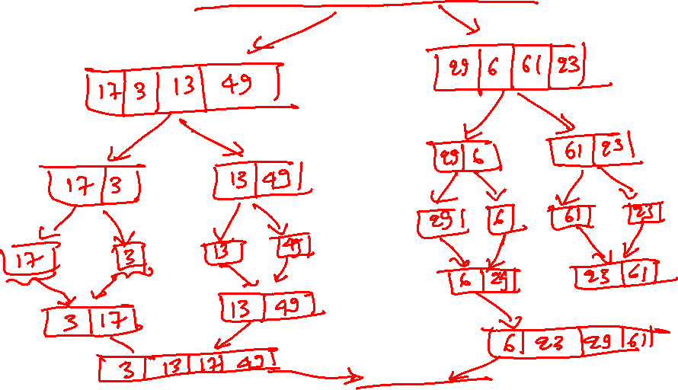
Merge sort
 |  |  |  |  |  | 17 | 3 | 13 | 49 | 29 | 6 | 61 | 23

Slide 20
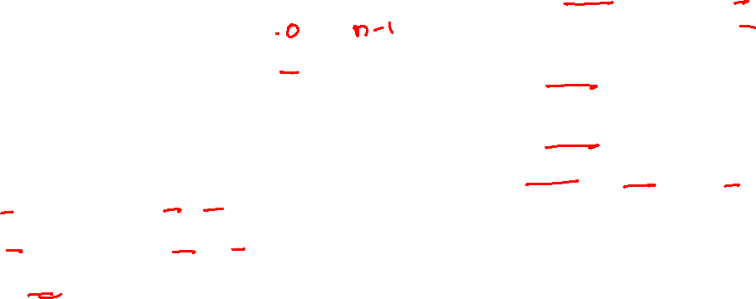
Merge sort
void merge(int arr[], int lo, int mid, int hi)
{
int i, j, k;
int n_elem_1 = mid - lo + 1;
int n_elem_2 = hi - mid;
// be careful; large array allocations may fail
int tmp1[n_elem_1 + 1];
int tmp2[n_elem_2 + 1];
for (i = 0; i < n_elem_1; i++) {
tmp1[i] = arr[lo + i];
}
for (j = 0; j < n_elem_2; j++) {
tmp2[j] = arr[mid + 1 + j];
}
tmp1[i] = tmp2[j] = INT_MAX;
i = j = 0;
for (k = lo; k <= hi; k++) {
if (tmp1[i] <= tmp2[j]) {
arr[k] = tmp1[i]; i += 1;
} else {
arr[k] = tmp2[j]; j += 1;
}
}
}
void mergesort(int arr[], int lo, int hi)
{
if (lo >= hi) {
return;
}
int mid = (lo + hi) / 2;
// recursively sort the first half
mergesort(arr, lo, mid);
// recursively sort the second half
mergesort(arr, mid+1, hi);
// merge the sorted arrays
merge(arr, lo, mid, hi);
}
Notes:
Initially, mergesort is called with mergesort(arr, 0, n-1), where n is the number of elements in the arr. You need to be careful during the static allocation of large arrays (like the one we are doing in the merge procedure) because they may fail without any warning. Dynamic memory allocations, as we will study in the following classes, are another option, but dynamically allocating and deallocating memory in the merge routine is also a bad idea because dynamic allocations can be much more expensive than static allocations. A better strategy would be to allocate a temporary array that can hold n elements in the “main” routine or the caller of mergesort and pass it to the merge routine. The temporary array can be deleted when the mergesort finally returns to its original caller (e.g., main). The mergesort routine recursively divides the array into two parts until the parts contain only one element. At this point, the parts are already sorted (because an unsorted one-element array doesn’t exist). Then before returning, the algorithm merges the sorted parts in a way that the merged array is also sorted (we have discussed a strategy to merge two sorted arrays before). This divide-and-merge approach continues until the entire array is sorted. The next slides show the sequence of events in more detail.

Slide 21
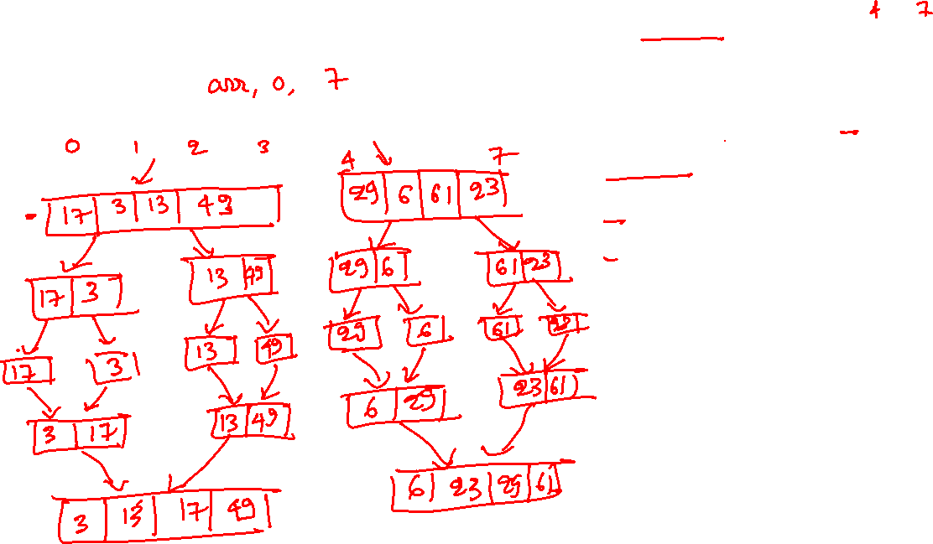
Merge sort
void mergesort(int arr[], int lo, int hi)
{
if (lo >= hi) {
return;
}
int mid = (lo + hi) / 2;
// recursively sort the first half
mergesort(arr, lo, mid);
// recursively sort the second half
mergesort(arr, mid+1, hi);
// merge the sorted arrays
merge(arr, lo, mid, hi);
}
17 | 3 | 13 | 49 | 29 | 6 | 61 | 23
Notes:
T

Slide 22
Merge sort
Divide phase: BLUE
Merge phase: RED
 |  |  |  |  |  | 17 | 3 | 13 | 49 | 29 | 6 | 61 | 23

Slide 23
Merge sort
Divide phase: BLUE
Merge phase: RED
 |  |  |  |  |  | 17 | 3 | 13 | 49 | 29 | 6 | 61 | 23
 |  |  | 17 | 3 | 13 | 49

Slide 24
Merge sort
Divide phase: BLUE
Merge phase: RED
 |  |  |  |  |  | 17 | 3 | 13 | 49 | 29 | 6 | 61 | 23
 |  |  | 17 | 3 | 13 | 49
 | 17 | 3

Slide 25
Merge sort
Divide phase: BLUE
Merge phase: RED
 |  |  |  |  |  | 17 | 3 | 13 | 49 | 29 | 6 | 61 | 23
 |  |  | 17 | 3 | 13 | 49
 | 17 | 3
17

Slide 26
Merge sort
Divide phase: BLUE
Merge phase: RED
 |  |  |  |  |  | 17 | 3 | 13 | 49 | 29 | 6 | 61 | 23
 |  |  | 17 | 3 | 13 | 49
 | 17 | 3
17 |  |  | 3

Slide 27
Merge sort
Divide phase: BLUE
Merge phase: RED
 |  |  |  |  |  | 17 | 3 | 13 | 49 | 29 | 6 | 61 | 23
 |  |  | 17 | 3 | 13 | 49
 | 17 | 3
17 |  |  | 3
 | 3 | 17

Slide 28
Merge sort
Divide phase: BLUE
Merge phase: RED
 |  |  |  |  |  | 17 | 3 | 13 | 49 | 29 | 6 | 61 | 23
 |  |  | 17 | 3 | 13 | 49
 | 17 | 3 |  |  |  | 13 | 49
17 |  |  | 3
 | 3 | 17

Slide 29
Merge sort
Divide phase: BLUE
Merge phase: RED
 |  |  |  |  |  | 17 | 3 | 13 | 49 | 29 | 6 | 61 | 23
 |  |  | 17 | 3 | 13 | 49
 | 17 | 3 |  |  |  | 13 | 49
17 |  |  | 3 |  | 13
 | 3 | 17

Slide 30
Merge sort
Divide phase: BLUE
Merge phase: RED
 |  |  |  |  |  | 17 | 3 | 13 | 49 | 29 | 6 | 61 | 23
 |  |  | 17 | 3 | 13 | 49
 | 17 | 3 |  |  |  | 13 | 49
17 |  |  | 3 |  | 13 |  |  | 49
 | 3 | 17

Slide 31
Merge sort
Divide phase: BLUE
Merge phase: RED
 |  |  |  |  |  | 17 | 3 | 13 | 49 | 29 | 6 | 61 | 23
 |  |  | 17 | 3 | 13 | 49
 | 17 | 3 |  |  |  | 13 | 49
17 |  |  | 3 |  | 13 |  |  | 49
 | 3 | 17 |  |  |  | 13 | 49

Slide 32
Merge sort
Divide phase: BLUE
Merge phase: RED
 |  |  |  |  |  | 17 | 3 | 13 | 49 | 29 | 6 | 61 | 23
 |  |  | 17 | 3 | 13 | 49
 | 17 | 3 |  |  |  | 13 | 49
17 |  |  | 3 |  | 13 |  |  | 49
 | 3 | 17 |  |  |  | 13 | 49
 |  |  | 3 | 13 | 17 | 49

Slide 33
Merge sort
Divide phase: BLUE
Merge phase: RED
 |  |  |  |  |  | 17 | 3 | 13 | 49 | 29 | 6 | 61 | 23
 |  |  | 17 | 3 | 13 | 49 |  |  |  |  |  |  | 29 | 6 | 61 | 23
 | 17 | 3 |  |  |  | 13 | 49
17 |  |  | 3 |  | 13 |  |  | 49
 | 3 | 17 |  |  |  | 13 | 49
 |  |  | 3 | 13 | 17 | 49

Slide 34
Merge sort
Divide phase: BLUE
Merge phase: RED
 |  |  |  |  |  | 17 | 3 | 13 | 49 | 29 | 6 | 61 | 23
 |  |  | 17 | 3 | 13 | 49 |  |  |  |  |  |  | 29 | 6 | 61 | 23
 | 17 | 3 |  |  |  | 13 | 49 |  |  |  | 29 | 6
17 |  |  | 3 |  | 13 |  |  | 49
 | 3 | 17 |  |  |  | 13 | 49
 |  |  | 3 | 13 | 17 | 49

Slide 35
Merge sort
Divide phase: BLUE
Merge phase: RED
 |  |  |  |  |  | 17 | 3 | 13 | 49 | 29 | 6 | 61 | 23
 |  |  | 17 | 3 | 13 | 49 |  |  |  |  |  |  | 29 | 6 | 61 | 23
 | 17 | 3 |  |  |  | 13 | 49 |  |  |  | 29 | 6
17 |  |  | 3 |  | 13 |  |  | 49 |  | 29
 | 3 | 17 |  |  |  | 13 | 49
 |  |  | 3 | 13 | 17 | 49

Slide 36
Merge sort
Divide phase: BLUE
Merge phase: RED
 |  |  |  |  |  | 17 | 3 | 13 | 49 | 29 | 6 | 61 | 23
 |  |  | 17 | 3 | 13 | 49 |  |  |  |  |  |  | 29 | 6 | 61 | 23
 | 17 | 3 |  |  |  | 13 | 49 |  |  |  | 29 | 6
17 |  |  | 3 |  | 13 |  |  | 49 |  | 29 |  |  | 6
 | 3 | 17 |  |  |  | 13 | 49
 |  |  | 3 | 13 | 17 | 49

Slide 37
Merge sort
Divide phase: BLUE
Merge phase: RED
 |  |  |  |  |  | 17 | 3 | 13 | 49 | 29 | 6 | 61 | 23
 |  |  | 17 | 3 | 13 | 49 |  |  |  |  |  |  | 29 | 6 | 61 | 23
 | 17 | 3 |  |  |  | 13 | 49 |  |  |  | 29 | 6
17 |  |  | 3 |  | 13 |  |  | 49 |  | 29 |  |  | 6
 | 3 | 17 |  |  |  | 13 | 49 |  |  |  | 6 | 29
 |  |  | 3 | 13 | 17 | 49

Slide 38
Merge sort
Divide phase: BLUE
Merge phase: RED
 |  |  |  |  |  | 17 | 3 | 13 | 49 | 29 | 6 | 61 | 23
 |  |  | 17 | 3 | 13 | 49 |  |  |  |  |  |  | 29 | 6 | 61 | 23
 | 17 | 3 |  |  |  | 13 | 49 |  |  |  | 29 | 6 |  |  |  |  | 61 | 23
17 |  |  | 3 |  | 13 |  |  | 49 |  | 29 |  |  | 6
 | 3 | 17 |  |  |  | 13 | 49 |  |  |  | 6 | 29
 |  |  | 3 | 13 | 17 | 49

Slide 39
Merge sort
Divide phase: BLUE
Merge phase: RED
 |  |  |  |  |  | 17 | 3 | 13 | 49 | 29 | 6 | 61 | 23
 |  |  | 17 | 3 | 13 | 49 |  |  |  |  |  |  | 29 | 6 | 61 | 23
 | 17 | 3 |  |  |  | 13 | 49 |  |  |  | 29 | 6 |  |  |  |  | 61 | 23
17 |  |  | 3 |  | 13 |  |  | 49 |  | 29 |  |  | 6 |  |  | 61
 | 3 | 17 |  |  |  | 13 | 49 |  |  |  | 6 | 29
 |  |  | 3 | 13 | 17 | 49

Slide 40
Merge sort
Divide phase: BLUE
Merge phase: RED
 |  |  |  |  |  | 17 | 3 | 13 | 49 | 29 | 6 | 61 | 23
 |  |  | 17 | 3 | 13 | 49 |  |  |  |  |  |  | 29 | 6 | 61 | 23
 | 17 | 3 |  |  |  | 13 | 49 |  |  |  | 29 | 6 |  |  |  |  | 61 | 23
17 |  |  | 3 |  | 13 |  |  | 49 |  | 29 |  |  | 6 |  |  | 61 |  |  | 23
 | 3 | 17 |  |  |  | 13 | 49 |  |  |  | 6 | 29
 |  |  | 3 | 13 | 17 | 49

Slide 41
Merge sort
Divide phase: BLUE
Merge phase: RED
 |  |  |  |  |  | 17 | 3 | 13 | 49 | 29 | 6 | 61 | 23
 |  |  | 17 | 3 | 13 | 49 |  |  |  |  |  |  | 29 | 6 | 61 | 23
 | 17 | 3 |  |  |  | 13 | 49 |  |  |  | 29 | 6 |  |  |  |  | 61 | 23
17 |  |  | 3 |  | 13 |  |  | 49 |  | 29 |  |  | 6 |  |  | 61 |  |  | 23
 | 3 | 17 |  |  |  | 13 | 49 |  |  |  | 6 | 29 |  |  |  |  | 23 | 61
 |  |  | 3 | 13 | 17 | 49

Slide 42
Merge sort
Divide phase: BLUE
Merge phase: RED
 |  |  |  |  |  | 17 | 3 | 13 | 49 | 29 | 6 | 61 | 23
 |  |  | 17 | 3 | 13 | 49 |  |  |  |  |  |  | 29 | 6 | 61 | 23
 | 17 | 3 |  |  |  | 13 | 49 |  |  |  | 29 | 6 |  |  |  |  | 61 | 23
17 |  |  | 3 |  | 13 |  |  | 49 |  | 29 |  |  | 6 |  |  | 61 |  |  | 23
 | 3 | 17 |  |  |  | 13 | 49 |  |  |  | 6 | 29 |  |  |  |  | 23 | 61
 |  |  | 3 | 13 | 17 | 49 |  |  |  |  |  |  | 6 | 23 | 29 | 61

Slide 43
Merge sort
Divide phase: BLUE
Merge phase: RED
 |  |  |  |  |  | 17 | 3 | 13 | 49 | 29 | 6 | 61 | 23
 |  |  | 17 | 3 | 13 | 49 |  |  |  |  |  |  | 29 | 6 | 61 | 23
 | 17 | 3 |  |  |  | 13 | 49 |  |  |  | 29 | 6 |  |  |  |  | 61 | 23
17 |  |  | 3 |  | 13 |  |  | 49 |  | 29 |  |  | 6 |  |  | 61 |  |  | 23
 | 3 | 17 |  |  |  | 13 | 49 |  |  |  | 6 | 29 |  |  |  |  | 23 | 61
 |  |  | 3 | 13 | 17 | 49 |  |  |  |  |  |  | 6 | 23 | 29 | 61
 |  |  |  |  |  | 3 | 6 | 13 | 17 | 23 | 29 | 49 | 61

Slide 44
Time complexity

Slide 45

Merge sort
void merge(int arr[], int lo, int mid, int hi)
{
int i, j, k;
int n_elem_1 = mid - lo + 1;
int n_elem_2 = hi - mid;
// be careful; large array allocations may fail
int tmp1[n_elem_1 + 1];
int tmp2[n_elem_2 + 1];
for (i = 0; i < n_elem_1; i++) {
tmp1[i] = arr[lo + i];
}
for (j = 0; j < n_elem_2; j++) {
tmp2[j] = arr[mid + 1 + j];
}
tmp1[i] = tmp2[j] = INT_MAX;
i = j = 0;
for (k = lo; k <= hi; k++) {
if (tmp1[i] <= tmp2[j]) {
arr[k] = tmp1[i]; i += 1;
} else {
arr[k] = tmp2[j]; j += 1;
}
}
}
void mergesort(int arr[], int lo, int hi)
{
if (lo >= hi) {
return;
}
int mid = (lo + hi) / 2;
// recursively sort the first half
mergesort(arr, lo, mid);
// recursively sort the second half
mergesort(arr, mid+1, hi);
// merge the sorted arrays
merge(arr, lo, mid, hi);
}
Time complexity:
Notes:
The recurrence relation for time complexity is T(n) = 2T(n/2) + c₁ * n +c₂. This is because the two recursive calls to mergesort are done for around n/2 elements, where n is the number of elements in the array. The merge procedure does O(n) operations. Other operations in the mergesort routine are O(1).

Slide 46
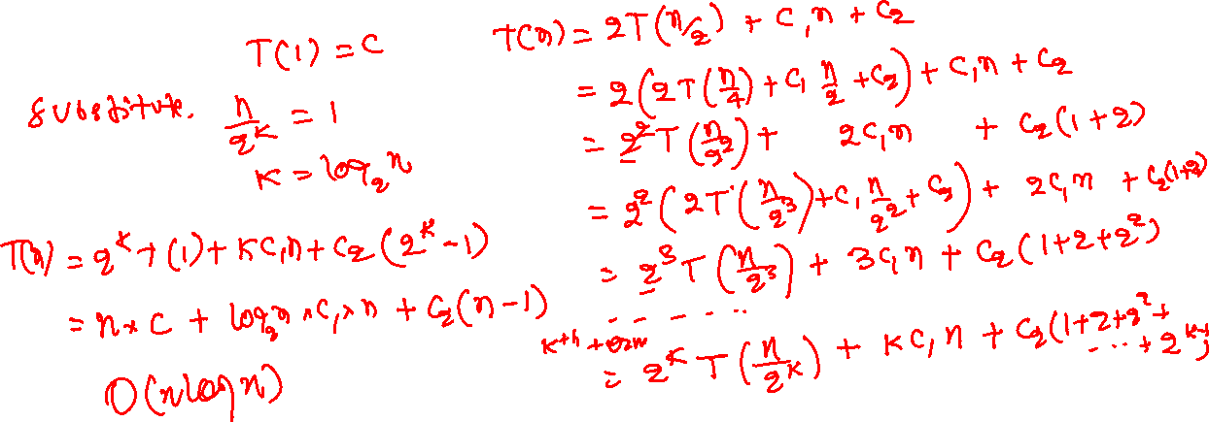
Merge sort
Time complexity
Notes:
Solving the recurrence relation gives us O(n * log(n)) time complexity.

Slide 47
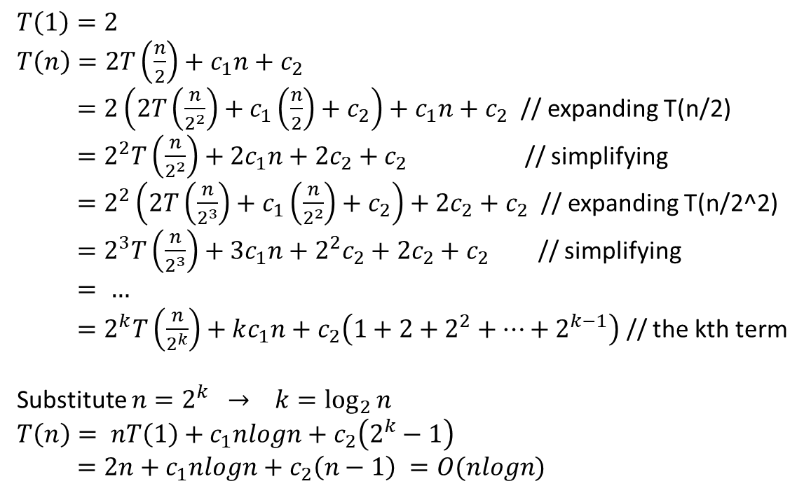
Merge sort
$$T\left(1\right)=2$$
$T\left(n\right)=2T\left(\frac{n}{2}\right)+c_{1}n+c_{2}$
$=2\left(2T\left(\frac{n}{2^{2}}\right)+c_{1}\left(\frac{n}{2}\right)+c_{2}\right)+c_{1}n+c_{2}$ // expanding T(n/2)
$=2^{2}T\left(\frac{n}{2^{2}}\right)+2c_{1}n+2c_{2}+c_{2}$ // simplifying
$=2^{2}\left(2T\left(\frac{n}{2^{3}}\right)+c_{1}\left(\frac{n}{2^{2}}\right)+c_{2}\right)+2c_{2}+c_{2}$ // expanding T(n/2^2)
$=2^{3}T\left(\frac{n}{2^{3}}\right)+3c_{1}n+2^{2}c_{2}+2c_{2}+c_{2}$ // simplifying
$= …$
$=2^{k}T\left(\frac{n}{2^{k}}\right)+kc_{1}n+c_{2}\left(1+2+2^{2}+…+2^{k−1}\right)$ // the kth term
Substitute $n=2^{k}$ $→ k=\log_{2}{n}$
$$T\left(n\right)= nT\left(1\right)+c_{1}nlogn+c_{2}\left(2^{k}−1\right)$$
$=2n+c_{1}nlogn+c_{2}\left(n−1\right) =O(nlogn)$

Slide 48
Quick sort

Slide 49
References
Read section-7.7 from Mark Allen Weiss

Slide 50
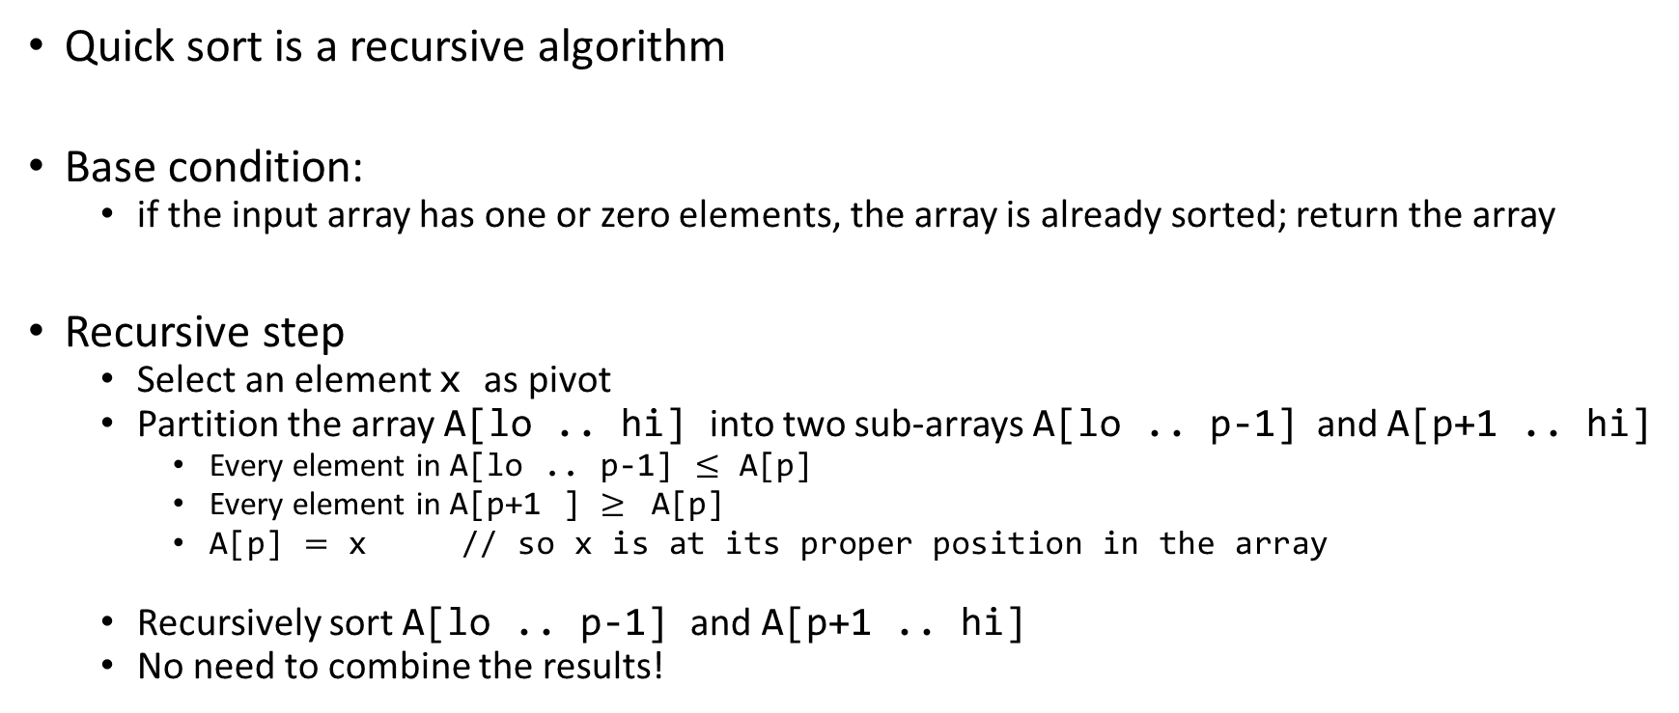
Quick sort
Quick sort is a recursive algorithm
Base condition:
if the input array has one or zero elements, the array is already sorted; return the array
Recursive step
Select an element x as pivot
Partition the array A[lo .. hi] into two sub-arrays A[lo .. p-1] and A[p+1 .. hi]
Every element in A[lo .. p-1] $≤$ A[p]
Every element in A[p+1 ] $≥$ A[p]
A[p] $=$ x // so x is at its proper position in the array
Recursively sort A[lo .. p-1] and A[p+1 .. hi]
No need to combine the results!

Slide 51
Quick sort
43
31
26
13
81
0
92
65
57
75
select pivot
43
31
26
13
81
0
92
65
57
75
partition
43
31
26
81
13
0
75
57
65
92
quicksort small
quicksort large
65
75
81
92
13
26
43
0
31
57
Notes:
The heart of the quick sort algorithm is the partitioning algorithm. In the partitioning algorithm, we select an element in the array as the pivot and partition the array into two parts, left and right, so that all the elements in the left partition are less than the pivot and all the elements in the right partition are greater than the pivot. After the partitioning, the final position of the pivot is the same as in the sorted array. We never look at the pivot element again and recursively run the partitioning algorithm for the left and right subarray until all the elements in the array are stored at an index that is equal to their position in the sorted array.

Slide 52
Quick sort
Quick sort algorithm performs best when the two partitions created after the partitioning are roughly of same size
Pivot selection may affect the complexity of the quicksort algorithm
Notes:
We will discuss later that the pivot selection is crucial for the performance of the quick sort algorithm. The quick sort performs best when the subarrays created after the partitioning are roughly of the same size. This could happen if we always select the median of n elements as the pivot. However, finding the median of n elements at low cost may be challenging.

Slide 53
Selecting the pivot
Select the first element as the pivot
Notes:
A simple strategy is to consider the first element as a pivot.

Slide 54
Partition
47 | 21 | 3 | 83 | 17 | 59 | 43 | 81 | 11 | 99
The first element of the array is the pivot. You can partition the array in multiple ways as long as the post-conditions for partitioning are met.

Slide 55
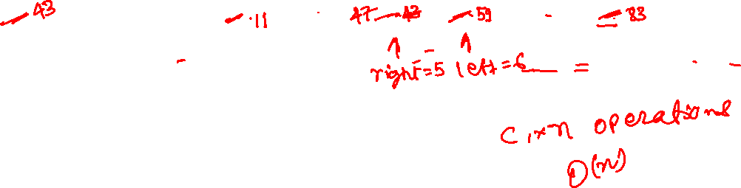
Partition
47 | 21 | 3 | 83 | 17 | 59 | 43 | 81 | 11 | 99
pivot = arr[0]
Set left = 1, right = n-1
while (arr[left] < pivot) left += 1
while (arr[right] > pivot) right -= 1
if (left <= right) exchange arr[right] with arr[left]; left++; right--;
if (right < left) exchange arr[0] (pivot) with arr[right]
Notes:
Let’s see how portioning is done. Initially, the first element is selected as the pivot. Now we use two variables, left and right, to keep track of elements that are less than or greater than the pivot. Initially, left is initialized to 1, and right is initialized to n-1, where n is the number of elements in the array. Now we keep incrementing left until we reach an index that contains a value greater than the pivot. Similarly, we keep decrementing the right until we reach an index that contains a value smaller than the pivot. Now, if left is greater than right, we know for sure that all the elements stored at indices greater than right are greater than the pivot, and all the values stored at indices less than or equal to right are less than the pivot. It means that the right holds the final position of the pivot, and we swap the pivot element with the element stored at the index right. However, if left is less than right, then we swap the values stored at indices left and right, increment the value of left, and decrement the value of right to ensure that all the elements stored before left are less than the pivot and all the elements stored after right are greater than the pivot. Notice that this algorithm will also work if there are duplicates in the array. This is something that you can explore yourself to verify. The following slides demonstrate the steps of this algorithm.

Slide 56
Partition
47 | 21 | 3 | 83 | 17 | 59 | 43 | 81 | 11 | 99
left = 1
right = 9
pivot = arr[0]
Set left = 1, right = n-1
while (arr[left] < pivot) left += 1
while (arr[right] > pivot) right -= 1
if (left <= right) exchange arr[right] with arr[left]; left++; right--;
if (right < left) exchange arr[0] (pivot) with arr[right]

Slide 57
Partition
47 | 21 | 3 | 83 | 17 | 59 | 43 | 81 | 11 | 99
left = 3
right = 9
After while (arr[left] < pivot) left += 1
pivot = arr[0]
Set left = 1, right = n-1
while (arr[left] < pivot) left += 1
while (arr[right] > pivot) right -= 1
if (left <= right) exchange arr[right] with arr[left]; left++; right--;
if (right < left) exchange arr[0] (pivot) with arr[right]

Slide 58
Partition
47 | 21 | 3 | 83 | 17 | 59 | 43 | 81 | 11 | 99
left = 3
right = 8
After while (arr[right] > pivot) right -= 1
pivot = arr[0]
Set left = 1, right = n-1
while (arr[left] < pivot) left += 1
while (arr[right] > pivot) right -= 1
if (left <= right) exchange arr[right] with arr[left]; left++; right--;
if (right < left) exchange arr[0] (pivot) with arr[right]

Slide 59
Partition
47 | 21 | 3 | 11 | 17 | 59 | 43 | 81 | 83 | 99
left = 3
right = 8
After if (left <= right) exchange arr[right] with arr[left]
pivot = arr[0]
Set left = 1, right = n-1
while (arr[left] < pivot) left += 1
while (arr[right] > pivot) right -= 1
if (left <= right) exchange arr[right] with arr[left]; left++; right--;
if (right < left) exchange arr[0] (pivot) with arr[right]

Slide 60
Partition
47 | 21 | 3 | 11 | 17 | 59 | 43 | 81 | 83 | 99
left = 5
right = 8
After while (arr[left] < pivot) left += 1
pivot = arr[0]
Set left = 1, right = n-1
while (arr[left] < pivot) left += 1
while (arr[right] > pivot) right -= 1
if (left <= right) exchange arr[right] with arr[left]; left++; right--;
if (right < left) exchange arr[0] (pivot) with arr[right]

Slide 61
Partition
47 | 21 | 3 | 11 | 17 | 59 | 43 | 81 | 83 | 99
left = 5
right = 8
After while (arr[right] > pivot) right -= 1
pivot = arr[0]
Set left = 1, right = n-1
while (arr[left] < pivot) left += 1
while (arr[right] > pivot) right -= 1
if (left <= right) exchange arr[right] with arr[left]; left++; right--;
if (right < left) exchange arr[0] (pivot) with arr[right]

Slide 62
Partition
47 | 21 | 3 | 11 | 17 | 43 | 59 | 81 | 83 | 99
left = 5
right = 8
After (left <= right) exchange arr[right] with arr[left]
pivot = arr[0]
Set left = 1, right = n-1
while (arr[left] < pivot) left += 1
while (arr[right] > pivot) right -= 1
if (left <= right) exchange arr[right] with arr[left]; left++; right--;
if (right < left) exchange arr[0] (pivot) with arr[right]

Slide 63
Partition
47 | 21 | 3 | 11 | 17 | 43 | 59 | 81 | 83 | 99
right = 8
left = 8
After while (arr[left] < pivot) left += 1
pivot = arr[0]
Set left = 1, right = n-1
while (arr[left] < pivot) left += 1
while (arr[right] > pivot) right -= 1
if (left <= right) exchange arr[right] with arr[left]; left++; right--;
if (right < left) exchange arr[0] (pivot) with arr[right]

Slide 64
Partition
47 | 21 | 3 | 11 | 17 | 43 | 59 | 81 | 83 | 99
right = 7
left = 8
After while (arr[right] > pivot) right -= 1
pivot = arr[0]
Set left = 1, right = n-1
while (arr[left] < pivot) left += 1
while (arr[right] > pivot) right -= 1
if (left <= right) exchange arr[right] with arr[left]; left++; right--;
if (right < left) exchange arr[0] (pivot) with arr[right]

Slide 65
Partition
43 | 21 | 3 | 11 | 17 | 47 | 59 | 81 | 83 | 99
right = 7
left = 8
After if (right < left) exchange arr[0] (pivot) with arr[right]
pivot = arr[0]
Set left = 1, right = n-1
while (arr[left] < pivot) left += 1
while (arr[right] > pivot) right -= 1
if (left <= right) exchange arr[right] with arr[left]; left++; right--;
if (right < left) exchange arr[0] (pivot) with arr[right]

Slide 66
Quick sort
After partition, all the elements in the left subarray are less than the pivot, and all the elements in the right subarray are greater than pivot
It means that after partition, the pivot is already at a position where it should be in the sorted array
No need to look at the final position of the pivot after partition!
Recursively call quick sort on the left and right subarrays to place the remaining elements at their final plosions in the sorted array

Slide 67
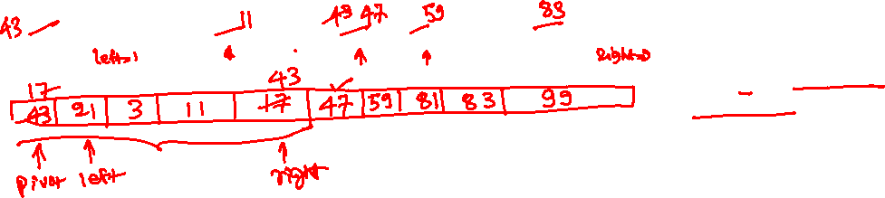
47 | 21 | 3 | 83 | 17 | 59 | 43 | 81 | 11 | 99
Quick sort
int p = partition(arr, lo, hi);
quicksort(arr, lo, p - 1);
quicksort(arr, p + 1, hi);
GREEN: initial position of pivot
YELLOW: final position of pivot
ORANGE: subarray we are looking at
Notes:
The following slides show the state after every partition. The number highlighted in green shows the pivot before partition, the orange boxes are the scope of the current partitioning algorithm, and the yellow ones show the final position of the pivot after partitioning. Notice that we never look at an element again once we place it at its final destination.

Slide 68
47 | 21 | 3 | 83 | 17 | 59 | 43 | 81 | 11 | 99
Quick sort
int p = partition(arr, lo, hi);
quicksort(arr, lo, p - 1);
quicksort(arr, p + 1, hi);
GREEN: initial position of pivot
YELLOW: final position of pivot
ORANGE: subarray we are looking at

Slide 69
47 | 21 | 3 | 83 | 17 | 59 | 43 | 81 | 11 | 99
43 | 21 | 3 | 11 | 17 | 47 | 59 | 81 | 83 | 99
Quick sort
int p = partition(arr, lo, hi);
quicksort(arr, lo, p - 1);
quicksort(arr, p + 1, hi);
AFTER PARTITION
GREEN: initial position of pivot
YELLOW: final position of pivot
ORANGE: subarray we are looking at

Slide 70
47 | 21 | 3 | 83 | 17 | 59 | 43 | 81 | 11 | 99
43 | 21 | 3 | 11 | 17 | 47 | 59 | 81 | 83 | 99
17 | 21 | 3 | 11 | 43 | 47 | 59 | 81 | 83 | 99
Quick sort
int p = partition(arr, lo, hi);
quicksort(arr, lo, p - 1);
quicksort(arr, p + 1, hi);
AFTER PARTITION
AFTER PARTITION
GREEN: initial position of pivot
YELLOW: final position of pivot
ORANGE: subarray we are looking at

Slide 71
47 | 21 | 3 | 83 | 17 | 59 | 43 | 81 | 11 | 99
43 | 21 | 3 | 11 | 17 | 47 | 59 | 81 | 83 | 99
17 | 21 | 3 | 11 | 43 | 47 | 59 | 81 | 83 | 99
3 | 11 | 17 | 21 | 43 | 47 | 59 | 81 | 83 | 99
Quick sort
int p = partition(arr, lo, hi);
quicksort(arr, lo, p - 1);
quicksort(arr, p + 1, hi);
AFTER PARTITION
AFTER PARTITION
AFTER PARTITION
GREEN: initial position of pivot
YELLOW: final position of pivot
ORANGE: subarray we are looking at

Slide 72
47 | 21 | 3 | 83 | 17 | 59 | 43 | 81 | 11 | 99
43 | 21 | 3 | 11 | 17 | 47 | 59 | 81 | 83 | 99
17 | 21 | 3 | 11 | 43 | 47 | 59 | 81 | 83 | 99
3 | 11 | 17 | 21 | 43 | 47 | 59 | 81 | 83 | 99
3 | 11 | 17 | 21 | 43 | 47 | 59 | 81 | 83 | 99
Quick sort
int p = partition(arr, lo, hi);
quicksort(arr, lo, p - 1);
quicksort(arr, p + 1, hi);
AFTER PARTITION
AFTER PARTITION
AFTER PARTITION
GREEN: initial position of pivot
YELLOW: final position of pivot
ORANGE: subarray we are looking at
AFTER PARTITION

Slide 73
47 | 21 | 3 | 83 | 17 | 59 | 43 | 81 | 11 | 99
43 | 21 | 3 | 11 | 17 | 47 | 59 | 81 | 83 | 99
17 | 21 | 3 | 11 | 43 | 47 | 59 | 81 | 83 | 99
3 | 11 | 17 | 21 | 43 | 47 | 59 | 81 | 83 | 99
3 | 11 | 17 | 21 | 43 | 47 | 59 | 81 | 83 | 99
3 | 11 | 17 | 21 | 43 | 47 | 59 | 81 | 83 | 99
Quick sort
int p = partition(arr, lo, hi);
quicksort(arr, lo, p - 1);
quicksort(arr, p + 1, hi);
AFTER PARTITION
AFTER PARTITION
AFTER PARTITION
GREEN: initial position of pivot
YELLOW: final position of pivot
ORANGE: subarray we are looking at
AFTER PARTITION
AFTER PARTITION

Slide 74
47 | 21 | 3 | 83 | 17 | 59 | 43 | 81 | 11 | 99
43 | 21 | 3 | 11 | 17 | 47 | 59 | 81 | 83 | 99
17 | 21 | 3 | 11 | 43 | 47 | 59 | 81 | 83 | 99
3 | 11 | 17 | 21 | 43 | 47 | 59 | 81 | 83 | 99
3 | 11 | 17 | 21 | 43 | 47 | 59 | 81 | 83 | 99
3 | 11 | 17 | 21 | 43 | 47 | 59 | 81 | 83 | 99
3 | 11 | 17 | 21 | 43 | 47 | 59 | 81 | 83 | 99
Quick sort
int p = partition(arr, lo, hi);
quicksort(arr, lo, p - 1);
quicksort(arr, p + 1, hi);
AFTER PARTITION
AFTER PARTITION
AFTER PARTITION
GREEN: initial position of pivot
YELLOW: final position of pivot
ORANGE: subarray we are looking at
AFTER PARTITION
AFTER PARTITION
AFTER PARTITION

Slide 75
47 | 21 | 3 | 83 | 17 | 59 | 43 | 81 | 11 | 99
43 | 21 | 3 | 11 | 17 | 47 | 59 | 81 | 83 | 99
17 | 21 | 3 | 11 | 43 | 47 | 59 | 81 | 83 | 99
3 | 11 | 17 | 21 | 43 | 47 | 59 | 81 | 83 | 99
3 | 11 | 17 | 21 | 43 | 47 | 59 | 81 | 83 | 99
3 | 11 | 17 | 21 | 43 | 47 | 59 | 81 | 83 | 99
3 | 11 | 17 | 21 | 43 | 47 | 59 | 81 | 83 | 99
3 | 11 | 17 | 21 | 43 | 47 | 59 | 81 | 83 | 99
Quick sort
int p = partition(arr, lo, hi);
quicksort(arr, lo, p - 1);
quicksort(arr, p + 1, hi);
AFTER PARTITION
AFTER PARTITION
AFTER PARTITION
GREEN: initial position of pivot
YELLOW: final position of pivot
ORANGE: subarray we are looking at
AFTER PARTITION
AFTER PARTITION
AFTER PARTITION
AFTER PARTITION

Slide 76
47 | 21 | 3 | 83 | 17 | 59 | 43 | 81 | 11 | 99
43 | 21 | 3 | 11 | 17 | 47 | 59 | 81 | 83 | 99
17 | 21 | 3 | 11 | 43 | 47 | 59 | 81 | 83 | 99
3 | 11 | 17 | 21 | 43 | 47 | 59 | 81 | 83 | 99
3 | 11 | 17 | 21 | 43 | 47 | 59 | 81 | 83 | 99
3 | 11 | 17 | 21 | 43 | 47 | 59 | 81 | 83 | 99
3 | 11 | 17 | 21 | 43 | 47 | 59 | 81 | 83 | 99
3 | 11 | 17 | 21 | 43 | 47 | 59 | 81 | 83 | 99
3 | 11 | 17 | 21 | 43 | 47 | 59 | 81 | 83 | 99
Quick sort
int p = partition(arr, lo, hi);
quicksort(arr, lo, p - 1);
quicksort(arr, p + 1, hi);
AFTER PARTITION
AFTER PARTITION
AFTER PARTITION
GREEN: initial position of pivot
YELLOW: final position of pivot
ORANGE: subarray we are looking at
AFTER PARTITION
AFTER PARTITION
AFTER PARTITION
AFTER PARTITION
AFTER PARTITION

Slide 77
47 | 21 | 3 | 83 | 17 | 59 | 43 | 81 | 11 | 99
43 | 21 | 3 | 11 | 17 | 47 | 59 | 81 | 83 | 99
17 | 21 | 3 | 11 | 43 | 47 | 59 | 81 | 83 | 99
3 | 11 | 17 | 21 | 43 | 47 | 59 | 81 | 83 | 99
3 | 11 | 17 | 21 | 43 | 47 | 59 | 81 | 83 | 99
3 | 11 | 17 | 21 | 43 | 47 | 59 | 81 | 83 | 99
3 | 11 | 17 | 21 | 43 | 47 | 59 | 81 | 83 | 99
3 | 11 | 17 | 21 | 43 | 47 | 59 | 81 | 83 | 99
3 | 11 | 17 | 21 | 43 | 47 | 59 | 81 | 83 | 99
3 | 11 | 17 | 21 | 43 | 47 | 59 | 81 | 83 | 99
Quick sort
int p = partition(arr, lo, hi);
quicksort(arr, lo, p - 1);
quicksort(arr, p + 1, hi);
AFTER PARTITION
AFTER PARTITION
AFTER PARTITION
GREEN: initial position of pivot
YELLOW: final position of pivot
ORANGE: subarray we are looking at
AFTER PARTITION
AFTER PARTITION
AFTER PARTITION
AFTER PARTITION
AFTER PARTITION
AFTER PARTITION

Slide 78
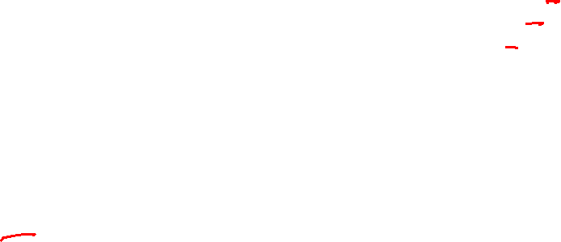
Quick sort
int partition(int arr[], int lo, int hi)
{
int pivot = arr[lo];
int left = lo + 1;
int right = hi;
while (left <= right) {
while (left <= right && arr[left] < pivot) {
left += 1;
}
while (right >= left && arr[right] > pivot) {
right -= 1;
}
if (left <= right) {
exchange(arr, left, right);
left++; right--;
}
}
exchange(arr, lo, right);
return right;
}
void quicksort(int arr[], int lo, int hi)
{
if (lo >= hi) {
return;
}
int p = partition(arr, lo, hi);
quicksort(arr, lo, p - 1);
quicksort(arr, p + 1, hi);
}
Notes:
This is the source code of the quick sort algorithm.

Slide 79
Worst case partition
3 | 11 | 17 | 21 | 43 | 47 | 59 | 81 | 83 | 99
In the worst case, the partition algorithm generates two arrays of size zero and (n-1) for further sorting.
Notes:
The worst-case partition results in two partitions of sizes zero and n-1. Notice that when that array is already sorted, we get the worst-case partition after every step.

Slide 80
Worst case partition
3 | 11 | 17 | 21 | 43 | 47 | 59 | 81 | 83 | 99
3 | 11 | 17 | 21 | 43 | 47 | 59 | 81 | 83 | 99
3 | 11 | 17 | 21 | 43 | 47 | 59 | 81 | 83 | 99
3 | 11 | 17 | 21 | 43 | 47 | 59 | 81 | 83 | 99
3 | 11 | 17 | 21 | 43 | 47 | 59 | 81 | 83 | 99
3 | 11 | 17 | 21 | 43 | 47 | 59 | 81 | 83 | 99
3 | 11 | 17 | 21 | 43 | 47 | 59 | 81 | 83 | 99
3 | 11 | 17 | 21 | 43 | 47 | 59 | 81 | 83 | 99
3 | 11 | 17 | 21 | 43 | 47 | 59 | 81 | 83 | 99
3 | 11 | 17 | 21 | 43 | 47 | 59 | 81 | 83 | 99
In the worst case, the partition algorithm generates two arrays of size zero and (n-1) for further sorting.

Slide 81
Time complexity

Slide 82
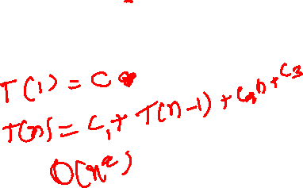
Time complexity
int partition(int arr[], int lo, int hi)
{
int pivot = arr[lo];
int left = lo + 1;
int right = hi;
while (left <= right) {
while (left <= right && arr[left] < pivot) {
left += 1;
}
while (right >= left && arr[right] > pivot) {
right -= 1;
}
if (left <= right) {
exchange(arr, left, right);
left++; right--;
}
}
exchange(arr, lo, right);
return right;
}
void quicksort(int arr[], int lo, int hi)
{
if (lo >= hi) {
return;
}
int p = partition(arr, lo, hi);
quicksort(arr, lo, p - 1);
quicksort(arr, p + 1, hi);
}
Worst case:
Notes:
In the worst case, the recursive call corresponding to no element performs constant operations. The other recursive call does T(n-1) operations. Also, the partition algorithm performs c₂ * n operations. The recurrence relation we get is similar to the recurrence relation for the selection sort algorithm. Therefore, the time complexity is O(n²).

Slide 83
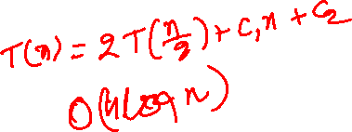
Time complexity
int partition(int arr[], int lo, int hi)
{
int pivot = arr[lo];
int left = lo + 1;
int right = hi;
while (left <= right) {
while (left <= right && arr[left] < pivot) {
left += 1;
}
while (right >= left && arr[right] > pivot) {
right -= 1;
}
if (left <= right) {
exchange(arr, left, right);
left++; right--;
}
}
exchange(arr, lo, right);
return right;
}
void quicksort(int arr[], int lo, int hi)
{
if (lo >= hi) {
return;
}
int p = partition(arr, lo, hi);
quicksort(arr, lo, p - 1);
quicksort(arr, p + 1, hi);
}
Best case:
Notes:
In the best case, we divide the array into two equal halves. In this case, the recurrence relation is similar to the one we obtained for the merge sort. Therefore, the best-case time complexity is O(n * log(n)).

Slide 84
Selecting the pivot
Select the first element as the pivot
This strategy is bad if the elements are already sorted
Randomly select an element as the pivot and swap it with the first element
Notes:
A simple strategy is to consider the first element as a pivot. However, this strategy is bad if the elements are already sorted, as we will see later.

Slide 85
Average case analysis
Notice that the partitioning algorithm may divide an array in N different ways, where N is the size of the array
Possible partitions are: [0, N-1], [1, N-2], [2, N-3], …., [N-1, 0]
If we pick the pivot in a truly random manner, the probabilities of each of these partitions would be 1/N,
Next slide shows the randomized quick sort algorithm
Notes:
To compute the average time complexity, we need to ensure that all possible outcomes of the partitioning algorithm are equally likely. For this, we can use the randomized quick sort algorithm.

Slide 86
Randomized quick sort

Slide 87

Randomized quick sort
int partition(int arr[], int lo, int hi) {
int idx = get_random_idx(lo, hi);
exchange(arr, lo, idx);
int pivot = arr[lo];
int left = lo + 1;
int right = hi;
while (left <= right) {
while (left <= right && arr[left] < pivot) {
left += 1;
}
while (right >= left && arr[right] > pivot) {
right -= 1;
}
if (left <= right) {
exchange(arr, left, right);
left++; right--;
}
}
exchange(arr, lo, right);
return right;
}
void quicksort(int arr[], int lo, int hi)
{
if (lo >= hi) {
return;
}
int p = partition(arr, lo, hi);
quicksort(arr, lo, p - 1);
quicksort(arr, p + 1, hi);
}
Notes:
In the randomize quick sort algorithm, we pick the pivot element randomly. If the pivot is truly random, then the probability of getting the final position of the pivot as 0, 1, 2, …, N-1 would be 1/N. However, generating a truly random number is hard, and that is a separate discussion outside the scope of this course. This algorithm is suitable for average time complexity.

Slide 88
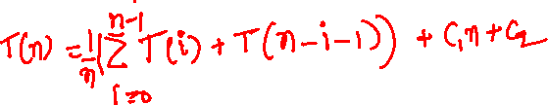
Time complexity
int partition(int arr[], int lo, int hi) {
int idx = get_random_idx(lo, hi);
exchange(arr, lo, idx);
int pivot = arr[lo];
int left = lo + 1;
int right = hi;
while (left <= right) {
while (left <= right && arr[left] < pivot) {
left += 1;
}
while (right >= left && arr[right] > pivot) {
right -= 1;
}
if (left <= right) {
exchange(arr, left, right);
left++; right--;
}
}
exchange(arr, lo, right);
return right;
}
void quicksort(int arr[], int lo, int hi)
{
if (lo >= hi) {
return;
}
int p = partition(arr, lo, hi);
quicksort(arr, lo, p - 1);
quicksort(arr, p + 1, hi);
}
Average case:
In the randomized algorithm, the probabilities of getting the final position of the pivot as 0, 1, 2, …, n-1 are equal. So, the average time complexity is the arithmetic mean of the number of operations in all N possible partitions.
Notes:
If the partitioning algorithm returns an index i, the first recursive call performs T(i) operations and the second recursive call performs T(n-i-1) operations. If we take the average of all possible outcomes for i, we get the recurrence relation shown on this slide.

Slide 89
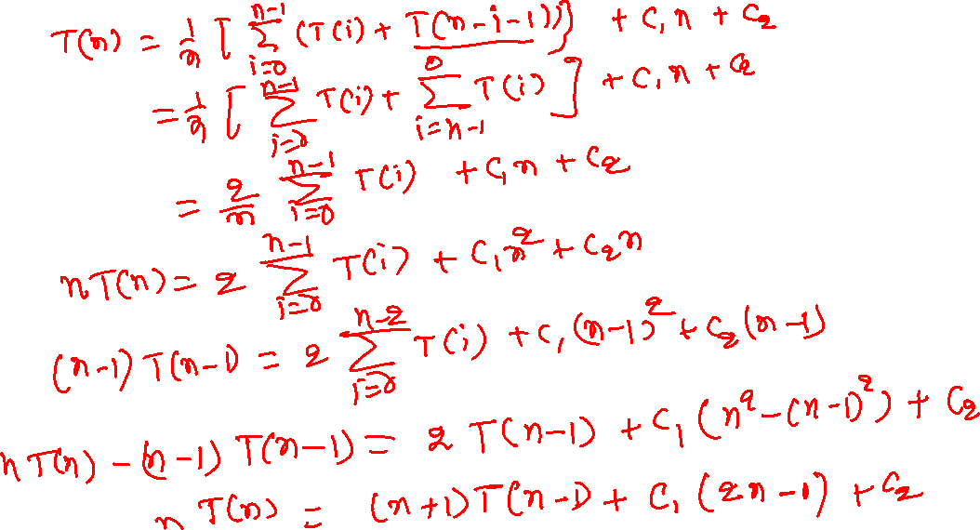
Time complexity (average case)
Notes:
To solve the recurrence relations in which the entire history is present, we can compute the value of T(n-1) and subtract it from T(n). This will ensure that most of the history will be canceled out and the corresponding equation is in the form that can be solved using the expansion method.

