Slide 2
Today’s class
Randomized quick sort
Pointers
Dynamic arrays

Slide 3

Randomized Quick sort
int partition(int arr[], int lo, int hi) {
int idx = get_random_idx(lo, hi);
exchange(arr, lo, idx);
int pivot = arr[lo];
int left = lo + 1;
int right = hi;
while (left <= right) {
while (left <= right && arr[left] < pivot) {
left += 1;
}
while (right >= left && arr[right] > pivot) {
right -= 1;
}
if (left <= right) {
exchange(arr, left, right);
left++; right--;
}
}
exchange(arr, lo, right);
return right;
}
void quicksort(int arr[], int lo, int hi)
{
if (lo >= hi) {
return;
}
int p = partition(arr, lo, hi);
quicksort(arr, lo, p - 1);
quicksort(arr, p + 1, hi);
}
Notes:
In the randomize quick sort algorithm, we pick the pivot element randomly. If the pivot is truly random, then the probability of getting the final position of the pivot as 0, 1, 2, …, N-1 would be 1/N. However, generating a truly random number is hard, and that is a separate discussion outside the scope of this course. This algorithm is suitable for average time complexity.

Slide 4
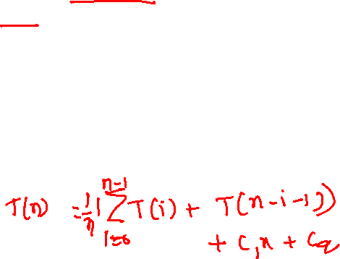
Time complexity
int partition(int arr[], int lo, int hi) {
int idx = get_random_idx(lo, hi);
exchange(arr, lo, idx);
int pivot = arr[lo];
int left = lo + 1;
int right = hi;
while (left <= right) {
while (left <= right && arr[left] < pivot) {
left += 1;
}
while (right >= left && arr[right] > pivot) {
right -= 1;
}
if (left <= right) {
exchange(arr, left, right);
left++; right--;
}
}
exchange(arr, lo, right);
return right;
}
void quicksort(int arr[], int lo, int hi)
{
if (lo >= hi) {
return;
}
int p = partition(arr, lo, hi);
quicksort(arr, lo, p - 1);
quicksort(arr, p + 1, hi);
}
Average case:
In the randomized algorithm, the probabilities of getting the final position of the pivot as 0, 1, 2, …, n-1 are equal. So, the average time complexity is the arithmetic mean of the number of operations in all N possible partitions.
Notes:
If the partitioning algorithm returns an index i, the first recursive call performs T(i) operations and the second recursive call performs T(n-i-1) operations. If we take the average of all possible outcomes for i, we get the recurrence relation shown on this slide.

Slide 5
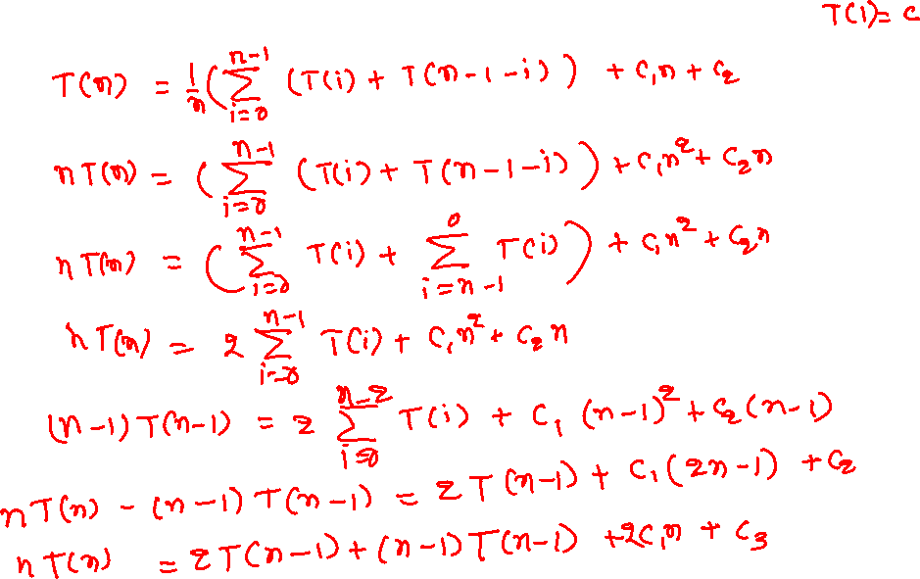
Time complexity (average case)
Notes:
To solve the recurrence relations in which the entire history is present, we can compute the value of T(n-1) and subtract it from T(n). This will ensure that most of the history will be canceled out and the corresponding equation is in the form that can be solved using the expansion method.

Slide 6
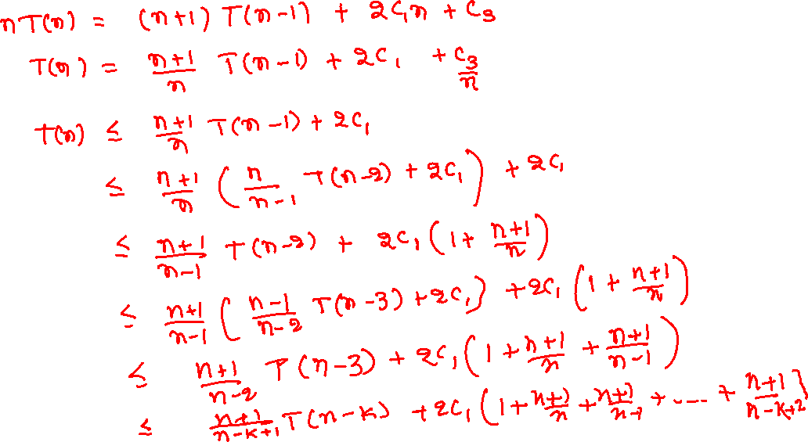
Time complexity (average case)
TYPO: Use c₄ instead of 2c₁ from here onwards
Notes:
Here, we are assuming that c₃/n will always be less than some other constant. Therefore, we can use another constant $c_{4}$ instead of 2c₁ + c₃ / n.

Slide 7
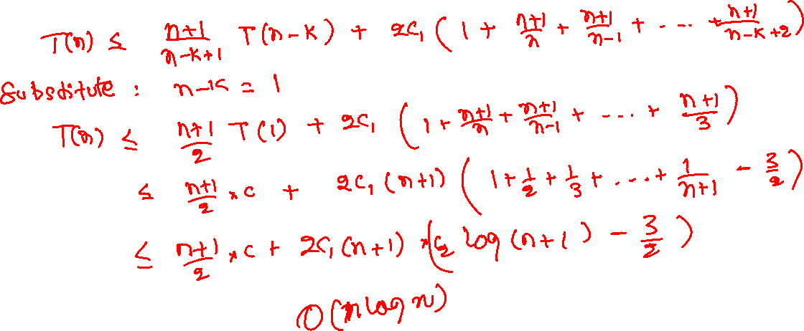
Time complexity (average case)

Slide 8
Harmonic series sum
https://en.wikipedia.org/wiki/Harmonic_series_(mathematics)
Comparison test
Integral test

Slide 9
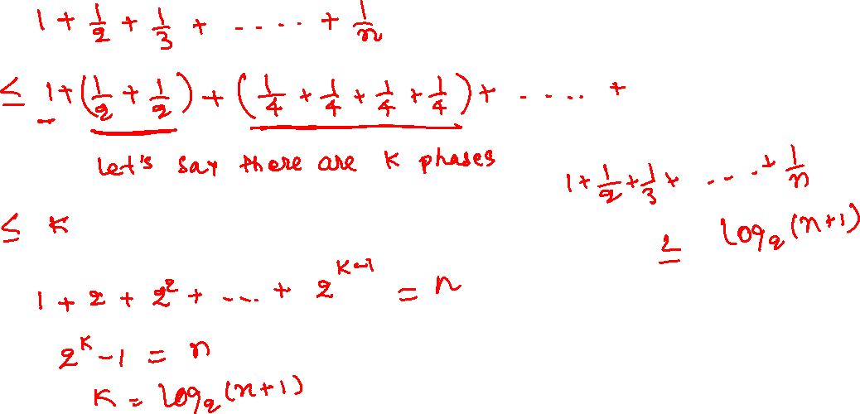
Harmonic series sum
Notes:
To find an upper bound, we can replace 1/3 with 1/2; 1/5, 1/6, 1/7 with 1/4; 1/9,1/10, …, 1/15 with 1/8, and so on until we have replaced all terms. Let’s say the group of all the terms with common denominators is a phase, and there are k phases. Therefore, the sum of the harmonic series would be k. Now, let’s add the number of terms in each phase to get the total number of terms. The number of terms in phase-1 is 1, the number of terms in phase-2 is 2, the number of elements in phase 3 is 2^2, and so on. Therefore, the number of elements in the kth phases would be 2^(k-1). The sum of the number of terms in all phases is the sum of the geometric series: 1, 2, 2^2, 2^3, …, 2^(k-1), which is equal to the total number of terms n. Solving these equations gives us the upper bound as log₂(n+1).

Slide 10
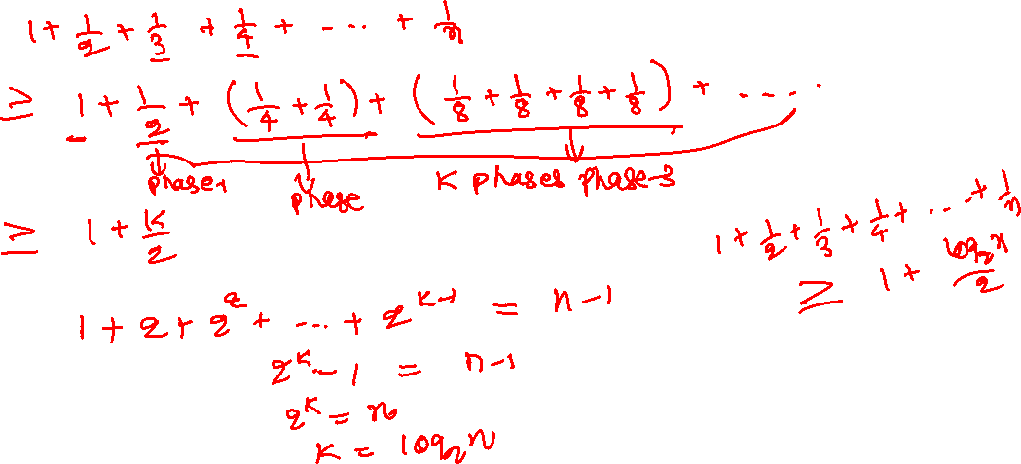
Harmonic series sum
Notes:
To find a lower bound, we can group them differently. We can replace 1/3 with 1/4; 1/5, 1/6, 1/7 with 1/8; 1/9,1/10, …, 1/15 with 1/16, and so on until we have replaced all terms. Let’s say the group of all the terms with common denominators except the first term is a phase, and there are k phases. The sum of the harmonic series would be 1 + k/2. Now, let’s add the number of terms in each phase to get the total number of terms. The number of terms in phase-1 is 1, the number of terms in phase-2 is 2, the number of elements in phase 3 is 4, and so on. Therefore, the number of elements in the kth phases is 2^(k-1). The sum of the number of terms in all phases is the sum of the geometric series: 1, 2, 2^2, 2^3, …, 2^(k-1), which is equal to n-1. Solving these equations gives us the lower bound as 1 + (log₂(n)/2).

Slide 11
Time complexity (average case)
Time complexity, when the portioning algorithm returns $i$
$$T\left(n\right)=T\left(i\right)+T\left(n−1−i\right)+c_{1}n+c_{2}$$
If each index has the same probability of being selected as a target position for the pivot, then the average complexity is
$$T\left(n\right)=\frac{1}{n}\left(\sum_{i=0}^{n−1}{(T\left(i\right)+T(n−1−i))}\right)+c_{1}n+c_{2}$$

Slide 12
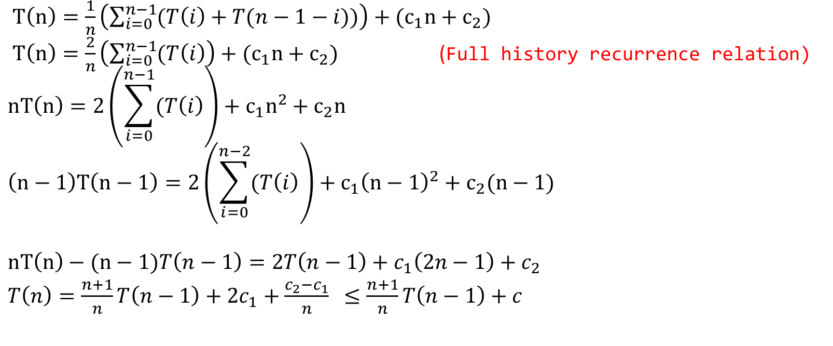
Time complexity (average case)
$T\left(n\right)=\frac{1}{n}\left(\sum_{i=0}^{n−1}{(T\left(i\right)+T(n−1−i))}\right)+{(c}_{1}n+c_{2})$
$T\left(n\right)=\frac{2}{n}\left(\sum_{i=0}^{n−1}{(T\left(i\right)}\right)+{(c}_{1}n+c_{2})$ (Full history recurrence relation)
$$nT\left(n\right)=2\left(\sum_{i=0}^{n−1}{(T\left(i\right)}\right)+c_{1}n^{2}+c_{2}n$$
$$\left(n−1\right)T\left(n−1\right)=2\left(\sum_{i=0}^{n−2}{(T\left(i\right)}\right)+c_{1}{\left(n−1\right)}^{2}+c_{2}(n−1)$$
$$nT\left(n\right)−(n−1)T\left(n−1\right)=2T\left(n−1\right)+c_{1}\left(2n−1\right)+c_{2}$$
$T\left(n\right)=\frac{n+1}{n}T\left(n−1\right)+2c_{1}+\frac{c_{2}−c_{1}}{n}$ $≤\frac{n+1}{n}T\left(n−1\right)+c_{}$
Notes:
Here, we are assuming that “(c_{2 –} c₁)/n” will always be less than some other constant c₃, and 2c₁ + c₃ = c.

Slide 13
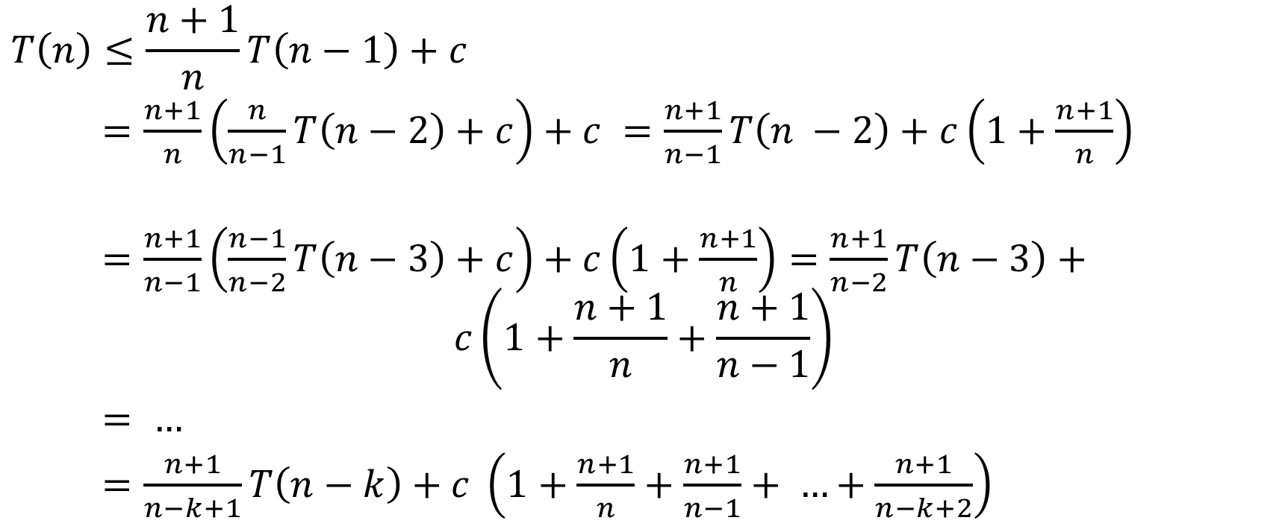
Time complexity(average case)
$$T\left(n\right)≤\frac{n+1}{n}T\left(n−1\right)+c$$
$=\frac{n+1}{n}\left(\frac{n}{n−1}T\left(n−2\right)+c\right)+c =\frac{n+1}{n−1}T\left(n −2\right)+c\left(1+\frac{n+1}{n}\right)$
$=\frac{n+1}{n−1}\left(\frac{n−1}{n−2}T\left(n−3\right)+c\right)+c\left(1+\frac{n+1}{n}\right)=\frac{n+1}{n−2}T\left(n−3\right)+$
$$c\left(1+\frac{n+1}{n}+\frac{n+1}{n−1}\right)$$
$= …$
$=\frac{n+1}{n−k+1}T\left(n−k\right)+c \left(1+\frac{n+1}{n}+\frac{n+1}{n−1}+ …+\frac{n+1}{n−k+2}\right)$

Slide 14
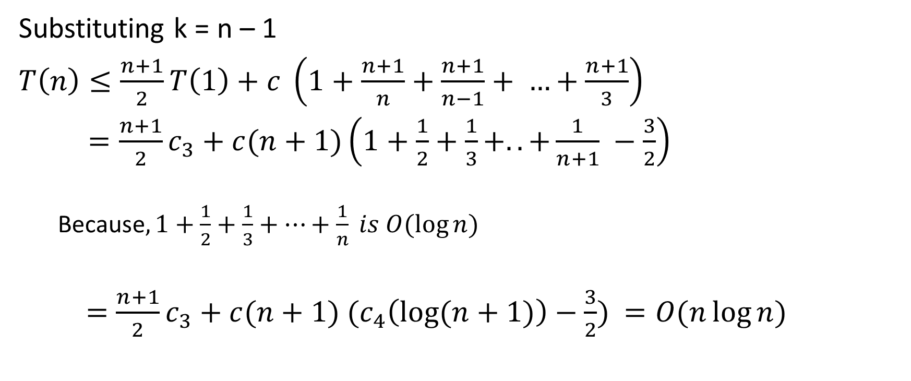
Time complexity (average case)
Substituting k = n – 1
$T\left(n\right)≤\frac{n+1}{2}T\left(1\right)+$ $c \left(1+\frac{n+1}{n}+\frac{n+1}{n−1}+ …+\frac{n+1}{3}\right)$
$=\frac{n+1}{2}c_{3}+c(n+1)\left(1+\frac{1}{2}+\frac{1}{3}+..+\frac{1}{n+1} −\frac{3}{2}\right)$
Because$, 1+\frac{1}{2}+\frac{1}{3}+…+\frac{1}{n} is O(\log{n})$
$=\frac{n+1}{2}c_{3}+c(n+1) (c_{4}\left(\log{(n+1)}\right)−\frac{3}{2})$ $=O(n\log{n})$

Slide 15
Harmonic series sum
$$1+\frac{1}{2}+\frac{1}{3}+…+\frac{1}{n}$$
$$≤1+\left(\frac{1}{2}+\frac{1}{2}\right)+\left(\frac{1}{4}+\frac{1}{4}+\frac{1}{4}+\frac{1}{4}\right)+…$$
$≤1+1+1+ …upto k terms$ = k
$$1+2+2^{2}+…+2^{k−1}=n$$
$$2^{k}−1=n$$
$$k=\log_{2}{(n+1)}$$
$$1+\frac{1}{2}+\frac{1}{3}+…+\frac{1}{n}≤\log_{2}{(n}+1)$$

Slide 16
Harmonic series sum
$$1+\frac{1}{2}+\frac{1}{3}+…+\frac{1}{n}$$
$$≥1+\frac{1}{2}+\left(\frac{1}{4}+\frac{1}{4}\right)+\left(\frac{1}{8}+\frac{1}{8}+\frac{1}{8}+\frac{1}{8}\right)+…$$
$$≥1+\frac{k}{2}$$
$$1+2+2^{2}+…+2^{k−1}=n−1$$
$$2^{k}−1=n −1$$
$$k=\log_{2}{n}$$
$$1+\frac{1}{2}+\frac{1}{3}+…+\frac{1}{n}≥1+\frac{\log_{2}{n}}{2}$$

Slide 17
Selecting the pivot
Select the first element as the pivot
This strategy is bad if the elements are already sorted
Randomly select an element as the pivot and swap it with the first element
Gives us the average time complexity as O(n * log(n))
Generating a random number may be expensive
No guarantee that the worst case never occurs
Ideally, the median of all elements would be the best choice for pivot
Worst case time complexity is O(n log (n)) if the median can be found in linear time
However, computing the median of all elements may itself be very expensive
Taking the median of the first, middle, and last element usually works well in practice

Slide 18
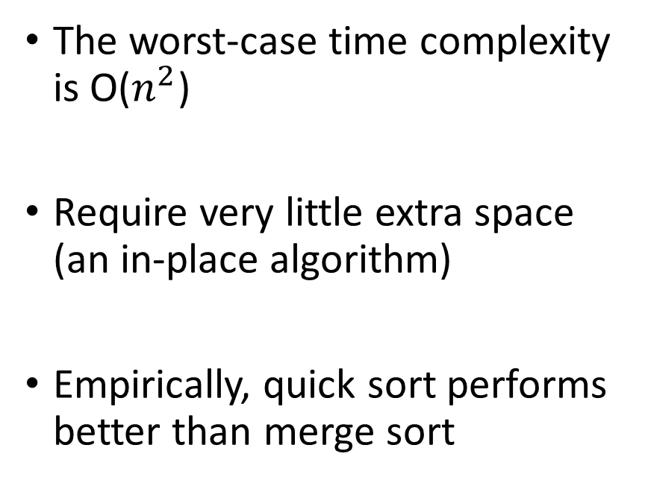
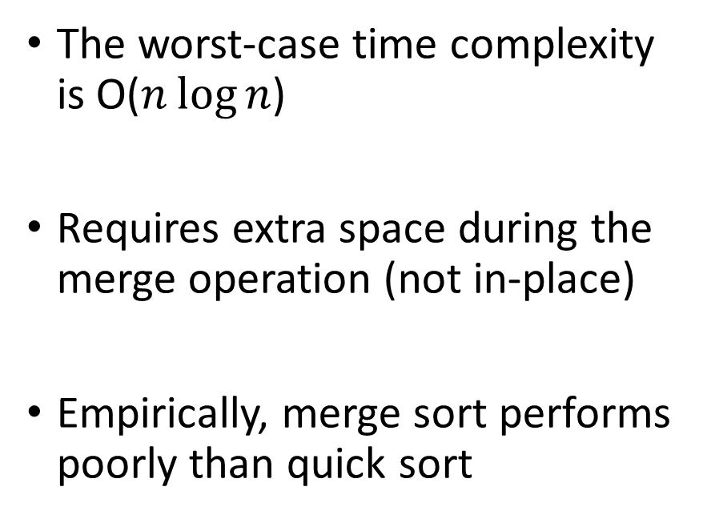
Quick sort vs merge sort
Quick sort
Merge sort
The worst-case time complexity is O($n^{2}$)
Require very little extra space (an in-place algorithm)
Empirically, quick sort performs better than merge sort
The worst-case time complexity is O($n\log{n}$)
Requires extra space during the merge operation (not in-place)
Empirically, merge sort performs poorly than quick sort

Slide 19

Quick sort
C++ standard library implements a hybrid sorting algorithm, Intro-sort, to mitigate the worst-case behavior of the quick sort
https://en.wikipedia.org/wiki/Introsort
Quick sort + Heap sort (worst case $n\log{n}$ ) + Insertion sort ($O(n^{2})$)

Slide 20
Homework
Modify the randomize quick sort algorithm to find the median of n numbers
No need to sort the entire array
There is also an algorithm with O(n) worst-case complexity for finding median of n numbers
You will get a chance to implement that algorithm in the bonus assignment

Slide 21
Asymptotic analysis

Slide 22
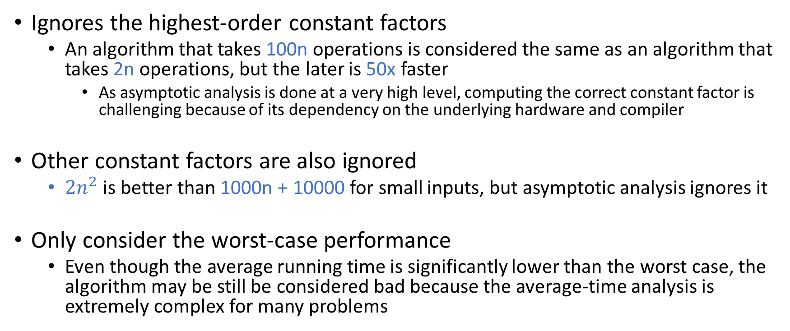
Shortcomings of asymptotic analysis
Ignores the highest-order constant factors
An algorithm that takes 100n operations is considered the same as an algorithm that takes 2n operations, but the later is 50x faster
As asymptotic analysis is done at a very high level, computing the correct constant factor is challenging because of its dependency on the underlying hardware and compiler
Other constant factors are also ignored
$2n^{2}$ is better than 1000n + 10000 for small inputs, but asymptotic analysis ignores it
Only consider the worst-case performance
Even though the average running time is significantly lower than the worst case, the algorithm may be still be considered bad because the average-time analysis is extremely complex for many problems

Slide 23
Pointers

Slide 24
Assignment
We can only do an assignment if the type of the variable in LHS and the type of the value in the RHS are the same
Otherwise, it is an error
When we do an assignment: a = b, where the type of a and b is Ty, sizeof(Ty) bytes are copied from b to a

Slide 25

Assignment
int a;
a = 10;
// Is this a valid assignment?
// How many bytes are copied during the assignment?
Notes:
a = 10 is a valid assignment because both sides are of type int. Four bytes will be copied because the size of int is 4.

Slide 26
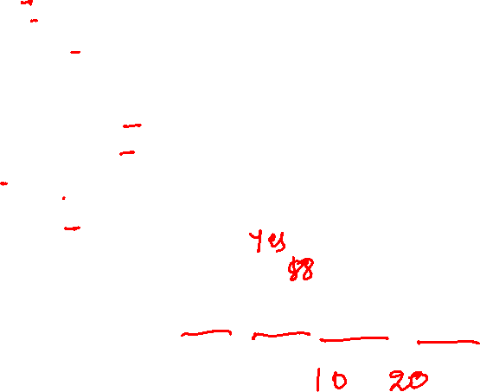
Assignment
struct record {
int a;
int b;
int c[20];
};
struct record var1;
struct record var2;
var1.a = 10;
var1.b = 20;
var2 = var1;
// Is this a legal assignment?
// How many bytes will be copied?
printf(“%d %d %d %d\n”, var2.a, var2.b, var2.c[0], var2.c[1]);
// what will be the output of the printf?
Notes:
“var2 = var1” is a legal assignment because both are of type struct record. Eighty-eight bytes will be copied because the size of struct record is 88.

Slide 27
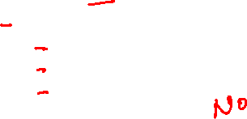
Assignment
struct record {
int a;
int b;
int c[20];
};
struct record var1;
int var2;
var1.a = 10;
var1.b = 20;
var2 = var1;
// Is this a legal assignment?
// How many bytes will be copied?
printf(“%d %d %d %d\n”, var2.a, var2.b, var2.c[0], var2.c[1]);
// what will be the output of the printf?
Notes:
var2 = var1 is not a legal assignment because their types are different.

Slide 28
Assignment
struct record {
int a;
int b;
int c[20];
};
struct record var1;
struct record var2;
var1.a = 10;
var1.b = 20;
var2.a = var1;
// Is this a legal assignment?
// How many bytes will be copied?
printf(“%d %d %d %d\n”, var2.a, var2.b, var2.c[0], var2.c[1]);
// what will be the output of the printf?
Notes:
var2.a = var1 is not a legal assignment because their types are different.

Slide 29

Memory layout
Address
Value
0
1
2
4
Every byte of the RAM has a unique address.
For every variable in your program, the compiler allocates space of size “sizeof(typeof(variable))” in the RAM.
The address of (&) operator returns the address of a variable.
RAM
k
k+1
k+2
2⁶⁴ - 1

Slide 30

Address of (&) operator
struct record {
int a;
int b;
int c[20];
};
struct record var1;
var1.a = 10;
var1.b = 20;
printf(“%p\n”, &var1);
// What will be the output of the printf?
// How can we store the address of var1 in a variable?
Notes:
The & operator returns the address of a variable in the RAM.

Slide 31

Pointers
int a;
The type of &a is int*. int* is called pointer to an integer.
Notes:
If a variable “a” is of type “int”, the type of “&a” is “int*”.

Slide 32
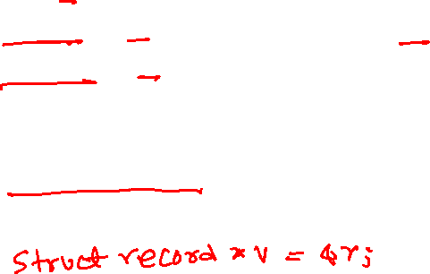
Pointers
A pointer variable stores the address of a variable (i.e., a RAM address)
int a = 10;
int *x = &a; // the type of &a is int*
int **y = &x; // the type of &x is int**
int ***z = &y; // the type of &z is int***
struct record r;
What is the type of variable that can store the address of variable r?
Notes:
Because “a” is of type “int”, the type of “&a” is “int*”. Therefore, x = &a is a valid assignment because both sides are of the same type. Similarly, the type of &x is int** because the type of x is int*. In general, the type of the address of a variable of type Ty followed by k stars is Ty followed by (k+1) stars. If we want to store the address of a variable of type “struct record”, we can store it in a variable of type struct record*.

Slide 33
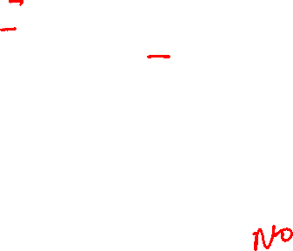
Pointers
struct record {
int a;
int b;
struct record *next;
};
struct record var1;
var1.a = 10;
var1.b = 20;
var1.next = 30;
Is this a legal program?
Notes:
This is not a legal program because at the line "var1.next = 30", the type of var1.next is "struct record*", and the type of 30 is int. Therefore, it is not a valid assignment.

Slide 34

Pointers
struct record {
int a;
int b;
struct record *next;
};
struct record var1;
var1.a = 10;
var1.b = 20;
var1.next = &var1;
Is this a legal program?
Notes:
This is a legal program because the statement “var1.next = &var1” is valid. The type of var1.next is "struct record*", and the type of &var1 is also "struct record*".

Slide 35
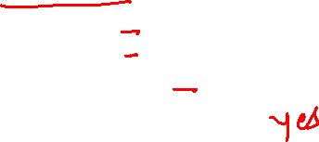
Pointers
struct record {
int a;
int b;
struct record *next;
};
struct record var1;
struct record *var2;
var2 = &var1;
var1.a = 10;
var1.b = 20;
var1.next = &var1;
Is this a legal program?
Notes:
This is a legal program because the assignment var2 = &var1 is valid. The type of var2 is "struct record*", and the type of &var1 is also "struct record*".

Slide 36
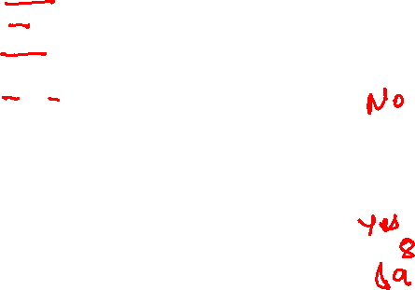
Copying address
We can copy the RAM address stored in the pointer variable ptr in a variable var using:
var = ptr;
int a = 10;
int *x = &a;
int y;
int *z;
y = x;
// Is this a legal assignment?
// How many bytes will be copied?
// What will be the value of y?
z = x;
// Is this a legal assignment?
// How many bytes will be copied?
// What will be the value of z?
Notes:
We can copy the RAM address stored in a pointer variable into another pointer variable of the same type by a simple assignment operation. The assignment y = x is not legal because the type of x is int* and y is int. The statement z = x is legal because the type of x and z both are int*. This statement copies the 8-byte RAM address stored in x to z. Notice that the size of the type int* is eight.

Slide 37
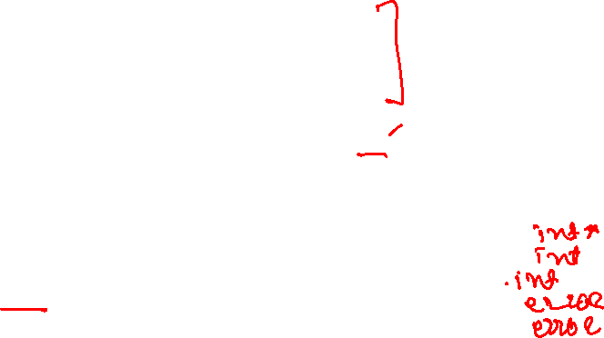
Loading from RAM
We can load the value stored in the RAM at an address stored in the pointer variable ptr into a variable var using:
var = *(ptr)
int a = 10;
int *x = &a;
int **y = &x;
int ***z = &y;
The type of *(x) is int
The type of *(y) is int *
The type of *(z) is int **
What is the type of **(z)?
What is the type of ***(z)?
What is the type of **(y)?
What is the type of **(x)?
What is the type of *(a)?
Notes:
If the type of ptr is int*, the type of *(ptr) is int. If the type of ptr is int**, the type of *(ptr) will be int*. In general, if the type of a variable ptr is Ty followed by i stars, then the type of *(ptr) would be Ty followed by (i-1) stars, the type of **(ptr) would be Ty followed by (i-2) stars and so on. Dereferencing a variable v using *v, where the type of v is not a pointer type, is an error.

Slide 38
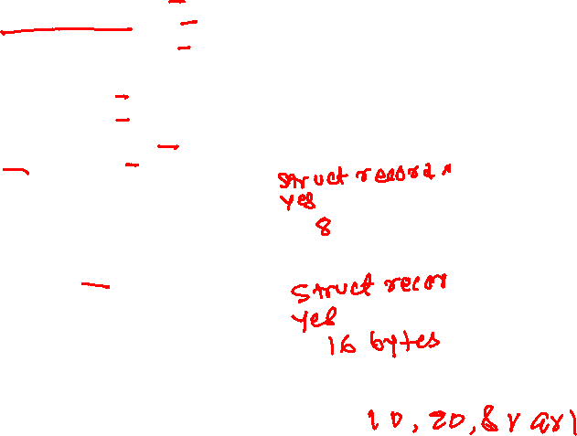
Loading from RAM
struct record {
int a;
int b;
struct record *next;
};
struct record var1;
struct record *var2;
struct record var3;
var1.a = 10;
var1.b = 20;
var1.next = &var1;
var2 = &var1;
// What is the type of &var1?
// Is this a legal assignment?
// How many bytes will be copied?
var3 = *(var2);
// What is the type of *(var2)?
// Is this a legal assignment?
// How many bytes will be copied?
printf("%d %d %p\n", var3.a, var3.b, var3.next);
// What will be the output of the printf?
We can load the value stored in the RAM at an address stored in the pointer variable ptr into a variable var using:
var = *(ptr)
Notes:
var2 = &var1 is a legal assignment because both sides are of type struct record*. var3 = *(var2) is also a legal assignment because both are of type struct record. During var3 = *(var2), 16 bytes will be copied because the type of both sides is "struct record". When we do a pointer dereference in this case, it will load the 16-byte value into var3 from the RAM starting from the address stored in var2. Because var2 contains the address of var1 at this point, the loading from RAM will eventually copy var1 to var3.

Slide 39
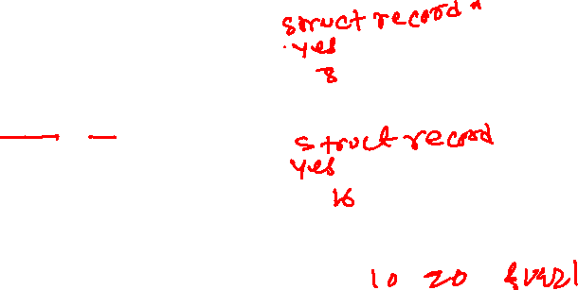
Storing in RAM
struct record {
int a;
int b;
struct record *next;
};
struct record var1;
struct record *var2;
struct record var3;
var1.a = 10;
var1.b = 20;
var1.next = &var1;
var2 = &var3;
// What is the type of &var3?
// Is this a legal assignment?
// How many bytes will be copied?
*(var2) = var1;
// What is the type of *(var2)?
// Is this a legal assignment?
// How many bytes will be copied?
printf("%d %d %p\n", var3.a, var3.b, var3.next);
// What will be the output of the printf?
You can store the value of a variable var in RAM at an address stored in the pointer variable ptr using:
*(ptr) = var
Notes:
var2 = &var3 is a legal assignment because both sides are of type "struct record*". *(var2) = var is also a legal assignment because both are of type "struct record". During "*(var2) = var1", 16 bytes will be copied because the type of both sides is "struct record". At this statement, a 16-byte value of var1 will be stored in RAM starting from the address stored in var2. Because var2 contains the address of var3 at this point, storing in RAM will eventually copy var1 to var3.

Slide 40
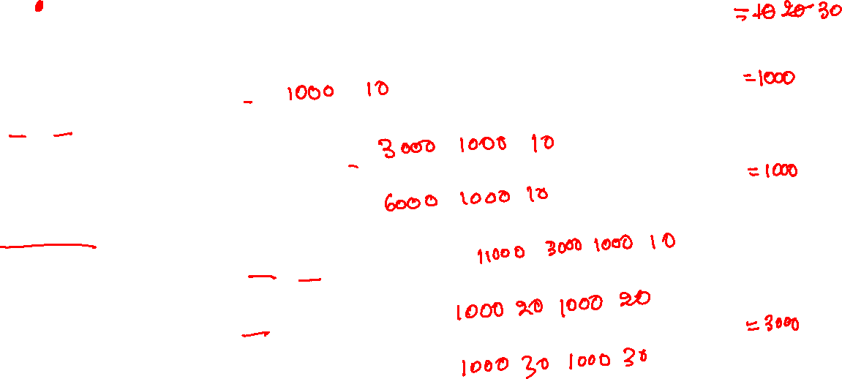
Pointers
int a;
int *p1;
int *p2;
int **p3;
a =10;
printf(“%p %d\n”, &a, a);
p1 = &a;
printf(“%p %p %d\n”, &p1, p1, *(p1));
p2 = p1;
printf(“%p %p %d\n”, &p2, p2, *(p2));
p3 = &p1;
printf(“%p %p %p %d\n”, &p3, p3, *(p3), **(p3));
*(p1) = 20;
printf(“%p %d %p %d\n”, p1, *(p1), p2, *(p2));
*(p2) = 30;
printf(“%p %d %p %d\n”, p1, *(p1), p2, *(p2));
a
p1
p2
p3
1000
3000
RAM
6000
11000
Notes:
We are assuming that the starting address of a is 1000, p1 is 3000, p2 is 6000, and p3 is 11000. These addresses are assigned at runtime. When you execute this program, you may get different addresses on different machines.

Slide 41
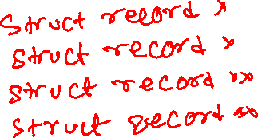
Pointer arithmetic
The type of the expression (ptr + i), where i is an integer and ptr is a pointer variable, is the same as the type of ptr
struct record *p;
struct record **q;
int i;
What is the type of “p + i”?
What is the type of “p - i”?
What is the type of “q + i”?
What is the type of “q - i”?

Slide 42
Pointer arithmetic
The pointer arithmetic rules are different from integer arithmetic
(p + i) is the RAM address of type typeof(p) after skipping i values of type typeof(*(p)) starting from p
(p - i) is the RAM address of type typeof(p) after skipping i values of type typeof(*(p)) starting from p in the reverse direction

Slide 43

Pointer arithmetic
The rules for pointer arithmetic are different from integer arithmetic
int *p;
int x;
int *q;
p = &x;
// Let’s assume, &x == 1000
q = p + 1;
What will be the value of q?
Notes:
Because the type of p is int*, p +1 is the address after skipping one "int" value starting from p. If the value of p is 1000, p + 1 will be 1004. The type of p+1 is the same as p, i.e., int*. q = p + 1 is a valid assignment because the type of both q and p+1 is int*.

Slide 44

Pointer arithmetic
The rules for pointer arithmetic are different from integer arithmetic
struct record {
int a[20];
int b;
};
struct record *p;
struct record x;
struct record *q;
p = &x;
// Let’s assume, &x == 1000
q = p + 5;
What will be the value of q?
Notes:
Because the type of p is “struct record *”, the address p + 5 will be computed as the address after skipping five "struct record" values. The size of "struct record" is 84; therefore, the actual RAM address corresponding to p+5 is 1000 + (84*5).

Slide 45
Arrays and Pointers

Slide 46

Array
The array elements are stored in contiguous memory locations
a[0] | a[1] | a[2] | a[3] | a[4] | a[5] | a[6] | a[7] | a[8] | a[9]
int a[10];
The base (starting) address of the array “a” is &a[0].
If &a[0] == X, where ($0≤X≤2^{64}−1$).
In this case,
&a[1] == X + 4
&a[2] == X + 8
&a[3] == X + 12
…
&a[i] == X + ?

Slide 47

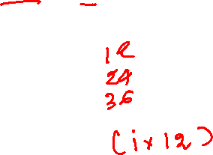
Array
The array elements are stored in contiguous memory locations
a[0] | a[1] | a[2] | a[3] | a[4] | a[5] | a[6] | a[7] | a[8] | a[9]
struct record {
int a;
struct record *next;
};
struct record a[10];
If &a[0] == X, where ($0≤X≤2^{64}−1$).
In this case,
&a[1] == X +
&a[2] == X +
&a[3] == X +
…
&a[i] == X +

