Slide 2
Today’s lecture
Strongest postcondition
Termination

Slide 3
Strongest postcondition

Slide 4
Assertion
assert(E) aborts the program if the E doesn’t hold
Because the strongest postcondition assumes that the program will successfully terminate, i.e., crash-free execution and no infinite loop, the semantics of assert is the same as assume for the strongest precondition

Slide 5

Assertion
SP[$assert E$, P] =
What needs to be true after the statement $assert E$ that would guarantee that $assert E$ executes successfully?

Slide 6
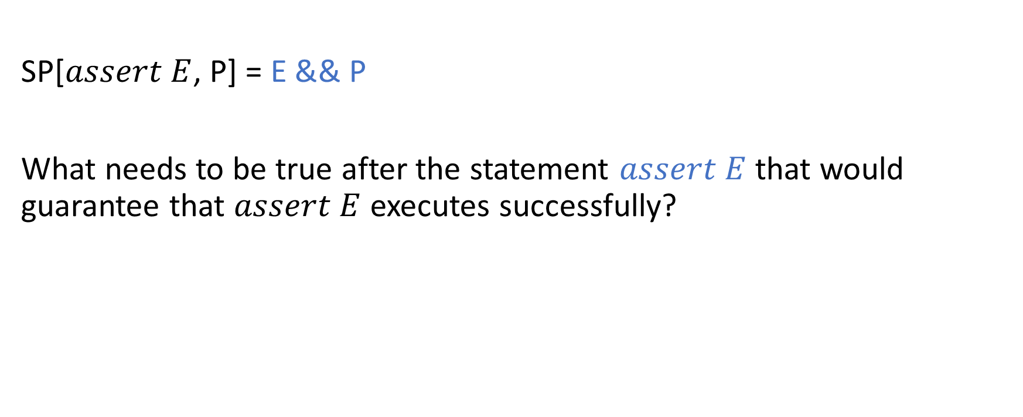
Assertion
SP[$assert E$, P] = E && P
What needs to be true after the statement $assert E$ that would guarantee that $assert E$ executes successfully?

Slide 7
Strongest postcondition
With the strongest postcondition rules, what needs to be done to prove that an assert statement indeed holds?

Slide 8
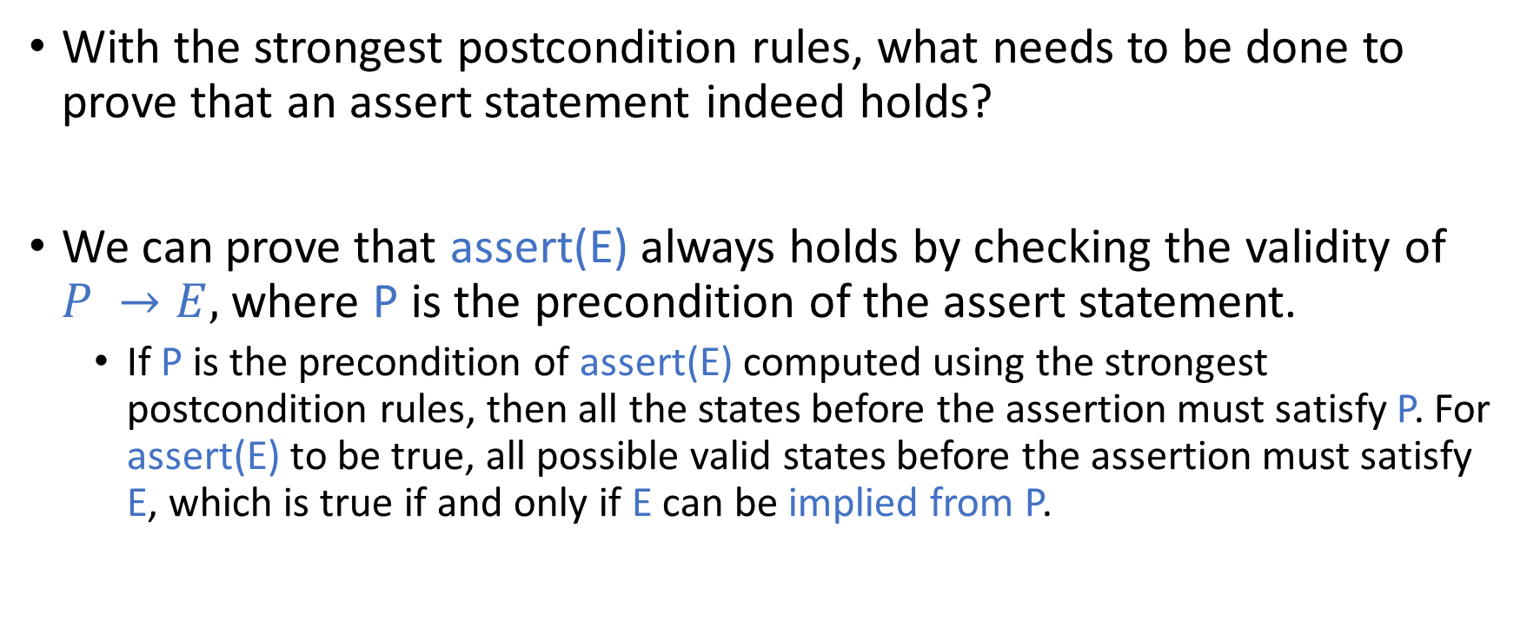
Strongest postcondition
With the strongest postcondition rules, what needs to be done to prove that an assert statement indeed holds?
We can prove that assert(E) always holds by checking the validity of $P →E,$ where P is the precondition of the assert statement.
If P is the precondition of assert(E) computed using the strongest postcondition rules, then all the states before the assertion must satisfy P. For assert(E) to be true, all possible valid states before the assertion must satisfy E, which is true if and only if E can be implied from P.

Slide 9
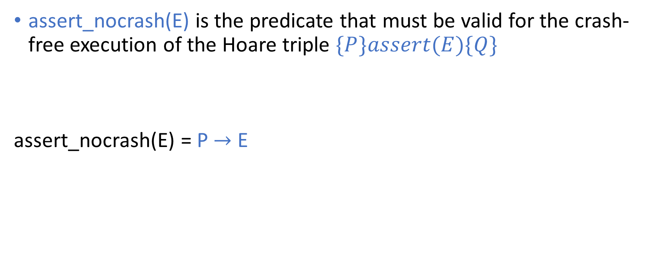
assert_nocrash
assert_nocrash(E) is the predicate that must be valid for the crash-free execution of the Hoare triple $\{P\}assert(E)\{Q\}$
assert_nocrash(E) = P $→$ E

Slide 10
Method call
method div(x: int, y: int) returns (r: int)
requires y != 0
ensures r * y <= x
method double(x: int, y: int) returns (r :int)
ensures r <= 2 *x
{
sp: T
r := div(x + x + x + x, 2 * y);
sp:
r := r * y;
sp:
}
To compute the strongest postcondition of a method call, first transform the code as shown in the next slide.

Slide 11
Method call
method div(x: int, y: int) returns (r: int)
requires y != 0
ensures r * y <= x
method double(x: int, y: int) returns (r :int)
ensures r <= 2 *x
{
sp: T
x’ = x + x + x + x
y’ = 2 * y;
assert_nocrash(y’ != 0);
assume(r’ * y’ <= x’);
r := r’;
sp:
r := r * y;
sp:
}
Remove the function call.
Create fresh variables for arguments and the return values for the function call, i.e., x’, y’, and r’ in this example.
Write preconditions and postconditions in terms of fresh variables x’, y’, and r’.
Assert that the precondition holds.
Assume that the postcondition holds.
The return value of the function is r’.

Slide 12
Method call
method div(x: int, y: int) returns (r: int)
requires y != 0
ensures r * y <= x
method double(x: int, y: int) returns (r :int)
ensures r <= 2 *x
{
sp: T
x’ = x + x + x + x
sp:
y’ = 2 * y;
sp:
assert_nocrash(y’ != 0);
sp:
assume(r’ * y’ <= x’);
sp:
r := r’;
sp:
r := r * y;
sp:
}
Compute the strongest postconditions at each program point.

Slide 13
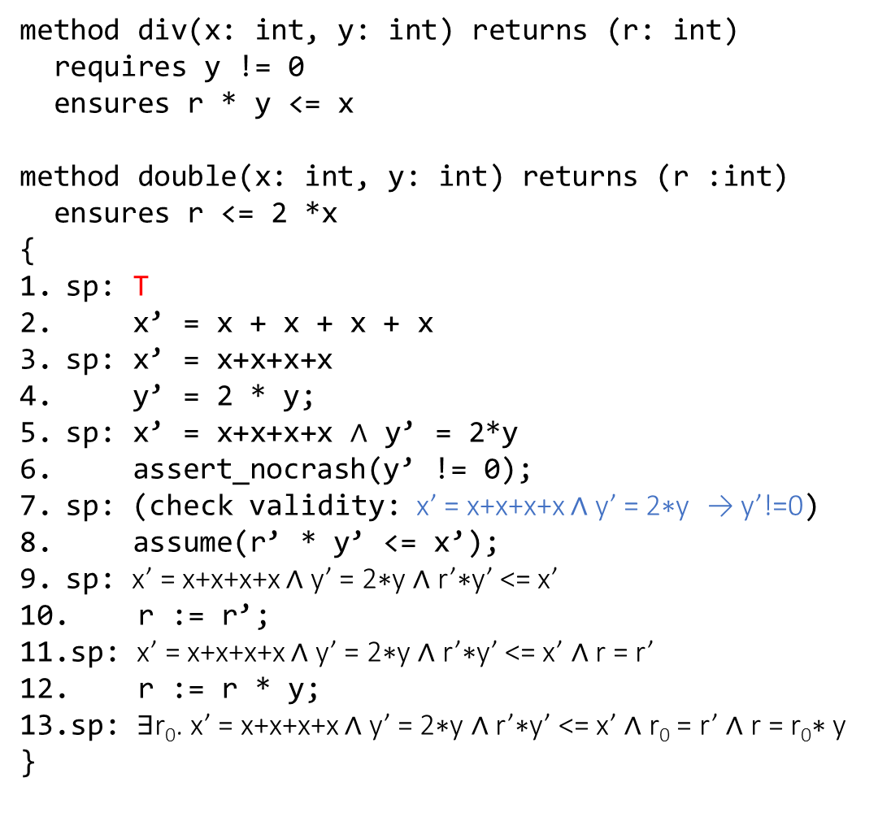
Method call
method div(x: int, y: int) returns (r: int)
requires y != 0
ensures r * y <= x
method double(x: int, y: int) returns (r :int)
ensures r <= 2 *x
{
sp: T
x’ = x + x + x + x
sp: x’ = x+x+x+x
y’ = 2 * y;
sp: x’ = x+x+x+x $∧$ y’ = 2*y
assert_nocrash(y’ != 0);
sp: (check validity: x’ = x+x+x+x ∧ y’ = 2∗y → y’!=0)
assume(r’ * y’ <= x’);
sp: x’ = x+x+x+x ∧ y’ = 2∗y ∧ r’∗y’ <= x’
r := r’;
sp: x’ = x+x+x+x ∧ y’ = 2∗y ∧ r’∗y’ <= x’ ∧ r = r’
r := r * y;
sp: ∃r₀. x’ = x+x+x+x ∧ y’ = 2∗y ∧ r’∗y’ <= x’ ∧ r₀ = r’ ∧ r = r₀∗ y
}
Compute the strongest postconditions at each program point.

Slide 14
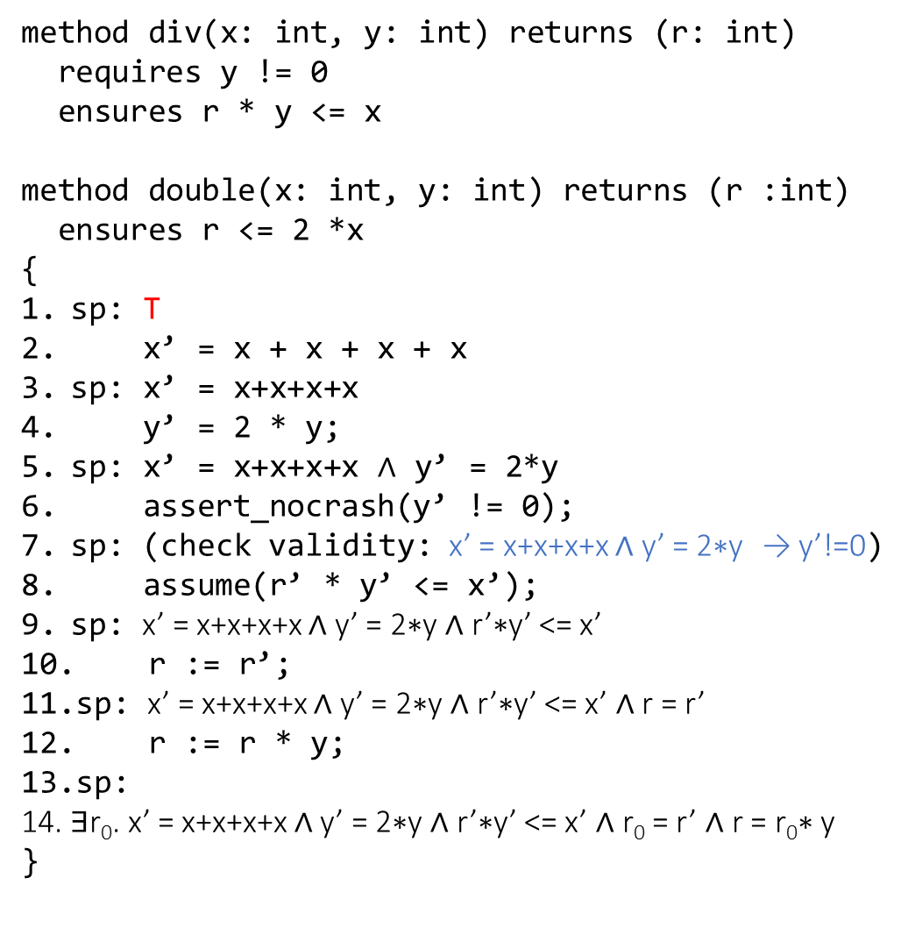
Method call
method div(x: int, y: int) returns (r: int)
requires y != 0
ensures r * y <= x
method double(x: int, y: int) returns (r :int)
ensures r <= 2 *x
{
sp: T
x’ = x + x + x + x
sp: x’ = x+x+x+x
y’ = 2 * y;
sp: x’ = x+x+x+x $∧$ y’ = 2*y
assert_nocrash(y’ != 0);
sp: (check validity: x’ = x+x+x+x ∧ y’ = 2∗y → y’!=0)
assume(r’ * y’ <= x’);
sp: x’ = x+x+x+x ∧ y’ = 2∗y ∧ r’∗y’ <= x’
r := r’;
sp: x’ = x+x+x+x ∧ y’ = 2∗y ∧ r’∗y’ <= x’ ∧ r = r’
r := r * y;
sp:
∃r₀. x’ = x+x+x+x ∧ y’ = 2∗y ∧ r’∗y’ <= x’ ∧ r₀ = r’ ∧ r = r₀∗ y
}
Is this program valid?
First, check the validity of:
(x’ = x+x+x+x ∧ y’ = 2∗y) → y’!=0
which is not valid.

Slide 15
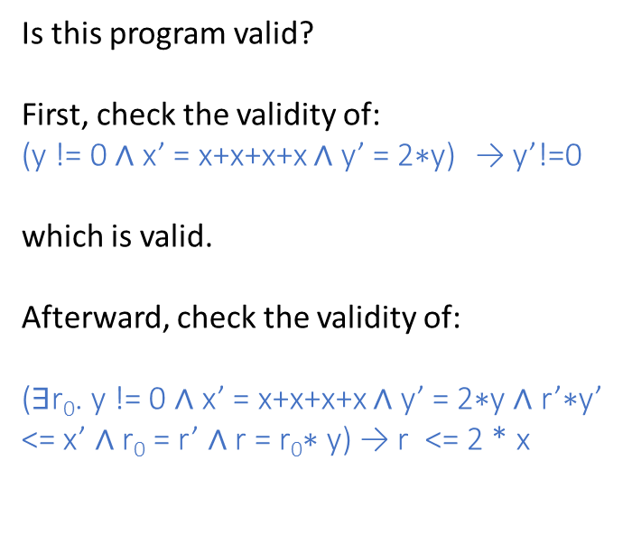
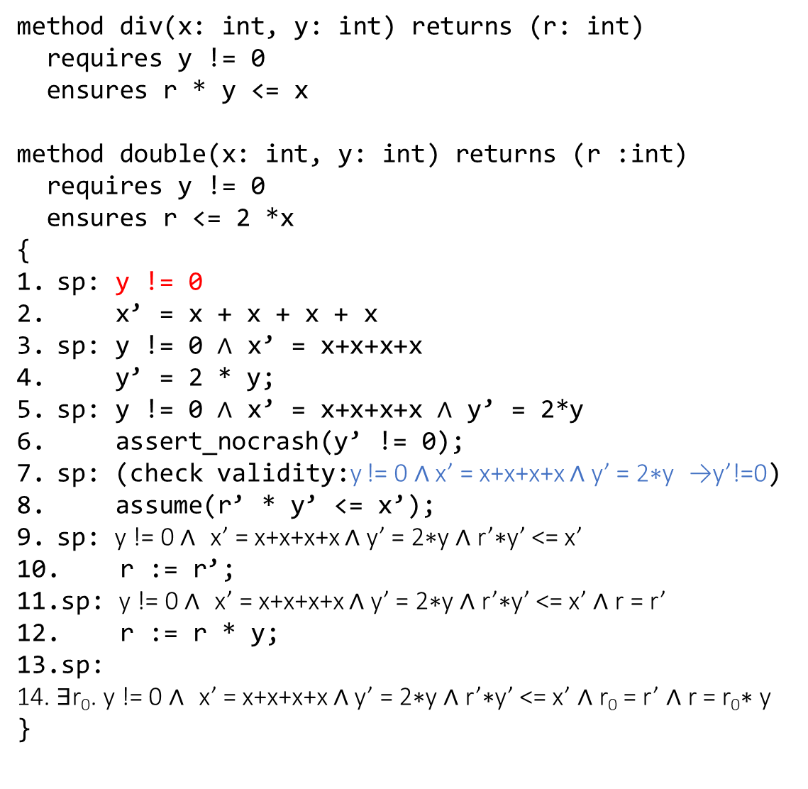
Method call
method div(x: int, y: int) returns (r: int)
requires y != 0
ensures r * y <= x
method double(x: int, y: int) returns (r :int)
requires y != 0
ensures r <= 2 *x
{
sp: y != 0
x’ = x + x + x + x
sp: y != 0 $∧$ x’ = x+x+x+x
y’ = 2 * y;
sp: y != 0 $∧$ x’ = x+x+x+x $∧$ y’ = 2*y
assert_nocrash(y’ != 0);
sp: (check validity:y != 0 ∧ x’ = x+x+x+x ∧ y’ = 2∗y →y’!=0)
assume(r’ * y’ <= x’);
sp: y != 0 ∧ x’ = x+x+x+x ∧ y’ = 2∗y ∧ r’∗y’ <= x’
r := r’;
sp: y != 0 ∧ x’ = x+x+x+x ∧ y’ = 2∗y ∧ r’∗y’ <= x’ ∧ r = r’
r := r * y;
sp:
∃r₀. y != 0 ∧ x’ = x+x+x+x ∧ y’ = 2∗y ∧ r’∗y’ <= x’ ∧ r₀ = r’ ∧ r = r₀∗ y
}
Is this program valid?
First, check the validity of:
(y != 0 $∧$ x’ = x+x+x+x ∧ y’ = 2∗y) → y’!=0
which is valid.
Afterward, check the validity of:
(∃r₀. y != 0 ∧ x’ = x+x+x+x ∧ y’ = 2∗y ∧ r’∗y’ <= x’ ∧ r₀ = r’ ∧ r = r₀∗ y) → r <= 2 * x

Slide 16
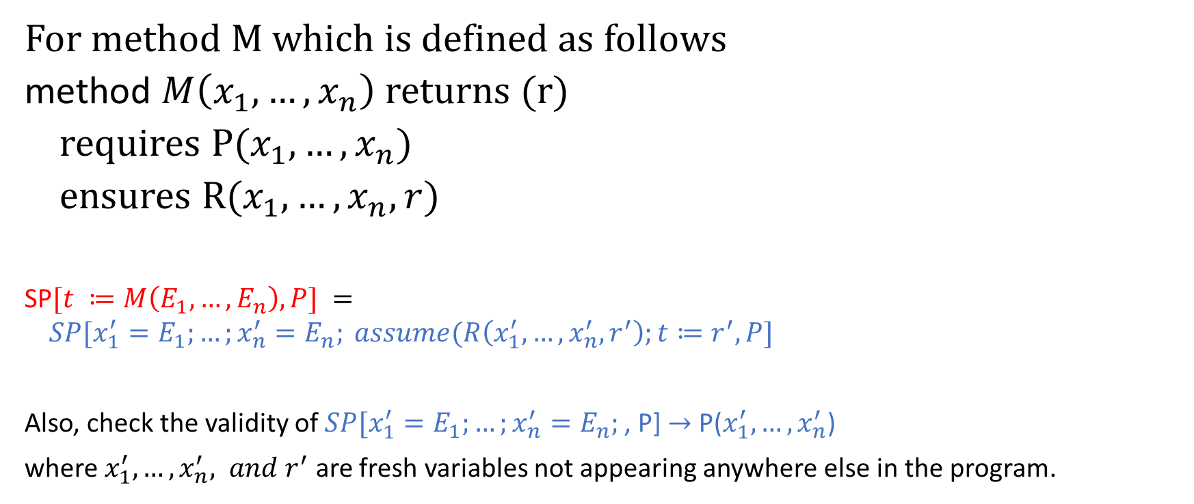
Method call
For method M which is defined as follows
method $M\left(x_{1}, …, x_{n}\right)$ returns (r)
requires P($x_{1}, …, x_{n}$)
ensures R($x_{1},…, x_{n}, r$)
SP$[t ≔M\left(E_{1},…,E_{n}\right), P] =$
$$SP[x_{1}^{′}=E_{1};…;x_{n}^{′}=E_{n}; assume(R\left(x_{1}^{′},…,x_{n}^{′}, r^{′}\right);t≔r^{′},P]$$
Also, check the validity of $SP[x_{1}^{′}=E_{1};…;x_{n}^{′}=E_{n};$, P] $→$ P($x_{1}^{′},…,x_{n}^{′}$)
where $x_{1}^{′},…,x_{n}^{′}, and r^{′}$ are fresh variables not appearing anywhere else in the program.

Slide 17
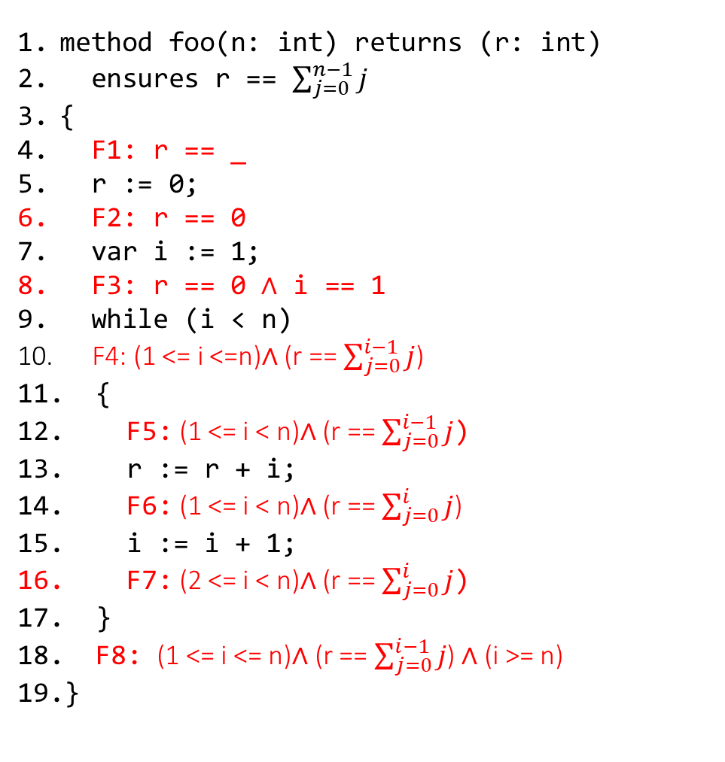
Loop invariant
method foo(n: int) returns (r: int)
ensures r == $\sum_{j=0}^{n−1}{j}$
{
F1: r == _
r := 0;
F2: r == 0
var i := 1;
F3: r == 0 $∧$ i == 1
while (i < n)
F4: (1 <= i <=n)$∧$ (r == $\sum_{j=0}^{i−1}{j}$)
{
F5: (1 <= i < n)$∧$ (r == $\sum_{j=0}^{i−1}{j}$)
r := r + i;
F6: (1 <= i < n)$∧$ (r == $\sum_{j=0}^{i}{j}$)
i := i + 1;
F7: (2 <= i < n)$∧$ (r == $\sum_{j=0}^{i}{j}$)
}
F8: (1 <= i <= n)$∧$ (r == $\sum_{j=0}^{i−1}{j}$) ∧ (i >= n)
}
The loop invariant is F4.
Moving loop body and loop skipping to foo_inv1 and foo_inv2.
method foo_inv1(i: int, r: int, n: int)
requires F4 && i < n
ensures F4
{
r := r + i;
i := i + 1;
}
method foo_inv2(i: int, r: int, n: int)
requires F4 && !(i < n)
ensures F8
{}

Slide 18
Loop invariant
SP[while (B){Inv} {S}, P] =

Slide 19
Loop invariant
SP[while (B){Inv} {S}, P] = Inv && !B
Also, check the correctness of the following Hoare triples:
{P}skip{Inv}
{Inv && B} S {Inv}

Slide 20
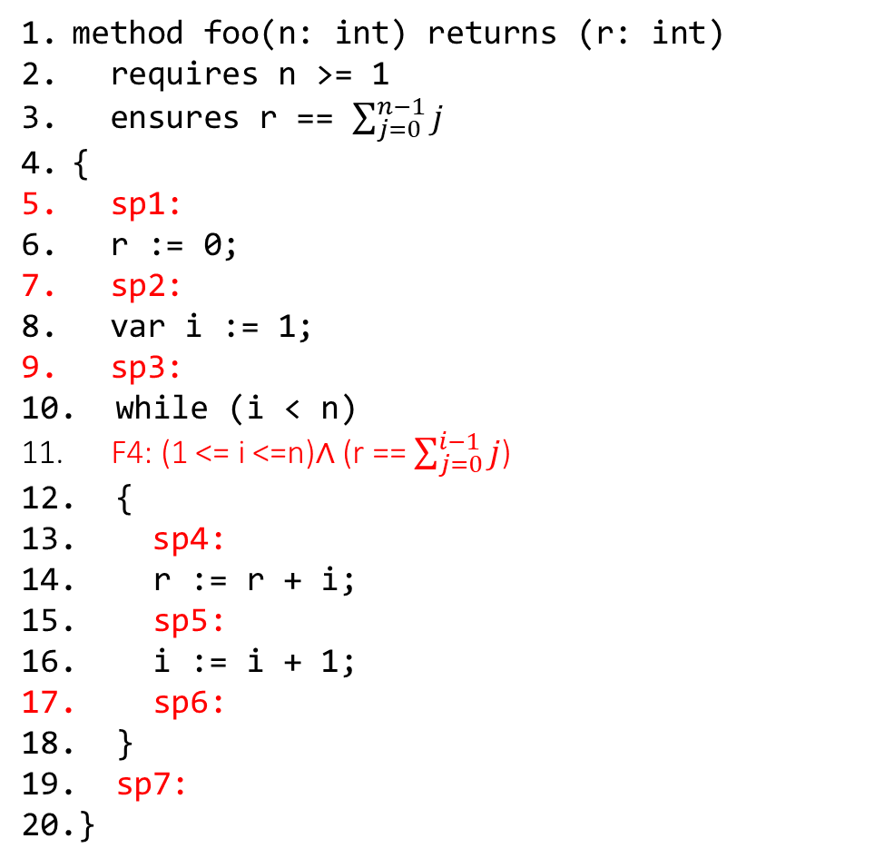
Loop invariant
method foo(n: int) returns (r: int)
requires n >= 1
ensures r == $\sum_{j=0}^{n−1}{j}$
{
sp1:
r := 0;
sp2:
var i := 1;
sp3:
while (i < n)
F4: (1 <= i <=n)$∧$ (r == $\sum_{j=0}^{i−1}{j}$)
{
sp4:
r := r + i;
sp5:
i := i + 1;
sp6:
}
sp7:
}
The strongest postcondition at line 5 sp1, and the loop invariant is F4. Prove that program is correct, assuming the loop invariant is correct.

Slide 21

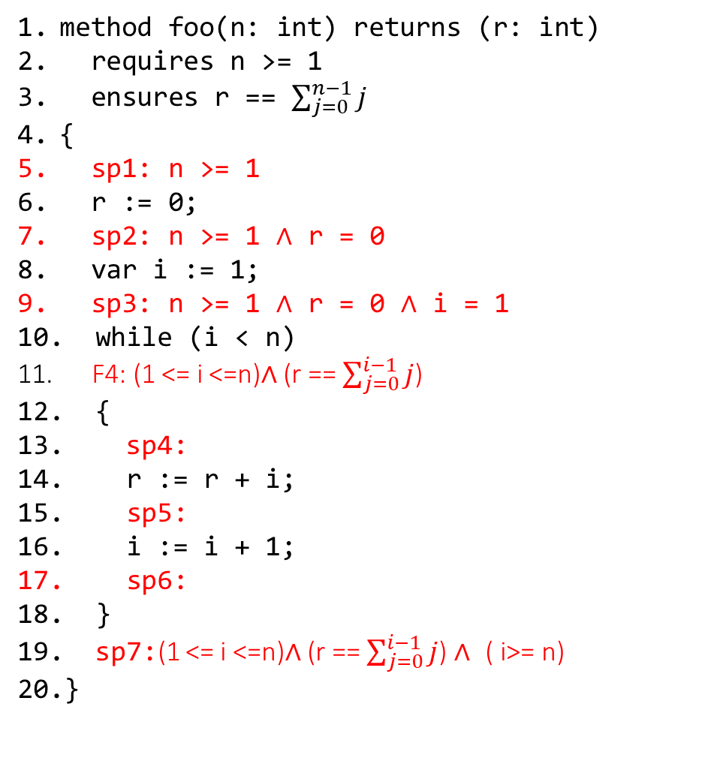
Loop invariant
method foo(n: int) returns (r: int)
requires n >= 1
ensures r == $\sum_{j=0}^{n−1}{j}$
{
sp1: n >= 1
r := 0;
sp2: n >= 1 $∧$ r = 0
var i := 1;
sp3: n >= 1 $∧$ r = 0 $∧$ i = 1
while (i < n)
F4: (1 <= i <=n)$∧$ (r == $\sum_{j=0}^{i−1}{j}$)
{
sp4:
r := r + i;
sp5:
i := i + 1;
sp6:
}
sp7:(1 <= i <=n)$∧$ (r == $\sum_{j=0}^{i−1}{j}$) $∧$ ( i>= n)
}
The strongest postcondition at line 5 sp1, and the loop invariant is F4. Prove that program is correct, assuming the loop invariant is correct.
The program is correct if:
((1 <= i <=n)$∧$ (r == $\sum_{j=0}^{i−1}{j}$) $∧$ ( i>= n)) $→$ r = $\sum_{j=0}^{n−1}{j}$
Simplifying LHS
(i = n)$∧$(r == $\sum_{j=0}^{n−1}{j}$) $→$ r = $\sum_{j=0}^{n−1}{j}$
i.e.,
(i = n) $∧$LHS $→$ RHS
which is valid.

Slide 22
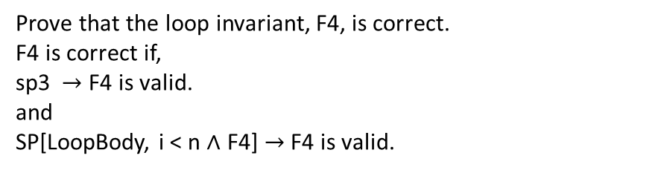
Loop invariant
method foo(n: int) returns (r: int)
requires n >= 1
ensures r == $\sum_{j=0}^{n−1}{j}$
{
sp1: n >= 1
r := 0;
sp2: n >= 1 $∧$ r = 0
var i := 1;
sp3: n >= 1 $∧$ r = 0 $∧$ i = 1
while (i < n)
F4: (1 <= i <=n)$∧$ (r == $\sum_{j=0}^{i−1}{j}$)
{
sp4:
r := r + i;
sp5:
i := i + 1;
sp6:
}
sp7:(1 <= i <=n)$∧$ (r == $\sum_{j=0}^{i−1}{j}$) $∧$ ( i>= n)
}
Prove that the loop invariant, F4, is correct.
F4 is correct if,
sp3 $→$ F4 is valid.
and
SP[LoopBody, i < n $∧$ F4] $→$ F4 is valid.

Slide 23
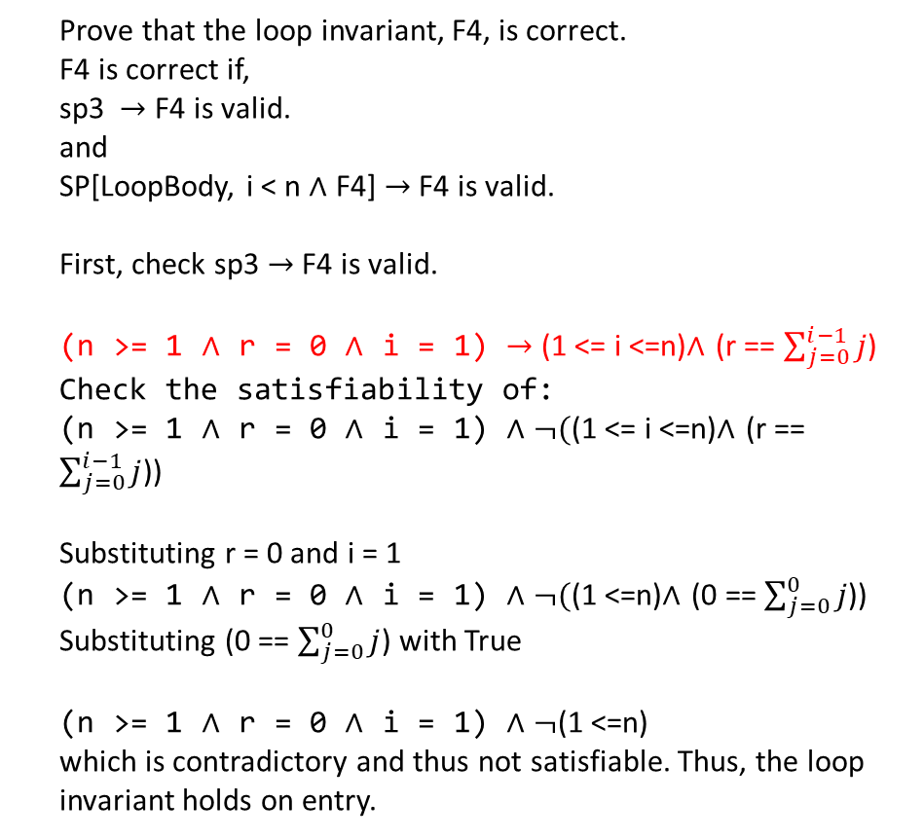
Loop invariant
method foo(n: int) returns (r: int)
requires n >= 1
ensures r == $\sum_{j=0}^{n−1}{j}$
{
sp1: n >= 1
r := 0;
sp2: n >= 1 $∧$ r = 0
var i := 1;
sp3: n >= 1 $∧$ r = 0 $∧$ i = 1
while (i < n)
F4: (1 <= i <=n)$∧$ (r == $\sum_{j=0}^{i−1}{j}$)
{
sp4:
r := r + i;
sp5:
i := i + 1;
sp6:
}
sp7:(1 <= i <=n)$∧$ (r == $\sum_{j=0}^{i−1}{j}$) $∧$ ( i>= n)
}
Prove that the loop invariant, F4, is correct.
F4 is correct if,
sp3 $→$ F4 is valid.
and
SP[LoopBody, i < n $∧$ F4] $→$ F4 is valid.
First, check sp3 $→$ F4 is valid.
(n >= 1 $∧$ r = 0 $∧$ i = 1) $→$ (1 <= i <=n)$∧$ (r == $\sum_{j=0}^{i−1}{j}$)
Check the satisfiability of:
(n >= 1 $∧$ r = 0 $∧$ i = 1) $∧$ $¬($(1 <= i <=n)$∧$ (r == $\sum_{j=0}^{i−1}{j}$))
Substituting r = 0 and i = 1
(n >= 1 $∧$ r = 0 $∧$ i = 1) $∧$ $¬($(1 <=n)$∧$ (0 == $\sum_{j=0}^{0}{j}$))
Substituting (0 == $\sum_{j=0}^{0}{j}$) with True
(n >= 1 $∧$ r = 0 $∧$ i = 1) $∧$ $¬$(1 <=n)
which is contradictory and thus not satisfiable. Thus, the loop invariant holds on entry.

Slide 24

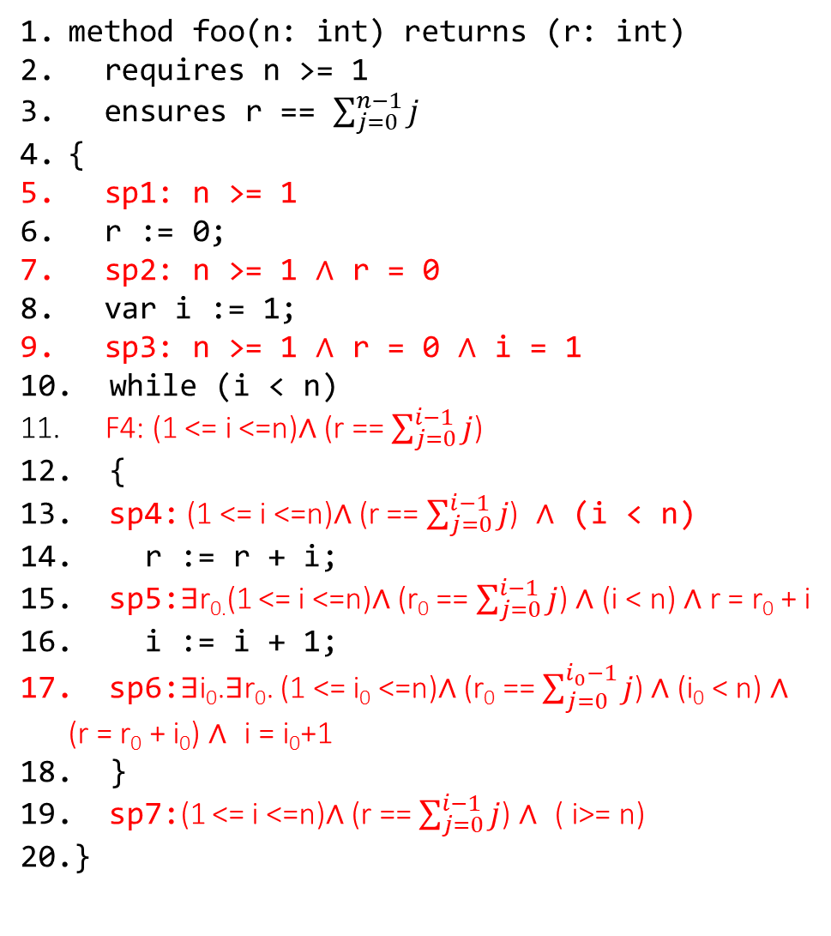
Loop invariant
method foo(n: int) returns (r: int)
requires n >= 1
ensures r == $\sum_{j=0}^{n−1}{j}$
{
sp1: n >= 1
r := 0;
sp2: n >= 1 $∧$ r = 0
var i := 1;
sp3: n >= 1 $∧$ r = 0 $∧$ i = 1
while (i < n)
F4: (1 <= i <=n)$∧$ (r == $\sum_{j=0}^{i−1}{j}$)
{
sp4: (1 <= i <=n)$∧$ (r == $\sum_{j=0}^{i−1}{j}$) $∧$ (i < n)
r := r + i;
sp5:$∃$r_{0.}(1 <= i <=n)$∧$ (r₀ == $\sum_{j=0}^{i−1}{j}$) ∧ (i < n) ∧ r = r₀ + i
i := i + 1;
sp6:∃i₀.∃r₀. (1 <= i₀ <=n)∧ (r₀ == $\sum_{j=0}^{i_{0}−1}{j}$) ∧ (i₀ < n) ∧ (r = r₀ + i₀) $∧$ i = i₀+1
}
sp7:(1 <= i <=n)$∧$ (r == $\sum_{j=0}^{i−1}{j}$) $∧$ ( i>= n)
}
Next, check SP[LoopBody, i < n $∧$ F4] $→$ F4 is valid.
Computing strongest postconditions in the loop body.
Check validity of
(∃i₀.∃r₀. (1 <= i₀ <=n)∧ (r₀ = $\sum_{j=0}^{i_{0}−1}{j}$) ∧ (i₀ < n) ∧ (r = r₀ + i₀) $∧$ (i = i₀+1))
$→$ (1 <= i <=n)$∧$ (r = $\sum_{j=0}^{i−1}{j}$)
Skolemization:
(1 <= i₀ <=n)∧ (r₀ = $\sum_{j=0}^{i_{0}−1}{j}$) ∧ (i₀ < n) ∧ (r = r₀ + i₀) $∧$ (i = i₀+1)
$→$ (1 <= i <=n)$∧$ (r = $\sum_{j=0}^{i−1}{j}$)
Check the satisfiability of:
(1 <= i₀ <=n)∧ (r₀ = $\sum_{j=0}^{i_{0}−1}{j}$) ∧ (i₀ < n) ∧ (r = r₀ + i₀) $∧$ (i = i₀+1)
$∧$ $¬($(1 <= i <=n)$∧$ (r = $\sum_{j=0}^{i−1}{j}$))
Substituting i = i₀ + 1 and merging (i₀ < n) and (1 <= i₀ <=n)
(1 <= i₀ <n)∧ (r₀ = $\sum_{j=0}^{i_{0}−1}{j}$) ∧ (r = r₀ + i₀) $∧$ (i = i₀+1)
$∧$ $¬($(0 <= i₀ <=n-1)$∧$ (r = $\sum_{j=0}^{i_{0}}{j}$))
Substituting r₀ = $\sum_{j=0}^{i_{0}−1}{j}$
(1 <= i₀ <n)∧ (r₀ = $\sum_{j=0}^{i_{0}−1}{j}$) ∧ (r = r₀ + i₀) $∧$ (i = i₀+1) ∧ ¬((0 <= i₀ <=n-1)∧ (r = r₀ + i₀))
Which is unsatisfiable, and thus, the loop invariant is valid.

Slide 25
Termination

Slide 26
References
Read Chapter-3 from the Program Proofs book
Read Chapter-4.3 from the COC book

Slide 27
Background

Slide 28
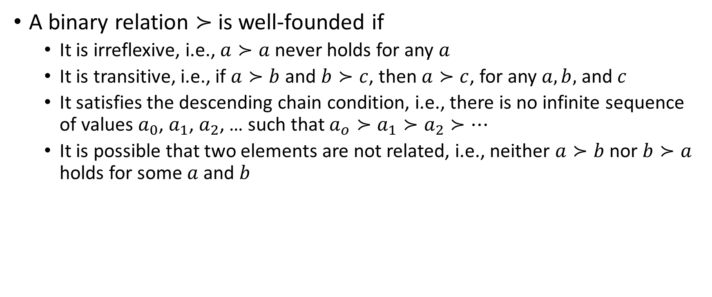
Well-Founded relations
A binary relation $≻$ is well-founded if
It is irreflexive, i.e., $a≻a$ never holds for any $a$
It is transitive, i.e., if $a≻b$ and $b≻c$, then $a≻c$, for any $a, b,$ and $c$
It satisfies the descending chain condition, i.e., there is no infinite sequence of values $a_{0}$, $a_{1}$, $a_{2}$, … such that $a_{o}≻a_{1}≻a_{2}≻…$
It is possible that two elements are not related, i.e., neither $a≻b$ nor $b≻a$ holds for some $a$ and $b$

Slide 29

Well-founded relations
Is the $<$ operator over integers a well-founded relation?
No, because there is an infinite sequence $1>0>−1>…>−∞$

Slide 30

Well-founded relations
Is the $<$ operator over natural numbers a well-founded relation?

Slide 31

Well-founded relations
Is the $<$ operator over natural numbers a well-founded relation?
Yes, because all sequences $a_{0}>a_{1}>a_{2}>…>0$ ends at zero

Slide 32
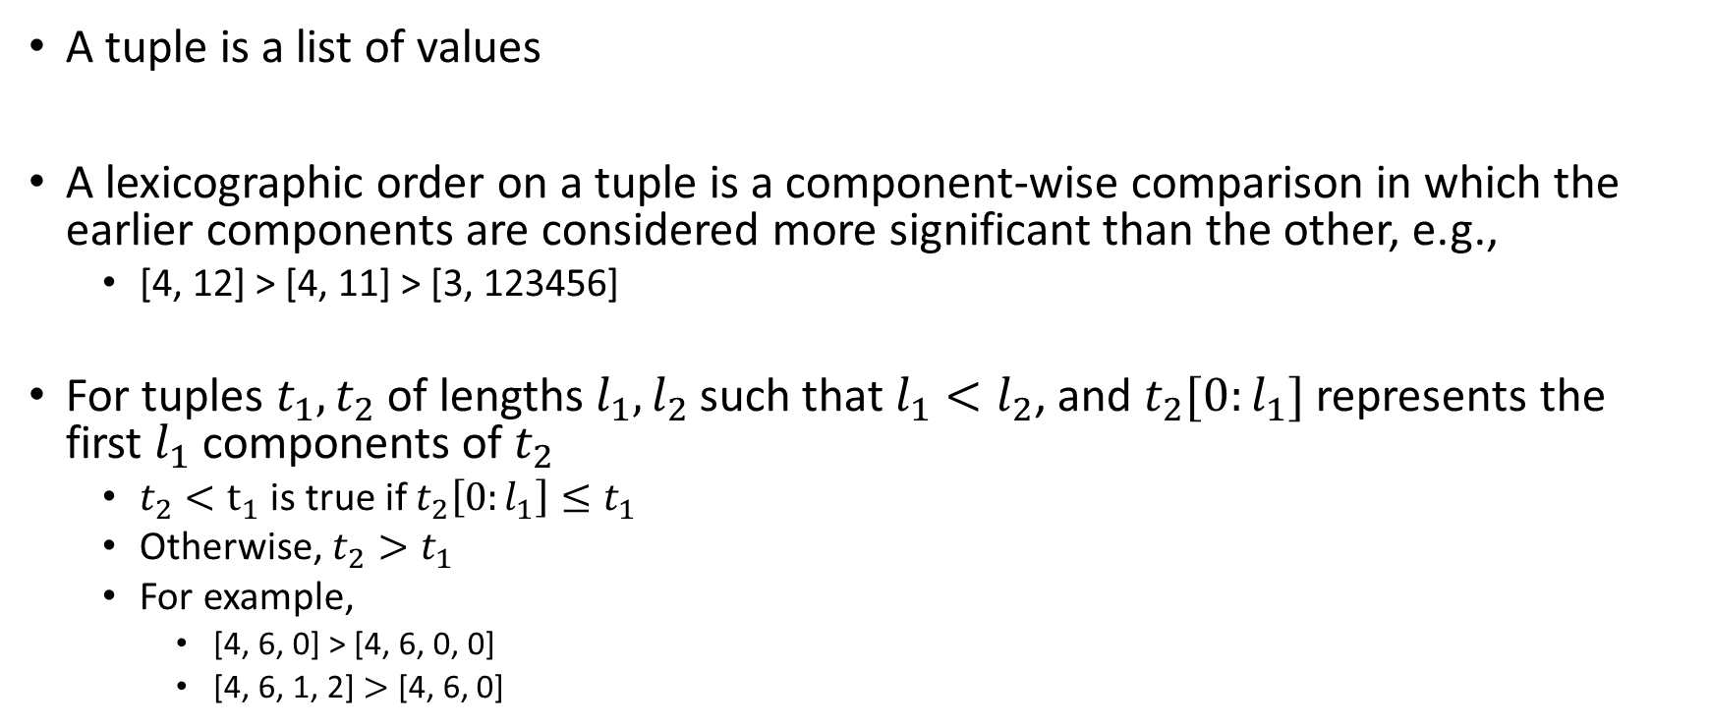
Lexicographic Tuples
A tuple is a list of values
A lexicographic order on a tuple is a component-wise comparison in which the earlier components are considered more significant than the other, e.g.,
[4, 12] > [4, 11] > [3, 123456]
For tuples $t_{1}, t_{2}$ of lengths $l_{1},l_{2}$ such that $l_{1}<l_{2}$, and $t_{2}[0:l_{1}]$ represents the first $l_{1}$ components of $t_{2}$
$t_{2}<t_{1}$ is true if $t_{2}\left[0:l_{1}\right]≤t_{1}$
Otherwise, $t_{2}>t_{1}$
For example,
[4, 6, 0] > [4, 6, 0, 0]
[4, 6, 1, 2] $>$ [4, 6, 0]

Slide 33
Lexicographic Tuples
If the component-wise comparison operator, say op, is well-founded, then op is a well-founded relation for finite-length lexicographic tuples

Slide 34
Termination
Can we use a well-founded relation to prove that the following function will eventually terminate?
function Fib(n: nat): nat {
if n < 2 then n else Fib(n-2) + Fib(n-1)
}

Slide 35
Termination
Can we use a well-founded relation to prove that the following function will eventually terminate?
function Fib(n: nat): nat {
if n < 2 then n else Fib(n-2) + Fib(n-1)
}
For each recursive call, if we can prove that some argument(s) always decrease using a well-defined relation, we can conclude that the program eventually terminates because a well-defined relation can’t decrease forever.

Slide 36
Decrease clause
The decrease clause in Dafny is followed by an expression consisting of argument(s) that says that the value of the expression decreases (but not infinitely) at every recursive call.
Decrease is not trusted. Dafny proves that the value of decreased expression indeed becomes less at every recursive call.
Dafny also proves that there is indeed a lower bound for all possible values of the decrease expression at the recursive call site.

Slide 37
Decrease clause
function Fib(n: nat): nat
decreases n
{
if n < 2 then n else Fib(n-2) + Fib(n-1)
}
To prove that Fib terminates, we need to prove that n ≻n-2 and n≻n-1 hold for both recursive calls. The termination condition indeed holds because n is a natural number.

Slide 38
Termination
function F(x: int): int
decreases x
{
if x < -1000 then x else F(x – 1)
}
In this case, decrease x is not sufficient to prove termination because x is an integer. The decrease expression must always be greater than or equal to a lower limit before the recursive call for well-foundness. In this case, x >= -1000 holds before the recursive call.

Slide 39
Termination
To prove the termination using a decrease expression that evaluates to an integer value, by default, Dafny tries to prove that the value of the decrease expression is always greater than or equal to zero before all recursive calls. Termination is guaranteed if the proof for the lower bound (i.e., zero) is successful and the decrease clause is valid.

Slide 40
Termination
function F(x: int): int
decreases x
{
if x < -1000 then x else F(x – 1)
}
Why is x not a correct decrease expression?

Slide 41
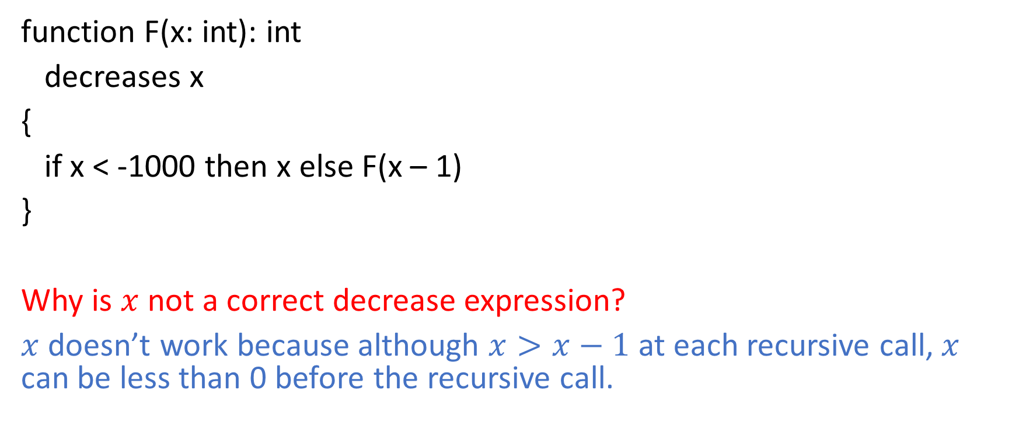
Termination
function F(x: int): int
decreases x
{
if x < -1000 then x else F(x – 1)
}
Why is $x$ not a correct decrease expression?
$x$ doesn’t work because although $x>x−1$ at each recursive call, $x$ can be less than 0 before the recursive call.

Slide 42
Termination
function F(x: int): int
decreases x
{
if x < -1000 then x else F(x – 1)
}
What would be a correct decrease expression?

Slide 43
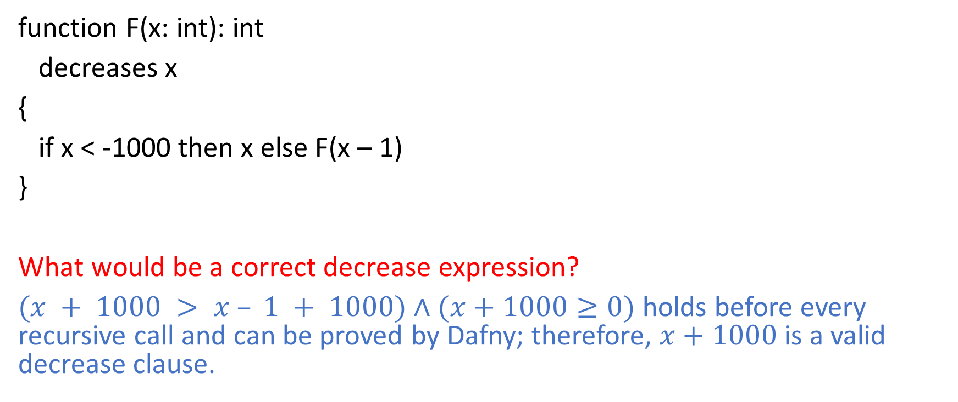
Termination
function F(x: int): int
decreases x
{
if x < -1000 then x else F(x – 1)
}
What would be a correct decrease expression?
$(x + 1000 > x – 1 + 1000)$ $∧$ $(x+1000≥0)$ holds before every recursive call and can be proved by Dafny; therefore, $x+1000$ is a valid decrease clause.

Slide 44
Termination
function Sum(a: array<int>, lo: int, hi: int): int
requires 0 <= lo <= hi <= a.Length
decreases
{
if lo == hi then 0 else Sum(a, lo + 1, hi)
}
What would be a correct decrease expression?

Slide 45
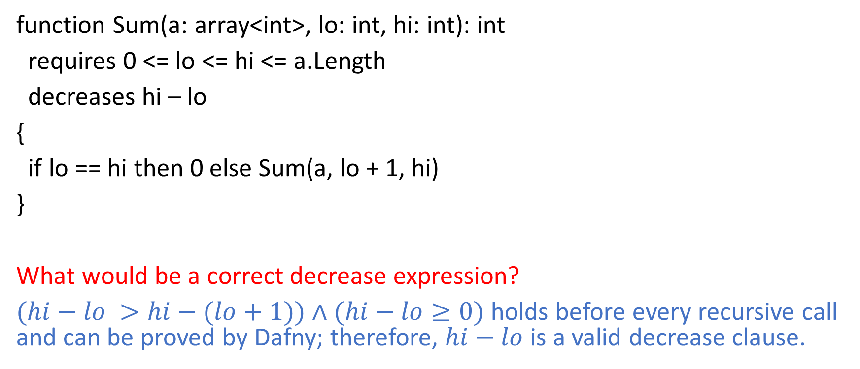
Termination
function Sum(a: array<int>, lo: int, hi: int): int
requires 0 <= lo <= hi <= a.Length
decreases hi – lo
{
if lo == hi then 0 else Sum(a, lo + 1, hi)
}
What would be a correct decrease expression?
$(hi−lo >hi−(lo+1))$ $∧$ $(hi−lo≥0)$ holds before every recursive call and can be proved by Dafny; therefore, $hi−lo$ is a valid decrease clause.

Slide 46
Termination
What should be the decrease clause?
Is m a valid decrease clause?
function Ack(m: nat, n: nat): nat
decreases m
{
if m == 0 then
n + 1
else if n == 0 then
Ack(m – 1, 1)
else
Ack(m-1, Ack(m, n - 1))
}

Slide 47

Termination
What should be the decrease clause?
Is m a valid decrease clause?
No, because the termination condition for the recursive call Ack(m, n-1) at Line-9 is m $≻m$, which is not valid.
function Ack(m: nat, n: nat): nat
decreases m
{
if m == 0 then
n + 1
else if n == 0 then
Ack(m – 1, 1)
else
Ack(m-1, Ack(m, n - 1))
}

Slide 48

Termination
What should be the decrease clause?
Is m a valid decrease clause?
No, because the termination condition for the recursive call Ack(m, n-1) at Line-9 is m $≻m$, which is not valid.
Is n a valid decrease clause?
function Ack(m: nat, n: nat): nat
decreases n
{
if m == 0 then
n + 1
else if n == 0 then
Ack(m – 1, 1)
else
Ack(m-1, Ack(m, n - 1))
}

Slide 49

Termination
What should be the decrease clause?
Is m a valid decrease clause?
No, because the termination condition for the recursive call Ack(m, n-1) at Line-9 is m $≻m$, which is not valid.
Is n a valid decrease clause?
No, because the condition for termination at Line-7 is $n≻1$, which is not valid.
function Ack(m: nat, n: nat): nat
decreases n
{
if m == 0 then
n + 1
else if n == 0 then
Ack(m – 1, 1)
else
Ack(m-1, Ack(m, n - 1))
}

Slide 50

Termination
What should be the decrease clause?
Is m a valid decrease clause?
No, because the termination condition for the recursive call Ack(m, n-1) at Line-9 is m $≻m$, which is not valid.
Is n a valid decrease clause?
No, because the condition for termination at Line-7 is $n≻1$, which is not valid.
Is the tuple m, n a valid decrease clause?
function Ack(m: nat, n: nat): nat
decreases m, n
{
if m == 0 then
n + 1
else if n == 0 then
Ack(m – 1, 1)
else
Ack(m-1, Ack(m, n - 1))
}

Slide 51

Termination
What should be the decrease clause?
Is m a valid decrease clause?
No, because the termination condition for the recursive call Ack(m, n-1) at Line-9 is m $≻m$, which is not valid.
Is n a valid decrease clause?
No, because the condition for termination at Line-7 is $n≻1$, which is not valid.
Is the tuple m, n a valid decrease clause?
Yes. Condition for termination at recursive calls:
Ack(m – 1, 1) is $m,n≻m−1,1$
Ack(m – 1, Ack(m,n-1)) is $m,n≻m−1, Ack\left(m,n−1\right)$
Ack(m, n-1) is $m,n≻m,n−1$
All of them are valid.
function Ack(m: nat, n: nat): nat
decreases m, n
{
if m == 0 then
n + 1
else if n == 0 then
Ack(m – 1, 1)
else
Ack(m-1, Ack(m, n - 1))
}

Slide 52
Termination
What could be a suitable value of the decrease clause?
// Time simulator
method Study(n: nat, h: nat)
decreases
{
if h != 0 {
// study for an hour
Study(n, h-1);
} else if n == 0 {
// no more courses to study, graduation time!
} else {
// calculate time required for the next course
var hours := RequiredStudyTime(n-1);
// Start the next course
Study(n-1, hours);
}
}

Slide 53
Termination
What could be a suitable value of the decrease clause?
The tuple n, h.
// Time simulator
method Study(n: nat, h: nat)
decreases n, h
{
if h != 0 {
// study for an hour
Study(n, h-1);
} else if n == 0 {
// no more courses to study, graduation time!
} else {
// calculate time required for the next course
var hours := RequiredStudyTime(n-1);
// Start the next course
Study(n-1, hours);
}
}

Slide 54
Bonus assignment
Suppose the university cracks down on professors to limit the required study time for a course to 200 hours. That is, the postcondition of the RequiredStudyTime is defined as follows.
method RequiredStudyTime(c: nat) returns (hours: nat)
ensures hours <= 200
In this case, we can write the decrease clause without using a lexicographic tuple. Suggest a valid value for the decrease clause that doesn’t use a lexicographic tuple.
// Time simulator
method Study(n: nat, h: nat)
decreases
{
if h != 0 {
// study for an hour
Study(n, h-1);
} else if n == 0 {
// no more courses to study, graduation time!
} else {
// calculate time required for the next course
var hours := RequiredStudyTime(n-1);
// Start the next course
Study(n-1, hours);
}
}

Slide 55
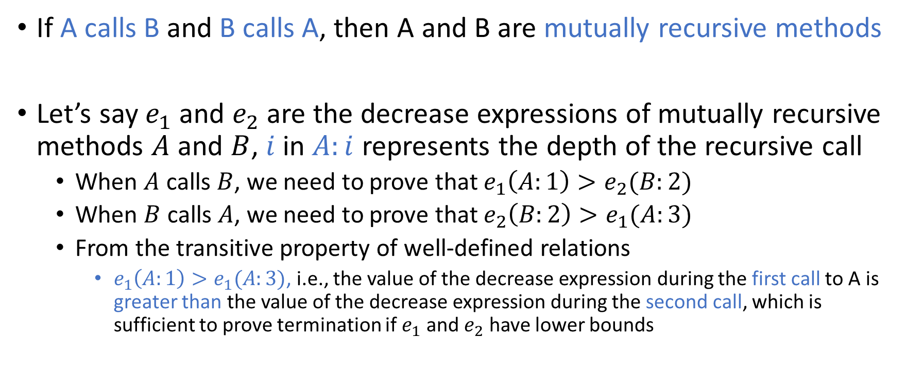
Mutually recursive methods
If A calls B and B calls A, then A and B are mutually recursive methods
Let’s say $e_{1}$ and $e_{2}$ are the decrease expressions of mutually recursive methods $A$ and $B$, $i$ in $A:i$ represents the depth of the recursive call
When $A$ calls $B$, we need to prove that $e_{1}\left(A:1\right)>e_{2}(B:2)$
When $B$ calls $A$, we need to prove that $e_{2}\left(B:2\right)>e_{1}(A:3)$
From the transitive property of well-defined relations
$e_{1}\left(A:1\right)>e_{1}(A:3)$, i.e., the value of the decrease expression during the first call to A is greater than the value of the decrease expression during the second call, which is sufficient to prove termination if $e_{1}$ and $e_{2}$ have lower bounds

Slide 56
Mutually recursive methods
// Time simulator
method StudyPlan(n: nat, h: nat)
requires n <= 40
decreases 40 - n
{
if n != 40 {
var hours := RequiredStudyTime(n);
Learn(n, hours);
}
}
method Learn(n: nat, h: nat)
requires n < 40
decreases 40 – n, h
{
if h == 0 {
StudyPlan(n+1);
} else {
Learn(n, h - 1);
}
}
StudyPlan and Learn are mutually recursive methods.
Proof obligations for termination:

Slide 57
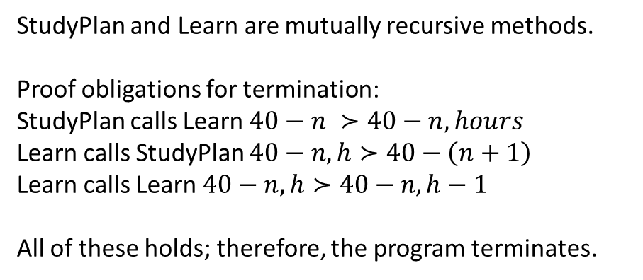
Mutually recursive methods
// Time simulator
method StudyPlan(n: nat, h: nat)
requires n <= 40
decreases 40 - n
{
if n != 40 {
var hours := RequiredStudyTime(n);
Learn(n, hours);
}
}
method Learn(n: nat, h: nat)
requires n < 40
decreases 40 – n, h
{
if h == 0 {
StudyPlan(n+1);
} else {
Learn(n, h - 1);
}
}
StudyPlan and Learn are mutually recursive methods.
Proof obligations for termination:
StudyPlan calls Learn $40−n ≻40−n,hours$
Learn calls StudyPlan $40−n,h≻40−\left(n+1\right)$
Learn calls Learn $40−n, h≻40−n,h−1$
All of these holds; therefore, the program terminates.

Slide 58
Collatz conjecture
method hail(N: nat)
decreases *
{
var n := N;
while 1 < n
decreases *
{
n := if n % 2 == 0 then n / 2 else n * 3 + 1;
}
}
Sometimes, we can’t prove termination. For example, the code shown on this slide implements the Collatz conjecture, whose termination depends on whether the conjecture is true. This is still an open problem in mathematics. In such cases, we can use decreases * annotation to disable the check for termination.
Reference: https://dafny.org/dafny/OnlineTutorial/Termination

Slide 59
Other applications

Slide 60
Program synthesis
PROGRAM
SYNTHESIZER
OUTPUT
AN IMPLEMENTATION THAT MATCHES THE SPECIFICATION
INPUT
SPECIFICATION
IN FOL

Slide 61
Approach
Naïve approach: Generate all possible programs. Check the correctness using the techniques discussed in this course.
Optimization: Checking correctness using an SMT solver is expensive. If a formula is satisfiable, the SMT solver also returns a model that satisfies the formula. Construct a test case using the model returned by the SMT solver. Before checking the correctness of a newly generated program using the SMT solver, check if it passes the test cases obtained using previous failed attempts.

Slide 62
Program synthesis
SPECIFICATION
IN FOL
PROGRAM
SYNTHESIZER
AN IMPLEMENTATION THAT MATCHES THE SPECIFICATION
OUTPUT
INPUT
SUBSET OF GRAMMAR
Generate programs using the restricted grammar; thus, the search space (i.e., all possible programs) is smaller.

Slide 63
Program synthesis
SPECIFICATION
IN FOL
PROGRAM
SYNTHESIZER
AN IMPLEMENTATION THAT MATCHES THE SPECIFICATION
OUTPUT
INPUT
PARTIAL
IMPLEMENTATION
The partial implementation misses some parts of the implementation (some fill-in-the-blanks). Synthesize code for the blanks. Thus, the search space is smaller than synthesizing the whole program.

Slide 64
Input-output driven program synthesis
OBTAIN THE CORRECT OUTPUT O FOR THE INPUT I USING AN ORACLE
GENERATE AN INPUT, I, FOR WHICH
Q GIVES A DIFFERENT OUTPUT THAN P
YES
Add I, O to I/O Examples
PROGRAM
SYNTHESIZER
PROGRAM, P, THAT WORKS FOR INPUT OUTPUT EXAMPLES
GENERATE PROGRAM Q THAT IS SEMANTICALLY DIFFERENT FROM P
SUCCESS
I/O
EXAMPLES
NO
OUTPUT P

Slide 65
Further reading
Syntax-Guided Synthesis, Alur et. al.
Oracle-Guided Component-Based Program Synthesis, Jha et. al.

Slide 66
Symbolic execution
Writing preconditions, postconditions, and loop invariants is hard
The static analysis tools that are used widely try to find bugs in the programs, such as assertion failures
Symbolic execution is one such technique that tries to find the counterexamples to prove that an assertion may not hold at runtime
However, this technique is not complete because it doesn’t guarantee that the assertions for which it couldn’t find a counterexample always hold

Slide 67
Symbolic execution
Symbolic execution statically analyzes a subset of program paths possible during the execution
However, there can be infinitely many paths possible due to the presence of loops
for (i = 0; i < n; i++)
loop-body
Here, the number of iterations depends on the value of n. To limit the total number of paths to analyze, the symbolic execution engine restricts the input such that all loops execute at most k times, where k is a constant.

Slide 68
Symbolic execution
for (i = 0; i < n; i++)
loop-body
In this example, the constraint n == k ensures that the loop executes k times.

Slide 69
Symbolic execution
Generate constraints for each path using rules similar to strongest postconditions, called path constraints
For function calls, symbolically execute the target function
If a path reaches an assertion, check if the assertion condition can be implied by the path constraint; if not, then the counterexample can be used to demonstrate how the assertion can fail during the actual execution

