Slide 2
Today’s topics
Transport layer
UDP
Reliable data transfer protocol

Slide 3
UDP packet header
In addition to data, what additional information is required for the services provided by UDP, i.e., allowing multiple applications, data delivery to applications, and bit-corruption detection

Slide 4
UDP packet header
In addition to data, what additional information is required for the services provided by UDP, i.e., allowing multiple applications, data delivery to applications, and bit-corruption detection
Source port number
Destination port number
Length of the message
Checksum

Slide 5

UDP packet header
struct udphdr { __be16 source; // source port __be16 dest; // destination port __be16 len; // length of UDP header + data
__sum16 check; // checksum of UDP header, payload, part of IP header };
The size of a UDP header is 8.

Slide 6
Pseudo header
struct pseudo_hdr {
__be32 src_ip_addr;
__be32 dst_ip_addr;
__u8 zero; // always zero
__u8 protocol; // 17
__be16 total_len; // size of UDP segment (UDP header + data)
// same as the UDP header len field
};

Slide 7
UDP checksum
The pseudo-header is prepended to the UDP segment (UDP header + data) for computing the checksum
The pseudo-header is not included in the actual packet. It’s used just for the checksum computation
If the length (in bytes) of the data is not even, a byte with zero value is padded to the data during the checksum computation
The check field in the UDP header is set to zero during the computation of the checksum

Slide 8
Example
In Little-endian format
Source port: 0x64
Destination port: 0x1234
Length: 0x0B
Data: 0x10, 0x34, 0x51
Source IP address: 10.5.7.3 (in decimal format)
Destination IP address: 20.8.15.9 (in decimal format)
Protocol: 0x11
What would be the value of the checksum?

Slide 9

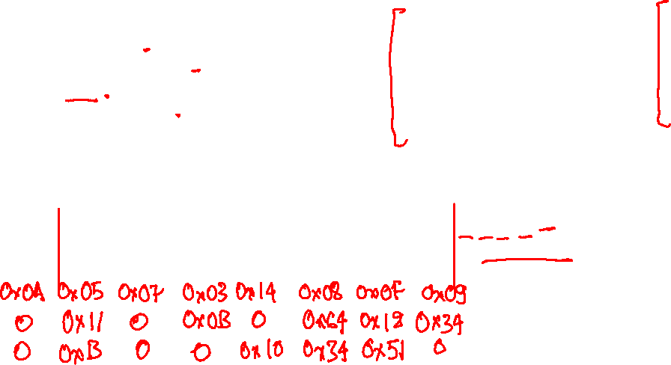
UDP packet
struct pseudo_hdr {
__be32 src_ip_addr;
__be32 dst_ip_addr;
__u8 zero; // always zero
__u8 protocol;
__be16 total_len;
};
struct udphdr { __be16 source; __be16 dest;
__be16 len;
__sum16 check;
};
In Little-endian format
Source port: 0x64
Destination port: 0x1234
Length: 0x0B
Data: 0x10, 0x34, 0x51
Source IP address: 10.5.7.3 (in decimal format)
Destination IP address: 20.8.15.9 (in decimal format)
Protocol: 0x11
Source IP address: 10.5.7.3 $→$ 0x0A050703
Destination IP address: 20.8.15.9 $→$ 0x14080F09

Slide 10
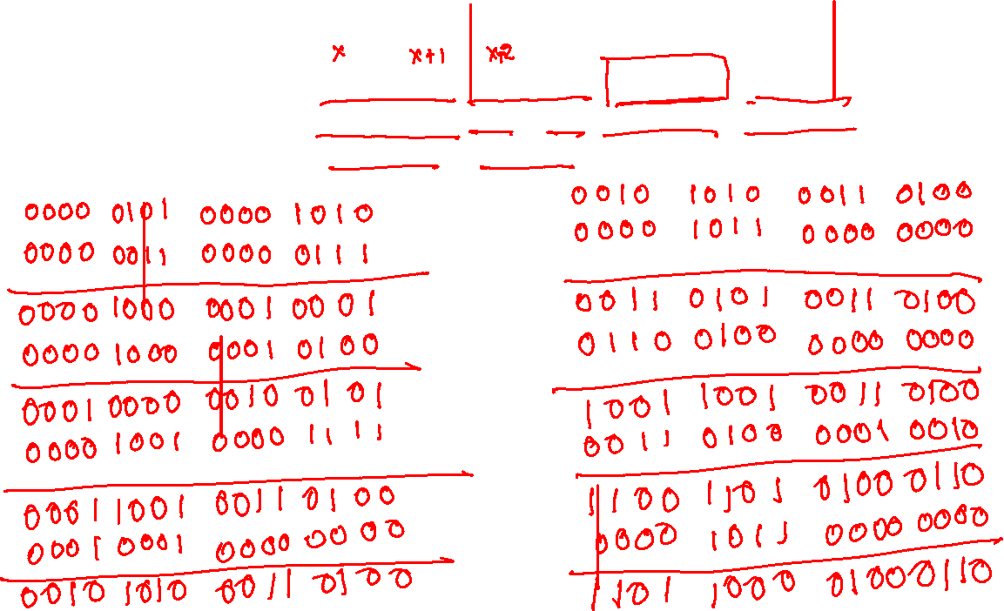
Checksum
0A | 05 | 07 | 03 | 0x14 | 08 | 0F | 09
00 | 0x11 | 00 | 0B | 00 | 0x64 | 0x12 | 0x34
00 | 0B | 00 | 00 | 0x10 | 0x34 | 0x51 | 00

Slide 11
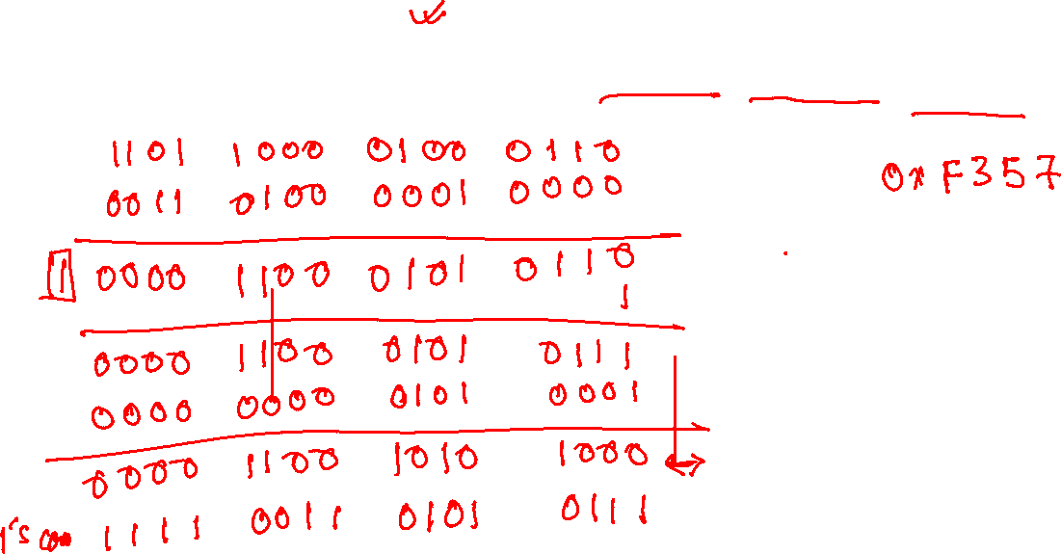
Checksum
0A | 05 | 07 | 03 | 0x14 | 08 | 0F | 09
00 | 0x11 | 00 | 0B | 00 | 0x64 | 0x12 | 0x34
00 | 0B | 00 | 00 | 0x10 | 0x34 | 0x51 | 00

Slide 12
UDP packet
struct pseudo_hdr {
__be32 src_ip_addr;
__be32 dst_ip_addr;
__u8 zero; // always zero
__u8 protocol;
__be16 total_len;
};
struct udphdr { __be16 source; __be16 dest;
__be16 len;
__sum16 check;
};
In Little-endian format
Source port: 0x64
Destination port: 0x1234
Length: 0x0B
Data: 0x10, 0x34, 0x51
Source IP address: 10.5.7.3 (in decimal format)
Destination IP address: 20.8.15.9 (in decimal format)
Protocol: 0x11
Source IP address: 10.5.7.3 $→$ 0x0A050703
Destination IP address: 20.8.15.9 $→$ 0x14080F09
0A | 05 | 07 | 03 | 0x14 | 08 | 0F | 09
00 | 0x11 | 00 | 0B | 00 | 0x64 | 0x12 | 0x34
00 | 0B | 00 | 00 | 0x10 | 0x34 | 0x51 | 00

Slide 13
UDP packet
1101 1000 0100 0110
0000 0000 0000 0000
-------------------------------
1101 1000 0100 0110
0011 0100 0001 0000
-------------------------------
1 0000 1100 0101 0110
---------------------------------
0000 1100 0101 0110
1
---------------------------------
0000 1100 0101 0111
0000 0000 0101 0001
---------------------------------
0000 1100 1010 1000
---------------------------------
1’s complement
1111 0011 0101 0111
Final checksum:
0xF357
0A | 05 | 07 | 03 | 0x14 | 08 | 0F | 09
00 | 0x11 | 00 | 0B | 00 | 0x64 | 0x12 | 0x34
00 | 0B | 00 | 00 | 0x10 | 0x34 | 0x51 | 00
0000 0101 0000 1010
0000 0011 0000 0111
------------------------------
0000 1000 0001 0001
0000 1000 0001 0100
------------------------------
0001 0000 0010 0101
0000 1001 0000 1111
------------------------------
0001 1001 0011 0100
0001 0001 0000 0000
------------------------------
0010 1010 0011 0100
0010 1010 0011 0100
0000 1011 0000 0000
------------------------------
0011 0101 0011 0100
0110 0100 0000 0000
------------------------------
1001 1001 0011 0100
0011 0100 0001 0010
------------------------------
1100 1101 0100 0110
0000 1011 0000 0000
------------------------------
1101 1000 0100 0110

Slide 14
Does checksum always work?

Slide 15
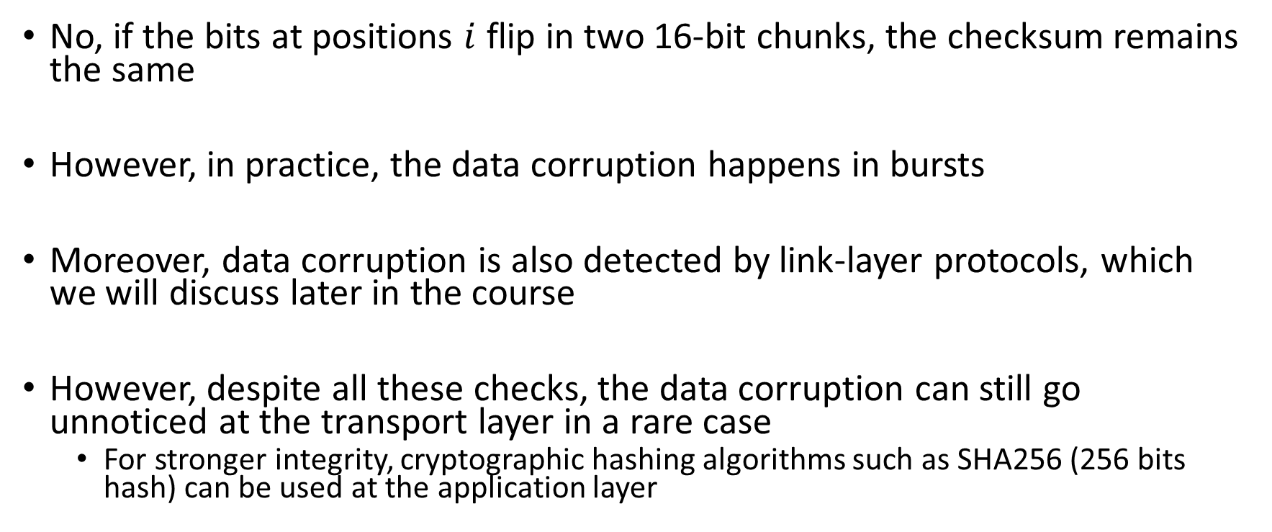
Does checksum always work?
No, if the bits at positions $i$ flip in two 16-bit chunks, the checksum remains the same
However, in practice, the data corruption happens in bursts
Moreover, data corruption is also detected by link-layer protocols, which we will discuss later in the course
However, despite all these checks, the data corruption can still go unnoticed at the transport layer in a rare case
For stronger integrity, cryptographic hashing algorithms such as SHA256 (256 bits hash) can be used at the application layer

Slide 16
Building a reliable data transfer protocol

Slide 17
References
Read chapter-3.4 from the Kurose and Ross book

Slide 18
Reliability issues
Packet bits can be corrupted
Packets may be lost
Packets can be reordered
Duplicate packets can arrive

Slide 19
Reliability issues
We’ll explain potential solutions by starting from a simple model and will add complexities to further refine our solutions
We will discuss the solution using a Finite State Machine (FSM)

Slide 20
Finite state machine (FSM)
FSM has one or more states, and there is one starting state
Each state is waiting for some event to happen
Arrow represents a transition from the current state to a state in the FSM
A transition is triggered by an event and the corresponding action
The arrows are labelled with an event and the corresponding action
The events and actions are separated by a horizontal line
The initial state is represented by a dashed line

Slide 21

Finite state machine (FSM)
The starting state at the sender end waits for the rdt_send event, which is triggered when the application sends data to the receiver
The starting state at the client end waits for the rdt_rcv event, which is triggered when the network layer hands the data to the transport layer

Slide 22
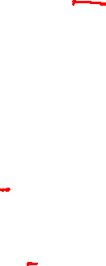
Other APIs
pkt = make_pkt(data, …)
make a packet from data
udt_send(packet)
send packet on the communication channel
udt stands for unreliable data transfer
data = extract(packet)
extract data from the packet
deliver(data)
deliver data to the application

Slide 23
rdt1.0
Reliable data transfer over a perfectly reliable channel
No data corruption
No packet loss

Slide 24
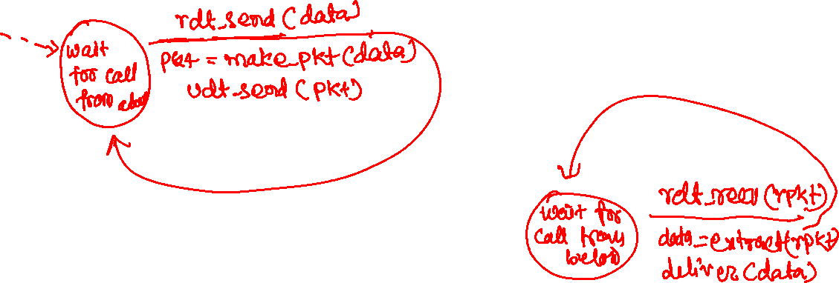
rdt1.0 sender and receiver

Slide 25
rdt1.0
Wait for call from above
rdt_send(data)
Wait for call from below
rdt_rcv(packet)
sender
packet = make_pkt(data)
udt_send(packet)
receiver
data = extract (packet)
deliver(data)
Copyright © 2010-2025 J.F. Kurose, K.W. Ross

Slide 26
rdt2.0
No packet loss
Packets can be corrupted

Slide 27
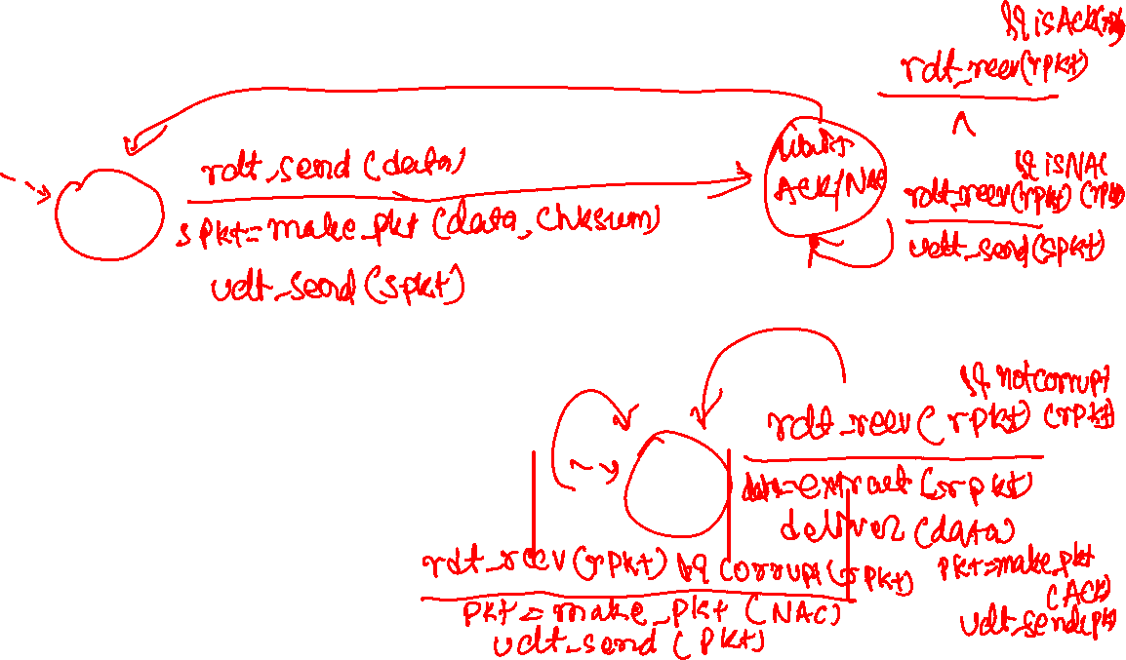
rdt2.0 sender and receiver

Slide 28
rdt2.0 sender
rdt_send(data)
snkpkt = make_pkt(data, checksum)
udt_send(sndpkt)
rdt_rcv(rcvpkt) &&
isNAK(rcvpkt)
sender
Wait for call from above
Wait for ACK or NAK
udt_send(sndpkt)
rdt_rcv(rcvpkt) && corrupt(rcvpkt)
udt_send(NAK)
rdt_rcv(rcvpkt) && isACK(rcvpkt)
Wait for call from below
Λ
receiver
rdt_rcv(rcvpkt) && notcorrupt(rcvpkt)
extract(rcvpkt,data)
deliver_data(data)
udt_send(ACK)
Copyright © 2010-2025 J.F. Kurose, K.W. Ross

Slide 29
rdt2.0 sender and receiver
rdt_send(data)
snkpkt = make_pkt(data, checksum)
udt_send(sndpkt)
rdt_rcv(rcvpkt) &&
isNAK(rcvpkt)
sender
Wait for call from above
Wait for ACK or NAK
udt_send(sndpkt)
rdt_rcv(rcvpkt) && corrupt(rcvpkt)
udt_send(NAK)
rdt_rcv(rcvpkt) && isACK(rcvpkt)
Wait for call from below
Λ
receiver
rdt_rcv(rcvpkt) && notcorrupt(rcvpkt)
Path taken when the packet is not corrupted
data = extract(rcvpkt)
deliver(data)
udt_send(ACK)
Copyright © 2010-2025 J.F. Kurose, K.W. Ross

Slide 30
rdt2.0 sender and receiver
rdt_send(data)
snkpkt = make_pkt(data, checksum)
udt_send(sndpkt)
rdt_rcv(rcvpkt) &&
isNAK(rcvpkt)
sender
Wait for call from above
Wait for ACK or NAK
udt_send(sndpkt)
rdt_rcv(rcvpkt) && corrupt(rcvpkt)
udt_send(NAK)
rdt_rcv(rcvpkt) && isACK(rcvpkt)
Wait for call from below
Λ
receiver
rdt_rcv(rcvpkt) && notcorrupt(rcvpkt)
Path taken when the packet is corrupted
data = extract(rcvpkt)
deliver(data)
udt_send(ACK)
Copyright © 2010-2025 J.F. Kurose, K.W. Ross

Slide 31
rdt2.0
No packet loss
Packets can be corrupted
Solution
The sender inserts a checksum into the packet
Sender waits for ACK/NAC
receiver detects corruption using the checksum
The receiver sends an ACK if the data wasn’t corrupted during the transmission
The receiver sends a NAC if the data was corrupted during the transmission
Sender retransmits if a NAC is received
Sender is free to send the next packet on receiving an ACK
Problem?

Slide 32
rdt2.0
No packet loss
Packets can be corrupted
Solution
The sender inserts a checksum into the packet
Sender waits for ACK/NAC
receiver detects corruption using the checksum
The receiver sends an ACK if the data wasn’t corrupted during the transmission
The receiver sends a NAC if the data was corrupted during the transmission
Sender retransmits if a NAC is received
Sender is free to send the next packet on receiving an ACK
Problem
ACK/NAC can be corrupted
Solution?

Slide 33
rdt2.1
Problem with rdt2.0?
ACK/NAC can be corrupted
Solution
Add checksum to ACK/NAC
resend the packet if ACK/NAC is corrupted

Slide 34
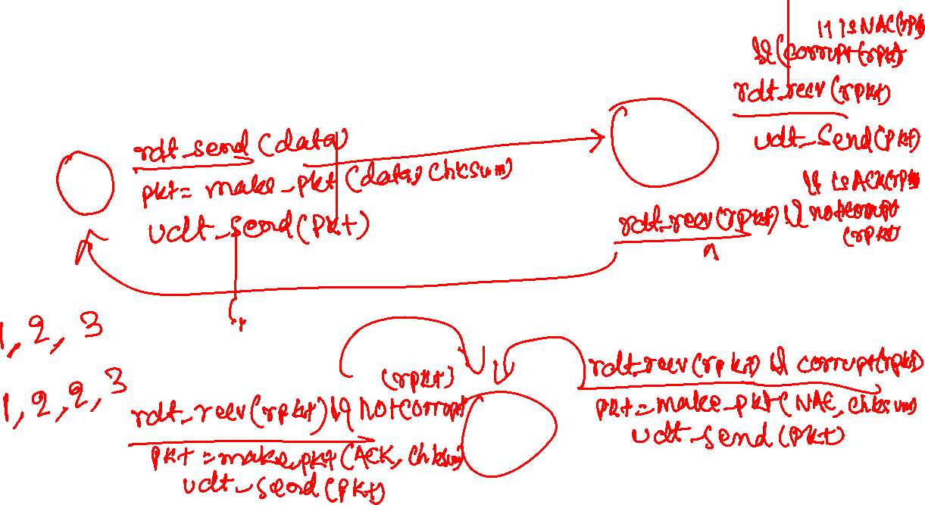
rdt2.1 sender and receiver

Slide 35
rdt2.1 sender and receiver
rdt_send(data)
snkpkt = make_pkt(data, checksum)
udt_send(sndpkt)
rdt_rcv(rcvpkt) &&
(isNAK(rcvpkt) ||
corrupt(rcvpkt))
Wait for call from above
Wait for ACK or NAK
rdt_rcv(rcvpkt) && corrupt(rcvpkt)
sender
sendpkt = make_pkt(NAK, chksum)
udt_send(sendpkt)
udt_send(sndpkt)
rdt_rcv(rcvpkt) && isACK(rcvpkt)
Wait for call from below
Λ
receiver
rdt_rcv(rcvpkt) && notcorrupt(rcvpkt)
data = extract(rcvpkt)
deliver(data)
sendpkt = make_pkt(ACK, chksum)
udt_send(sendpkt)
Copyright © 2010-2025 J.F. Kurose, K.W. Ross

Slide 36
rdt2.1
Problem with rdt2.0?
ACK/NAC can be corrupted
Solution
Add checksum to ACK/NAC
resend the packet if ACK/NAC is corrupted
Problem
After sending an ACK, the receiver might be expecting the next packet. How does the receiver know if the packet it received is the new packet or an already received packet that was retransmitted due to corruption of the last ACK?
Solution?

Slide 37
rdt2.1
Problem with rdt2.0?
ACK/NAC can be corrupted
Solution
Add checksum to ACK/NAC
resend the packet if ACK/NAC is corrupted
Problem
After sending an ACK, the receiver might be expecting the next packet. How does the receiver know if the packet it received is the new packet or an already received packet that was retransmitted due to corruption of the last ACK?
Solution
Add a sequence number to every packet

Slide 38
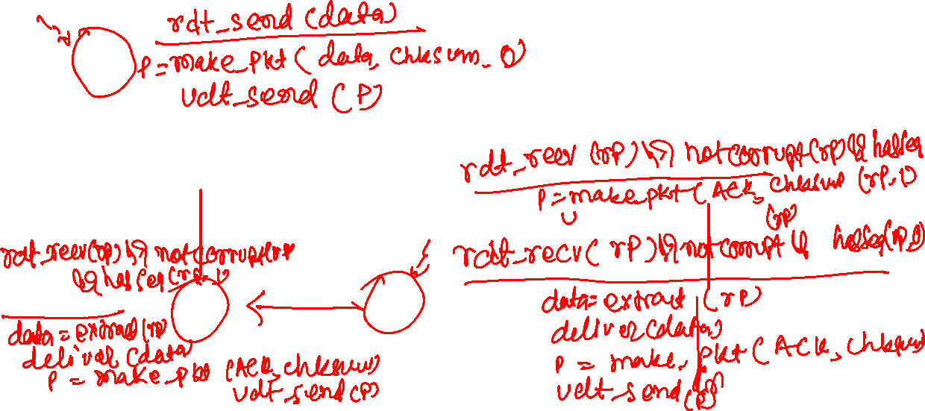
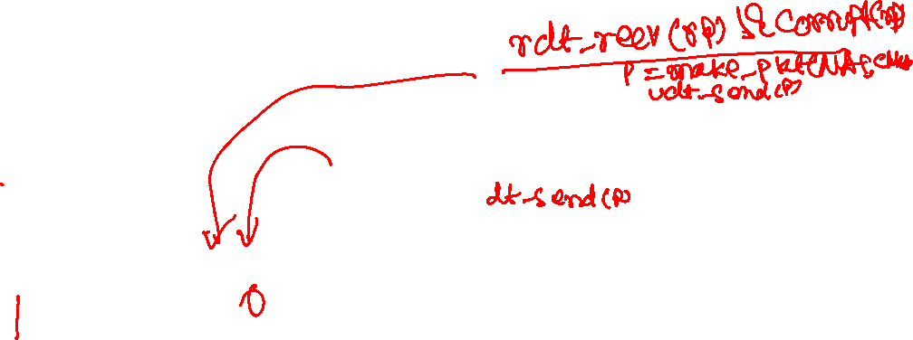
rdt2.1 sender and receiver

Slide 39
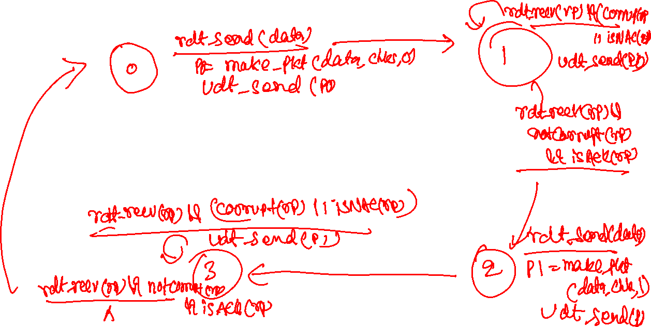
rdt2.1 sender

Slide 40
rdt2.1 sender
rdt_send(data)
sndpkt = make_pkt(0, data, checksum)
udt_send(sndpkt)
rdt_rcv(rcvpkt) && (corrupt(rcvpkt) ||
isNAK(rcvpkt) )
Wait for call 0 from above
Wait for ACK or NAK 0
udt_send(sndpkt)
rdt_rcv(rcvpkt)
&& notcorrupt(rcvpkt) && isACK(rcvpkt)
rdt_rcv(rcvpkt)
&& notcorrupt(rcvpkt)
&& isACK(rcvpkt)
Λ
Λ
Wait for ACK or NAK 1
Wait for
call 1 from above
rdt_rcv(rcvpkt)
&& (corrupt(rcvpkt) ||
isNAK(rcvpkt) )
rdt_send(data)
udt_send(sndpkt)
sndpkt = make_pkt(1, data, checksum)
udt_send(sndpkt)
Copyright © 2010-2025 J.F. Kurose, K.W. Ross

Slide 41
rdt2.1 receiver
rdt_rcv(rcvpkt) && notcorrupt(rcvpkt)
&& has_seq0(rcvpkt)
data = extract(rcvpkt)
deliver(data)
sndpkt = make_pkt(ACK, chksum)
udt_send(sndpkt)
rdt_rcv(rcvpkt) && (corrupt(rcvpkt)
rdt_rcv(rcvpkt) && (corrupt(rcvpkt)
sndpkt = make_pkt(NAK, chksum)
udt_send(sndpkt)
sndpkt = make_pkt(NAK, chksum)
udt_send(sndpkt)
Wait for
0 from below
Wait for
1 from below
rdt_rcv(rcvpkt) &&
not corrupt(rcvpkt) &&
has_seq1(rcvpkt)
rdt_rcv(rcvpkt) &&
not corrupt(rcvpkt) &&
has_seq0(rcvpkt)
sndpkt = make_pkt(ACK, chksum)
udt_send(sndpkt)
sndpkt = make_pkt(ACK, chksum)
udt_send(sndpkt)
rdt_rcv(rcvpkt) && notcorrupt(rcvpkt)
&& has_seq1(rcvpkt)
data = extract(rcvpkt)
deliver(data)
sndpkt = make_pkt(ACK, chksum)
udt_send(sndpkt)
Copyright © 2010-2025 J.F. Kurose, K.W. Ross

Slide 42
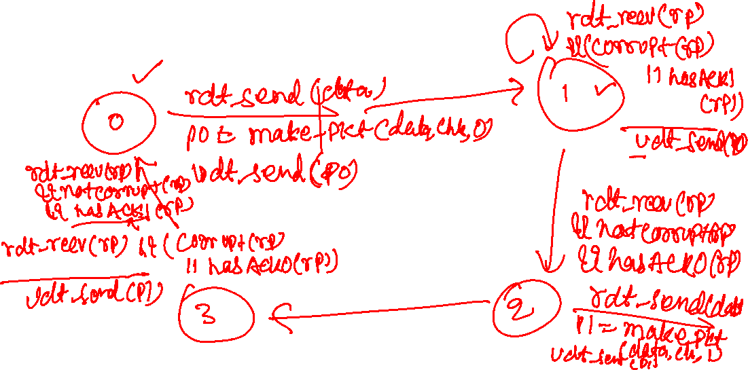
rdt2.1
Let’s try replacing the NAC with an ACK

Slide 43
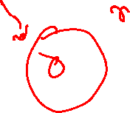
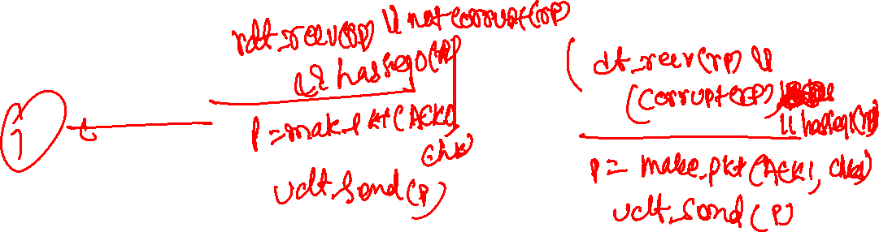
rdt2.1 sender and receiver

Slide 44
rdt2.1
Let’s try replacing the NAC with an ACK
Instead of sending NAC, the receiver can send an ack for the last received packet. So, the sequence number is also added in the ACK.

Slide 45
rdt2.1
rdt_send(data)
sndpkt = make_pkt(0, data, checksum)
udt_send(sndpkt)
rdt_rcv(rcvpkt) &&
( corrupt(rcvpkt) ||
isACK(rcvpkt,1) )
Wait for call 0 from above
Wait for ACK
0
udt_send(sndpkt)
sender FSM
fragment
rdt_rcv(rcvpkt)
&& notcorrupt(rcvpkt)
&& isACK(rcvpkt,0)
rdt_rcv(rcvpkt) &&
(corrupt(rcvpkt) ||
has_seq1(rcvpkt))
Λ
Wait for
0 from below
receiver FSM
fragment
udt_send(sndpkt)
rdt_rcv(rcvpkt) && notcorrupt(rcvpkt)
&& has_seq1(rcvpkt)
data = extract(rcvpkt)
deliver(data)
sndpkt = make_pkt(ACK1, chksum)
udt_send(sndpkt)
Copyright © 2010-2025 J.F. Kurose, K.W. Ross

Slide 46
rdt3.0
Let’s allow packet loss.
What modifications are needed in rdt2.1?

Slide 47
rdt3.0
Let’s allow packet loss.
What modifications are needed in rdt2.1?
Introduce a timeout at the sender
If an ACK isn’t received during a given period of time, resend the packet
What value should we pick for the timeout?
What is the problem when the timeout is very small?
What is the problem when the timeout is very large?
What should be an ideal timeout?

Slide 48
rdt3.0
Let’s allow packet loss.
What modifications are needed in rdt2.1?
Introduce a timeout at the sender
If an ACK isn’t received during a given period of time, resend the packet
What value should we pick for the timeout?
What is the problem when the timeout is very small?
Unnecessary retransmissions
What is the problem when the timeout is very large?
Retransmissions are delayed. Poor performance.
What should be an ideal timeout?
It should be slightly more than RTT. However, RTT is not fixed and may vary due to the change in load at intermediate gateways, so finding an ideal timeout might be tricky.

