Slide 2
Today’s topics
Midterm format
Reliable data transfer protocol
Go-Back-N (GBN)

Slide 3
References
Read chapter-3.4 from the Kurose and Ross book

Slide 4
Finite state machine (FSM)
FSM has one or more states, and there is one starting state
Each state is waiting for some event to happen
Arrow represents a transition from the current state to a state in the FSM
A transition is triggered by an event and the corresponding action
The arrows are labelled with an event and the corresponding action
The events and actions are separated by a horizontal line
The initial state is represented by a dashed line

Slide 5
Finite state machine (FSM)
The starting state at the sender end waits for the rdt_send event, which is triggered when the application sends data to the receiver
The starting state at the client end waits for the rdt_rcv event, which is triggered when the network layer hands the data to the transport layer

Slide 6
Other APIs
pkt = make_pkt(data, …)
make a packet from data
udt_send(packet)
send packet on the communication channel
udt stands for unreliable data transfer
data = extract(packet)
extract data from the packet
deliver(data)
deliver data to the application

Slide 7
rdt3.0
Let’s allow packet loss, in addition to the packet corruption
What modifications are needed in rdt2.1?

Slide 8
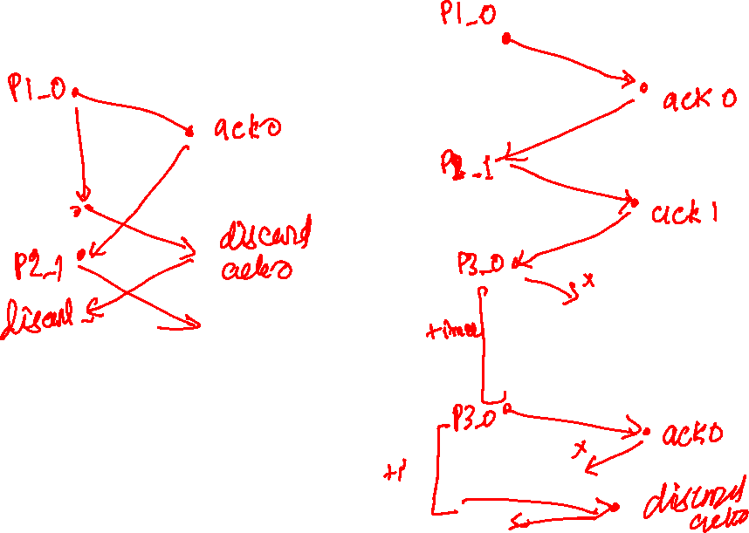
rdt3.0 (packet loss)

Slide 9
rdt3.0 (ACK loss)

Slide 10
rdt3.0 (ACK delayed)

Slide 11

rdt3.0 (stop-and-wait)
sender
receiver
sender
receiver
send pkt0
pkt0
send pkt0
pkt0
rcv pkt0
rcv pkt0
ack0
send ack0
ack0
send ack0
rcv ack0
rcv ack0
send pkt1
pkt1
send pkt1
pkt1
rcv pkt1
X
ack1
send ack1
loss
rcv ack1
send pkt0
pkt0
rcv pkt0
timeout
resend pkt1
ack0
send ack0
pkt1
rcv pkt1
ack1
send ack1
rcv ack1
send pkt0
pkt0
(a) no loss
rcv pkt0
ack0
send ack0
(b) packet loss
Copyright © 2010-2025 J.F. Kurose, K.W. Ross

Slide 12
rdt3.0 (stop-and-wait)
sender
receiver
sender
receiver
send pkt0
pkt0
rcv pkt0
send pkt0
pkt0
send ack0
rcv pkt0
rcv ack0
ack0
ack0
send ack0
send pkt1
pkt1
rcv ack0
rcv pkt1
send pkt1
pkt1
send ack1
rcv pkt1
ack1
ack1
send ack1
X
timeout
resend pkt1
loss
pkt1
rcv pkt1
timeout
resend pkt1
rcv ack1
(detect duplicate)
pkt1
rcv pkt1
send ack1
send pkt0
pkt0
ack1
(detect duplicate)
rcv pkt0
rcv ack1
send ack1
rcv ack1
ack1
ack0
send ack0
send pkt0
pkt0
(ignore)
rcv pkt0
ack0
send ack0
pkt1
(c) ACK loss
(d) premature timeout/ delayed ACK
Copyright © 2010-2025 J.F. Kurose, K.W. Ross

Slide 13
rdt3.0
Let’s allow packet loss
What modifications are needed in rdt2.1?
Introduce a timeout at the sender
If an ACK isn’t received during a given period of time, resend the packet
What value should we pick for the timeout?
What is the problem when the timeout is very small?
What is the problem when the timeout is very large?
What should be an ideal timeout?

Slide 14
rdt3.0
Let’s allow packet loss.
What modifications are needed in rdt2.1?
Introduce a timeout at the sender
If an ACK isn’t received during a given period of time, resend the packet
What value should we pick for the timeout?
What is the problem when the timeout is very small?
Unnecessary retransmissions
What is the problem when the timeout is very large?
Retransmissions are delayed. Poor performance.
What should be an ideal timeout?
It should be slightly more than RTT. However, RTT is not fixed and may vary due to the change in load at intermediate gateways, so finding an ideal timeout might be tricky.

Slide 15
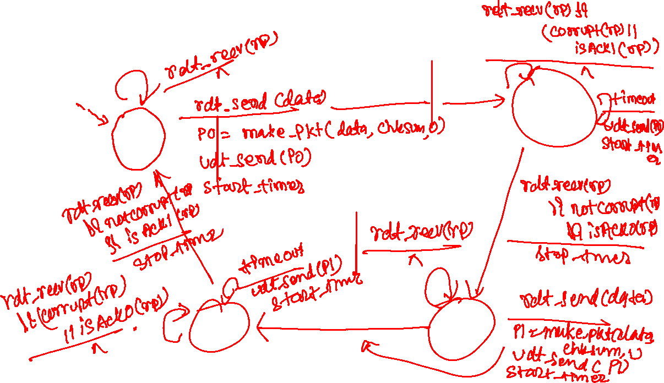
rdt3.0 sender

Slide 16
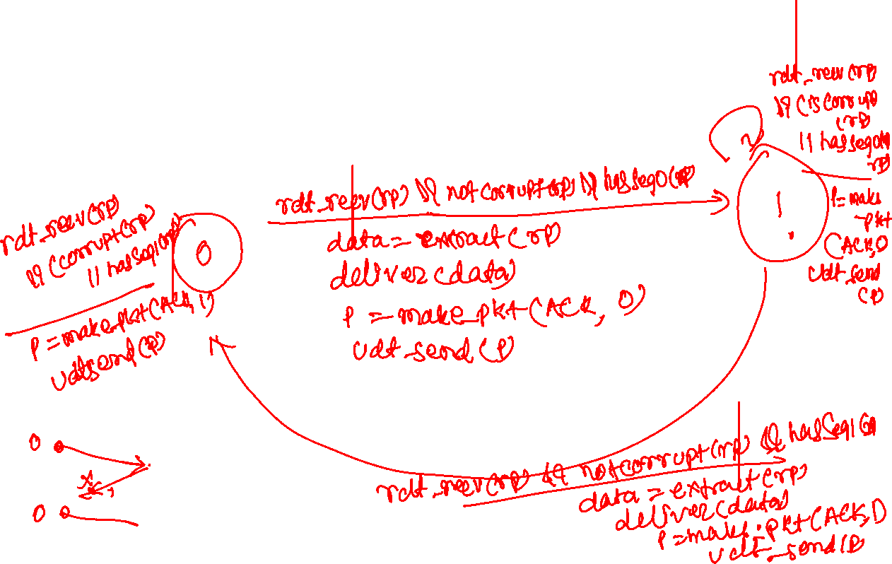
rdt3.0 receiver

Slide 17
rdt3.0 sender
rdt_send(data)
rdt_rcv(rcvpkt) &&
( corrupt(rcvpkt) ||
isACK(rcvpkt,1) )
sndpkt = make_pkt(0, data, checksum)
udt_send(sndpkt)
start_timer
rdt_rcv(rcvpkt)
Λ
Λ
Wait for
call 0 from above
Wait for ACK0
timeout
udt_send(sndpkt)
start_timer
rdt_rcv(rcvpkt)
&& notcorrupt(rcvpkt)
&& isACK(rcvpkt,1)
rdt_rcv(rcvpkt)
&& notcorrupt(rcvpkt)
&& isACK(rcvpkt,0)
stop_timer
stop_timer
Wait for ACK1
Wait for
call 1 from above
timeout
udt_send(sndpkt)
start_timer
rdt_rcv(rcvpkt)
rdt_send(data)
Λ
rdt_rcv(rcvpkt) &&
( corrupt(rcvpkt) ||
isACK(rcvpkt,0) )
sndpkt = make_pkt(1, data, checksum)
udt_send(sndpkt)
start_timer
Λ
Copyright © 2010-2025 J.F. Kurose, K.W. Ross

Slide 18
rdt3.0 receiver
rdt_rcv(rcvpkt) && notcorrupt(rcvpkt)
&& has_seq0(rcvpkt)
data = extract(rcvpkt)
deliver(data)
sndpkt = make_pkt(ACK0, chksum)
udt_send(sndpkt)
rdt_rcv(rcvpkt) && (corrupt(rcvpkt)
rdt_rcv(rcvpkt) && (corrupt(rcvpkt)
sndpkt = make_pkt(ACK1, chksum)
udt_send(sndpkt)
sndpkt = make_pkt(ACK0, chksum)
udt_send(sndpkt)
Wait for
0 from below
Wait for
1 from below
rdt_rcv(rcvpkt) &&
not corrupt(rcvpkt) &&
has_seq1(rcvpkt)
rdt_rcv(rcvpkt) &&
not corrupt(rcvpkt) &&
has_seq0(rcvpkt)
sndpkt = make_pkt(ACK1, chksum)
udt_send(sndpkt)
sndpkt = make_pkt(ACK0, chksum)
udt_send(sndpkt)
rdt_rcv(rcvpkt) && notcorrupt(rcvpkt)
&& has_seq1(rcvpkt)
data = extract(rcvpkt)
deliver(data)
sndpkt = make_pkt(ACK1, chksum)
udt_send(sndpkt)
Copyright © 2010-2025 J.F. Kurose, K.W. Ross

Slide 19
rdt3.0
rdt3.0 is also called a stop-and-wait protocol
The sender sends a packet if and only if it is convinced that the receiver has received the previous packet

Slide 20
rdt3.0 (stop-and-wait)
no loss

Slide 21
rdt3.0 (stop-and-wait)
packet loss

Slide 22
rdt3.0 (stop-and-wait)
ACK loss

Slide 23
rdt3.0 (stop-and-wait)
ACK delayed

Slide 24
rdt3.0 (stop-and-wait)
sender
receiver
sender
receiver
send pkt0
pkt0
send pkt0
pkt0
rcv pkt0
rcv pkt0
ack0
send ack0
ack0
send ack0
rcv ack0
rcv ack0
send pkt1
pkt1
send pkt1
pkt1
rcv pkt1
X
ack1
send ack1
loss
rcv ack1
send pkt0
pkt0
rcv pkt0
timeout
resend pkt1
ack0
send ack0
pkt1
rcv pkt1
ack1
send ack1
rcv ack1
send pkt0
pkt0
(a) no loss
rcv pkt0
ack0
send ack0
(b) packet loss
Copyright © 2010-2025 J.F. Kurose, K.W. Ross

Slide 25
rdt3.0 (stop-and-wait)
sender
receiver
sender
receiver
send pkt0
pkt0
rcv pkt0
send pkt0
pkt0
send ack0
rcv pkt0
rcv ack0
ack0
ack0
send ack0
send pkt1
pkt1
rcv ack0
rcv pkt1
send pkt1
pkt1
send ack1
rcv pkt1
ack1
ack1
send ack1
X
timeout
resend pkt1
loss
pkt1
rcv pkt1
timeout
resend pkt1
rcv ack1
(detect duplicate)
pkt1
rcv pkt1
send ack1
send pkt0
pkt0
ack1
(detect duplicate)
rcv pkt0
rcv ack1
send ack1
rcv ack1
ack1
ack0
send ack0
send pkt0
pkt0
(ignore)
rcv pkt0
ack0
send ack0
pkt1
(c) ACK loss
(d) premature timeout/ delayed ACK
Copyright © 2010-2025 J.F. Kurose, K.W. Ross

Slide 26
rdt3.0
Assumption:
The rdt3.0 assumes that if a packet is not lost, it will be received in the same order in which it was sent, i.e., the network will not reorder the packet

Slide 27
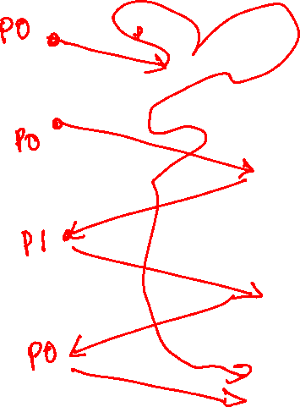
rdt3.0 (stop-and-wait)

Slide 28
rdt3.0 (stop-and-wait)
sender
receiver
send pkt0
pkt1_0
timeout
resend pkt0
pkt1_0
rcv pkt1_0
send ack0
ack0
rcv ack0
send pkt1
pkt2_1
rcv pkt2_1
ack1
send ack1
rcv ack1
send pkt0
pkt3_0
rcv pkt1_0
send ack0
rcv ack0
ack0
rcv pkt3_0
(detect duplicate)
ack0
send ack0
rcv ack0
Copyright © 2010-2025 J.F. Kurose, K.W. Ross

Slide 29
rdt3.0 reordering
Assumption:
The rdt3.0 assumes that if packet is not lost, it will be received in the same order in which it was sent, i.e., the network will not reorder the packet
Let’s consider the following example
A user wants to send three packets: pkt1_0, pkt2_1, and pkt3_0 with sequence numbers 0, 1, and 0, respectively. pkt1_0 somehow took a very long path; consequently, it was retransmitted and received at the receiver end. After that, the sender sends pkt2_1, which was also successfully delivered to the receiver. Then the sender sends pkt3_0, but this time, before pkt3_0 can reach the receiver, pkt1_0 arrives at the receiver. Because the receiver was hoping to accept a packet with sequence number zero, it accepts pkt1_0, but discards pkt3_0 if it arrives just after pkt1_0 (because it was expecting a packet with sequence number 1 after receiving pkt1_0).

Slide 30
rdt3.0 reordering
How to fix the reordering problem?

Slide 31
rdt3.0 reordering
How to fix the reordering problem?
Use a unique sequence number for each packet

Slide 32
rdt3.0 reordering
How to fix the reordering problem?
Use a unique sequence number for each packet
But the sequence number is of finite width

Slide 33
rdt3.0 reordering
How to fix the reordering problem?
Use a unique sequence number for each packet
But the sequence number is of finite width
Ensure that a packet is thrown out of the network after a maximum interval
This is actually the case. The IP layer adds a time-to-live field that discards the packet if it traverses through a certain number of hops
Usually, the maximum lifetime of the packet is 180 seconds
We need to ensure that the sequence number doesn’t exhaust in 180 seconds in order to fix the reordering problem.
As of now, we will assume that the reordering problem doesn’t exist in our subsequent discussions

Slide 34
RDT 3.0 utilization
Utilization: the fraction of time sender is actually busy sending the packets into the channel

Slide 35
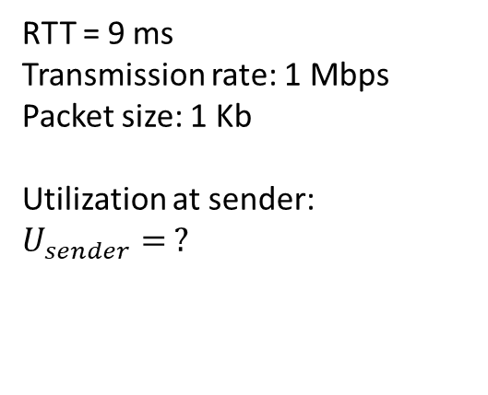
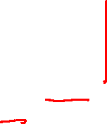
rdt3.0: stop-and-wait utilization
sender
receiver
first packet bit transmitted, t = 0
RTT = 9 ms
Transmission rate: 1 Mbps
Packet size: 1 Kb
Utilization at sender:
$$U_{sender}= ?$$
first packet bit arrives
RTT
last packet bit arrives, send ACK
ACK arrives, send next
packet, t = RTT + L / R
Copyright © 2010-2025 J.F. Kurose, K.W. Ross

Slide 36
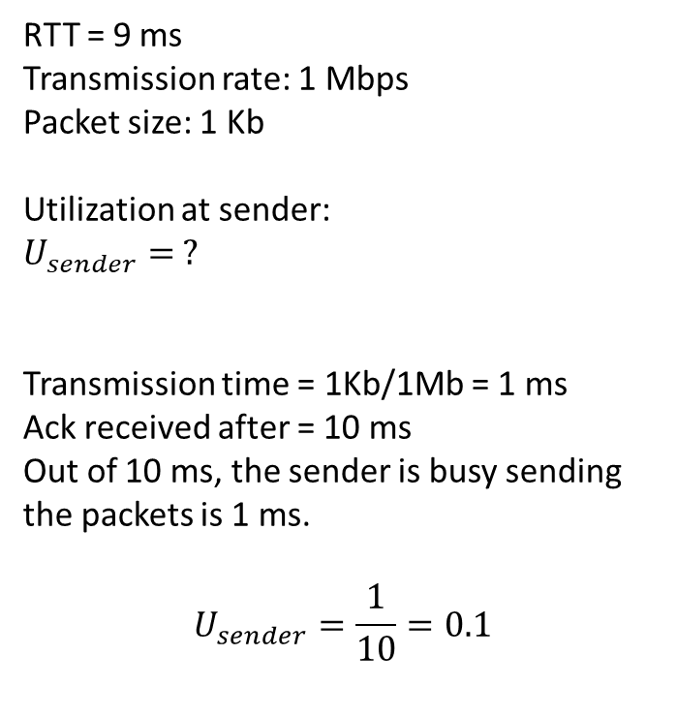
rdt3.0: stop-and-wait utilization
sender
receiver
first packet bit transmitted, t = 0
RTT = 9 ms
Transmission rate: 1 Mbps
Packet size: 1 Kb
Utilization at sender:
$$U_{sender}= ?$$
Transmission time = 1Kb/1Mb = 1 ms
Ack received after = 10 ms
Out of 10 ms, the sender is busy sending the packets is 1 ms.
$$U_{sender}=\frac{1}{10}=0.1$$
first packet bit arrives
RTT
last packet bit arrives, send ACK
ACK arrives, send next
packet, t = RTT + L / R
Copyright © 2010-2025 J.F. Kurose, K.W. Ross

Slide 37
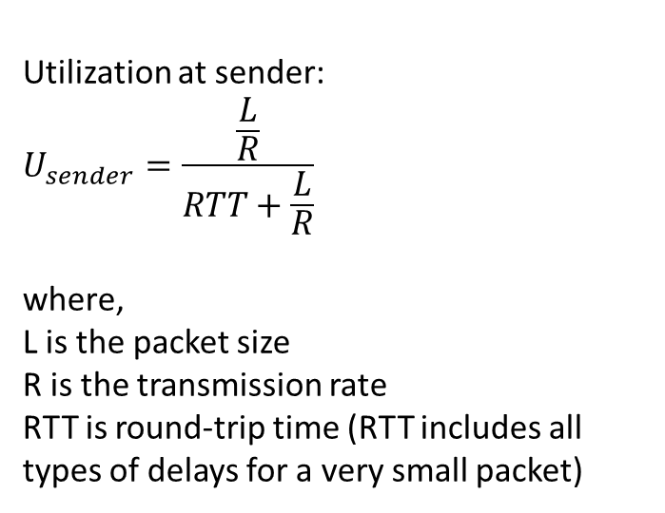
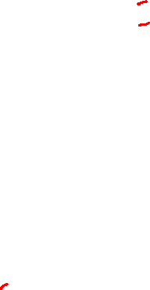
rdt3.0: stop-and-wait utilization
sender
receiver
first packet bit transmitted, t = 0
Utilization at sender:
$$U_{sender}=\frac{\frac{L}{R}}{RTT+\frac{L}{R}}$$
where,
L is the packet size
R is the transmission rate
RTT is round-trip time (RTT includes all types of delays for a very small packet)
first packet bit arrives
RTT
last packet bit arrives, send ACK
ACK arrives, send next
packet, t = RTT + L / R
Copyright © 2010-2025 J.F. Kurose, K.W. Ross

Slide 38
How can we improve the performance?

Slide 39
How can we improve the performance?
Pipelining
Send multiple packets instead of one without waiting for an acknowledgement

Slide 40
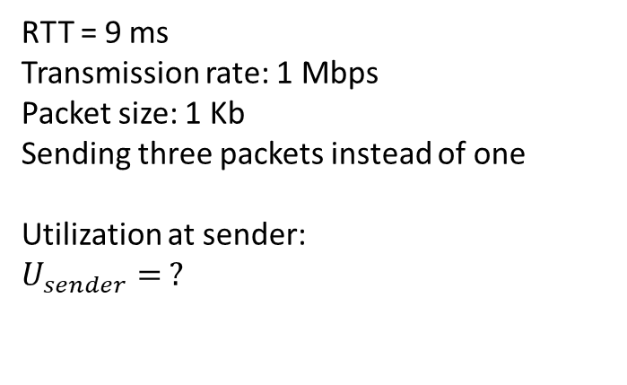
Pipelining
sender
receiver
first packet bit transmitted, t = 0
last bit transmitted, t = L / R
first packet bit arrives
RTT
last packet bit arrives, send ACK
last bit of 2nd packet arrives, send ACK
last bit of 3rd packet arrives, send ACK
RTT = 9 ms
Transmission rate: 1 Mbps
Packet size: 1 Kb
Sending three packets instead of one
Utilization at sender:
$$U_{sender}= ?$$
ACK arrives, send next
packet, t = RTT + L / R
Copyright © 2010-2025 J.F. Kurose, K.W. Ross

Slide 41
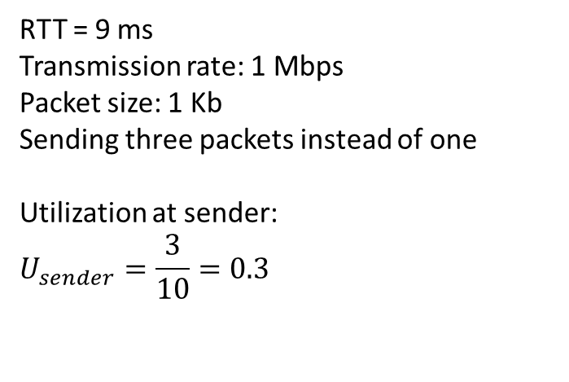
Pipelining
sender
receiver
first packet bit transmitted, t = 0
last bit transmitted, t = L / R
first packet bit arrives
RTT
last packet bit arrives, send ACK
last bit of 2nd packet arrives, send ACK
last bit of 3rd packet arrives, send ACK
RTT = 9 ms
Transmission rate: 1 Mbps
Packet size: 1 Kb
Sending three packets instead of one
Utilization at sender:
$$U_{sender}=\frac{3}{10}=0.3$$
ACK arrives, send next
packet, t = RTT + L / R
Copyright © 2010-2025 J.F. Kurose, K.W. Ross

Slide 42
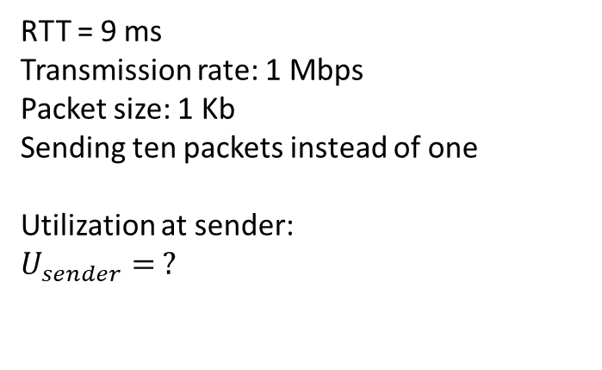
Pipelining
sender
receiver
first packet bit transmitted, t = 0
last bit transmitted, t = L / R
first packet bit arrives
RTT
last packet bit arrives, send ACK
last bit of 2nd packet arrives, send ACK
last bit of 3rd packet arrives, send ACK
RTT = 9 ms
Transmission rate: 1 Mbps
Packet size: 1 Kb
Sending ten packets instead of one
Utilization at sender:
$$U_{sender}= ?$$
ACK arrives, send next
packet, t = RTT + L / R
…
last bit of 10th packet arrives, send ACK
Copyright © 2010-2025 J.F. Kurose, K.W. Ross

Slide 43
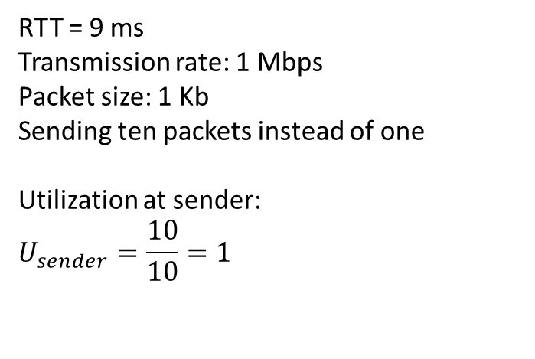
Pipelining
sender
receiver
first packet bit transmitted, t = 0
last bit transmitted, t = L / R
first packet bit arrives
RTT
last packet bit arrives, send ACK
last bit of 2nd packet arrives, send ACK
last bit of 3rd packet arrives, send ACK
RTT = 9 ms
Transmission rate: 1 Mbps
Packet size: 1 Kb
Sending ten packets instead of one
Utilization at sender:
$$U_{sender}=\frac{10}{10}=1$$
ACK arrives, send next
packet, t = RTT + L / R
last bit of 10th packet arrives, send ACK
Copyright © 2010-2025 J.F. Kurose, K.W. Ross

Slide 44
Utilization
The optimal number of packets (for best utilization) in the pipeline mode depends on the RTT and the transmission rate

Slide 45
Pipelining
How long does the sender need to keep a copy of a sent packet in stop-and-wait and pipeline mode?

Slide 46
Pipelining
How long does the sender need to keep a copy of a sent packet in stop-and-wait and pipeline mode?
Until the acknowledgement arrives
Is the memory overhead at the sender higher in the pipeline mode compared to the stop-and-wait mode?

Slide 47
Pipelining
How long does the sender need to keep a copy of a sent packet in stop-and-wait and pipeline mode?
Until the acknowledgement arrives
Is the memory overhead at the sender higher in the pipeline mode compared to the stop-and-wait mode?
Yes, because the kernel needs to keep a copy of all unacknowledged packets in transit, which is just one in the stop-and-wait mode
Therefore, for good performance, the total number of unacknowledged packets in the pipeline mode must fit in the sender’s queue

Slide 48
Pipelining
How can we implement pipelining?
How many packets should be allowed in the pipeline?
What information needs to be saved at the sender’s end?
What information needs to be saved at the receiver end?
What additional information needs to be added to the packets?
What is the format of acknowledgements?
How frequently does the receiver need to send the acknowledgements?

Slide 49
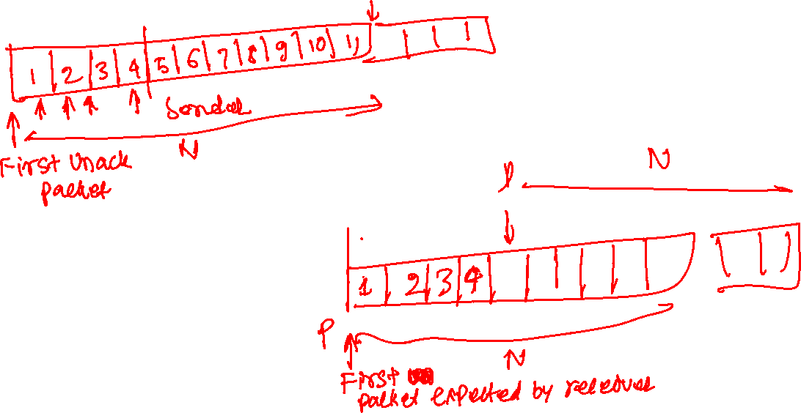
Pipelining (sender and receiver)

Slide 50
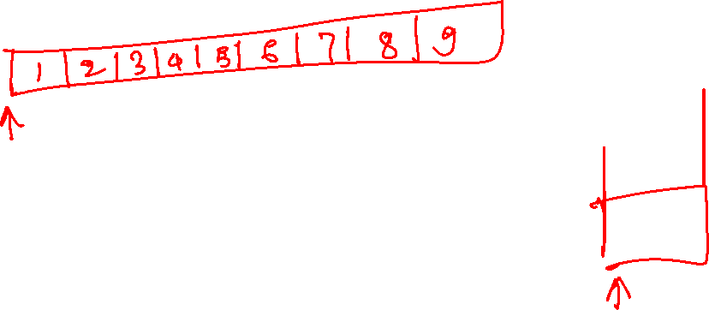
Go-Back-N
The Go-Back-N scheme allows at most N unacknowledged packets in the pipeline.

Slide 51
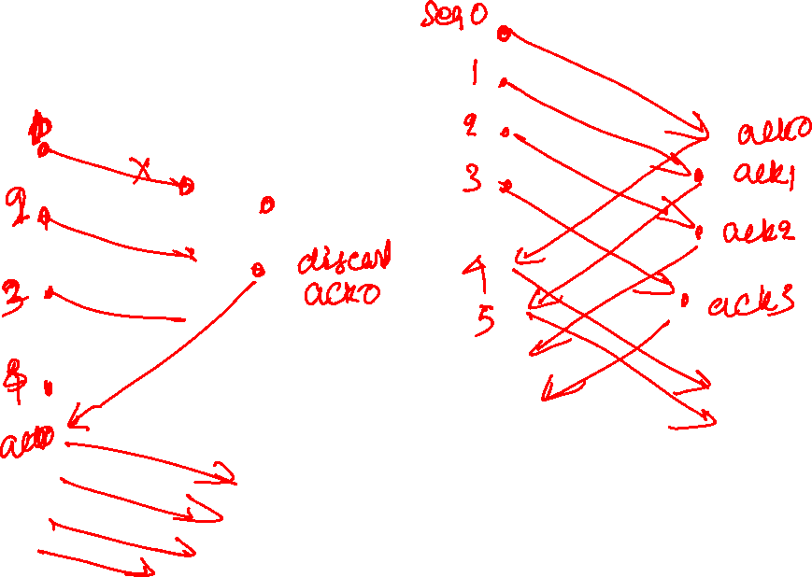
Go-Back-N

Slide 52
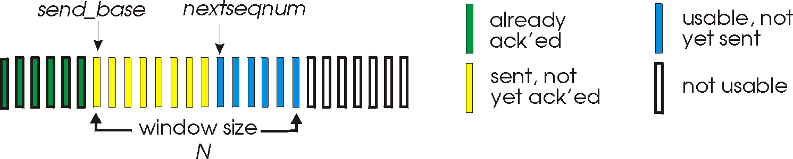
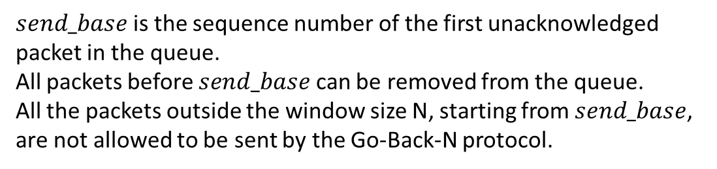
Go-Back-N
$send_base$is the sequence number of the first unacknowledged packet in the queue.
All packets before $send_base$can be removed from the queue.
All the packets outside the window size N, starting from $send_base$, are not allowed to be sent by the Go-Back-N protocol.
Copyright © 2010-2025 J.F. Kurose, K.W. Ross

Slide 53
Go-Back-N (GBN)
The maximum number of unacknowledged packets in GBN is called the window size
The GBN protocol is also an example of a sliding-window protocol

Slide 54
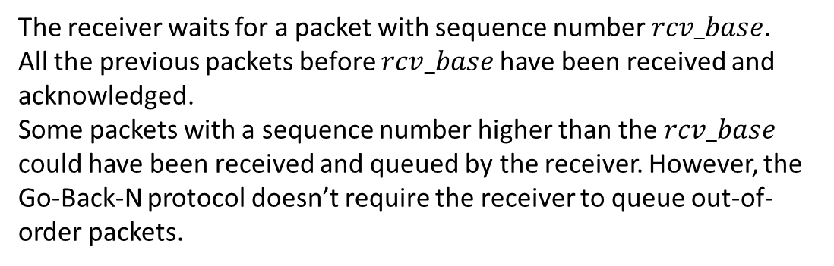
Go-Back-N
The receiver waits for a packet with sequence number $rcv_base$.
All the previous packets before $rcv_base$have been received and acknowledged.
Some packets with a sequence number higher than the $rcv_base$ could have been received and queued by the receiver. However, the Go-Back-N protocol doesn’t require the receiver to queue out-of-order packets.
Receiver view of sequence number space:
received and ACKed
…
…
Out-of-order: received but not ACKed
rcv_base
Not received
Copyright © 2010-2025 J.F. Kurose, K.W. Ross

Slide 55

GBN Sender
Initialization
$nextseqnum$ is set to the first available sequence number, i.e., 1
$send_base$is set to the first unacknowledged sequence number, i.e., 1
The sender window is empty when $send_base == nextseqnum$
Maximum window size is $N$

Slide 56
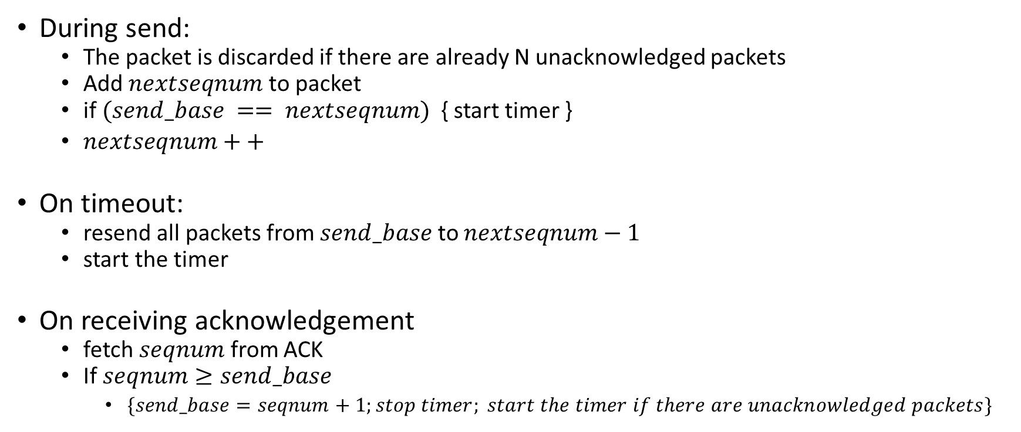
GBN Sender
During send:
The packet is discarded if there are already N unacknowledged packets
Add $nextseqnum$ to packet
if $(send_base == nextseqnum)$ { start timer }
$nextseqnum++$
On timeout:
resend all packets from $send_base$ to $nextseqnum−1$
start the timer
On receiving acknowledgement
fetch $seqnum$ from ACK
If $seqnum≥send_base$
$\{send_base=seqnum+1;stop timer; start the timer if there are unacknowledged packets\}$

Slide 57
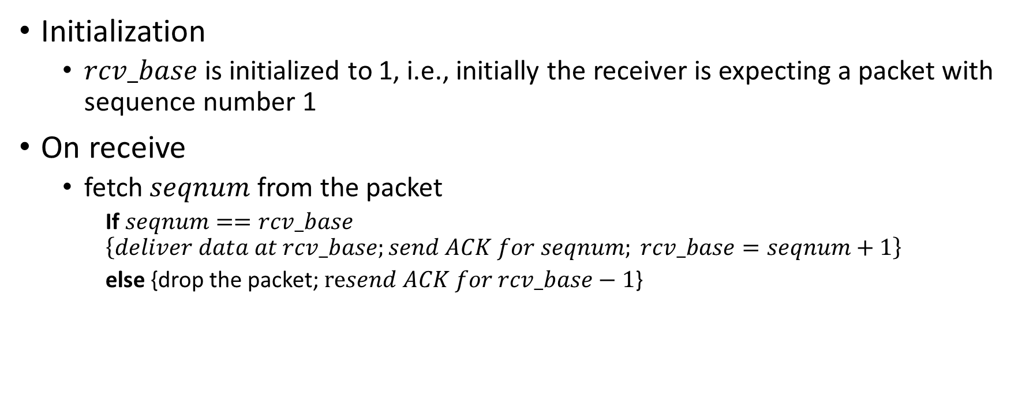
GBN Receiver
Initialization
$rcv_base$is initialized to 1, i.e., initially the receiver is expecting a packet with sequence number 1
On receive
fetch $seqnum$ from the packet
If $seqnum==rcv_base$ $\left\{deliver data at rcv_base;send ACK for seqnum; rcv_base=seqnum+1\right\}$
else {drop the packet; $resend ACK for rcv_base−1$}

Slide 58
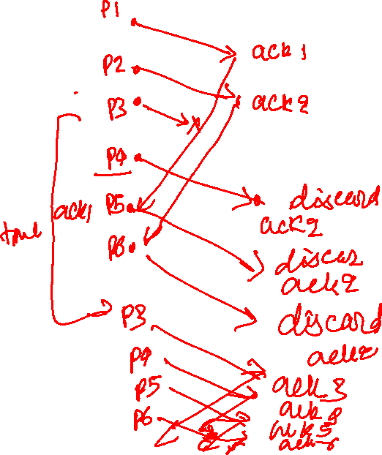
GBN in action
window size=4
The third packet is lost

Slide 59
GBN in action
sender window (N=4)
sender
receiver
0 1 2 3 4 5 6 7 8
send pkt0
send pkt1
send pkt2
send pkt3
(wait)
0 1 2 3 4 5 6 7 8
receive pkt0, send ack0
receive pkt1, send ack1
receive pkt3, discard,
(re)send ack1
0 1 2 3 4 5 6 7 8
X
0 1 2 3 4 5 6 7 8
loss
0 1 2 3 4 5 6 7 8
rcv ack0, send pkt4
0 1 2 3 4 5 6 7 8
rcv ack1, send pkt5
receive pkt4, discard,
(re)send ack1
ignore duplicate ACK
receive pkt5, discard,
(re)send ack1
pkt 2 timeout
0 1 2 3 4 5 6 7 8
send pkt2
send pkt3
send pkt4
send pkt5
0 1 2 3 4 5 6 7 8
0 1 2 3 4 5 6 7 8
rcv pkt2, deliver, send ack2
rcv pkt3, deliver, send ack3
rcv pkt4, deliver, send ack4
rcv pkt5, deliver, send ack5
0 1 2 3 4 5 6 7 8
Copyright © 2010-2025 J.F. Kurose, K.W. Ross

Slide 60
Finite state machine
For variable initialization, we add an action that is not preceded by any event
The initialization action is taken when the execution reaches a particular state for the first time

Slide 61
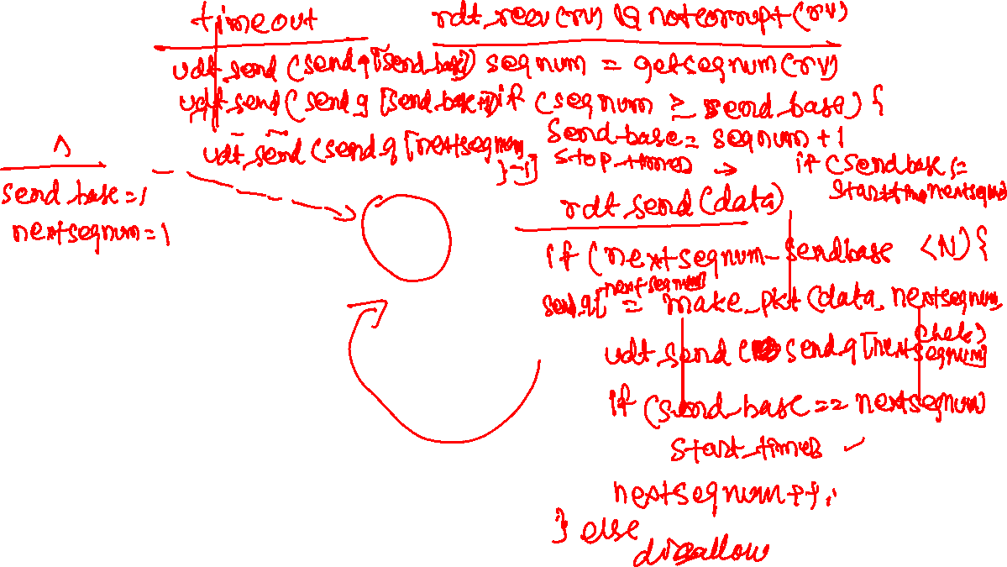

Slide 62


GBN sender (FSM)
rdt_rcv(rcvpkt) && notcorrupt(rcvpkt)
ackseqno = getackseqnum(rcvpkt)
if (ackseqno >= send_base) {
send_base = ackseqno + 1
stop_timer
if (nextseqno != send_base)
start_timer
}
sender
$$∧$$
send_base = 1
nextseqnum = 1
timeout
Wait for call from below
start_timer
udt_send(sndpkt[base])
udt_send(sndpkt[base+1])
…
udt_send(sndpkt[nextseqnum-1])
rdt_rcv(rcvpkt) && corrupt(rcvpkt)
$$∧$$
rdt_send(data)
if (nextseqnum<send_base+N) {
sndpkt[nextseqnum] = make_pkt(data, csum, nextseqnum)
udt_send(sndpkt[nextseqnum])
if (send_base == nextseqnum)
start_timer
nextseqnum++
} else
refuse_data(data)
Copyright © 2010-2025 J.F. Kurose, K.W. Ross

Slide 63

GBN receiver (FSM)
rdt_rcv(rcvpkt) && (corrupt(rcvpkt) || ! hasseqnum(rcvpkt, rcv_base))
udt_send(sendpkt)
$$∧$$
rcv_base = 1
Wait for call from below
receiver
rdt_rcv(rcvpkt) && notcorrupt(rcvpkt) && hasseqnum(rcvpkt, rcv_base)
data = extract(rcvpkt)
deliver(data)
sendpkt = make_pkt(rcv_base, ACK, chksum)
udt_send(sendpkt)
rcv_base++
Copyright © 2010-2025 J.F. Kurose, K.W. Ross

