Slide 2
Today’s topics
Homework
TCP
MSS and MTU
Estimated RTT and Timeout

Slide 3
References
Read Chapter-3.5.1, 3.5.2, 3.5.3, 3.5.4 from the Kurose and Ross book

Slide 4
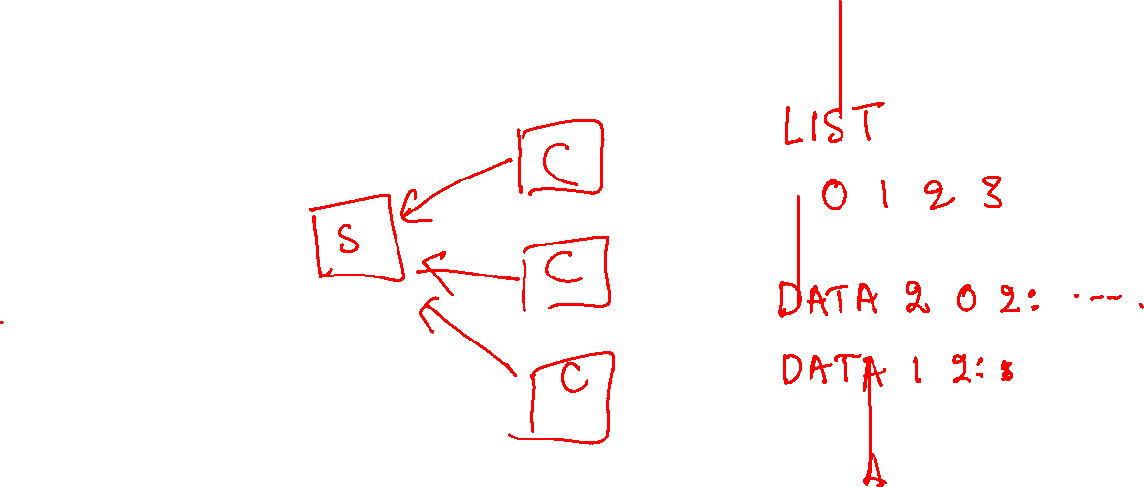
Homework

Slide 5
TCP (transmission control protocol)
TCP guarantees reliable, in-order delivery of a stream of bytes
Full-duplex protocol
Each TCP connection supports a pair of byte streams, corresponding to both directions
Flow-control mechanism
The receiver can limit how much data the sender can transmit
Allows multiple applications on a single host
Allow congestion control
Keep the sender from overloading the core network

Slide 6
TCP
TCP connections are always point-to-point
i.e., between two communicating hosts
TCP encapsulates application data into a segment
Segment contains TCP header in addition to payload

Slide 7
TCP
TCP is a connection-oriented protocol
Two communicating end-hosts must establish a TCP connection (using socket, bind, listen, accept, connect system calls) before data can be exchanged
After establishing the connection, a TCP application can send or receive data using the socket, without verifying the identity of the other end-host
why?

Slide 8
TCP
TCP is a connection-oriented protocol
Two communicating end-hosts must establish a TCP connection (using socket, bind, listen, accept, connect system calls) before data can be exchanged
After establishing the connection, a TCP application can send or receive data using the socket, without verifying the identity of the other end-host
why?
Because each TCP socket is bound to a particular connection. If the data is received on a socket, the receiver knows that it’s the same client that established the connection

Slide 9
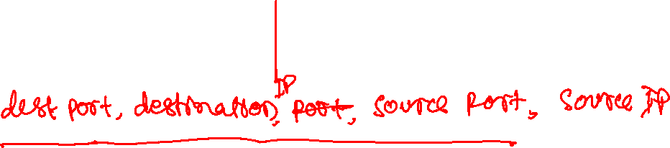
TCP
On receiving a packet, what information does the transport layer use to deliver a TCP packet to its destination socket?

Slide 10
TCP
On receiving a packet, what information does the transport layer use to deliver a TCP packet to its destination socket?
source port, source IP, destination port, destination IP
why?

Slide 11
TCP
On receiving a packet, what information does the transport layer use to deliver a TCP packet to its destination socket?
source port, source IP, destination port, destination IP
why?
because a TCP socket is used to receive data from one particular end-host that established the TCP connection. A TCP server listening to a particular IP and the source port can establish connections with many clients. To deliver a packet to the correct socket at the server, the source IP and source port are needed.
In contrast, what information does the UDP protocol need to deliver a packet to its destination socket on receiving a packet?

Slide 12
TCP
On receiving a packet, what information does the transport layer use to deliver a TCP packet to its destination socket?
source port, source IP, destination port, destination IP
why?
because a TCP socket is used to receive data from one particular end-host that established the TCP connection. A TCP server listening to a particular IP and the source port can establish connections with many clients. To deliver a packet to the correct socket at the server, the source IP and source port are needed.
In contrast, what information does the UDP protocol need to deliver a packet to its destination socket on receiving a packet?
Only the destination port and the destination IP
why?

Slide 13
TCP
On receiving a packet, what information does the transport layer use to deliver a TCP packet to its destination socket?
source port, source IP, destination port, destination IP
why?
because a TCP socket is used to receive data from one particular end-host that established the TCP connection. A TCP server listening to a particular IP and the source port can establish connections with many clients. To deliver a packet to the correct socket at the server, the source IP and source port are needed.
In contrast, what information does the UDP protocol need to deliver a packet to its destination socket on receiving a packet?
Only the destination port and the destination IP
why?
Because a UDP connection is stateless. Anyone can send a packet to a UDP receiver

Slide 14
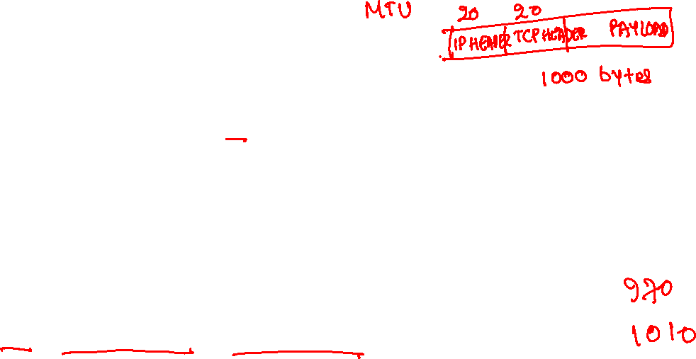
MSS and MTU
Maximum segment size (MSS) is the maximum amount of data that can be encapsulated in a segment
Maximum transmission unit (MTU) is the maximum length of a network layer packet a host or gateway can send, i.e., the maximum packet size supported by the NIC (excluding the Ethernet header)
What would be a good value for MSS?
MTU – TCP_HEADER_SIZE – IP_HEADER_SIZE
Should we pick the MTU of the sender?

Slide 15
TCP
MSS can be computed using the MTU at the communicating hosts as well as the MTU at the intermediate gateways
We can pick the minimum MTU among both hosts and intermediate gateways
What will happen if we pick MSS larger than MTU?

Slide 16
TCP
MSS can be computed using the MTU at the communicating hosts as well as the MTU at the intermediate gateways
We can pick the minimum MTU among both hosts and intermediate gateways
What will happen if we pick MSS larger than MTU?
The IP layer will fragment the packets into smaller sizes
However, it could cause performance issues
Better to compute the minimum MTU along the path

Slide 17
IP fragmentation
Why is IP layer fragmentation more costly than multiple segments at the TCP layer?

Slide 18
IP fragmentation
Why is IP layer fragmentation more costly than multiple segments at the TCP layer?
IP layer fragmentation may happen on gateways, which requires additional computation at these performance-critical nodes in the network core

Slide 19
MSS?
A
G1
G2
G3
B
MTU = 1000
MTU = 700
MTU = 800
MTU = 500
MTU = 600
MSS = ?
IP HEADER SIZE = 20 bytes
TCP HEADER SIZE = 20 bytes
ETHERNET HEADER SIZE = 14 bytes
PSEUDO IP HEADER SIZE = 12 bytes
What would be an ideal MSS size?

Slide 20
MSS?
A
G1
G2
G3
B
MTU = 1000
MTU = 700
MTU = 800
MTU = 500
MTU = 600
MSS = 460
IP HEADER SIZE = 20 bytes
TCP HEADER SIZE = 20 bytes
ETHERNET HEADER SIZE = 14 bytes
PSEUDO IP HEADER SIZE = 12 bytes
What would be an ideal MSS size?

Slide 21
TCP
TCP uses buffers at both the sender and receiver, much like the selective repeat protocol
However, the acknowledgments are sent in the GO-Back-N way
TCP protocol can buffer out-of-order packets at the receiving host; however, it’s not strictly required by the protocol
Almost all modern implementations of TCP buffer out-of-order packets, and we are going to follow one such implementation in the lectures

Slide 22
TCP
Instead of a sequence number for every packet, TCP uses a sequence number for every byte
The sequence number in the packet contains the sequence number of the first byte in the packet
The acknowledgment contains the sequence number of the byte that is expected by the receiver

Slide 23
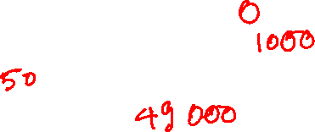
TCP sequence numbers
Let’s say a host A wants to send a file of 50,000 bytes, and the MSS is 1000
Assuming the starting sequence number is zero
What would be the sequence number of the first segment
What would be the sequence number of the second segment
What is the total number of segments
What is the sequence number of the last segment

Slide 24
TCP sequence numbers
Let’s say a host A wants to send a file of 50,000 bytes, and the MSS is 1000
Assuming the starting sequence number is zero
What would be the sequence number of the first segment
0
What would be the sequence number of the second segment
1000
What is the total number of segments
50
What is the sequence number of the last segment
49000

Slide 25
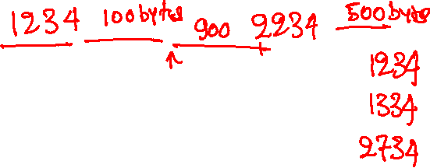
TCP acknowledgments
Let’s say a receiver B is expecting to receive a segment with sequence number 1234, but it received a segment with 500 bytes of data and the sequence number 2234. What should be the sequence number in the acknowledgement?
The next packet received is a segment with 100 bytes of data and the sequence number 1234. What should be the sequence number in the acknowledgement?
The next packet received is a segment with 900 bytes of data and the sequence number 1334. What would be the sequence number in the acknowledgement?

Slide 26
TCP acknowledgments
Let’s say a receiver B is expecting to receive a segment with sequence number 1234, but it received a segment with 500 bytes of data and the sequence number 2234. What should be the sequence number in the acknowledgement?
1234
The next packet received is a segment with 100 bytes of data and the sequence number 1234. What should be the sequence number in the acknowledgement?
1334
The next packet received is a segment with 900 bytes of data and the sequence number 1334. What would be the sequence number in the acknowledgement?
2734

Slide 27
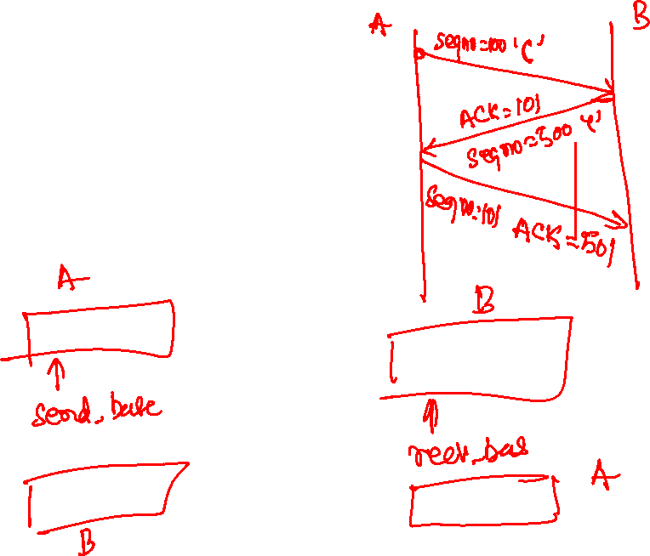
Telnet example
A sends character ‘C’
B replies with character ‘C’
A sends acknowledgment

Slide 28

Telnet example
Host B
User types‘C’
Seq=42, ACK=79, data = ‘C’
host ACKs receipt of‘C’, echoes back ‘C’
Seq=79, ACK=43, data = ‘C’
host ACKs receipt of echoed ‘C’
Seq=43, ACK=80
simple telnet scenario
Copyright © 2010-2025 J.F. Kurose, K.W. Ross

Slide 29
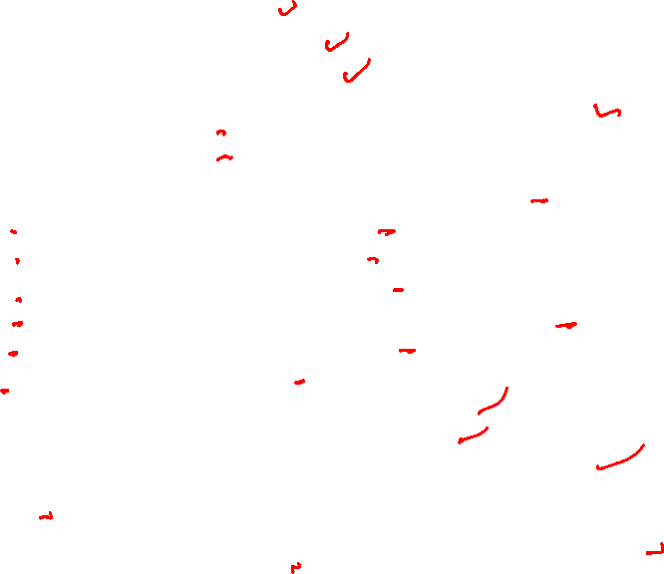
TCP header
struct tcphdr { __be16 source; // source port __be16 dest; // destination port __be32 seq; // sequence number __be32 ack_seq; // acknowledgement sequence number __u16 ae:1; // unused __u16 res1:1; // unused __u16 doff:4; // Length of TCP header = doff * 4 __u16 fin:1; // connection teardown __u16 syn:1; // connection setup __u16 rst:1; // connection teardown __u16 psh:1; // immediate pass data to application __u16 ack:1; // acknowledgment valid __u16 urg:1; // data is urgent __u16 ece:1; // used for congestion control __u16 cwr:1; // used for congestion control __be16 window; // receive window used for flow control __sum16 check; // checksum of TCP header, data, part of IP header __be16 urg_ptr; // the location of the last byte of urgent data char options[]; // variable length };

Slide 30
Estimating round-trip time
RTT is not fixed. It depends on the current load at the network core.
Correct estimation of RTT is important for retransmission.
Early retransmission wastes network resources
Late retransmission hurts performance
Therefore, a moving average called EstimatedRTT and RTT variation called DevRTT are used to compute the timeout interval

Slide 31
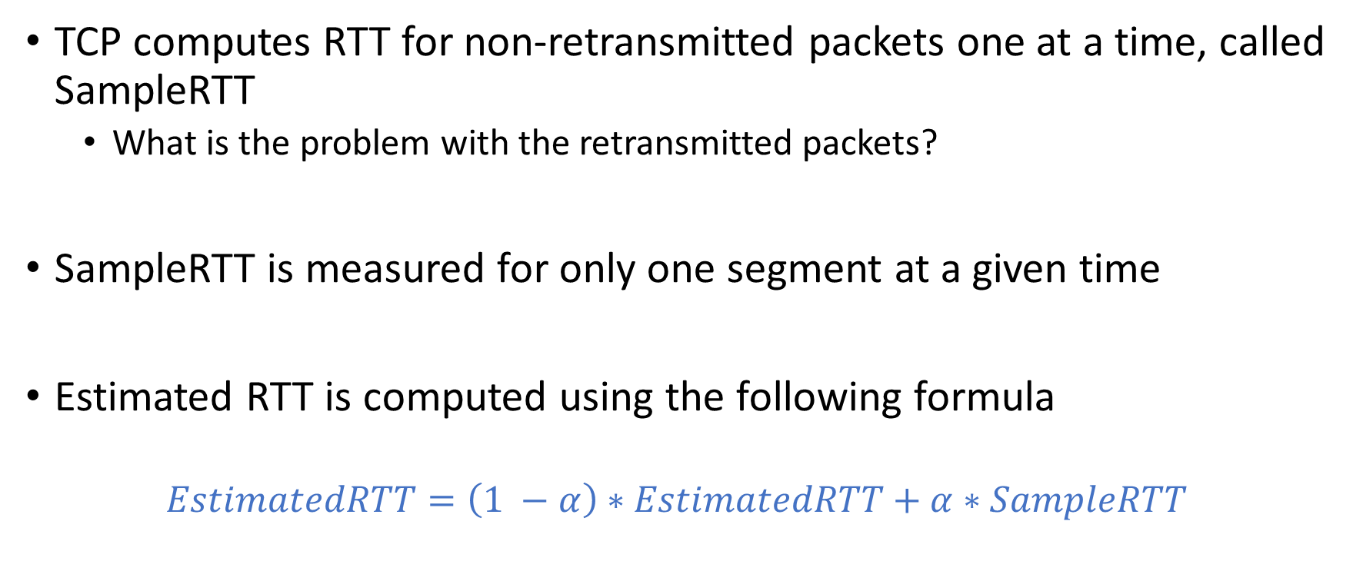
Estimated RTT
TCP computes RTT for non-retransmitted packets one at a time, called SampleRTT
What is the problem with the retransmitted packets?
SampleRTT is measured for only one segment at a given time
Estimated RTT is computed using the following formula
$$EstimatedRTT=\left(1 −α\right)∗EstimatedRTT+α∗SampleRTT$$

Slide 32
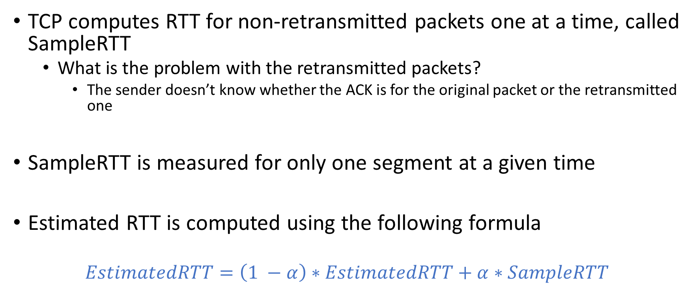
Estimated RTT
TCP computes RTT for non-retransmitted packets one at a time, called SampleRTT
What is the problem with the retransmitted packets?
The sender doesn’t know whether the ACK is for the original packet or the retransmitted one
SampleRTT is measured for only one segment at a given time
Estimated RTT is computed using the following formula
$$EstimatedRTT=\left(1 −α\right)∗EstimatedRTT+α∗SampleRTT$$

Slide 33

Estimated RTT
$$EstimatedRTT=\left(1 −α\right)∗EstimatedRTT+α∗SampleRTT$$
Estimated RTT is also called an exponential weighted moving average because the weight of a given SampleRTT decays exponentially

Slide 34
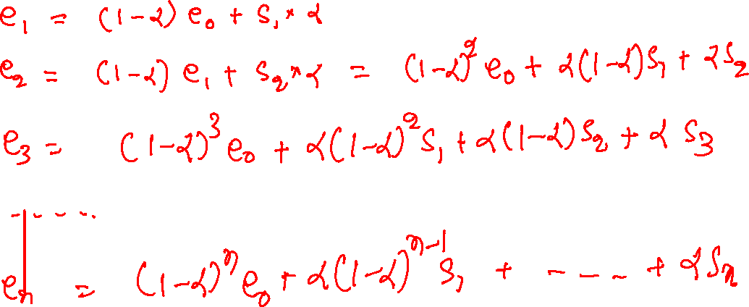
Estimated RTT

Slide 35
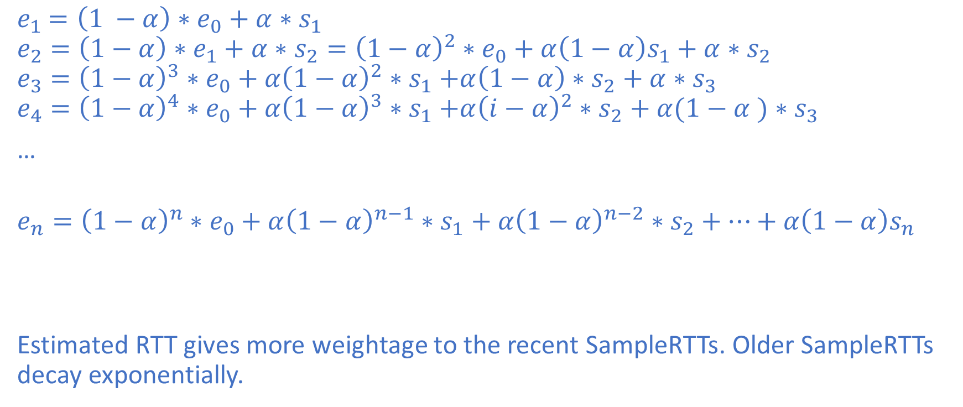
Estimated RTT
$e_{1}$ $=\left(1 −α\right)∗e_{0}+α∗s_{1}$
$$e_{2}=\left(1−α\right)∗e_{1}+α∗s_{2}={\left(1−α\right)}^{2}∗e_{0}+α\left(1−α\right)s_{1}+α∗s_{2}$$
$$e_{3}={\left(1−α\right)}^{3}∗e_{0}+α{\left(1−α\right)}^{2}{∗s}_{1}+α\left(1−α\right)∗s_{2}+α∗s_{3}$$
$$e_{4}={\left(1−α\right)}^{4}∗e_{0}+α{\left(1−α\right)}^{3}{∗s}_{1}+α{\left(i−α\right)}^{2}∗s_{2}+α(1−α )∗s_{3}$$
…
$$e_{n}={\left(1−α\right)}^{n}∗e_{0}+α{\left(1−α\right)}^{n−1}∗s_{1}+α{\left(1−α\right)}^{n−2}∗s_{2}+…+α\left(1−α\right)s_{n}$$
Estimated RTT gives more weightage to the recent SampleRTTs. Older SampleRTTs decay exponentially.

Slide 36

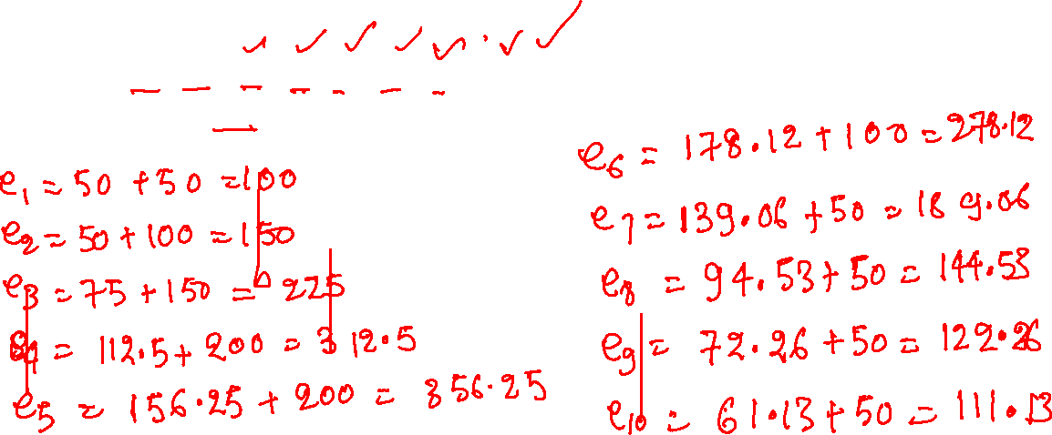
Estimated RTT
$α$ = 0.5
SampleRTTs = 100, 200, 300, 400, 400, 200, 100, 100, 100, 100
Initial estimated RTT = 100

Slide 37
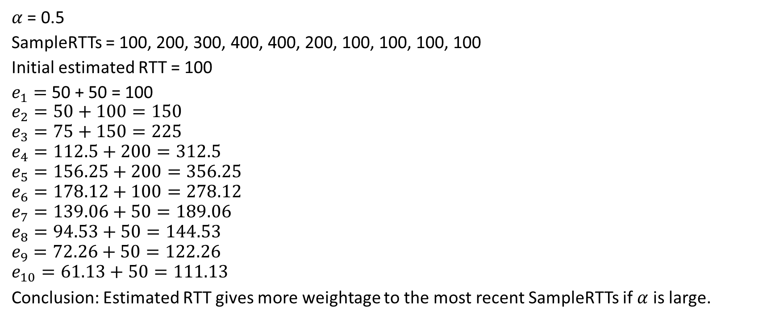
Estimated RTT
$α$ = 0.5
SampleRTTs = 100, 200, 300, 400, 400, 200, 100, 100, 100, 100
Initial estimated RTT = 100
$e_{1}=$ 50 + 50 = 100
$$e_{2}=50+100=150$$
$$e_{3}=75+150=225$$
$$e_{4}=112.5+200=312.5$$
$$e_{5}=156.25+200=356.25$$
$$e_{6}=178.12+100=278.12$$
$$e_{7}=139.06+50=189.06$$
$$e_{8}=94.53+50=144.53$$
$$e_{9}=72.26+50=122.26$$
$$e_{10}=61.13+50=111.13$$
Conclusion: Estimated RTT gives more weightage to the most recent SampleRTTs if $α$ is large.

Slide 38


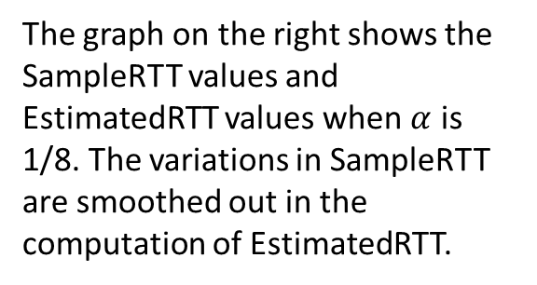
Estimated RTT
$EstimatedRTT=\left(1 −α\right)∗EstimatedRTT+α∗SampleRTT$
Typical value of $α$ is 0.125 which works well in practice
The graph on the right shows the SampleRTT values and EstimatedRTT values when $α$ is 1/8. The variations in SampleRTT are smoothed out in the computation of EstimatedRTT.
RTT: gaia.cs.umass.edu to fantasia.eurecom.fr
RTT (milliseconds)
SampleRTT
EstimatedRTT
Copyright © 2010-2025 J.F. Kurose, K.W. Ross
time (seconds)

Slide 39
Timeout
If there is too much variance in the SampleRTT then estimated RTT alone might not be sufficient to obtain a good timeout value
DevRTT estimates how much SampleRTT deviates from the EstimatedRTT
DevRTT is also computed as exponential weighted moving average

Slide 40

DevRTT
$$DevRTT=\left(1−β\right)∗DevRTT+β∗|EstimatedRTT −SampleRTT|$$
If the SampleRTT has little fluctuation, the value of DevRTT will be small.

Slide 41
TimeoutInterval
Should TimeoutInterval be equal to EstimatedRTT?

Slide 42
TimeoutInterval
Should TimeoutInterval be equal to EstimatedRTT?
It should be slightly more than EstimatedRTT
What should be an ideal margin?
If the fluctuations between SampleRTTs are high
If SampleRTTs doesn’t fluctuate much
What is the indicator of high fluctuation?

Slide 43
TimeoutInterval
Should TimeoutInterval be equal to EstimatedRTT?
It should be slightly more than EstimatedRTT
What should be an ideal margin?
If the fluctuations between SampleRTTs are high
High
If SampleRTTs doesn’t fluctuate much
Low
What is the indicator of high fluctuation?
DevRTT

Slide 44

TimeoutInterval
The TimeoutInterval is computed using the following formula
$$TimeoutInterval=EstimatedRTT+4 ∗DevRTT$$

Slide 45
TCP
TCP acknowledgments are similar to Go-Back-N, i.e, the acknowledgments are cumulative, but the acknowledgment contains the next expected sequence number instead of the last received sequence number
TCP buffers packets similar to Selective-Repeat
The retransmission is done for the first unacknowledged packet, instead of all unacknowledged packets as in Go-Back-N

Slide 46
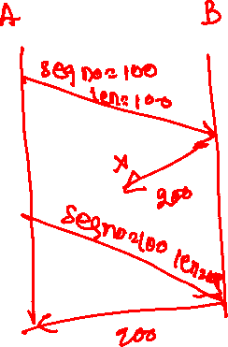
TCP retransmission scenarios
Lost ACK

Slide 47
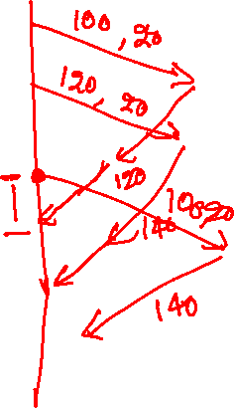
TCP retransmission scenarios
Premature Timeout

Slide 48
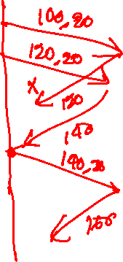
TCP retransmission scenarios
Cumulative ACK covers lost ACK

Slide 49
TCP: retransmission scenarios
Host A
Host B
Host A
Host B
SendBase=92
Seq=92, 8 bytes of data
Seq=92, 8 bytes of data
timeout
timeout
Seq=100, 20 bytes of data
ACK=100
X
ACK=100
ACK=120
Seq=92, 8 bytes of data
Seq=92, 8
bytes of data
SendBase=100
send cumulative
ACK for 120
SendBase=120
ACK=100
ACK=120
SendBase=120
lost ACK scenario
premature timeout
Copyright © 2010-2025 J.F. Kurose, K.W. Ross
Notes:
To cement our understanding of TCP reliability, let’s look a a few retransmission scenarios
In the first case a TCP segments is transmitted and the ACK is lost, and the TCP timeout mechanism results in another copy of being transmitted and then re-ACKed a the sender
In the second example two segments are sent and acknowledged, but there is a premature timeout e for the first segment, which is retransmitted. Note that when this retransmitted segment is received, the receiver has already received the first two segments, and so resends a cumulative ACK for both segments received so far, rather than an ACK for just this fist segment.

Slide 50
TCP: retransmission scenarios
Host A
Host B
Seq=92, 8 bytes of data
Seq=100, 20 bytes of data
ACK=100
X
ACK=120
What would be the sequence number in the last ACK?
Seq=120, 15 bytes of data
cumulative ACK covers for earlier lost ACK
Copyright © 2010-2025 J.F. Kurose, K.W. Ross
Notes:
And in this last example, two segments are again transmitted, the first ACK is lost but the second ACK, a cumulative ACK arrives at the sender, which then can transmit a third segment, knowing that the first two have arrived, even though the ACK for the first segment was lost

