Slide 2
Today’s topics
TCP
TCP FSM
Fast retransmit
RDT assignment

Slide 3
References
Read Chapter-3.5.4, 3.5.5, 3.5.6 from the Kurose and Ross book
Read Chapter-5.2.4 from Peterson and Davie

Slide 4
TCP
TCP acknowledgments are similar to Go-Back-N, i.e, the acknowledgments are cumulative, but the acknowledgment contains the next expected sequence number instead of the last received sequence number
TCP buffers packets similar to Selective-Repeat
The retransmission is done for the first unacknowledged packet, instead of all unacknowledged packets as in Go-Back-N

Slide 5
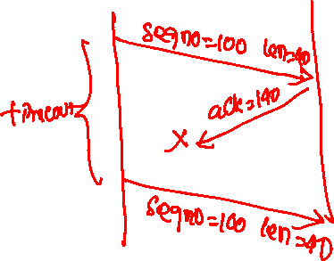
TCP retransmission scenarios
Lost ACK

Slide 6
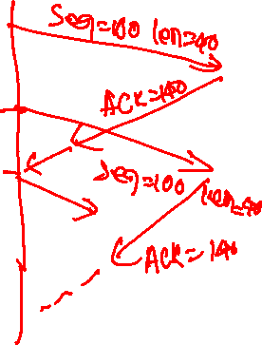
TCP retransmission scenarios
Premature Timeout

Slide 7
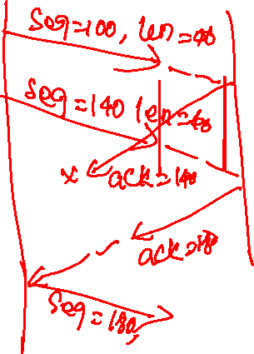
TCP retransmission scenarios
Cumulative ACK covers lost ACK

Slide 8

TCP: retransmission scenarios
Host A
Host B
Host A
Host B
SendBase=92
Seq=92, 8 bytes of data
Seq=92, 8 bytes of data
timeout
timeout
Seq=100, 20 bytes of data
ACK=100
X
ACK=100
ACK=120
Seq=92, 8 bytes of data
Seq=92, 8
bytes of data
SendBase=100
send cumulative
ACK for 120
SendBase=120
ACK=100
ACK=120
SendBase=120
lost ACK scenario
premature timeout
Copyright © 2010-2025 J.F. Kurose, K.W. Ross
Notes:
To cement our understanding of TCP reliability, let’s look a a few retransmission scenarios
In the first case a TCP segments is transmitted and the ACK is lost, and the TCP timeout mechanism results in another copy of being transmitted and then re-ACKed a the sender
In the second example two segments are sent and acknowledged, but there is a premature timeout e for the first segment, which is retransmitted. Note that when this retransmitted segment is received, the receiver has already received the first two segments, and so resends a cumulative ACK for both segments received so far, rather than an ACK for just this fist segment.

Slide 9
TCP: retransmission scenarios
Host A
Host B
Seq=92, 8 bytes of data
Seq=100, 20 bytes of data
ACK=100
X
ACK=120
What would be the sequence number in the last ACK?
Seq=120, 15 bytes of data
cumulative ACK covers for earlier lost ACK
Copyright © 2010-2025 J.F. Kurose, K.W. Ross
Notes:
And in this last example, two segments are again transmitted, the first ACK is lost but the second ACK, a cumulative ACK arrives at the sender, which then can transmit a third segment, knowing that the first two have arrived, even though the ACK for the first segment was lost

Slide 10
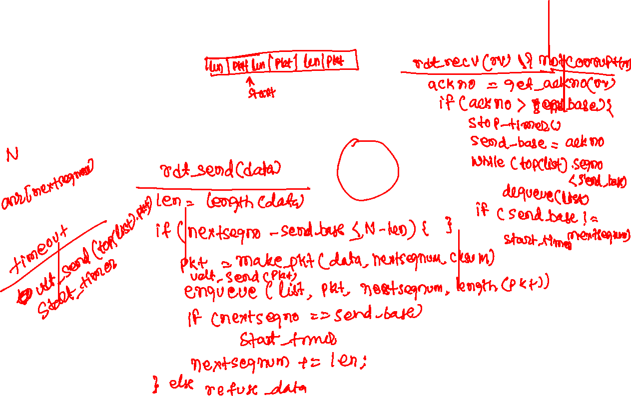
TCP sender (FSM)

Slide 11
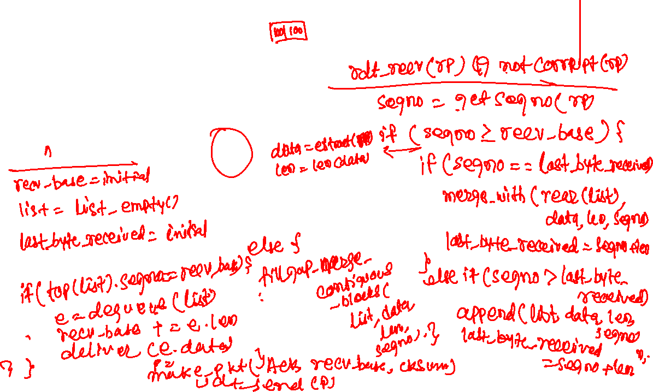
TCP receiver (FSM)

Slide 12


TCP sender (FSM)
rdt_rcv(rcvpkt) && notcorrupt(rcvpkt)
ackseqno = getackseqnum(rcvpkt)
if (ackseqno > send_base) {
stop_timer()
send_base = ackseqno
if (send_base != nextseqnum) {
start_timer()
while (top(list).seqnum < send_base)
dequeue(list)
} else
dequeue_all(list)
}
$$∧$$
send_base = initial_val
nextseqnum = initial_val
list = empty_list()
sender
rdt_send(data)
timeout
len = length(data)
// assuming no packet splitting
if (nextseqnum – send_base <= N - len) {
pkt = make_pkt(data, csum, nextseqnum)
udt_send(pkt)
enqueue(list, pkt, nextseqnum, length(pkt))
if (send_base == nextseqnum)
start_timer()
nextseqnum += len
} else
refuse_data(data)
Wait for call from below
udt_send(top(list).pkt)
start_timer()
rdt_rcv(rcvpkt) && corrupt(rcvpkt)
$$∧$$
Copyright © 2010-2025 J.F. Kurose, K.W. Ross

Slide 13


TCP Receiver (FSM)
rdt_rcv(rcvpkt) && corrupt(rcvpkt)
$$∧$$
$$∧$$
rcv_base = initial_val
last_byte_received = initial_val
list = empty_list()
Wait for call from below
receiver
rdt_rcv(rcvpkt) && notcorrupt(rcvpkt)
seqnum = getseqnum(recvpkt)
if (seqnum >= rcv_base) {
data = extract(rcvpkt)
len = length(data)
if (seqnum >= last_byte_received) {
merge_or_append_list_last_elem(list, data, len)
last_byte_received = seqnum + len
} else
fill_gap_and_merge_contiguous_blocks(list, data, len, seqnum)
if (top(list)->seqnum == rcv_base) {
e = dequeue(list) // remove and return front element
deliver(e.data, e.len)
rcv_base = e.seqnum+e.len
}
}
pkt = make_pkt(ACK, rcv_base, checksum)
udt_send(pkt)
Copyright © 2010-2025 J.F. Kurose, K.W. Ross

Slide 14
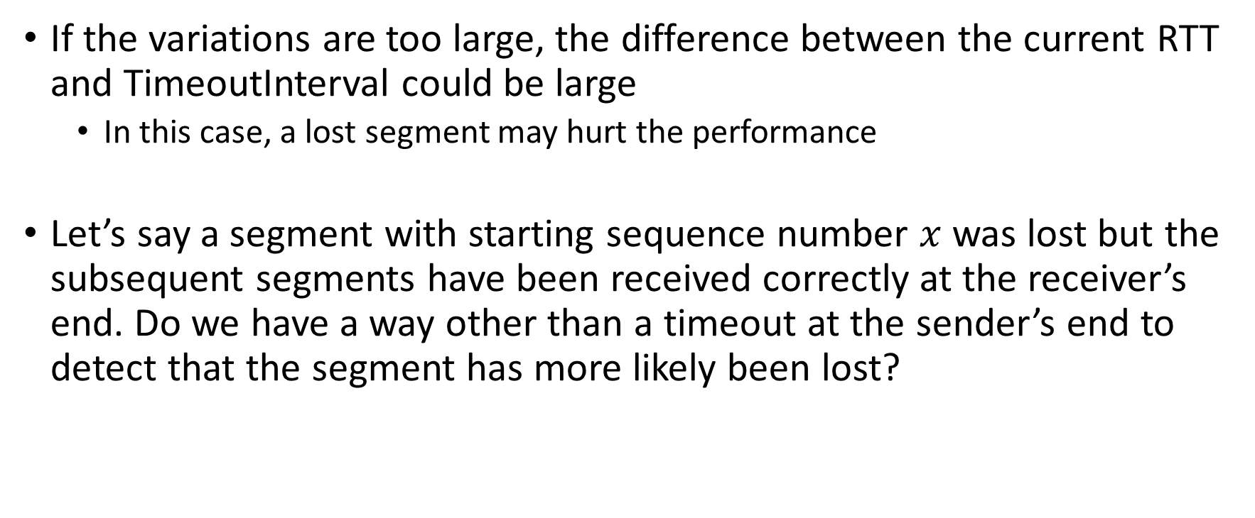
Retransmission
If the variations are too large, the difference between the current RTT and TimeoutInterval could be large
In this case, a lost segment may hurt the performance
Let’s say a segment with starting sequence number $x$ was lost but the subsequent segments have been received correctly at the receiver’s end. Do we have a way other than a timeout at the sender’s end to detect that the segment has more likely been lost?

Slide 15
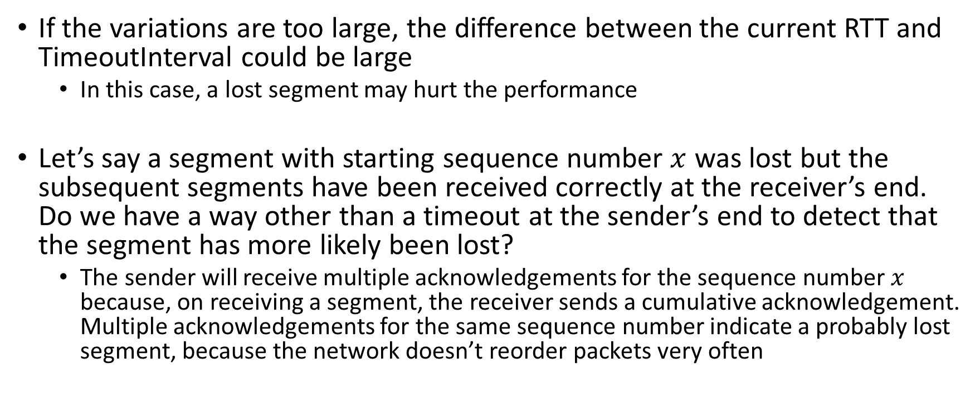
Retransmission
If the variations are too large, the difference between the current RTT and TimeoutInterval could be large
In this case, a lost segment may hurt the performance
Let’s say a segment with starting sequence number $x$ was lost but the subsequent segments have been received correctly at the receiver’s end. Do we have a way other than a timeout at the sender’s end to detect that the segment has more likely been lost?
The sender will receive multiple acknowledgements for the sequence number $x$ because, on receiving a segment, the receiver sends a cumulative acknowledgement. Multiple acknowledgements for the same sequence number indicate a probably lost segment, because the network doesn’t reorder packets very often

Slide 16
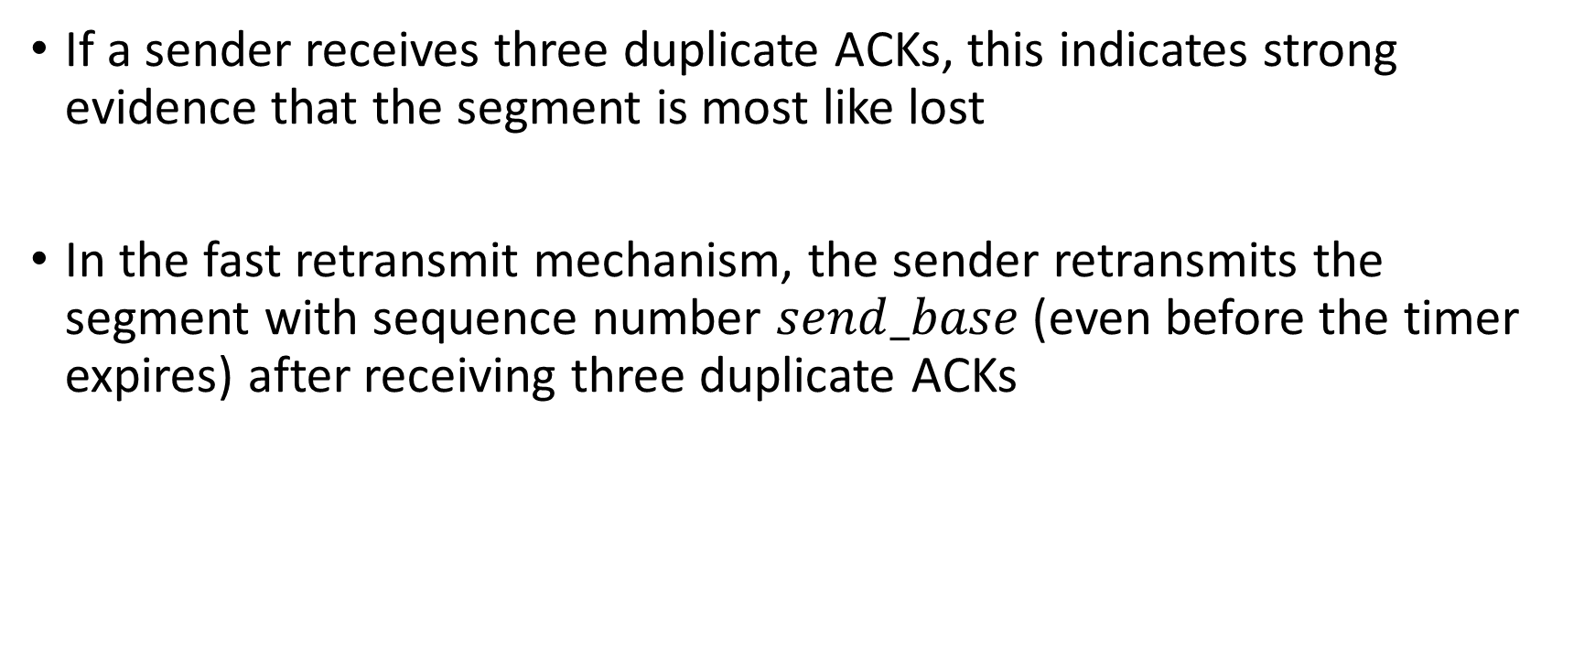
Fast retransmit
If a sender receives three duplicate ACKs, this indicates strong evidence that the segment is most like lost
In the fast retransmit mechanism, the sender retransmits the segment with sequence number $send_base$(even before the timer expires) after receiving three duplicate ACKs

Slide 17
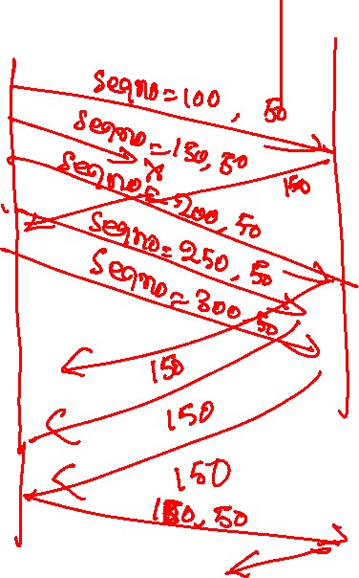
Fast retransmit

Slide 18

Fast retransmit
Host A
Host B
Seq=92, 8 bytes of data
Seq=100, 20 bytes of data
X
ACK=100
timeout
ACK=100
ACK=100
Receipt of three duplicate ACKs indicates 3 segments received after a missing segment – lost segment is likely. So retransmit!
ACK=100
Seq=100, 20 bytes of data
Copyright © 2010-2025 J.F. Kurose, K.W. Ross

Slide 19
Assignment
Implement a TCP sender and receiver on top of UDP
There is no restriction on the window size; all out-of-order packets must be stored at the receiver end
No unnecessary retransmission
Packets may be lost but not corrupted

Slide 20
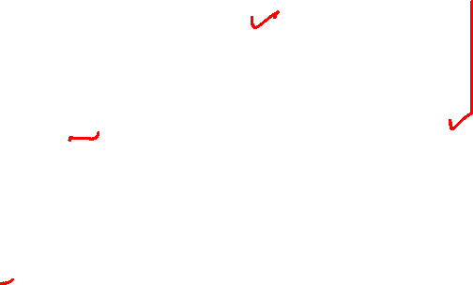
Sender
APIs you can directly use
udt_send(void ∗pkt, size_t len)
Send a packet of length len to the receiver
make_pkt(void∗ buf, unsigned long long seqno)
Adds an eight-byte sequence number, seqno, to the packet (buf)
buf needs to be at least eight bytes long
start_timer() and stop_timer()
start/ stop the timer

Slide 21

Sender
APIs you need to implement
rdt_send(void ∗data, size_t len)
Send buffer (data) of length len to the receiver
len >= 8 always holds
You are not allowed to modify the contents of the data or add additional padding
You can use make_pkt to add a sequence number
rdt_ recv_ack(unsigned long long ackno)
The sender received an acknowledgement with sequence number ackno
timeout()
Called when the timer has expired

Slide 22
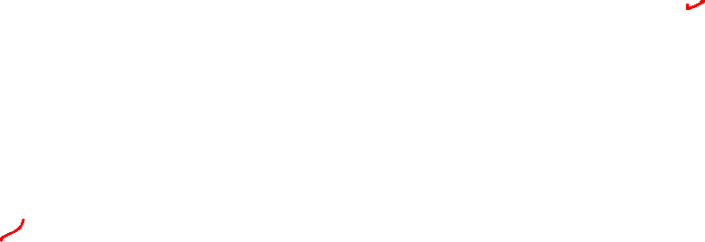
Receiver
APIs you can directly use
const unsigned char ∗get_data(const unsigned char∗ pkt)
Get a pointer to the data from the packet, pkt
unsigned long long get_seqno(const unsigned char ∗pkt)
Fetch sequence number from packet
void send_ack(unsigned long long ackno)
Send an acknowledgement number, ackno, to the sender
notify_app()
Notify the application that some data is available so that it can call app_recv

Slide 23
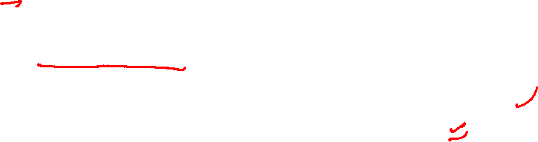
Receiver
APIs you need to implement
rdt_recv(const unsigned char ∗pkt, size_t len)
A packet, pkt, of length, len, is received
You can obtain the length of the data by subtracting the length of the packet header, i.e., PACKET_HEADER_LEN, from the length of the packet
If needed, store the packet in the receive window
If some data is available for application use, call notify_app
size_t app_recv(unsigned char ∗buf, size_t len)
Application requested data of length, len
If some data (max size len) is available for application use, copy it to buf
After copying the data to buf, the receiver no longer needs to keep the data that has already been handed over to the application
Next time app_recv is called, it should get new data
The return value is the number of bytes copied to buf

Slide 24
APIs
You are not allowed to directly use network-related system calls such as select, poll, epoll, socket, bind, listen, send, recv, sendto, recvfrom, connect, accept, etc.
Use the APIs already provided to you

Slide 25
TCP
Is TCP always better than selective repeat?

Slide 26
TCP
Is TCP always better than selective repeat?
No, because it transmits only one segment after a timeout
If multiple segments are lost, the retransmission for other segments is delayed
How does selective repeat solve the problem?

Slide 27
TCP
Is TCP always better than selective repeat?
No, because it transmits only one segment after a timeout
If multiple segments are lost, the retransmission for other segments is delayed
How does selective repeat solve the problem?
It sends an acknowledgement for every packet it receives, including out-of-order packets
The sender retransmits all packets for which an acknowledgement is not received

Slide 28
TCP selective acknowledgment (SACK)

Slide 29
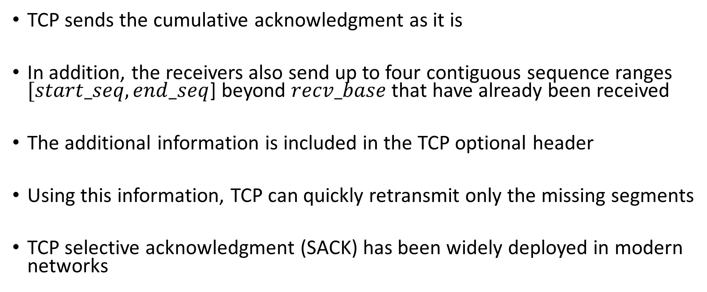
TCP selective acknowledgment (SACK)
TCP sends the cumulative acknowledgment as it is
In addition, the receivers also send up to four contiguous sequence ranges $[start_seq, end_seq$] beyond $recv_base$that have already been received
The additional information is included in the TCP optional header
Using this information, TCP can quickly retransmit only the missing segments
TCP selective acknowledgment (SACK) has been widely deployed in modern networks

