Slide 2
Today’s topics
TCP SACK homework
Flow control
TCP connection management
Congestion control

Slide 3
References
Read Chapter-3.5.6, 3.6 from the Kurose and Ross book

Slide 4
TCP SACK homework
What are TCP SACK acknowledgments?

Slide 5
TCP SACK homework
What are TCP SACK acknowledgments?
A receiver uses TCP SACK acknowledgements to inform the sender regarding the range of sequence numbers received by it beyond the cumulative acknowledgment number
Where are TCP SACK acknowledgments stored?

Slide 6
TCP SACK homework
What are TCP SACK acknowledgments?
A receiver uses TCP SACK acknowledgements to inform the sender regarding the range of sequence numbers received by it beyond the cumulative acknowledgment number
Where are TCP SACK acknowledgments stored?
In the optional TCP header

Slide 7
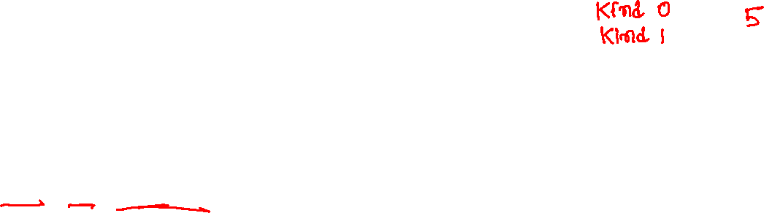
TCP SACK homework
A TCP optional header looks as follows
kind | len | value | kind | len | value | kind | len | value | ….
kind and len are of one byte. The value could be of variable length.
kind 0 and 1 are not followed by len and value.
kind 0 →end of option (you can stop parsing)
kind 1 → no operation (nop, skip the byte)
kind 0 and 1 are followed by another kind (if the current byte is not the end of the header)

Slide 8
TCP SACK homework
kind 5 is used for TCP SACK acknowledgments
Each SACK range is eight bytes long. You can find the number of ranges using the value of len stored in the subsequent byte.
len = length of value + 2
In this assignment, you are to implement
void print_tcp_options(unsigned char *options, size_t len)
options points to the TCP optional header
len is the length of the optional header
Objective: print TCP SACK ranges stored in the header

Slide 9
TCP SACK homework
Drop packets using sudo tc qdisc add dev eth0 root netem loss 10% to trigger SACK acknowledgements
Measure the performance of transferring a large file with and without SACK in a congested network

Slide 10
Flow control
If the application can not consume data at the rate it is arriving at the receiver, then the packets can be dropped if the receive window is full
Let’s consider the example on the next slide

Slide 11
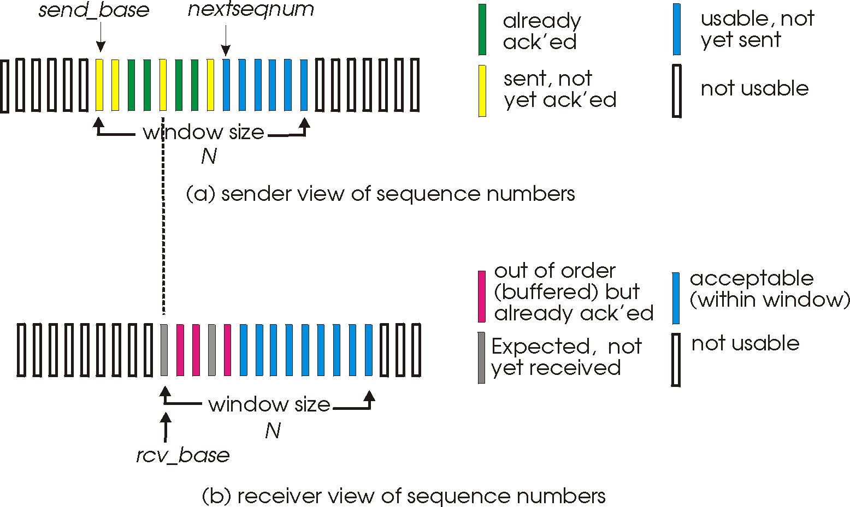
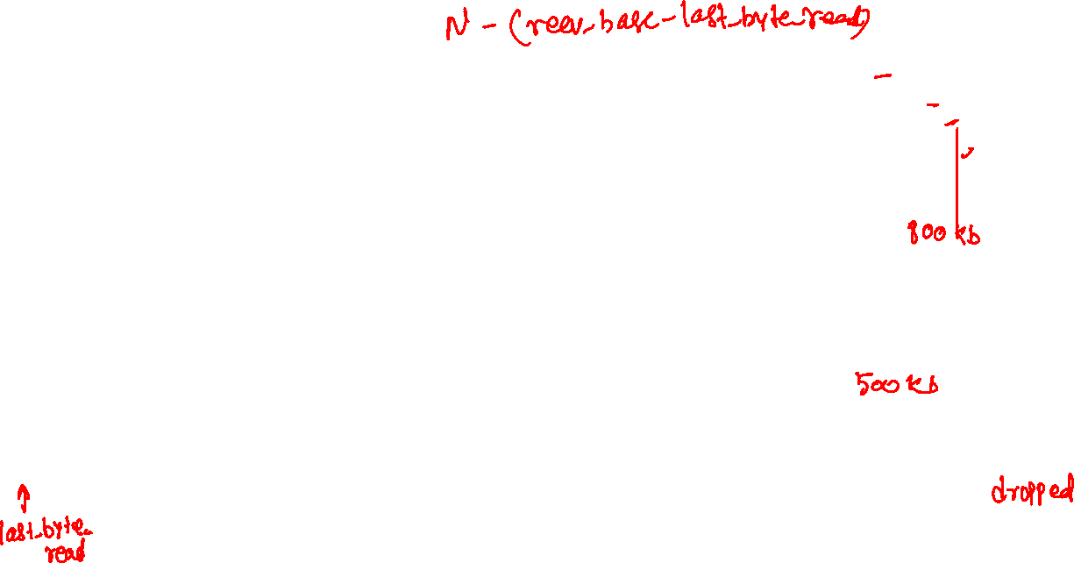
Flow control
N = 1000 Kb
rcv_base = 500 Kb
send_base = 400 Kb
nextseqnum = 600 Kb
How much more data can the sender send?
What if the application has not yet received any data? How much more data can the receiver actually receive?
What will happen to the data post 1000 Kb at the receiver?
How can we prevent packet drop?
Copyright © 2010-2025 J.F. Kurose, K.W. Ross

Slide 12

Flow control
N = 1000 Kb
rcv_base = 500 Kb
send_base = 400 Kb
nextseqnum = 600 Kb
How much more data can the sender send?
800 Kb
What if the application has not yet received any data? How much more data can the receiver actually receive?
500 Kb after recv_base
What will happen to the data post 1000 Kb at the receiver?
dropped
How can we prevent packet drop?
Copyright © 2010-2025 J.F. Kurose, K.W. Ross

Slide 13
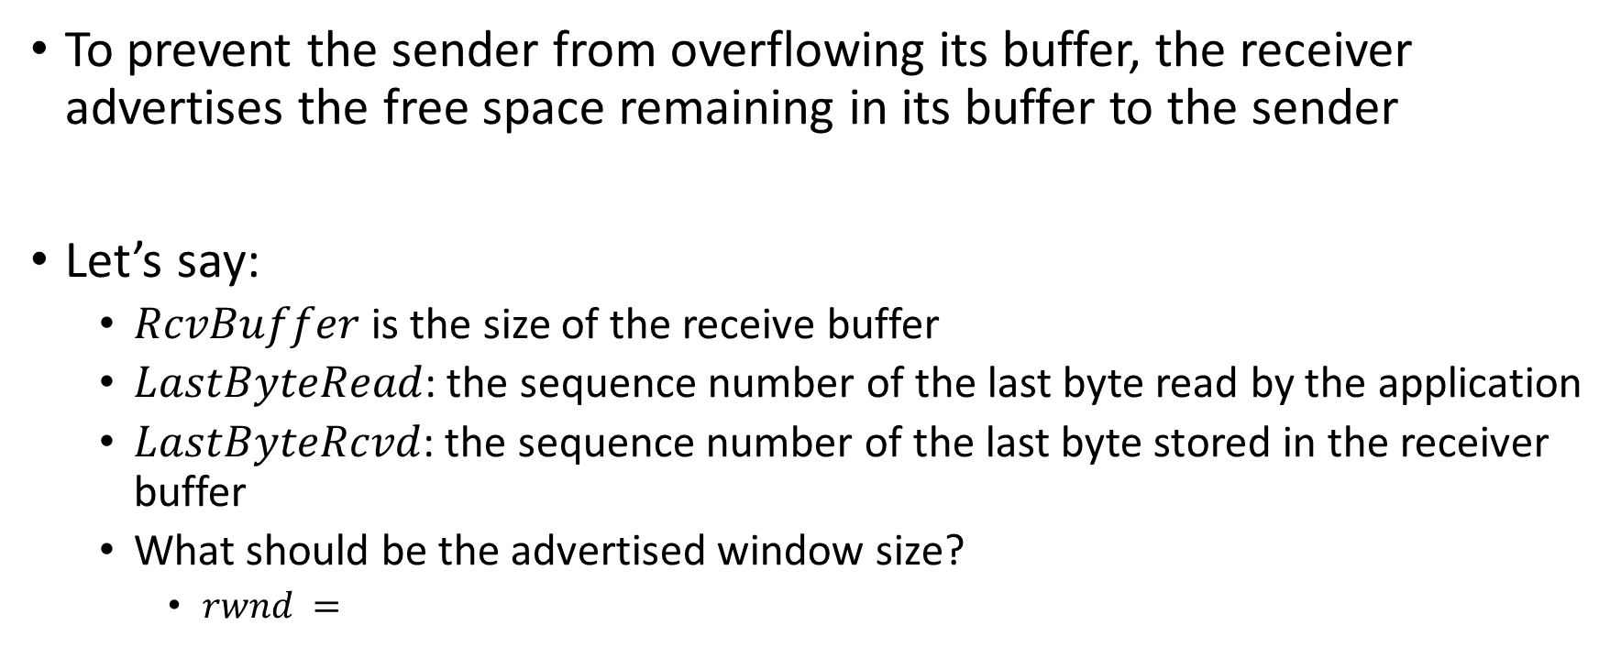
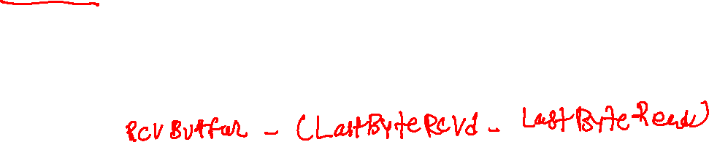
Flow control
To prevent the sender from overflowing its buffer, the receiver advertises the free space remaining in its buffer to the sender
Let’s say:
$RcvBuffer$ is the size of the receive buffer
$LastByteRead$: the sequence number of the last byte read by the application
$LastByteRcvd$: the sequence number of the last byte stored in the receiver buffer
What should be the advertised window size?
$rwnd =$

Slide 14
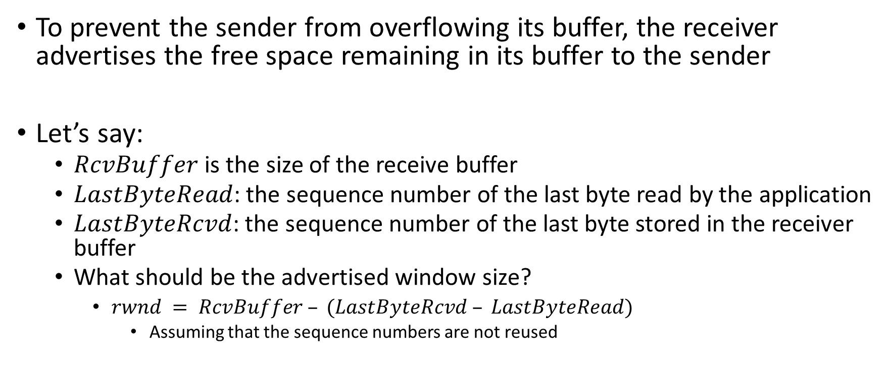
Flow control
To prevent the sender from overflowing its buffer, the receiver advertises the free space remaining in its buffer to the sender
Let’s say:
$RcvBuffer$ is the size of the receive buffer
$LastByteRead$: the sequence number of the last byte read by the application
$LastByteRcvd$: the sequence number of the last byte stored in the receiver buffer
What should be the advertised window size?
$rwnd = RcvBuffer – (LastByteRcvd – LastByteRead)$
Assuming that the sequence numbers are not reused

Slide 15
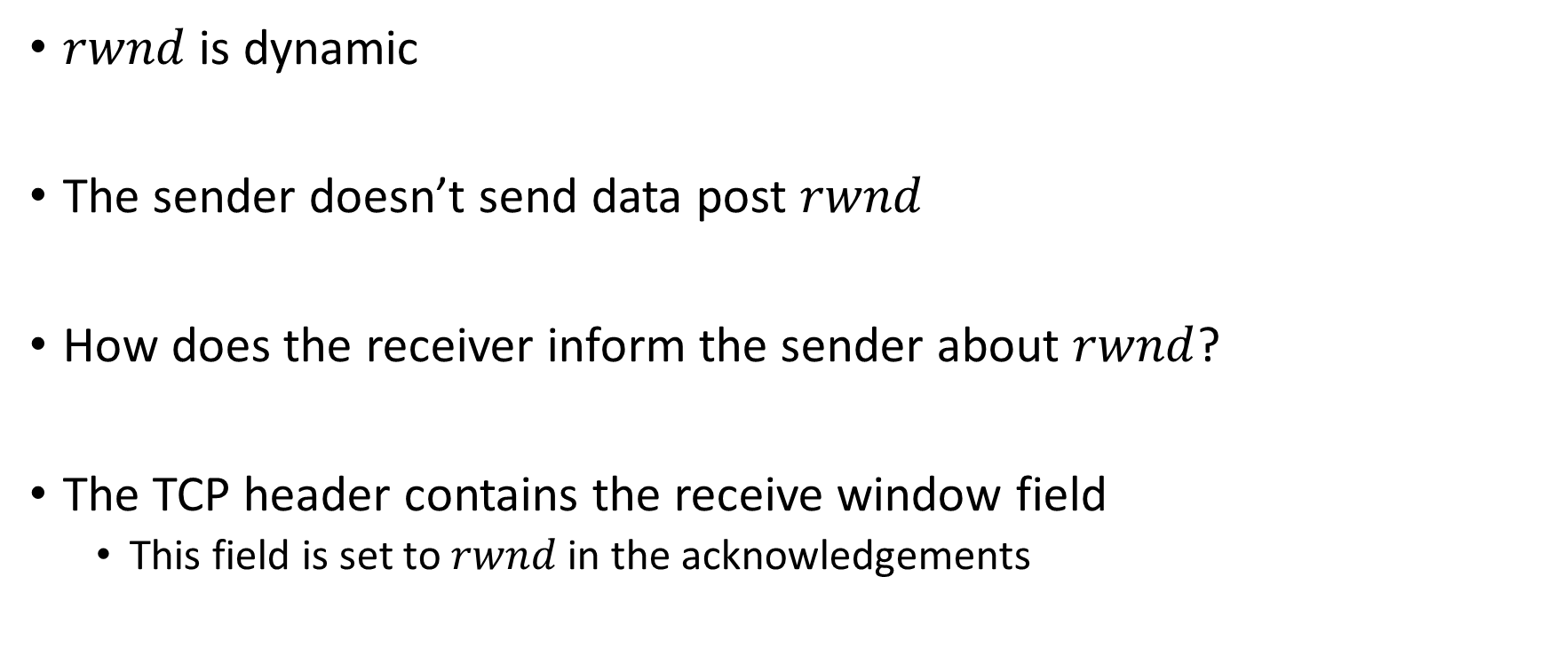
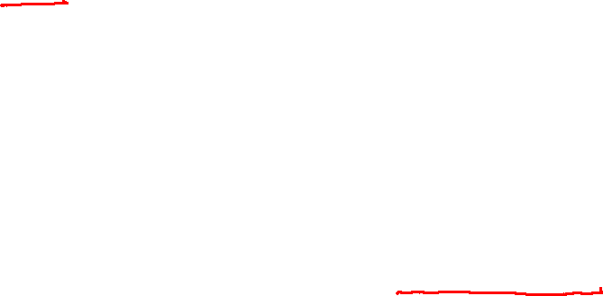
Flow control
$rwnd$ is dynamic
The sender doesn’t send data post $rwnd$
How does the receiver inform the sender about $rwnd$?
The TCP header contains the receive window field
This field is set to $rwnd$ in the acknowledgements

Slide 16


Flow control
What will happen if the receiver advertises $rwnd$ as zero?

Slide 17
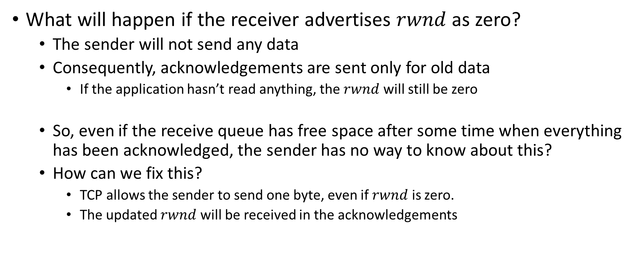
Flow control
What will happen if the receiver advertises $rwnd$ as zero?
The sender will not send any data
Consequently, acknowledgements are sent only for old data
If the application hasn’t read anything, the $rwnd$ will still be zero
So, even if the receive queue has free space after some time when everything has been acknowledged, the sender has no way to know about this?
How can we fix this?
TCP allows the sender to send one byte, even if $rwnd$ is zero.
The updated $rwnd$ will be received in the acknowledgements

Slide 18
keeping the pipe full
Suppose A and B are connected using a 100 Kbps link and the RTT is 100 ms. What should be the window size in order to keep the sender busy all the time, if it has enough data to send?

Slide 19
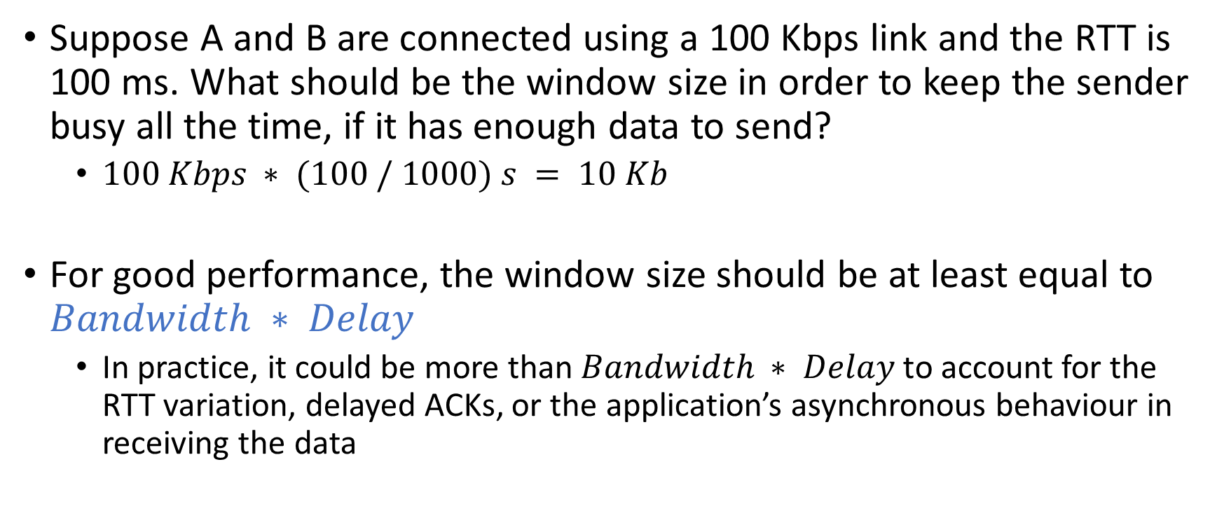
keeping the pipe full
Suppose A and B are connected using a 100 Kbps link and the RTT is 100 ms. What should be the window size in order to keep the sender busy all the time, if it has enough data to send?
$100 Kbps ∗ (100 / 1000) s = 10 Kb$
For good performance, the window size should be at least equal to $Bandwidth ∗ Delay$
In practice, it could be more than $Bandwidth ∗ Delay$to account for the RTT variation, delayed ACKs, or the application’s asynchronous behaviour in receiving the data

Slide 20
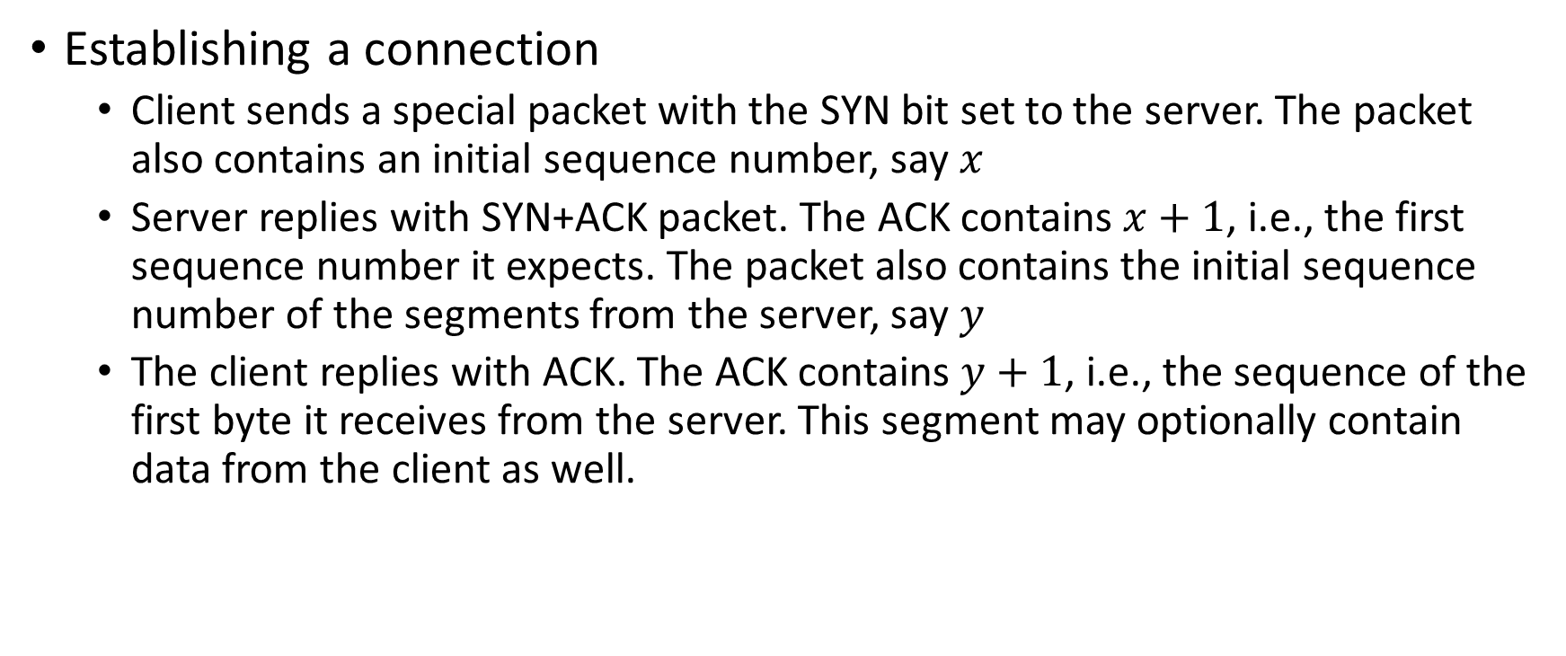
TCP connection management
Establishing a connection
Client sends a special packet with the SYN bit set to the server. The packet also contains an initial sequence number, say $x$
Server replies with SYN+ACK packet. The ACK contains $x+1$, i.e., the first sequence number it expects. The packet also contains the initial sequence number of the segments from the server, say $y$
The client replies with ACK. The ACK contains $y+1$, i.e., the sequence of the first byte it receives from the server. This segment may optionally contain data from the client as well.

Slide 21
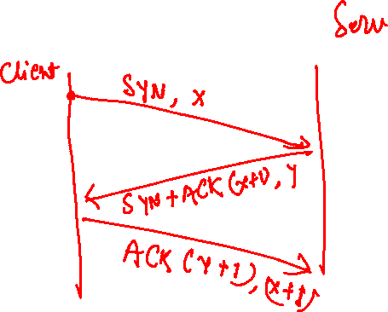
Three way handshake

Slide 22



Two-way handshake
Let’s talk
ESTAB
OK
ESTAB
choose x
req_conn(x)
ESTAB
acc_conn(x)
ESTAB
Copyright © 2010-2025 J.F. Kurose, K.W. Ross

Slide 23

Two-way handshake
choose x
req_conn(x)
ESTAB
acc_conn(x)
ESTAB
data(x+1)
accept
data(x+1)
ACK(x+1)
connection
x completes
No problem!
Copyright © 2010-2025 J.F. Kurose, K.W. Ross

Slide 24

Two-way handshake
choose x
req_conn(x)
ESTAB
retransmit
req_conn(x)
acc_conn(x)
ESTAB
req_conn(x)
connection
x completes
client terminates
server
forgets x
ESTAB
acc_conn(x)
Problem: half open connection! (no client)
Copyright © 2010-2025 J.F. Kurose, K.W. Ross

Slide 25
TCP three-way handshake
Server state
Client state
s = socket(PF_INET, SOCK_STREAM, 0)
bind(s, &saddr, sizeof(saddr))
listen(s, MAX_PENDING)
new_s = accept(s, &caddr, &addr_len)
s = socket(PF_INET, SOCK_STREAM, 0)
connect(s, &saddr, sizeof(saddr))
LISTEN
choose init seq num, x
send TCP SYN msg
SYN SENT
SYNbit=1, Seq=x
choose init seq num, y
send TCP SYNACK
msg, acking SYN
SYN RCVD
SYNbit=1, Seq=y
ACKbit=1; ACKnum=x+1
received SYNACK(x)
indicates server is live;
send ACK for SYNACK;
this segment may contain
client-to-server data
ESTAB
ACKbit=1, ACKnum=y+1
received ACK(y)
indicates client is live
ESTAB
Copyright © 2010-2025 J.F. Kurose, K.W. Ross

Slide 26
TCP connection management
Closing a connection
The client or server can close the connection at their end in two steps
Suppose A wants to close the connection with B
A sends a packet with the FIN bit set to B
B sends an ACK
After this point, A can’t send packets to B, called half close
However, A can receive packets and send acknowledgments
After some time, B wants to close the connection with A
B sends a packet with the FIN bit set to A
A sends an ACK
At this point, the connection has been closed completely
Additionally, ACK can be combined with FIN
e.g., if B also wants to close the connection after receiving a FIN from A, it can send FIN along with ACK.

Slide 27
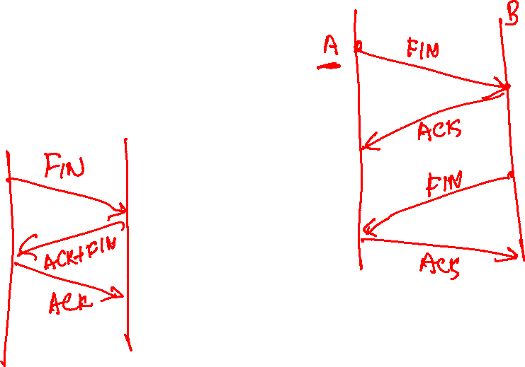
Closing a connection

Slide 28
SYN flood attack
In a SYN flood attack, an attacker sends too many SYN segments to the server
On receiving a SYN segment, the TCP server may allocate resources, e.g., socket, send, and receive buffers, a separate thread, an initial sequence number, etc., and replies with a SYN+ACK to the client
However, the SYN+ACK segments never reach the attacker, and too many half-open connections exhaust the server resources, which is the main objective of the SYN flood attack
After the attack, the server won’t be able to service other legitimate clients

Slide 29
SYN flood attack
SYN cookie approach aims to mitigate this attack
In this approach, the server doesn’t need to remember any state, not even the starting sequence number sent in the SYN+ACK segment
Can you think of a scheme using which the server can verify the initial sequence number in the legitimate ACK without remembering its earlier response?

Slide 30
SYN cookie approach

Slide 31
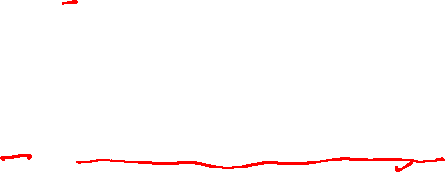
SYN cookie approach
In the SYN cookie approach, the TCP server doesn’t allocate any resources after receiving a SYN segment
The starting sequence number is computed using a hash function on source IP, destination IP, source port, destination port, and the server’s secret key
initial_seqno = hash_fn(srcIP, dstIP, srcPort, dstPort, secretKey)
After receiving an ACK segment from the client, the server recomputes the initial sequence number using the same hash function
In a legitimate ACK, the acknowledgment number must match the recomputed value + 1
verify, ACK.ackno == hash_fn(srcIP, dstIP, srcPort, dstPort, secretKey) + 1
At this point, the server allocates actual resources

Slide 32
SYN cookie approach
Why is secretKey needed? What is the problem with the following hash function?
hash_fn(srcIP, dstIP, srcPort, dstPort)

Slide 33
SYN cookie approach
Why is secretKey needed? What is the problem with the following hash function?
hash_fn(srcIP, dstIP, srcPort, dstPort)
If the secretKey is not part of the hash function, the attacker can recompute the sender’s sequence number, y, using the same hash_fn and send an ACK segment with y+1
secretKey is preventing the attacker from computing y

Slide 34
Congestion control
The flow control is done between the two communicating hosts
If a receiver can receive data at a rate R, then the sender is allowed to send at rate R
However, if multiple senders are sending at the full speed as allowed by the flow control, it is possible that the traffic intensity at an intermediate gateway is close to one or even more than one, causing packet drops. This condition is known as network congestion.

Slide 35
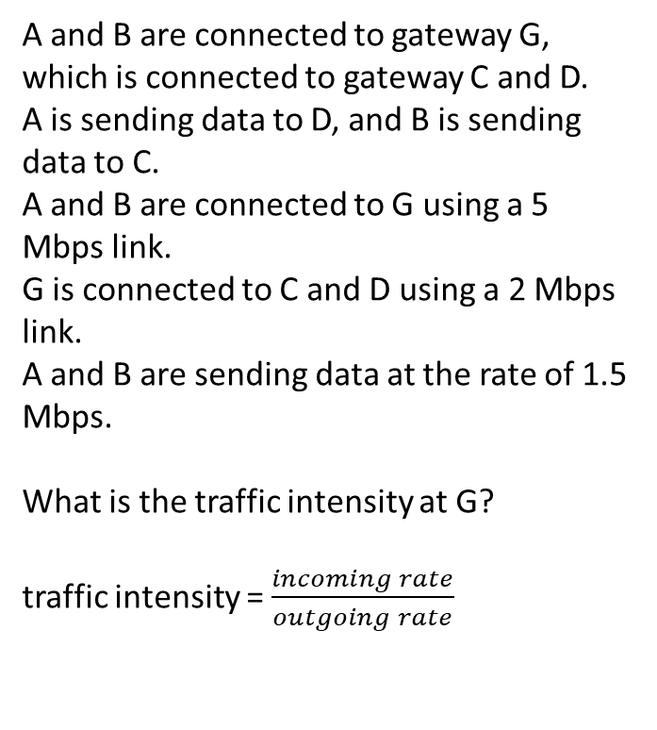
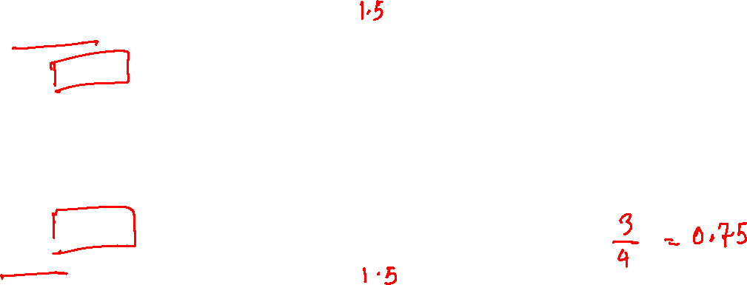
Congestion control
A and B are connected to gateway G, which is connected to gateway C and D.
A is sending data to D, and B is sending data to C.
A and B are connected to G using a 5 Mbps link.
G is connected to C and D using a 2 Mbps link.
A and B are sending data at the rate of 1.5 Mbps.
What is the traffic intensity at G?
traffic intensity = $\frac{incoming rate}{outgoing rate}$
A
1.5 Mbps
C
5 Mbps
2 Mbps
G
B
2 Mbps
D
5 Mbps
1.5 Mbps

Slide 36
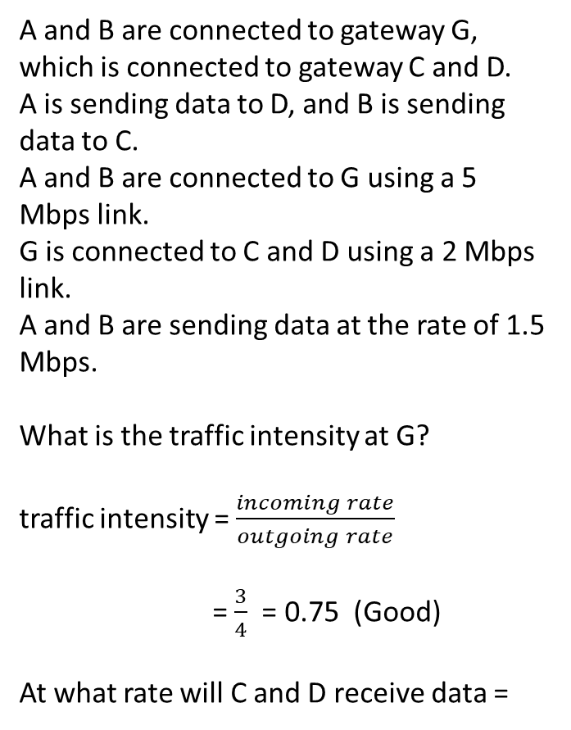
Congestion control
A and B are connected to gateway G, which is connected to gateway C and D.
A is sending data to D, and B is sending data to C.
A and B are connected to G using a 5 Mbps link.
G is connected to C and D using a 2 Mbps link.
A and B are sending data at the rate of 1.5 Mbps.
What is the traffic intensity at G?
traffic intensity = $\frac{incoming rate}{outgoing rate}$
= $\frac{3}{4}$ = 0.75 (Good)
At what rate will C and D receive data =
A
1.5 Mbps
C
5 Mbps
2 Mbps
G
B
2 Mbps
D
5 Mbps
1.5 Mbps

Slide 37
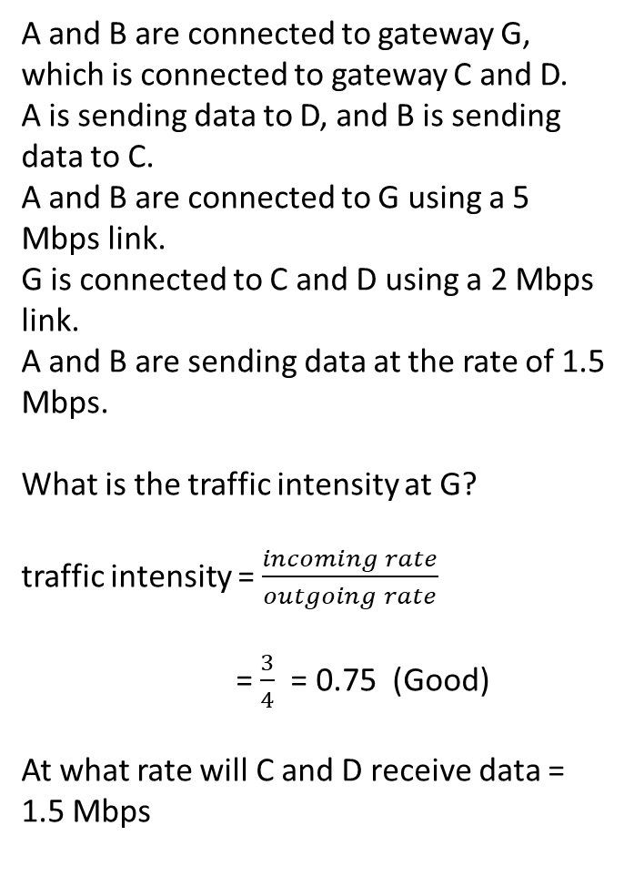
Congestion control
A and B are connected to gateway G, which is connected to gateway C and D.
A is sending data to D, and B is sending data to C.
A and B are connected to G using a 5 Mbps link.
G is connected to C and D using a 2 Mbps link.
A and B are sending data at the rate of 1.5 Mbps.
What is the traffic intensity at G?
traffic intensity = $\frac{incoming rate}{outgoing rate}$
= $\frac{3}{4}$ = 0.75 (Good)
At what rate will C and D receive data = 1.5 Mbps
A
1.5 Mbps
C
5 Mbps
2 Mbps
G
B
2 Mbps
D
5 Mbps
1.5 Mbps

Slide 38
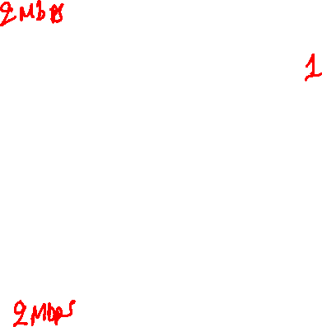
Congestion control
After some time, A and B are sending data at the maximum rate of 2 Mbps (window size / RTT) allowed by flow control (assuming no loss).
What is the traffic intensity at G?
A
2 Mbps
C
5 Mbps
2 Mbps
G
B
2 Mbps
D
5 Mbps
2 Mbps

Slide 39
Congestion control
After some time, A and B are sending data at the maximum rate of 2 Mbps (window size / RTT) allowed by flow control (assuming no loss).
What is the traffic intensity at G?
= 1 (Bad)
At what rate will C and D receive data (assuming infinite queue size at G)
A
2 Mbps
C
5 Mbps
2 Mbps
G
B
2 Mbps
D
5 Mbps
2 Mbps

Slide 40
Congestion control
After some time, A and B are sending data at the maximum rate of 2 Mbps (window size / RTT) allowed by flow control (assuming no loss).
What is the traffic intensity at G?
= 1 (Bad)
At what rate will C and D receive data (assuming infinite queue size at G) = 2 Mbps
A
2 Mbps
C
5 Mbps
2 Mbps
G
B
2 Mbps
D
5 Mbps
2 Mbps

Slide 41
Congestion control
After some time, A and B are sending data at the maximum rate of 2 Mbps (window size / RTT) allowed by flow control (assuming no loss).
What is the traffic intensity at G?
= 1 (Bad)
At what rate will C and D receive data (assuming infinite queue size at G) = 2 Mbps
Will there be any difference from the previous case when A and B were sending at 1.5 Mbps, apart from the new receive rate?
A
2 Mbps
C
5 Mbps
2 Mbps
G
B
2 Mbps
D
5 Mbps
2 Mbps

Slide 42
Congestion control
After some time, A and B are sending data at the maximum rate of 2 Mbps (window size / RTT) allowed by flow control (assuming no loss).
What is the traffic intensity at G?
= 1 (Bad)
At what rate will C and D receive data (assuming infinite queue size at G) = 2 Mbps
Will there be any difference from the previous case when A and B were sending at 1.5 Mbps, apart from the new receive rate?
The packet will experience significant delays.
A
2 Mbps
C
5 Mbps
2 Mbps
G
B
2 Mbps
D
5 Mbps
2 Mbps

Slide 43
Congestion control
A
2 Mbps
C
5 Mbps
average queueing delay
2 Mbps
G
traffic intensity = LA/R
1
B
2 Mbps
D
5 Mbps
2 Mbps
Copyright © 2010-2025 J.F. Kurose, K.W. Ross

Slide 44

Congestion control
After some time, A and B are sending data at the maximum rate of 2 Mbps (window size / RTT) allowed by flow control (assuming no loss).
What is the traffic intensity at G?
= 1 (Bad)
At what rate will C and D receive data (if the queue size is finite) =
A
2 Mbps
C
5 Mbps
2 Mbps
G
B
2 Mbps
D
5 Mbps
2 Mbps
10% packets were dropped.

Slide 45
Congestion control
After some time, A and B are sending data at the maximum rate of 2 Mbps (window size / RTT) allowed by flow control (assuming no loss).
What is the traffic intensity at G?
= 1 (Bad)
At what rate will C and D receive data (if the queue size is finite) =
Depends on the packet drop rate. Let’s say 10% packets were dropped, the receive rate would be 1.8 Mbps.
A
2 Mbps
C
5 Mbps
2 Mbps
G
B
2 Mbps
D
5 Mbps
2 Mbps
10% packets were dropped.

Slide 46
Congestion control
After some time, A and B are sending data at the maximum rate of 2 Mbps (window size / RTT) allowed by flow control (assuming no loss).
What is the traffic intensity at G?
= 1 (Bad)
At what rate will C and D receive data (if the queue size is finite) =
Depends on the packet drop rate. Let’s say 10% packets were dropped, the receive rate would be 1.8 Mbps.
Can A and B send data at a higher rate to compensate for the packet loss?
A
2 Mbps
C
5 Mbps
2 Mbps
G
B
2 Mbps
D
5 Mbps
2 Mbps
10% packets were dropped.

Slide 47
Congestion control
After some time, A and B are sending data at the maximum rate of 2 Mbps (window size / RTT) allowed by flow control (assuming no loss).
What is the traffic intensity at G?
= 1 (Bad)
At what rate will C and D receive data (if the queue size is finite) =
Depends on the packet drop rate. Let’s say 10% packets were dropped, the receive rate would be 1.8 Mbps.
Can A and B send data at a higher rate to compensate for the packet loss?
Yes, if a segment is lost within the advertised window, the sender can retransmit it as many times as necessary.
A
2 Mbps
C
5 Mbps
2 Mbps
G
B
2 Mbps
D
5 Mbps
2 Mbps
10% packets were dropped.

