Slide 2
Today’s topics
Congestion control
TCP Reno, TCP Tahoe
AIMD
TCP Cubic

Slide 3
References
Read Chapter-3.5.6, 3.6, 3.7 from the Kurose and Ross book

Slide 4
Congestion control
The flow control is done between the two communicating hosts
If a receiver can receive data at a rate R, then the sender is allowed to send at rate R
However, if multiple senders are sending at the full speed as allowed by the flow control, it is possible that the traffic intensity at an intermediate gateway is close to one or even more than one, causing packet drops. This condition is known as network congestion.

Slide 5
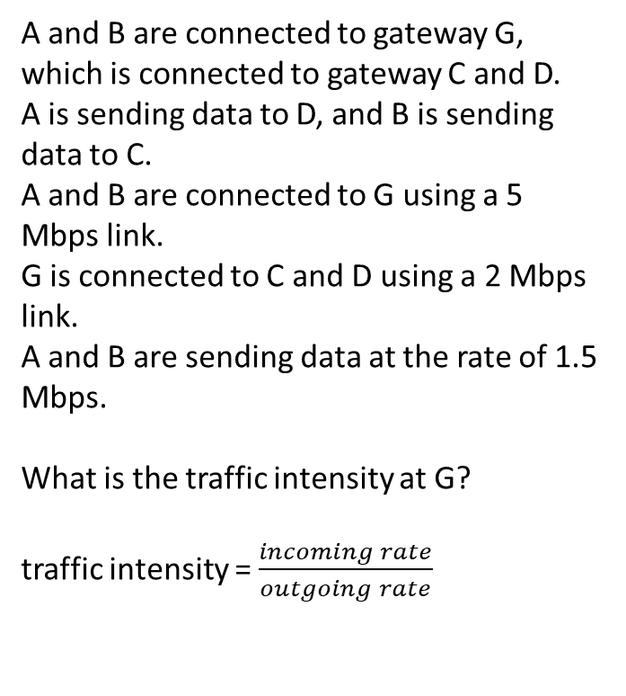
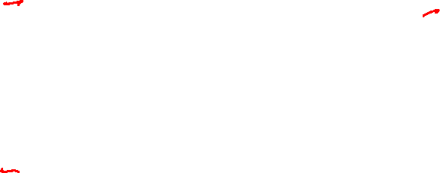
Congestion control
A and B are connected to gateway G, which is connected to gateway C and D.
A is sending data to D, and B is sending data to C.
A and B are connected to G using a 5 Mbps link.
G is connected to C and D using a 2 Mbps link.
A and B are sending data at the rate of 1.5 Mbps.
What is the traffic intensity at G?
traffic intensity = $\frac{incoming rate}{outgoing rate}$
A
1.5 Mbps
C
5 Mbps
2 Mbps
G
B
2 Mbps
D
5 Mbps
1.5 Mbps

Slide 6
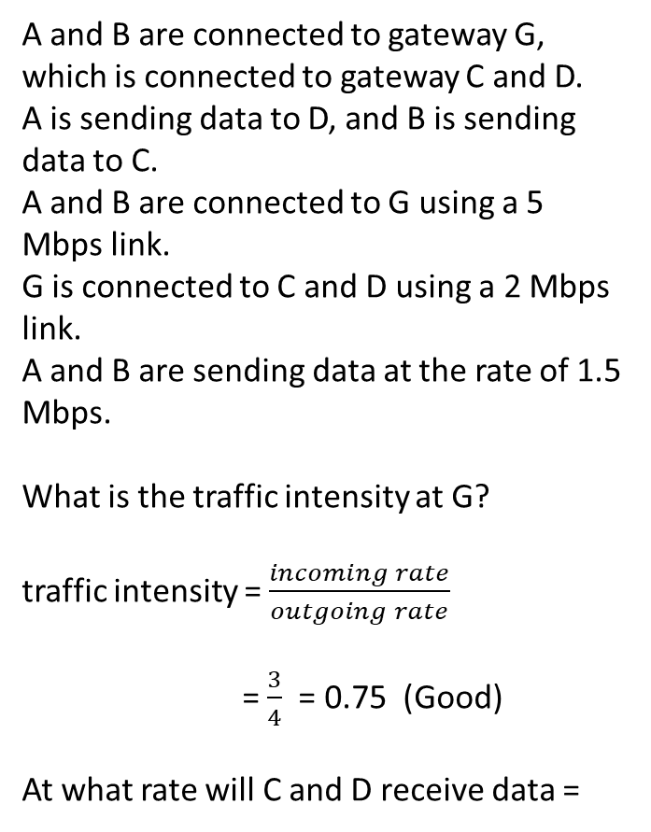
Congestion control
A and B are connected to gateway G, which is connected to gateway C and D.
A is sending data to D, and B is sending data to C.
A and B are connected to G using a 5 Mbps link.
G is connected to C and D using a 2 Mbps link.
A and B are sending data at the rate of 1.5 Mbps.
What is the traffic intensity at G?
traffic intensity = $\frac{incoming rate}{outgoing rate}$
= $\frac{3}{4}$ = 0.75 (Good)
At what rate will C and D receive data =
A
1.5 Mbps
C
5 Mbps
2 Mbps
G
B
2 Mbps
D
5 Mbps
1.5 Mbps

Slide 7
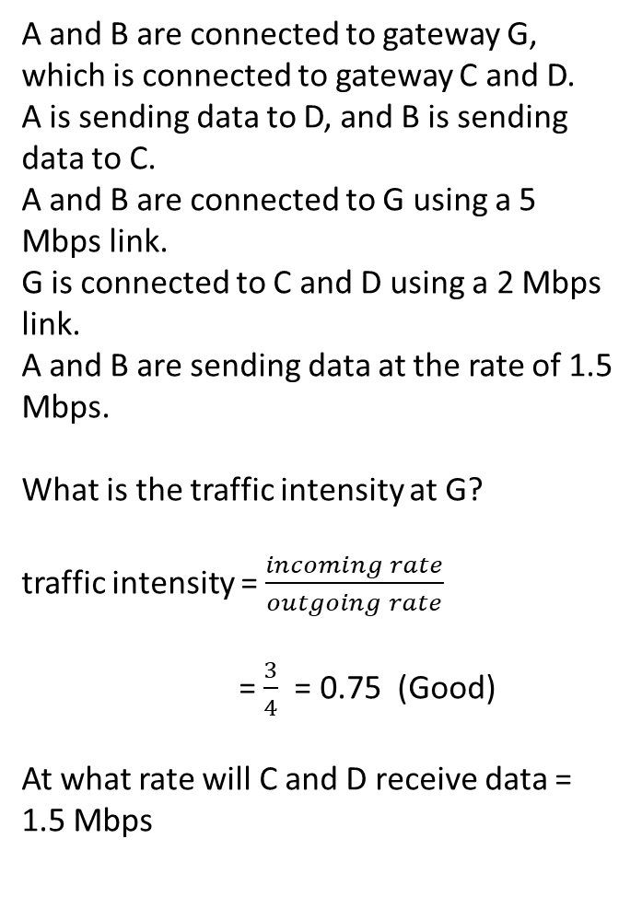
Congestion control
A and B are connected to gateway G, which is connected to gateway C and D.
A is sending data to D, and B is sending data to C.
A and B are connected to G using a 5 Mbps link.
G is connected to C and D using a 2 Mbps link.
A and B are sending data at the rate of 1.5 Mbps.
What is the traffic intensity at G?
traffic intensity = $\frac{incoming rate}{outgoing rate}$
= $\frac{3}{4}$ = 0.75 (Good)
At what rate will C and D receive data = 1.5 Mbps
A
1.5 Mbps
C
5 Mbps
2 Mbps
G
B
2 Mbps
D
5 Mbps
1.5 Mbps

Slide 8
Congestion control
After some time, A and B are sending data at the maximum rate of 2 Mbps (window size / RTT) allowed by flow control (assuming no loss).
What is the traffic intensity at G?
A
2 Mbps
C
5 Mbps
2 Mbps
G
B
2 Mbps
D
5 Mbps
2 Mbps

Slide 9
Congestion control
After some time, A and B are sending data at the maximum rate of 2 Mbps (window size / RTT) allowed by flow control (assuming no loss).
What is the traffic intensity at G?
= 1 (Bad)
At what rate will C and D receive data (assuming infinite queue size at G)
A
2 Mbps
C
5 Mbps
2 Mbps
G
B
2 Mbps
D
5 Mbps
2 Mbps

Slide 10
Congestion control
After some time, A and B are sending data at the maximum rate of 2 Mbps (window size / RTT) allowed by flow control (assuming no loss).
What is the traffic intensity at G?
= 1 (Bad)
At what rate will C and D receive data (assuming infinite queue size at G) = 2 Mbps
A
2 Mbps
C
5 Mbps
2 Mbps
G
B
2 Mbps
D
5 Mbps
2 Mbps

Slide 11
Congestion control
After some time, A and B are sending data at the maximum rate of 2 Mbps (window size / RTT) allowed by flow control (assuming no loss).
What is the traffic intensity at G?
= 1 (Bad)
At what rate will C and D receive data (assuming infinite queue size at G) = 2 Mbps
Will there be any difference from the previous case when A and B were sending at 1.5 Mbps, apart from the new receive rate?
A
2 Mbps
C
5 Mbps
2 Mbps
G
B
2 Mbps
D
5 Mbps
2 Mbps

Slide 12
Congestion control
After some time, A and B are sending data at the maximum rate of 2 Mbps (window size / RTT) allowed by flow control (assuming no loss).
What is the traffic intensity at G?
= 1 (Bad)
At what rate will C and D receive data (assuming infinite queue size at G) = 2 Mbps
Will there be any difference from the previous case when A and B were sending at 1.5 Mbps, apart from the new receive rate?
The packet will experience significant delays.
A
2 Mbps
C
5 Mbps
2 Mbps
G
B
2 Mbps
D
5 Mbps
2 Mbps

Slide 13
Congestion control
A
2 Mbps
C
5 Mbps
average queueing delay
2 Mbps
G
traffic intensity = LA/R
1
B
2 Mbps
D
5 Mbps
2 Mbps
Copyright © 2010-2025 J.F. Kurose, K.W. Ross

Slide 14
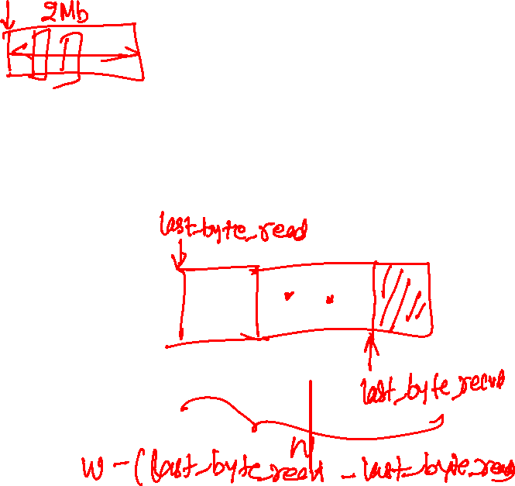
Congestion control
After some time, A and B are sending data at the maximum rate of 2 Mbps (window size / RTT) allowed by flow control (assuming no loss).
What is the traffic intensity at G?
= 1 (Bad)
At what rate will C and D receive data (if the queue size is finite) =
A
2 Mbps
C
5 Mbps
2 Mbps
G
B
2 Mbps
D
5 Mbps
2 Mbps
10% packets were dropped.

Slide 15
Congestion control
After some time, A and B are sending data at the maximum rate of 2 Mbps (window size / RTT) allowed by flow control (assuming no loss).
What is the traffic intensity at G?
= 1 (Bad)
At what rate will C and D receive data (if the queue size is finite) =
Depends on the packet drop rate. Let’s say 10% packets were dropped, the receive rate would be 1.8 Mbps.
A
2 Mbps
C
5 Mbps
2 Mbps
G
B
2 Mbps
D
5 Mbps
2 Mbps
10% packets were dropped.

Slide 16
Congestion control
After some time, A and B are sending data at the maximum rate of 2 Mbps (window size / RTT) allowed by flow control (assuming no loss).
What is the traffic intensity at G?
= 1 (Bad)
At what rate will C and D receive data (if the queue size is finite) =
Depends on the packet drop rate. Let’s say 10% packets were dropped, the receive rate would be 1.8 Mbps.
Can A and B send data at a higher rate to compensate for the packet loss?
A
2 Mbps
C
5 Mbps
2 Mbps
G
B
2 Mbps
D
5 Mbps
2 Mbps
10% packets were dropped.

Slide 17
Congestion control
After some time, A and B are sending data at the maximum rate of 2 Mbps (window size / RTT) allowed by flow control (assuming no loss).
What is the traffic intensity at G?
= 1 (Bad)
At what rate will C and D receive data (if the queue size is finite) =
Depends on the packet drop rate. Let’s say 10% packets were dropped, the receive rate would be 1.8 Mbps.
Can A and B send data at a higher rate to compensate for the packet loss?
Yes, if a segment is lost within the advertised window, the sender can retransmit it as many times as necessary.
A
2 Mbps
C
5 Mbps
2 Mbps
G
B
2 Mbps
D
5 Mbps
2 Mbps
10% packets were dropped.

Slide 18
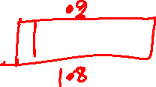
Congestion control
To compensate for the packet loss, A and B are sending data at the rate of 2.2 Mbps, including retransmitted segments.
What is the traffic intensity at G?
A
2.2 Mbps
C
5 Mbps
2 Mbps
G
B
2 Mbps
D
5 Mbps
2.2 Mbps

Slide 19

Congestion control
To compensate for the packet loss, A and B are sending data at the rate of 2.2 Mbps, including retransmitted segments.
What is the traffic intensity at G?
traffic intensity = $\frac{4.4}{4}$ = 1.1 (very bad)
What will happen now?
A
2.2 Mbps
C
5 Mbps
2 Mbps
G
B
2 Mbps
D
5 Mbps
2.2 Mbps

Slide 20
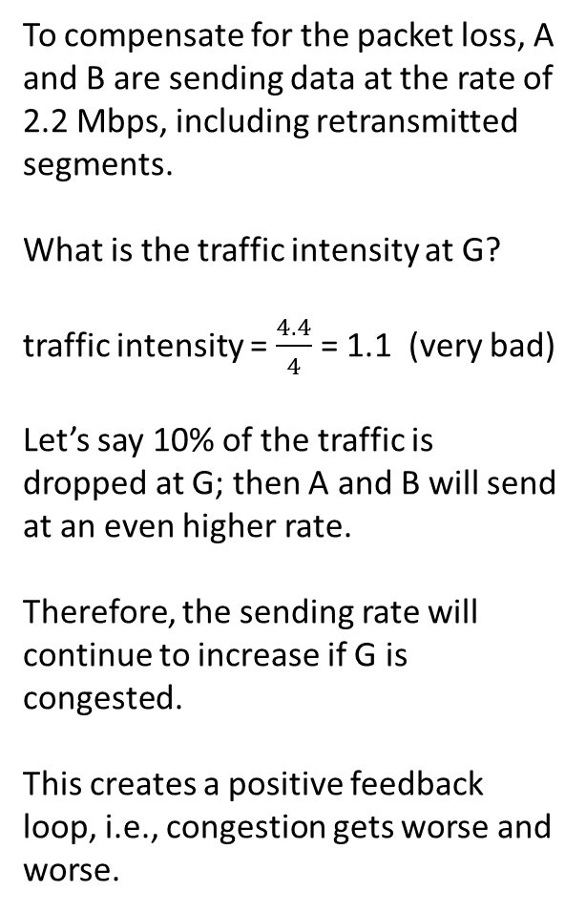
Congestion control
To compensate for the packet loss, A and B are sending data at the rate of 2.2 Mbps, including retransmitted segments.
What is the traffic intensity at G?
traffic intensity = $\frac{4.4}{4}$ = 1.1 (very bad)
Let’s say 10% of the traffic is dropped at G; then A and B will send at an even higher rate.
Therefore, the sending rate will continue to increase if G is congested.
This creates a positive feedback loop, i.e., congestion gets worse and worse.
A
2.2 Mbps
C
5 Mbps
2 Mbps
G
B
2 Mbps
D
5 Mbps
2.2 Mbps

Slide 21
Congestion control
Due to higher queuing delays, timeouts occurred, and approximately 10% of duplicate packets arrived at C and D as a result of retransmission. Let’s C and D are receiving at the rate R; will the effective throughput be R?
A
2.4 Mbps
C
5 Mbps
2 Mbps
G
B
2 Mbps
D
5 Mbps
2.4 Mbps

Slide 22
Congestion control
Due to higher queuing delays, timeouts occurred, and approximately 10% of duplicate packets arrived at C and D as a result of retransmission. Let’s C and D are receiving at the rate R; will the effective throughput be R?
No, because 10% duplicate packets will be dropped, the effective throughput is 0.9 * R.
Conclusion: traffic intensity can not only add latency but also affect the throughput even though the links are fully utilized.
A
2.4 Mbps
C
5 Mbps
2 Mbps
G
B
2 Mbps
D
5 Mbps
2.4 Mbps

Slide 23
Congestion control
What will happen if A and B continue transmitting more and more data due to timeouts, and consequently, the effective throughput at C and D decreases?
A
2.4 Mbps
C
5 Mbps
2 Mbps
G
B
2 Mbps
D
5 Mbps
2.4 Mbps

Slide 24
Congestion control
What will happen if A and B continue transmitting more and more data due to timeouts, and consequently, the effective throughput at C and D decreases?
The queues at G will immediately fill up due to the large data rate from A and B, and the effective throughput can reach zero.
A
2.4 Mbps
C
5 Mbps
2 Mbps
G
B
2 Mbps
D
5 Mbps
2.4 Mbps

Slide 25
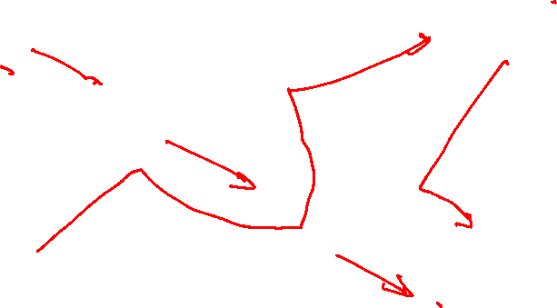
Congestion control
A is sending data at the 2 Mbps rate to D.
B is sending data at the 2 Mbps rate to C.
C is sending data at the 3 Mbps rate to D.
Which nodes are congested? A node is congested if the traffic intensity is close to 1.
2 Mbps to D
3 Mbps to D
A
C
G4
3 Mbps
3 Mbps
G3
3 Mbps
3 Mbps
3 Mbps
5 Mbps
G2
3 Mbps
B
D
2 Mbps to C

Slide 26
Congestion control
A is sending data at the 2 Mbps rate to D.
B is sending data at the 2 Mbps rate to C.
C is sending data at the 3 Mbps rate to D.
Which nodes are congested? A node is congested if the traffic intensity is close to 1.
G2
If G2 is congested, will it cause A to send more packets?
Yes
2 Mbps to D
3 Mbps to D
A
C
G4
3 Mbps
3 Mbps
G3
3 Mbps
3 Mbps
3 Mbps
5 Mbps
G2
3 Mbps
B
D
2 Mbps to C

Slide 27
Congestion control
A is sending data at the 2 Mbps rate to D.
B is sending data at the 2 Mbps rate to C.
C is sending data at the 3 Mbps rate to D.
Which nodes are congested? A node is congested if the traffic intensity is close to 1.
G2
If G2 is congested, will it cause A to send more packets?
Yes
Consequently, is it possible that the G3 could also be congested?
2 Mbps to D
3 Mbps to D
A
C
G4
3 Mbps
3 Mbps
G3
3 Mbps
3 Mbps
3 Mbps
5 Mbps
G2
3 Mbps
B
D
2 Mbps to C

Slide 28
Congestion control
A is sending data at the 2 Mbps rate to D.
B is sending data at the 2 Mbps rate to C.
C is sending data at the 3 Mbps rate to D.
Which nodes are congested? A node is congested if the traffic intensity is close to 1.
G2
If G2 is congested, will it cause A to send more packets?
Yes
Consequently, is it possible that the G3 could also be congested?
Yes, if A starts sending at the 3 Mbps rate, due to the timeouts.
Conclusion: A congested gateway at the downstream can cause congestion at all upstream gateways along the path.
2 Mbps to D
3 Mbps to D
A
C
G4
3 Mbps
3 Mbps
G3
3 Mbps
3 Mbps
3 Mbps
5 Mbps
G2
3 Mbps
B
D
2 Mbps to C

Slide 29
Conclusion
Even if each sender respects flow control, the network as a whole can get congested
We need a separate mechanism for congestion control

Slide 30

Congestion control mechanism
What is a strong indicator of congestion?

Slide 31
Congestion control mechanism
What is a strong indicator of congestion?
Timeout
What is a slightly weaker indicator of congestion?

Slide 32
Congestion control mechanism
What is a strong indicator of congestion?
Timeout
What is a slightly weaker indicator of congestion?
duplicate ACKs
What could be the other indicator of network congestion?

Slide 33
Congestion control mechanism
What is a strong indicator of congestion?
Timeout
What is a slightly weaker indicator of congestion?
duplicate ACKs
What could be the other indicator of network congestion?
increasing RTT

Slide 34
Approaches for congestion control
End-to-end congestion control
The congestion is detected and controlled at endpoints. The network doesn’t provide any help.
The endpoints use the timeouts, duplicate ACKs, or increasing RTTs, as an indicator of the congestion state, and adjust the transmission rate accordingly
Network-assisted congestion control
The network getaways provide explicit feedback to end hosts regarding the state of the congestion in the network
We’ll study both mechanisms

Slide 35
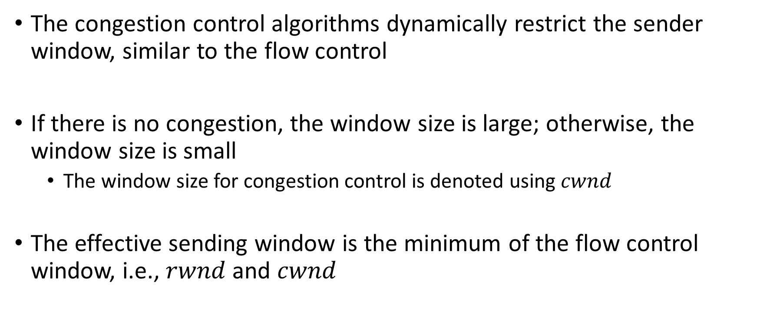
Congestion control mechanism
The congestion control algorithms dynamically restrict the sender window, similar to the flow control
If there is no congestion, the window size is large; otherwise, the window size is small
The window size for congestion control is denoted using $cwnd$
The effective sending window is the minimum of the flow control window, i.e., $rwnd$ and $cwnd$

Slide 36
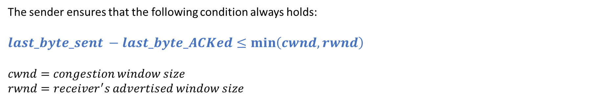
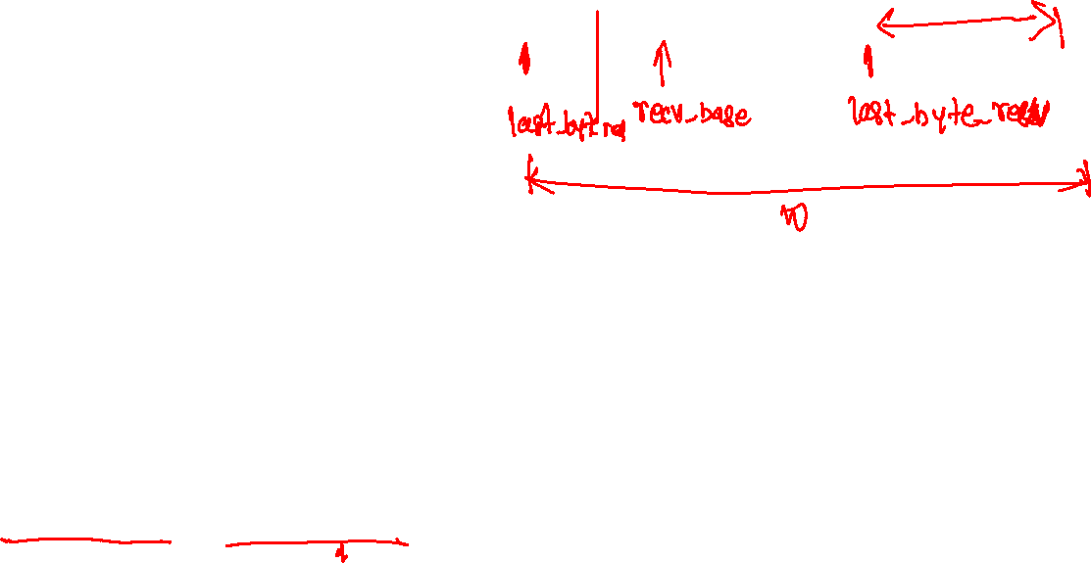
Congestion control
sender sequence number space
cwnd
last byte
ACKed
sent, but not-yet ACKed
(“in-flight”)
available but not used
last byte sent
The sender ensures that the following condition always holds:
$$last_byte_sent −last_byte_ACKed≤\min\left(cwnd, rwnd\right)$$
$$cwnd=congestion window size$$
$$rwnd=receiver^{′}s advertised window size$$
Copyright © 2010-2025 J.F. Kurose, K.W. Ross

Slide 37
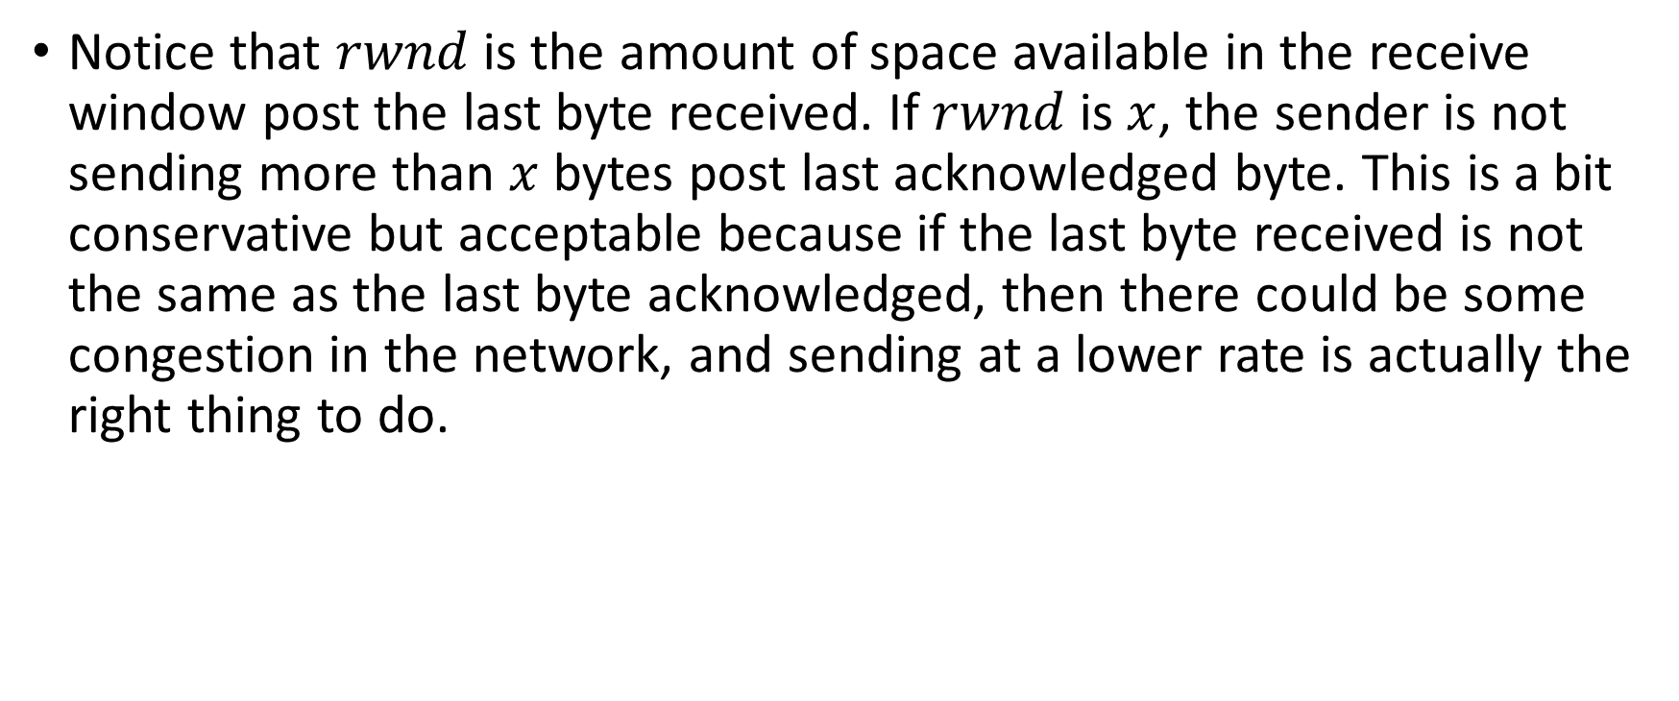
rwnd
Notice that $rwnd$ is the amount of space available in the receive window post the last byte received. If $rwnd$ is $x$, the sender is not sending more than $x$ bytes post last acknowledged byte. This is a bit conservative but acceptable because if the last byte received is not the same as the last byte acknowledged, then there could be some congestion in the network, and sending at a lower rate is actually the right thing to do.

Slide 38
cwnd estimation
Let’s say there is a possibility of congestion. How can we determine the window size before hitting a congestion?

Slide 39
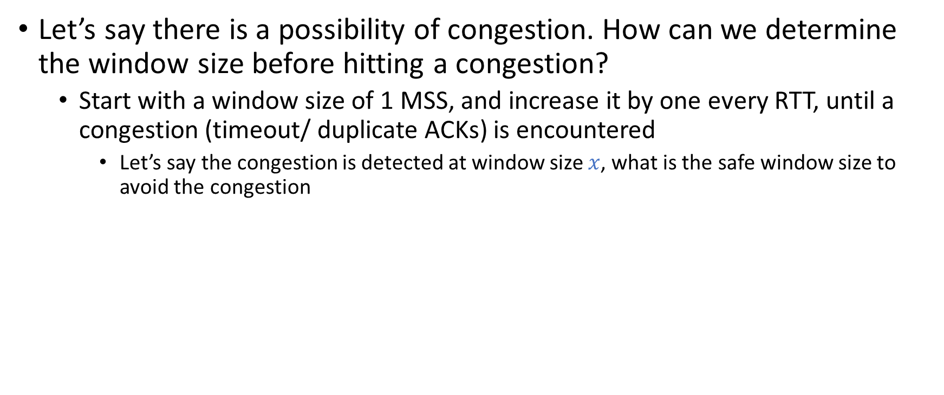
cwnd estimation
Let’s say there is a possibility of congestion. How can we determine the window size before hitting a congestion?
Start with a window size of 1 MSS, and increase it by one every RTT, until a congestion (timeout/ duplicate ACKs) is encountered
Let’s say the congestion is detected at window size $x$, what is the safe window size to avoid the congestion

Slide 40
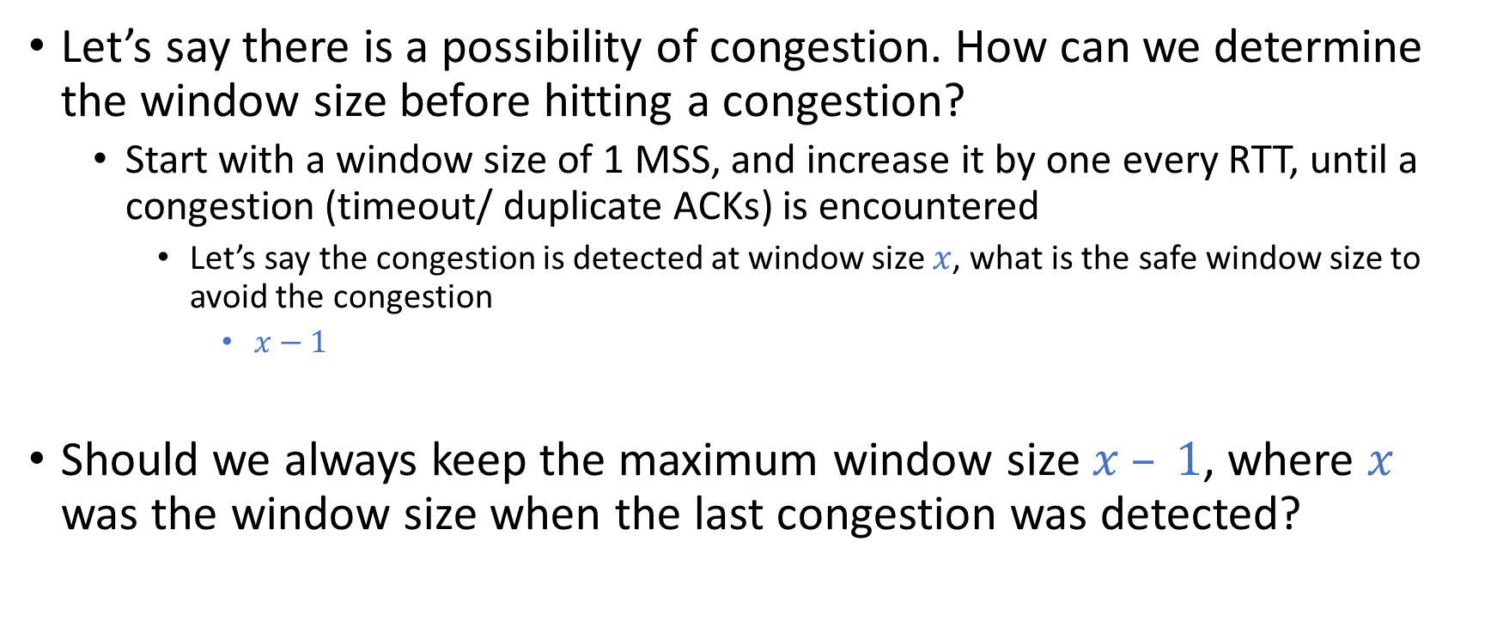
cwnd estimation
Let’s say there is a possibility of congestion. How can we determine the window size before hitting a congestion?
Start with a window size of 1 MSS, and increase it by one every RTT, until a congestion (timeout/ duplicate ACKs) is encountered
Let’s say the congestion is detected at window size $x$, what is the safe window size to avoid the congestion
$x−1$
Should we always keep the maximum window size $x – 1$, where $x$ was the window size when the last congestion was detected?

Slide 41
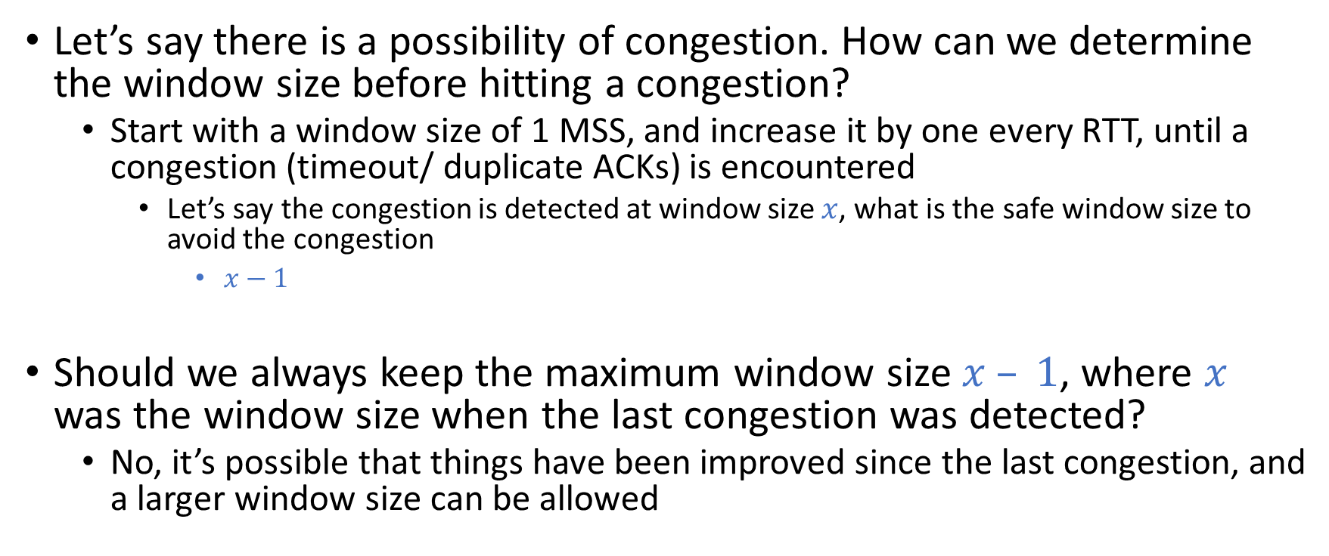
cwnd estimation
Let’s say there is a possibility of congestion. How can we determine the window size before hitting a congestion?
Start with a window size of 1 MSS, and increase it by one every RTT, until a congestion (timeout/ duplicate ACKs) is encountered
Let’s say the congestion is detected at window size $x$, what is the safe window size to avoid the congestion
$x−1$
Should we always keep the maximum window size $x – 1$, where $x$ was the window size when the last congestion was detected?
No, it’s possible that things have been improved since the last congestion, and a larger window size can be allowed

Slide 42

cwnd estimation
After congestion is detected, should we keep the window size $x – 1$

Slide 43

cwnd estimation
After congestion is detected, should we keep the window size $x – 1$
No, because right now the gateways are congested, better to slow down a bit to reduce the load on the gateways
What should be the policy to reduce the sending rate?

Slide 44
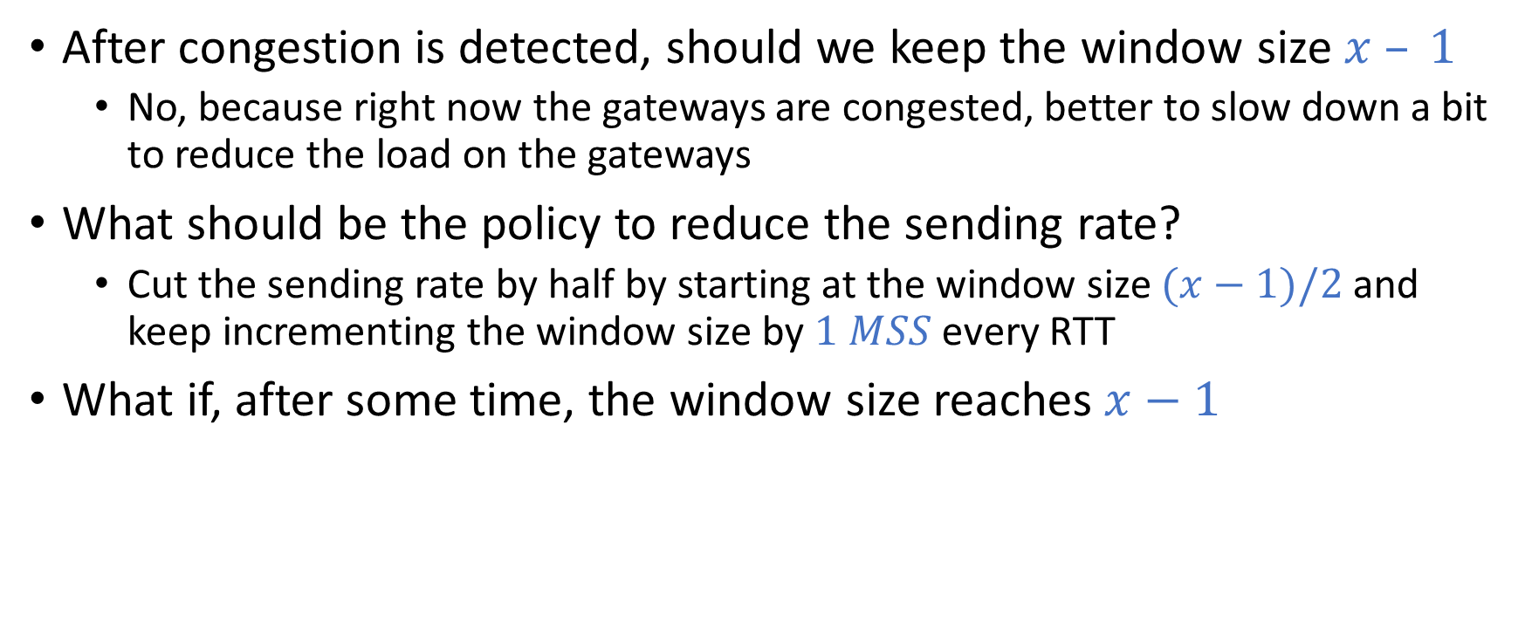
cwnd estimation
After congestion is detected, should we keep the window size $x – 1$
No, because right now the gateways are congested, better to slow down a bit to reduce the load on the gateways
What should be the policy to reduce the sending rate?
Cut the sending rate by half by starting at the window size $(x−1)/2$and keep incrementing the window size by $1 MSS$every RTT
What if, after some time, the window size reaches $x−1$

Slide 45
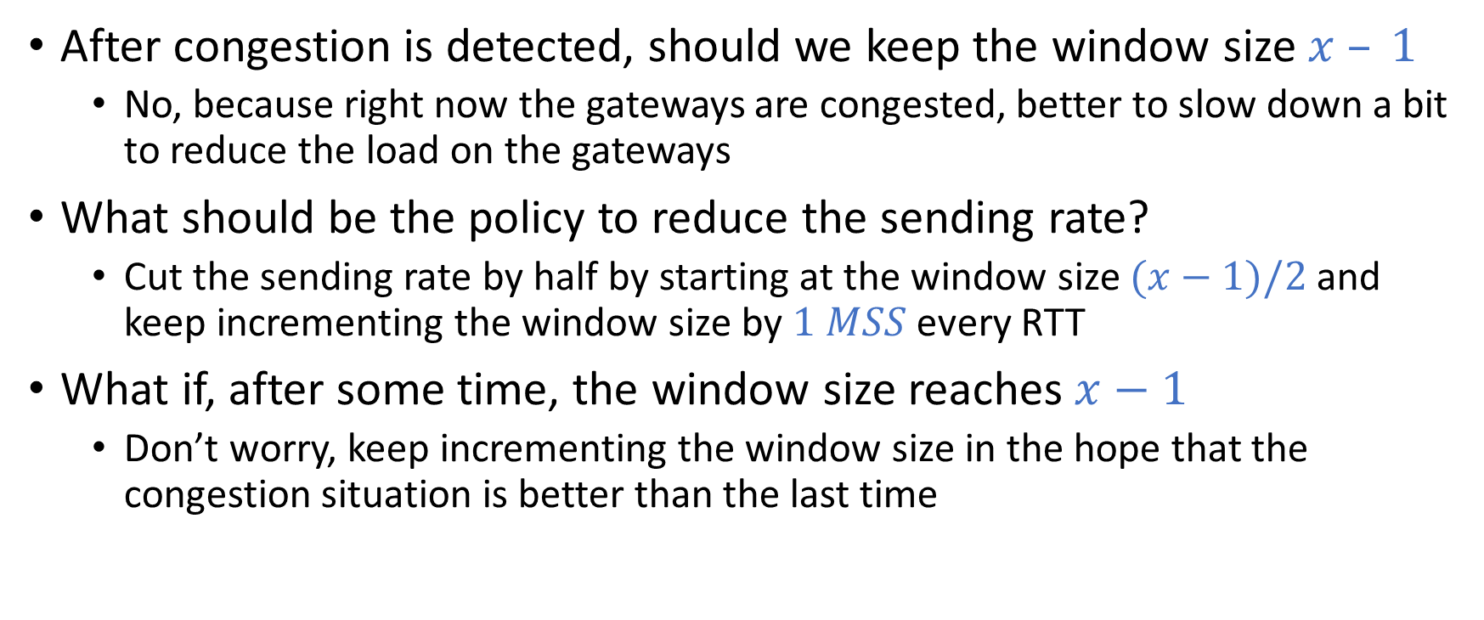
cwnd estimation
After congestion is detected, should we keep the window size $x – 1$
No, because right now the gateways are congested, better to slow down a bit to reduce the load on the gateways
What should be the policy to reduce the sending rate?
Cut the sending rate by half by starting at the window size $(x−1)/2$and keep incrementing the window size by $1 MSS$every RTT
What if, after some time, the window size reaches $x−1$
Don’t worry, keep incrementing the window size in the hope that the congestion situation is better than the last time

Slide 46
cwnd estimation
Congestion window estimation
Start with a window size of 1 MSS, and increase it by one every RTT, until a congestion (timeout/ duplicate ACKs) is encountered
Do you see a problem with the above congestion window estimation algorithm?

Slide 47
cwnd estimation
Congestion window estimation
Start with a window size of 1 MSS, and increase it by one every RTT, until a congestion (timeout/ duplicate ACKs) is encountered
Do you see a problem with the above congestion window estimation algorithm?
Yes, very slow. It’ll take a while to detect the congestion point
How can we improve the previous algorithm to discover the congestion point quickly?

Slide 48

cwnd estimation
How can we improve the previous algorithm to discover the congestion point quickly?
Start from 1 MSS, and then double the window size every RTT
Let’s say the congestion is detected at window size $x$, what is the safe window size to avoid the congestion

Slide 49
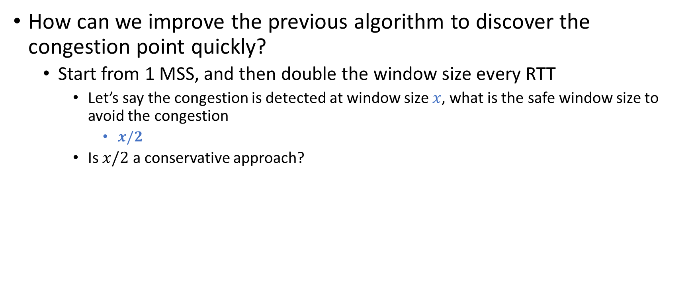
cwnd estimation
How can we improve the previous algorithm to discover the congestion point quickly?
Start from 1 MSS, and then double the window size every RTT
Let’s say the congestion is detected at window size $x$, what is the safe window size to avoid the congestion
$x/2$
Is $x/2$ a conservative approach?

Slide 50
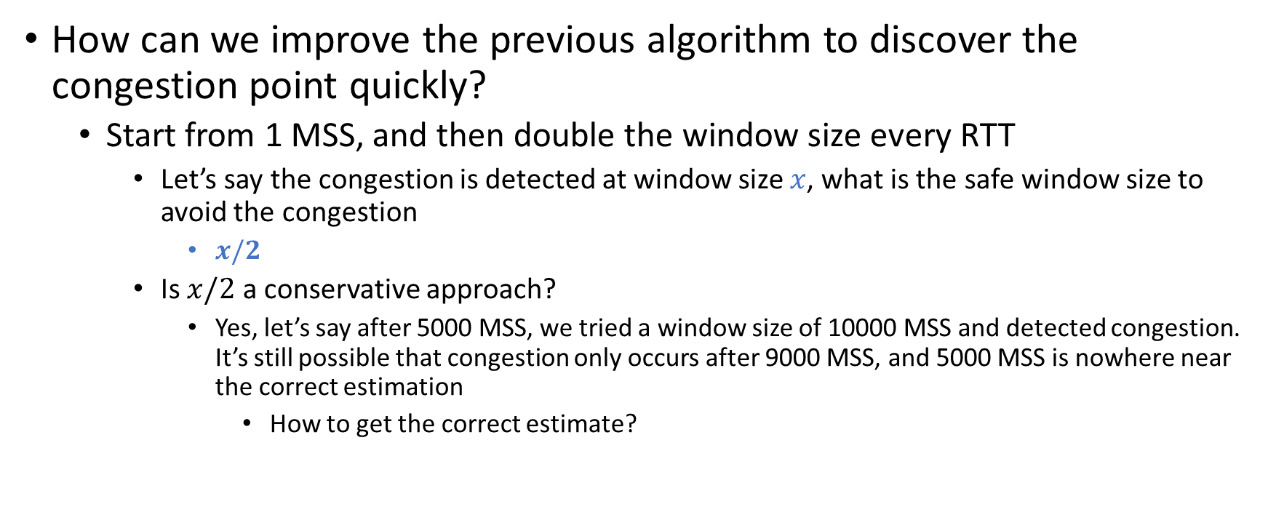
cwnd estimation
How can we improve the previous algorithm to discover the congestion point quickly?
Start from 1 MSS, and then double the window size every RTT
Let’s say the congestion is detected at window size $x$, what is the safe window size to avoid the congestion
$x/2$
Is $x/2$ a conservative approach?
Yes, let’s say after 5000 MSS, we tried a window size of 10000 MSS and detected congestion. It’s still possible that congestion only occurs after 9000 MSS, and 5000 MSS is nowhere near the correct estimation
How to get the correct estimate?

Slide 51

cwnd estimation
How can we improve the previous algorithm to discover the congestion point quickly?
Start from 1 MSS, and then double the window size every RTT
Let’s say the congestion is detected at window size $x$, what is the safe window size to avoid the congestion
$x/2$
Is $x/2$ a conservative approach?
Yes, let’s say after 5000 MSS, we tried a window size of 10000 MSS and detected congestion. It’s still possible that congestion only occurs after 9000 MSS, and 5000 MSS is nowhere near the correct estimation
How to get the correct estimate?
Increase the window size by 1 MSS starting from 5000 MSS till you hit a congestion

Slide 52
TCP congestion control
As we have built some intuition behind the congestion control, let’s discuss how TCP implements congestion control

Slide 53
TCP congestion control
TCP congestion control consists of three phases
Slow start
Congestion avoidance
Fast recovery

Slide 54
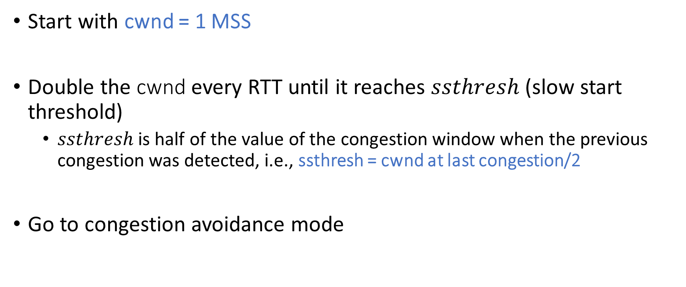
Slow start
Start with cwnd = 1 MSS
Double the cwnd every RTT until it reaches $ssthresh$ (slow start threshold)
$ssthresh$ is half of the value of the congestion window when the previous congestion was detected, i.e., ssthresh = cwnd at last congestion/2
Go to congestion avoidance mode

Slide 55
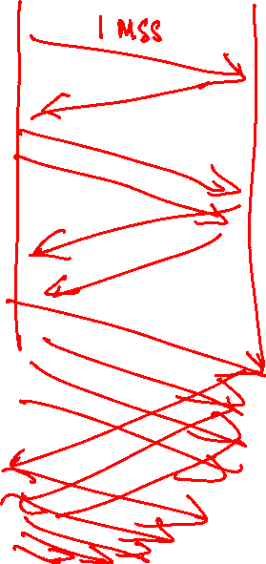
Slow start

Slide 56

Slow start
Host A
Host B
one segment
RTT
two segments
four segments
time
Copyright © 2010-2025 J.F. Kurose, K.W. Ross

Slide 57
Congestion avoidance
At this point cwnd, is halfway since the last congestion was detected
Be extra conscious now because congestion may likely happen
Increase the cwnd by 1 MSS every RTT
If there is a timeout (strong evidence of congestion)
set ssthresh = cwnd/2 and cwnd = 1
go to the slow start phase
If three duplicate ACKs (slightly weaker congestion)
The congestion might not be so bad because the receiver is still receiving out-of-order segments
The idea is to resume congestion avoidance after reducing the sending rate by half
set ssthresh = cwnd/2 and cwnd = ssthresh + 3 ∗ MSS
go to fast recovery mode

Slide 58
Fast recovery
Stay in recovery mode until new ACKs start arriving
Go to congestion avoidance mode once you encounter a new ACK
cwnd = ssthresh
On receiving a duplicate ACK, i.e., the one that triggered the fast recovery
cwnd = cwnd+1

Slide 59
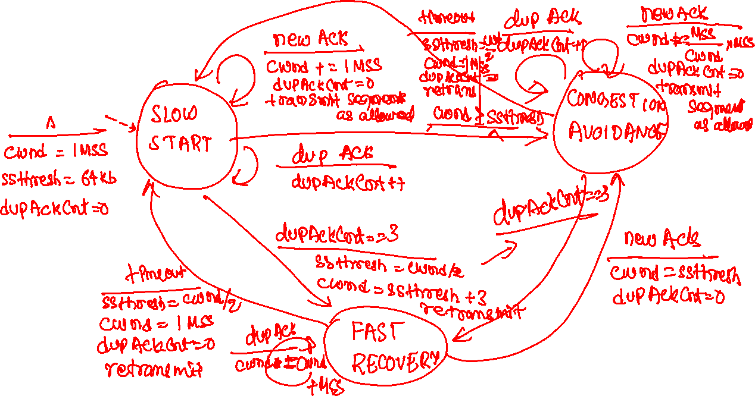
FSM

Slide 60


FSM
New
ACK!
New
ACK!
.
duplicate ACK
new ACK
dupACKcount++
new ACK
cwnd = cwnd + MSS (MSS/cwnd)
dupACKcount = 0
transmit new segment(s), as allowed
cwnd = cwnd+MSS
dupACKcount = 0
transmit new segment(s), as allowed
Λ
cwnd = 1 MSS
ssthresh = 64 KB
dupACKcount = 0
cwnd > ssthresh
slow
start
Λ
congestion
avoidance
timeout
ssthresh = cwnd/2
cwnd = 1 MSS
dupACKcount = 0
retransmit missing segment
duplicate ACK
timeout
dupACKcount++
ssthresh = cwnd/2
cwnd = 1 MSS
dupACKcount = 0
retransmit missing segment
timeout
New
ACK!
ssthresh = cwnd/2
cwnd = 1
dupACKcount = 0
retransmit missing segment
New ACK
dupACKcount == 3
cwnd = ssthresh
dupACKcount = 0
dupACKcount == 3
ssthresh= cwnd/2
cwnd = ssthresh + 3
retransmit missing segment
ssthresh= cwnd/2
cwnd = ssthresh + 3
retransmit missing segment
fast
recovery
duplicate ACK
cwnd = cwnd + MSS
transmit new segment(s), as allowed
Copyright © 2010-2025 J.F. Kurose, K.W. Ross

Slide 61
TCP versions
TCP Tahoe
Doesn’t have the fast recovery phase. Goes to the slow start on three duplicate ACKs.
The congestion control algorithm we discussed so far is implemented by TCP Reno

Slide 62
AIMD (additive-increase, multiplicative decrease)
In a common case, the congestion is detected using three duplicate ACKs
Therefore, the TCP congestion control shows a linear-increase (1 MSS per-RTT) and multiplicative decrease (halving the cwnd) behaviour, referred to as AIMD
AIMD makes the congestion window vs. time graph look like a sawtooth

Slide 63
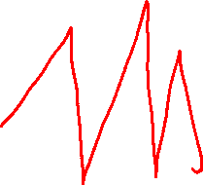
AIMD

Slide 64

AIMD
$W_{max}$ is the window size at which congestion is detected
Let’s say the congestion point didn’t change a lot and resulted in the following graph
Could there be a better scheme than AIMD
W_{max}
W_{max}/2
Copyright © 2010-2025 J.F. Kurose, K.W. Ross

Slide 65

TCP Cubic
$W_{max}$ is the window size at which congestion is detected
Let’s say the congestion point didn’t change a lot and resulted in the following graph
Could there be a better scheme than AIMD
CUBIC uses a cubic function that ramps up quickly initially, but slows down as the window size approaches $W_{max}$
TCP Cubic is the default on Linux
W_{max}
classic TCP
TCP CUBIC - higher throughput in this example
W_{max}/2
Copyright © 2010-2025 J.F. Kurose, K.W. Ross

