Slide 2
Today’s topics
Congestion control
Fairness
TCP vs UDP

Slide 3
References
Read Chapter-3.7, 4.2 from the Kurose and Ross book
Read Chapter-5.2.3 from the Peterson and Davie book

Slide 4
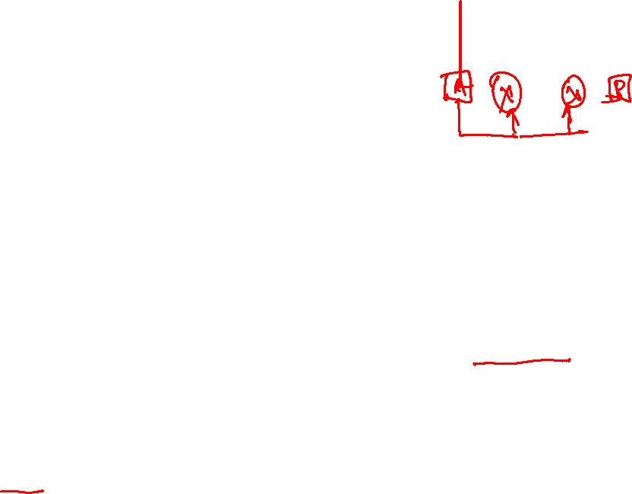
Network assisted congestion control
On experiencing congestion, instead of dropping the packets, the gateways (routers) set the ECN (explicit congestion notification) bits in the network header of the packets
If the ECN bit is set in the network header, the TCP sets the ECN-Echo (ECE) flag in the TCP ACK to notify the sender
The sender sets its cwnd to half on seeing the ECE flag set in the TCP ACK, and sets the CWR (congestion window reduced) in the header of the next transmitted segment

Slide 5
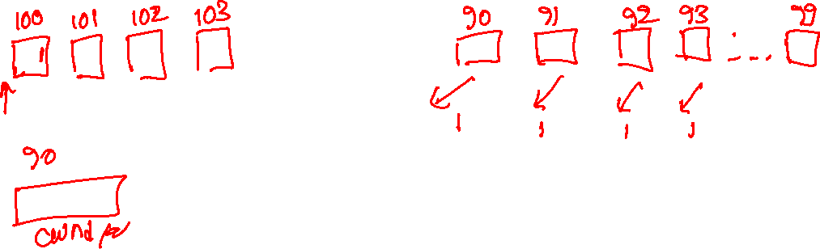
Network assisted congestion control
The advantage of network assisted congestion control is that the senders can reduce their window size hopefully before the packet loss

Slide 6

Delay-based congestion control

Slide 7
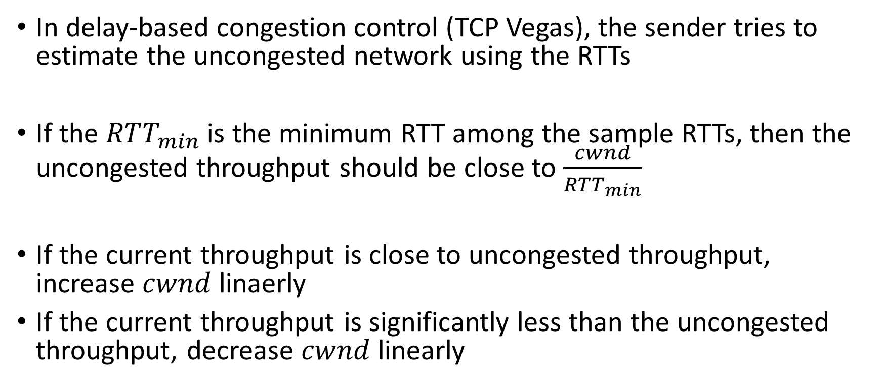
Delay-based congestion control
In delay-based congestion control (TCP Vegas), the sender tries to estimate the uncongested network using the RTTs
If the $RTT_{min}$ is the minimum RTT among the sample RTTs, then the uncongested throughput should be close to $\frac{cwnd}{RTT_{min}}$
If the current throughput is close to uncongested throughput, increase $cwnd$ linaerly
If the current throughput is significantly less than the uncongested throughput, decrease $cwnd$ linearly

Slide 8

Fairness
If $k$ TCP connections are passing through a bottleneck link with transmission rate $R$ bps, a congestion control mechanism is fair if the average sending rate of each TCP connection is $\frac{R}{k}$ (assuming each connection has enough data to send all the time)

Slide 9
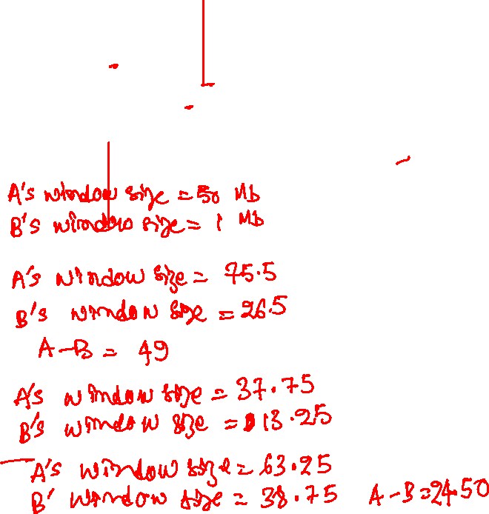
Is AIMD fair?
Initially:
MSS = 1 Mb
A’s window size = 100 Mb
B’s window size = 2 Mb
A – B = 98
Let’s assume that congestion always occurs at 102 Mb

Slide 10
Is AIMD fair?
Initially:
MSS = 1MB
A’s window size = 100 Mb
B’s window size = 2 Mb
A – B = 98
Let’s assume that congestion always occurs at 102 Mb
After a multiplicative decrease
A’s window size = 50 Mb
B’s window size = 1 Mb
Congestion will be detected when
A’s window size = 75.5 Mb
B’s window size = 26.5 Mb
A – B = 49
After a multiplicative decrease
A’s window size = 37.75
B’s window size = 13.25
Congestion will be detected at:
A’s window size = 63.25
A’s window size = 38.75
A – B = 24.5

Slide 11
Is AIMD fair?
Initially:
MSS = 1MB
A’s window size = 100 Mb
B’s window size = 2 Mb
A – B = 98
Let’s assume that congestion always occurs at 102 Mb
After a multiplicative decrease
A’s window size = 50 Mb
B’s window size = 1 Mb
Congestion will be detected when
A’s window size = 75.5 Mb
B’s window size = 26.5 Mb
A – B = 49
After a multiplicative decrease
A’s window size = 37.75
B’s window size = 13.25
Congestion will be detected at:
A’s window size = 63.25
A’s window size = 38.75
A – B = 24.5
Conclusion: AIMD is fair, because the throughput of A and B gradually becomes roughly equal.

Slide 12

Example
TCP connection 1
bottleneck
router
capacity R
TCP connection 2
Copyright © 2010-2025 J.F. Kurose, K.W. Ross

Slide 13

Example
Connection-2 throughput
Full utilization
Equal bandwidth
Connection-1 throughput
Copyright © 2010-2025 J.F. Kurose, K.W. Ross

Slide 14
Example
Connection-2 throughput
Full utilization
Equal bandwidth
Connection-1 throughput
Copyright © 2010-2025 J.F. Kurose, K.W. Ross

Slide 15
Example
Connection-2 throughput
Full utilization
Equal bandwidth
Connection-1 throughput
Copyright © 2010-2025 J.F. Kurose, K.W. Ross

Slide 16
Example
Connection-2 throughput
Full utilization
Equal bandwidth
Connection-1 throughput
Copyright © 2010-2025 J.F. Kurose, K.W. Ross

Slide 17
Example
Connection-2 throughput
Full utilization
Equal bandwidth
Connection-1 throughput
Copyright © 2010-2025 J.F. Kurose, K.W. Ross

Slide 18
Example
Connection-2 throughput
Full utilization
Equal bandwidth
Connection-1 throughput
Copyright © 2010-2025 J.F. Kurose, K.W. Ross

Slide 19
Example
Connection-2 throughput
Full utilization
Equal bandwidth
Connection-1 throughput
Copyright © 2010-2025 J.F. Kurose, K.W. Ross

Slide 20
AIMD fairness
Even though the AIMD algorithm is fair, can a TCP user still get a larger share of the bandwidth than other peers who are also transmitting through the congested path

Slide 21
AIMD fairness
Even though the AIMD algorithm is fair, can a TCP user still get a larger share of the bandwidth than other peers who are also transmitting through the congested path
Yes, the user can create multiple TCP connections. The congestion control protocol is per TCP connection
In fact, web browsers before HTTP/2 used parallel TCP connections to receive multiple objects on a web page

Slide 22
Fairness and UDP
Multimedia applications, such as internet telephony or video conferencing, prefer UDP because it doesn’t throttle the transmission rate in the event of congestion

Slide 23
TCP vs. UDP
TCP is a byte-stream-oriented protocol, i.e., the sender sends a stream of bytes and expects a stream of bytes at the receiver end
Does this mean that the transport layer can merge TCP segments?

Slide 24
TCP vs. UDP
TCP is a byte-stream-oriented protocol, i.e., the sender sends a stream of bytes and expects a stream of bytes at the receiver end
Does this mean that the transport layer can merge TCP segments?
Yes, of course, the TCP receiver just expects a sequence of bytes in the correct order, enforced by sequence numbers
Is UDP also stream-oriented
No UDP is message-oriented (datagram-oriented)
Each UDP segment is independent
The receiver gets exactly what the sender sent, as a single datagram
Merging or splitting UDP segments is not allowed

Slide 25
Merging TCP segments
Is there any incentive for merging TCP segments

Slide 26
Merging TCP segments
Is there any incentive for merging TCP segments
Yes, if the combined size is less than or equal to MSS, then the merged TCP segment would require only one TCP header, saving the total amount of data transferred on the physical link
What could be a possible strategy to merge TCP segments?

Slide 27
Merging TCP segments
Is there any incentive for merging TCP segments
Yes, if the combined size is less than or equal to MSS, then the merged TCP segment would require only one TCP header, saving the total amount of data transferred on the physical link
What could be a possible strategy to merge TCP segments?
TCP can buffer small amounts of data before sending to fill a segment closer to MSS

Slide 28
Nagle’s algorithm
when the application produces data to send
if both the available data and the window >= MSS
send a full segment
else
if there is unACKed data in flight
buffer the new data until ACK arrives
else
send all the new data now

Slide 29
Merging TCP segments
Have you noticed TCP segments merging somewhere?

Slide 30
Merging TCP segments
Have you noticed TCP segments merging somewhere?
Yes, in assignment-1, when we changed the buffer size to 128 in the receiver

Slide 31
Network layer
The primary goal of the network layer is to forward packets destined to a given IP address using a forwarding table
The forwarding is done by routers (a type of Gateway) that operate at the network layer
In addition to forwarding, the routers also compute the forwarding table
The forwarding table is computed in a decentralized manner by all the routers
The routers are the central entity in the network layer, responsible for both packet forwarding and route computation

Slide 32
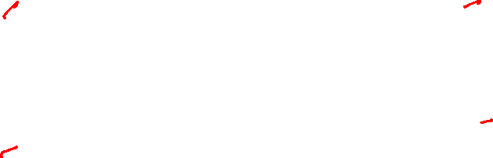
What is inside a router?
routing, management
control plane (software)
operates in millisecond
time frame
routing
processor
forwarding data plane (hardware) operates in nanosecond timeframe
high-speed
switching
fabric
router input ports
router output ports
Copyright © 2010-2025 J.F. Kurose, K.W. Ross

Slide 33
What is inside a router?
Routing processor
Runs the routing protocols to compute the forwarding table
Input physical port
An input port is always connected to a transmission link
Packets arrive at the input port
Packets could be control packets or data packets
Control packets are used to build the forwarding table and are passed to the routing processor
Other data packets are transferred to an output port suggested by the forwarding table

Slide 34
What is inside a router?
Switching fabric
Connects the router’s input ports to its output ports
It’s responsible for transferring packets from input to output once the forwarding decision has been taken
Output physical port
An output port temporarily stores the packets received from the switching fabric and transmits them to the physical link connected to the port

Slide 35
What is inside a router?
The input ports, output ports, and switching fabric are implemented in hardware
For a 100 Gbps input link, the hardware has only 5.12 ns to process a 64-byte packet before another packet may arrive
A software implementation is much slower and can’t support such a high bandwidth

Slide 36

How does the forwarding table look like?
DESTINATION ADDRESS | OUTPUT PORT
200.23.16.0/21 | 0
200.23.24.0/24 | 1
200.23.25.0/21 | 2
Otherwise | 3
Top 21 bits of 200.23.16.0 == Top 21 bits of the destination address, forward the packet to the output port 0.
Top 24 bits of 200.23.24.0 == Top 21 bits of the destination address, forward the packet to the output port 1.
Top 21 bits of 200.23.25.0 == Top 21 bits of the destination address, forward the packet to the output port 2.
Otherwise, forward the packet to the output port 3.

Slide 37
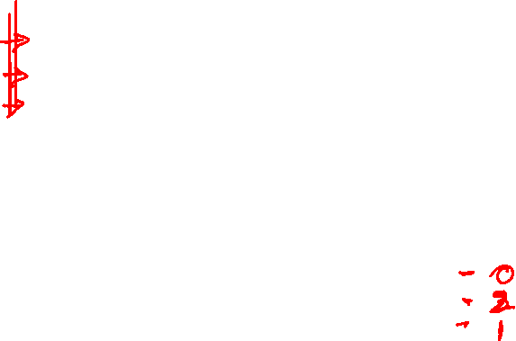
How does the forwarding table look like?
PREFIX (bitmap) | OUTPUT PORT
11001000 00010111 00010 | 0
11001000 00010111 00011000 | 1
11001000 00010111 00011 | 2
Otherwise | 3
What would be the output port for the following destination addresses?
11001000 00010111 00010110 10100001
11001000 00010111 00011100 11001100
11001000 00010111 00011000 11001100

Slide 38
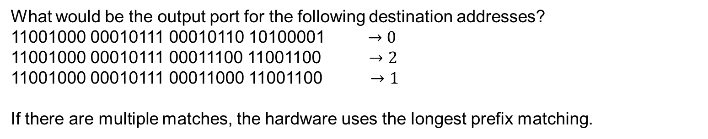
How does the forwarding table look like?
PREFIX (bitmap) | OUTPUT PORT
11001000 00010111 00010 | 0
11001000 00010111 00011000 | 1
11001000 00010111 00011 | 2
Otherwise | 3
What would be the output port for the following destination addresses?
11001000 00010111 00010110 10100001 $→0$
11001000 00010111 00011100 11001100 $→2$
11001000 00010111 00011000 11001100 $→1$
If there are multiple matches, the hardware uses the longest prefix matching.

Slide 39
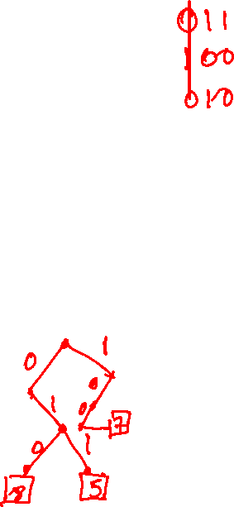
How routers implement prefix match
High-speed routers store the forwarding table in Ternary Content Addressable Memory (TCAM)
Unlike RAM, TCAM can search the entire contents in a single clock cycle by comparing an input to all the contents simultaneously

Slide 40
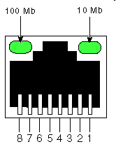
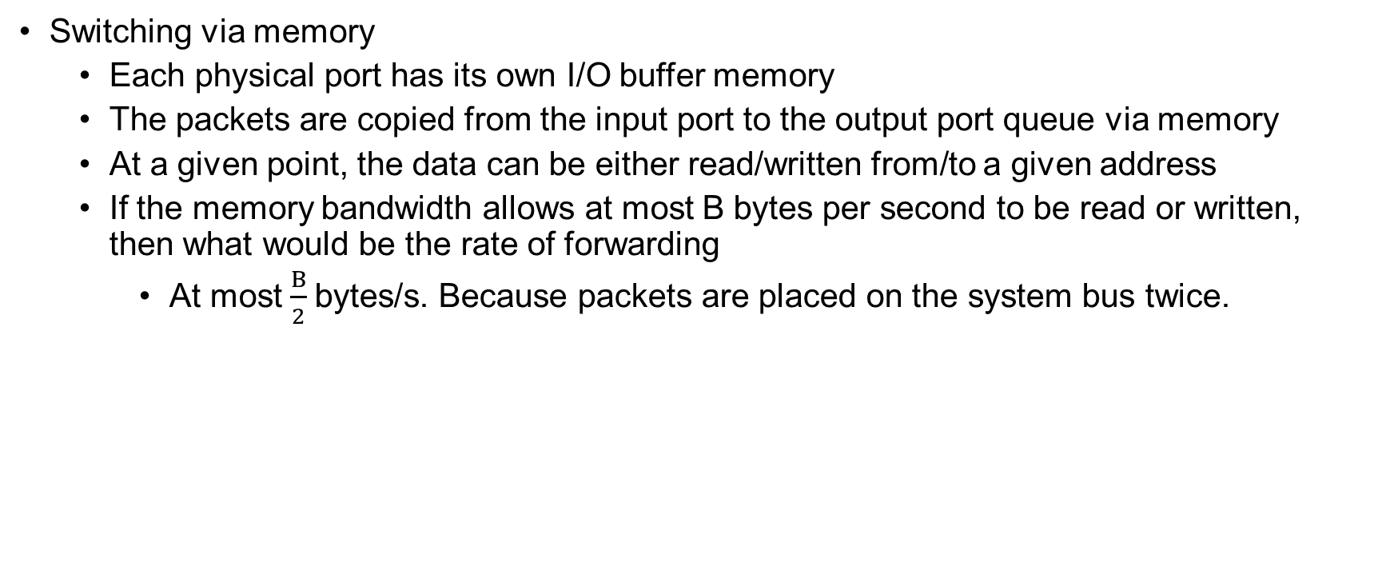
Switching fabric
Switching via memory
Each physical port has its own I/O buffer memory
The packets are copied from the input port to the output port queue via memory
At a given point, the data can be either read/written from/to a given address
If the memory bandwidth allows at most B bytes per second to be read or written, then what would be the rate of forwarding
At most $\frac{B}{2}$bytes/s. Because packets are placed on the system bus twice.
input
port
(e.g.,
Ethernet)
output
port
(e.g.,
Ethernet)
memory
system bus
Copyright © 2010-2025 J.F. Kurose, K.W. Ross

Slide 41
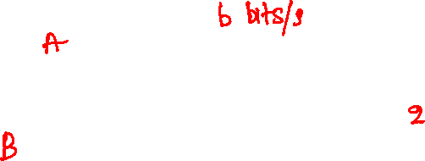
Switching fabric
Switching via a bus
All input and output ports are connected via a shared bus
When an input port wants to transfer a packet, it attaches a tag corresponding to the output port to the packet and places it on the shared bus
All output ports receive the data, but the one whose tag matches keeps the packet
Only one port can transmit data at a time
Packets are placed on the bus only once
2x better performance than switching via memory, because packets are placed only once, not twice, as in the case of memory, on the shared bus
Copyright © 2010-2025 J.F. Kurose, K.W. Ross

Slide 42
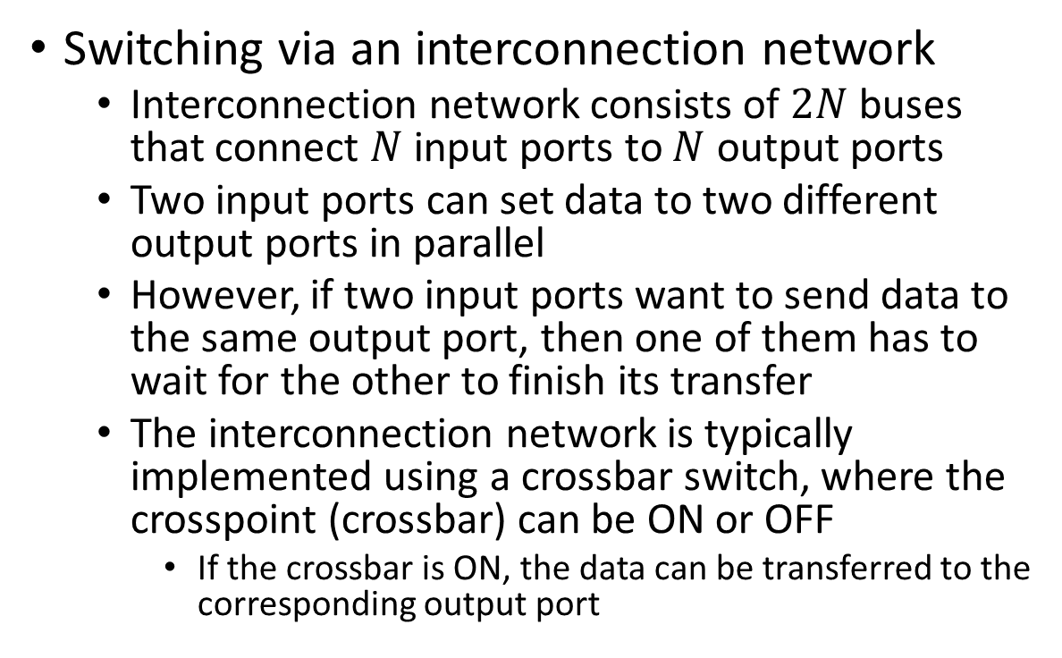
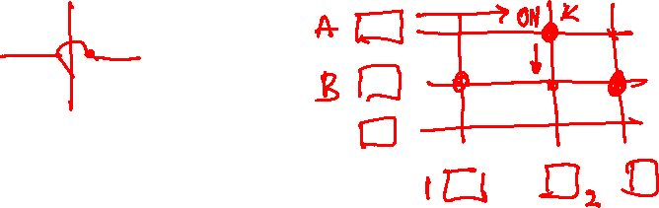
Switching fabric
Switching via an interconnection network
Interconnection network consists of $2N$ buses that connect $N$ input ports to $N$ output ports
Two input ports can set data to two different output ports in parallel
However, if two input ports want to send data to the same output port, then one of them has to wait for the other to finish its transfer
The interconnection network is typically implemented using a crossbar switch, where the crosspoint (crossbar) can be ON or OFF
If the crossbar is ON, the data can be transferred to the corresponding output port
interconnection
network
Copyright © 2010-2025 J.F. Kurose, K.W. Ross

Slide 43
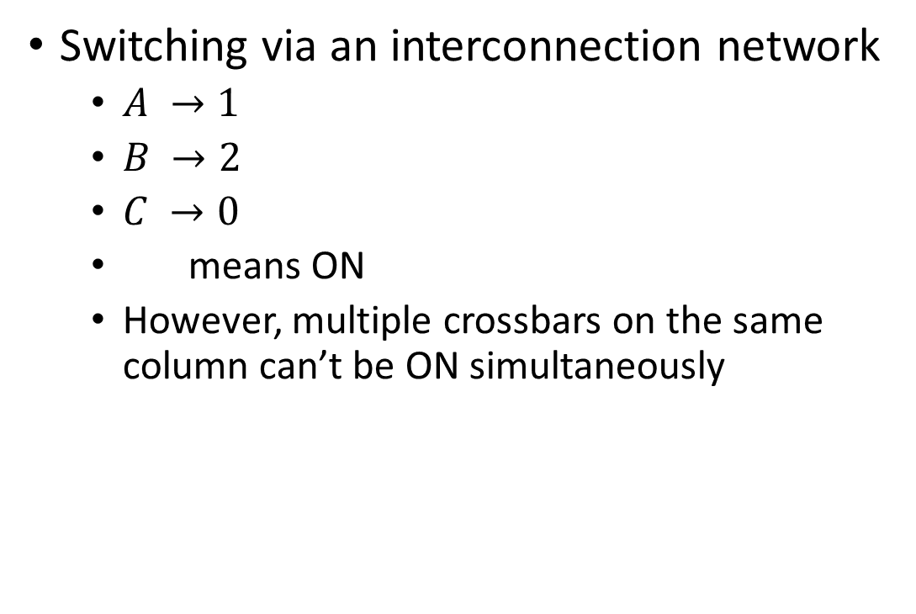
Switching fabric
Switching via an interconnection network
$A →1$
$B →2$
$C →0$
means ON
However, multiple crossbars on the same column can’t be ON simultaneously
A
B
C
interconnection
network
0
1
2
Copyright © 2010-2025 J.F. Kurose, K.W. Ross

Slide 44
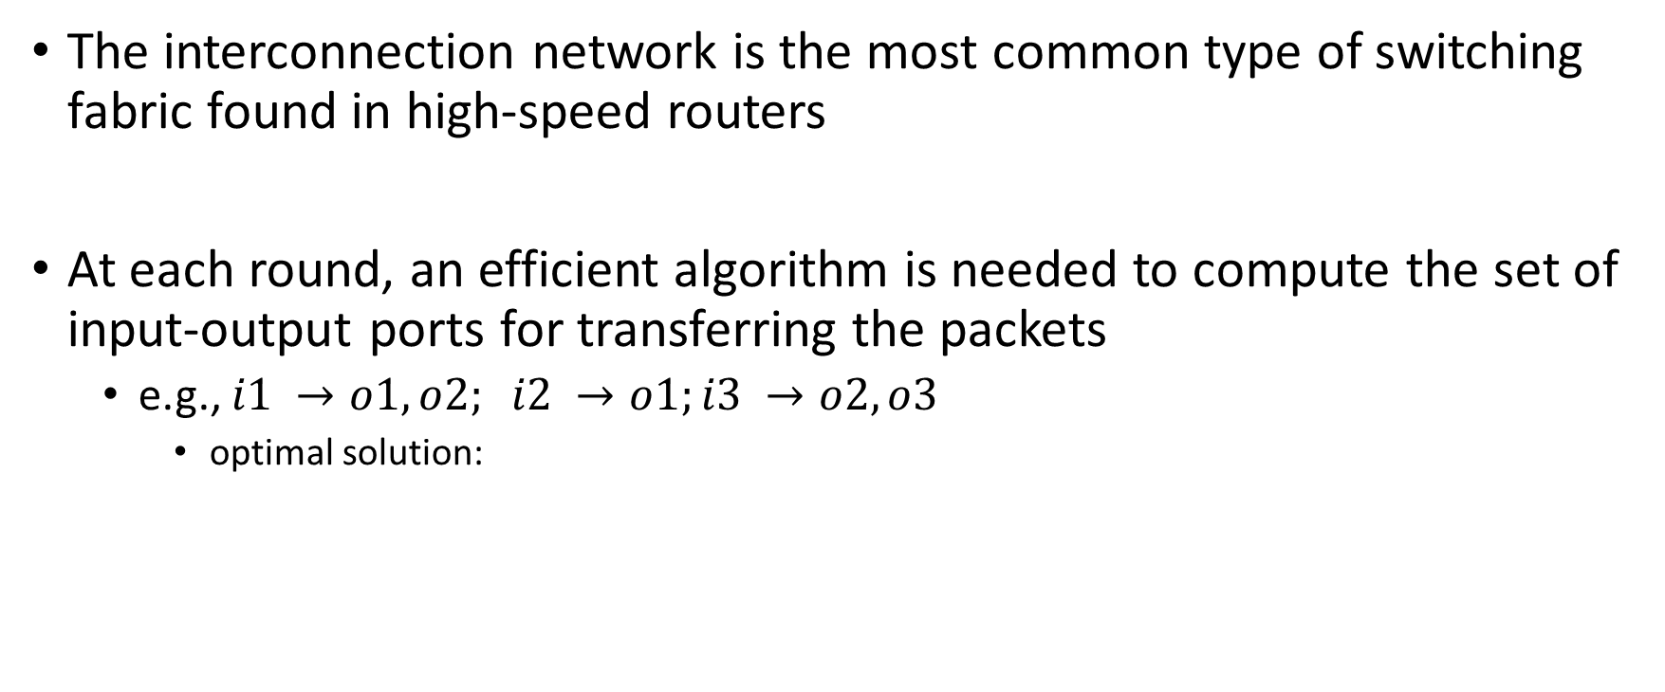
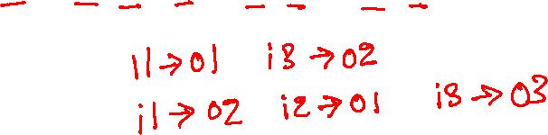
Interconnection network
The interconnection network is the most common type of switching fabric found in high-speed routers
At each round, an efficient algorithm is needed to compute the set of input-output ports for transferring the packets
e.g., $i1 →o1, o2; i2 →o1;i3 →o2, o3$
optimal solution:

Slide 45
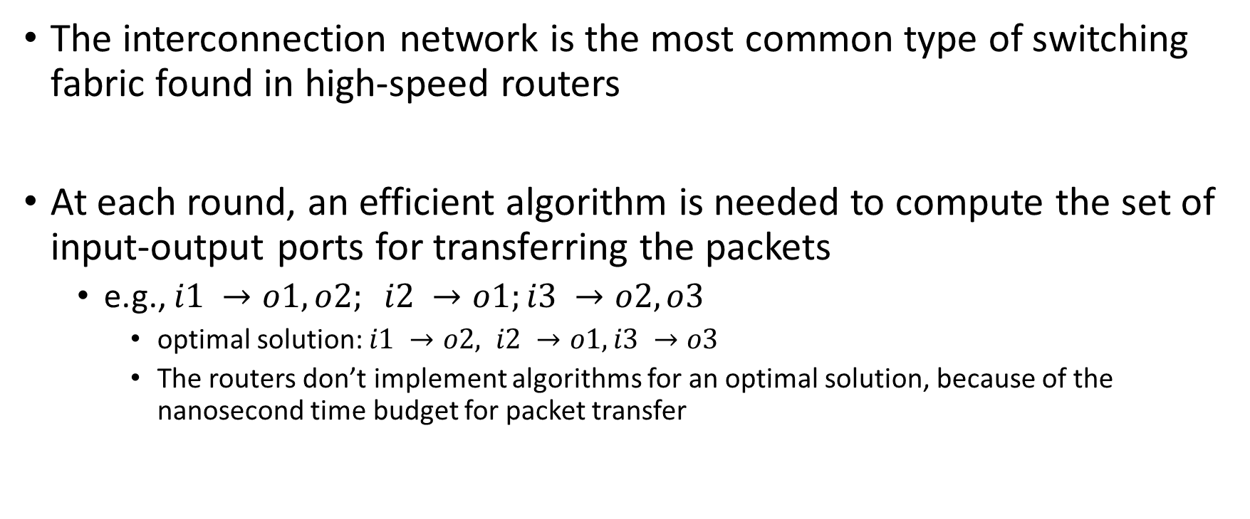
Interconnection network
The interconnection network is the most common type of switching fabric found in high-speed routers
At each round, an efficient algorithm is needed to compute the set of input-output ports for transferring the packets
e.g., $i1 →o1, o2; i2 →o1;i3 →o2, o3$
optimal solution: $i1 →o2, i2 →o1, i3 →o3$
The routers don’t implement algorithms for an optimal solution, because of the nanosecond time budget for packet transfer

Slide 46
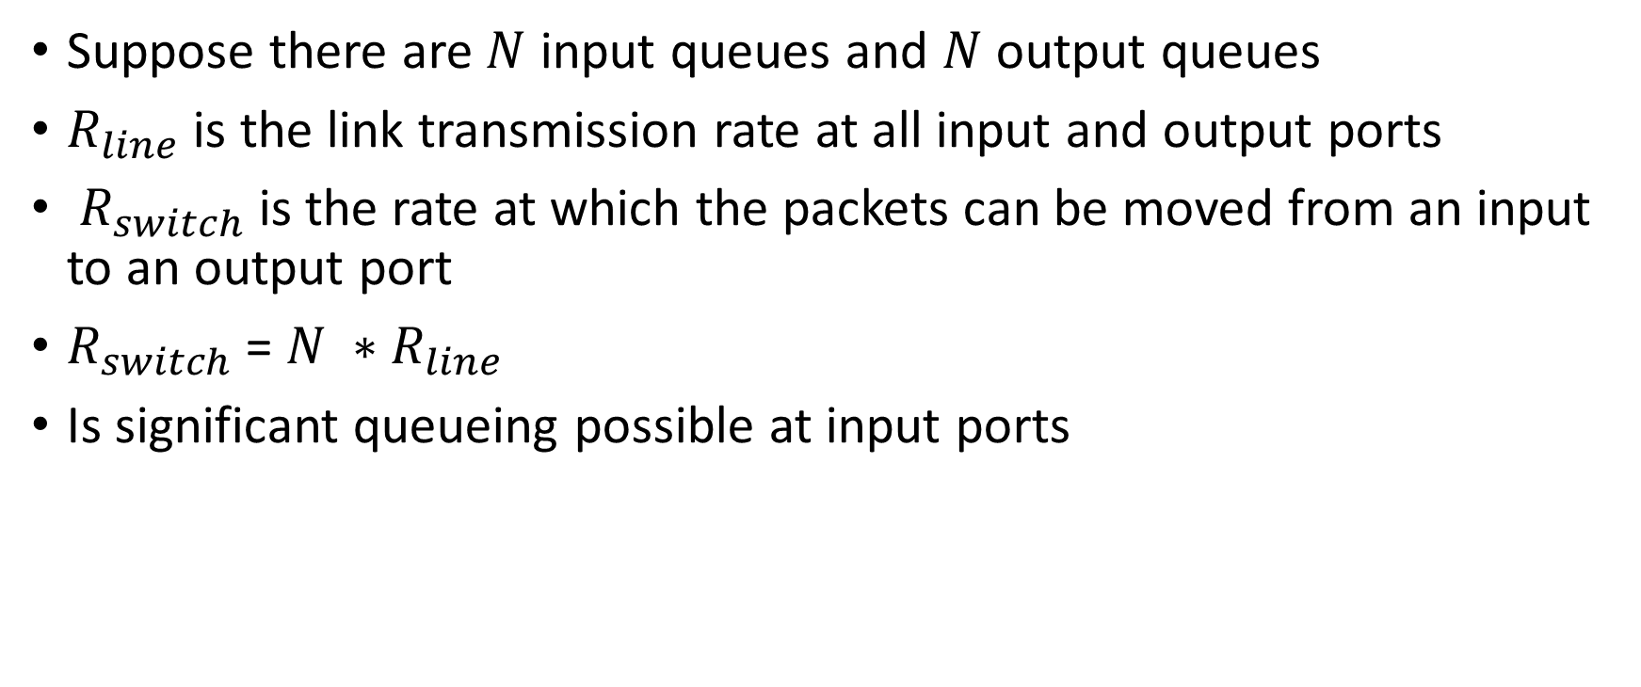
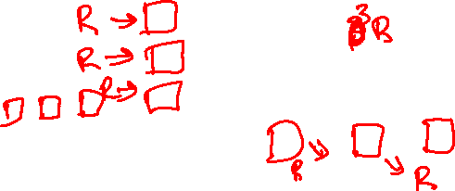
Queuing
Suppose there are $N$ input queues and $N$ output queues
$R_{line}$ is the link transmission rate at all input and output ports
$R_{switch}$ is the rate at which the packets can be moved from an input to an output port
$R_{switch}$ = $N ∗R_{line}$
Is significant queueing possible at input ports

Slide 47
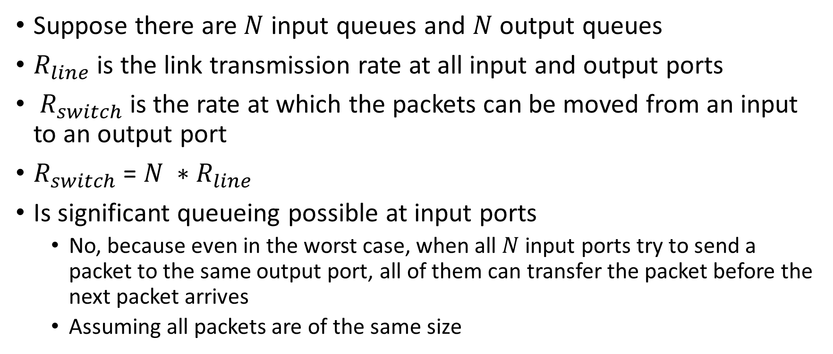
Queuing
Suppose there are $N$ input queues and $N$ output queues
$R_{line}$ is the link transmission rate at all input and output ports
$R_{switch}$ is the rate at which the packets can be moved from an input to an output port
$R_{switch}$ = $N ∗R_{line}$
Is significant queueing possible at input ports
No, because even in the worst case, when all $N$ input ports try to send a packet to the same output port, all of them can transfer the packet before the next packet arrives
Assuming all packets are of the same size

