Slide 2
Today’s topics
Switching fabric
Packet scheduling
Network Interface
Subnet
Classless interdomain routing

Slide 3
References
Read Chapter-4.2, 4.3 from the Kurose and Ross book

Slide 4
How does the forwarding table look like?
DESTINATION ADDRESS | OUTPUT PORT
200.23.16.0/21 | 0
200.23.24.0/24 | 1
200.23.25.0/21 | 2
Otherwise | 3
Top 21 bits of 200.23.16.0 == Top 21 bits of the destination address, forward the packet to the output port 0.
Top 24 bits of 200.23.24.0 == Top 21 bits of the destination address, forward the packet to the output port 1.
Top 21 bits of 200.23.25.0 == Top 21 bits of the destination address, forward the packet to the output port 2.
Otherwise, forward the packet to the output port 3.

Slide 5
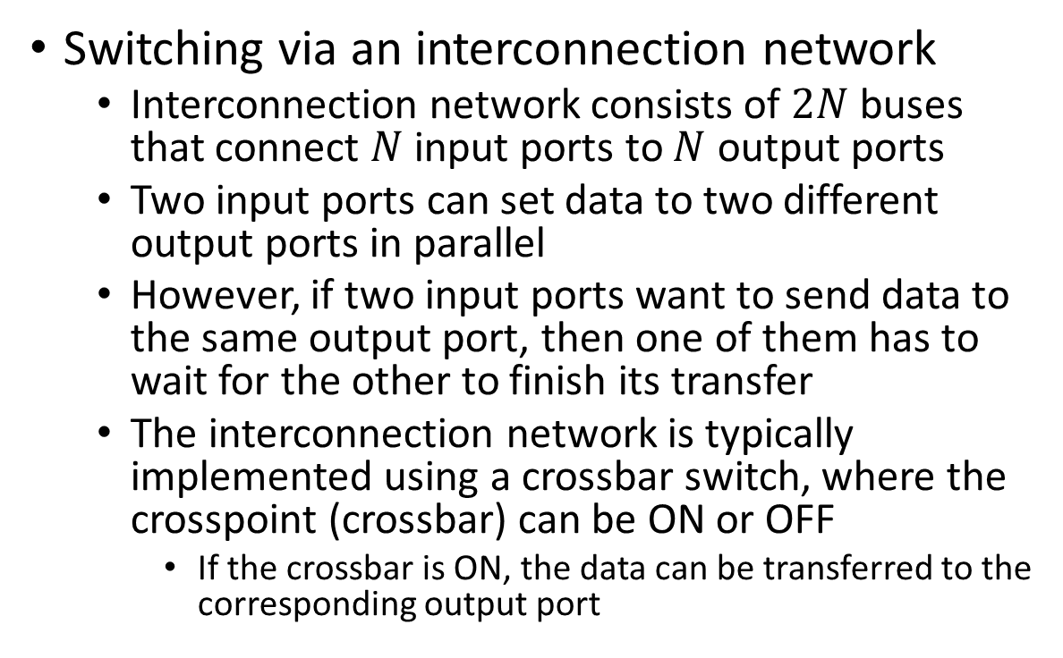

Switching fabric
Switching via an interconnection network
Interconnection network consists of $2N$ buses that connect $N$ input ports to $N$ output ports
Two input ports can set data to two different output ports in parallel
However, if two input ports want to send data to the same output port, then one of them has to wait for the other to finish its transfer
The interconnection network is typically implemented using a crossbar switch, where the crosspoint (crossbar) can be ON or OFF
If the crossbar is ON, the data can be transferred to the corresponding output port
A
B
C
interconnection
network
0
1
2
Copyright © 2010-2025 J.F. Kurose, K.W. Ross

Slide 6
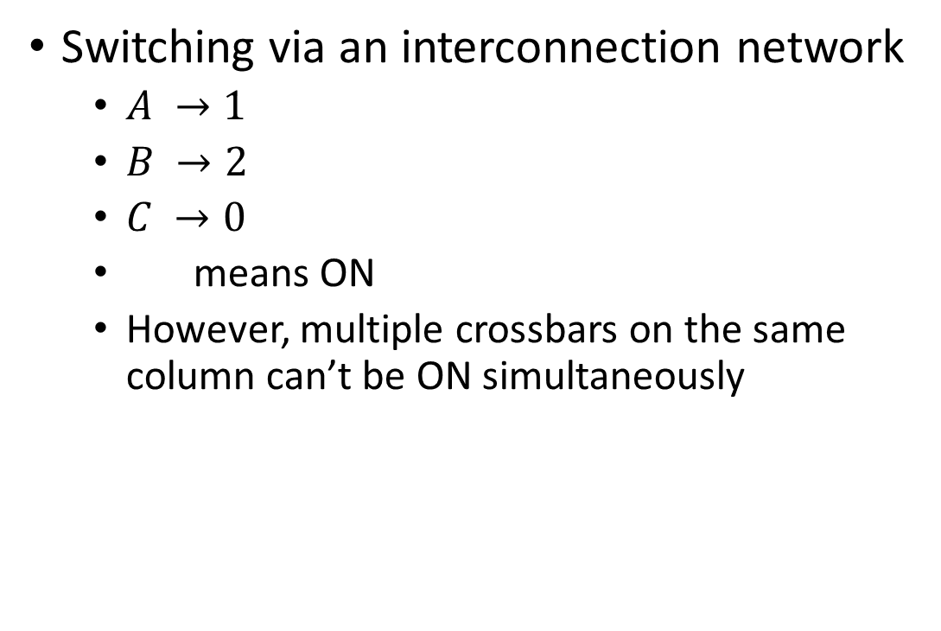
Switching fabric
Switching via an interconnection network
$A →1$
$B →2$
$C →0$
means ON
However, multiple crossbars on the same column can’t be ON simultaneously
A
B
C
interconnection
network
0
1
2
Copyright © 2010-2025 J.F. Kurose, K.W. Ross

Slide 7
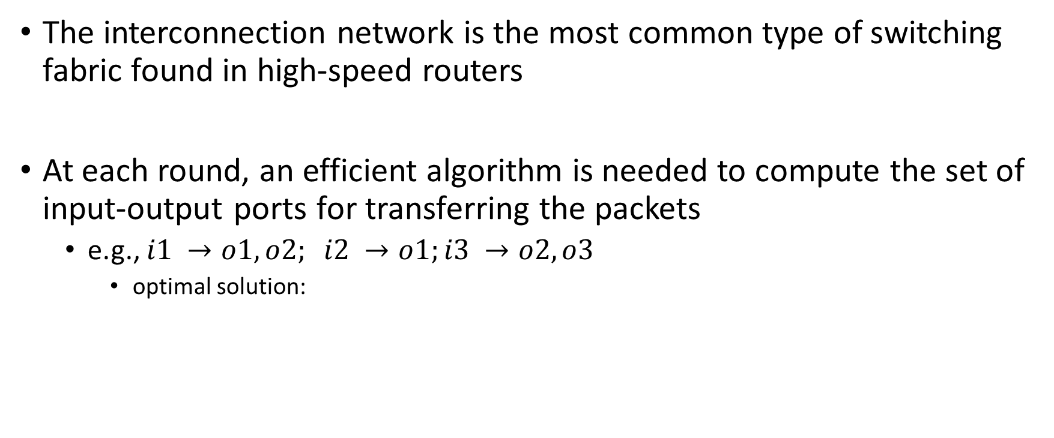
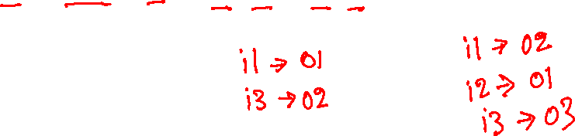
Interconnection network
The interconnection network is the most common type of switching fabric found in high-speed routers
At each round, an efficient algorithm is needed to compute the set of input-output ports for transferring the packets
e.g., $i1 →o1, o2; i2 →o1;i3 →o2, o3$
optimal solution:

Slide 8
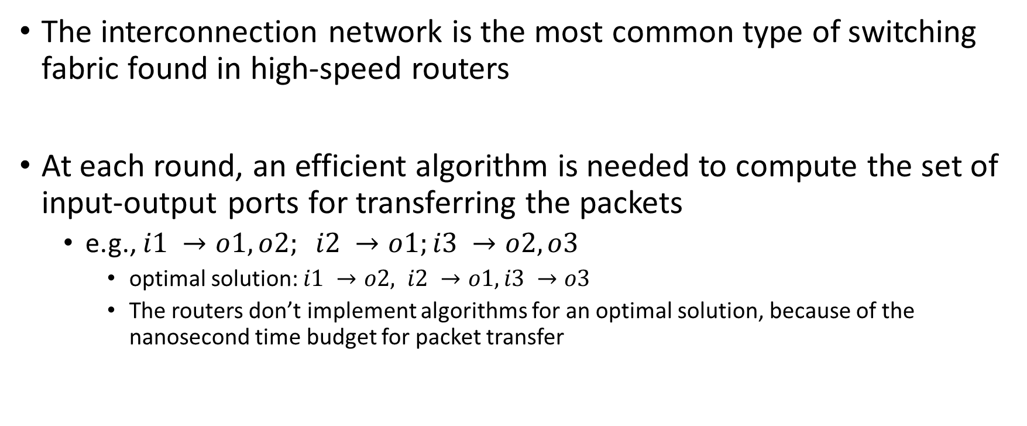
Interconnection network
The interconnection network is the most common type of switching fabric found in high-speed routers
At each round, an efficient algorithm is needed to compute the set of input-output ports for transferring the packets
e.g., $i1 →o1, o2; i2 →o1;i3 →o2, o3$
optimal solution: $i1 →o2, i2 →o1, i3 →o3$
The routers don’t implement algorithms for an optimal solution, because of the nanosecond time budget for packet transfer

Slide 9
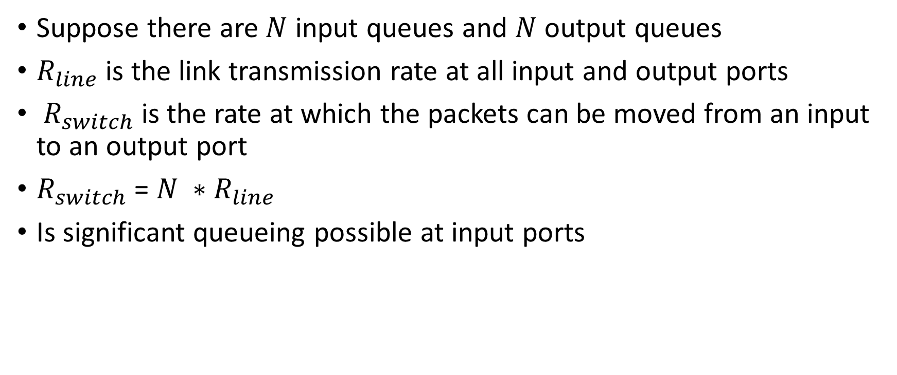
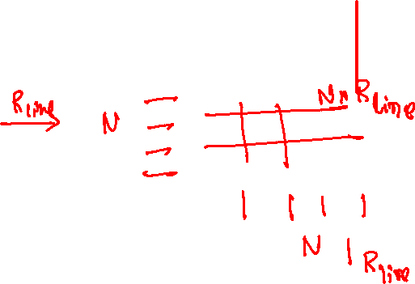
Queuing
Suppose there are $N$ input queues and $N$ output queues
$R_{line}$ is the link transmission rate at all input and output ports
$R_{switch}$ is the rate at which the packets can be moved from an input to an output port
$R_{switch}$ = $N ∗R_{line}$
Is significant queueing possible at input ports

Slide 10
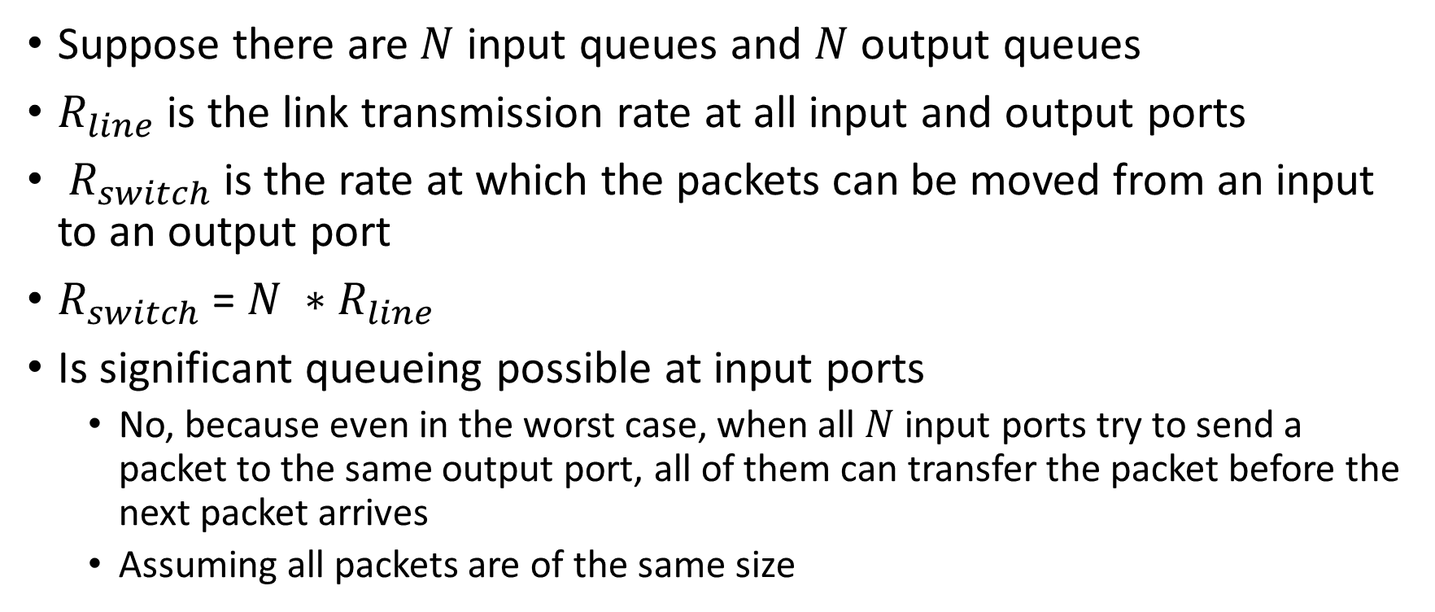
Queuing
Suppose there are $N$ input queues and $N$ output queues
$R_{line}$ is the link transmission rate at all input and output ports
$R_{switch}$ is the rate at which the packets can be moved from an input to an output port
$R_{switch}$ = $N ∗R_{line}$
Is significant queueing possible at input ports
No, because even in the worst case, when all $N$ input ports try to send a packet to the same output port, all of them can transfer the packet before the next packet arrives
Assuming all packets are of the same size

Slide 11

Queuing
What if $R_{switch}$ = $R_{line}$
Is queuing possible?

Slide 12

Queuing
What if $R_{switch}$ = $R_{line}$
Is queuing possible?
Yes

Slide 13

Head-of-the-line (HOL) blocking
Even though the green packet at the third input port can be transferred along with the red packet at the first input port, it has to wait because it’s not at the head of the queue
switch
fabric
switch
fabric
output port contention: only one red datagram can be transferred. lower red packet is blocked
one packet time later: green packet experiences HOL blocking
Copyright © 2010-2025 J.F. Kurose, K.W. Ross

Slide 14
HOL blocking
How can we eliminate HOL blocking?

Slide 15
HOL blocking
How can we eliminate HOL blocking?
Multiple queues corresponding to each output port at each input port

Slide 16
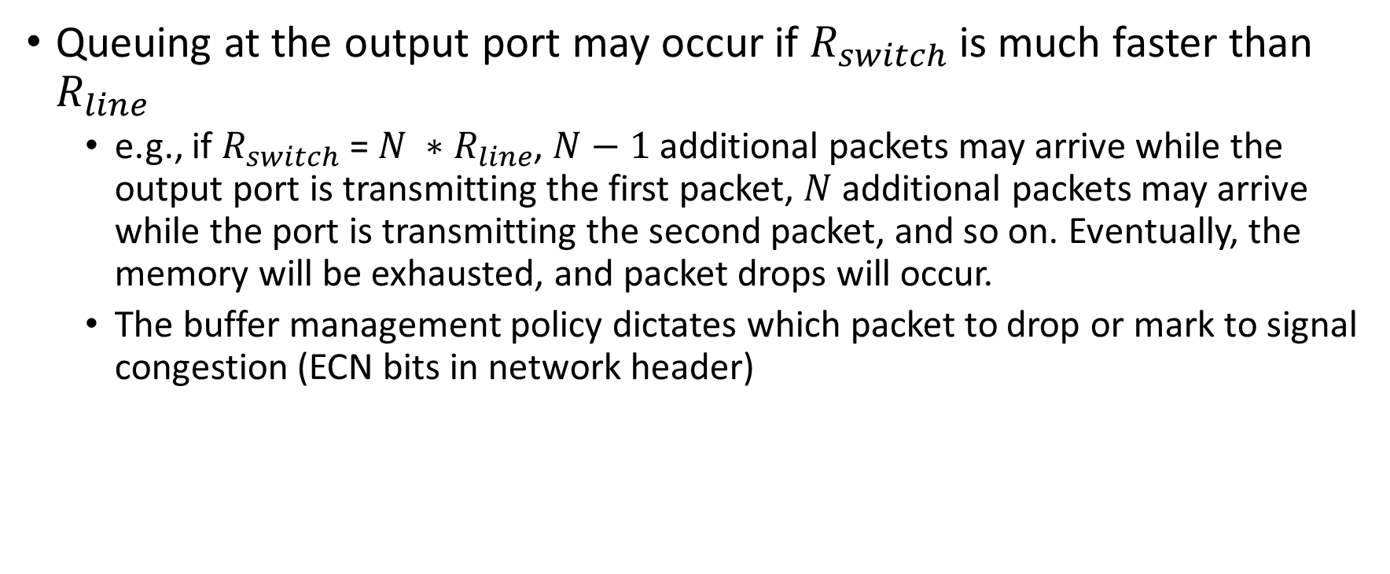
Output queuing
Queuing at the output port may occur if $R_{switch}$ is much faster than $R_{line}$
e.g., if $R_{switch}$ = $N ∗R_{line}$, $N−1$ additional packets may arrive while the output port is transmitting the first packet, $N$ additional packets may arrive while the port is transmitting the second packet, and so on. Eventually, the memory will be exhausted, and packet drops will occur.
The buffer management policy dictates which packet to drop or mark to signal congestion (ECN bits in network header)

Slide 17
Buffer size
What should be an ideal buffer size at an output port
An ideal buffer size would the total outstanding data in flight

Slide 18
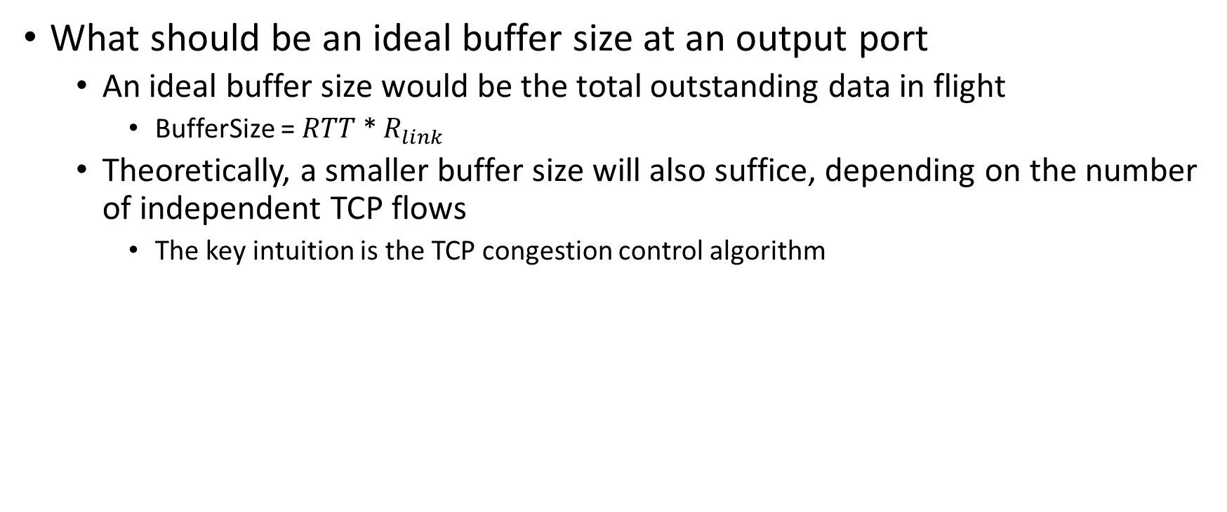
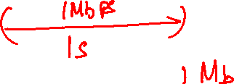
Buffer size
What should be an ideal buffer size at an output port
An ideal buffer size would be the total outstanding data in flight
BufferSize = $RTT$ * $R_{link}$
Theoretically, a smaller buffer size will also suffice, depending on the number of independent TCP flows
The key intuition is the TCP congestion control algorithm

Slide 19
Buffer size
What should be an ideal buffer size at an input port
In addition to the transmission rate at input links, the buffer size at the input port depends on various factors, such as the number of output ports, the packet scheduling algorithm, the speed and matching algorithm of the switching fabric, etc.
Typically, the queue size at the input port is small

Slide 20
Packet scheduling
Packet scheduling decides the order in which the queued packets are transmitted over an outgoing link

Slide 21
First-come-first-serve
 | ARRIVAL TIME | DEPARTURE START AT
1 | 0
2 | 1.5
3 | 2.5
4 | 7.5
5 | 13
Each packet takes three units of time to be transmitted.

Slide 22
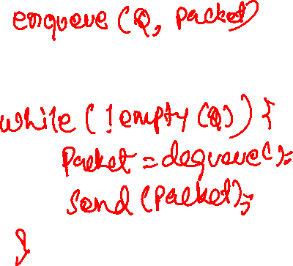
First-come-first-serve
Arrival
SendAll
Abstraction: queue
R
packet
departures
packet
arrivals
queue
(waiting area)
link
(server)
Copyright © 2010-2025 J.F. Kurose, K.W. Ross

Slide 23
First-come-first-serve
First-come-first-serve (FCFS) or first-in-first-out (FIFO)
Transmit the packets in the order of their arrival
Arrival
enqueue(Q, packet)
SendAll
while (!empty(Q)) {
packet = dequeue(Q);
send(packet);
}
Abstraction: queue
R
packet
departures
packet
arrivals
queue
(waiting area)
link
(server)
Copyright © 2010-2025 J.F. Kurose, K.W. Ross

Slide 24

Priority Queuing
 | ARRIVAL TIME | PRIORITY CLASS | DEPARTURE START AT
1 | 0 | HIGH
2 | 1.5 | LOW
3 | 2.5 | HIGH
4 | 7.5 | HIGH
5 | 13 | LOW
Each packet takes three units of time to be transmitted.

Slide 25
Priority Queuing
Some packets can be given higher priority over the others
e.g., real-time traffic gets more priority over the non-real-time traffic. Network management packets may get more priority over user data packets, etc.
The type of service field in the IP header can be used to mark a packet as low latency, medium priority, or default priority

Slide 26
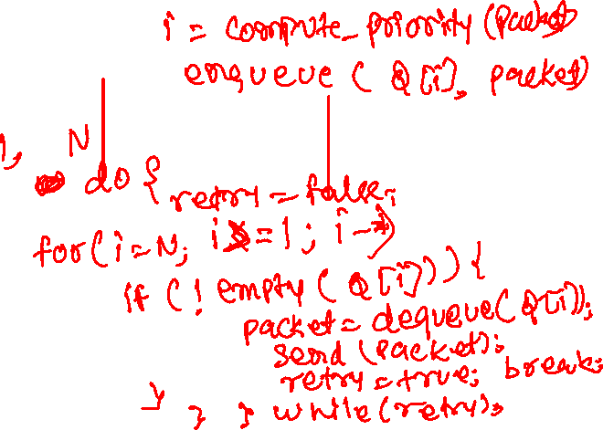
Priority Queuing
Lowest priority = 1, Highest Priority = N
Arrival
SendAll
arrivals
classify
link
departures
low priority queue
2
1
3
4
5
arrivals
packet in service
1
3
2
4
5
departures
1
3
2
4
5
Copyright © 2010-2025 J.F. Kurose, K.W. Ross

Slide 27
Priority Queuing
Lowest priority = 1, Highest Priority = N
Arrival
i = compute_priority(packet)
enqueue(Q[i], packet)
SendAll
do {
retry = false
for i = N down to 1 {
if (!empty(Q[i])) {
packet = dequeue(Q[i]);
send(packet);
retry = true;
break;
}
}
} while (retry);
arrivals
classify
link
departures
low priority queue
2
1
3
4
5
arrivals
packet in service
1
3
2
4
5
departures
1
3
2
4
5
Copyright © 2010-2025 J.F. Kurose, K.W. Ross

Slide 28
Priority Queuing
Problem?

Slide 29
Priority Queuing
Problem?
Starvation

Slide 30
Round Robin Queuing
Each packet is classified into a class
The type of service field can be used to mark a packet as low latency, medium priority, or default priority
In priority queuing, low priority packets can be starved
Round-robin queuing gives an equal chance to each class
One packet from each class gets transmitted in each round

Slide 31

Round Robin Queuing
 | ARRIVAL TIME | CLASS | DEPARTURE START AT
1 | 0 | 1
2 | 1.5 | 2
3 | 2.5 | 1
4 | 7.5 | 1
5 | 13 | 2
Each packet takes three units of time to be transmitted.

Slide 32
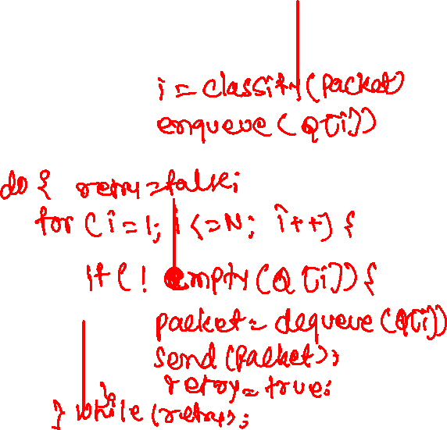
Round Robin Queuing
N classes
Arrival
Send_All
R
classify
arrivals
link
departures
Copyright © 2010-2025 J.F. Kurose, K.W. Ross

Slide 33
Round Robin queuing
N classes
Arrival
i = classify(packet)
enqueue(Q[i], packet)
Send_All
do {
retry = false;
for i = 1 to N {
if (!empty(Q[i])) {
packet = dequeue(Q[i]);
send(packet);
retry = true;
}
}
} while (retry);
R
classify
arrivals
link
departures
Copyright © 2010-2025 J.F. Kurose, K.W. Ross

Slide 34


Round Robin and Weighted Fair queueing
Each packet is classified into a class
Each class $i$ has a weight $w_{i}$ associated with it
The scheduling policy ensures that the class $i$ average throughput will be approximately $R.\frac{w_{i}}{\sum{w_{i}}}$, where $R$ is the transmission rate of the link

Slide 35
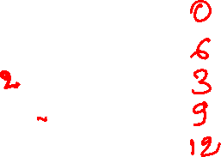
Round Robin and Weighted Fair queueing
 | ARRIVAL TIME | CLASS - WEIGHT | DEPARTURE START AT
1 | 0 | C1 - 2
2 | 1.5 | C2 - 1
3 | 2 | C1 - 2
4 | 2.5 | C1 –2
5 | 3 | C2 - 1
Each packet takes three units of time to be transmitted.

Slide 36
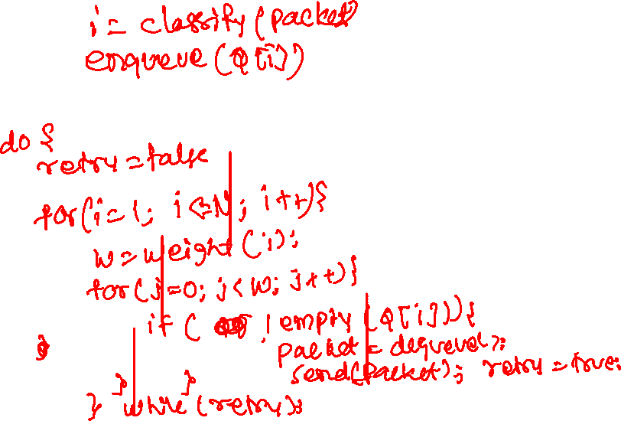
Round Robin and Weighted Fair queueing
Arrival
Send_All
w₁
w₂
R
classify
arrivals
link
departures
w₃
Copyright © 2010-2025 J.F. Kurose, K.W. Ross

Slide 37
Round Robin and Weighted Fair queueing
Arrival
i = classify(packet)
enqueue(Q[i], packet)
Send_All
do {
retry = false;
for i = 1 to N {
if (!empty(Q[i])) {
w = weight[i]; // number of packets
while (w > 0 && !empty(Q[i])) {
packet = dequeue(q);
send(packet);
w--; retry = true;
}
}
}
} while (retry);
w₁
w₂
R
classify
arrivals
link
departures
w₃
Copyright © 2010-2025 J.F. Kurose, K.W. Ross

Slide 38
IPv4 vs. IPv6
In IPv4, IP addresses are 32-bit
In IPv6, IP addresses are 128-bit
Due to the rapidly increasing number of internet devices, a 32-bit IP address is no longer sufficient to provide a unique address to each and every network-capable device on the planet
IPv6 solves the above problem by supporting 128-bit addresses
Due to the widespread use of mechanisms such as network address translation (NAT) to solve the scarcity of 32-bit addresses, more than half of the internet traffic is still IPv4

Slide 39
IPv4 header
struct iphdr {
__u8 ihl:4; // length of header = ihl * 4
__u8 version:4; // 4-bit version
__u8 tos; // type of service
__be16 tot_len; // Entire packet size, header + data
__be16 id; // 16-bit identifier
__be16 frag_off; // 3-bit flags followed by 13-bit fragment offset
__u8 ttl; // Time to live, decremented at each hop
__u8 protocol; // Upper layer protocol
__sum16 check; // Header checksum
__be32 saddr; // source IP address
__be32 daddr; // destination IP address
char options[]; // variable length options (if any)
};

Slide 40

IP header
version: Always 4 for IPv4
ihl: header length = ihl * 4
tos: contains the priority of the packet. Explicit congestion notification.
tot_len: total length of the packet. Header + data
id: used for fragmenting a packet, if the size > MTU
frag_off: related to fragmented packet
ttl: Time to live. Decremented at each hop.
protocol: Higher level protocols used, e.g., TCP, UDP, or ICMP
check: Checksum of just the IP header, not payload
saddr: Source IP address
daddr: Destination IP address
options: variable length options. Rarely used.

Slide 41
Network Interface
A host typically has one interface, e.g., eth0
i.e., number of links to the network
A router may have multiple interfaces
Internet protocol (IP) requires each interface to have an IP address

Slide 42

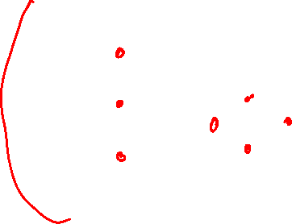
Network interface
223.1.1.1
223.1.2.1
Each host and router is connected to the physical link via an interface.
Each interface has an IP address.
223.1.1.2
223.1.1.4
223.1.2.9
223.1.1.3
223.1.3.27
223.1.2.2
223.1.3.1
223.1.3.2
dotted-decimal IP address notation:
Copyright © 2010-2025 J.F. Kurose, K.W. Ross

Slide 43


Network internet
223.1.1.1
Within an organization, sometimes hosts are connected using a switch
Switch operates at the data-link layer, which is below the network layer
IP address is not used at data-link layer
We’ll discuss the data-link layer later in this course
223.1.2.1
223.1.1.2
A: wired
Ethernet interfaces connected by Ethernet switches
223.1.1.4
223.1.2.9
223.1.1.3
223.1.3.27
223.1.2.2
223.1.3.1
223.1.3.2
A: wireless WiFi interfaces connected by WiFi base station
Copyright © 2010-2025 J.F. Kurose, K.W. Ross

Slide 44
Network internet
223.1.1.1
Subnet
If we conceptually remove all the routers and hosts from the network, then each remaining disjoint set of links is called a subnet.
223.1.2.1
223.1.1.2
A: wired
Ethernet interfaces connected by Ethernet switches
223.1.1.4
223.1.2.9
223.1.1.3
223.1.3.27
223.1.2.2
223.1.3.1
223.1.3.2
A: wireless WiFi interfaces connected by WiFi base station
Copyright © 2010-2025 J.F. Kurose, K.W. Ross

Slide 45

Network internet
223.1.1.1
Subnet
If we conceptually remove all the routers and hosts from the network, then each remaining disjoint set of links is called a subnet.
223.1.2.1
223.1.1.2
223.1.1.4
223.1.2.9
223.1.1.3
223.1.3.27
223.1.2.2
223.1.3.1
223.1.3.2
Copyright © 2010-2025 J.F. Kurose, K.W. Ross

Slide 46

Subnet address
All interfaces in the subnet have IP addresses of the form: a.b.c.d/x
where x is the subnet mask.
a, b, c, and d are 1-byte values.
a is the most significant byte.
top x bits are the subnet part, which is the same for all IP addresses in a subnet
subnet
part
host
part
11001000 00010111 00010000 00000000
200.23.16.0/23
Copyright © 2010-2025 J.F. Kurose, K.W. Ross

Slide 47
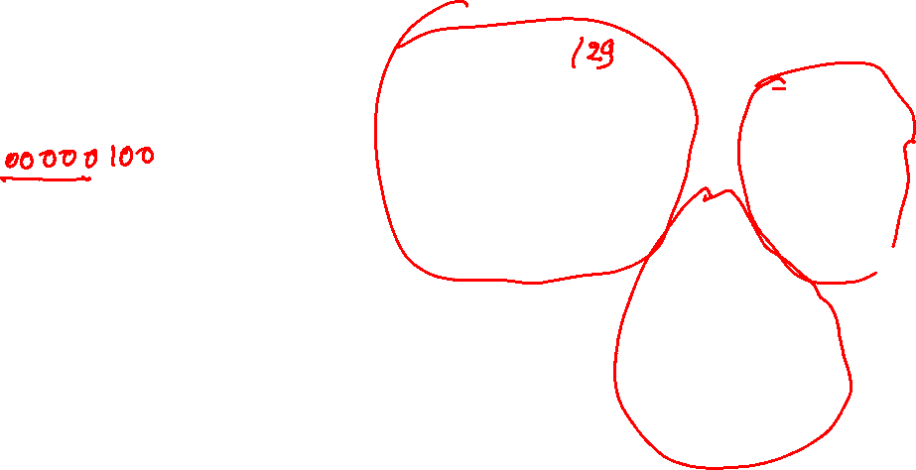
Subnet address
223.1.1.1
223.1.2.1
223.1.1.2
223.1.1.4
223.1.2.9
223.1.1.3
223.1.3.27
223.1.2.2
223.1.3.1
223.1.3.2
Copyright © 2010-2025 J.F. Kurose, K.W. Ross

Slide 48
Subnet address
223.1.1.1/24
223.1.2.1/24
223.1.1.2/24
223.1.2.9/24
223.1.1.4/24
223.1.1.3/24
223.1.3.27/24
223.1.2.2/24
223.1.3.1/24
223.1.3.2/24
Copyright © 2010-2025 J.F. Kurose, K.W. Ross

Slide 49
Subnets
223.1.1.2
223.1.1.1
223.1.1.4
How many subnets?
223.1.1.3
223.1.9.2
223.1.7.0
223.1.9.1
223.1.7.1
223.1.8.1
223.1.8.0
223.1.2.6
223.1.3.27
223.1.2.1
223.1.2.2
223.1.3.1
223.1.3.2
Copyright © 2010-2025 J.F. Kurose, K.W. Ross

Slide 50

Subnets
223.1.1.2
223.1.1.1
223.1.1.4
How many subnets?
6
223.1.1.3
223.1.9.2
223.1.7.0
223.1.9.1
223.1.7.1
223.1.8.1
223.1.8.0
223.1.2.6
223.1.3.27
223.1.2.1
223.1.2.2
223.1.3.1
223.1.3.2
Copyright © 2010-2025 J.F. Kurose, K.W. Ross

Slide 51
Subnet address
223.1.1.2
223.1.1.1
223.1.1.4
Subnet IP addresses?
223.1.1.3
223.1.9.2
223.1.7.0
223.1.9.1
223.1.7.1
223.1.8.1
223.1.8.0
223.1.2.6
223.1.3.27
223.1.2.1
223.1.2.2
223.1.3.1
223.1.3.2
Copyright © 2010-2025 J.F. Kurose, K.W. Ross

Slide 52
Subnet address
223.1.1.2
subnet 223.1.1/24
223.1.1.1
223.1.1.4
223.1.1.3
223.1.9.2
223.1.7.0
subnet 223.1.7/24
subnet 223.1.9/24
223.1.9.1
223.1.7.1
223.1.8.1
223.1.8.0
subnet 223.1.2/24
223.1.2.6
subnet 223.1.8/24
223.1.3.27
subnet 223.1.3/24
223.1.2.1
223.1.2.2
223.1.3.1
223.1.3.2
Copyright © 2010-2025 J.F. Kurose, K.W. Ross

Slide 53
Classless interdomain routing
The internet’s address assignment strategy is called Classless Interdomain Routing (CIDR—pronounced cider)
The IP address is divided into two parts and has the following form
a.b.c.d/x
The x most-significant bits are called the prefix of the IP address
An organization is typically allocated a block of contiguous addresses with a common prefix
The routers only look at the prefix of an IP address
This considerably reduces the size of the forwarding table at routers

Slide 54
Classless interdomain routing
The lower 32-x bits of the address a.b.c.d/x is used by the organization for different devices

Slide 55
Who manages IP address?
Internet Corporation of Assigned Names and Numbers (ICANN)
Regional Internet Registries (RIRs)
Internet Service Providers (ISPs)
Organizations / Home Internet Users (e.g., IIITD / Individual)

Slide 56
Assigning IP address
Let’s say, the ISP receives a subnet address 200.23.16.0/20 from RIR
When IIITD contacts its ISP for a range of IP addresses, the ISP can assign a subnet out of its allocated addresses to IIITD
Say 200.23.16.0/23
Let’s say GB Pant asked the ISP to give it a range of addresses
Can ISP give 200.23.17.0/23 to GB Pant?

Slide 57
Assigning IP address
Let’s say, the ISP receives a subnet address 200.23.16.0/20 from RIR
When IIITD contacts its ISP for a range of IP addresses, the ISP can assign a subnet out of its allocated addresses to IIITD
Say 200.23.16.0/23
Let’s say GB Pant asked the ISP to give it a range of addresses
Can ISP give 200.23.17.0/23 to GB Pant?
No, because IIITD addresses are also included in 200.23.17.0/23
How about 200.23.18.0/23?

Slide 58
Assigning IP address
Let’s say, the ISP receives a subnet address 200.23.16.0/20 from RIR
When IIITD contacts its ISP for a range of IP addresses, the ISP can assign a subnet out of its allocated addresses to IIITD
Say 200.23.16.0/23
Let’s say GB Pant asked the ISP to give it a range of addresses
Can ISP give 200.23.17.0/23 to GB Pant?
No, because IIITD addresses are also included in 200.23.17.0/23
How about 200.23.18.0/23?
Yes, no overlap with IIITD

