Slide 2
Today’s topics
DHCP
NAT
IPv6

Slide 3
References
Read Chapter-4.2, 4.3 from the Kurose and Ross book

Slide 4


Subnet address
223.1.1.2
subnet 223.1.1/24
223.1.1.1
223.1.1.4
223.1.1.3
223.1.9.2
223.1.7.0
subnet 223.1.7/24
subnet 223.1.9/24
223.1.9.1
223.1.7.1
223.1.8.1
223.1.8.0
subnet 223.1.2/24
223.1.2.6
subnet 223.1.8/24
223.1.3.27
subnet 223.1.3/24
223.1.2.1
223.1.2.2
223.1.3.1
223.1.3.2
Copyright © 2010-2025 J.F. Kurose, K.W. Ross

Slide 5
Who manages IP address?
Internet Corporation of Assigned Names and Numbers (ICANN)
Regional Internet Registries (RIRs)
Internet Service Providers (ISPs)
Organizations / Home Internet Users (e.g., IIITD / Individual)

Slide 6
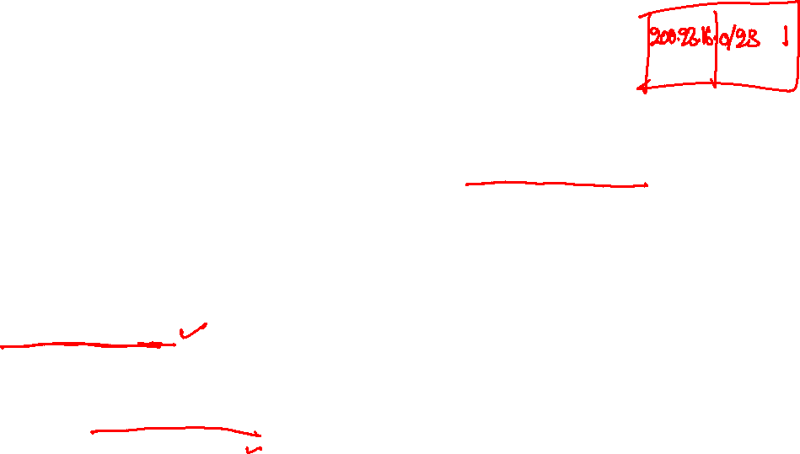
Assigning IP address
Let’s say, the ISP receives a subnet address 200.23.16.0/20 from RIR
When IIITD contacts its ISP for a range of IP addresses, the ISP can assign a subnet out of its allocated addresses to IIITD
Say 200.23.16.0/23
Let’s say GB Pant asked the ISP to give it a range of addresses
Can ISP give 200.23.17.0/23 to GB Pant?

Slide 7
Assigning IP address
Let’s say, the ISP receives a subnet address 200.23.16.0/20 from RIR
When IIITD contacts its ISP for a range of IP addresses, the ISP can assign a subnet out of its allocated addresses to IIITD
Say 200.23.16.0/23
Let’s say GB Pant asked the ISP to give it a range of addresses
Can ISP give 200.23.17.0/23 to GB Pant?
No, because IIITD addresses are also included in 200.23.17.0/23
How about 200.23.18.0/23?

Slide 8
Assigning IP address
Let’s say, the ISP receives a subnet address 200.23.16.0/20 from RIR
When IIITD contacts its ISP for a range of IP addresses, the ISP can assign a subnet out of its allocated addresses to IIITD
Say 200.23.16.0/23
Let’s say GB Pant asked the ISP to give it a range of addresses
Can ISP give 200.23.17.0/23 to GB Pant?
No, because IIITD addresses are also included in 200.23.17.0/23
How about 200.23.18.0/23?
Yes, no overlap with IIITD

Slide 9
Obtaining host address
Let’s say IIITD got 200.23.16.0/23
Can we use 200.23.16.1 for user A and 200.23.16.2 for user B

Slide 10

Obtaining host address
Let’s say IIITD got 200.23.16.0/23
Can we use 200.23.16.1 for user A and 200.23.16.2 for user B
Yes
If the users know about the subnet, should we allow them to pick a random address for the pool of addresses allocated to IIITD

Slide 11

Obtaining host address
Let’s say IIITD got 200.23.16.0/23
Can we use 200.23.16.1 for user A and 200.23.16.2 for user B
Yes
If the users know about the subnet, should we allow them to pick a random address for the pool of addresses allocated to IIITD
No, two users may end up assigning the same IP address
IP assignment?

Slide 12
Obtaining host address
Let’s say IIITD got 200.23.16.0/23
Can we use 200.23.16.1 for user A and 200.23.16.2 for user B
Yes
If the users know about the subnet, should we allow them to pick a random address for the pool of addresses allocated to IIITD
No, two users may end up assigning the same IP address
IP assignment?
A central authority can assign an address to each user
The central authority will tell the user which IP to use
The user will configure its machine to use the suggested IP address
Problem?

Slide 13

Obtaining host address
Let’s say IIITD got 200.23.16.0/23
Can we use 200.23.16.1 for user A and 200.23.16.2 for user B
Yes
If the users know about the subnet, should we allow them to pick a random address for the pool of addresses allocated to IIITD
No, two users may end up assigning the same IP address
IP assignment?
A central authority can assign an address to each user
The central authority will tell the user which IP to use
The user will configure its machine to use the suggested IP address
Problem?
Whenever a user moves from one subnet to another, it has to manually configure the IP address
We need a mechanism to do this automatically

Slide 14
Obtaining host address
A DHCP server can keep a mapping of all allocated addresses and can lease an IP address on demand
How can a user talk to the DHCP server?
How does the user know the IP address of the DHCP server?

Slide 15
Obtaining host address
A DHCP server can keep a mapping of all allocated addresses and can lease an IP address on demand
How can a user talk to the DHCP server?
How does the user know the IP address of the DHCP server?
It could be fixed
What if it’s not fixed?

Slide 16
Obtaining host address
A DHCP server can keep a mapping of all allocated addresses and can lease an IP address on demand
How can a user talk to the DHCP server?
How does the user know the IP address of the DHCP server?
It could be fixed
What if it’s not fixed?
broadcast DHCP request
How does the DHCP server reply to the requesting host? The requesting host doesn’t have an IP yet.

Slide 17
Obtaining host address
A DHCP server can keep a mapping of all allocated addresses and can lease an IP address on demand
How can a user talk to the DHCP server?
How does the user know the IP address of the DHCP server?
It could be fixed
What if it’s not fixed?
broadcast DHCP request
How does the DHCP server reply to the requesting host? The requesting host doesn’t have an IP yet.
broadcast DHCP response

Slide 18
DHCP
Dynamic Host Configuration Protocol (DHCP) is a client-server protocol
One or more DHCP servers are present in the subnet (if not, a relay agent knows the address of the DHCP server)
255.255.255.255 is a broadcast destination address
We’ll read about broadcasting later in our discussion of the data-link layer

Slide 19
DHCP
Client sends a DHCP discover message
UDP DST port: 67, SRC port: 68, DST IP: 255.255.255.255, SRC IP: 0.0.0.0, transaction ID
DHCP servers reply with DHCP offer messages
DST IP: 255.255.255.255, Proposed IP address, transaction ID, DHCP server ID, Lifetime
why broadcast?

Slide 20
DHCP
Client sends a DHCP discover message
UDP DST port: 67, SRC port: 68, DST IP: 255.255.255.255, SRC IP: 0.0.0.0, transaction ID
DHCP servers reply with DHCP offer messages
DST IP: 255.255.255.255, Proposed IP address, transaction ID, DHCP server ID, Lifetime
why broadcast?
client doesn’t have an IP address yet
Client chooses one response and responds with a DHCP request message
DST IP: 255.255.255.255, Proposed IP address, transaction ID, DHCP server ID
The server sends a DHCP ACK message to confirm the allocation
DST IP: 255.255.255.255, Proposed IP address, transaction ID, DHCP server ID, Lifetime

Slide 21
DHCP
DHCP also provides a mechanism to renew an IP address
Renewals can use direct messages if the client has a valid IP at the time of renewal

Slide 22




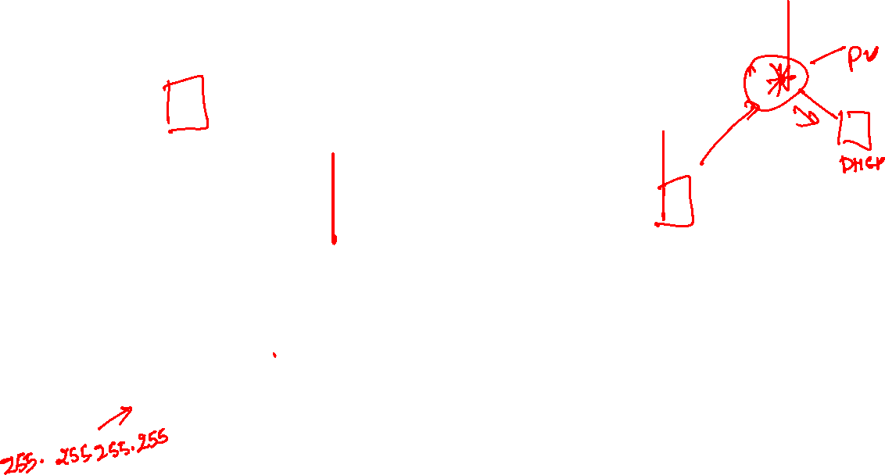
DHCP
DHCP server
223.1.1.1
223.1.2.1
223.1.2.5
223.1.1.2
223.1.1.4
223.1.2.9
223.1.1.3
223.1.3.27
arriving DHCP client needs
address in this network
223.1.2.2
223.1.3.1
223.1.3.2
Copyright © 2010-2025 J.F. Kurose, K.W. Ross

Slide 23



DHCP
DHCP server: 223.1.2.5
DHCP discover
Arriving client
src : 0.0.0.0, 68
dest.: 255.255.255.255,67
yiaddr: 0.0.0.0
transaction ID: 654
Broadcast: is there a DHCP server out there?
DHCP offer
src: 223.1.2.5, 67
dest: 255.255.255.255, 68
yiaddr: 223.1.2.4
transaction ID: 654
lifetime: 3600 secs
Broadcast: I’m a DHCP server! Here’s an IP address you can use
The two steps above can be skipped “if a client remembers and wishes to reuse a previously allocated network address” [RFC 2131]
DHCP request
src: 0.0.0.0, 68
dest:: 255.255.255.255, 67
yiaddr: 223.1.2.4
transaction ID: 655
lifetime: 3600 secs
Broadcast: OK. I would like to use this IP address!
DHCP ACK
src: 223.1.2.5, 67
dest: 255.255.255.255, 68
yiaddr: 223.1.2.4
transaction ID: 655
lifetime: 3600 secs
Broadcast: OK. You’ve got that IP address!
Copyright © 2010-2025 J.F. Kurose, K.W. Ross

Slide 24
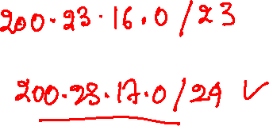
Network address translation (NAT)
Let’s say IIITD was initially allocated 256 IP addresses
200.23.16.0/24
After a few years, as the number of intakes increased, it now wants 256 more addresses
How can we assign more addresses to IIITD while keeping the previously assigned addresses and a single subnet mask

Slide 25
Network address translation (NAT)
Let’s say IIITD was initially allocated 256 IP addresses
200.23.16.0/24
After a few years, as the number of intakes increased, it now wants 256 more addresses
How can we assign more addresses to IIITD while keeping the previously assigned addresses and a single subnet mask
assign 200.23.16.0/23
It’s always possible

Slide 26
Network address translation (NAT)
Let’s say IIITD was initially allocated 256 IP addresses
200.23.16.0/24
After a few years, as the number of intakes increased, it now wants 256 more addresses
How can we assign more addresses to IIITD while keeping the previously assigned addresses and a single subnet mask
assign 200.23.16.0/23
It’s always possible
No, because 200.23.17.0/24 might have been allocated to someone else

Slide 27
Network address translation (NAT)
NAT allows different organizations to reuse IP addresses
NAT significantly decreases the requirement for unique IP addresses because addresses are shared among organizations
A part of available IP addresses is reserved for private use, such as for NAT
e.g., 10.0.0.0/8, 192.168.0.0/16

Slide 28
NAT
How NAT works?
All traffic of an organization goes via an internal router, say X, which is connected to the public network
There could be more than one internal router; all of them will work in the same way
The outgoing interface of X has a public IP address, say 138.76.29.7
The incoming interfaces of the router have unique private IP addresses
All devices in the organization have unique private IP addresses
All devices in the organization can talk to each other via private addresses
The forwarding is done via switches and internal routers
All outside communication is done via X

Slide 29
NAT
rest of
Internet
local network (e.g., home network) 10.0.0/24
10.0.0.1
138.76.29.7
10.0.0.4
10.0.0.2
X
10.0.0.3
Copyright © 2010-2025 J.F. Kurose, K.W. Ross

Slide 30
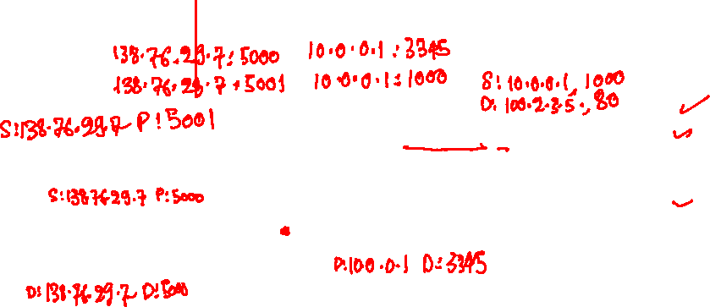
NAT
NAT translation table
public addr private addr
S: 10.0.0.1, 3345
D: 128.119.40.186, 80
10.0.0.1
138.76.29.7
10.0.0.4
1
2
10.0.0.2
X
4
10.0.0.3
3
Copyright © 2010-2025 J.F. Kurose, K.W. Ross

Slide 31
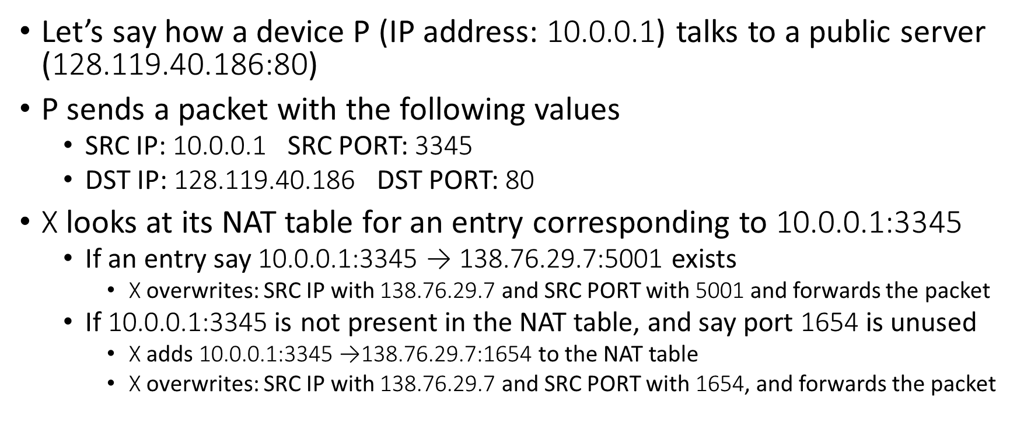
NAT send
Let’s say how a device P (IP address: 10.0.0.1) talks to a public server (128.119.40.186:80)
P sends a packet with the following values
SRC IP: 10.0.0.1 SRC PORT: 3345
DST IP: 128.119.40.186 DST PORT: 80
X looks at its NAT table for an entry corresponding to 10.0.0.1:3345
If an entry say 10.0.0.1:3345 → 138.76.29.7:5001 exists
X overwrites: SRC IP with 138.76.29.7 and SRC PORT with 5001 and forwards the packet
If 10.0.0.1:3345 is not present in the NAT table, and say port 1654 is unused
X adds 10.0.0.1:3345 →138.76.29.7:1654 to the NAT table
X overwrites: SRC IP with 138.76.29.7 and SRC PORT with 1654, and forwards the packet

Slide 32
NAT receive
X receives a packet with DST IP 138.76.29.7 and DST port 5001
X looks for an entry with the target port 5001
It finds 10.0.0.1:3345 → 138.76.29.7:5001
NAT replaces the DST IP with 10.0.0.1 and DST port with 3345 and forwards the packet to one of its internal links, depending on the DST IP

Slide 33
NAT
NAT translation table
public addr private addr
138.76.29.7, 5001 10.0.0.1, 3345
…… ……
S: 10.0.0.1, 3345
D: 128.119.40.186, 80
10.0.0.1
138.76.29.7
10.0.0.4
1
2
S: 138.76.29.7, 5001
D: 128.119.40.186, 80
10.0.0.2
X
S: 128.119.40.186, 80
D: 10.0.0.1, 3345
4
10.0.0.3
S: 128.119.40.186, 80
D: 138.76.29.7, 5001
3
Copyright © 2010-2025 J.F. Kurose, K.W. Ross

Slide 34
Communication between two organizations
Let’s say A and B are two hosts in different organizations, and both of them have IP address 10.0.0.1
How can they talk to each other?

Slide 35

Communication between two organizations
Let’s say A and B are two hosts in different organizations, and both of them have IP address 10.0.0.1
How can they talk to each other?
Let’s say a server X offered to help them establish the connection

Slide 36
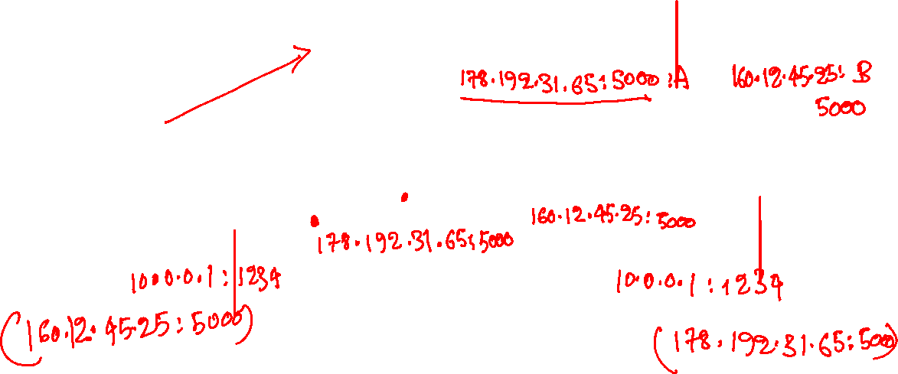
Communication between two organizations
X
100.100.23.43:80
A
160.12.45.25
B
178.192.31.65
10.0.0.1
10.0.0.1
Copyright © 2010-2025 J.F. Kurose, K.W. Ross

Slide 37
Communication between two organization
A sends a message to X with SRC IP: 10.0.0.1 and #port 1234
NAT maps 10.0.0.1:1234 → 178.192.31.65:9753
B sends a message to X with SRC IP: 10.0.0.1 and #port 2000
NAT maps 10.0.0.1:2000 → 160.12.45.25:6544
X learns both extremal addresses and shares them
X sends a message to B with 178.192.31.65:9753 as payload
X sends a message to A with 160.12.45.25:6544 as payload
B sends a message to A at 178.192.31.65:9753
NAT-enabled router in A’s organization finds 178.192.31.65:9753 → 10.0.0.1:1234 and forwards the message to 10.0.0.1:1234
A receives the message, and verifies the IP address of B 160.12.45.25:6544 in the packet header
A sends a message to 160.12.45.25:6544
NAT-enabled router in B’s organization forwards it to B

Slide 38
Communication between two organizations
Google STUN servers allow clients behind a NAT to discover their public IP address

Slide 39
More restrictive NAT
Some versions of NAT are more restrictive
They use a unique mapping for (SRC IP, SRC PORT, DST IP, DST PORT), which makes it harder for two hosts behind different NATs to communicate with each other

Slide 40
NAT
Advantages
Provides anonymity for end users
Enable reuse of IP addresses, which temporarily solves the problem of the scarcity of available IP addresses
Disadvantage
Two hosts behind different NATs can’t easily talk to each other
Breaks the end-to-end argument, which states that all the intelligence should be at the end hosts
If the payload contains private addresses, they can’t be overwritten by the NAT-enabled router

Slide 41

IPv6 Header
// Size of the IPv6 header is 40 bytes
struct ipv6hdr {
__u8 traffic_class:4; // traffic class, e.g., voice call
__u8 version:4; // IP version number, 6 for IPv6
__u8 flow_label[3]; // assign priority to flows
__be16 payload_len; // length of the payload, i.e., size of IPv6 datagram - 40
__u8 nexthdr; // same as protocol in IPv4
__u8 hop_limit; // same as TTL in IPv4
__be32 saddr[4]; // 128-bit source IP address
__be32 daddr[4]; // 128-bit destination IP address
};

Slide 42
IPv6
IPv6 was designed in late 1990s to solve the problem of the possible exhaustion of IPv4 addresses
IPv6 addresses are 128-bit long
Now, every grain of sand on the planet is IP addressable
Flow labelling
IPv6 introduces a flow label field in the header, allowing packets belonging to the same flow to be labeled
This enables routers to identify and provide special handling (such as QoS or priority scheduling) for specific flows without inspecting transport-layer headers

Slide 43
IPv6
Fragmentation
IPv6 does not allow fragmentation and reassembly of packets of sizes greater than MTU, which adds additional overhead at the routers
Instead, routers drop the datagrams and send a “Packet too Big” ICMP error message to the sender
Sender resends the data with a smaller IP datagram
Header checksum
The header checksum is removed in IPv6 because data-link and transport layers also add integrity checks, and recomputing the checksum at the IP layer adds additional overhead

Slide 44
Interoperability of IPv6 and IPv4
How two IPv6 hosts can talk to each other, when some of the intermediate routers only support IPv4

Slide 45
Tunneling
A
B
IPv4 tunnel
connecting IPv6 routers
E
F
logical view:
IPv6
IPv6/v4
IPv6/v4
IPv6
A
B
C
D
E
F
physical view:
IPv6
IPv6/v4
IPv4
IPv4
IPv6/v4
IPv6
Copyright © 2010-2025 J.F. Kurose, K.W. Ross

Slide 46
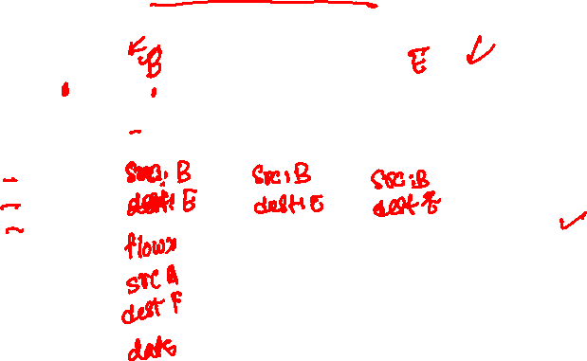
Tunneling
A
B
IPv4 tunnel
connecting IPv6 routers
E
F
logical view:
IPv6
IPv6/v4
IPv6/v4
IPv6
A
B
C
D
E
F
physical view:
IPv6
IPv6/v4
IPv4
IPv4
IPv6/v4
IPv6
flow: X
src: A
dest: F
data
flow: X
src: A
dest: F
data
Note source and destination addresses!
A-to-B:
IPv6
B-to-C:
IPv6 inside
IPv4
B-to-C:
IPv6 inside
IPv4
B-to-C:
IPv6 inside
IPv4
E-to-F:
IPv6
Copyright © 2010-2025 J.F. Kurose, K.W. Ross

Slide 47
Tunneling
The intervening sets of IPv4 routers between two IPv6 routers is called a tunnel
The sending side of the tunnel encapsulates the IPv6 datagram inside an IPv4 packet
The destination address is the IPv4 address of the receiving end of the tunnel
The routers in the tunnel forward the packet as usual, unaware of the fact that the packet actually contains an IPv6 datagram
The receiving end of the tunnel retrieves the IPv6 datagram from the packet and forwards the IPv6 datagram to the next hop

Slide 48
Tunneling
A
B
IPv4 tunnel
connecting IPv6 routers
E
F
logical view:
IPv6
IPv6/v4
IPv6/v4
IPv6
A
B
C
D
E
F
physical view:
IPv6
IPv6/v4
IPv4
IPv4
IPv6/v4
IPv6
flow: X
src: A
dest: F
data
src:B
dest: E
src:B
dest: E
src:B
dest: E
flow: X
src: A
dest: F
data
Flow: X
Src: A
Dest: F
data
Flow: X
Src: A
Dest: F
data
Flow: X
Src: A
Dest: F
data
Note source and destination addresses!
A-to-B:
IPv6
B-to-C:
IPv6 inside
IPv4
B-to-C:
IPv6 inside
IPv4
B-to-C:
IPv6 inside
IPv4
E-to-F:
IPv6
Copyright © 2010-2025 J.F. Kurose, K.W. Ross

Slide 49
IPv6 deployment status
Complete migration to IPv6 is still very much a work in progress
Migration started in early 2000s
As of October 2025, around 45-49% of the global internet traffic uses IPv6
https://en.wikipedia.org/wiki/IPv6_deployment

