Slide 2
Today’s topics
Packet switching vs. circuit switching
Delay
Throughput
Protocol layers

Slide 3
References
Chapter- 1.3, 1.4 from the Kurose and Ross book
Chapter- 1.5.1 from the Peterson and Davie book

Slide 4
Packet switching
The routers and switches that forward packets are called packet switches (or gateways)
Most packet switches use store-and-forward transmission
The packet switches must receive the entire packet before forwarding it to the output link
Queues to temporarily store incoming packets
Queue size is infinite

Slide 5

Store and forward
R = 100 Mb/s
C
A
R = 1.5 Mb/s
D
B
E
queue of packets
waiting for transmission over output link
Copyright © 2010-2025 J.F. Kurose, K.W. Ross

Slide 6
Packet switching
What will happen if the packets arrive faster than they can be transmitted?

Slide 7
Packet switching
What will happen if the packets arrive faster than they can be transmitted?
Packets may accumulate in the queues before they can be processed
Packets may get dropped if the queue is full
Packets may experience variable delay

Slide 8
Circuit switching
In packet switching, packets may experience unexpected delay under heavy load
It could be problematic for real-time applications such as video calls or voice communication
Solution?

Slide 9

Circuit switching
Copyright © 2010-2025 J.F. Kurose, K.W. Ross

Slide 10
Circuit switching
In circuit switching, the network establishes a dedicated end-to-end connection between the two communication hosts A and B
No other hosts can send messages on the dedicated path until A and B decides to end the connection
Does this solves the problem of real-time communication?

Slide 11
Circuit switching
In circuit switching, the network establishes a dedicated end-to-end connection between the two communication hosts A and B
No other hosts can send messages on the dedicated path until A and B decides to end the connection
Does this solves the problem of real-time communication?
Yes
Any other problem?

Slide 12
Circuit switching
In circuit switching, the network establishes a dedicated end-to-end connection between the two communication hosts A and B
No other hosts can send messages on the dedicated path until A and B decides to end the connection
Does this solves the problem of real-time communication?
Yes
Any other problem?
Wastage of network resources during the silent period of the communication
e.g., no one is speaking

Slide 13
Multiplexing
Even though the circuit switches reserve intermediate links, a link can still serve multiple circuits (dedicated channel between communication hosts) using multiplexing techniques
Time-division multiplexing
Time is divided into slots
Each circuit is assigned a slot
The circuit can use the full transmission rate during its turn in a round-robin manner

Slide 14
Multiplexing

Slide 15
Multiplexing
Frequency-division multiplexing (FDM)
Each communication is assigned a unique frequency band
e.g., FM radio stations use FDM where each station uses a different frequency in the frequency spectrum
If the transmission rate is 100 Mbps, then n users sharing the link can roughly send at slightly less than 100/n Mbps

Slide 16
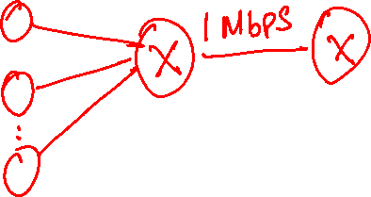
Example
How many users can be supported?
Users share 1 Mbps link
Users are generating data at the rate 100 kbps
Users are active only 10% of time
How many users can be supported in circuit switching scheme?

Slide 17
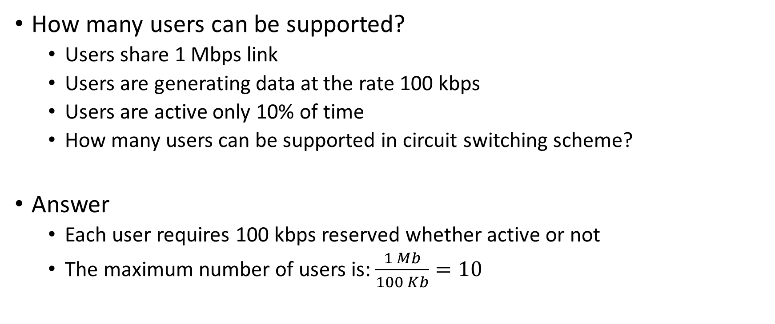
Example
How many users can be supported?
Users share 1 Mbps link
Users are generating data at the rate 100 kbps
Users are active only 10% of time
How many users can be supported in circuit switching scheme?
Answer
Each user requires 100 kbps reserved whether active or not
The maximum number of users is: $\frac{1 Mb}{100 Kb}=10$

Slide 18
Example
How many users can be supported?
Users share 1 Mbps link
Users are generating data at the rate 100 kbps
Users are active only 10% of time
How many users can be supported in packet switching scheme
Answer

Slide 19
Example
How many users can be supported?
Users share 1 Mbps link
Users are generating data at the rate 100 kbps
Users are active only 10% of time
How many users can be supported in packet switching scheme
Answer
The problem happens when more that 10 users are active at the same time
If there are 35 users who are active 10% of the time, the probability that 11 or more users being active at a given time is 0.04% (calculated using Binomial distribution)
Therefore, with a tiny risk of overload, we can support 35 users
In which case, 35 users can share 1 Mbps link in circuit switching mode?

Slide 20
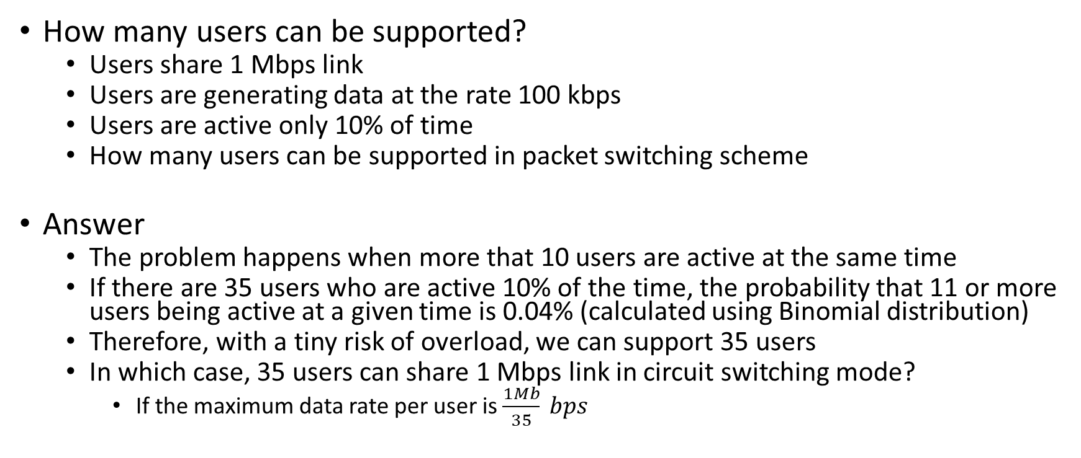
Example
How many users can be supported?
Users share 1 Mbps link
Users are generating data at the rate 100 kbps
Users are active only 10% of time
How many users can be supported in packet switching scheme
Answer
The problem happens when more that 10 users are active at the same time
If there are 35 users who are active 10% of the time, the probability that 11 or more users being active at a given time is 0.04% (calculated using Binomial distribution)
Therefore, with a tiny risk of overload, we can support 35 users
In which case, 35 users can share 1 Mbps link in circuit switching mode?
If the maximum data rate per user is $\frac{1Mb}{35} bps$

Slide 21
Takeaway
Packet switching supports more users, relying on the fact that not all users are active simultaneously

Slide 22
Example
10 users sharing 1 Mbps link
A wants to transmit 1 Mb data
Other users are inactive
Total transfer time:
Packet switching:
Circuit switching:

Slide 23
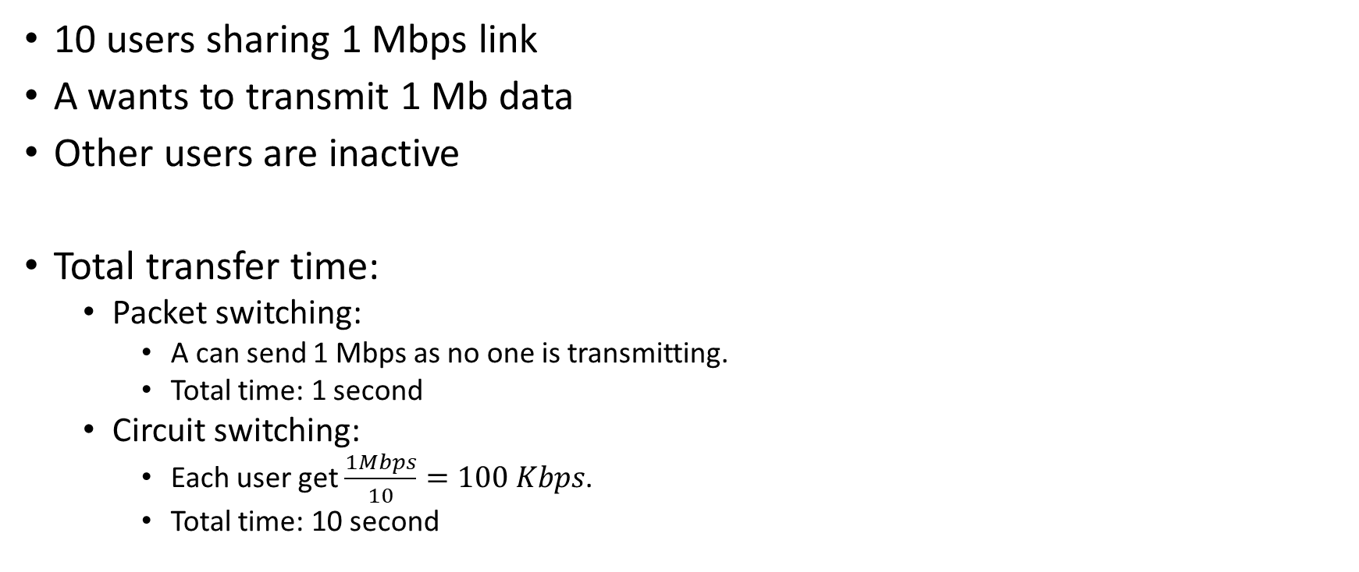
Example
10 users sharing 1 Mbps link
A wants to transmit 1 Mb data
Other users are inactive
Total transfer time:
Packet switching:
A can send 1 Mbps as no one is transmitting.
Total time: 1 second
Circuit switching:
Each user get $\frac{1Mbps}{10}=100 Kbps$.
Total time: 10 second

Slide 24
Takeaway
Packet switching is better when link is underutilized

Slide 25
Example
10 users sharing 1 Mbps link
First five users are on a video call and generating data at the rate 100 Kbps
Other five users are sending large volume of data
Will the video call users experience lag in circuit switching mode?

Slide 26
Example
10 users sharing 1 Mbps link
First five users are on a video call and generating data at the rate 100 Kbps.
Other five users are sending large volume of data
Will the video call users experience lag in circuit switching mode?
No. In circuit switch mode, 100 Kbps bandwidth is reserved for each user.
All users will transmit at a maximum rate of 100 Kbps.
Since the bandwidth is reserved, the video call packets can be transmitted without delay, ensuring smooth video calls.

Slide 27
Example
10 users sharing 1 Mbps link
First five users are on a video call and generating data at the rate 100 Kbps.
Other five users are sending large volume of data
Will the video call users experience lag in packet switching mode?

Slide 28
Example
10 users sharing 1 Mbps link
First five users are on a video call and generating data at the rate 100 Kbps.
Other five users are sending large volume of data
Will the video call users experience lag in packet switching mode?
Yes, in packet switching, the link capacity is shared dynamically
The other five users may attempt to send data at high rates, potentially filling up the queues at gateways
Thus, the video call packets may be delayed in the queue, leading to lag or jitter during the call

Slide 29
Quality of service
If the Internet doesn’t use circuit switching, how are real-time applications supported?
No strict reliability. Applications such as video games or video calls can tolerate some packet loss.
Gateways can be configured to give high priority to time-sensitive traffic

Slide 30
Delay in packet-switched networks
A packet may experience several kinds of delay at each node along the path.
A
1 Mbps
B
packets in buffers
free (available) buffers: arriving packets
dropped (loss) if no free buffers
Copyright © 2010-2025 J.F. Kurose, K.W. Ross

Slide 31
Delay in packet-switched networks
A packet may experience several kinds of delay at each node along the path.
Processing delay: checking the destination address, looking at the forwarding table to find the output port, verifying checksum, etc.

Slide 32
Delay in packet-switched networks
A packet may experience several kinds of delay at each node along the path.
Queueing delay: Time spent at gateways queues. If the queue is empty, the queuing delay is zero.
A
B
packets in buffers (queueing delay)
free (available) buffers: arriving packets
dropped (loss) if no free buffers
Copyright © 2010-2025 J.F. Kurose, K.W. Ross

Slide 33
Delay in packet-switched networks
A packet may experience several kinds of delay at each node along the path.
Transmission delay: If the packet size is L bits and the transmission rate is R bits/sec, then the transmission delay is L/R.
packet being transmitted (transmission delay)
A
B
packets in buffers (queueing delay)
free (available) buffers: arriving packets
dropped (loss) if no free buffers
Copyright © 2010-2025 J.F. Kurose, K.W. Ross

Slide 34
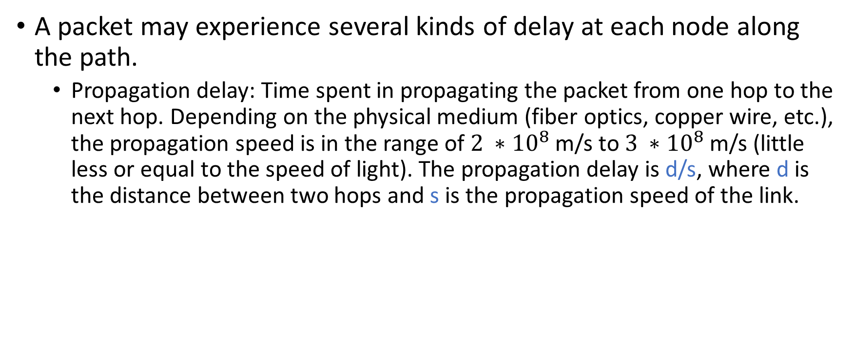
Delay in packet-switched networks
A packet may experience several kinds of delay at each node along the path.
Propagation delay: Time spent in propagating the packet from one hop to the next hop. Depending on the physical medium (fiber optics, copper wire, etc.), the propagation speed is in the range of $2 ∗{10}^{8}$ m/s to $3 ∗{10}^{8}$ m/s (little less or equal to the speed of light). The propagation delay is d/s, where d is the distance between two hops and s is the propagation speed of the link.
transmission
A
propagation
B
nodal
processing
queueing
Copyright © 2010-2025 J.F. Kurose, K.W. Ross

Slide 35
Propagation delay
It turns out that propagation delay is always going to be very small given the very high propagation speed. When does it matter?

Slide 36
Propagation delay
It turns out that propagation delay is always going to be very small given the very high propagation speed. When does it matter?
The propagation delay matters when two gateways are very far from each other, e.g., two gateways connected using a geostationary satellite link.

Slide 37

Transmission and propagation delay
The transmission delay is the time spent in putting the packet from host/gateway to transmission link. It depends on the size of the packet and the transmission rate of the transmitting link. For example, if the transmission rate is 1 Kbps, then it will require 1 second to put the entire 1 kb packet on the transmission link.
After a bit is on the transmission link, it can travel at the speed of light to the next hop on the link. Because of the super high propagation speed, It’s possible that the first bit can reach the other end of the link even before the gateway/host managed to put the second bit on the link. Notice, that in the store and forward transmission a gateway doesn’t forward the packet until the arrival of the entire packet.

Slide 38

Nodal delay
Nodal delay is the delay at one node (host/gateway)
$$d_{nodal}=d_{proc}+d_{queue}+d_{trans}+d_{prop}$$

Slide 39

Example
Packet size = 1 kb
Link transmission rate = 1 Mbps
Link length 200 km
Propagation speed 200000 km/s
Processing time = 1 ms
Queueing delay = 3 ms
$$d_{nodal}= ?$$

Slide 40
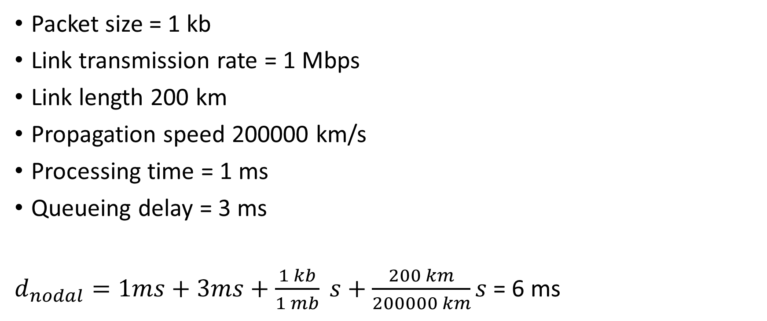
Example
Packet size = 1 kb
Link transmission rate = 1 Mbps
Link length 200 km
Propagation speed 200000 km/s
Processing time = 1 ms
Queueing delay = 3 ms
$d_{nodal}=1ms+3ms+\frac{1 kb}{1 mb} s+\frac{200 km}{200000 km}s$= 6 ms

Slide 41
Example
100 Kbps
G
1 Mbps
S
R
Number packets 1000
Packet size 1 Mb
Propagation speed 200000 km/s
Processing time = 0 ms
No other traffic at G
Total transmission time = ?
10 m
20 m

Slide 42
Example
100 Kbps
G
1 Mbps
S
R
Number packets 1000
Packet size 1 Mb
Propagation speed 200000 km/s
Processing time = 0 ms
No other traffic at G
Total transmission time = (10 * 1000) + 1 seconds
Each packet takes 10 seconds to arrive at G
G waits until the entire packet arrives
The first packet can be transferred from G to R, while the second packet from S to G is in transit
propagation delay is negligible
10 m
20 m

Slide 43
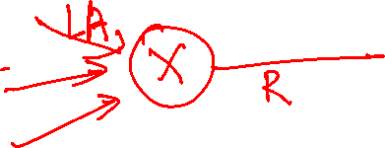
Queuing delay
Unlike other delays queuing delay can vary from packet to packet
If 10 packets arrive at an empty queue at the same time
The first packet will receive no queuing delay
The last packet will suffer from a relatively large delay
Usually, we measure the average queuing delay.
All packets are of size L
packets arrive at an average rate A packets/sec at a queue
R bits/sec is the transmission rate
LA/R is called the traffic intensity
if LA/R > 1 then the data is arriving at a higher rate than it can be transmitted
In this case, the packets will suffer from infinite delay, assuming the queue size is infinite

Slide 44
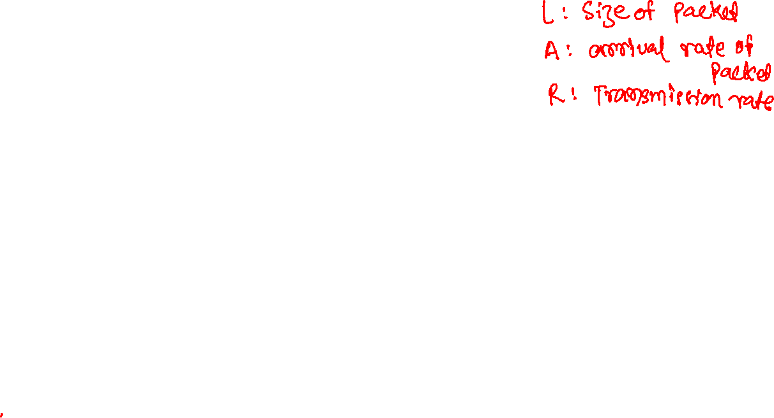
Queuing delay
On the other hand, if LA/R <= 1, the nature of arriving traffic impacts the queuing delay
In which case there will be no queuing delay

Slide 45
Queuing delay
On the other hand, if LA/R <= 1, the nature of arriving traffic impacts the queuing delay
In which case there will be no queuing delay
If packets arrive at a fixed interval of L/R then there will be no queuing delay.

Slide 46
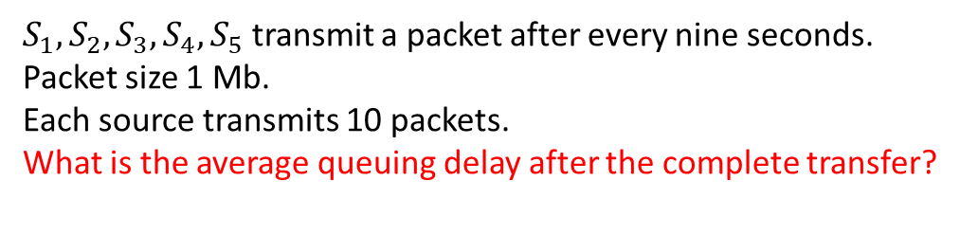
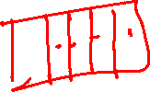
Queuing delay
S₁
1 Mbps
S₂
1 Mbps
1 Mbps
G
1 Mbps
S₃
R
1 Mbps
S₄
1 Mbps
S₅
$S_{1}, S_{2},S_{3},S_{4},S_{5}$ transmit a packet after every nine seconds.
Packet size 1 Mb.
Each source transmits 10 packets.
What is the average queuing delay after the complete transfer?

Slide 47
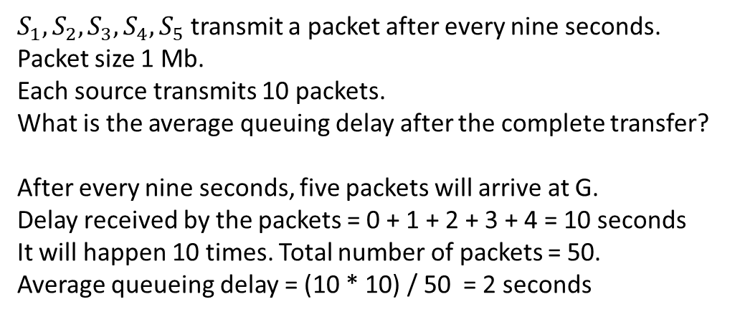
Queuing delay
S₁
1 Mbps
S₂
1 Mbps
1 Mbps
G
1 Mbps
S₃
R
1 Mbps
S₄
1 Mbps
S₅
$S_{1}, S_{2},S_{3},S_{4},S_{5}$ transmit a packet after every nine seconds.
Packet size 1 Mb.
Each source transmits 10 packets.
What is the average queuing delay after the complete transfer?
After every nine seconds, five packets will arrive at G.
Delay received by the packets = 0 + 1 + 2 + 3 + 4 = 10 seconds
It will happen 10 times. Total number of packets = 50.
Average queueing delay = (10 * 10) / 50 = 2 seconds

Slide 48
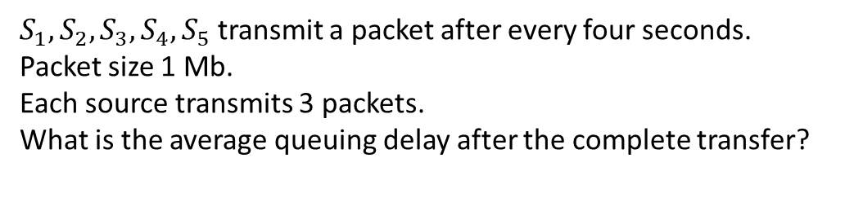
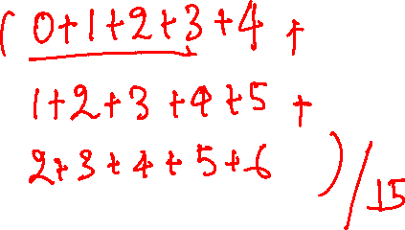
Queuing delay
S₁
1 Mbps
S₂
1 Mbps
1 Mbps
G
1 Mbps
S₃
R
1 Mbps
S₄
1 Mbps
S₅
$S_{1}, S_{2},S_{3},S_{4},S_{5}$ transmit a packet after every four seconds.
Packet size 1 Mb.
Each source transmits 3 packets.
What is the average queuing delay after the complete transfer?

Slide 49
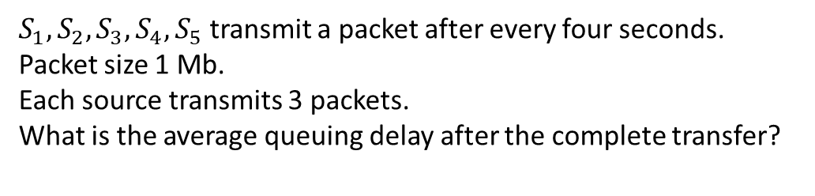
Queuing delay
S₁
1 Mbps
S₂
1 Mbps
1 Mbps
G
1 Mbps
S₃
R
Packet Arrival Processing Delay
1 1 1 0
2 1 2 1
3 1 3 2
4 1 4 3
5 1 5 4
6 5 6 1
7 5 7 2
8 5 8 3
9 5 9 4
10 5 10 5
11 9 11 2
12 9 12 3
13 9 13 4
14 9 14 5
15 9 15 6
1 Mbps
S₄
1 Mbps
S₅
$S_{1}, S_{2},S_{3},S_{4},S_{5}$ transmit a packet after every four seconds.
Packet size 1 Mb.
Each source transmits 3 packets.
What is the average queuing delay after the complete transfer?

Slide 50
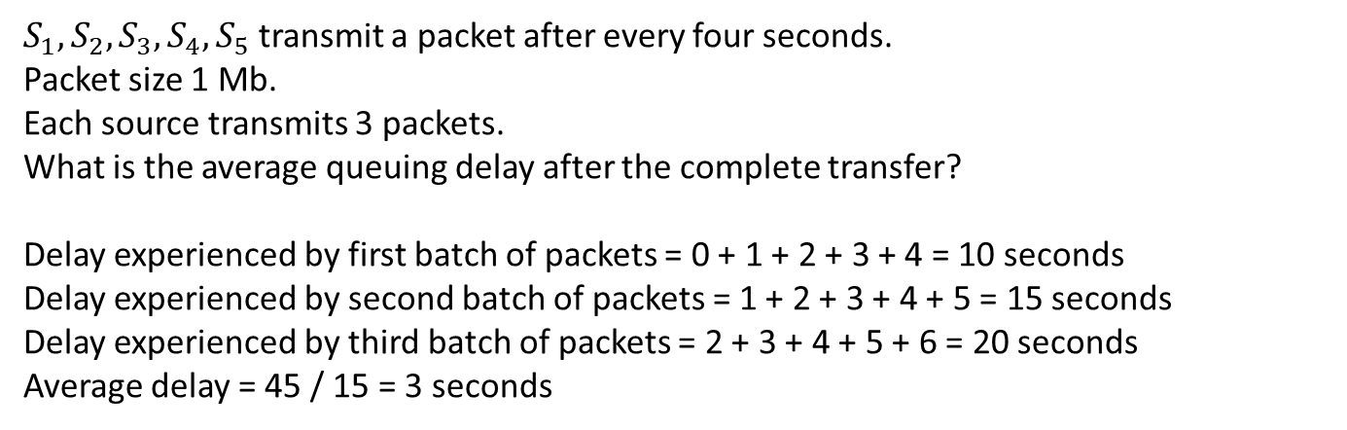
Queuing delay
S₁
1 Mbps
S₂
1 Mbps
1 Mbps
G
1 Mbps
S₃
R
1 Mbps
S₄
1 Mbps
S₅
$S_{1}, S_{2},S_{3},S_{4},S_{5}$ transmit a packet after every four seconds.
Packet size 1 Mb.
Each source transmits 3 packets.
What is the average queuing delay after the complete transfer?
Delay experienced by first batch of packets = 0 + 1 + 2 + 3 + 4 = 10 seconds
Delay experienced by second batch of packets = 1 + 2 + 3 + 4 + 5 = 15 seconds
Delay experienced by third batch of packets = 2 + 3 + 4 + 5 + 6 = 20 seconds
Average delay = 45 / 15 = 3 seconds

Slide 51
Queuing delay
Typically, the packets arrive randomly in bursts
In this case, LA/R is not sufficient to fully characterize the queuing delay, but it still provides useful intuition.
If the traffic intensity is close to zero, the queuing delay is nearly zero.
Queuing delay rises sharply as the traffic intensity reaches 1. This happens because packets arrive almost continuously, so any burst of arrivals quickly builds up in the queue.
This is similar to road traffic: near peak hours, even a small increase in cars can cause a large jump in wait times.
average queueing delay
traffic intensity = LA/R
1
Copyright © 2010-2025 J.F. Kurose, K.W. Ross

Slide 52
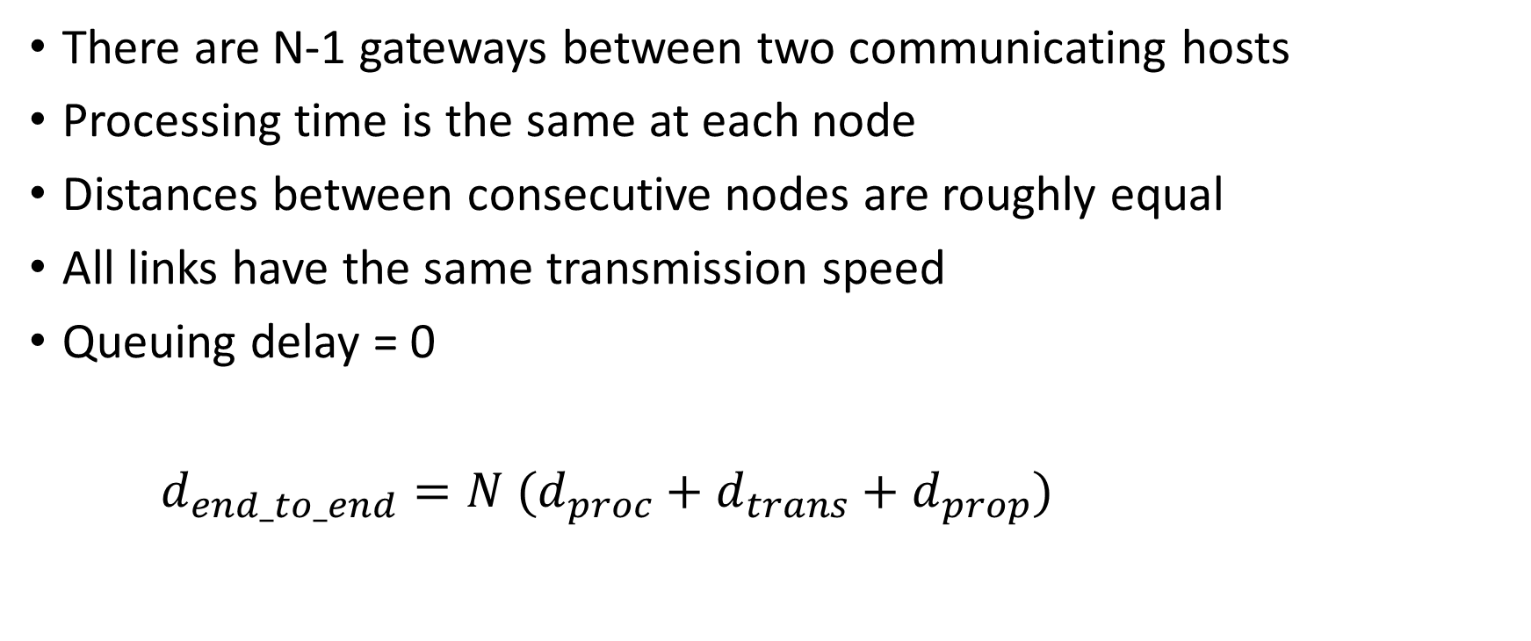
End-to-End delay (no queuing)
There are N-1 gateways between two communicating hosts
Processing time is the same at each node
Distances between consecutive nodes are roughly equal
All links have the same transmission speed
Queuing delay = 0
$d_{end_to_end}=N (d_{proc}+d_{trans}+d_{prop})$

Slide 53
Traceroute
Identifies the gateways between two communicating hosts.
Takes the destination host as input.
Sends special packets with time-to-live (TTL) values = 1, 2, …, N.
When a gateway receives a packet whose TTL expires:
It stops forwarding and replies with its identity to the source.
Destination also replies when it receives its packet.
Output:
The identity of each intermediate gateway
Round-trip time (RTT) to each gateway
Traceroute repeats this process 3 times for each hop.

Slide 54
Traceroute
traceroute www.chatgpt.com
traceroute to www.chatgpt.com (104.18.32.47), 30 hops max, 60 byte packets
1 DESKTOP-OHR9MU3.mshome.net (172.20.240.1) 5.552 ms 5.378 ms 5.168 ms
2 ralink.dlink.com (192.168.0.1) 7.411 ms 6.369 ms 7.077 ms
3 192.168.1.2 (192.168.1.2) 7.424 ms 7.353 ms 4.443 ms
4 vpn.iiitd.edu.in (192.168.1.3) 4.086 ms 4.400 ms 4.343 ms
5 103.25.231.1 (103.25.231.1) 4.409 ms 4.631 ms 4.651 ms
6 * * *
7 10.119.234.162 (10.119.234.162) 4.056 ms 29.300 ms 29.254 ms
8 103.218.244.94 (103.218.244.94) 57.768 ms 57.747 ms 57.713 ms
9 104.23.231.7 (104.23.231.7) 79.175 ms 104.23.231.5 (104.23.231.5) 61.477 ms 104.23.231.7 (104.23.231.7) 79.083 ms
104.18.32.47 (104.18.32.47) 55.607 ms 55.586 ms 55.558 ms
Why does the round trip time to each hop vary among different probes?

Slide 55
Traceroute
traceroute www.chatgpt.com
traceroute to www.chatgpt.com (104.18.32.47), 30 hops max, 60 byte packets
1 DESKTOP-OHR9MU3.mshome.net (172.20.240.1) 5.552 ms 5.378 ms 5.168 ms
2 ralink.dlink.com (192.168.0.1) 7.411 ms 6.369 ms 7.077 ms
3 192.168.1.2 (192.168.1.2) 7.424 ms 7.353 ms 4.443 ms
4 vpn.iiitd.edu.in (192.168.1.3) 4.086 ms 4.400 ms 4.343 ms
5 103.25.231.1 (103.25.231.1) 4.409 ms 4.631 ms 4.651 ms
6 * * *
7 10.119.234.162 (10.119.234.162) 4.056 ms 29.300 ms 29.254 ms
8 103.218.244.94 (103.218.244.94) 57.768 ms 57.747 ms 57.713 ms
9 104.23.231.7 (104.23.231.7) 79.175 ms 104.23.231.5 (104.23.231.5) 61.477 ms 104.23.231.7 (104.23.231.7) 79.083 ms
104.18.32.47 (104.18.32.47) 55.607 ms 55.586 ms 55.558 ms
Why does the round trip time to each hop vary among different probes?
Packets may receive different queuing or processing delays.

Slide 56
Traceroute
traceroute www.chatgpt.com
traceroute to www.chatgpt.com (104.18.32.47), 30 hops max, 60 byte packets
1 DESKTOP-OHR9MU3.mshome.net (172.20.240.1) 5.552 ms 5.378 ms 5.168 ms
2 ralink.dlink.com (192.168.0.1) 7.411 ms 6.369 ms 7.077 ms
3 192.168.1.2 (192.168.1.2) 7.424 ms 7.353 ms 4.443 ms
4 vpn.iiitd.edu.in (192.168.1.3) 4.086 ms 4.400 ms 4.343 ms
5 103.25.231.1 (103.25.231.1) 4.409 ms 4.631 ms 4.651 ms
6 * * *
7 10.119.234.162 (10.119.234.162) 4.056 ms 29.300 ms 29.254 ms
8 103.218.244.94 (103.218.244.94) 57.768 ms 57.747 ms 57.713 ms
9 104.23.231.7 (104.23.231.7) 79.175 ms 104.23.231.5 (104.23.231.5) 61.477 ms 104.23.231.7 (104.23.231.7) 79.083 ms
104.18.32.47 (104.18.32.47) 55.607 ms 55.586 ms 55.558 ms
Why did we get replies from three different gateways at the ninth hop?
Packets may reach the destination through different routes depending on the load.

Slide 57
whois
whois 103.218.244.94
whois retrieves the public registry record for an IP address
Organization name
Country/region
Contact info
Network allocation details

Slide 58
Throughput
Throughput is usually measured for a continuous stream of data, such as file transfer, video streaming, and similar applications.
If A is sending a file to B, the instantaneous throughput at any instant of time is the rate at which B is receiving the file.
If A is sending a file of size F bits and B receives the entire file after T seconds, the average throughput is:
Average throughput = F / T.

Slide 59
Throughput
For real time applications, it’s desirable to have an instantaneous throughput to stay consistently above a certain threshold.
For example, internet telephony typically requires over 24 Kbps.

Slide 60

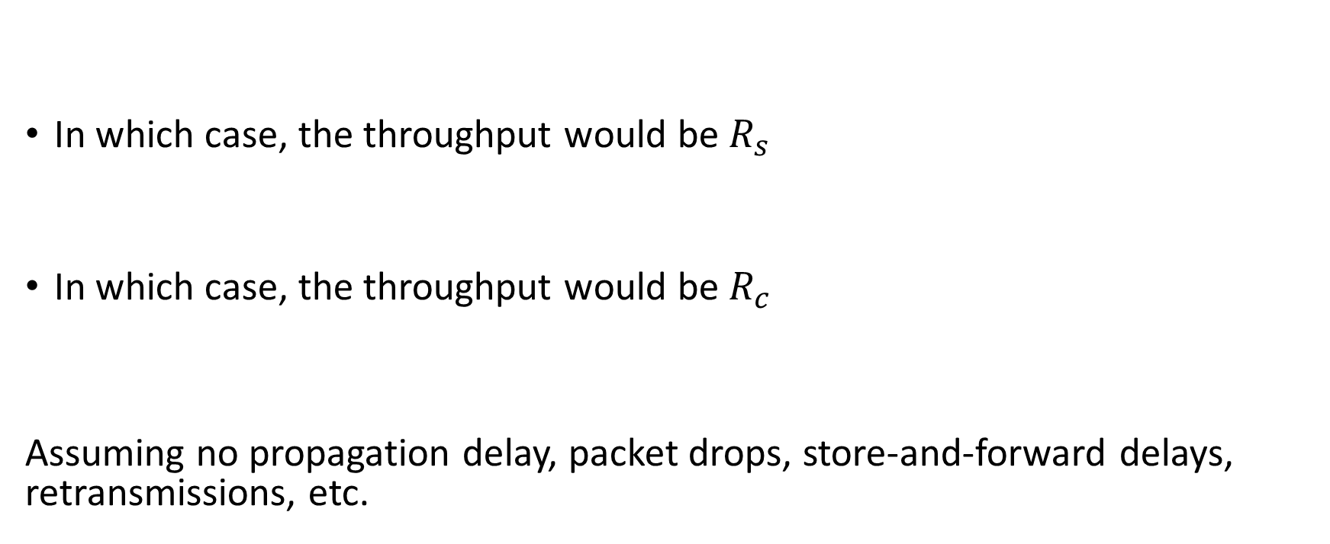

Example
$$R_{s}$$
G
$$R_{c}$$
S
C
In which case, the throughput would be $R_{s}$
In which case, the throughput would be $R_{c}$
Assuming no propagation delay, packet drops, store-and-forward delays, retransmissions, etc.

Slide 61
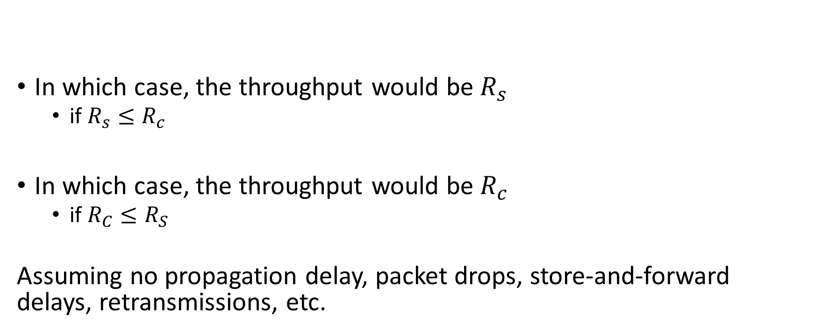
Example
$$R_{s}$$
G
$$R_{c}$$
S
C
In which case, the throughput would be $R_{s}$
if $R_{s}≤R_{c}$
In which case, the throughput would be $R_{c}$
if $R_{C}≤R_{S}$
Assuming no propagation delay, packet drops, store-and-forward delays, retransmissions, etc.

Slide 62

Example
$$R_{s}$$
G
$$R_{c}$$
S
C
For a simple two-line network, throughput is:
throughput = $min⁡(R_{s}, R_{c})$

Slide 63
Bottleneck link
A bottleneck link during the transmission of data from A to B is the link in the path whose available data rate for this communication is the smallest among all links.

Slide 64

Example
$$R_{s}$$
G
$$R_{c}$$
S
C
What is the average throughput and time required to transfer the file from S to C, given:
F = 32 Mb
$R_{S}$ = 2 Mbps
$R_{C}$ = 1 Mbps

Slide 65
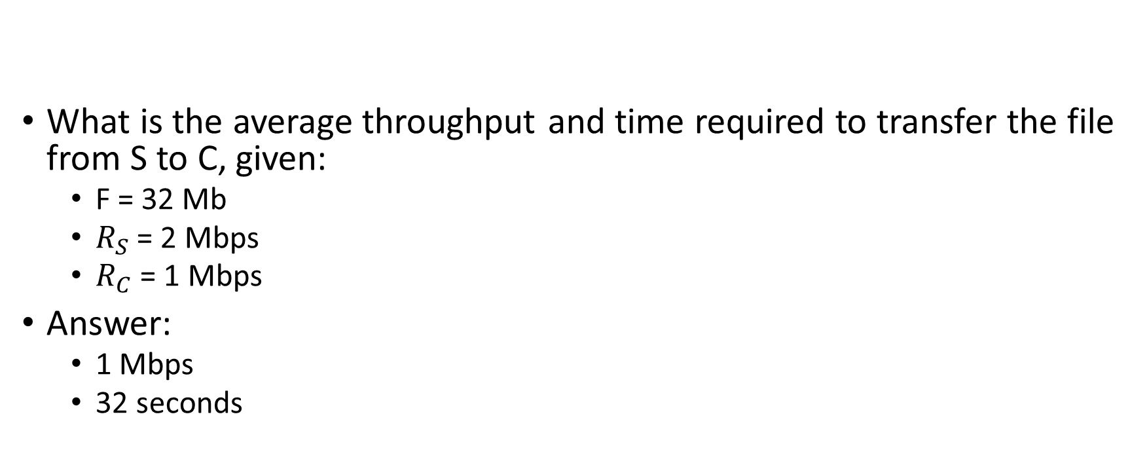
Example
$$R_{s}$$
G
$$R_{c}$$
S
C
What is the average throughput and time required to transfer the file from S to C, given:
F = 32 Mb
$R_{S}$ = 2 Mbps
$R_{C}$ = 1 Mbps
Answer:
1 Mbps
32 seconds

Slide 66

Throughput
If there are n links between the server and client, with transmission rate $R_{1}, …, R_{n}$, what will be throughput, assuming no other data traffic on these links?

Slide 67

Throughput
If there are $n$ links between the server and client, with transmission rate $R_{1}, …, R_{n}$, what will be throughput, assuming no other data traffic on these links?
min($R_{1}, …, R_{n}$)

Slide 68
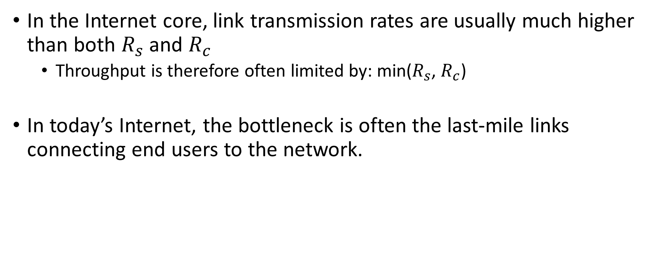
The real internet
In the Internet core, link transmission rates are usually much higher than both $R_{s}$ and $R_{c}$
Throughput is therefore often limited by: min($R_{s}$, $R_{c}$)
In today’s Internet, the bottleneck is often the last-mile links connecting end users to the network.

Slide 69
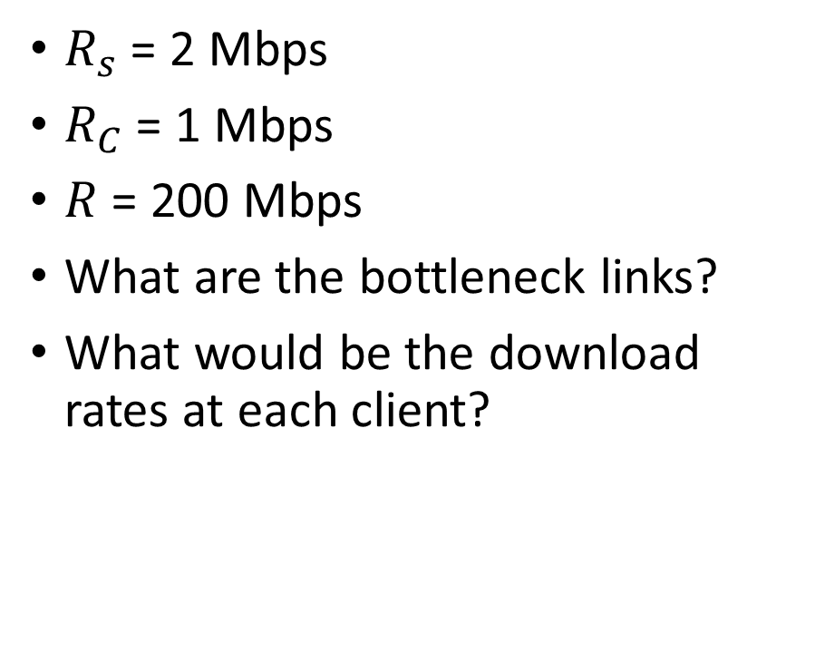
The real internet
R_{s}
$R_{s}$ = 2 Mbps
$R_{C}$ = 1 Mbps
$R$ = 200 Mbps
What are the bottleneck links?
What would be the download rates at each client?
R_{s}
R_{s}
R
R_{c}
R_{c}
R_{c}
10 connections (fairly) share backbone bottleneck link R bits/sec
Copyright © 2010-2025 J.F. Kurose, K.W. Ross

Slide 70
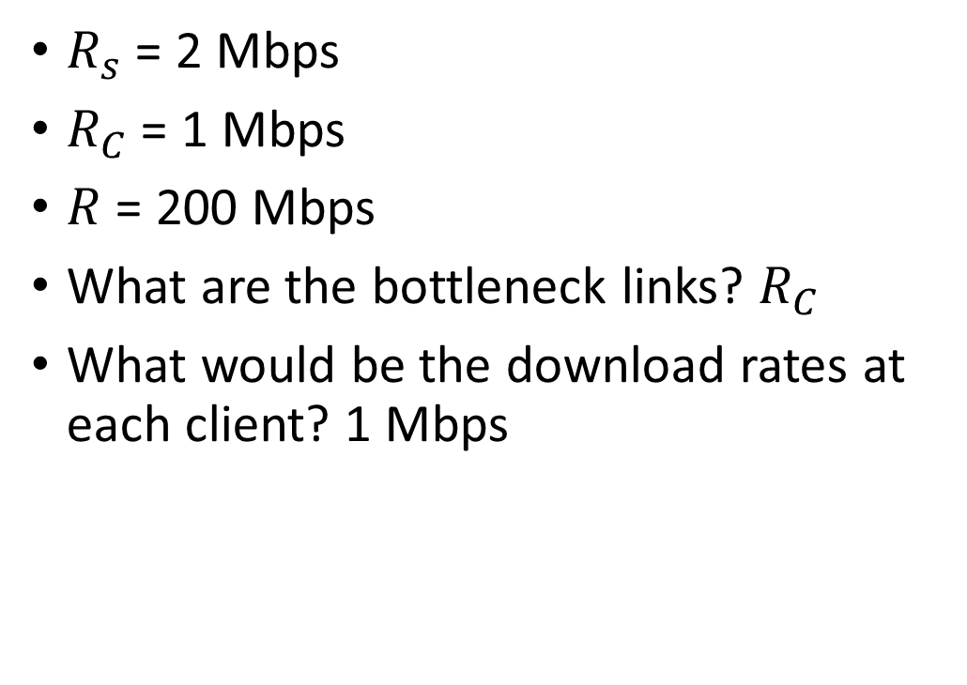
The real internet
R_{s}
$R_{s}$ = 2 Mbps
$R_{C}$ = 1 Mbps
$R$ = 200 Mbps
What are the bottleneck links? $R_{C}$
What would be the download rates at each client? 1 Mbps
R_{s}
R_{s}
R
R_{c}
R_{c}
R_{c}
10 connections (fairly) share backbone bottleneck link R bits/sec
Copyright © 2010-2025 J.F. Kurose, K.W. Ross

Slide 71
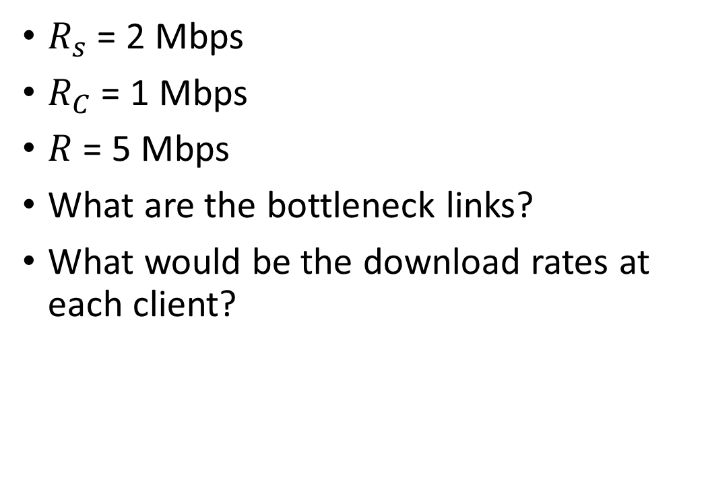
The real internet
R_{s}
$R_{s}$ = 2 Mbps
$R_{C}$ = 1 Mbps
$R$ = 5 Mbps
What are the bottleneck links?
What would be the download rates at each client?
R_{s}
R_{s}
R
R_{c}
R_{c}
R_{c}
10 connections (fairly) share backbone bottleneck link R bits/sec
Copyright © 2010-2025 J.F. Kurose, K.W. Ross

Slide 72
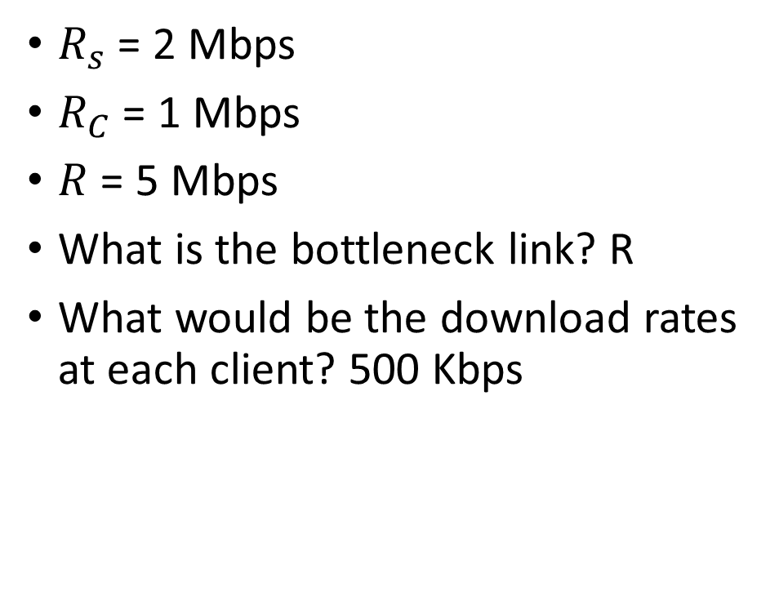
The real internet
R_{s}
$R_{s}$ = 2 Mbps
$R_{C}$ = 1 Mbps
$R$ = 5 Mbps
What is the bottleneck link? R
What would be the download rates at each client? 500 Kbps
R_{s}
R_{s}
R
R_{c}
R_{c}
R_{c}
10 connections (fairly) share backbone bottleneck link R bits/sec
Copyright © 2010-2025 J.F. Kurose, K.W. Ross

Slide 73
Bottleneck link
If there are n links between the path from A to B and the i^{th} link has the highest transmission rate. Is it possible that the i^{th} link is the bottleneck link?

Slide 74
Bottleneck link
If there are n links between the path from A to B and the i^{th} link has the highest transmission rate. Is it possible that the i^{th} link is the bottleneck link?
Yes, if many other data flows are passing through the i^{th} link.

Slide 75
Bandwidth
Literally bandwidth is a measure of the width of a frequency band
e.g., if the frequency range is 100 Hz to 1000 Hz. Bandwidth 900 Hz.
However, it is also used in the context of data rate
Bandwidth of a communication link is the number of bits per second that can be transmitted on the link.

Slide 76
Protocol
A formal set of rules that define how two or more entities communicate or interact.
For example: Handshake protocol
client → server (hello)
server → client (hello)
client → server (I received your hello)

