Slide 2
Today’s topics
Routing protocols
Link state routing
Distance vector routing

Slide 3
References
Read Chapter-5.2 from the Kurose and Ross
Read Chapter-3.4 from the Peterson and Davie

Slide 4
Forwarding table
The forwarding table is populated in two ways
Distributed approach (traditional networks)
All routers collaborate to compute their own forwarding tables
Centralized approach (software-defined networking, SDN)
A central controller computes the forwarding tables for all routers and pushes them to the routers

Slide 5





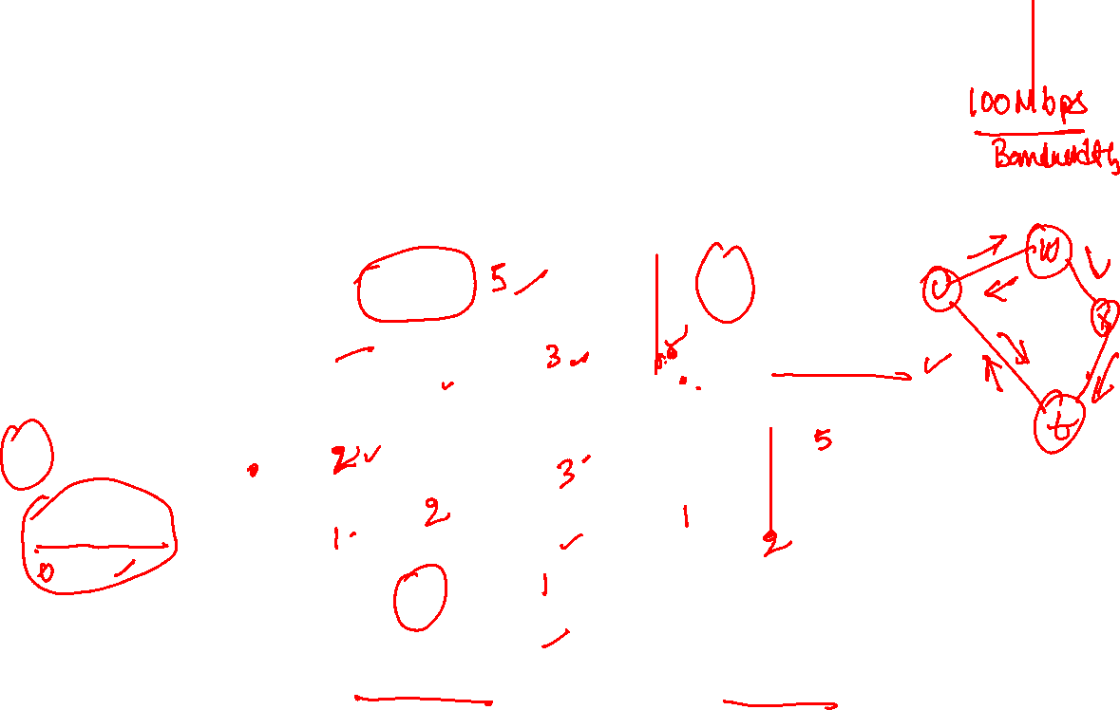
Interconnection of routers
mobile network
20 Mbps
mobile network
100.23.25.0/24
v
30 Mbps
w
50 Mbps
20 Mbps
u
50 Mbps
100 Mbps
z
200.23.16.0/26
30 Mbps
100 Mbps
50 Mbps
x
y
100 Mbps
200.23.18.0/23
200.24.0.0/16
Copyright © 2010-2025 J.F. Kurose, K.W. Ross

Slide 6
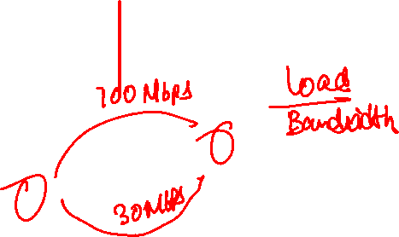
Cost of a link
.

Slide 7
Cost of a link
The cost of a link could be the inverse of bandwidth, link delay, the amount of traffic on the link, or defined by a network operator, etc.

Slide 8
Reliable flooding

Slide 9
Reliable flooding
Each router sends its link-state information to all other routers via reliable flooding
The link-state information is stored in a link-state packet (LSP)

Slide 10

Link-state packet (LSP)
The LSP of router A contains
sequence number
If the next hop is router B
ID of B
IP address A’s network interface connected to B
the cost of the outgoing link
If the next hop is an end user’s or an organization's network
network prefix and subnet mask of the A’s interface that connects to the network

Slide 11
Reliable flooding
Each router reliably (i.e., using acknowledgments) sends LSPs to its neighbors
Neighbors check if they already have a stored version of the LSP
If the sequence number is larger than the stored one
they replace the old version with the new one and reliably forward the packet to all neighbors except the one from which they received the packet
Otherwise, the LSP is discarded
This ensures that eventually all routers will receive LSP from all other routers

Slide 12
Reliable flooding
Goal
Newest information must propagate as quickly as possible, whereas the old information must be removed and should not propagate

Slide 13
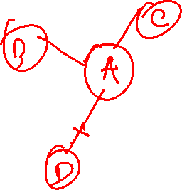
Change in topology

Slide 14
Change in topology
The routers periodically send ping messages to neighbors to detect link or router failures
If a router goes down, its neighbors start reliable flooding to propagate the change in topology
The routers compute their forwarding table again if they encounter a change in the topology

Slide 15
Change in topology
When the router is up again, it requests LSPs from neighboring routers, stores them, and shares its own LSPs with neighboring nodes using reliable flooding to inform all routers about the change in topology
The routers compute their forwarding table again if they encounter a change in the topology

Slide 16




Shortest Path
t
x
$$∞$$
1
$$∞$$
10
2
9
0
3
6
4
s
5
7
$$∞$$
$$∞$$
2
y
z

Slide 17









Shortest Path
0
t
x
t
x
$$∞$$
1
$$∞$$
1
$$8$$
$$9$$
$$5$$
10
10
2
9
9
0
3
6
2
3
4
0
6
$$7$$
4
s
s
5
7
7
$$∞$$
$$∞$$
$$8$$
5
$$5$$
$$7$$
2
2
y
z
z
y
$$9$$

Slide 18
Shortest Path
0
t
x
t
x
$$∞$$
1
$$∞$$
1
$$8$$
$$9$$
$$5$$
10
10
2
9
9
0
3
6
2
3
4
0
6
$$7$$
4
s
s
5
7
7
$$∞$$
$$∞$$
$$8$$
5
$$5$$
$$7$$
2
2
y
z
z
y
$$9$$
We can also use gravity to find the shortest path. Let’s say vertices are some solid objects. If we connect the adjacent objects using a thread of length equal to the weight of the corresponding edge and hang the source object to a hook in the ceiling, then the order in which the objects will appear from top the bottom, would be the order in which we are going to compute the shortest path. All the threads that are not loose are on the shortest path. We also need to remove the threads that are going in the upward direction.

Slide 19
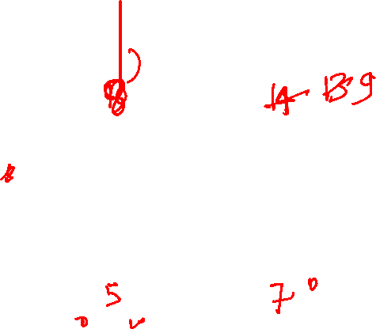
Shortest Path
t
x
$$∞$$
1
$$∞$$
10
2
9
0
3
6
4
s
5
7
$$∞$$
$$∞$$
2
y
z

Slide 20

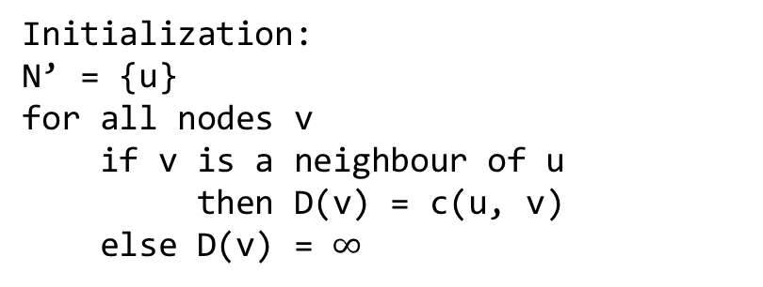




Shortest Path
t
x
$$10$$
1
$$∞$$
10
9
Initialization:
N’ = {u}
for all nodes v
if v is a neighbour of u
then D(v) = c(u, v)
else D(v) = $∞$
2
3
0
6
4
s
5
7
$$5$$
$$∞$$
2
y
z
The next node that appears due to gravity must be directly connected to s.
y will appear next, because it has the shortest distance among all nodes directly connected to s.
White nodes are in N’
The values in the circles represent D(v)

Slide 21

Shortest Path
t
x
$$10$$
1
$$∞$$
10
9
Loop
find w not in N’ such that D(w) is minimum
add w to N’
update D(v) for each neighbour v of w and not in N’:
D(v) = min(D(v), D(w) + c(w, v))
until N’ = N
2
3
0
6
4
s
5
7
$$5$$
$$∞$$
2
y
z
The next node that appears next due to gravity must be directly connected to s or y.
Update distances from y.

Slide 22



Shortest Path
t
x
$$8$$
1
$$14$$
10
9
Loop
find w not in N’ such that D(w) is minimum
add w to N’
update D(v) for each neighbour v of w and not in N’:
D(v) = min(D(v), D(w) + c(w, v))
until N’ = N
2
3
0
6
4
s
5
7
$$5$$
$$7$$
2
y
z
After updating distances from y.
The node that appears next must be directly connected to s or y
It’s z, because z has the shortest distance.

Slide 23

Shortest Path
t
x
$$8$$
1
$$14$$
10
9
Loop
find w not in N’ such that D(w) is minimum
add w to N’
update D(v) for each neighbour v of w and not in N’:
D(v) = min(D(v), D(w) + c(w, v))
until N’ = N
2
3
0
6
4
s
5
7
$$5$$
$$7$$
2
y
z
The next node that appears due to gravity must be directly connected to s, y, or z.
Update distances from z.

Slide 24

Shortest Path
t
x
$$8$$
1
$$13$$
10
9
Loop
find w not in N’ such that D(w) is minimum
add w to N’
update D(v) for each neighbour v of w and not in N’:
D(v) = min(D(v), D(w) + c(w, v))
until N’ = N
2
3
0
6
4
s
5
7
$$5$$
$$7$$
2
y
z
After updating distances from z.
The node that appears next must be directly connected to s, y, or z.
It’s t, because t has the shortest distance.

Slide 25

Shortest Path
t
x
$$8$$
1
$$13$$
10
9
Loop
find w not in N’ such that D(w) is minimum
add w to N’
update D(v) for each neighbour v of w and not in N’:
D(v) = min(D(v), D(w) + c(w, v))
until N’ = N
2
3
0
6
4
s
5
7
$$5$$
$$7$$
2
y
z
The next node that appears due to gravity must be directly connected to s, y, z, or t.
Update distances from t.

Slide 26

Shortest Path
t
x
$$8$$
1
$$9$$
10
9
Loop
find w not in N’ such that D(w) is minimum
add w to N’
update D(v) for each neighbour v of w and not in N’:
D(v) = min(D(v), D(w) + c(w, v))
until N’ = N
2
3
0
6
4
s
5
7
$$5$$
$$7$$
2
y
z
After updating distances from t.
The node that appears next must be directly connected to s, y, z, t
It’s x, because we have no other option.

Slide 27
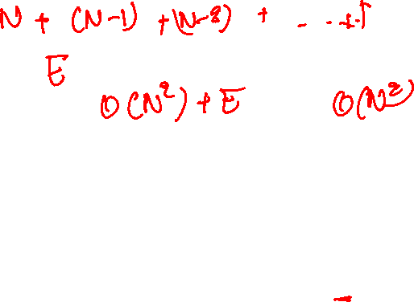

Shortest Path
t
x
$$8$$
1
$$9$$
10
9
Loop
find w not in N’ such that D(w) is minimum
add w to N’
update D(v) for each neighbour v of w and not in N’:
D(v) = min(D(v), D(w) + c(w, v))
until N’ = N
2
3
0
6
4
s
5
7
$$5$$
$$7$$
2
y
z
All the nodes are in N’. The algorithm terminates.

Slide 28
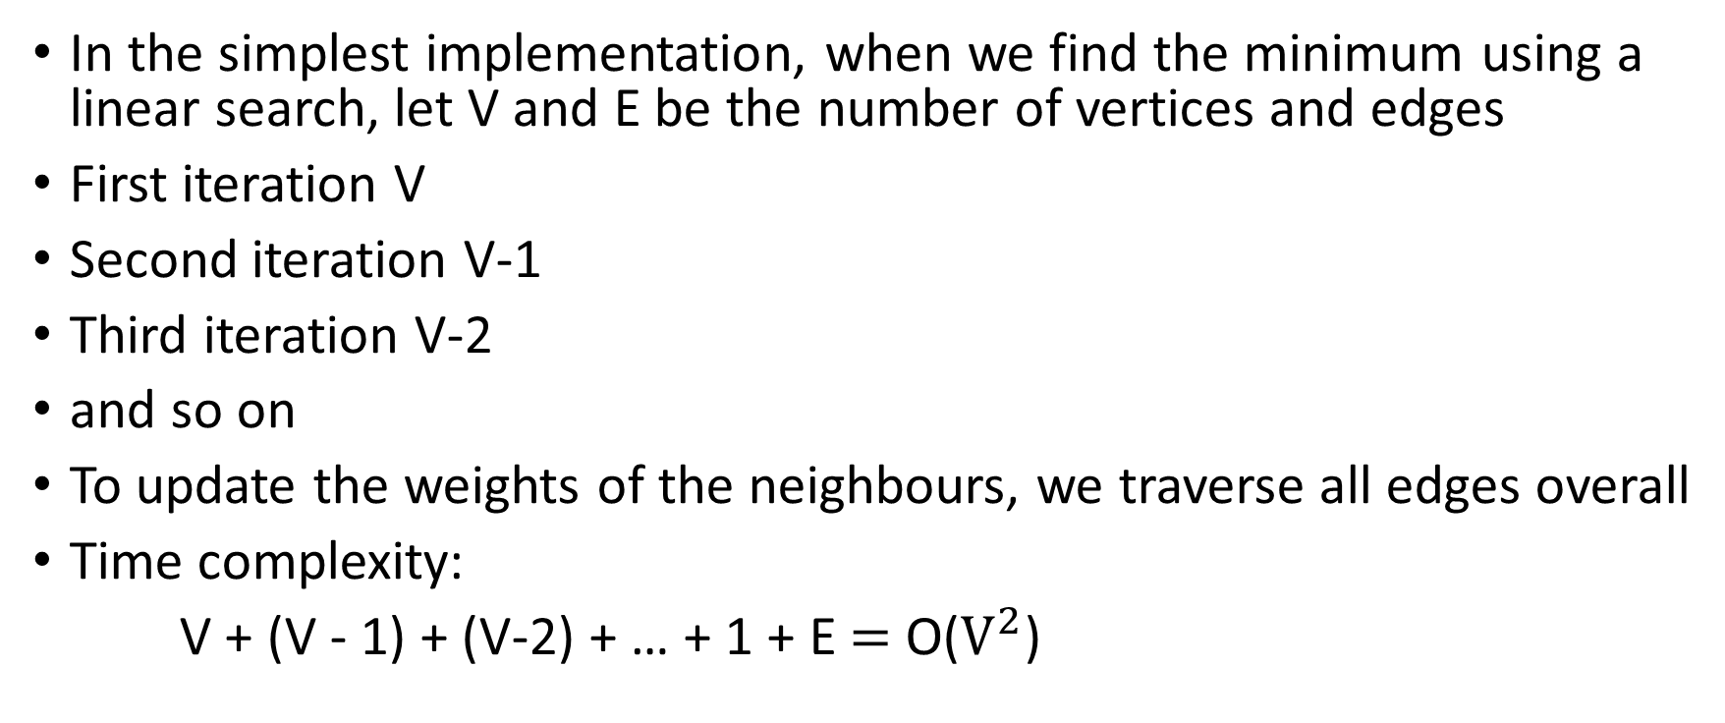
Time complexity
In the simplest implementation, when we find the minimum using a linear search, let V and E be the number of vertices and edges
First iteration V
Second iteration V-1
Third iteration V-2
and so on
To update the weights of the neighbours, we traverse all edges overall
Time complexity:
V + (V - 1) + (V-2) + … + 1 + E $=$ O($V^{2}$)

Slide 29

Time complexity
Using min-heap: $O(\left(V+E\right)\log{V})$

Slide 30
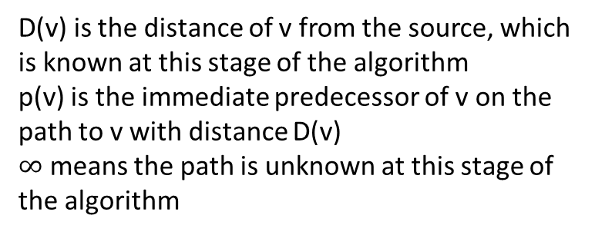
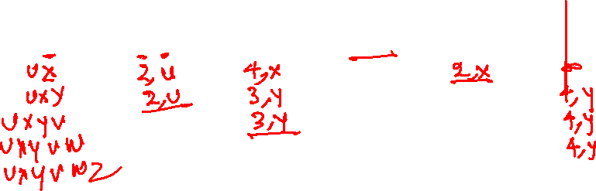
Link-state routing (example)
v
w
x
y
z
Step
0
1
2
3
4
5
N'
D(v),p(v)
D(w),p(w)
D(x),p(x)
D(y),p(y)
D(z),p(z)
u
2,u
5,u
1,u
∞
∞
5
v
3
w
2
5
D(v) is the distance of v from the source, which is known at this stage of the algorithm
p(v) is the immediate predecessor of v on the path to v with distance D(v)
$∞$ means the path is unknown at this stage of the algorithm
u
2
1
z
3
1
2
x
y
1
Copyright © 2010-2025 J.F. Kurose, K.W. Ross

Slide 31
Link-state routing (example)
v
w
x
y
z
Step
0
1
2
3
4
5
N'
D(v),p(v)
D(w),p(w)
D(x),p(x)
D(y),p(y)
D(z),p(z)
u
2,u
5,u
1,u
∞
∞
5
v
3
w
2
5
D(v) is the distance of v from the source, which is known at this stage of the algorithm
p(v) is the immediate predecessor of v on the path to v with distance D(v)
$∞$ means the path is unknown at this stage of the algorithm
u
2
1
z
3
1
2
x
y
1
Copyright © 2010-2025 J.F. Kurose, K.W. Ross

Slide 32
Link-state routing (example)
v
w
x
y
z
Step
0
1
2
3
4
5
N'
D(v),p(v)
D(w),p(w)
D(x),p(x)
D(y),p(y)
D(z),p(z)
u
2,u
5,u
1,u
∞
∞
ux
2,u
4,x
2,x
∞
5
v
3
w
2
5
D(v) is the distance of v from the source, which is known at this stage of the algorithm
p(v) is the immediate predecessor of v on the path to v with distance D(v)
$∞$ means the path is unknown at this stage of the algorithm
u
2
1
z
3
1
2
x
y
1
Copyright © 2010-2025 J.F. Kurose, K.W. Ross

Slide 33
Link-state routing (example)
v
w
x
y
z
Step
0
1
2
3
4
5
N'
D(v),p(v)
D(w),p(w)
D(x),p(x)
D(y),p(y)
D(z),p(z)
u
2,u
5,u
1,u
∞
∞
ux
2,u
4,x
2,x
∞
uxy
2,u
3,y
4,y
5
v
3
w
2
5
D(v) is the distance of v from the source, which is known at this stage of the algorithm
p(v) is the immediate predecessor of v on the path to v with distance D(v)
$∞$ means the path is unknown at this stage of the algorithm
u
2
1
z
3
1
2
x
y
1
Copyright © 2010-2025 J.F. Kurose, K.W. Ross

Slide 34
Link-state routing (example)
v
w
x
y
z
Step
0
1
2
3
4
5
N'
D(v),p(v)
D(w),p(w)
D(x),p(x)
D(y),p(y)
D(z),p(z)
u
2,u
5,u
1,u
∞
∞
ux
2,u
4,x
2,x
∞
uxy
2,u
3,y
4,y
uxyv
3,y
4,y
5
v
3
w
2
5
D(v) is the distance of v from the source, which is known at this stage of the algorithm
p(v) is the immediate predecessor of v on the path to v with distance D(v)
$∞$ means the path is unknown at this stage of the algorithm
u
2
1
z
3
1
2
x
y
1
Copyright © 2010-2025 J.F. Kurose, K.W. Ross

Slide 35
Link-state routing (example)
v
w
x
y
z
Step
0
1
2
3
4
5
N'
D(v),p(v)
D(w),p(w)
D(x),p(x)
D(y),p(y)
D(z),p(z)
u
2,u
5,u
1,u
∞
∞
ux
2,u
4,x
2,x
∞
uxy
2,u
3,y
4,y
uxyv
3,y
4,y
uxyvw
4,y
5
v
3
w
2
5
D(v) is the distance of v from the source, which is known at this stage of the algorithm
p(v) is the immediate predecessor of v on the path to v with distance D(v)
$∞$ means the path is unknown at this stage of the algorithm
u
2
1
z
3
1
2
x
y
1
Copyright © 2010-2025 J.F. Kurose, K.W. Ross

Slide 36
Link-state routing (example)
v
w
x
y
z
Step
0
1
2
3
4
5
N'
D(v),p(v)
D(w),p(w)
D(x),p(x)
D(y),p(y)
D(z),p(z)
u
2,u
5,u
1,u
∞
∞
ux
2,u
4,x
2,x
∞
uxy
2,u
3,y
4,y
uxyv
3,y
4,y
uxyvw
4,y
uxyvwz
5
v
3
w
2
5
D(v) is the distance of v from the source, which is known at this stage of the algorithm
p(v) is the immediate predecessor of v on the path to v with distance D(v)
$∞$ means the path is unknown at this stage of the algorithm
u
2
1
z
3
1
2
x
y
1
Copyright © 2010-2025 J.F. Kurose, K.W. Ross

Slide 37
Link-state routing (Exercise)
x
D(v),
p(v)
D(w),
p(w)
D(x),
p(x)
D(y),
p(y)
D(z),
p(z)
9
Step
N'
0
u
7,u
3,u
5,u
∞
∞
5
7
4
8
u
3
w
y
z
2
3
7
4
v
Copyright © 2010-2025 J.F. Kurose, K.W. Ross

Slide 38
Link-state routing (example)
x
D(v),
p(v)
D(w),
p(w)
D(x),
p(x)
D(y),
p(y)
D(z),
p(z)
9
Step
N'
0
u
7,u
3,u
5,u
∞
∞
5
7
4
8
u
3
w
y
z
2
3
7
4
v
Copyright © 2010-2025 J.F. Kurose, K.W. Ross

Slide 39
Link-state routing (example)
x
D(v),
p(v)
D(w),
p(w)
D(x),
p(x)
D(y),
p(y)
D(z),
p(z)
9
Step
N'
0
u
7,u
3,u
5,u
∞
∞
5
7
4
1
uw
6,w
5,u
11,w
∞
8
u
3
w
y
z
2
3
7
4
v
Copyright © 2010-2025 J.F. Kurose, K.W. Ross

Slide 40
Link-state routing (example)
x
D(v),
p(v)
D(w),
p(w)
D(x),
p(x)
D(y),
p(y)
D(z),
p(z)
9
Step
N'
0
u
7,u
3,u
5,u
∞
∞
5
7
4
1
uw
6,w
5,u
11,w
∞
8
2
uwx
6,w
11,w
14,x
u
3
w
y
z
2
3
7
4
v
Copyright © 2010-2025 J.F. Kurose, K.W. Ross

Slide 41
Link-state routing (example)
x
D(v),
p(v)
D(w),
p(w)
D(x),
p(x)
D(y),
p(y)
D(z),
p(z)
9
Step
N'
0
u
7,u
3,u
5,u
∞
∞
5
7
4
1
uw
6,w
5,u
11,w
∞
8
2
uwx
6,w
11,w
14,x
u
3
w
y
z
2
3
uwxv
10,v
14,x
3
7
4
v
Copyright © 2010-2025 J.F. Kurose, K.W. Ross

Slide 42
Link-state routing (example)
x
D(v),
p(v)
D(w),
p(w)
D(x),
p(x)
D(y),
p(y)
D(z),
p(z)
9
Step
N'
0
u
7,u
3,u
5,u
∞
∞
5
7
4
1
uw
6,w
5,u
11,w
∞
8
2
uwx
6,w
11,w
14,x
u
3
w
y
z
2
3
uwxv
10,v
14,x
3
4
uwxvy
12,y
7
4
v
Copyright © 2010-2025 J.F. Kurose, K.W. Ross

Slide 43

Link-state routing (example)
x
D(v),
p(v)
D(w),
p(w)
D(x),
p(x)
D(y),
p(y)
D(z),
p(z)
9
Step
N'
0
u
7,u
3,u
5,u
∞
∞
5
7
4
1
uw
6,w
5,u
11,w
∞
8
2
uwx
6,w
11,w
14,x
u
3
w
y
z
2
3
uwxv
10,v
14,x
3
4
uwxvy
12,y
7
4
4
uwxvyz
v
Copyright © 2010-2025 J.F. Kurose, K.W. Ross

Slide 44

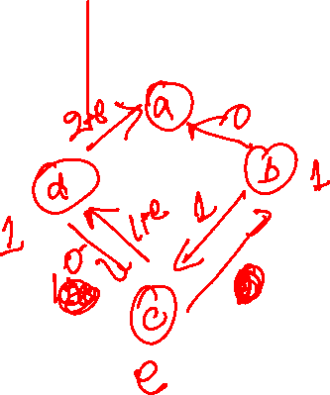
Oscillations
Let’s use the load on a link as its cost. Edge labels are the current load. Nodes $c$, $b$, and $d$ are sending data at a constant rate of $e$, 1, 1 Mbps to $a$.
a
What will be the shortest paths if we run the link-state routing protocol at this point?
1
1+e
d
b
0
0
1
0
c
e
1
e
initially
Copyright © 2010-2025 J.F. Kurose, K.W. Ross

Slide 45
Oscillations
Let’s use the load on a link as its cost. Edge labels are the current load. Nodes $c$, $b$, and $d$ are sending data at a constant rate of $e$, 1, 1 Mbps to $a$.
a
1
1+e
d
b
0
0
1
0
c
e
1
e
initially
Copyright © 2010-2025 J.F. Kurose, K.W. Ross

Slide 46
Oscillations
Let’s use the load on a link as its cost. Edge labels are the current load. Nodes $c$, $b$, and $d$ are sending data at a constant rate of $e$, 1, 1 Mbps to $a$.
a
a
1
1+e
2+e
0
d
b
d
1
b
0
0
1+e
1
0
e
1
0
c
0
1
c
1
e
e
given these costs,
find new routing….
resulting in new costs
initially
Copyright © 2010-2025 J.F. Kurose, K.W. Ross

Slide 47
Oscillations
Let’s use the load on a link as its cost. Edge labels are the current load. Nodes $c$, $b$, and $d$ are sending data at a constant rate of $e$, 1, 1 Mbps to $a$.
a
a
a
1
1+e
2+e
0
0
2+e
d
b
d
1
b
d
b
0
0
1+e
0
0
1
0
e
1
0
c
0
1
1
1
c
1+e
1
c
1
e
e
e
given these costs,
find new routing….
resulting in new costs
given these costs,
find new routing….
resulting in new costs
initially
Copyright © 2010-2025 J.F. Kurose, K.W. Ross

Slide 48
Oscillations
Let’s use the load on a link as its cost. Edge labels are the current load. Nodes $c$, $b$, and $d$ are sending data at a constant rate of $e$, 1, 1 Mbps to $a$.
a
a
a
a
1
1+e
2+e
0
0
2+e
2+e
0
d
b
d
1
b
d
b
d
b
0
0
1+e
0
0
1+e
1
1
0
e
1
0
c
0
1
1
1
c
1+e
1
1
0
0
1
c
1
c
e
e
e
e
given these costs,
find new routing….
resulting in new costs
given these costs,
find new routing….
resulting in new costs
given these costs,
find new routing….
resulting in new costs
initially
Copyright © 2010-2025 J.F. Kurose, K.W. Ross

Slide 49
Oscillations
How to prevent oscillations?

Slide 50
Oscillations
How to prevent oscillations?
Don’t use the current load as the cost of a link
Undesirable: the goal of routing to find efficient (uncongested) routes
Instead of using the instantaneous load, the average load over a period of time could be a better metric
It turns out that if routers advertise their link-state at random times and all nodes don’t run the routing algorithms at the same time, this oscillation can be reduced
Additionally, network operators can assign costs to different links to achieve better load balancing

