Slide 2
Today’s topics
Distance vector routing

Slide 3
References
Read Chapter-5.2 from the Kurose and Ross

Slide 4
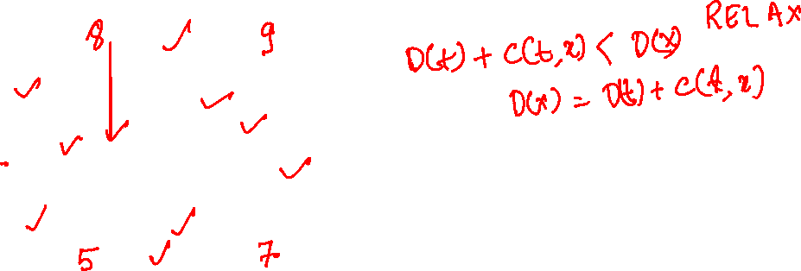




Shortest Path (Bellman-Ford)
t
x
$$∞$$
1
$$∞$$
10
2
9
0
3
6
4
s
5
7
$$∞$$
$$∞$$
2
y
z

Slide 5




Shortest Path (Bellman-Ford)
t
x
$$8$$
1
$$9$$
10
2
9
0
3
6
4
s
5
7
$$5$$
$$7$$
2
y
z

Slide 6
Distance-vector routing
In link-state routing, each router advertises its link-state information to all other routers, and each router individually computes its forwarding table
Unlike link-state routing in distance-vector routing, each router shares its distance vector (i.e., the cost to reach each destination) with all its neighbors, who update their distance vector based on the information shared by the neighbors
Whenever a router notices a change in its distance vector using the information from its neighbors, it advertises the updated vector to all of its neighbors
The algorithm terminates when none of the routers have any updates to share

Slide 7

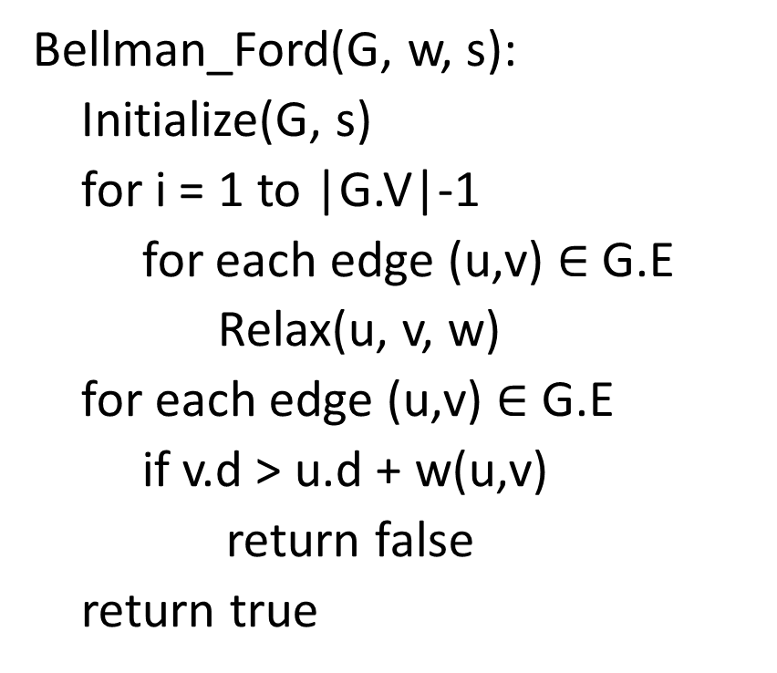
Bellman-Ford algorithm
Bellman_Ford(G, w, s):
Initialize(G, s)
for i = 1 to |G.V|-1
for each edge (u,v) $∈$ G.E
Relax(u, v, w)
for each edge (u,v) $∈$ G.E
if v.d > u.d + w(u,v)
return false
return true
Relax(u, v, w)
if v.d > u.d + w(u, v)
v.d = u.d + w(u, v)
v.$π$ = u

Slide 8

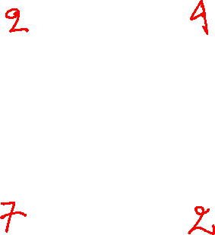



Example
E2 = 5
t
x
$$∞$$
$$∞$$
Let’s say that the edges are visited in the order E1 to E10.
E3 = -2
E1 = 6
E4 = -3
0
E10 = 8
E9 = 7
E5 = -4
s
E8 = 7
E6 = 2
$$∞$$
$$∞$$
E7 = 9
y
z

Slide 9




Example
E2 = 5
t
x
$$6$$
$$9$$
After visiting all edges in the first iteration.
E3 = -2
E1 = 6
E4 = -3
0
E10 = 8
E9 = 7
E5 = -4
s
E8 = 7
E6 = 2
$$7$$
$$2$$
E7 = 9
y
z

Slide 10

Example
E2 = 5
t
x
$$6$$
$$4$$
After visiting all edges in the second iteration.
E3 = -2
E1 = 6
E4 = -3
0
E10 = 8
E9 = 7
E5 = -4
s
E8 = 7
E6 = 2
$$7$$
$$2$$
E7 = 9
y
z

Slide 11


Example
E2 = 5
t
x
$$2$$
$$4$$
After visiting all edges in the third iteration.
E3 = -2
E1 = 6
E4 = -3
0
E10 = 8
E9 = 7
E5 = -4
s
E8 = 7
E6 = 2
$$7$$
$$−2$$
E7 = 9
y
z

Slide 12
Example
E2 = 5
t
x
$$2$$
$$4$$
After visiting all edges in the fourth iteration.
No change during this iteration; therefore, the algorithm terminates.
E3 = -2
E1 = 6
E4 = -3
0
E10 = 8
E9 = 7
E5 = -4
s
E8 = 7
E6 = 2
$$7$$
$$−2$$
E7 = 9
y
z

Slide 13
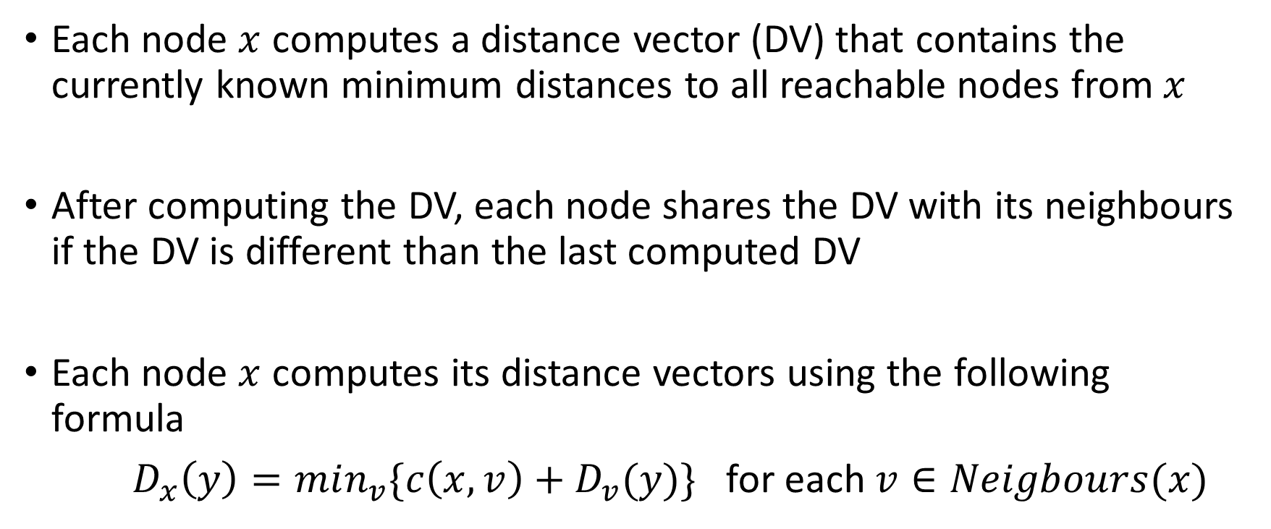
Distance vector routing
Each node $x$ computes a distance vector (DV) that contains the currently known minimum distances to all reachable nodes from $x$
After computing the DV, each node shares the DV with its neighbours if the DV is different than the last computed DV
Each node $x$ computes its distance vectors using the following formula
$D_{x}\left(y\right)=min_{v}{\{c\left(x,v\right)+D_{v}(y)\}}$ for each $v∈Neigbours(x)$

Slide 14
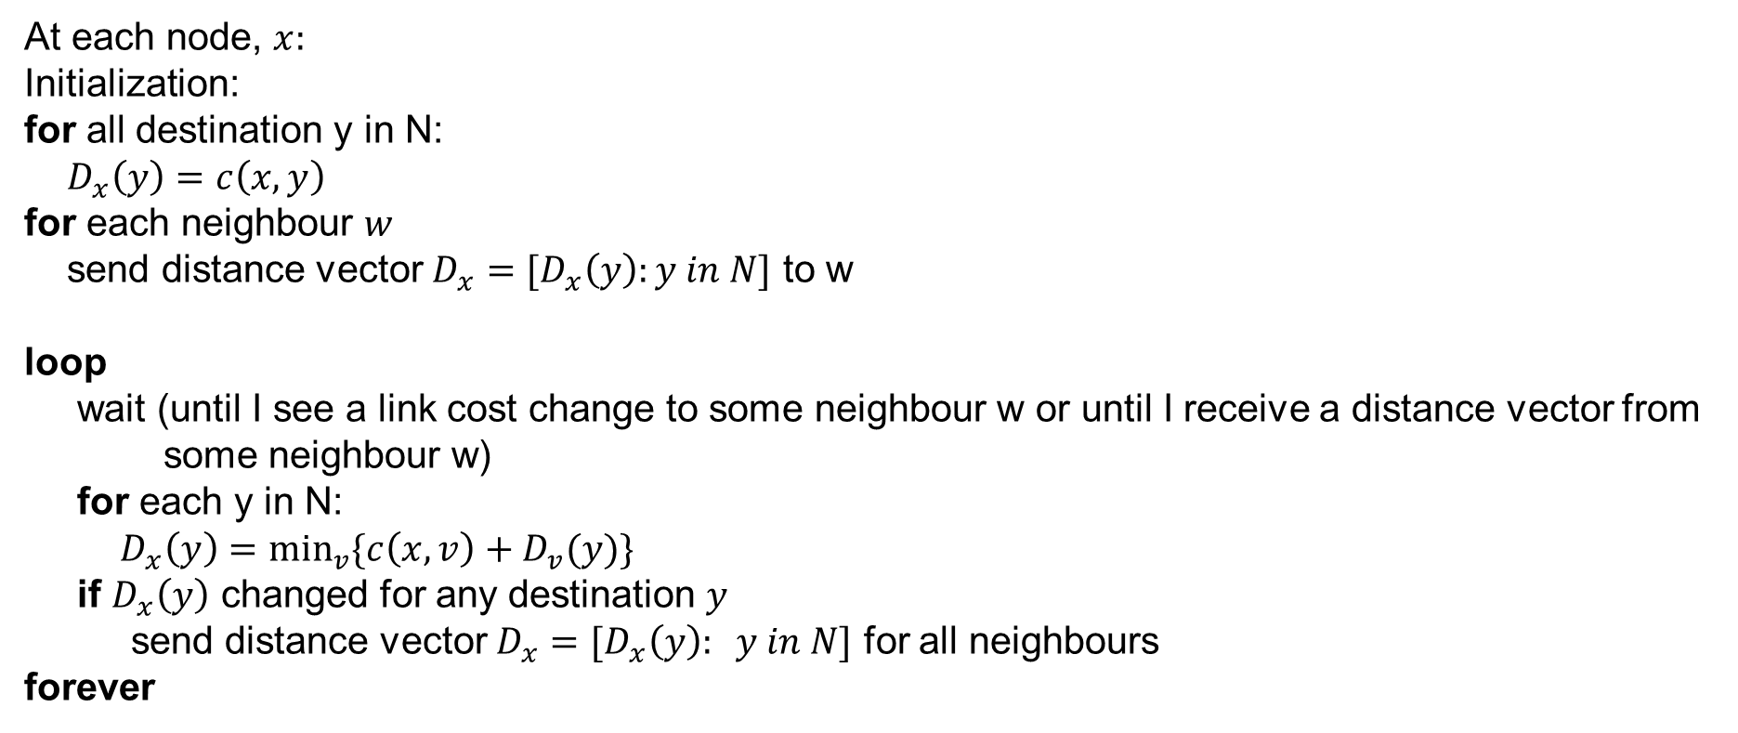
Distance vector algorithm
At each node, $x:$
Initialization:
for all destination y in N:
$D_{x}\left(y\right)=c\left(x,y\right)$
for each neighbour $w$
send distance vector $D_{x}=[D_{x}\left(y\right):y in N]$ to w
loop
wait (until I see a link cost change to some neighbour w or until I receive a distance vector from some neighbour w)
for each y in N:
$D_{x}\left(y\right)=\min_{v}{\{c\left(x,v\right)+D_{v}(y)\}}$
if $D_{x}\left(y\right)$ changed for any destination $y$
send distance vector $D_{x}=[D_{x}\left(y\right): y in N]$ for all neighbours
forever

Slide 15
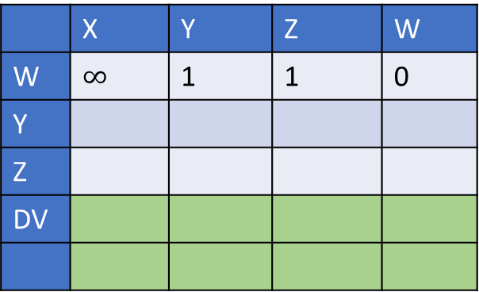
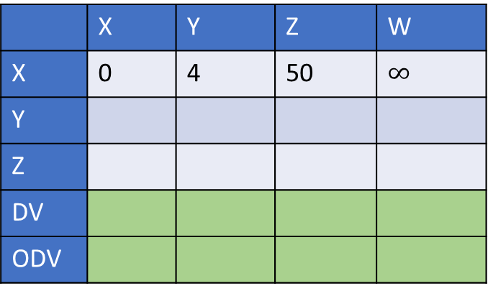
Distance vector routing
 | X | Y | Z | W
W | $$∞$$ | 1 | 1 | 0
Y
Z
DV
 | X | Y | Z | W
Y | 4 | 0 | 3 | 1
X
Z
W
DV
ODV
Y
1
W
4
3
1
 | X | Y | Z | W
Z | 50 | 3 | 0 | 1
Y
X
W
DV
 | X | Y | Z | W
X | 0 | 4 | 50 | $$∞$$
Y
Z
DV
ODV
X
Z
50

Slide 16
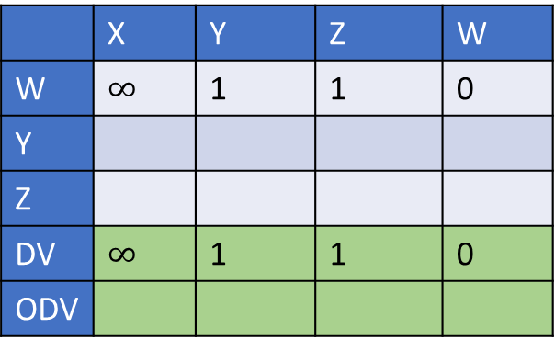
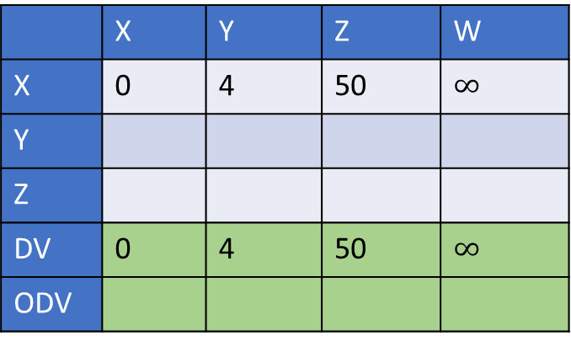
Distance vector routing
 | X | Y | Z | W
W | $$∞$$ | 1 | 1 | 0
Y
Z
DV | $$∞$$ | 1 | 1 | 0
ODV
 | X | Y | Z | W
Y | 4 | 0 | 3 | 1
X
Z
W
DV | 4 | 0 | 3 | 1
ODV
Compute DV
Y
1
W
4
3
1
 | X | Y | Z | W
Z | 50 | 3 | 0 | 1
Y
X
W
DV | 50 | 3 | 0 | 1
ODV
 | X | Y | Z | W
X | 0 | 4 | 50 | $$∞$$
Y
Z
DV | 0 | 4 | 50 | $$∞$$
ODV
X
Z
50

Slide 17
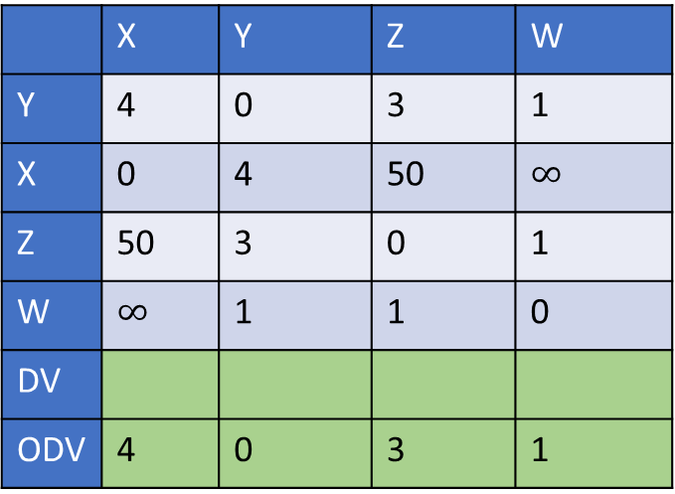
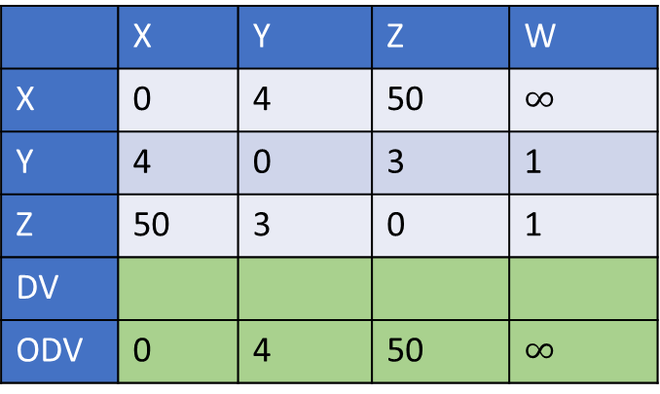
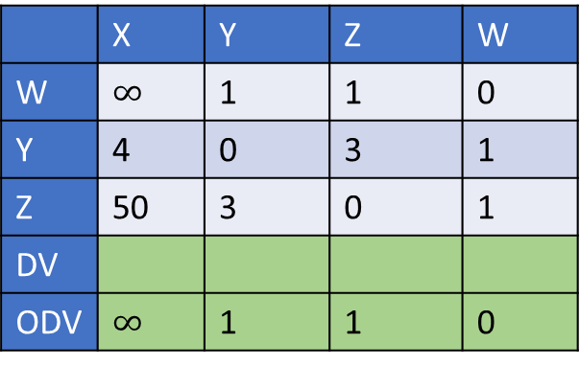
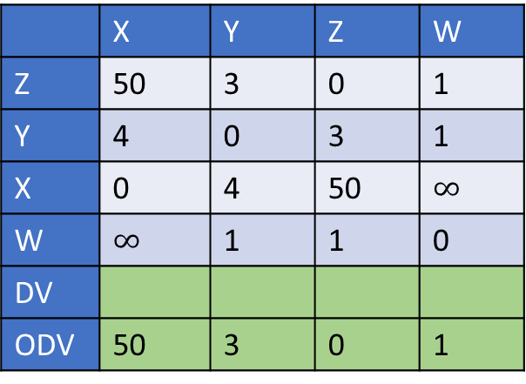
Distance vector routing
 | X | Y | Z | W
W | $$∞$$ | 1 | 1 | 0
Y | 4 | 0 | 3 | 1
Z | 50 | 3 | 0 | 1
DV
ODV | $$∞$$ | 1 | 1 | 0
 | X | Y | Z | W
Y | 4 | 0 | 3 | 1
X | 0 | 4 | 50 | $$∞$$
Z | 50 | 3 | 0 | 1
W | $$∞$$ | 1 | 1 | 0
DV
ODV | 4 | 0 | 3 | 1
Share DV
Y
1
W
4
3
1
 | X | Y | Z | W
Z | 50 | 3 | 0 | 1
Y | 4 | 0 | 3 | 1
X | 0 | 4 | 50 | $$∞$$
W | $$∞$$ | 1 | 1 | 0
DV
ODV | 50 | 3 | 0 | 1
 | X | Y | Z | W
X | 0 | 4 | 50 | $$∞$$
Y | 4 | 0 | 3 | 1
Z | 50 | 3 | 0 | 1
DV
ODV | 0 | 4 | 50 | $$∞$$
X
Z
50

Slide 18

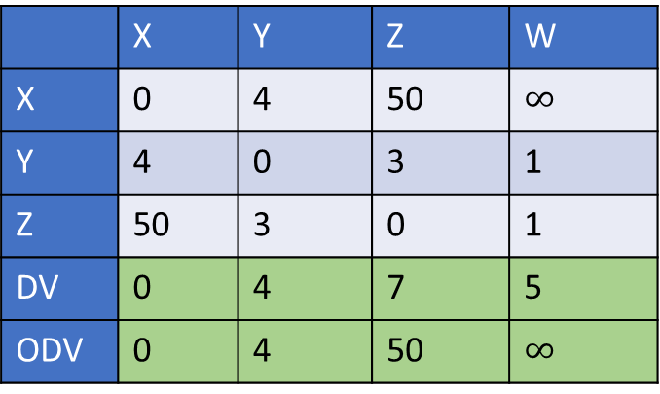
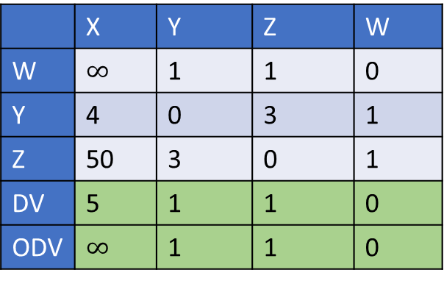
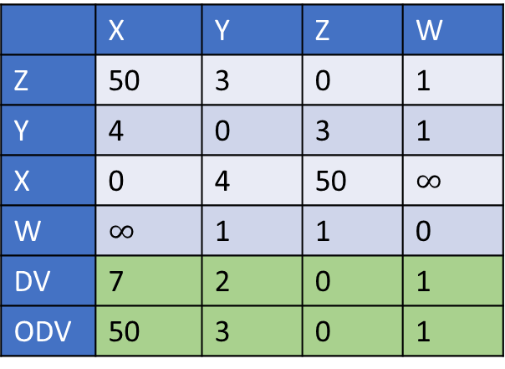
Distance vector routing
 | X | Y | Z | W
W | $$∞$$ | 1 | 1 | 0
Y | 4 | 0 | 3 | 1
Z | 50 | 3 | 0 | 1
DV | 5 | 1 | 1 | 0
ODV | $$∞$$ | 1 | 1 | 0
 | X | Y | Z | W
Y | 4 | 0 | 3 | 1
X | 0 | 4 | 50 | $$∞$$
Z | 50 | 3 | 0 | 1
W | $$∞$$ | 1 | 1 | 0
DV | 4 | 0 | 2 | 1
ODV | 4 | 0 | 3 | 1
Compute DV
Y
1
W
4
3
1
 | X | Y | Z | W
Z | 50 | 3 | 0 | 1
Y | 4 | 0 | 3 | 1
X | 0 | 4 | 50 | $$∞$$
W | $$∞$$ | 1 | 1 | 0
DV | 7 | 2 | 0 | 1
ODV | 50 | 3 | 0 | 1
 | X | Y | Z | W
X | 0 | 4 | 50 | $$∞$$
Y | 4 | 0 | 3 | 1
Z | 50 | 3 | 0 | 1
DV | 0 | 4 | 7 | 5
ODV | 0 | 4 | 50 | $$∞$$
X
Z
50

Slide 19
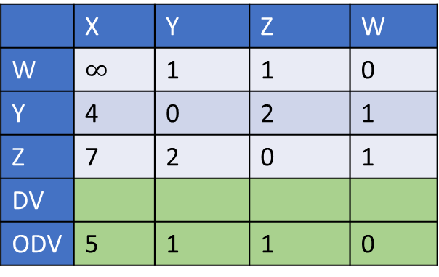
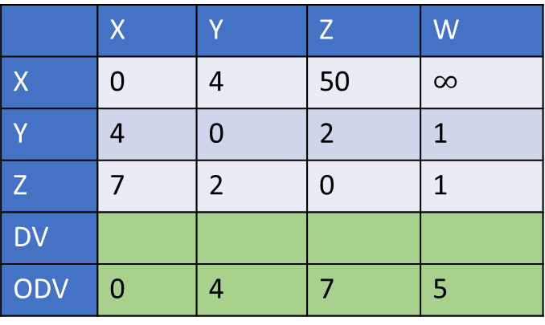
Distance vector routing
 | X | Y | Z | W
W | $$∞$$ | 1 | 1 | 0
Y | 4 | 0 | 2 | 1
Z | 7 | 2 | 0 | 1
DV
ODV | 5 | 1 | 1 | 0
 | X | Y | Z | W
Y | 4 | 0 | 3 | 1
X | 0 | 4 | 7 | 5
Z | 7 | 2 | 0 | 1
W | 5 | 1 | 1 | 0
DV
ODV | 4 | 0 | 2 | 1
Share DV
Y
1
W
4
3
1
 | X | Y | Z | W
Z | 50 | 3 | 0 | 1
Y | 4 | 0 | 2 | 1
X | 0 | 4 | 7 | 5
W | 5 | 1 | 1 | 0
DV
ODV | 7 | 2 | 0 | 1
 | X | Y | Z | W
X | 0 | 4 | 50 | $$∞$$
Y | 4 | 0 | 2 | 1
Z | 7 | 2 | 0 | 1
DV
ODV | 0 | 4 | 7 | 5
X
Z
50

Slide 20

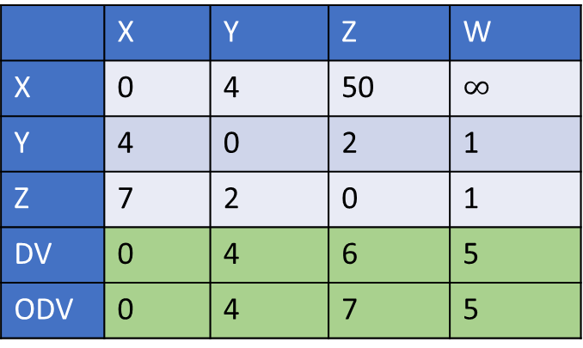
Distance vector routing
 | X | Y | Z | W
W | $$∞$$ | 1 | 1 | 0
Y | 4 | 0 | 2 | 1
Z | 7 | 2 | 0 | 1
DV | 5 | 1 | 1 | 0
ODV | 5 | 1 | 1 | 0
 | X | Y | Z | W
Y | 4 | 0 | 3 | 1
X | 0 | 4 | 7 | 5
Z | 7 | 2 | 0 | 1
W | 5 | 1 | 1 | 0
DV | 4 | 0 | 2 | 1
ODV | 4 | 0 | 2 | 1
Compute DV
Y
1
W
4
3
1
 | X | Y | Z | W
Z | 50 | 3 | 0 | 1
Y | 4 | 0 | 2 | 1
X | 0 | 4 | 7 | 5
W | 5 | 1 | 1 | 0
DV | 6 | 2 | 0 | 1
ODV | 7 | 2 | 0 | 1
 | X | Y | Z | W
X | 0 | 4 | 50 | $$∞$$
Y | 4 | 0 | 2 | 1
Z | 7 | 2 | 0 | 1
DV | 0 | 4 | 6 | 5
ODV | 0 | 4 | 7 | 5
X
Z
50

Slide 21


Distance vector routing
 | X | Y | Z | W
W | $$∞$$ | 1 | 1 | 0
Y | 4 | 0 | 2 | 1
Z | 6 | 2 | 0 | 1
DV
ODV | 5 | 1 | 1 | 0
 | X | Y | Z | W
Y | 4 | 0 | 3 | 1
X | 0 | 4 | 6 | 5
Z | 6 | 2 | 0 | 1
W | 5 | 1 | 1 | 0
DV
ODV | 4 | 0 | 2 | 1
Share DV
Y
1
W
4
3
1
 | X | Y | Z | W
Z | 50 | 3 | 0 | 1
Y | 4 | 0 | 2 | 1
X | 0 | 4 | 6 | 5
W | 5 | 1 | 1 | 0
DV
ODV | 6 | 2 | 0 | 1
 | X | Y | Z | W
X | 0 | 4 | 50 | $$∞$$
Y | 4 | 0 | 2 | 1
Z | 6 | 2 | 0 | 1
DV
ODV | 0 | 4 | 6 | 5
X
Z
50

Slide 22


Distance vector routing
 | X | Y | Z | W
W | $$∞$$ | 1 | 1 | 0
Y | 4 | 0 | 2 | 1
Z | 6 | 2 | 0 | 1
DV | 5 | 1 | 1 | 0
ODV | 5 | 1 | 1 | 0
 | X | Y | Z | W
Y | 4 | 0 | 3 | 1
X | 0 | 4 | 6 | 5
Z | 6 | 2 | 0 | 1
W | 5 | 1 | 1 | 0
DV | 4 | 0 | 2 | 1
ODV | 4 | 0 | 2 | 1
Compute DV
All DVs are the same as ODVs. STOP.
Y
1
W
4
3
1
 | X | Y | Z | W
Z | 50 | 3 | 0 | 1
Y | 4 | 0 | 2 | 1
X | 0 | 4 | 6 | 5
W | 5 | 1 | 1 | 0
DV | 6 | 2 | 0 | 1
ODV | 6 | 2 | 0 | 1
 | X | Y | Z | W
X | 0 | 4 | 50 | $$∞$$
Y | 4 | 0 | 2 | 1
Z | 6 | 2 | 0 | 1
DV | 0 | 4 | 6 | 5
ODV | 0 | 4 | 6 | 5
X
Z
50

Slide 23
Link cost update

Slide 24
Link-cost change
If the cost of a link changes, the nodes connected to the link recompute their DVs, using the old advertised DVs of neighbours
If the DV is not the same as the last computed DV, the node shares the new DV with all its neighbours
If the link cost decreases, the algorithm quickly stabilizes
If the link cost increases, it sometimes gets into the count-to-infinity problem

Slide 25
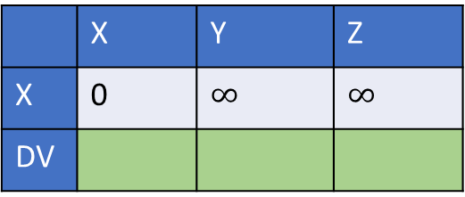
Distance vector routing
 | X | Y | Z
Y | 4 | 0 | 3
Z
DV
Y
4
3
X
Z
50
 | X | Y | Z
X | 0 | $$∞$$ | $$∞$$
DV
 | X | Y | Z
Z | 50 | 3 | 0
X
DV

Slide 26

Distance vector routing
The link cost between $y$ and $x$ changed to 1
The link cost between $y$ and $x$ changed to 60

