Slide 2
Today’s topics
Distance vector routing
BGP

Slide 3
References
Read Chapter-5.2, 5.4 from the Kurose and Ross

Slide 4
Link-cost change

Slide 5
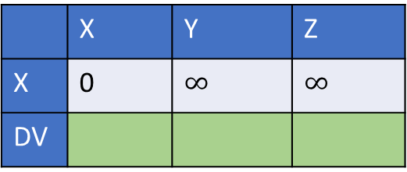
Distance vector routing
 | X | Y | Z
Y | 4 | 0 | 3
Z
DV
ODV
Initial cost
Y
4
3
X
Z
50
 | X | Y | Z
X | 0 | $$∞$$ | $$∞$$
DV
 | X | Y | Z
Z | 50 | 3 | 0
Y
DV
ODV

Slide 6
Distance vector routing
 | X | Y | Z
Y | 4 | 0 | 3
Z
DV | 4 | 0 | 3
ODV
Compute DV
Y
4
3
X
Z
50
 | X | Y | Z
X | 0 | $$∞$$ | $$∞$$
DV
 | X | Y | Z
Z | 50 | 3 | 0
Y
DV | 50 | 3 | 0
ODV

Slide 7
Distance vector routing
 | X | Y | Z
Y | 4 | 0 | 3
Z | 50 | 3 | 0
DV
ODV | 4 | 0 | 3
Share DV
Y
4
3
X
Z
50
 | X | Y | Z
X | 0 | $$∞$$ | $$∞$$
DV
 | X | Y | Z
Z | 50 | 3 | 0
Y | 4 | 0 | 3
DV
ODV | 50 | 3 | 0

Slide 8
Distance vector routing
 | X | Y | Z
Y | 4 | 0 | 3
Z | 50 | 3 | 0
DV | 4 | 0 | 3
ODV | 4 | 0 | 3
Compute DV
Y
4
3
X
Z
50
 | X | Y | Z
X | 0 | $$∞$$ | $$∞$$
DV
 | X | Y | Z
Z | 50 | 3 | 0
Y | 4 | 0 | 3
DV | 7 | 3 | 0
ODV | 50 | 3 | 0

Slide 9
Distance vector routing
 | X | Y | Z
Y | 4 | 0 | 3
Z | 7 | 3 | 0
DV
ODV | 4 | 0 | 3
Share DV
Y
4
3
X
Z
50
 | X | Y | Z
X | 0 | $$∞$$ | $$∞$$
DV
 | X | Y | Z
Z | 50 | 3 | 0
Y | 4 | 0 | 3
DV
ODV | 7 | 3 | 0

Slide 10
Distance vector routing
 | X | Y | Z
Y | 4 | 0 | 3
Z | 7 | 3 | 0
DV | 4 | 0 | 3
ODV | 4 | 0 | 3
Compute DV
Y
4
3
X
Z
50
 | X | Y | Z
X | 0 | $$∞$$ | $$∞$$
DV
 | X | Y | Z
Z | 50 | 3 | 0
Y | 4 | 0 | 3
DV
ODV | 7 | 3 | 0

Slide 11
Distance vector routing
 | X | Y | Z
Y | 4 | 0 | 3
Z | 7 | 3 | 0
DV
ODV | 4 | 0 | 3
No change
Y
4
3
X
Z
50
 | X | Y | Z
X | 0 | $$∞$$ | $$∞$$
DV
 | X | Y | Z
Z | 50 | 3 | 0
Y | 4 | 0 | 3
DV
ODV | 7 | 3 | 0

Slide 12
Distance vector routing
 | X | Y | Z
Y | 4 | 0 | 3
Z | 7 | 3 | 0
DV
ODV | 4 | 0 | 3
New Cost: 100
Y
100
3
4
X
Z
50
 | X | Y | Z
X | 0 | $$∞$$ | $$∞$$
DV
 | X | Y | Z
Z | 50 | 3 | 0
Y | 4 | 0 | 3
DV
ODV | 7 | 3 | 0

Slide 13
Distance vector routing
 | X | Y | Z
Y | 100 | 0 | 3
Z | 7 | 3 | 0
DV | 10 | 0 | 3
ODV | 4 | 0 | 3
Compute DV
Y
100
3
4
X
Z
50
 | X | Y | Z
X | 0 | $$∞$$ | $$∞$$
DV
 | X | Y | Z
Z | 50 | 3 | 0
Y | 4 | 0 | 3
DV
ODV | 7 | 3 | 0

Slide 14
Distance vector routing
 | X | Y | Z
Y | 100 | 0 | 3
Z | 7 | 3 | 0
DV
ODV | 10 | 0 | 3
Share DV
Y
100
3
4
X
Z
50
 | X | Y | Z
X | 0 | $$∞$$ | $$∞$$
DV
 | X | Y | Z
Z | 50 | 3 | 0
Y | 10 | 0 | 3
DV
ODV | 7 | 3 | 0

Slide 15
Distance vector routing
 | X | Y | Z
Y | 100 | 0 | 3
Z | 7 | 3 | 0
DV
ODV | 10 | 0 | 3
Compute DV
Y
100
3
4
X
Z
50
 | X | Y | Z
X | 0 | $$∞$$ | $$∞$$
DV
 | X | Y | Z
Z | 50 | 3 | 0
Y | 10 | 0 | 3
DV | 13 | 3 | 0
ODV | 7 | 3 | 0

Slide 16
Distance vector routing
 | X | Y | Z
Y | 100 | 0 | 3
Z | 13 | 3 | 0
DV
ODV | 10 | 0 | 3
Share DV
Y
100
3
4
X
Z
50
 | X | Y | Z
X | 0 | $$∞$$ | $$∞$$
DV
 | X | Y | Z
Z | 50 | 3 | 0
Y | 10 | 0 | 3
DV
ODV | 13 | 3 | 0

Slide 17
Distance vector routing
 | X | Y | Z
Y | 100 | 0 | 3
Z | 13 | 3 | 0
DV | 16 | 0 | 3
ODV | 10 | 0 | 3
Compute DV
Y
100
3
4
X
Z
50
 | X | Y | Z
X | 0 | $$∞$$ | $$∞$$
DV
 | X | Y | Z
Z | 50 | 3 | 0
Y | 10 | 0 | 3
DV
ODV | 13 | 3 | 0

Slide 18
Distance vector routing
 | X | Y | Z
Y | 100 | 0 | 3
Z | 13 | 3 | 0
DV
ODV | 16 | 0 | 3
Share DV
Y
100
3
4
X
Z
50
 | X | Y | Z
X | 0 | $$∞$$ | $$∞$$
DV
 | X | Y | Z
Z | 50 | 3 | 0
Y | 16 | 0 | 3
DV
ODV | 13 | 3 | 0

Slide 19
Distance vector routing
 | X | Y | Z
Y | 100 | 0 | 3
Z | 13 | 3 | 0
DV
ODV | 16 | 0 | 3
Compute DV
Count to infinity problem.
Y
100
3
4
X
Z
50
 | X | Y | Z
X | 0 | $$∞$$ | $$∞$$
DV
 | X | Y | Z
Z | 50 | 3 | 0
Y | 16 | 0 | 3
DV | 19 | 3 | 0
ODV | 13 | 3 | 0

Slide 20
Poisoned reverse

Slide 21
Poisoned reverse
Don’t advertise the actual distance back to a node from which you have learned the distance; instead, advertise an infinity

Slide 22
Distance vector routing
 | X | Y | Z
Y | 4 | 0 | 3
Z
DV
ODV
Initial cost
Y
4
3
X
Z
50
 | X | Y | Z
X | 0 | $$∞$$ | $$∞$$
DV
 | X | Y | Z
Z | 50 | 3 | 0
Y
DV
ODV

Slide 23
Distance vector routing
 | X | Y | Z
Y | 4 | 0 | 3
Z
DV | 4 | 0 | 3
ODV
Compute DV
Y
4
3
X
Z
50
 | X | Y | Z
X | 0 | $$∞$$ | $$∞$$
DV
 | X | Y | Z
Z | 50 | 3 | 0
Y
DV | 50 | 3 | 0
ODV

Slide 24
Distance vector routing
 | X | Y | Z
Y | 4 | 0 | 3
Z | 50 | 3 | 0
DV
ODV | 4 | 0 | 3
Share DV
Y
4
3
X
Z
50
 | X | Y | Z
X | 0 | $$∞$$ | $$∞$$
DV
 | X | Y | Z
Z | 50 | 3 | 0
Y | 4 | 0 | 3
DV
ODV | 50 | 3 | 0

Slide 25
Distance vector routing
 | X | Y | Z
Y | 4 | 0 | 3
Z | 50 | 3 | 0
DV | 4 | 0 | 3
ODV | 4 | 0 | 3
Compute DV
Y
4
3
X
Z
50
 | X | Y | Z
X | 0 | $$∞$$ | $$∞$$
DV
 | X | Y | Z
Z | 50 | 3 | 0
Y | 4 | 0 | 3
DV | 7, Y | 3 | 0
ODV | 50 | 3 | 0

Slide 26
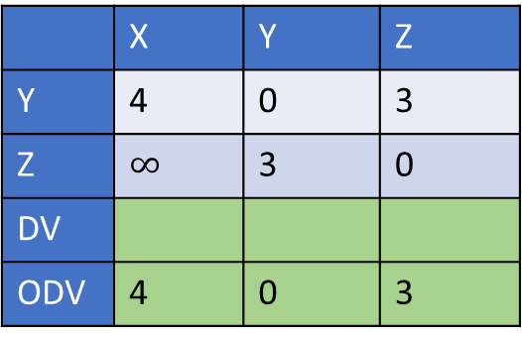
Distance vector routing
 | X | Y | Z
Y | 4 | 0 | 3
Z | $$∞$$ | 3 | 0
DV
ODV | 4 | 0 | 3
Share DV
Y
4
3
X
Z
50
 | X | Y | Z
X | 0 | $$∞$$ | $$∞$$
DV
 | X | Y | Z
Z | 50 | 3 | 0
Y | 4 | 0 | 3
DV
ODV | 7 | 3 | 0

Slide 27
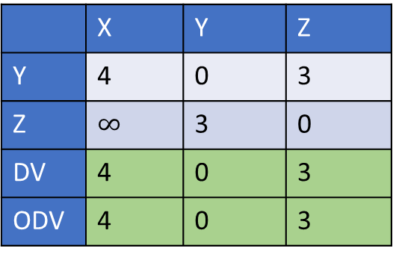
Distance vector routing
 | X | Y | Z
Y | 4 | 0 | 3
Z | $$∞$$ | 3 | 0
DV | 4 | 0 | 3
ODV | 4 | 0 | 3
Compute DV
Y
4
3
X
Z
50
 | X | Y | Z
X | 0 | $$∞$$ | $$∞$$
DV
 | X | Y | Z
Z | 50 | 3 | 0
Y | 4 | 0 | 3
DV
ODV | 7 | 3 | 0

Slide 28

Distance vector routing
 | X | Y | Z
Y | 4 | 0 | 3
Z | $$∞$$ | 3 | 0
DV
ODV | 4 | 0 | 3
No change
Y
4
3
X
Z
50
 | X | Y | Z
X | 0 | $$∞$$ | $$∞$$
DV
 | X | Y | Z
Z | 50 | 3 | 0
Y | 4 | 0 | 3
DV
ODV | 7 | 3 | 0

Slide 29
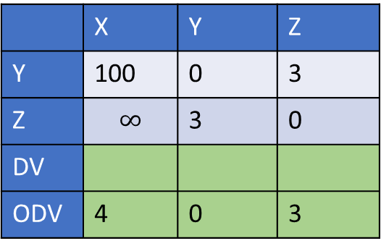
Distance vector routing
 | X | Y | Z
Y | 100 | 0 | 3
Z | $$∞$$ | 3 | 0
DV
ODV | 4 | 0 | 3
New Cost: 100
Y
100
3
4
X
Z
50
 | X | Y | Z
X | 0 | $$∞$$ | $$∞$$
DV
 | X | Y | Z
Z | 50 | 3 | 0
Y | 4 | 0 | 3
DV
ODV | 7 | 3 | 0

Slide 30
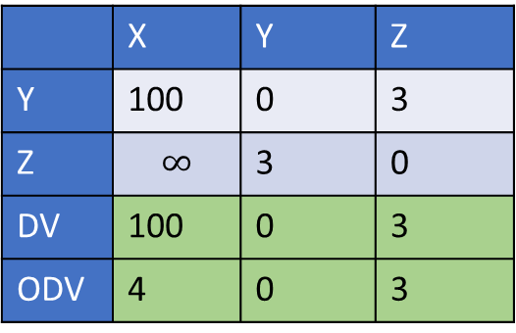
Distance vector routing
 | X | Y | Z
Y | 100 | 0 | 3
Z | $$∞$$ | 3 | 0
DV | 100 | 0 | 3
ODV | 4 | 0 | 3
Compute DV
Y
100
3
4
X
Z
50
 | X | Y | Z
X | 0 | $$∞$$ | $$∞$$
DV
 | X | Y | Z
Z | 50 | 3 | 0
Y | 4 | 0 | 3
DV
ODV | 7 | 3 | 0

Slide 31
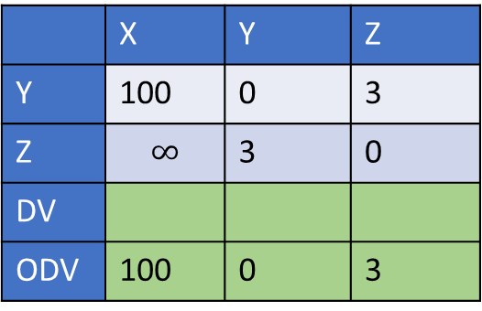
Distance vector routing
 | X | Y | Z
Y | 100 | 0 | 3
Z | $$∞$$ | 3 | 0
DV
ODV | 100 | 0 | 3
Share DV
Y
100
3
4
X
Z
50
 | X | Y | Z
X | 0 | $$∞$$ | $$∞$$
DV
 | X | Y | Z
Z | 50 | 3 | 0
Y | 100 | 0 | 3
DV
ODV | 7 | 3 | 0

Slide 32
Distance vector routing
 | X | Y | Z
Y | 100 | 0 | 3
Z | $$∞$$ | 3 | 0
DV
ODV | 100 | 0 | 3
Compute DV
Y
100
3
4
X
Z
50
 | X | Y | Z
X | 0 | $$∞$$ | $$∞$$
DV
 | X | Y | Z
Z | 50 | 3 | 0
Y | 100 | 0 | 3
DV | 50 | 3 | 0
ODV | 7 | 3 | 0

Slide 33
Distance vector routing
 | X | Y | Z
Y | 100 | 0 | 3
Z | 50 | 3 | 0
DV
ODV | 100 | 0 | 3
Share DV
Y
100
3
4
X
Z
50
 | X | Y | Z
X | 0 | $$∞$$ | $$∞$$
DV
 | X | Y | Z
Z | 50 | 3 | 0
Y | 10 | 0 | 3
DV
ODV | 50 | 3 | 0

Slide 34
Distance vector routing
 | X | Y | Z
Y | 100 | 0 | 3
Z | 50 | 3 | 0
DV | 53, Z | 0 | 3
ODV | 100 | 0 | 3
Compute DV
Y
100
3
4
X
Z
50
 | X | Y | Z
X | 0 | $$∞$$ | $$∞$$
DV
 | X | Y | Z
Z | 50 | 3 | 0
Y | 10 | 0 | 3
DV
ODV | 50 | 3 | 0

Slide 35
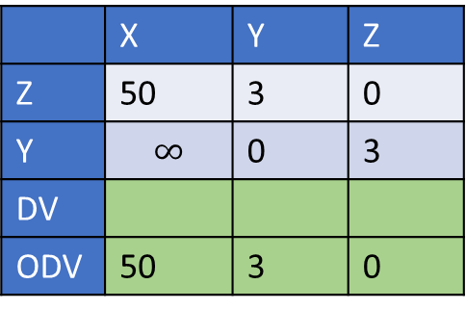
Distance vector routing
 | X | Y | Z
Y | 100 | 0 | 3
Z | 50 | 3 | 0
DV
ODV | 53, Z | 0 | 3
Share DV
Y
100
3
4
X
Z
50
 | X | Y | Z
X | 0 | $$∞$$ | $$∞$$
DV
 | X | Y | Z
Z | 50 | 3 | 0
Y | $$∞$$ | 0 | 3
DV
ODV | 50 | 3 | 0

Slide 36
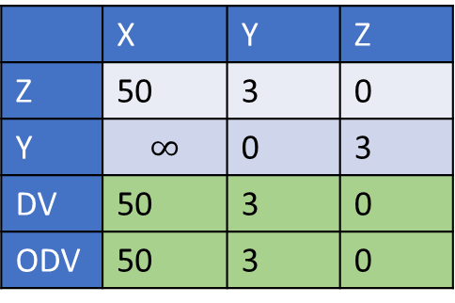
Distance vector routing
 | X | Y | Z
Y | 100 | 0 | 3
Z | 50 | 3 | 0
DV
ODV | 53, Z | 0 | 3
Compute DV
No change
The algorithm stops
Y
100
3
4
X
Z
50
 | X | Y | Z
X | 0 | $$∞$$ | $$∞$$
DV
 | X | Y | Z
Z | 50 | 3 | 0
Y | $$∞$$ | 0 | 3
DV | 50 | 3 | 0
ODV | 50 | 3 | 0

Slide 37
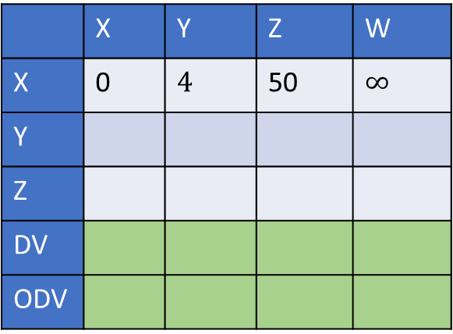
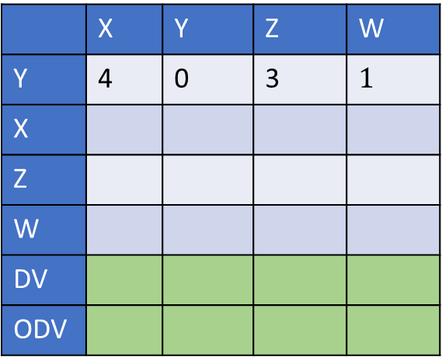
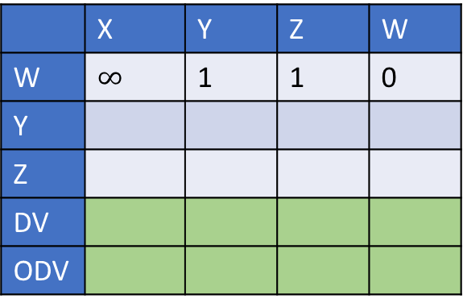
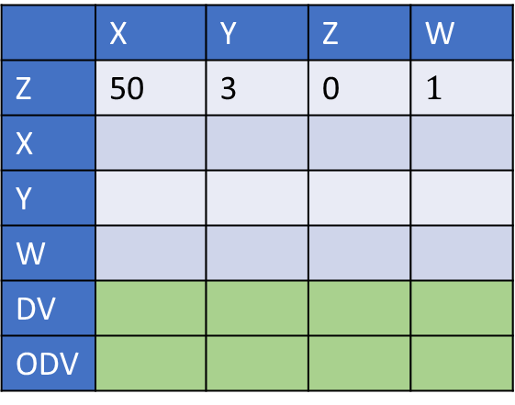
Poisoned reverse
 | X | Y | Z | W
Y | 4 | 0 | 3 | $$1$$
X
Z
W
DV
ODV
 | X | Y | Z | W
W | $$∞$$ | 1 | 1 | 0
Y
Z
DV
ODV
Y
1
W
3
1
4
 | X | Y | Z | W
Z | 50 | 3 | 0 | $$1$$
X
Y
W
DV
ODV
 | X | Y | Z | W
X | 0 | $$4$$ | 50 | $$∞$$
Y
Z
DV
ODV
X
Z
50

Slide 38
Poisoned reverse
The poisoned reverse doesn’t solve the count-to-infinity problem if more than two nodes are involved in a loop

Slide 39
Robustness
What happens if a router malfunctions or is compromised?
Link state (LS)
Distance vector (DV)

Slide 40
Robustness
What happens if a router malfunctions or is compromised?
Link state (LS)
The router can advertise at most incorrect link costs to its neighbors
Each router computes its own table
What prevents a malicious router from advertising a low-cost link to everyone?
The other routers, except the real neighbors, don’t advertise a path to the malicious routers
The routers can check if a dual path exists
Distance vector (DV)
A router can advertise an incorrect path to everyone (may end up creating a blackhole)

Slide 41
Scalability
On today’s Internet, we have millions of routers
Can we run LS and DV on all of them
The algorithm may take forever
Idea:
Divide the Internet into autonomous systems (AS)
run LS, DV, or custom protocols inside an AS
Use a common routing protocol, BGP, for inter-AS communication

Slide 42
BGP
Border gateway protocol
The routers inside an AS that are directly connected to other ASes are the border routers
The border gateways communicate with other ASes using the eBGP protocol
All the routers get information about the other ASes from the border gateways using the iBGP protocol

Slide 43
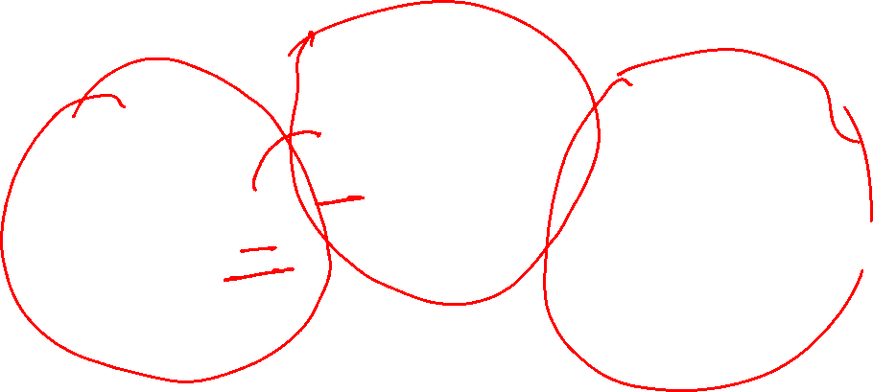
eBGP, iBGP
2b
∂
2a
2c
1b
3b
2d
∂
1a
1c
3a
3c
AS 2
1d
3d
AS 1
eBGP connectivity
AS 3
logical iBGP connectivity
1c
gateway routers run both eBGP and iBGP protocols
Copyright © 2010-2025 J.F. Kurose, K.W. Ross

Slide 44
eBGP
BGP is policy-driven, not necessarily the shortest path
An AS can deny routing the packets of another AS based on its policy
AS can prefer a path over another path based on the policy
eBGP messages contain the entire path
A border gateway can advertise a path to all internal routers or selective internal routers, based on its policy

Slide 45

BGP path advertisement
AS 3
3b
AS 1
1b
3a
3c
1a
1c
AS 2
3d
X
2b
1d
AS3, X
AS2,AS3,X
2a
2c
2d
AS2 router 2c receives path advertisement AS3,X (via eBGP) from AS3 router 3a
based on AS2 policy, AS2 router 2c accepts path AS3,X, propagates (via iBGP) to all AS2 routers
based on AS2 policy, AS2 router 2a advertises (via eBGP) path AS2, AS3, X to AS1 router 1c
Copyright © 2010-2025 J.F. Kurose, K.W. Ross

Slide 46
BGP path advertisement: multiple paths
AS 3
3b
AS 1
1b
AS3,X
3a
3c
AS3,X
AS3,X
1a
1c
AS 2
3d
X
2b
AS3,X
1d
AS3, X
AS2,AS3,X
2a
2c
2d
gateway router may learn about multiple paths to destination:
AS1 gateway router 1c learns path AS2,AS3,X from 2a
AS1 gateway router 1c learns path AS3,X from 3a
based on policy, AS1 gateway router 1c chooses path AS3,X and advertises path within AS1 via iBGP
Copyright © 2010-2025 J.F. Kurose, K.W. Ross

Slide 47
BGP: populating forwarding tables
AS 3
3b
AS 1
1b
AS3,X
3a
3c
1
AS3,X
1a
AS3,X
1c
AS 2
2b
3d
X
local link interfaces
at 1a, 1d
2
AS3,X
2
1d
1
AS3, X
AS2,AS3,X
2a
2c
2d
dest
interface
recall: 1a, 1b, 1d learn via iBGP from 1c: “path to X goes through 1c”
…
…
at 1d: intra-domain routing: to get to 1c, use interface 1
1c
1
X
1
at 1d: to get to X, use interface 1
…
…
Copyright © 2010-2025 J.F. Kurose, K.W. Ross

Slide 48

BGP: populating forwarding tables
AS 3
3b
AS 1
1b
3a
3c
1
1a
1c
AS 2
3d
X
2
2b
1d
2a
2c
2d
dest
interface
…
…
recall: 1a, 1b, 1d learn via iBGP from 1c: “path to X goes through 1c”
1c
2
at 1d: intra-domain routing: to get to 1c, use interface 1
X
2
…
…
at 1d: to get to X, use interface 1
at 1a: intra-domain routing: to get to 1c, use interface 2
at 1a: to get to X, use interface 2
Copyright © 2010-2025 J.F. Kurose, K.W. Ross

Slide 49
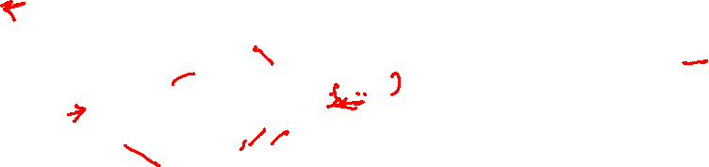
Hot potato routing
AS 3
3b
AS 1
1b
3a
3c
1a
1c
AS 2
3d
X
2b
112
1d
AS3,X
AS1,AS3,X
2a
2c
201
263
2d
OSPF link weights
2d learns (via iBGP) it can route to X via 2a or 2c
hot potato routing: choose local gateway that has least intra-domain cost (e.g., 2d chooses 2a, even though more AS hops to X): don’t worry about inter-domain cost!
Copyright © 2010-2025 J.F. Kurose, K.W. Ross

Slide 50

BGP: achieving policy via advertisements
A,w
B
x
provider
w
A
network
legend:
C
customer
A,w
y
network:
ISP only wants to route traffic to/from its customer networks (does not want to carry transit traffic between other ISPs – a typical “real world” policy)
A advertises path Aw to B and to C
B chooses not to advertise BAw to C!
B gets no “revenue” for routing CBAw, since none of C, A, w are B’s customers
C does not learn about CBAw path
C will route CAw (not using B) to get to w
Copyright © 2010-2025 J.F. Kurose, K.W. Ross

Slide 51
BGP: achieving policy via advertisements (more)
B
x
provider
w
A
network
legend:
C
customer
y
network:
ISP only wants to route traffic to/from its customer networks (does not want to carry transit traffic between other ISPs – a typical “real world” policy)
A,B,C are provider networks
x,w,y are customer (of provider networks)
x is dual-homed: attached to two networks
policy to enforce: x does not want to route from B to C via x
.. so x will not advertise to B a route to C
Copyright © 2010-2025 J.F. Kurose, K.W. Ross

Slide 52
BGP route selection
router may learn about more than one route to destination AS, selects route based on:
local preference value attribute: policy decision
shortest AS-PATH
closest NEXT-HOP router: hot potato routing
additional criteria
Copyright © 2010-2025 J.F. Kurose, K.W. Ross

Slide 53
Inter-AS routing vs. Intra-AS routing

Slide 54
Inter-AS routing vs. Intra-AS routing
The primary concern in intra-AS routing is the scalability, whereas in inter-AS routing, “policy” dictates the protocol
If AS has a large number of routers, we can divide it into multiple ASes to fix the scalability issue of the LS and DV algorithms
Any drawback?
Using iBGP and eBGP increases the overall complexity a lot
Communication between two nodes belonging to different ASes might not use the shortest path
Multiple ASes can reduce the size of forwarding tables on routers, as an AS can advertise its allocated subnet to other ASes

