Slide 2
Today’s lecture
Link layer
Error detection and correction
Multiple access links and protocols

Slide 3
References
Chapter – 6.1, 6.2, and 6.3 from the Kurose and Ross

Slide 4
Terminology
Node: Hosts, routers, switches, WiFi access points
Link: communication channels that connect adjacent nodes

Slide 5

















Node and Link
mobile network
Which ones are nodes?
Which are the links?
national or global ISP
datacenter
network
enterprise
network
Copyright © 2010-2025 J.F. Kurose, K.W. Ross

Slide 6

Data transmission
mobile network
In order for a datagram to be transferred from the source node to the destination node, it must be moved over each of the individual links in the end-to-end path
How many links will be traversed in order to send data from A to B
national or global ISP
B
datacenter
network
A
enterprise
network
Copyright © 2010-2025 J.F. Kurose, K.W. Ross

Slide 7
Services provided by Data Link layer
Encapsulates network-layer datagram in a frame. The structure of a frame depends on a specific link layer protocol.
Link access: A medium access control (MAC) defines transmission rules to facilitate the sharing of a link by multiple users
Reliable delivery: On certain communication channels, such as WiFi, the error rate is high. The data link layer ensures reliable delivery of data between two adjacent nodes.
TCP already provides reliability. Why a separate mechanism for the link layer?

Slide 8
Services provided by Data Link layer
Error detection and correction
For reliable transmission, the data link layer needs to detect and correct errors

Slide 9
Where is link layer implemented?
The link layer is implemented on a network interface controller (NIC). Apart from the NIC hardware, a network driver (software) is also a part of the data link layer. Network driver configures NIC, sets up DMA and interrupts to transmit a network layer packet using NIC, or delivers a packet received from NIC to the network layer

Slide 10
Error detection and correction
To detect and correct errors, additional bits of information are sent along with the data. The additional information is used to detect and correct errors.
datagram
datagram
otherwise
all
bits in D’
OK
?
N
detected
error
d data bits
D
EDC
D’
EDC’
bit-error prone link
Copyright © 2010-2025 J.F. Kurose, K.W. Ross

Slide 11
Error detection
Can we use 1-bit additional information to detect potential errors during transmission?

Slide 12
Error detection
The additional bit can be used to make the total number of ones an even value
If the total number of ones at the receiver is odd, then we have an error
Can it detect all errors?
No. Only if the number of bits that are changed is odd.
Typically, the bit errors happen in bursts, and therefore, we can only detect bugs with a probability of 50%

Slide 13

Parity checking
One parity bit is used to make the total number of bits odd/even
Can only detect an odd number of bit flops
0111000110101011
1
d data bits
parity bit
Copyright © 2010-2025 J.F. Kurose, K.W. Ross

Slide 14
Two dimensional parity
divide d bits into i rows and j columns
a parity value is computed for each row and column
the additional i + j + 1 bits are used for error detection and correction
row parity
d_{1,1}
. . .
d_{1,j}
d_{1,j+1}
d_{2,1}
. . .
d_{2,j}
d_{2,j+1}
. . .
. . .
. . .
. . .
d_{i,1}
. . .
d_{i,j}
d_{i,j+1}
column
parity
d_{i+1,1}
. . .
d_{i+1,j}
d_{i+1,j+1}
Copyright © 2010-2025 J.F. Kurose, K.W. Ross

Slide 15
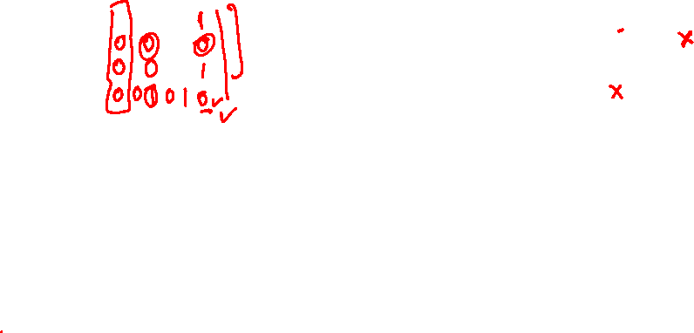
Two dimensional parity
no errors:
1 0 1 0 1
1 0 1 0 1
1 1 1 1 0
1 0 1 1 0
0 1 1 1 0
0 1 1 1 0
Copyright © 2010-2025 J.F. Kurose, K.W. Ross

Slide 16
Two-dimensional parity
Can we detect and correct all one-bit errors?
Can we detect and correct all two-bit errors?
Can we detect all two-bit errors?
Can we detect all three-bit errors?
Can we detect all four-bit errors?

Slide 17
Two dimensional parity
Can always detect errors if an odd number of bits are flipped
May not detect errors if an even number (> 2) bit flips occur
Can always correct a 1-bit error

Slide 18
Checksum
Checksum is another way of detecting errors
Already used for TCP segment, UDP segment, and an IP header
A stronger error detection scheme called Cyclic Redundancy Check is used at the data-link layer

Slide 19
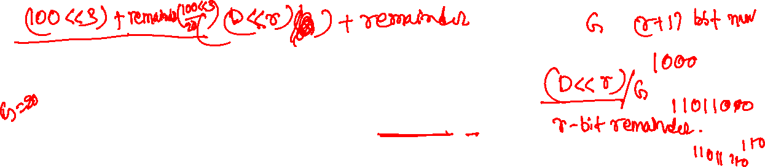
Cyclic Redundancy Check (CRC)
The sender sends r additional bits with d bits of data D
The additional bits are the remainder obtained by dividing (D << r) by G, where G is a r+1-bit value (the top bit is always 1)
Both sender and receiver know the value of G
Let’s say REM is the remainder obtained by dividing (D << r) by G, the sender sends (D << r) + REM
The receiver divides (D << r) + REM by G; if the corresponding remainder is not zero, there was a bit error during the transmission

Slide 20
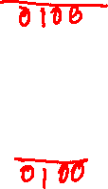
CRC
CRC uses modulo 2 division, in which both addition and subtraction are the same
The carry and borrow bits are ignored
Addition:
1011
1111
Subtraction:
1011
1111

Slide 21
CRC
Both addition and subtraction are XOR operations

Slide 22
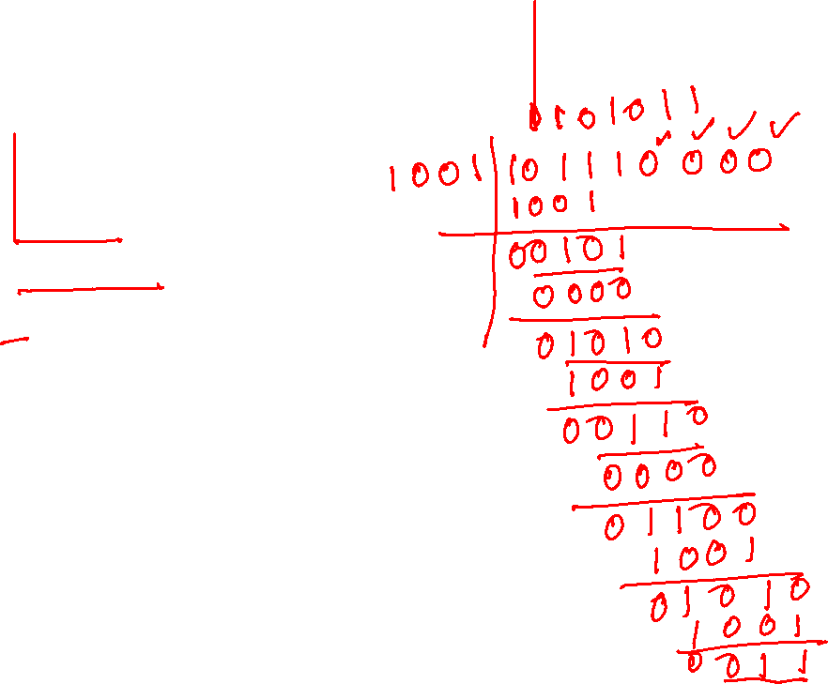
Example (sender)
G = 1 0 0 1
D = 1 0 1 1 1 0
r = 3

Slide 23
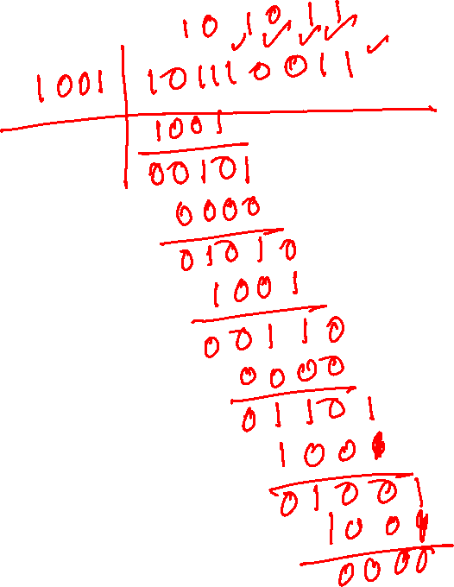
Example (receiver)

Slide 24
CRC
G
1
0
1
0 1 1
1 0 0 1
1 0 1 1 1 0
0 0 0
1 0 0 1
1 0 1
D
2^{r} (here, r=3)
0 0 0
*
1 0 1 0
1 0 0 1
1 1 0
0 0 0
1 1 0 0
1 0 0 1
1 0 1 0
1 0 0 1
0 1 1
R
Copyright © 2010-2025 J.F. Kurose, K.W. Ross

Slide 25
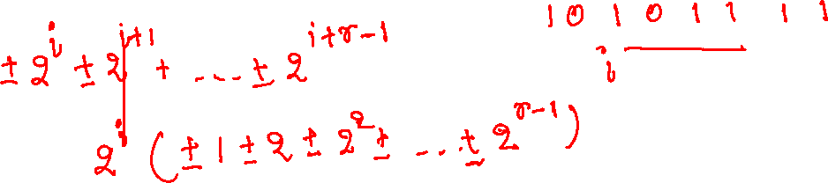
Cyclic Redundancy Check (CRC)
The CRC can detect burst errors if the size of the burst is less than or equal to r

Slide 26
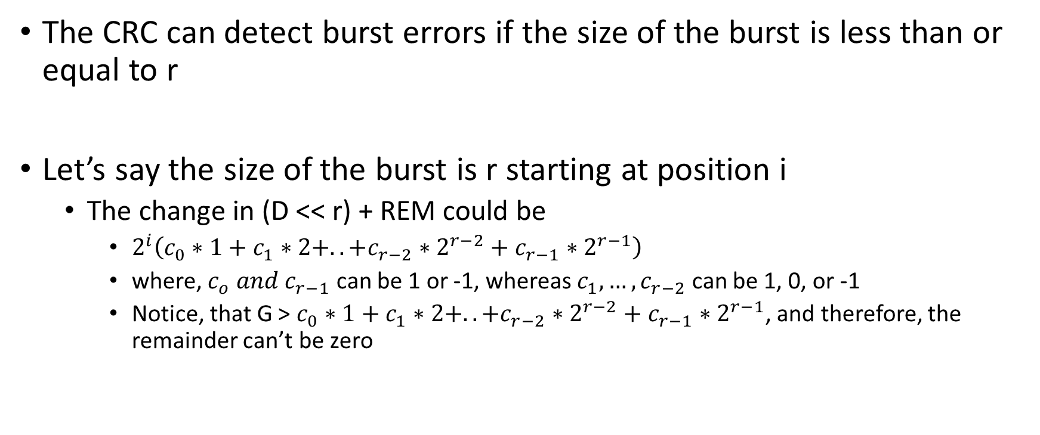
Cyclic Redundancy Check (CRC)
The CRC can detect burst errors if the size of the burst is less than or equal to r
Let’s say the size of the burst is r starting at position i
The change in (D << r) + REM could be
$2^{i}\left(c_{0}∗1+c_{1}∗2+..+c_{r−2}∗2^{r−2}+c_{r−1}∗2^{r−1}\right)$
where, $c_{o} and c_{r−1}$ can be 1 or -1, whereas $c_{1},…,c_{r−2}$ can be 1, 0, or -1
Notice, that G > $c_{0}∗1+c_{1}∗2+..+c_{r−2}∗2^{r−2}+c_{r−1}∗2^{r−1}$, and therefore, the remainder can’t be zero

Slide 27
Multiple access link protocols

Slide 28



Multiple access links, protocols
two types of “links”:
point-to-point
point-to-point link between Ethernet switch, host
PPP for dial-up access
broadcast (shared wire or medium)
old-school Ethernet
upstream HFC in cable-based access network
802.11 wireless LAN, 4G/4G. satellite
shared wire (e.g.,
cabled Ethernet)
shared radio: 4G/5G
shared radio: WiFi
shared radio: satellite
humans at a cocktail party
(shared air, acoustical)
Copyright © 2010-2025 J.F. Kurose, K.W. Ross

Slide 29
Multiple access protocols
single shared broadcast channel
two or more simultaneous transmissions by nodes: interference
collision if node receives two or more signals at the same time
multiple access protocol
distributed algorithm that determines how nodes share channel, i.e., determine when node can transmit
communication about channel sharing must use channel itself!
no out-of-band channel for coordination
Copyright © 2010-2025 J.F. Kurose, K.W. Ross

Slide 30
An ideal multiple access protocol
given: multiple access channel (MAC) of rate R bps
desiderata:
1. when one node wants to transmit, it can send at rate R.
2. when M nodes want to transmit, each can send at average rate R/M
3. fully decentralized:
no special node to coordinate transmissions
no synchronization of clocks, slots
4. simple
Copyright © 2010-2025 J.F. Kurose, K.W. Ross

Slide 31
MAC protocols: taxonomy
three broad classes:
channel partitioning
divide channel into smaller “pieces” (time slots, frequency, code)
allocate piece to node for exclusive use
random access
channel not divided, allow collisions
“recover” from collisions
“taking turns”
nodes take turns, but nodes with more to send can take longer turns
Copyright © 2010-2025 J.F. Kurose, K.W. Ross

Slide 32
Channel partitioning MAC protocols: TDMA
TDMA: time division multiple access
access to channel in “rounds”
each station gets fixed length slot (length = packet transmission time) in each round
unused slots go idle
example: 6-station LAN, 1,3,4 have packets to send, slots 2,5,6 idle
6-slot
frame
6-slot
frame
1
3
4
1
3
4
Copyright © 2010-2025 J.F. Kurose, K.W. Ross

Slide 33
Channel partitioning MAC protocols: FDMA
FDMA: frequency division multiple access
channel spectrum divided into frequency bands
each station assigned fixed frequency band
unused transmission time in frequency bands go idle
example: 6-station LAN, 1,3,4 have packet to send, frequency bands 2,5,6 idle
time
frequency bands
FDM cable
Copyright © 2010-2025 J.F. Kurose, K.W. Ross

Slide 34
Random access protocols
when node has packet to send
transmit at full channel data rate R
no a priori coordination among nodes
two or more transmitting nodes: “collision”
random access protocol specifies:
how to detect collisions
how to recover from collisions (e.g., via delayed retransmissions)
examples of random access MAC protocols:
ALOHA, slotted ALOHA
CSMA, CSMA/CD, CSMA/CA
Copyright © 2010-2025 J.F. Kurose, K.W. Ross

Slide 35
Slotted ALOHA
operation:
when node obtains fresh frame, transmits in next slot
if no collision: node can send new frame in next slot
if collision: node retransmits frame in each subsequent slot with probability p until success
t₀
t₀+1
assumptions:
all frames same size
time divided into equal size slots (time to transmit 1 frame)
nodes start to transmit only slot beginning
nodes are synchronized
if 2 or more nodes transmit in slot, all nodes detect collision
randomization – why?
Copyright © 2010-2025 J.F. Kurose, K.W. Ross

Slide 36
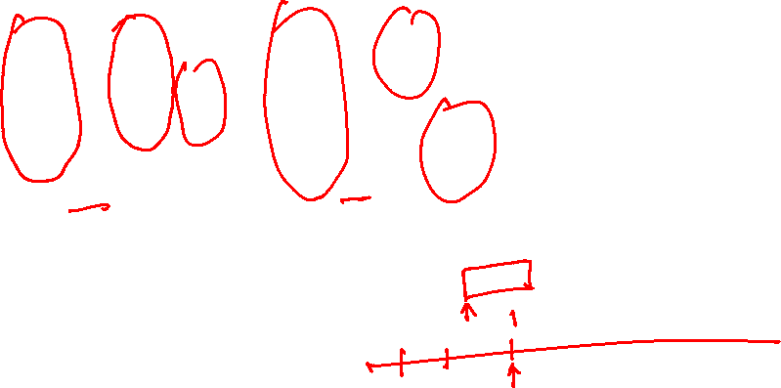
Slotted ALOHA
node 1
1
1
1
1
C: collision
S: success
E: empty
node 2
2
2
2
node 3
3
3
3
C
E
C
S
E
C
E
S
S
Pros:
single active node can continuously transmit at full rate of channel
highly decentralized: only slots in nodes need to be in sync
simple
Cons:
collisions, wasting slots
idle slots
nodes may be able to detect collision in less than time to transmit packet
clock synchronization
Copyright © 2010-2025 J.F. Kurose, K.W. Ross
Notes:
Slotted ALOHA would appear to have many advantages. Unlike channel partitioning, slotted ALOHA allows a node to transmit continuously at the full rate, R, when that node is the only active node. (A node is said to be active if it has frames to send.) Slotted ALOHA is also highly decentralized, because each node detects collisions and independently decides when to retransmit. (Slotted ALOHA does, however, require the slots to be synchronized in the nodes; shortly we’ll discuss an unslotted version of the ALOHA protocol, as well as CSMA protocols, none of which require such synchronization.) Slotted ALOHA is also an extremely simple protocol.

Slide 37


Slotted ALOHA: efficiency
Notes:
Suppose there are N nodes. Then the probability that a given slot is a successful slot is the probability that one of the nodes transmits and that the remaining N - 1 nodes do not transmit. The probability that a given node transmits is p; the probability that the remaining nodes do not transmit is (1 - p)N-1. Therefore, the probability a given node has a success is p(1 - p)N-1. Because there are N nodes, the probability that any one of the N nodes has a success is Np(1 - p)N - 1.
only 37 percent of the slots do useful work. Thus, the effective transmission rate of the channel is not R bps but only 0.37 R bps! A similar analysis also shows that 37 percent of the slots go empty and 26 percent of slots have collisions.

Slide 38
Slotted ALOHA: efficiency
efficiency: long-run fraction of successful slots (many nodes, all with many frames to send)
suppose: N nodes with many frames to send, each transmits in slot with probability p
prob that given node has success in a slot = p(1-p)^{N-1}
prob that any node has a success = Np(1-p)^{N-1}
max efficiency: find p* that maximizes Np(1-p)^{N-1}
for many nodes, take limit of Np*(1-p*)^{N-1} as N goes to infinity, gives:
max efficiency = 1/e = .37
at best: channel used for useful transmissions 37% of time!
Copyright © 2010-2025 J.F. Kurose, K.W. Ross
Notes:
Suppose there are N nodes. Then the probability that a given slot is a successful slot is the probability that one of the nodes transmits and that the remaining N - 1 nodes do not transmit. The probability that a given node transmits is p; the probability that the remaining nodes do not transmit is (1 - p)N-1. Therefore, the probability a given node has a success is p(1 - p)N-1. Because there are N nodes, the probability that any one of the N nodes has a success is Np(1 - p)N - 1.
only 37 percent of the slots do useful work. Thus, the effective transmission rate of the channel is not R bps but only 0.37 R bps! A similar analysis also shows that 37 percent of the slots go empty and 26 percent of slots have collisions.

Slide 39
Pure ALOHA
unslotted Aloha: simpler, no synchronization
when frame first arrives: transmit immediately
collision probability increases with no synchronization:
frame sent at t₀ collides with other frames sent in [t₀-1,t₀+1]
will overlap
with start of
i’s frame
will overlap
with end of
i’s frame
t₀ - 1
t₀
t₀ + 1
pure Aloha efficiency: 18% !
Copyright © 2010-2025 J.F. Kurose, K.W. Ross

