Slide 2
Today’s lecture
Slotted ALOHA
Pure ALOHA
CSMA
Switched Local-area network (LAN)
ARP

Slide 3
References
Chapter – 6.3, 6.4 from the Kurose and Ross

Slide 4
Slotted ALOHA
node 1
1
1
1
1
C: collision
S: success
E: empty
node 2
2
2
2
node 3
3
3
3
C
E
C
S
E
C
E
S
S
Pros:
single active node can continuously transmit at full rate of channel
highly decentralized: only slots in nodes need to be in sync
simple
Cons:
collisions, wasting slots
idle slots
nodes may be able to detect collision in less than time to transmit packet
clock synchronization
Copyright © 2010-2025 J.F. Kurose, K.W. Ross
Notes:
Slotted ALOHA would appear to have many advantages. Unlike channel partitioning, slotted ALOHA allows a node to transmit continuously at the full rate, R, when that node is the only active node. (A node is said to be active if it has frames to send.) Slotted ALOHA is also highly decentralized, because each node detects collisions and independently decides when to retransmit. (Slotted ALOHA does, however, require the slots to be synchronized in the nodes; shortly we’ll discuss an unslotted version of the ALOHA protocol, as well as CSMA protocols, none of which require such synchronization.) Slotted ALOHA is also an extremely simple protocol.

Slide 5

Slotted ALOHA: efficiency
efficiency: long-run fraction of successful slots (many nodes, all with many frames to send)
suppose: N nodes with many frames to send, each transmits in slot with probability p
prob that given node has success in a slot = p(1-p)^{N-1}
prob that any node has a success = Np(1-p)^{N-1}
max efficiency: find p* that maximizes Np(1-p)^{N-1}
for many nodes, take limit of Np*(1-p*)^{N-1} as N goes to infinity, gives:
max efficiency = 1/e = .37
at best: channel used for useful transmissions 37% of time!
Copyright © 2010-2025 J.F. Kurose, K.W. Ross
Notes:
Suppose there are N nodes. Then the probability that a given slot is a successful slot is the probability that one of the nodes transmits and that the remaining N - 1 nodes do not transmit. The probability that a given node transmits is p; the probability that the remaining nodes do not transmit is (1 - p)N-1. Therefore, the probability a given node has a success is p(1 - p)N-1. Because there are N nodes, the probability that any one of the N nodes has a success is Np(1 - p)N - 1.
only 37 percent of the slots do useful work. Thus, the effective transmission rate of the channel is not R bps but only 0.37 R bps! A similar analysis also shows that 37 percent of the slots go empty and 26 percent of slots have collisions.

Slide 6
Pure ALOHA
unslotted Aloha: simpler, no synchronization
when frame first arrives: transmit immediately
collision probability increases with no synchronization:
frame sent at t₀ collides with other frames sent in [t₀-1,t₀+1]
will overlap
with start of
i’s frame
will overlap
with end of
i’s frame
t₀ - 1
t₀
t₀ + 1
pure Aloha efficiency: 18% !
Copyright © 2010-2025 J.F. Kurose, K.W. Ross

Slide 7
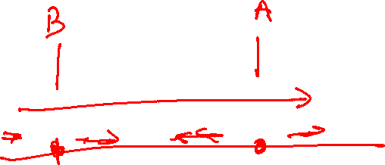
Collision avoidance and detection
How can we further minimise collisions?

Slide 8
Collision avoidance and detection
How can we further minimise collisions?
How do people avoid collisions in a sense that two people do not talk at the same time?

Slide 9
Collision avoidance and detection
How can we further minimise collisions?
How do people avoid collisions in a sense that two people do not talk at the same time?
People can listen. They won’t speak unless another person is talking.
Is it possible that there could still be a collision?

Slide 10
Collision avoidance and detection
How can we further minimise collisions?
How do people avoid collisions in a sense that two people do not talk at the same time?
People can listen. They won’t speak unless another person is talking.
Is it possible that there could still be a collision?
Yes, if they both start the conversation nearly at the same time.

Slide 11
CSMA (carrier sense multiple access)
CSMA also works in a similar way
All the hosts sense the carrier before sending anything
If there is already something on the link, they wait until the link becomes idle
As soon as the link becomes idle, they start transmitting

Slide 12
CSMA (carrier sense multiple access)
Can there still be collisions if the nodes sense the carrier before sending

Slide 13
CSMA (carrier sense multiple access)
Can there still be collisions if the nodes sense the carrier before sending
Yes, even though the propagation speed is nearly the speed of light, it’s still possible that it takes some time to reach the other node, which is also keen to transmit some data

Slide 14
CSMA (carrier sense multiple access)
What should the nodes do after detecting collisions?
What is the issue if the probability is low?
What is the issue if the probability is high?
How to adaptively adjust the probability rate?
Is it possible that another node can transmit a new frame, while others are trying to avoid collisions

Slide 15
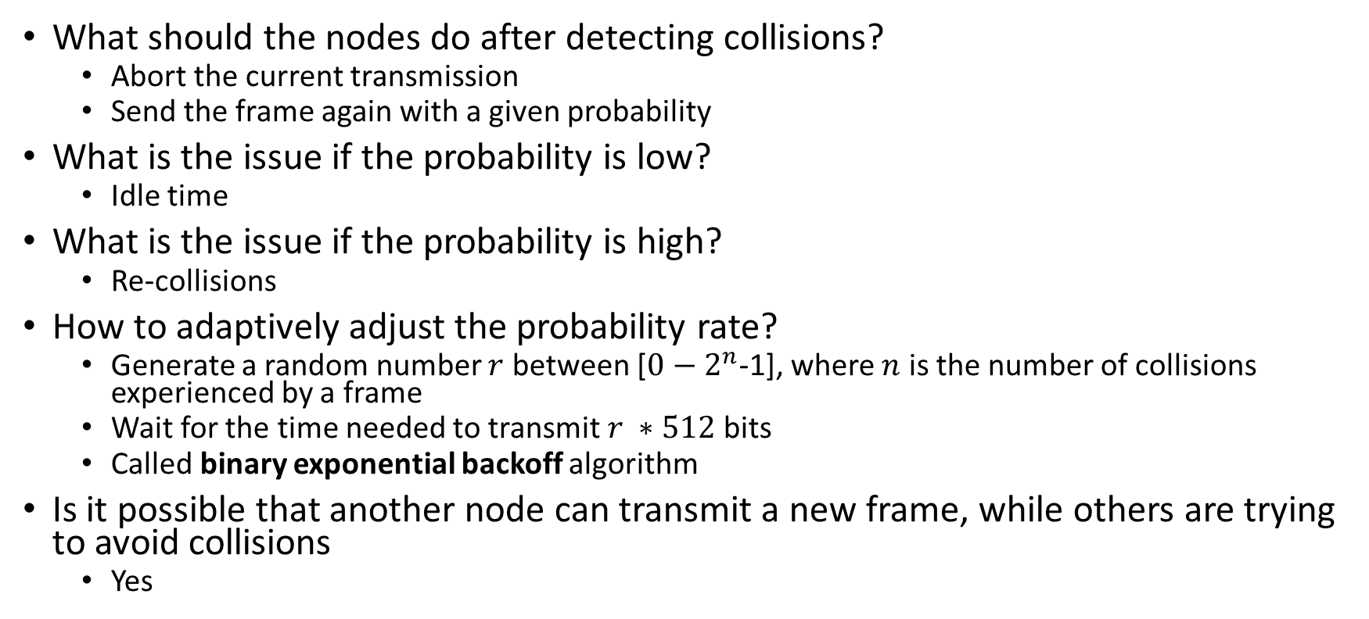

CSMA (carrier sense multiple access)
What should the nodes do after detecting collisions?
Abort the current transmission
Send the frame again with a given probability
What is the issue if the probability is low?
Idle time
What is the issue if the probability is high?
Re-collisions
How to adaptively adjust the probability rate?
Generate a random number $r$ between [$0−2^{n}$-1], where $n$ is the number of collisions experienced by a frame
Wait for the time needed to transmit $r ∗512$ bits
Called binary exponential backoff algorithm
Is it possible that another node can transmit a new frame, while others are trying to avoid collisions
Yes

Slide 16
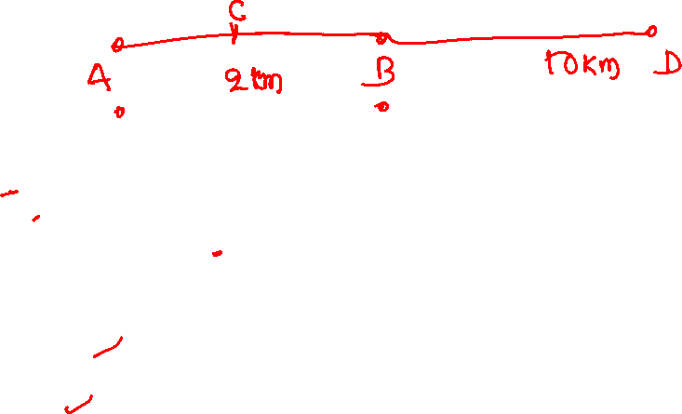
Example
Let’s say A and B are 2 KM apart, and both want to send a frame to D, which is 12 KM and 10 KM away from A and B.
Propagation speed 1 KM/millisecond
Transmission speed: 512 bits/millisecond
A and B both transmitted at time 0. Will there be a collision?
After the first retry, will there be a collision?
After the second retry, will there be a collision?
After the third retry, will there be a collision?
Is it possible that during the third retry, node C, which is exactly between A and B, can successfully transmit a frame to D?
Is it possible that A and B can never transmit to D?

Slide 17
Example
Let’s say A and B are 2 KM apart, and both want to send a frame to D, which is 12 KM and 10 KM away from A and B.
Propagation speed 1 KM/millisecond
Transmission speed: 512 bits/millisecond
A and B both transmitted at time 0. Will there be a collision? Yes.
After the first retry, will there be a collision? Yes, definitely.
After the second retry, will there be a collision? Yes, if the difference in the random number is <= 1.
After the third retry, will there be a collision? Yes, if the difference in the random number is <= 1.
Is it possible that during the third retry, node C, which is exactly between A and B, can successfully transmit a frame to D? Yes. E.g., A wants to retransmit after 2ms and B after 4ms, but C transmitted immediately after the link is cleared.
Is it possible that A and B can never transmit to D? Yes, but with a very low probability.

Slide 18
Example
Note that the packet should be large enough to detect collisions, as the nodes can detect collisions only during the transmission

Slide 19

CSMA/CD efficiency
$$Efficiency= \frac{1}{1+ \frac{5d_{prop}}{d_{trans}}}$$
$d_{prop}$ = propagation delay
$d_{trans}$ = transmission delay
Efficiency is highest when $d_{prop}$ = 0 or $d_{trans}=∞$

Slide 20
Taking-Turns protocol
How can we completely avoid collisions?
Use deterministic scheduling

Slide 21
Taking-Turns protocol

Slide 22
Taking-Turns protocol
One master node asks each node to transmit a maximum number of frames in a round-robin manner
The master node senses the carrier to wait until a node has finished transmitting its data
The master node moves to the next node after that
Shortcomings:
polling delay even if only one node wants to transmit
If the master fails, the entire channel becomes inoperative

Slide 23
Token-passing protocol

Slide 24
Token-passing protocol
No master node. A special frame called a token is circulated among the nodes in some fixed order.
If a node doesn’t have anything to send, it’ll immediately pass the token to the next node; otherwise, it can send up to a maximum number of frames before forwarding the token.
Shortcoming:
If a node fails, the entire channel becomes inoperative

Slide 25
Switched local-area network (LAN)
In a switched local-area network, all hosts are connected to a switch or router, which is connected to other switches and routers
There is no collision because hosts don’t share a common link, and switches serialize the traffic, similarly to a router
You can think of switches as routers that operate at the data-link layer
Switches don’t run the shortest-path algorithm to create their forwarding table
They work on physical addresses rather than IP addresses

Slide 26
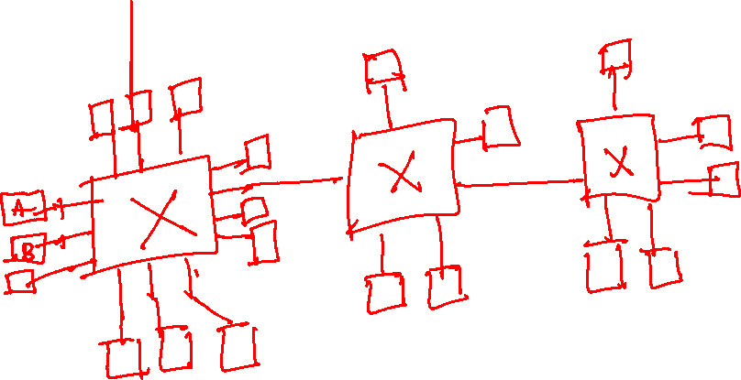
LAN

Slide 27
Physical address
Each NIC (or network adapter) has a unique 6-byte physical address called a MAC address
IEEE assigns MAC address ranges to NIC vendors
MAC address is fixed for a NIC and doesn’t change even if a host moves from one network to another (e.g., Aadhar card no.)
The IP addresses follow a hierarchical structure, and they change whenever a host moves from one network to another (e.g., Postal address)

Slide 28
Physical address
If there are multiple network adapters on a host, then each adapter will have a separate MAC address

Slide 29


MAC addresses
each interface on LAN
has unique 48-bit MAC address
has a locally unique 32-bit IP address (as we’ve seen)
137.196.7.78
1A-2F-BB-76-09-AD
LAN
(wired or wireless)
137.196.7/24
71-65-F7-2B-08-53
58-23-D7-FA-20-B0
137.196.7.23
137.196.7.14
0C-C4-11-6F-E3-98
137.196.7.88
Copyright © 2010-2025 J.F. Kurose, K.W. Ross

Slide 30
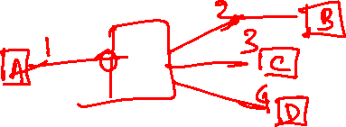
Frame transfer
Whenever a host wants to transfer a frame to another host within the LAN, it puts the MAC address of the destination in the frame
The intermediate switch looks at its forwarding table to forward the frame to a port that is connected to the destination host
If an entry doesn’t exist in its forwarding table, the switch forwards the frame to all ports except the one from which the message arrived
If a host wants to send a frame to all nodes in the LAN, it uses a special broadcast address FF : FF : FF : FF : FF : FF

Slide 31
Sender
How does sender A send a packet to B, which is present in the LAN, with IP address 10.2.1.5?

Slide 32
Sender
How does sender A send a packet to B, which is present in the LAN, with IP address 10.2.1.5?
A can use a broadcast MAC address because it doesn’t know the MAC address of B
What does a host do when it receives a packet with a broadcast MAC address
The host passes this packet to the network layer. The network layer checks if the destination IP address matches its. If yes, it gives the packet to the transport layer. Otherwise, the packet is discarded.

Slide 33
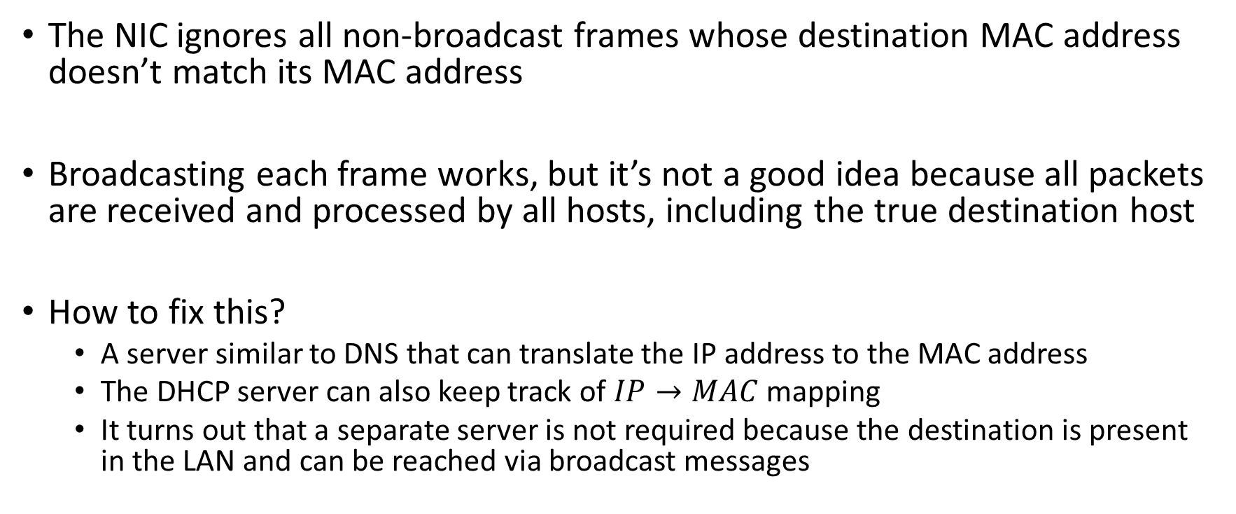
Sender
The NIC ignores all non-broadcast frames whose destination MAC address doesn’t match its MAC address
Broadcasting each frame works, but it’s not a good idea because all packets are received and processed by all hosts, including the true destination host
How to fix this?
A server similar to DNS that can translate the IP address to the MAC address
The DHCP server can also keep track of $IP→MAC$ mapping
It turns out that a separate server is not required because the destination is present in the LAN and can be reached via broadcast messages

Slide 34
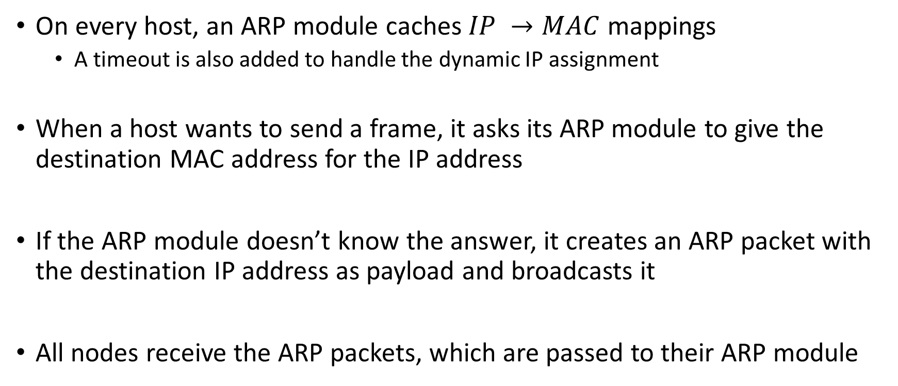
Address resolution protocol (ARP)
On every host, an ARP module caches $IP →MAC$mappings
A timeout is also added to handle the dynamic IP assignment
When a host wants to send a frame, it asks its ARP module to give the destination MAC address for the IP address
If the ARP module doesn’t know the answer, it creates an ARP packet with the destination IP address as payload and broadcasts it
All nodes receive the ARP packets, which are passed to their ARP module

Slide 35
Address resolution protocol (ARP)
The ARP module checks if the IP address matches its own
If yes, the ARP module respond back to the sender with its MAC address
Otherwise, the ARP module discards the frame
Is ARP a network-layer protocol or link-layer protocol?
It sits on the boundary between the link-layer and the network layer

Slide 36
ARP: address resolution protocol
Question: how to determine interface’s MAC address, knowing its IP address?
ARP table: each IP node (host, router) on LAN has table
ARP
137.196.7.78
IP/MAC address mappings for some LAN nodes:
< IP address; MAC address; TTL>
TTL (Time To Live): time after which address mapping will be forgotten (typically 20 min)
1A-2F-BB-76-09-AD
ARP
ARP
LAN
71-65-F7-2B-08-53
58-23-D7-FA-20-B0
137.196.7.23
137.196.7.14
ARP
0C-C4-11-6F-E3-98
137.196.7.88
Copyright © 2010-2025 J.F. Kurose, K.W. Ross

Slide 37
ARP protocol in action
example: A wants to send datagram to B
B’s MAC address not in A’s ARP table, so A uses ARP to find B’s MAC address
A broadcasts ARP query, containing B's IP addr
destination MAC address = FF-FF-FF-FF-FF-FF
all nodes on LAN receive ARP query
1
Ethernet frame (sent to FF-FF-FF-FF-FF-FF)
C
Source MAC: 71-65-F7-2B-08-53
Source IP: 137.196.7.23
Target IP address: 137.196.7.14
…
ARP table in A
IP addr
MAC addr
TTL
TTL
A
B
1
71-65-F7-2B-08-53
58-23-D7-FA-20-B0
137.196.7.23
137.196.7.14
D
Copyright © 2010-2025 J.F. Kurose, K.W. Ross

Slide 38
ARP protocol in action
example: A wants to send datagram to B
B’s MAC address not in A’s ARP table, so A uses ARP to find B’s MAC address
ARP message into Ethernet frame (sent to 71-65-F7-2B-08-53)
C
Target IP address: 137.196.7.14
Target MAC address:
58-23-D7-FA-20-B0
…
ARP table in A
IP addr
MAC addr
TTL
TTL
A
B
2
71-65-F7-2B-08-53
58-23-D7-FA-20-B0
137.196.7.23
137.196.7.14
2
B replies to A with ARP response, giving its MAC address
D
Copyright © 2010-2025 J.F. Kurose, K.W. Ross

Slide 39
ARP protocol in action
example: A wants to send datagram to B
B’s MAC address not in A’s ARP table, so A uses ARP to find B’s MAC address
C
ARP table in A
IP addr
MAC addr
TTL
TTL
A
B
137.196.
7.14
58-23-D7-FA-20-B0
500
71-65-F7-2B-08-53
58-23-D7-FA-20-B0
137.196.7.23
137.196.7.14
3
A receives B’s reply, adds B entry into its local ARP table
D
Copyright © 2010-2025 J.F. Kurose, K.W. Ross

Slide 40

Sending to another subnet
A wants to send a packet to B
A identifies using its subnet mask that B’s IP address is in a different subnet
A uses ARP to find the MAC address of the default gateway R
R uses ARP to find the MAC address of B
R creates a new frame with B’s MAC address and A’s payload
A
R
B
111.111.111.111
74-29-9C-E8-FF-55
222.222.222.222
49-BD-D2-C7-56-2A
222.222.222.220
1A-23-F9-CD-06-9B
111.111.111.112
111.111.111.110
CC-49-DE-D0-AB-7D
E6-E9-00-17-BB-4B
222.222.222.221
Copyright © 2010-2025 J.F. Kurose, K.W. Ross
88-B2-2F-54-1A-0F

