Slide 2
Today’s lecture
ARP
Spanning tree
Forwarding and learning
Virtual LAN

Slide 3
References
Chapter – 6.4 from the Kurose and Ross
Chapter – 3.2 from Peterson and Davie

Slide 4


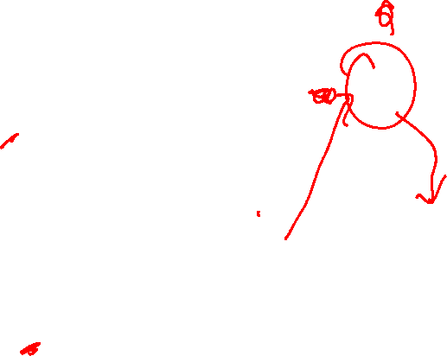
Address resolution protocol (ARP)
Copyright © 2010-2025 J.F. Kurose, K.W. Ross
A wants to send a packet to C
A wants to send a packet to B
A
R
B
111.111.111.111
74-29-9C-E8-FF-55
222.222.222.222
49-BD-D2-C7-56-2A
222.222.222.220
C
1A-23-F9-CD-06-9B
111.111.111.112
111.111.111.110
CC-49-DE-D0-AB-7D
E6-E9-00-17-BB-4B
222.222.222.221
88-B2-2F-54-1A-0F

Slide 5
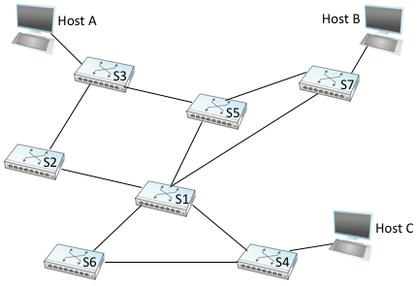

Switch forwarding
ARP request from A for Host C will go via which switches?
Image: “Computer Networks: A Systems Approach” (Peterson & Davie), CC BY 4.0.

Slide 6
Switch forwarding
ARP request from A for Host C will go via which switches?
All switches. But the request will keep circulating.
Image: “Computer Networks: A Systems Approach” (Peterson & Davie), CC BY 4.0.

Slide 7
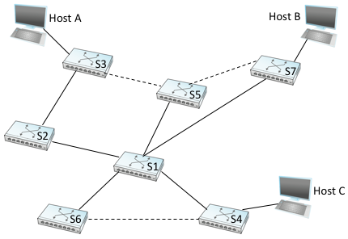
Switch forwarding
ARP request from A for Host C will go via which switches?
All switches. But the request will keep circulating.
How about this? The dotted links are not connected.
Image: “Computer Networks: A Systems Approach” (Peterson & Davie), CC BY 4.0.

Slide 8
Spanning tree protocol (decentralized)

Slide 9
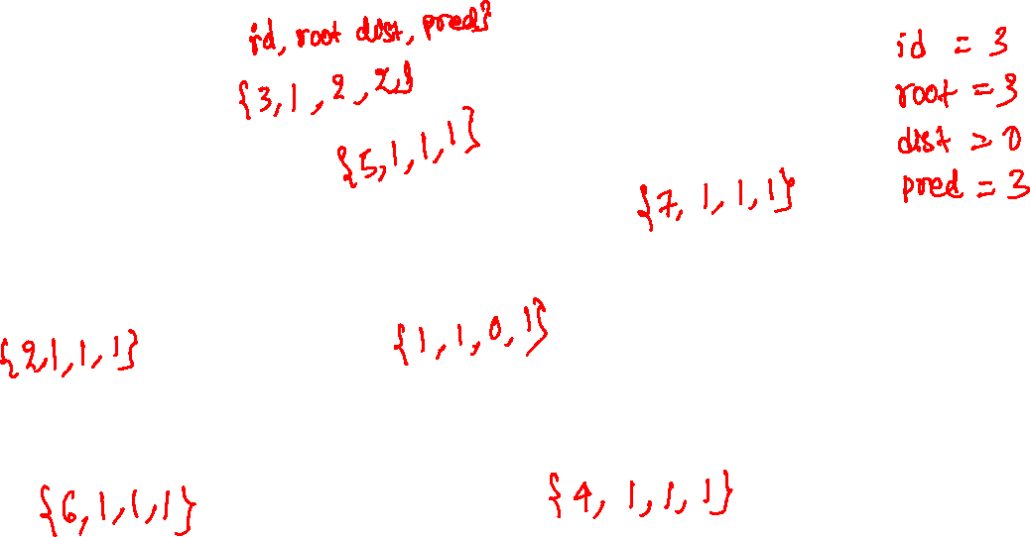
Spanning tree protocol (decentralized)
Image: “Computer Networks: A Systems Approach” (Peterson & Davie), CC BY 4.0.

Slide 10
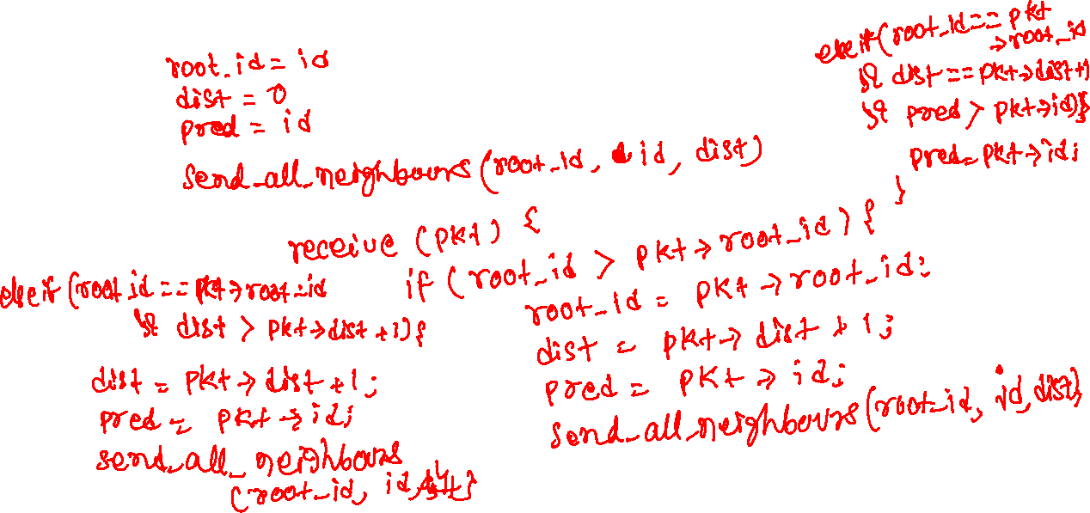
Spanning tree protocol (decentralized)

Slide 11
Initialization
All switches elect a root and compute the spanning tree
Each switch maintains four variables
root_id : id of the root
pred : immediate predecessor in the spanning tree
dist : distance from the root
id : its own ID
Initially, each switch thinks that it’s the root and sends packets to all neighbouring switches as follows
root_id = id;
pred = id;
dist = 0
send_all_neighbours(root_id, id, dist)

Slide 12
Receive
Upon receiving a packet, a switch updates its variables and informs its neighbours as per the algorithm on the left
void receive(pkt) {
if (pkt->root_id < root_id) {
root_id = pkt->root_id;
pred = pkt->id;
dist = pkt->dist + 1;
send_all_neighbours(root_id, id, dist);
}
else if (pkt->root_id == root_id && pkt->dist < dist - 1) {
pred = pkt->id;
dist = pkt->dist + 1;
send_all_neighbours(root_id, id, dist);
}
else if (pkt->root_id == root_id && pkt->dist == dist - 1 && pkt->id < pred) {
pred = pkt->id;
}
}

Slide 13
Failure
To handle failure, the root switch periodically sends the configuration message that is forwarded by the other switches
The configuration messages are sent on all ports, including the ones that are not on the spanning tree

Slide 14

Switch forwarding
What if S2 is down?
Image: “Computer Networks: A Systems Approach” (Peterson & Davie), CC BY 4.0.

Slide 15
Spanning tree
Image: “Computer Networks: A Systems Approach” (Peterson & Davie), CC BY 4.0.

Slide 16
Spanning tree
SEND: (root, id, dist)
CUR: (root, pred, dist)
CUR: (5, 5, 0)
SEND: (5, 5, 0)
CUR: (3, 3, 0)
SEND: (3, 3, 0)
CUR: (7, 7, 0)
SEND: (7, 7, 0)
CUR: (2, 2, 0)
SEND: (2, 2, 0)
CUR: (1, 1, 0)
SEND: (1, 1, 0)
CUR: (6, 6, 0)
SEND: (6, 6, 0)
CUR: (4, 4, 0)
SEND: (4, 4, 0)
Image: “Computer Networks: A Systems Approach” (Peterson & Davie), CC BY 4.0.

Slide 17
Spanning tree
CUR: (root, pred, dist)
SEND: (root, id, dist)
CUR: (1, 1, 1)
SEND: (1, 5, 1)
CUR: (2, 2, 1)
SEND: (2, 3, 1)
CUR: (1, 1, 1)
SEND: (1, 7, 1)
CUR: (1, 1, 1)
SEND: (1, 2, 1)
CUR: (1, 1, 0)
SEND: (1, 1, 0)
CUR: (1, 1, 1)
SEND: (1, 6, 1)
CUR: (1, 1, 1)
SEND: (1, 4, 1)
Image: “Computer Networks: A Systems Approach” (Peterson & Davie), CC BY 4.0.

Slide 18
Spanning tree
CUR: (root, pred, dist)
SEND: (root, id, dist)
CUR: (1, 1, 1)
CUR: (1, 2, 2)
SEND: (1, 3, 2)
CUR: (1, 1, 1)
CUR: (1, 1, 1)
CUR: (1, 1, 0)
CUR: (1, 1, 1)
CUR: (1, 1, 1)
Image: “Computer Networks: A Systems Approach” (Peterson & Davie), CC BY 4.0.

Slide 19
Spanning tree
CUR: (root, pred, dist)
SEND: (root, id, dist)
CUR: (1, 1, 1)
CUR: (1, 2, 2)
CUR: (1, 1, 1)
CUR: (1, 1, 1)
CUR: (1, 1, 0)
CUR: (1, 1, 1)
CUR: (1, 1, 1)
Image: “Computer Networks: A Systems Approach” (Peterson & Davie), CC BY 4.0.

Slide 20
Spanning tree
CUR: (root, pred, dist)
SEND: (root, id, dist)
CUR: (1, 1, 1)
CUR: (1, 2, 2)
CUR: (1, 1, 1)
CUR: (1, 1, 1)
CUR: (1, 1, 0)
CUR: (1, 1, 1)
CUR: (1, 1, 1)
Image: “Computer Networks: A Systems Approach” (Peterson & Davie), CC BY 4.0.

Slide 21
Forwarding and Filtering
Each Switch maintains a switch table for forwarding
A switch table entry consists of
MAC address
Destination port
Time at which the entry was created
MAC | PORT | TIME
62-FE-F7-11-89-A3 | 1 | 9:32
7C-BA-B2-B4-91-10 | 3 | 9:36
…

Slide 22
Forwarding and Filtering
Filtering decides whether a frame should be forwarded or dropped
MAC | PORT | TIME
62-FE-F7-11-89-A3 | 1 | 9:32
7C-BA-B2-B4-91-10 | 3 | 9:36
…
Let’s say the switch has four ports, 1, 2, 3, 4.
A packet with destination 7C-BA-B2-B4-91-10 at port 1.
What should the switch do?
A packet with destination 7C-BA-B2-B4-91-10 at port 3.
What should the switch do?
A packet with destination DD-BA-B2-B4-91-10 at port 1.
What should the switch do?

Slide 23
Forwarding and Filtering
Filtering decides whether a frame should be forwarded or dropped
MAC | PORT | TIME
62-FE-F7-11-89-A3 | 1 | 9:32
7C-BA-B2-B4-91-10 | 3 | 9:36
…
Let’s say the switch has four ports, 1, 2, 3, 4.
A packet with destination 7C-BA-B2-B4-91-10 at port 1.
What should the switch do?
Forward to port 3.
A packet with destination 7C-BA-B2-B4-91-10 at port 3.
What should the switch do?
Discard.
A packet with destination DD-BA-B2-B4-91-10 at port 1.
What should the switch do?
Forward to ports 2, 3, 4.

Slide 24

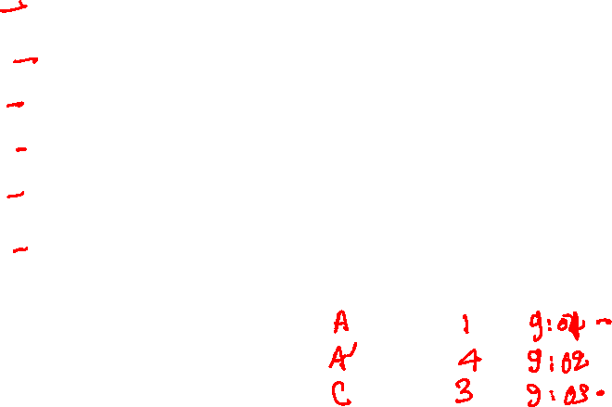
Self-Learning
$A →A^{′}$
$A →B^{′}$
$A^{′}→C$
$C →B^{′}$
$A→B^{′}$
$A →C$
A
C’
B
1
2
6
3
5
4
B’
C
A’
MAC | PORT | TIME
switch table
(initially empty)
Copyright © 2010-2025 J.F. Kurose, K.W. Ross

Slide 25
Self-Learning
$A →A^{′}$
$A →B^{′}$
$A^{′}→C$
$C →B^{′}$
$A→B^{′}$
$A →C$
A
C’
B
1
2
6
3
5
4
B’
C
A’
MAC | PORT | TIME
switch table
(initially empty)
Copyright © 2010-2025 J.F. Kurose, K.W. Ross

Slide 26

Self-Learning
$A →A^{′}$
forwarded to 2,3,4,5,6
A
C’
B
1
2
6
3
5
4
B’
C
A’
MAC | PORT | TIME
A | 1 | 9:00
Copyright © 2010-2025 J.F. Kurose, K.W. Ross

Slide 27

Self-Learning
$A →A^{′}$
$A →B^{′}$
forwarded to 2,3,4,5,6
A
C’
B
1
2
6
3
5
4
B’
C
A’
MAC | PORT | TIME
A | 1 | 9:01
Copyright © 2010-2025 J.F. Kurose, K.W. Ross

Slide 28

Self-Learning
$A →A^{′}$
$A →B^{′}$
$A^{′}→C$
forwarded to 1,2,3,5,6
A
C’
B
1
2
6
3
5
4
B’
C
A’
MAC | PORT | TIME
A | 1 | 9:01
A’ | 4 | 9:03
Copyright © 2010-2025 J.F. Kurose, K.W. Ross

Slide 29

Self-Learning
$A →A^{′}$
$A →B^{′}$
$A^{′}→C$
$C →B^{′}$
forwarded to 1,2,4,5,6
A
C’
B
1
2
6
3
5
4
B’
C
A’
MAC | PORT | TIME
A | 1 | 9:01
A’ | 4 | 9:03
C | 3 | 9:04
Copyright © 2010-2025 J.F. Kurose, K.W. Ross

Slide 30

Self-Learning
$A →A^{′}$
$A →B^{′}$
$A^{′}→C$
$C →B^{′}$
$A→B^{′}$
forwarded to 2,3,4,5,6
A
C’
B
1
2
6
3
5
4
B’
C
A’
MAC | PORT | TIME
A | 1 | 9:05
A’ | 4 | 9:03
C | 3 | 9:04
Copyright © 2010-2025 J.F. Kurose, K.W. Ross

Slide 31

Self-Learning
$A →A^{′}$
$A →B^{′}$
$A^{′}→C$
$C →B^{′}$
$A→B^{′}$
$A →C$
forwarded to 3
A
C’
B
1
2
6
3
5
4
B’
C
A’
MAC | PORT | TIME
A | 1 | 9:06
A’ | 4 | 9:03
C | 3 | 9:04
Copyright © 2010-2025 J.F. Kurose, K.W. Ross

Slide 32


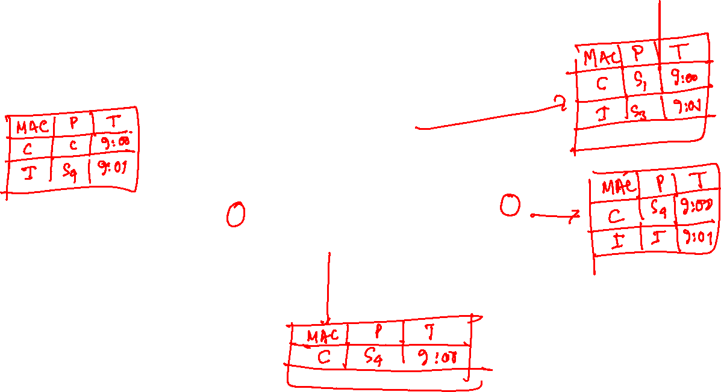
Self-learning multi-switch example
Suppose C sends frame to I, I responds to C
S₄
S₁
S₃
A
S₂
F
I
B
C
D
E
G
H
Q: show switch tables and packet forwarding in S₁, S₂, S₃, S₄
Copyright © 2010-2025 J.F. Kurose, K.W. Ross

Slide 33
Switches vs. Routers

Slide 34
Switches vs. Routers
Switches
Routers
Process frames up to layer-2.
Spanning tree topology.
MAC addressing is flat.
Often handles broadcast frames.
Small per-packet processing time.
Plug and play. Static configuration is not needed.
Process datagram up to layer-3.
Network topology may have loops.
Network addressing is hierarchical.
Don’t forward broadcast datagrams.
Large per-packet processing time.
Need a network administrator to configure the IP addresses of router interfaces.

Slide 35
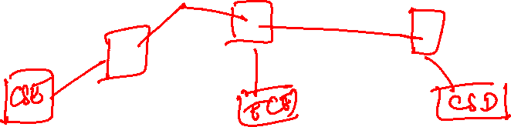
Virtual LANs
Suppose, IIITD has a hierarchy of switches that are connected to all departments; however, we don’t want to broadcast CSE packets to ECE and so on. How can we achieve this?
One switch may be connected to more than one department or each switch may be connected to more than one departments.

Slide 36
Virtual LANs
Suppose, IIITD has a hierarchy of switches that are connected to all departments; however, we don’t want to broadcast CSE packets to ECE and so on. How can we achieve this?
One switch may be connected to more than one department or each switch may be connected to more than one departments.
Replace switches with routers
Can we work only with the switches?

Slide 37
Virtual LAN
Computer
Science
ECE
Copyright © 2010-2025 J.F. Kurose, K.W. Ross

Slide 38
Virtual LANs
Some switches support virtual local area networks (VLANs)
Switch ports are divided into groups by a network manager
Each group is called a VLAN
Each VLAN acts as a standalone switch
VLAN traffic is isolated from each other

Slide 39

Virtual LANs
1
7
9
15
2
8
10
16
…
…
ECE (VLAN ports 1-8)
CS (VLAN ports 9-15)
… operates as multiple virtual switches
1
7
9
15
2
8
10
16
…
…
ECE (VLAN ports 1-8)
CS (VLAN ports 9-15)
Copyright © 2010-2025 J.F. Kurose, K.W. Ross

Slide 40
Virtual LANs
How can a student in ECE VLAN talk to a student in CSE VLAN, if the inter-VLANs traffic is blocked?

Slide 41
Virtual LANs
How can a student in ECE VLAN talk to a student in CSE VLAN, if the inter-VLANs traffic is blocked?
Add a router between VLANs
The VLAN switches already contain a router, so an external router is not needed

Slide 42
Virtual LANs
1
7
9
15
2
8
10
16
…
…
ECE (VLAN ports 1-8)
CS (VLAN ports 9-15)
CS (VLAN ports 9-15)
Copyright © 2010-2025 J.F. Kurose, K.W. Ross

Slide 43
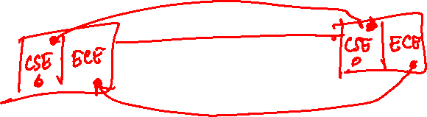
Virtual LANs
Let’s say some ports on switch A belong to CSE and some to ECE. Additionally, some ports on switch B belong to CSE and some to ECE. Both CSE and ECE frames will be forwarded from switch A to switch B. How does switch B distinguish between CSE and ECE frames?

Slide 44
Virtual LANs
Let’s say some ports on switch A belong to CSE and some to ECE. Additionally, some ports on switch B belong to CSE and some to ECE. Both CSE and ECE frames will be forwarded from switch A to switch B. How does switch B distinguish between CSE and ECE frames?
Separate ports for CSE and ECE for inter-switch communication
If there are N VLANS, how many ports per-switch need to be reserved for inter-switch communication?
N

