Slide 2
Today’s lecture
Virtual LAN
Ethernet header
Network security

Slide 3
References
Chapter – 6.4, 6.7 from the Kurose and Ross

Slide 4
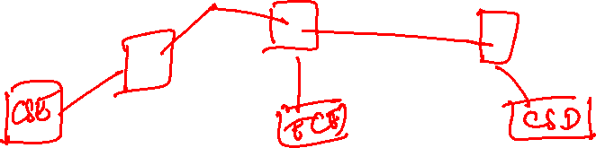
Virtual LAN
Suppose, IIITD has a hierarchy of switches that are connected to all departments; however, we don’t want to broadcast CSE packets to ECE and so on. How can we achieve this?
One switch may be connected to more than one department or each switch may be connected to more than one departments.

Slide 5
Virtual LAN
Suppose, IIITD has a hierarchy of switches that are connected to all departments; however, we don’t want to broadcast CSE packets to ECE and so on. How can we achieve this?
One switch may be connected to more than one department or each switch may be connected to more than one departments.
Replace switches with routers
Can we work only with the switches?

Slide 6

Virtual LAN
Computer
Science
ECE
Copyright © 2010-2025 J.F. Kurose, K.W. Ross

Slide 7
Virtual LANs
Some switches support virtual local area networks (VLANs)
Switch ports are divided into groups by a network manager
Each group is called a VLAN
Each VLAN acts as a standalone switch
VLAN traffic is isolated from each other

Slide 8


Virtual LANs
1
7
9
15
2
8
10
16
…
…
ECE (VLAN ports 1-8)
CS (VLAN ports 9-15)
… operates as multiple virtual switches
1
7
9
15
2
8
10
16
…
…
ECE (VLAN ports 1-8)
CS (VLAN ports 9-15)
Copyright © 2010-2025 J.F. Kurose, K.W. Ross

Slide 9
Virtual LANs
How can a student in ECE VLAN talk to a student in CSE VLAN, if the inter-VLANs traffic is blocked?

Slide 10
Virtual LANs
How can a student in ECE VLAN talk to a student in CSE VLAN, if the inter-VLANs traffic is blocked?
Add a router between VLANs
The VLAN switches already contain a router, so an external router is not needed

Slide 11
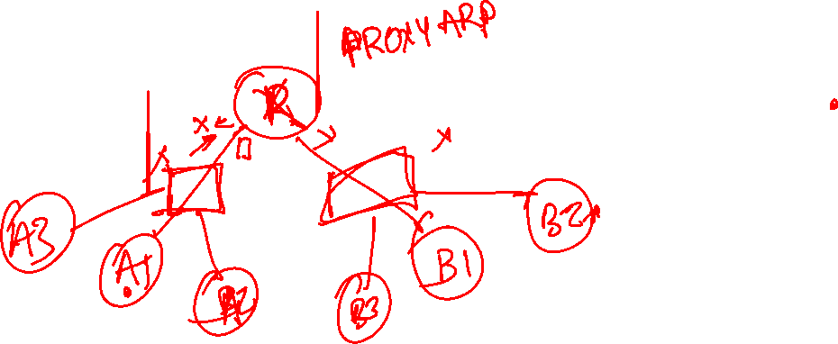
Virtual LANs
1
7
9
15
2
8
10
16
…
…
ECE (VLAN ports 1-8)
CS (VLAN ports 9-15)
CS (VLAN ports 9-15)
Copyright © 2010-2025 J.F. Kurose, K.W. Ross

Slide 12
Inter-VLAN communication
The hosts are unaware of the presence of a VLAN
If two VLANs are in the same subnet, then how can a host obtain the MAC address of another host present in a different VLAN
Good practice to apply subnetting at the VLAN granularity
Ideally, each VLAN should belong to a different subnet
However, if multiple VLANs are in the same subnet, proxy ARP can be used

Slide 13
Proxy ARP
A router can be configured to implement proxy ARP
If an ARP request is coming to one of its ports, the router replies with its own MAC address if
The target IP is in a different LAN/VLAN reachable via it
The target IP belongs to the same IP subnet as the interface on which the ARP request arrived
When the requesting host sends the packet with the router’s MAC address, the router forwards it to the correct destination

Slide 14
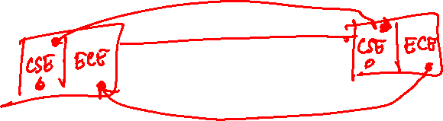
Virtual LANs
Let’s say some ports on switch A belong to CSE and some to ECE. Additionally, some ports on switch B belong to CSE and some to ECE. Both CSE and ECE frames will be forwarded from switch A to switch B. How does switch B distinguish between CSE and ECE frames?

Slide 15
Virtual LANs
Let’s say some ports on switch A belong to CSE and some to ECE. Additionally, some ports on switch B belong to CSE and some to ECE. Both CSE and ECE frames will be forwarded from switch A to switch B. How does switch B distinguish between CSE and ECE frames?
Separate ports for CSE and ECE for inter-switch communication
If there are N VLANS, how many ports per-switch need to be reserved for inter-switch communication?
N

Slide 16
Virtual LANs
Let’s say some ports on switch A belong to CSE and some to ECE. Additionally, some ports on switch B belong to CSE and some to ECE. Both CSE and ECE frames will be forwarded from switch A to switch B. How does switch B distinguish between CSE and ECE frames?
Separate ports for CSE and ECE for inter-switch communication
If there are N VLANS, how many ports per-switch need to be reserved for inter-switch communication?
N

Slide 17
VLAN trunking
A separate port on each switch is configured as a trunk port for inter-switch communication
All the traffic that goes via the trunk port uses a VLAN-tagged Ethernet frame
VLAN-tagged Ethernet frame contains the ID of the VLAN to which the frame belongs
VLAN tag is added by the sending side of the VLAN trunk, which is parsed and removed by the receiving side of the VLAN trunk

Slide 18
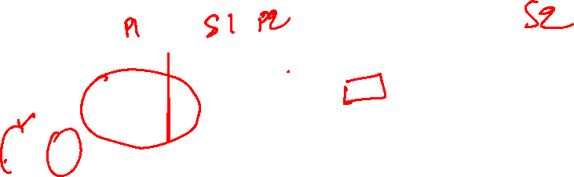
Virtual LANs
1
7
9
15
1
3
5
7
2
8
10
16
16
2
4
6
8
…
…
…
EE (VLAN ports 1-8)
CS (VLAN ports 9-15)
Copyright © 2010-2025 J.F. Kurose, K.W. Ross

Slide 19

802.1Q VLAN frame format
type
preamble
dest.
address
source
address
data (payload)
CRC
802.1 Ethernet frame
type
preamble
dest.
address
source
address
data (payload)
CRC
802.1Q frame
2-byte Tag Protocol Identifier
(value: 81-00)
Recomputed
CRC
Tag Control Information
(12 bit VLAN ID field, 3 bit priority field like IP TOS)
Copyright © 2010-2025 J.F. Kurose, K.W. Ross

Slide 20
MAC-based VLANs
In MAC-based VLANs, a network manager specifies the set of MAC addresses that belong to each VLAN
Whenever a device is attached to a port, the port is connected to an appropriate VLAN based on the MAC address of the device

Slide 21

Ethernet header (Linux)
struct ethhdr {
__u8 h_dest[6]; // destination MAC
__u8 h_source[6]; // source MAC
__be16 h_proto; // Porotocol: IPv4, IPv6, ARP, VLAN tag, etc.
};

Slide 22
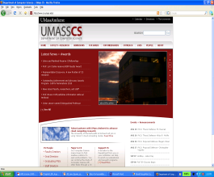


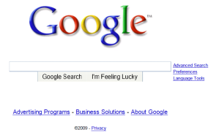
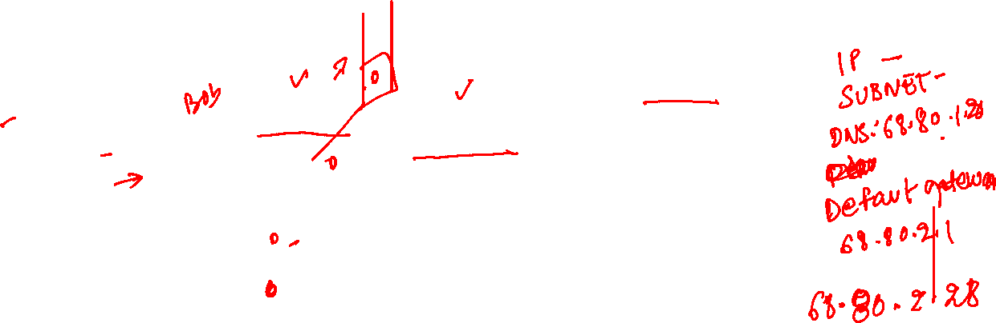
A day in the life of a Web Page Request
browser
DNS server
68.80.1.20
IIITD network
68.80.2.0/24
JIO network
68.80.0.0/13
00:16:D3:23:68:6A
0.0.0.0
00:22:6B:45:1F:1B
68.80.2.1
web page
web server
Google’s network
64.10.20.0/19
64.10.20.24
Copyright © 2010-2025 J.F. Kurose, K.W. Ross

Slide 23

A day in the life of a Web Page Request
browser
DNS server
68.80.1.20
IIITD network
68.80.2.0/24
JIO network
68.80.0.0/13
00:16:D3:23:68:6A
68.80.2.28
00:22:6B:45:1F:1B
68.80.2.1
web page
web server
Google’s network
64.10.20.0/19
64.10.20.24
Copyright © 2010-2025 J.F. Kurose, K.W. Ross

Slide 24
A day in the life of a Web Page Request
The OS of Bob’s laptop creates a DHCP request (UDP)
Destination port 67 (DHCP server)
Source port 68 (DHCP client)
Destination IP address: 255.255.255.255 (broadcast)
Source IP: 0.0.0.0
Source MAC: 00:16:D3:23:68:6A
Destination MAC: FF:FF:FF:FF:FF:FF (broadcast)

Slide 25
A day in the life of a Web Page Request
The router, which is also acting as a DHCP server, forwards this packet to its application layer, which creates a DHCP offer (UDP)
Destination port 68 (DHCP client)
Source port 67 (DHCP server)
Destination IP address: 255.255.255.255 (broadcast)
Source IP: 68.80.2.1
Source MAC: 00:22:6B:45:1F:1B
Destination MAC: 00:16:D3:23:68:6A
Offered IP: 68.80.2.28, DNS: 68.80.1.20, Default gateway: 68.80.2.1, Subnet Block: 60.80.2.0/24

Slide 26
A day in the life of a Web Page Request
The self learning switch forwards the message to Bob. Bob sends a DHCP request (UDP)
Destination port 67 (DHCP server)
Source port 68 (DHCP client)
Destination IP address: 255.255.255.255 (broadcast)
Source IP: 0.0.0.0
Source MAC: 00:16:D3:23:68:6A
Destination MAC: FF:FF:FF:FF:FF:FF (broadcast)
Requested IP: 68.80.2.28

Slide 27
A day in the life of a Web Page Request
The router forwards the DHCP request its application layer, which creates a DHCP ACK (UDP)
Destination port 68 (DHCP client)
Source port 67 (DHCP server)
Destination IP address: 255.255.255.255 (broadcast)
Source IP: 68.80.2.1
Source MAC: 00:22:6B:45:1F:1B
Destination MAC: 00:16:D3:23:68:6A
Offered IP: 68.80.2.28, DNS: 68.80.1.20, Default gateway: 68.80.2.1, Subnet Block: 60.80.2.0/24

Slide 28
A day in the life of a Web Page Request
Bob creates a DNS query message
Destination port 53 (DNS server)
Destination IP address: 68.80.1.20
Source IP: 68.80.2.28
Source MAC: 00:16:D3:23:68:6A
Destination MAC: ?
Query: www.google.com
As the DNS server is outside the Bob subnet, it needs the MAC address of the default gateway to forward this packet. Bob’s laptop creates an ARP request for 68.80.2.1 to obtain 00:22:6B:45:1F:1B

Slide 29
A day in the life of a Web Page Request
Bob’s laptop sends a DNS query message
Destination port 53 (DNS server)
Destination IP address: 68.80.1.20
Source IP: 68.80.2.28
Source MAC: 00:16:D3:23:68:6A
Destination MAC: 00:22:6B:45:1F:1B
Query: www.google.com

Slide 30
A day in the life of a Web Page Request
Router 68.80.2.1 receives the packet, looks at its forwarding table to forward to the next router in the path to the DNS server 68.80.1.20
The forwarding table is created via LS/DV and BGP protocols
The DNS server looks at its cached data to obtain the IP address of www.google.com. If an entry is not present, it reaches out the root, TLD, and authoritative DNS servers, depending on the cached information, to obtain the IP address. It then places the DNS reply in a UDP segment, and sends it to Bob.

Slide 31
A day in the life of a Web Page Request
The Bob laptop retrieves the IP address (64.10.20.24) from the DNS reply, and creates a TCP socket to perform a three-way handshake with the Google server
Bob’s laptop first creates a TCP SYN segment with destination port 80 and sends it to destination IP address 64.10.20.24 and the MAC address 00:22:6B:45:1F:1B (default gateway)
The default gateway, JIO routers, and Google routers forward the datagram to 64.10.20.24
The TCP SYN packet is delivered to the HTTP application on 64.10.20.24, which will create a socket to communicate with Bob and generate a TCP SYNACK, which is forwarded to Bob

Slide 32
A day in the life of a Web Page Request
On receiving SYNACK, Bob’s browser enters the connected state
Bob’s browser then creates an HTTP GET request with the TCP ACK bit set, and sends it to Google’s server (64.10.20.24)
Google’s server (64.10.20.24) replies back with an HTTP response, which is forwarded through Google’s, Jio’s, and IIITD routers to Bob.
Bob’s browser reads the HTTP response and displays it

Slide 33
A short overview of secure communication

Slide 34

Secure communication
Suppose A wants to talk to B via the Internet. Who can read A's messages?

Slide 35
Secure communication
Suppose A wants to talk to B via the Internet. Who can read A's messages?
All the routers in the path from A to B.
All the hosts that share the same communication channel with A.
All the hosts that share the same communication channel with B.

Slide 36
Secure communication
Suppose A wants nobody else apart from B to read its message. How can it achieve that?

Slide 37
Secure communication
Suppose A wants nobody else apart from B to read its message. How can it achieve that?
A can encrypt the message.
An encryption algorithm converts a good-looking message to random bytes with the help of a key (password). It is extremely hard to retrieve the original message from the random bytes unless you know the key.
Encryption requires a key - but which key?

Slide 38
Public-key cryptography
In public-key cryptography, each host has two keys:
public: Everybody knows the public key of other hosts.
private: Nobody else knows the private key of a host.
If a message is encrypted using a public key, it can only be decrypted using the corresponding private key.
If a message is encrypted using a private key, it can only be decrypted using the corresponding public key.

Slide 39
Secure communication
A encrypts using B's public key.
What if someone changes the packet during transit?

Slide 40
Secure communication
A encrypts using B's public key.
What if someone changes the packet during transit?
Decryption may produce garbage or even a different valid-looking message.
How can we be sure that the message has not been tampered with?

Slide 41
Secure communication
How can we be sure that the message has not been tampered with?
Add a cryptographic hash to the message. It's very unlikely that two different messages can have the same cryptographic hash, even if there is just a minor change, such as a single bit.

Slide 42
Secure communication
How can we be sure that the message has not been tampered with?
Add a cryptographic hash to the message. It's very unlikely that two different messages can have the same cryptographic hash, even if there is just a minor change, such as a single bit.
A will append the cryptographic hash of the message to the original message and encrypt the whole bundle using B's public key.

Slide 43
Secure communication
Is it possible that somebody else can impersonate A?

Slide 44
Secure communication
Is it possible that somebody else can impersonate A?
Yes
How can we prevent this?

Slide 45
Secure communication
Is it possible that somebody else can impersonate A?
Yes
How can we prevent this?
A can encrypt the cryptographic hash using its private key, append it to the message, and then encrypt the entire message using B's public key.
B will decrypt the cryptographic hash using A's public key and compute the cryptographic hash of the message. If the decrypted hash matches the computed hash, it means that the message was not tampered with, and it was indeed sent by A.

Slide 46
Secure communication
Somebody can resend A's message after a while to mislead B.
For example, the original message says transfer 10000. The duplicate message can cause B to transfer the money twice.
How can we prevent this?
Add a sequence number or timestamp to the message. B will ignore duplicate timestamps.

Slide 47
Secure communication
Public-key cryptography is used to implement secure protocols used on the Internet
More details in the Network Security and Cryptography courses

