Slide 2
Today’s topics
Assignment-1
Cookies
Web caching

Slide 3
References
Chapter 2.2.4 and 2.2.5 from the Kurose and Ross

Slide 4
Assignment-1
Simulating packet drop using the E1000 network driver

Slide 5

Big-endian and Little-endian
Big-endian: Store the most significant byte first in the memory. Little-endian: Store the least significant byte first in the memory.
For example, let’s say we want to store a 4-byte word 0xab12cd87 at location 0x1000.

Slide 6
Big-endian and Little-endian
For example, let’s say we want to store a 4-byte word 0xab12cd87 at location 0x1000.
In Big-endian: 0xab will be stored at 0x1000. 0x12 will be stored at 0x1001. 0xcd will be stored at 0x1002. 0x87 will be stored at 0x1003.

Slide 7
Big-endian and Little-endian
For example, let’s say we want to store a 4-byte word 0xab12cd87 at location 0x1000.
In Little-endian: 0x87 will be stored at 0x1000. 0xcd will be stored at 0x1001. 0x12 will be stored at 0x1002. 0xab will be stored at 0x1003.

Slide 8
Byte order
On an Intel CPU, the data is stored in the Little-endian format.
In network headers, the data is stored in Big-endian format, often called network byte order.

Slide 9
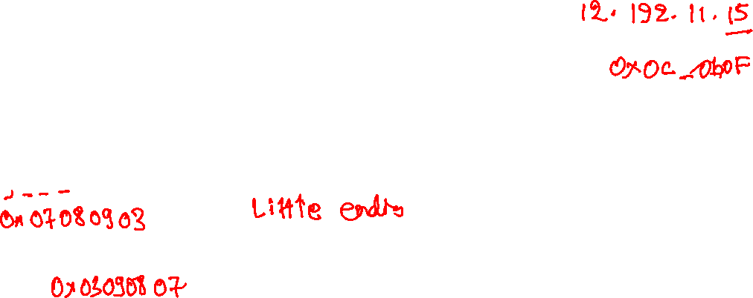
IP address
Convert the following IP address to a 32-bit hexadecimal value
7.8.9.3
How will it be stored in a network header?

Slide 10
IP address
Convert the following IP address to a 32-bit hexadecimal value
7.8.9.3
0x07080903
How will it be stored in a network header?
0x03090807

Slide 11
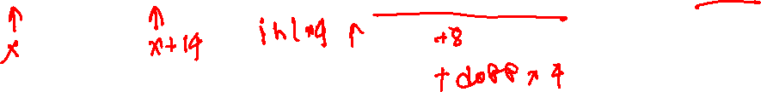
Packet structure

Slide 12

Data-link layer header (14 bytes)
struct ethhdr { unsigned char h_dest[6]; // destination mac address unsigned char h_source[6]; // source mac address __be16 h_proto; // 2-byte protocol };
__be16: two-byte value stored in Big-endian format

Slide 13

Network layer header (minimum 20 bytes)
struct iphdr { __u8 ihl:4; // length of header = ihl * 4 __u8 version:4; // 4-bit version __u8 tos; __be16 tot_len; // Entire packet size, header + data __be16 id; __be16 frag_off; __u8 ttl; // Hop limit, decremented at each hop __u8 protocol; // protocol TCP=6, UDP=17 __sum16 check; // header checksum __be32 saddr; // source IP address __be32 daddr; // destination IP address char options[]; // variable length };

Slide 14

UDP header (8 bytes)
struct udphdr { __be16 source; // source port __be16 dest; // destination port __be16 len; // length of UDP header + data __sum16 check; // checksum of UDP header, payload, part of IP header };

Slide 15

TCP header (minimum 20 bytes)
struct tcphdr { __be16 source; // source port __be16 dest; // destination port __be32 seq; // sequence number __be32 ack_seq; // acknowledgement number __u16 ae:1; __u16 res1:1; __u16 doff:4; // Length of TCP header = doff * 4 __u16 fin:1; __u16 syn:1; // start connection __u16 rst:1; __u16 psh:1; __u16 ack:1; // acknowledgment valid __u16 urg:1; __u16 ece:1; __u16 cwr:1; __be16 window; // window size __sum16 check; // checksum of TCP header, data, part of IP header __be16 urg_ptr; char options[]; // variable length };

Slide 16
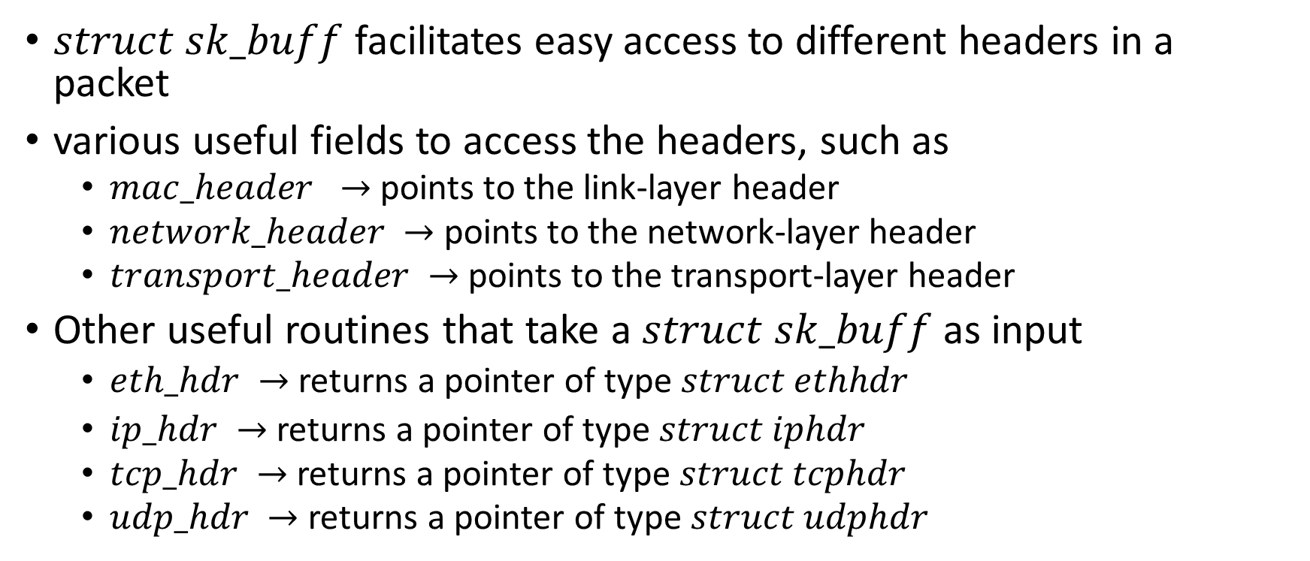
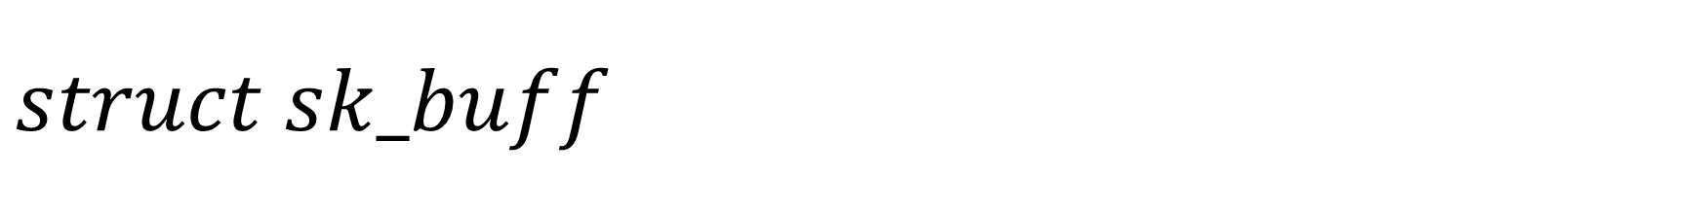

$$struct sk_buff$$
$struct sk_buff$facilitates easy access to different headers in a packet
various useful fields to access the headers, such as
$mac_header →$ points to the link-layer header
$network_header →$ points to the network-layer header
$transport_header →$ points to the transport-layer header
Other useful routines that take a $struct sk_buff$as input
$eth_hdr →$ returns a pointer of type $struct ethhdr$
$ip_hdr →$ returns a pointer of type $struct iphdr$
$tcp_hdr →$ returns a pointer of type $struct tcphdr$
$udp_hdr →$ returns a pointer of type $struct udphdr$

Slide 17

Useful routines
e1000_xmit_frame
takes an argument skb of type struct sk_buff
skb contains pointers to the various headers of the actual packet
updates an available descriptor in the transmit ring with the physical address of the packet
updates the TDT register, which allows the NIC to transmit the packet
e1000_clean_tx_irq
part of the interrupt handling for sending packets
Once the packet has been sent, the NIC sends an interrupt
Notes that the transmit descriptors can now be available for future transmits
May also free the buffers used for the sent packets.

Slide 18

User tools
server: A TCP server that receives data from the client
client: A TCP client that sends data to the server
Takes the IP address of the server as input
block: An application that instructs the driver to drop future packets to a given destination at a given rate
./block 172.32.89.10 20
Drop 10% packets with destination IP address = 172.32.89.10
The block application creates a UDP packet with a 5-byte payload.
The first four bytes are 172, 32, 89, 10, i.e., the IP address
The fifth byte is 20, i.e., the drop rate

Slide 19
Implementation
Monitor all ongoing packets
If the destination IP address is 100.100.100.100, record the IP address and drop rate from the payload
If the IP address matches the blocking IP address, drop packets with the given rate
Notice that after dropping a packet, you may need to release the buffer
Look at the interrupt handler for better clarity
Only one IP can be registered for dropping packets
./block 192.1.3.4 10
dropping 10% packets to 192.1.3.4
./block 123.43.24.52 1
192.1.3.4 is unblocked, i.e., no dropping
dropping 1% packets to 192.1.3.4
./block 123.43.24.52 5
Now dropping with 5% probability

Slide 20
Test you implementation
Start server on host using ./server
Drop 5% packets to the host
./block 192.3.5.6 5
Replace 192.3.5.6 with the IP address of your host.
Run client inside the VM
./client 192.3.5.6
Replace 192.3.5.6 with the IP address of your host.
If everything works perfectly, the TCP protocol should be able to handle the packet loss
The server will print “100001 packets received in ... milliseconds”

Slide 21
Monitor retransmission
Monitor retransmission by the TCP protocol before and after the invocation of the client
netstat -s | grep retransmitted

Slide 22
Block websites
Ping Google using
ping www.google.com
Block all packets to Google using ./block 172.34.54.65 100
Replace 172.34.54.65 with the actual IP address of Google
The ping www.google.com should not work now

Slide 23
Compiling and using the E1000 device driver
Compile the E1000 driver using
make M=drivers/net/ethernet/intel/e1000
Copy linux-6.16/drivers/net/ethernet/intel/e1000/e1000.ko to your VM
Reload the driver
sudo modprobe -r e1000 followed by sudo insmod e1000.ko

Slide 24
Submission
Implement everything in e1000_main.c
Report various statistics for different drop rates as mentioned in the assignment
Ask any queries related to the assignment after the class or during office hours

Slide 25
Cookies

Slide 26
Cookies
HTTP, being a stateless protocol, sometimes may not be the best thing for both users and the server hosting a website
For example, the server may want to show the relevant content based on their previous browsing sessions, e.g., YouTube, Amazon
How can we solve the problem?

Slide 27
Cookies
HTTP, being a stateless protocol, sometimes may not be the best thing for both users and the server hosting a website
For example, the server may want to show the relevant content based on their previous browsing sessions, e.g., YouTube, Amazon
How can we solve the problem?
Ask users to authenticate every time
Might not be the best policy. Users may not want to share their private information.

Slide 28
Cookies
HTTP is stateless
Each request is independent; the server doesn’t remember previous requests.
Problem: Personalized content (shopping history, recommendations) becomes difficult.
How can we solve the problem?
Ask user to authenticate every time
inconvenient for users.
Ask browsers to save an identifier suggested by the website
For subsequent visits, the browser sends the identifier along with the URL
The website looks into its database, finds metadata corresponding to the user, and customizes content
For example, if the user has searched for shoes previously, the website can suggest catchy shoes that might tempt the user to buy them.

Slide 29
Cookies
When a user visits a website, say amazon, the first time it creates an ID, say 1678, for the user and adds a line called Set-Cookie 1678 in its response
The browser saves amazon: 1678 in its cookie file. The cookie file may have other entries, such as ebay: 8734
For subsequent requests to amazon, the browser adds a line cookie: 1678 in its request
The amazon keeps a mapping ``1678 → user’’ data in its backend
If the user visits again after a week, the browser again sends cookie: 1678 in its request, allowing amazon to send a customized response to the user

Slide 30
Cookies

Slide 31


Cookies
Amazon server
ebay 8734
usual HTTP request msg
Amazon server
creates ID
1678 for user
cookie file
usual HTTP response
set-cookie: 1678
backend
database
create
entry
ebay 8734
amazon 1678
usual HTTP request msg
cookie: 1678
cookie-
specific
action
access
usual HTTP response msg
one week later:
access
ebay 8734
amazon 1678
usual HTTP request msg
cookie: 1678
cookie-
specific
action
usual HTTP response msg
time
Copyright © 2010-2025 J.F. Kurose, K.W. Ross

Slide 32
Cookies
Cookies can also be used for authentication
When first-time users log in to a website, the server creates a cookie for the user
For subsequent visits, users don’t need to log in again; instead, the server can authenticate the user based on the cookie provided by the browser

Slide 33
Cookies
Issues?

Slide 34
Cookies
Cookies are controversial because they can invade a user’s privacy.
The Digital Personal Data Protection (DPDP) Act in India prevents websites from collecting personal data without the user’s explicit consent.

Slide 35
Performance
Suppose a popular website is hosted in the US, e.g., Netflix
It gets a lot of traffic from all over the world
In addition to the website servers, due to the high demand across the globe, gateways all over the world may get overloaded
How can we reduce the load on the website and the intermediate gateways?

Slide 36
Web caching

Slide 37
Web caching
A web cache (proxy server) is used as a cache for the original server
Each request is forwarded to a web cache
If a local copy is present on the web cache, it is served to the client
Otherwise, the web cache obtains a copy from the server, saves it in its local storage, and sends it back to the client

Slide 38

Web caching
Web
cache
HTTP request
HTTP request
client
HTTP response
HTTP response
origin
server
HTTP request
HTTP response
client
Copyright © 2010-2025 J.F. Kurose, K.W. Ross

Slide 39
Web caching
There can be more than one web cache
Web caches are placed strategically to reduce the load on gateways in the network core
A client’s requests are forwarded to the nearest web cache

Slide 40

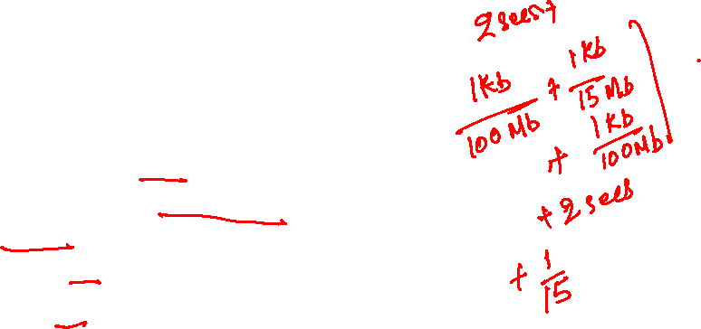
Example
Machines in the institutional network are clients
Clients connected to gateway B via 100 Mbps links
Gateway B to the public internet using a 15 Mbps link
Servers are connected to A using a 100 Mbps link
Average object size = 1 Mb
Average request rate = 1 request/second
RTT = 2 seconds
Request size: 1 Kb
Packet size: 1 Kb
How long will it take for C to receive a response from D
origin
servers
D
public
Internet
A
15 Mbps
B
institutional
network
100 Mbps
100 Mbps
C
Copyright © 2010-2025 J.F. Kurose, K.W. Ross

Slide 41
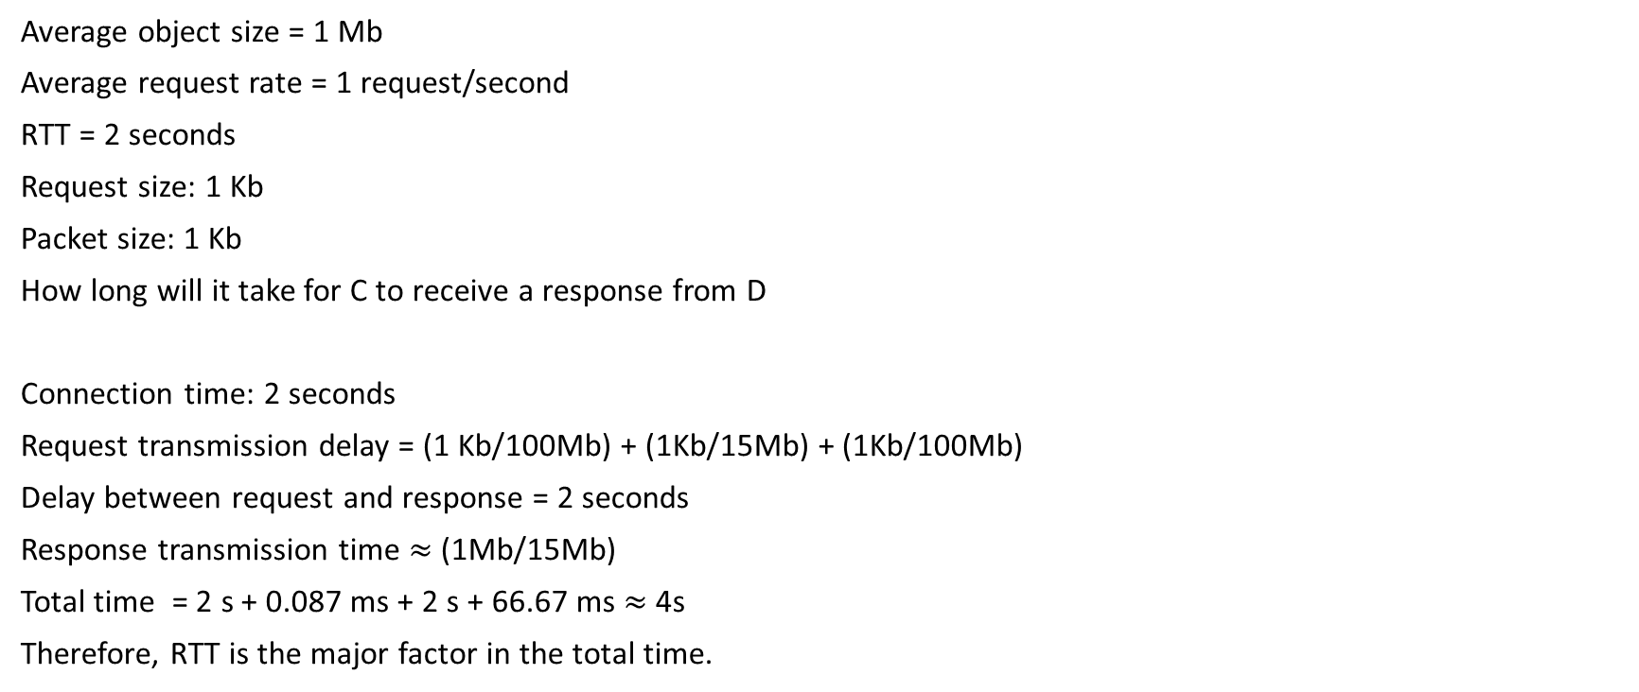
Example
Average object size = 1 Mb
Average request rate = 1 request/second
RTT = 2 seconds
Request size: 1 Kb
Packet size: 1 Kb
How long will it take for C to receive a response from D
Connection time: 2 seconds
Request transmission delay = (1 Kb/100Mb) + (1Kb/15Mb) + (1Kb/100Mb)
Delay between request and response = 2 seconds
Response transmission time $≈$ (1Mb/15Mb)
Total time = 2 s + 0.087 ms + 2 s + 66.67 ms $≈$ 4s
Therefore, RTT is the major factor in the total time.
origin
servers
D
public
Internet
A
15 Mbps
B
institutional
network
100 Mbps
100 Mbps
C
Copyright © 2010-2025 J.F. Kurose, K.W. Ross

Slide 42
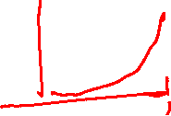
Example
Let’s say the average request rate increased to 15 requests / second
Average object size = 1 Mb
Average request rate = 15 requests / second
Request size: 1 Kb
Packet size: 1 Kb
Does the RTT remain the same?
origin
servers
D
public
Internet
A
15 Mbps
B
institutional
network
100 Mbps
100 Mbps
C
Copyright © 2010-2025 J.F. Kurose, K.W. Ross

Slide 43
Example
Let’s say the average request rate increased to 15 requests / second
Average object size = 1 Mb
Average request rate = 15 requests / second
Request size: 1 Kb
Packet size: 1 Kb
Does the RTT remain the same?
No, the traffic intensity at router A during the return path is: 1
As the traffic intensity reaches one, the queuing delay rises sharply
RRT could be of the order of minutes
How can we fix this problem?
origin
servers
D
public
Internet
A
15 Mbps
B
institutional
network
100 Mbps
100 Mbps
C
Copyright © 2010-2025 J.F. Kurose, K.W. Ross

Slide 44
Example
Let’s say the average request rate increased to 15 requests / second
Average object size = 1 Mb
Average request rate = 15 requests / second
Request size: 1 Kb
Packet size: 1 Kb
Does the RTT remain the same?
No, the traffic intensity at router A during the return path is: 1
As the traffic intensity reaches one, the queuing delay rises sharply
RRT could be of the order of minutes
How can we fix this problem?
Upgrade the network link between A and B to 100 Mbps
origin
servers
D
public
Internet
A
100 Mbps
B
institutional
network
100 Mbps
100 Mbps
C
Copyright © 2010-2025 J.F. Kurose, K.W. Ross

Slide 45
Example
Let’s say the average request rate increased to 15 requests / second
Average object size = 1 Mb
Average request rate = 15 requests / second
Request size: 1 Kb
Packet size: 1 Kb
After upgrading the network link between A and B to 100 Mbps
Will the RTT still increase after this upgrade?
origin
servers
D
public
Internet
A
100 Mbps
B
institutional
network
100 Mbps
100 Mbps
C
Copyright © 2010-2025 J.F. Kurose, K.W. Ross

Slide 46
Example
Let’s say the average request rate increased to 15 requests / second
Average object size = 1 Mb
Average request rate = 15 requests / second
Request size: 1 Kb
Packet size: 1 Kb
After upgrading the network link between A and B to 100 Mbps
Will the RTT still increase after this upgrade?
No, the traffic intensity at A is 0.15, which is low.
Upgrading the bandwidth of links in the network core could be very expensive.
Any other option?
origin
servers
D
public
Internet
A
100 Mbps
B
institutional
network
100 Mbps
100 Mbps
C
Copyright © 2010-2025 J.F. Kurose, K.W. Ross

Slide 47

Example
Let’s say the average request rate increased to 15 requests / second
Average object size = 1 Mb
Average request rate = 15 requests / second
Request size: 1 Kb
Packet size: 1 Kb
Upgrading the bandwidth of links in the network core could be very expensive.
Any other option?
Install a web cache in the institutional network
If the Hit rate of the web cache is 40%.
Will the RRT increase?
Traffic intensity at $A →B$
Traffic intensity at $B →C$
origin
servers
D
public
Internet
A
15 Mbps
B
institutional
network
100 Mbps
1 Gbps LAN
100 Mbps
C
Copyright © 2010-2025 J.F. Kurose, K.W. Ross

Slide 48

Example
Let’s say the average request rate increased to 15 requests / second
Average object size = 1 Mb
Average request rate = 15 requests / second
Request size: 1 Kb
Packet size: 1 Kb
Upgrading the bandwidth of links in the network core could be very expensive.
Any other option?
Install a web cache in the institutional network
If the Hit rate of the web cache is 40%.
Will the RRT increase?
Traffic intensity at $A →B$ = 0.6
Traffic intensity at $B →C$ = 0.15 (assuming all traffic goes to C)
A traffic intensity of less than 0.8 typically corresponds to a small delay.
origin
servers
D
public
Internet
A
15 Mbps
B
institutional
network
100 Mbps
1 Gbps LAN
100 Mbps
C
Copyright © 2010-2025 J.F. Kurose, K.W. Ross

Slide 49
Web caches
Web caches play an important role in reducing end-to-end latency to your popular streaming website, such as YouTube and Netflix

Slide 50
Web caches
Problem with web caches

Slide 51
Web caches
Problem with web caches
The copy in the web cache could be stale

Slide 52

Conditional GET
An HTTP response message contains the Last-Modified field
It indicates the last time this page was modified
It also has a Cache-Control field that controls how long the webpage can be cached, without checking the server
e.g., max-age=2049, means that the webpage can be cached for 2049 seconds
HTTP/1.1 200 OK
Content-Type: text/html
ETag: "84238dfc8092e5d9c0dac8ef93371a07:1736799080.121134"
Last-Modified: Mon, 13 Jan 2025 20:11:20 GMT
Cache-Control: max-age=2049
Date: Sun, 17 Aug 2025 13:02:20 GMT
Content-Length: 1256

Slide 53
Conditional GET
client
server
HTTP request msg
If-modified-since: <date>
object
not
modified
before
<date>
HTTP response
HTTP/1.0
304 Not Modified
HTTP request msg
If-modified-since: <date>
object
modified
after
<date>
HTTP response
HTTP/1.0 200 OK
<data>
Copyright © 2010-2025 J.F. Kurose, K.W. Ross

Slide 54
Conditional GET
After the page has expired, the web cache issues a conditional GET request to the server
The conditional GET request contains the following line
If-Modified-since: Mon, 13 Jan 2025 20:11:20 GMT
(Notice, the timestamp is the same as the last modification timestamp in the cached response)
If the webpage was not modified, the server responds with:
HTTP/1.1 304 Not Modified
The actual object is not included in the response
However, the response may contain new Cache-Control instructions to extend the lifetime of the cached response

