Slide 2
Today’s topics
E-mail
Domain name system (DNS)

Slide 3
References
Chapter 2.3 and 2.4 from the Kurose and Ross book

Slide 4
Electronic mail (e-mail)

Slide 5

Electronic Mail (e-mail) in the Internet
Can we use HTTP to send and receive emails?
alice@gmail.com $→$ bob@yahoo.com

Slide 6
e-mail
user agents
outlook, gmail, etc.
mail servers
corresponding to every user agent, there is a mail server
A mail server is used to send/receive email to/from another mail server
Simple Mail Transfer Protocol (SMTP)
SMTP is used to push mail from a user agent to its mail server, or from one mail server to another mail server

Slide 7
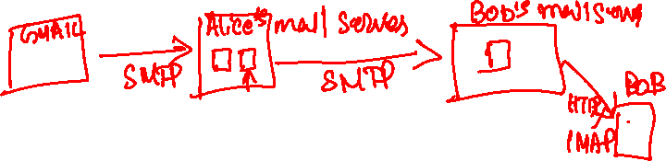
e-mail
When Alice sends a message to Bob, the following sequence of events takes place
Alice composes an email in her user agent, provides Bob’s email address, and instructs her agent to send the email
Mail is pushed from Alice’s agent to Alice’s mail server using SMTP, where it is queued
When the queue is processed, Alice’s mail server pushes the mail to Bob’s mail server using SMTP
Bob invokes his user agent, which pulls the Alice email from its mail server using HTTP/IMAP (Internet Mail Access Protocol)

Slide 8



e-mail
user
agent
e-mail access
protocol
user
agent
SMTP
SMTP
Using SMTP, user agents push messages to an SMTP server
Using HTTP/ IMAP, user agents pull messages from an HTTP/IMAP server
(e.g., IMAP, HTTP)
sender’s e-mail
server
receiver’s e-mail
server
Copyright © 2010-2025 J.F. Kurose, K.W. Ross

Slide 9
SMTP
SMTP protocol uses TCP connection at port 25 to transfer the message
If the server is down, SMTP retries after some time

Slide 10
SMTP
Why does Alice need to send an email through her mail server? Why not directly send to Bob’s mail server?

Slide 11
SMTP
Why does Alice need to send an email through her mail server? Why not directly send to Bob’s mail server?
Bob’s mail server may be down at that moment. Once the message is delivered to Alice’s mail server, it may retry after a while.

Slide 12
Demo
// run ./MailHog
telnet localhost 1025
EHLO localhost
MAIL FROM:<prof@iiitd.ac.in>
RCPT TO:<students@iiitd.ac.in>
DATA
Subject: Assignment due
From: prof@iiitd.ac.in
To: students@iiitd.ac.in
Dear Students,
The assignment is due in two hours.
Cheers
.
QUIT
View email at http://localhost:8025

Slide 13
SMTP
The popular mail servers require additional authentication steps, which are supported by an extended SMTP protocol

Slide 14
Domain name system (DNS)

Slide 15
Domain name system (DNS)
Hostnames such as www.google.com, etc., are mnemonics that help humans to easily remember the websites; however, they aren’t gateway-friendly
why?

Slide 16
Domain name system (DNS)
Hostnames such as www.google.com, etc., are mnemonics that help humans to easily remember the websites; however, they aren’t gateway-friendly
i.e., it’s hard for a gateway to parse variable-length hostnames and use them in the forwarding table
Instead, the core internet uses an IP address to recognise the end host
IP address is a 32-bit value, e.g., 132.168.71.41, where a decimal separates each byte. Note that the value of a byte is from 0 to 255.

Slide 17
DNS
How can we convert a hostname to the corresponding IP address?

Slide 18
DNS
How can we convert a hostname to the corresponding IP address?
A DNS server keeps a mapping from hostname to IP address
But how can we get the IP address of a DNS server

Slide 19
DNS
How can we convert a hostname to the corresponding IP address?
A DNS server keeps a mapping from hostname to IP address
But how can we get the IP address of a DNS server
The IP address of a DNS server could be fixed
What if the IP of the DNS server is not fixed? Is there a way to support dynamic addresses for the DNS server?

Slide 20
DNS server
In practice, a local DNS server exists in the private network, e.g., a small institutional network or a local ISP. If the IP of the local DNS server is not fixed, at least one machine that is connected to your device via a shared link knows the address of the local DNS server and can supply it using the link-layer protocols.
The local DNS server knows how to fetch the IP address of the target host from the actual DNS servers

Slide 21
DNS server
Can we have just one DNS server?

Slide 22
DNS server
Can we have just one DNS server?
Yes, but what if the server is down

Slide 23
DNS server
Can we have just one DNS server?
Yes, but what if the server is down
Multiple DNS servers to handle failure
Any other problem?

Slide 24
DNS server
Can we have just one DNS server?
Yes, but what if the server is down
Multiple DNS servers to handle failure
Any other problem?
Huge traffic on the DNS server
Somehow, we need to distribute the traffic

Slide 25
DNS server hierarchy
In practice, for better load balancing and availability, a hierarchy of DNS servers is present
Root DNS servers
provide the IP address of top-level domain servers
Top-level domain servers
com, org, net, edu, gov, etc
provide the IP address of intermediate or authoritative DNS servers
Intermediate DNS servers (optional)
iiid, iit, etc
provide the IP address of intermediate or authoritative DNS servers
Authoritative DNS servers
google, facebook, cse, ece, csam
provide the actual IP address

Slide 26
DNS server hierarchy
Root DNS Servers
Root
…
…
.com DNS servers
.ac.in DNS servers
.edu DNS servers
Top Level Domain
…
…
…
…
iiitd.ac.in
DNS servers
Intermediate
yahoo.com
DNS servers
amazon.com
DNS servers
cse.iiitd.ac.in
DNS servers
ece.iiitd.ac.in
DNS servers
nyu.edu
DNS servers
umass.edu
DNS servers
Authoritative
Copyright © 2010-2025 J.F. Kurose, K.W. Ross

Slide 27
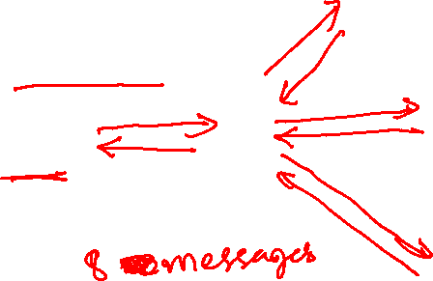
Recursive + iterated chain
root DNS server
requesting host at
engineering.nyu.edu
TLD DNS server
local DNS server
dns.nyu.edu
target host at
gaia.cs.umass.edu
authoritative DNS server
dns.cs.umass.edu
Copyright © 2010-2025 J.F. Kurose, K.W. Ross

Slide 28
Recursive + iterated chain
Steps in converting a hostname to an IP address
The requesting host sends a request to the local DNS server (the IP address of a local DNS server is either fixed or can be received by another server that is connected to the host machine via a direct link)
The local DNS server forwards the query to the root DNS server
The root DNS server replies to the local DNS server with the IP address of a TLD DNS server
The local DNS server sends a request to the TLD DNS server
The TLD DNS server replies to the local DNS server with the IP address of the authoritative DNS server (or intermediate DNS server)
The local DNS server sends a request to the authoritative DNS server, which returns the actual IP address of the target host to the local DNS server
Local DNS server replies to the requesting host with the IP address of the hostname
root DNS server
2
requesting host at
engineering.nyu.edu
3
TLD DNS server
1
4
8
5
local DNS server
dns.nyu.edu
target host at
gaia.cs.umass.edu
7
6
authoritative DNS server
dns.cs.umass.edu
Copyright © 2010-2025 J.F. Kurose, K.W. Ross

Slide 29
Recursive iterated chain
How many messages are exchanged in order to find the IP address of the target host?
root DNS server
2
requesting host at
engineering.nyu.edu
3
TLD DNS server
1
4
8
5
local DNS server
dns.nyu.edu
target host at
gaia.cs.umass.edu
7
6
authoritative DNS server
dns.cs.umass.edu
Copyright © 2010-2025 J.F. Kurose, K.W. Ross

Slide 30
Recursive iterated chain
How many messages are exchanged in order to find the IP address of the target host?
Eight messages
root DNS server
2
requesting host at
engineering.nyu.edu
3
TLD DNS server
1
4
8
5
local DNS server
dns.nyu.edu
target host at
gaia.cs.umass.edu
7
6
authoritative DNS server
dns.cs.umass.edu
Copyright © 2010-2025 J.F. Kurose, K.W. Ross

Slide 31
Recursive iterated chain
How many messages are exchanged in order to find the IP address of the target host?
Eight messages
Can it be more than eight for a different target host?
root DNS server
2
requesting host at
engineering.nyu.edu
3
TLD DNS server
1
4
8
5
local DNS server
dns.nyu.edu
target host at
gaia.cs.umass.edu
7
6
authoritative DNS server
dns.cs.umass.edu
Copyright © 2010-2025 J.F. Kurose, K.W. Ross

Slide 32
Recursive iterated chain
How many messages are exchanged in order to find the IP address of the target host?
Eight messages
Can it be more than eight for a different target host?
Yes, if there are intermediate DNS servers between the TLD DNS server and the authoritative DNS server
root DNS server
2
requesting host at
engineering.nyu.edu
3
TLD DNS server
1
4
8
5
local DNS server
dns.nyu.edu
target host at
gaia.cs.umass.edu
7
6
authoritative DNS server
dns.cs.umass.edu
Copyright © 2010-2025 J.F. Kurose, K.W. Ross

Slide 33
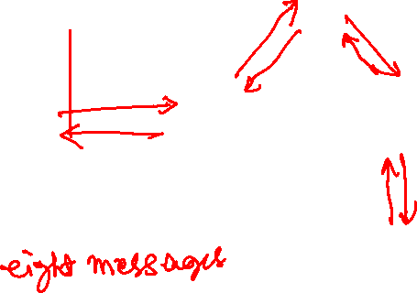
Recursive chain
root DNS server
requesting host at
engineering.nyu.edu
TLD DNS server
local DNS server
dns.nyu.edu
target host at
gaia.cs.umass.edu
authoritative DNS server
dns.cs.umass.edu
Copyright © 2010-2025 J.F. Kurose, K.W. Ross

Slide 34
Recursive chain
root DNS server
In the recursive query approach, once a server (root/ TLD/ intermediate) receives a request from the local DNS server, the server itself resolves the target host IP address by making a query to the next server (TLD/ intermediate/ authoritative), and replies back with the actual IP address of the target host.
How many message exchanges are required to find the IP address of the target host?
3
2
requesting host at
engineering.nyu.edu
7
6
1
TLD DNS server
8
local DNS server
dns.nyu.edu
5
4
target host at
gaia.cs.umass.edu
authoritative DNS server
dns.cs.umass.edu
Copyright © 2010-2025 J.F. Kurose, K.W. Ross

Slide 35
Recursive chain
root DNS server
In the recursive query approach, once a server (root/ TLD/ intermediate) receives a request from the local DNS server, the server itself resolves the target host IP address by making a query to the next server (TLD/ intermediate/ authoritative), and replies back with the actual IP address of the target host.
How many message exchanges are required to find the IP address of the target host?
Eight
3
2
requesting host at
engineering.nyu.edu
7
6
1
TLD DNS server
8
local DNS server
dns.nyu.edu
5
4
target host at
gaia.cs.umass.edu
authoritative DNS server
dns.cs.umass.edu
Copyright © 2010-2025 J.F. Kurose, K.W. Ross

Slide 36
Recursive + iterative vs. recursive
Which one is better recursive + iterative or pure recursive
Both require a similar number of message exchanges

Slide 37
Recursive + iterative vs. recursive
Which one is better recursive + iterative or pure recursive
Both require a similar number of message exchanges
Contrary to the local DNS server, the root/TLD/authoritative servers need to serve millions of requests. In pure recursive mode, they have to maintain additional states and do additional computation to keep track of requesting servers and replies from the DNS server one level down the tree to respond back to the requesting servers. Therefore, a simple stateless protocol like the one used in the iterative version is better.

Slide 38
Further optimization
Suggestions?

Slide 39
Further optimization
The local DNS server caches the responses from the other servers to improve performance

Slide 40

Caching
Local DNS server received the first query for www.example.com

Slide 41
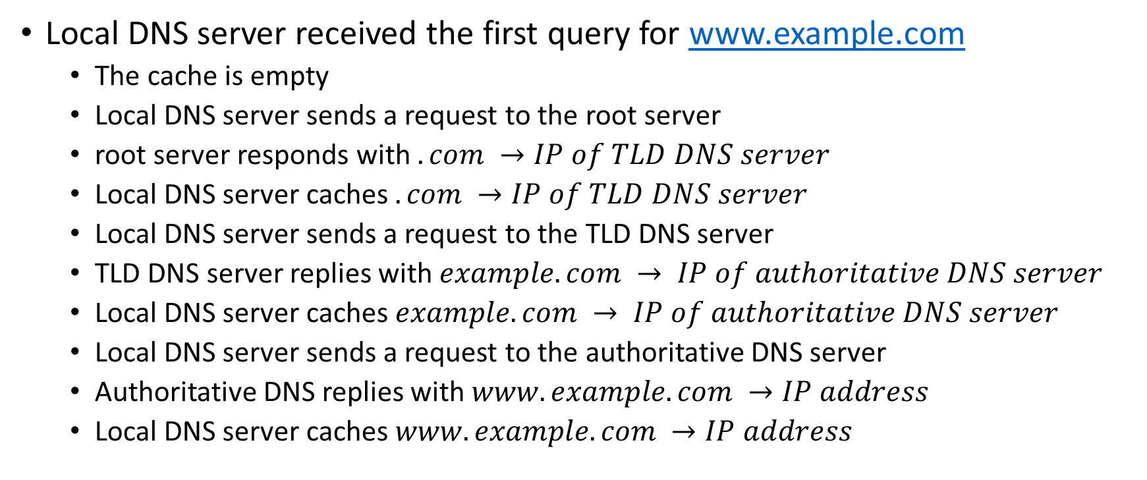
Caching
Local DNS server received the first query for www.example.com
The cache is empty
Local DNS server sends a request to the root server
root server responds with $.com →IP of TLD DNS server$
Local DNS server caches $.com →IP of TLD DNS server$
Local DNS server sends a request to the TLD DNS server
TLD DNS server replies with $example.com → IP of authoritative DNS server$
Local DNS server caches $example.com → IP of authoritative DNS server$
Local DNS server sends a request to the authoritative DNS server
Authoritative DNS replies with $www.example.com →IP address$
Local DNS server caches $www.example.com →IP address$

Slide 42
Caching
Local DNS server receives the next request for www.facebook.com

Slide 43
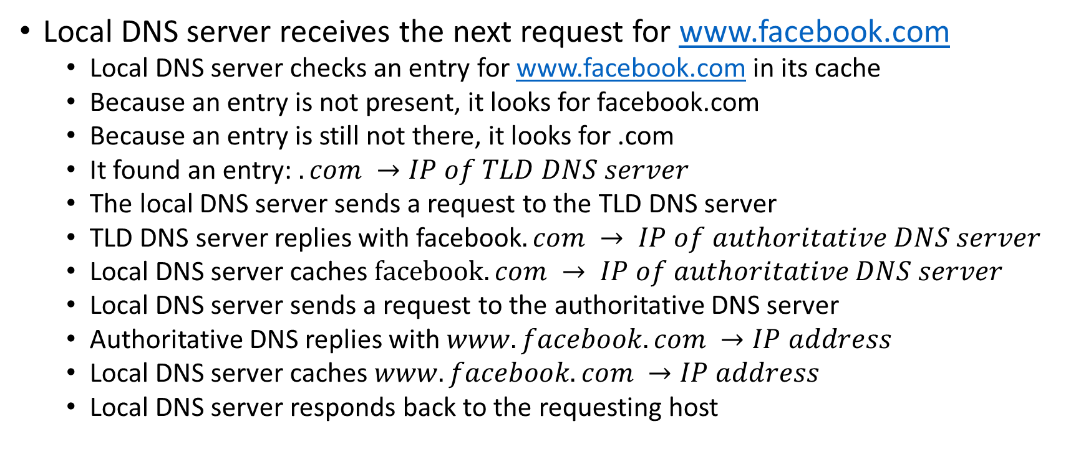
Caching
Local DNS server receives the next request for www.facebook.com
Local DNS server checks an entry for www.facebook.com in its cache
Because an entry is not present, it looks for facebook.com
Because an entry is still not there, it looks for .com
It found an entry: $.com →IP of TLD DNS server$
The local DNS server sends a request to the TLD DNS server
TLD DNS server replies with facebook$.com → IP of authoritative DNS server$
Local DNS server caches $facebook.com → IP of authoritative DNS server$
Local DNS server sends a request to the authoritative DNS server
Authoritative DNS replies with $www.facebook.com →IP address$
Local DNS server caches $www.facebook.com →IP address$
Local DNS server responds back to the requesting host

Slide 44
Caching
Local DNS server receives the next request for www.facebook.com

Slide 45

Caching
Local DNS server receives the next request for www.facebook.com
Local DNS server checks an entry for www.facebook.com in its cache
Because an entry is present, $www.facebook.com →IP address$, it directly responds back to the requesting host

Slide 46

Caching
Let’s say after a while $www.example.com →IP address$ is evicted from the cache
Local DNS server receives a query for www.example.com

Slide 47
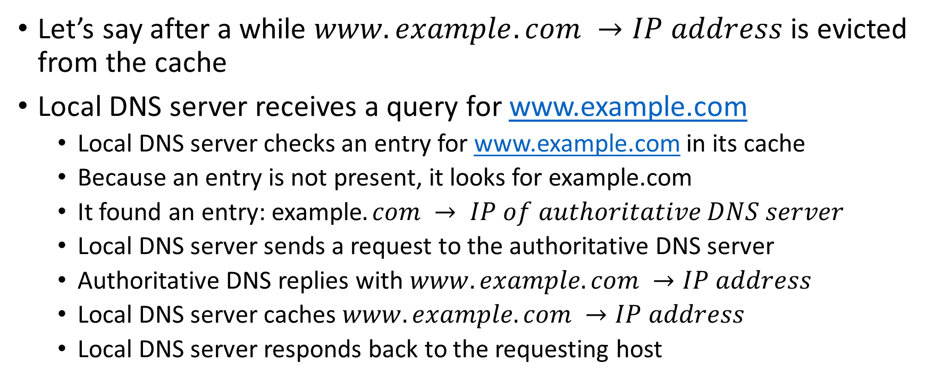
Caching
Let’s say after a while $www.example.com →IP address$ is evicted from the cache
Local DNS server receives a query for www.example.com
Local DNS server checks an entry for www.example.com in its cache
Because an entry is not present, it looks for example.com
It found an entry: example$.com → IP of authoritative DNS server$
Local DNS server sends a request to the authoritative DNS server
Authoritative DNS replies with $www.example.com →IP address$
Local DNS server caches $www.example.com →IP address$
Local DNS server responds back to the requesting host

Slide 48
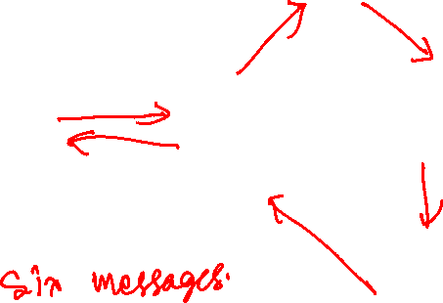
Recursive chain optimized
root DNS server
requesting host at
engineering.nyu.edu
TLD DNS server
local DNS server
dns.nyu.edu
target host at
gaia.cs.umass.edu
authoritative DNS server
dns.cs.umass.edu
Copyright © 2010-2025 J.F. Kurose, K.W. Ross

Slide 49
Recursive chain optimized
In this approach, the root server passes the address of the local DNS server to the TLD, which further passes it to the authoritative DNS server. The authoritative DNS server can directly reply to the local DNS server.
Interestingly, this reduces the number of message exchanges to six in contrast to the recursive + iterative or pure recursive approach.
Any problem with this approach?
root DNS server
2
3
requesting host at
engineering.nyu.edu
1
TLD DNS server
6
local DNS server
dns.nyu.edu
5
4
target host at
gaia.cs.umass.edu
authoritative DNS server
dns.cs.umass.edu
Copyright © 2010-2025 J.F. Kurose, K.W. Ross

Slide 50
Recursive chain optimized
In this approach, the root server passes the address of the local DNS server to the TLD, which further passes it to the authoritative DNS server. The authoritative DNS server can directly reply to the local DNS server.
Interestingly, this reduces the number of message exchanges to six in contrast to the recursive + iterative or pure recursive approach.
The problem with this approach is that it puts an additional burden on root/TLD/authoritative servers. Also, the responses from the root/TLD/intermediate servers are not cached on the local DNS server, which may cause additional message exchanges. For example, the DNS server rarely sends a request to the root DNS server in the original approach, because they are almost always cached.
root DNS server
2
3
requesting host at
engineering.nyu.edu
1
TLD DNS server
6
local DNS server
dns.nyu.edu
5
4
target host at
gaia.cs.umass.edu
authoritative DNS server
dns.cs.umass.edu
Copyright © 2010-2025 J.F. Kurose, K.W. Ross

Slide 51
Canonical hostname
The original (canonical) hostname can be very different from the hostname we usually remember, i.e., an alias hostname
e.g., www.yahoo.com is an alias hostname and relay1.west-coast.yahoo.com could be the canonical hostname
Notice that the canonical hostname could be complex because it allows developers to identify the location of the server handling the requests
There could be more than one canonical name for load balancing
e.g., relay1.east-coast.yahoo.com and relay1.west-coast.yahoo.com
Alias names are useful because they are more mnemonic than the canonical name
i.e., the user doesn’t need to remember relay1.west-coast.yahoo.com
DNS servers can return the canonical hostname in their reply

Slide 52
DNS resource record
A DNS reply contains a resource record
A resource record is of the following type
(Name, Value, Type, TTL)
TTL dictates how long the record can be cached.

Slide 53
DNS resource record
if type=A, name is a hostname, e.g., www.example.com, and the value is the IP address
if type=NS, name is a domain, e.g., example.com, and the value is the hostname of an authoritative DNS server that knows how to obtain the IP addresses of the host in that domain, e.g., dns1.example.com
A type=NS record is often accompanied by another type=A record that contains the IP address of the authoritative DNS server
if type=CNAME, name is an alias hostname and the value is the canonical hostname
if type=MX, then the name is a domain name and the value is the hostname of the mail server corresponding to the domain

Slide 54
DNS message format
Both request and reply have the same format
The question section contains the name and the type of the query
The answer contains the resource records for the name that was originally queried
The authority section contains the record of other authoritative servers
The additional section contains other useful information
e.g., the answer field contains the canonical name, and the additional section contains type A records for the canonical name
2 bytes
2 bytes
identification
flags
# questions
# answer RRs
# authority RRs
# additional RRs
questions (variable # of questions)
answers (variable # of RRs)
authority (variable # of RRs)
additional info (variable # of RRs)
Copyright © 2010-2025 J.F. Kurose, K.W. Ross

Slide 55
DNS example
root servers:
https://www.iana.org/domains/root/servers
a.root-servers.net 198.41.0.4
b.root-servers.net 170.247.170.2
etc.
dig @198.41.0.4 www.example.com
dig is a DNS lookup tool.

