Slide 2
Today’s topics
Domain name system (DNS)
Peer-to-peer (P2P) file distribution

Slide 3
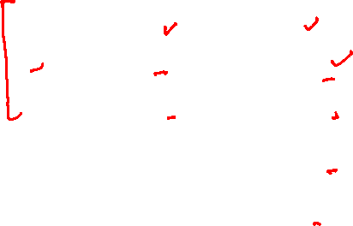
DNS message format
Both request and reply have the same format
The question section contains the name and the type of the query
The answer contains the resource records for the name that was originally queried
The authority section contains the record of other authoritative servers
The additional section contains other useful information
e.g., the answer field contains the canonical name and the additional section contains type A record for the canonical name
2 bytes
2 bytes
identification
flags
# questions
# answer RRs
# authority RRs
# additional RRs
questions (variable # of questions)
answers (variable # of RRs)
authority (variable # of RRs)
additional info (variable # of RRs)
Copyright © 2010-2025 J.F. Kurose, K.W. Ross

Slide 4
DNS example
root servers:
https://www.iana.org/domains/root/servers
a.root-servers.net 198.41.0.4
b.root-servers.net 170.247.170.2
etc.
dig @198.41.0.4 www.example.com
dig is a DNS lookup tool.

Slide 5
Inserting records
The records are inserted by registrars, e.g., www.godaddy.com
Registrar verifies the uniqueness of the domain name
enter the new domain name in its database
You may also provide the name and IP address of your authoritative DNS server; the registrar will add it to the corresponding TLD servers

Slide 6
Inserting records
Let’s you want to register a new website networkguy.com
You also created an authoritative DNS server dns1.networkguy.com with the IP address 121.23.43.54
What needs to be done in order to allow users to find the IP address of your website?

Slide 7
Inserting records
Let’s you want to register a new website networkguy.com
You also created an authoritative DNS server dns1.networkguy.com with the IP address 121.23.43.54
What needs to be done in order to allow users to find the IP address of your website?
.com TLD servers must have an entry for your authoritative DNS server

Slide 8
Inserting records
Let’s you want to register a new website networkguy.com
You also created an authoritative DNS server dns1.networkguy.com with the IP address 121.23.43.54
The registrar will add the following entries to the .com TLD servers
(networkguy.com, dns1.networkguy.com, NS)
(dns1.networkguy.com, 121.23.43.54, A)
When a local DNS server tries to find the IP address of www.networkguy.com it will receive the following response from the TLD server
(networkguy.com, dns1.networkguy.com, NS)
(dns1.networkguy.com, 121.23.43.54, A)
Afterward, the local DNS server will send a query to 121.23.43.54 to get the address of www.networkguy.com

Slide 9
DNS vulnerabilities
DNS spoofing
Can you guess what it might be?

Slide 10
DNS vulnerabilities
DNS spoofing
An attacker sends a lot of requests to the DNS server to keep it busy
Before the DNS server could reply to the victim, the attacker sends a fake response to the requesting host, impersonating itself as the DNS server
The victim fetches the attacker’s chosen IP from the response and starts talking to the wrong website, which may steal sensitive information from the user
We’ll discuss later how these attacks can be prevented

Slide 11
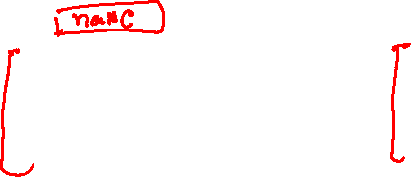
DNS homework
// DNS header
struct dns_header {
__be16 id;
__be16 flags;
__be16 num_ques; // # questions
__be16 num_ans; // # answer RRs
__be16 num_auth; // # authority RRs
__be16 num_add; // # additional RRs
};
2 bytes
2 bytes
identification
flags
# questions
# answer RRs
# authority RRs
# additional RRs
questions (variable # of questions)
answers (variable # of RRs)
struct dns_rr {
__be16 type;
__be16 class;
__be32 ttl;
__be16 rlen;
unsigned char rdata[];
};
struct dns_q {
__be16 type;
__be16 class;
};
authority (variable # of RRs)
additional info (variable # of RRs)
Copyright © 2010-2025 J.F. Kurose, K.W. Ross

Slide 12
DNS homework
The port number of a DNS server is 53
If the source/destination port address in a UDP packet is 53, it means that it could be a DNS request/response message
The question section starts just after the DNS header

Slide 13
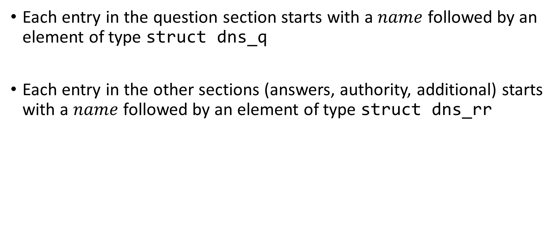
DNS homework
Each entry in the question section starts with a $name$ followed by an element of type struct dns_q
Each entry in the other sections (answers, authority, additional) starts with a $name$ followed by an element of type struct dns_rr

Slide 14
Compressing names
dig @198.41.0.4 www.example.com

Slide 15


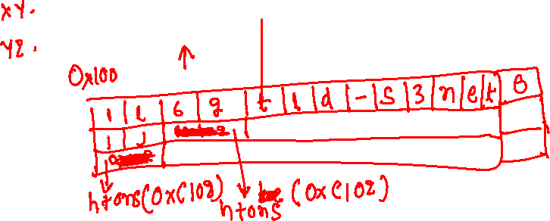
Storing $name$
The $name$ is stored in a compressed format
Let’s say there are three names in a DNS record:
l.gtld-s.net.
j.gtld-s.net.
gtld-s.net.

Slide 16
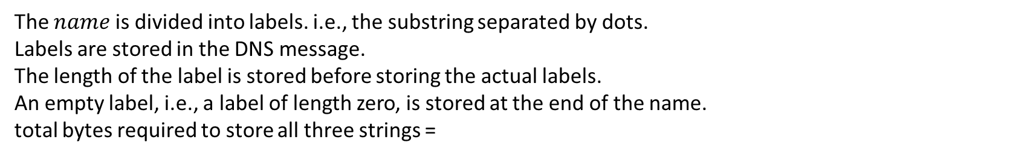
Storing name
Without compression
l.gtld-s.net.
j.gtld-s.net.
gtld-s.net.
1 | l | 6 | g | t | l | d | - | s | 3 | n | e | t | 0
1 | j | 6 | g | t | l | d | - | s | 3 | n | e | t | 0
6 | g | t | l | d | - | s | 3 | n | e | t | 0
The $name$ is divided into labels. i.e., the substring separated by dots.
Labels are stored in the DNS message.
The length of the label is stored before storing the actual labels.
An empty label, i.e., a label of length zero, is stored at the end of the name.
total bytes required to store all three strings =

Slide 17
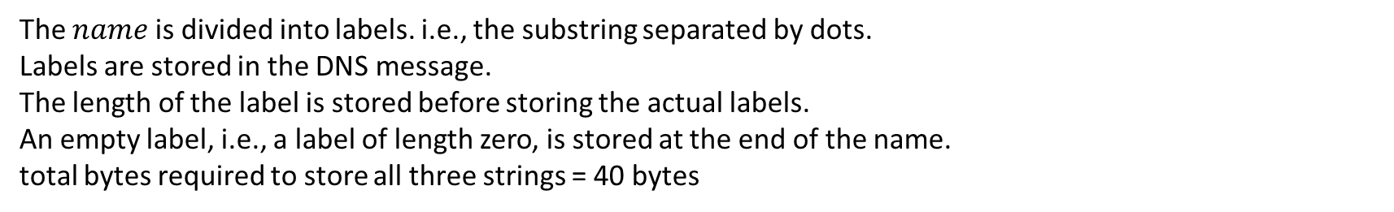
Storing name
Without compression
l.gtld-s.net.
j.gtld-s.net.
gtld-s.net.
1 | l | 6 | g | t | l | d | - | s | 3 | n | e | t | 0
1 | j | 6 | g | t | l | d | - | s | 3 | n | e | t | 0
6 | g | t | l | d | - | s | 3 | n | e | t | 0
The $name$ is divided into labels. i.e., the substring separated by dots.
Labels are stored in the DNS message.
The length of the label is stored before storing the actual labels.
An empty label, i.e., a label of length zero, is stored at the end of the name.
total bytes required to store all three strings = 40 bytes

Slide 18
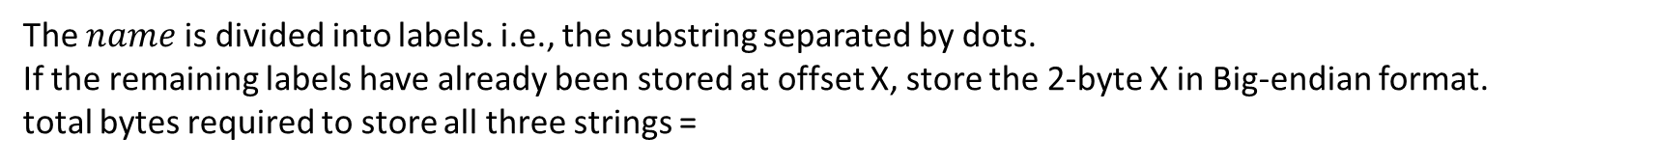
Storing name
Start offset of the first name w.r.t. the starting address of the DNS message is 0x10
l.gtld-s.net.
j.gtld-s.net.
gtld-s.net.
1 | l | 6 | g | t | l | d | - | s | 3 | n | e | t | 0
1 | j
htons(0x12)
htons(0x12)
The $name$ is divided into labels. i.e., the substring separated by dots.
If the remaining labels have already been stored at offset X, store the 2-byte X in Big-endian format.
total bytes required to store all three strings =

Slide 19
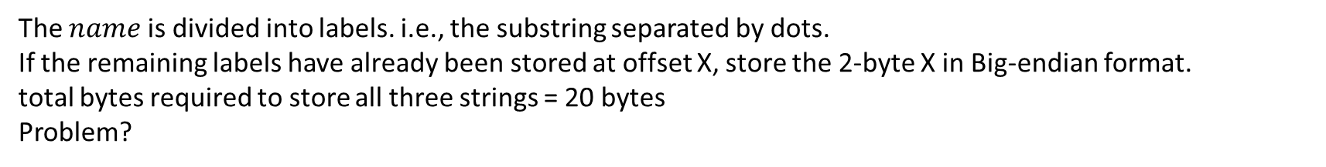
Storing name
Start offset of the first name w.r.t. the starting address of the DNS message is 0x10
l.gtld-s.net.
j.gtld-s.net.
gtld-s.net.
1 | l | 6 | g | t | l | d | - | s | 3 | n | e | t | 0
1 | j
htons(0x12)
htons(0x12)
The $name$ is divided into labels. i.e., the substring separated by dots.
If the remaining labels have already been stored at offset X, store the 2-byte X in Big-endian format.
total bytes required to store all three strings = 20 bytes
Problem?

Slide 20
Storing name
How do we know if the first byte of a name corresponds to the length of a label or the offset of the string with respect to the starting address of the DNS record (i.e., the address of the DNS header)
Restrict the maximum length of a label to 63
Restrict the maximum offset to 14 bits
If the top two bits in the first two bytes are one, then the remaining 14 bits are offset; otherwise, the first byte is the length of the label stored in the next bytes
Why does this work?

Slide 21
Storing name
How do we know if the first byte of a name corresponds to the length of a label or the offset of the string with respect to the starting address of the DNS record (i.e., the address of the DNS header)
Restrict the maximum length of a label to 63
Restrict the maximum offset to 14 bits
If the top two bits in the first two bytes are one, then the remaining 14 bits are offset; otherwise, the first byte is the length of the label stored in the next bytes
Why does this work?
Because the maximum length of a label is 63, it can fit into 6 bits

Slide 22
Storing name
Start offset of the first name w.r.t. the starting address of the DNS message is 0x10
l.gtld-s.net.
j.gtld-s.net.
gtld-s.net.
1 | l | 6 | g | t | l | d | - | s | 3 | n | e | t | 0
1 | j
htons(0xc012)
htons(0xc012)
The name is divided into labels. i.e., the substring separated by dots.
If the remaining substring has already been stored at offset X, store 2-byte (X | 0xc000) in Big-endian format.
Total bytes required to store all three strings = 20 bytes

Slide 23
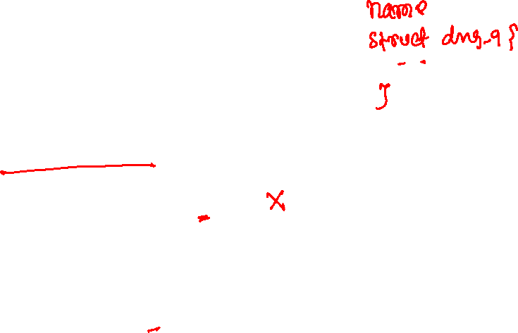
How to read name
// read offset
unsigned short off = ntohs(*((__be16*)buf));
if ((off >> 14) == 3) {
// string is stored at the offset, (off & 0x3FFF)
// record header starts at ((char*)buf) + 2
}
else {
// length of the next label is len = buf[0]
// if the len is zero, the next byte corresponds to the record header
// After reading len bytes corresponding to label, advance buf and goto line 1
}

Slide 24
rdata
The value of a resource record is stored in a variable-length byte array called rdata
The length of the rdata is rlen
Depending on the type, the length of the rdata varies
e.g., for a type-A record, it would be a 32-bit IP address
for type CNAME, it would be a name
etc.
In the homework, you need to skip the rdata to find the address of the next record

Slide 25
Peer-to-peer (P2P) file distribution

Slide 26
Peer-to-peer (P2P) file distribution
Unlike the client-server mode in the peer-to-peer model, each client plays the role of both client and server
i.e., a client downloads part of the file from some clients and uploads the already downloaded parts to some clients who don’t have them

Slide 27

File distribution
u_{s}: server upload capacity
d_{i}: peer i download capacity
file, size F
u₁
d₁
u₂
u_{s}
d₂
server
d_{i}
u_{N}
network (with abundant
bandwidth)
u_{i}
d_{N}
u_{i}: peer i upload capacity
Copyright © 2010-2025 J.F. Kurose, K.W. Ross

Slide 28
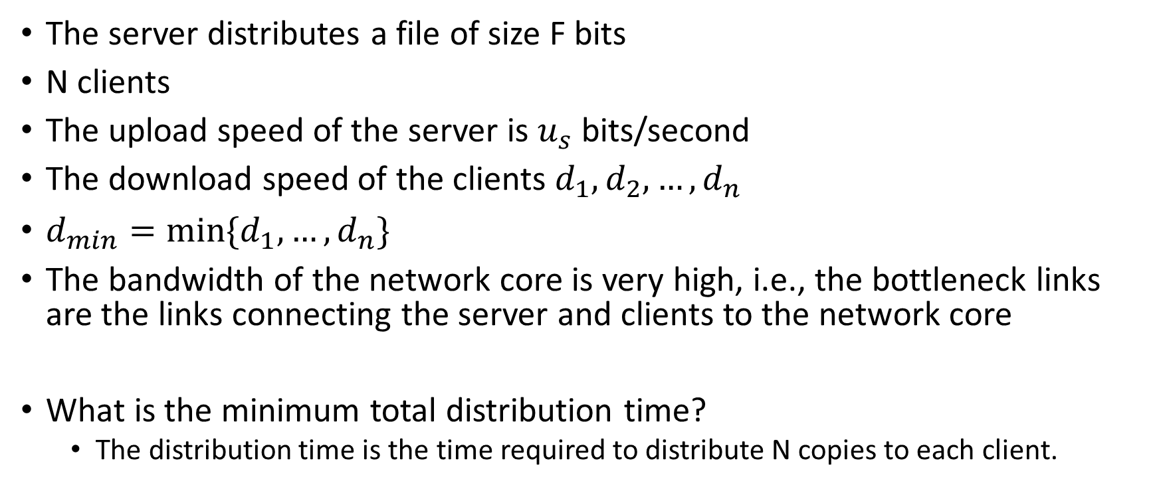
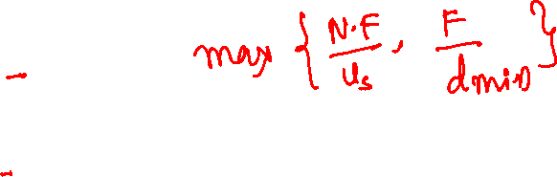
File distribution in client-server architecture
The server distributes a file of size F bits
N clients
The upload speed of the server is $u_{s}$ bits/second
The download speed of the clients $d_{1}, d_{2},…,d_{n}$
$d_{min}=\min{\{d_{1},…,d_{n}\}}$
The bandwidth of the network core is very high, i.e., the bottleneck links are the links connecting the server and clients to the network core
What is the minimum total distribution time?
The distribution time is the time required to distribute N copies to each client.

Slide 29
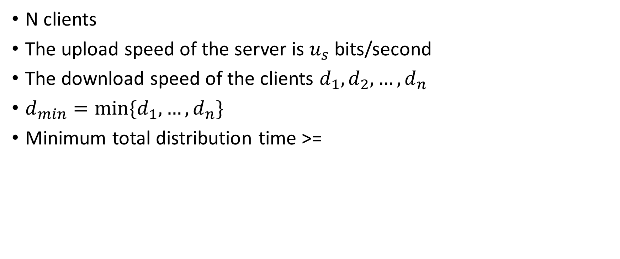
File distribution in client-server architecture
N clients
The upload speed of the server is $u_{s}$ bits/second
The download speed of the clients $d_{1}, d_{2},…,d_{n}$
$d_{min}=\min{\{d_{1},…,d_{n}\}}$
Minimum total distribution time >=

Slide 30
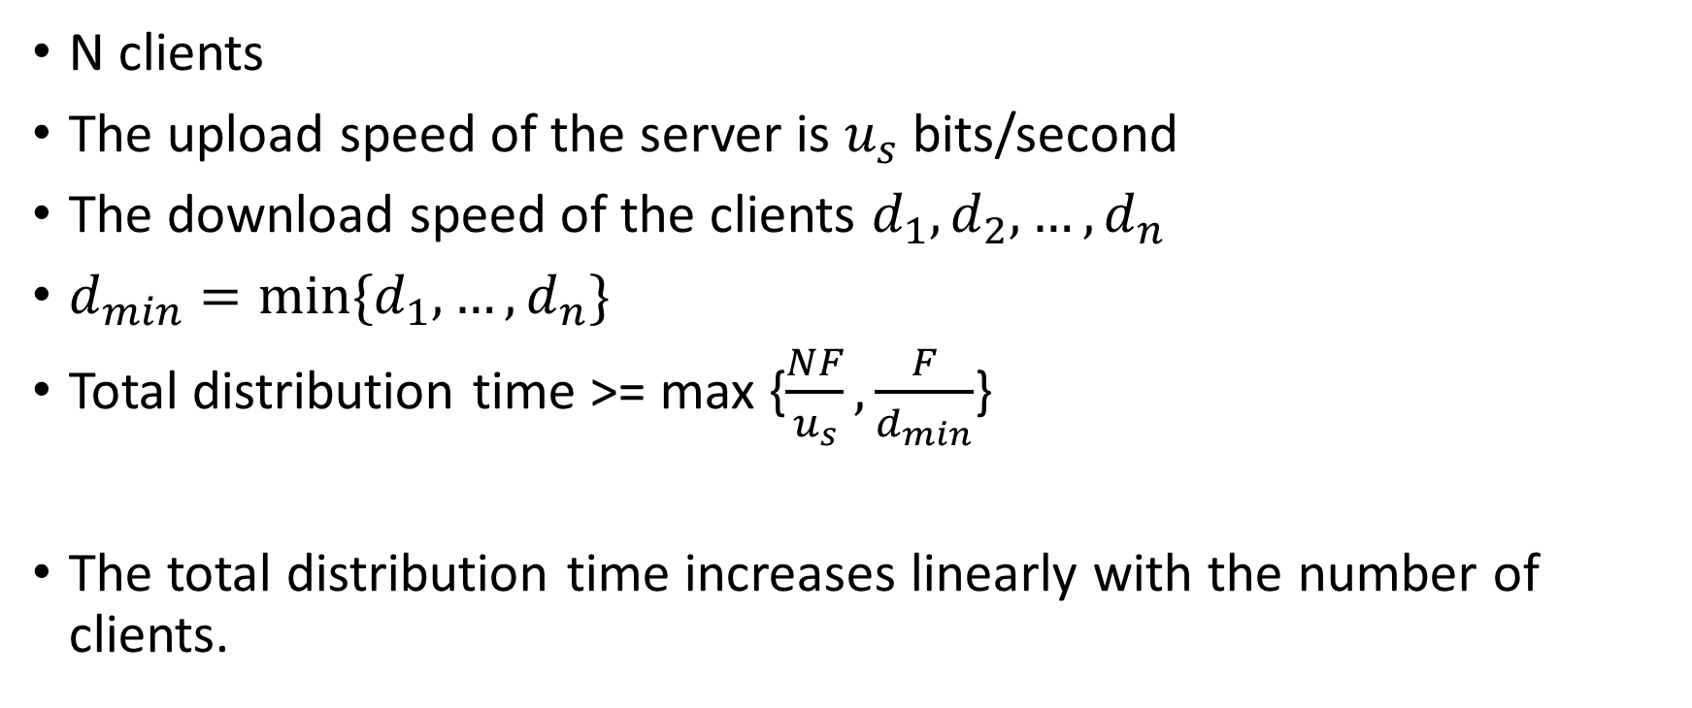
File distribution in client-server architecture
N clients
The upload speed of the server is $u_{s}$ bits/second
The download speed of the clients $d_{1}, d_{2},…,d_{n}$
$d_{min}=\min{\{d_{1},…,d_{n}\}}$
Total distribution time >= max {$\frac{NF}{u_{s}},\frac{F}{d_{min}}$}
The total distribution time increases linearly with the number of clients.

Slide 31
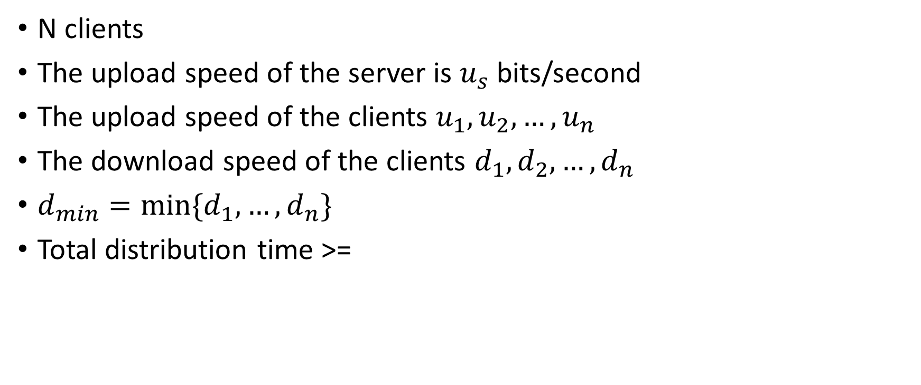
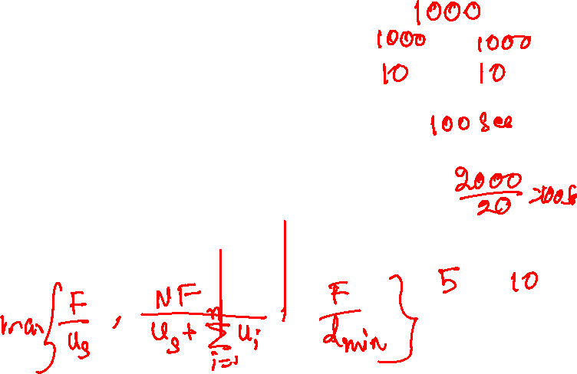
File distribution in P2P architecture
N clients
The upload speed of the server is $u_{s}$ bits/second
The upload speed of the clients $u_{1},u_{2},…,u_{n}$
The download speed of the clients $d_{1}, d_{2},…,d_{n}$
$d_{min}=\min{\{d_{1},…,d_{n}\}}$
Total distribution time >=

Slide 32
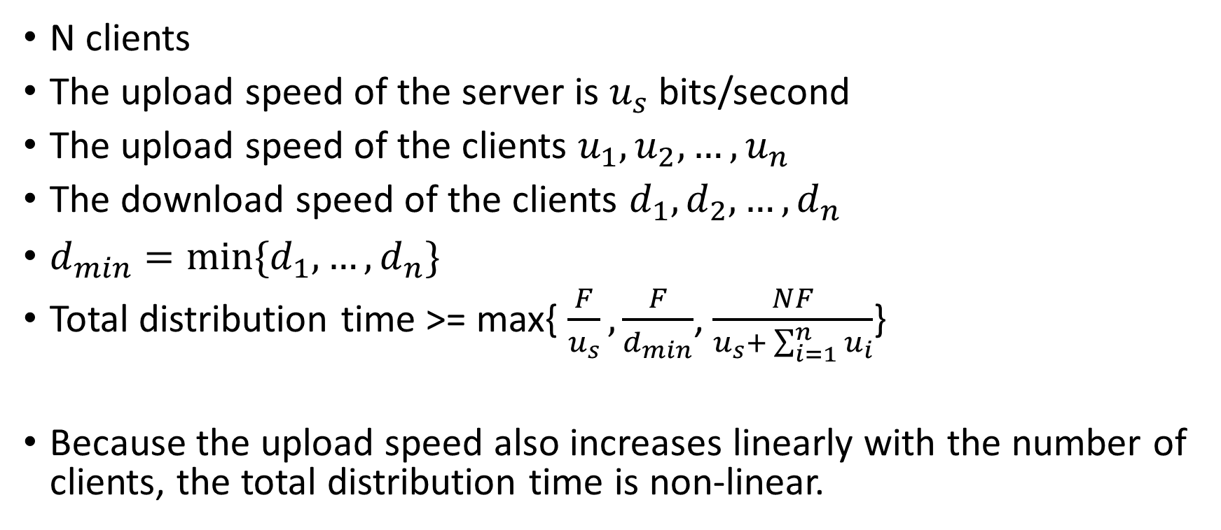
File distribution in P2P architecture
N clients
The upload speed of the server is $u_{s}$ bits/second
The upload speed of the clients $u_{1},u_{2},…,u_{n}$
The download speed of the clients $d_{1}, d_{2},…,d_{n}$
$d_{min}=\min{\{d_{1},…,d_{n}\}}$
Total distribution time >= max{ $\frac{F}{u_{s}},\frac{F}{d_{min}}$, $\frac{NF}{u_{s}+ \sum_{i=1}^{n}{u_{i}}}$}
Because the upload speed also increases linearly with the number of clients, the total distribution time is non-linear.

Slide 33
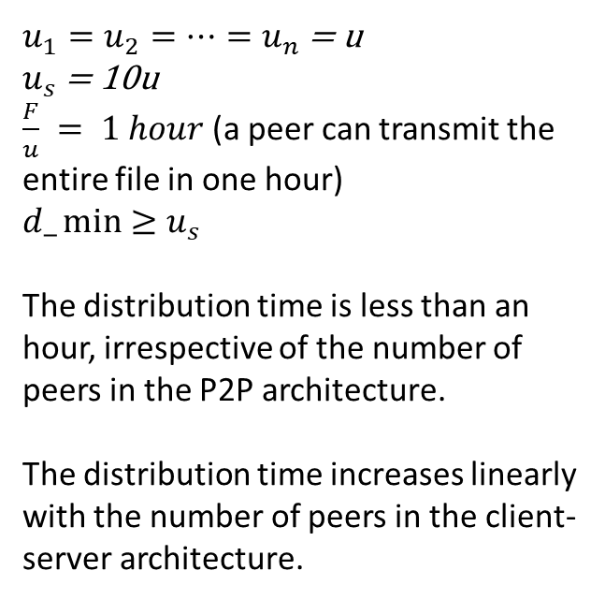

File distribution in P2P architecture
$u_{1}=u_{2}=…=u_{n}$ = u
$u_{s}$ = 10u
$\frac{F}{u} = 1 hour$ (a peer can transmit the entire file in one hour)
$$d_\min{≥u_{s}}$$
The distribution time is less than an hour, irrespective of the number of peers in the P2P architecture.
The distribution time increases linearly with the number of peers in the client-server architecture.
Copyright © 2010-2025 J.F. Kurose, K.W. Ross

Slide 34
BitTorrent
A collection of peers (called torrent) distribute a particular file
File is divided into equal size chunks, peers download chunks from each other
When a peer first joins a torrent it has no chunks. Once it accumulates some chunks it also uploads the downloaded chunks to other peers
A peer may leave or join at any time
A peer may choose to upload chunks even after acquiring the file

Slide 35
BitTorrent
How will you design something like BitTorrent?

Slide 36
BitTorrent
Each torrent has an infrastructure node called a tracker (kind of a server)
When a peer (say Alice) joins, she registers herself with the tracker
The tracker randomly selects a list of peers, say 50 peers, and sends it to Alice
Alice tries to establish a TCP connection with those peers. The successful connections, say 10, are called neighbours

Slide 37
BitTorrent
Alice obtains the list of chunks from the neighbors, and requests first for the rarest chunks (the chunks that are rarest among the neighbors)
The idea is to roughly equalize the number of copies of the chunks
For uploading data, Alice picks four users who are supplying her data at the highest rate, called tit-for-tat trading
called the unchoked peers
The download rates are recalculated every 30 seconds
She also picks one random neighbor, say Bob, after every 30 seconds, in addition to the prioritized peers
Bob is called optimistically unchoked
This scheme allows new peers to receive data
Bob can become an unchoked peer by sending data to Alice at a high rate
All other peers are choked, and they don’t receive anything from Alice

