Slide 2
Today’s topics
Peer-to-peer (P2P) file distribution
Transport layer
UDP

Slide 3
References
Read Chapter - 3.1, 3.2, 3.3 from the Kurose and Ross book

Slide 4
P2P
Another application of P2P distribution is a distributed hash table (DTH)
The key-value pairs are stored in a distributed manner
For example, DTH is used to find the list of peers that have a particular file
Eliminates the need for a centralized tracker
However, some publicly known peers or a DNS server are required to connect a new peer to a peer in the list of peers storing the distributed hash table

Slide 5
Transport layer
The transport layer allows a process on one host to communicate with a process on another host
How does the transport layer identify a process?

Slide 6
Transport layer
The transport layer allows a process on one host to communicate with a process on another host
How does the transport layer identify a process?
Using port number

Slide 7
What do we want from transport layer?
Guarantees message delivery
Delivers messages in the order in which they are sent
Delivers at most one copy of the message
Support arbitrarily large messages
Allow a receiver to apply flow control to the sender
Supports multiple applications, where each application can open one or more sockets

Slide 8
What transport layer can’t guarantee?

Slide 9
What transport layer can’t guarantee?
Timely delivery of messages

Slide 10
Limitations of the underlying network
Drop messages
Reorder messages
Deliver duplicate copies of a given message
Limit messages to some finite size
Deliver messages after an arbitrarily long delay

Slide 11
Existing transport layer protocols
User Datagram Protocol (UDP)
Transmission Control Protocol (TCP)

Slide 12
UDP
Allows multiple sockets on an end-host to share the network
Provide basic checks for corruption of the message
No other guarantees
Messages may arrive out of order
Messages can be dropped
Limitations on the length of a message
No flow control

Slide 13
UDP
Allowing multiple sockets?

Slide 14
UDP
Allowing multiple sockets?
Sender: multiplex data from multiple sockets. Store additional information about the sockets in the transport layer header.
Receiver: demultiplex data, i.e., use information in the header to deliver it to the correct socket

Slide 15
UDP
A UDP server running on port 100 received two messages from clients A and B. How will it know the identity of the client?

Slide 16
UDP
A UDP server running on port 100 received two messages from clients A and B. How will it know the identity of the client
The recvfrom API also returns the IP address and the port number of the client
What information UDP uses to demultiplex a message at the receiver end

Slide 17
UDP
A UDP server running on port 100 received two messages from clients A and B. How will it know the identity of the client
The recvfrom API also returns the IP address and the port number of the client
What information UDP uses to demultiplex a message at the receiver end
The destination port in the UDP header

Slide 18
UDP
How does a client know the port number of the server?

Slide 19
UDP
How does a client know the port number of the server?
Server uses a well-known port, e.g., port 80 for HTTP, port 53 for DNS, port 25 for SMTP, etc.
The mapping is available in the file /etc/services on Linux

Slide 20
Port implementation
Typically, a port is implemented using a queue
When a message arrives, the protocol (e.g., UDP) appends the message to the end of the queue
If the queue is full, the message is discarded
There is no mechanism in UDP to tell the server to slow down

Slide 21
recv implementation

Slide 22
recv implementation
recv pops a message from the front of the queue and returns
If the queue is empty, the process waits until a message becomes available

Slide 23
Checksum
UDP uses a checksum to identify corruption of bits during transmission
Checksum is optional in IPv4, but it’s mandatory in IPv6

Slide 24
Checksum computation
Chapter 2.4.1 from Peterson and Davie

Slide 25
Checksum computation
The buffer is divided into 16 bits chunks
If the buffer size is not a multiple of 16 bits a padding with zero is done to align it to 16 bits
The 16 bits chunks are added one by one
If a carry is generated after any addition, it’s added to the sum
The 1’s complement of the final 16-bit sum is the checksum

Slide 26

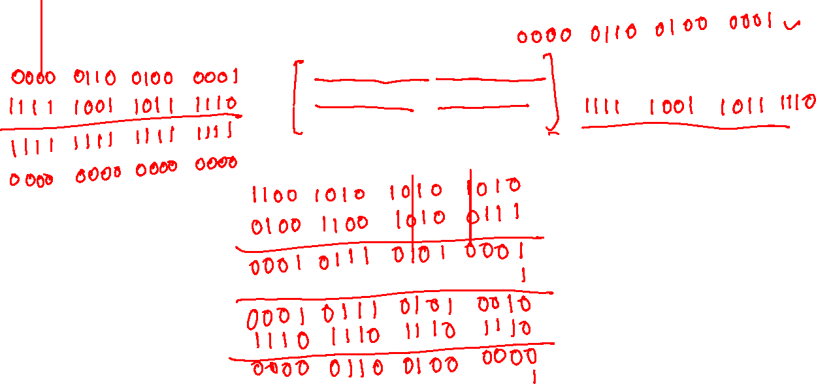
Checksum computation
$$1100 1010 1010 1010$$
$$0100 1100 1010 0111$$
$$1110 1110 1110 1110$$

Slide 27
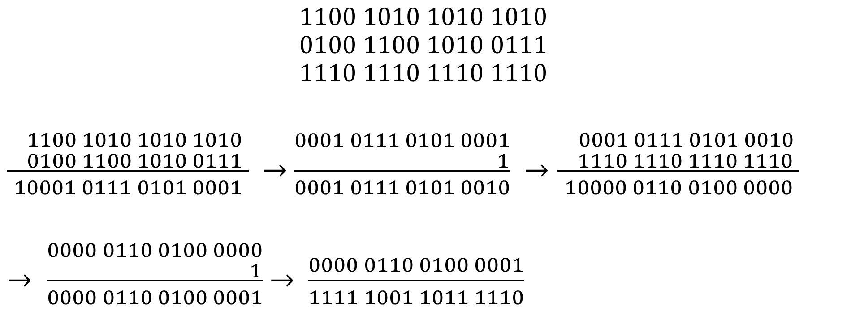
Checksum computation
$$1100 1010 1010 1010$$
$$0100 1100 1010 0111$$
$$1110 1110 1110 1110$$
$\frac{\begin{aligned} 1100 1010 1010 1010 \\ 0100 1100 1010 0111 \end{aligned}}{10001 0111 0101 0001}$ $→$ $\frac{\begin{aligned}0001 0111 0101 0001 \\ 1\end{aligned}}{0001 0111 0101 0010}$ $→\frac{\begin{aligned} 0001 0111 0101 0010 \\ 1110 1110 1110 1110 \end{aligned}}{10000 0110 0100 0000}$
$→ \frac{\begin{aligned}0000 0110 0100 0000 \\ 1\end{aligned}}{0000 0110 0100 0001}$ $→$ $\frac{0000 0110 0100 0001}{1111 1001 1011 1110}$
sum
add carry
sum
add carry
1’s complement

Slide 28

Checksum computation
// buf is the input buffer, which has already been padded with 0s to a 16-bit boundary
// count length of buffer measured in 16-bit units
unsigned short checksum(unsigned short *buf, int count) {
unsigned long sum = 0;
int i;
for (i = 0; i < count; i++) {
sum = sum + buf[i];
if ((sum & 0xFFFF) != sum) {
sum = (sum & 0xFFFF);
sum++;
}
}
sum = ~sum;
return (unsigned short)(sum & 0xFFFF);
}

Slide 29
Checksum verification
At the receiver end, the checksum is computed in a similar way, including the value of the checksum stored in the header
If the checksum matches the original, the final value must be zero

Slide 30

Checksum verification
$$1100 1010 1010 1010$$
$$0100 1100 1010 0111$$
$$1110 1110 1110 1110$$
$$1111 1001 1011 1110$$

Slide 31
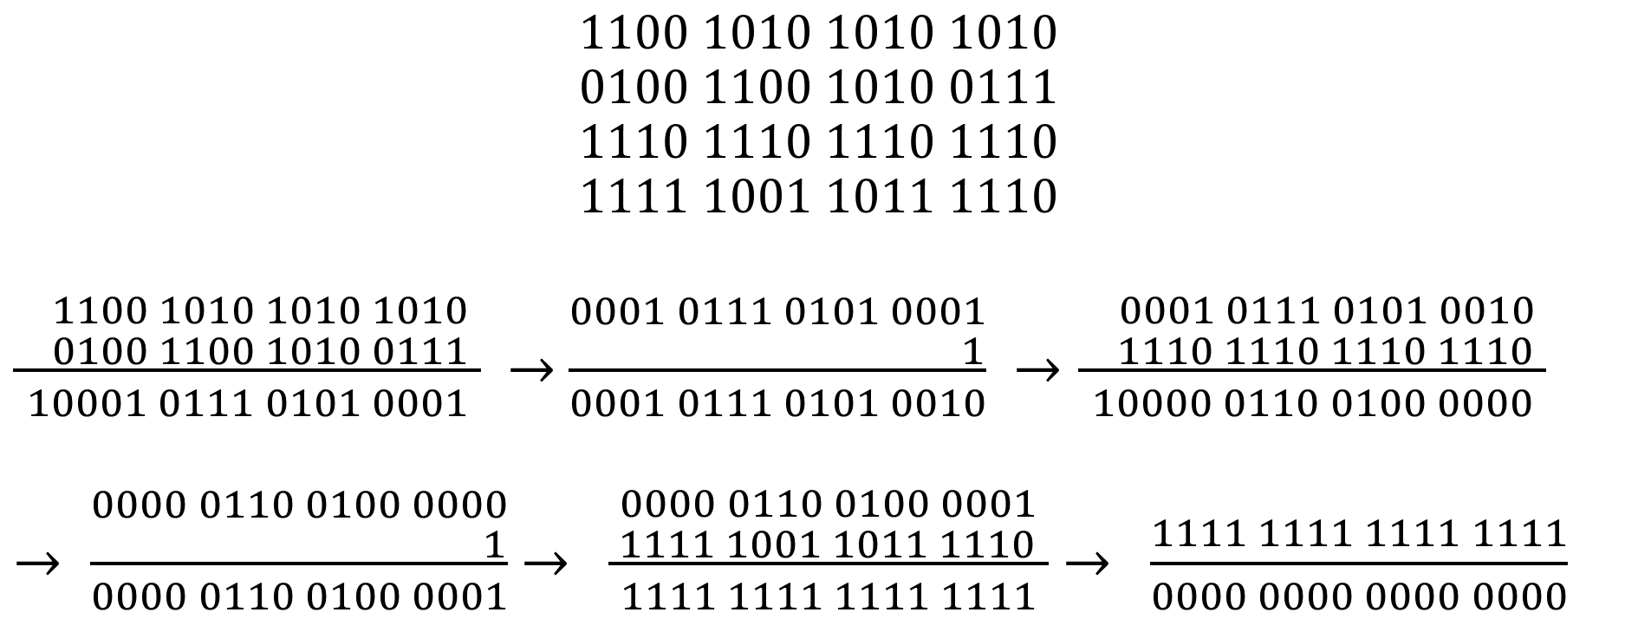
Checksum verification
$$1100 1010 1010 1010$$
$$0100 1100 1010 0111$$
$$1110 1110 1110 1110$$
$$1111 1001 1011 1110$$
$\frac{\begin{aligned} 1100 1010 1010 1010 \\ 0100 1100 1010 0111 \end{aligned}}{10001 0111 0101 0001}$ $→$ $\frac{\begin{aligned}0001 0111 0101 0001 \\ 1\end{aligned}}{0001 0111 0101 0010}$ $→\frac{\begin{aligned} 0001 0111 0101 0010 \\ 1110 1110 1110 1110 \end{aligned}}{10000 0110 0100 0000}$
$→ \frac{\begin{aligned}0000 0110 0100 0000 \\ 1\end{aligned}}{0000 0110 0100 0001}$ $→$ $\frac{\begin{aligned}0000 0110 0100 0001 \\ 1111 1001 1011 1110 \end{aligned}}{1111 1111 1111 1111}$ $→$ $\frac{1111 1111 1111 1111}{0000 0000 0000 0000}$
sum
add carry
sum
add carry
sum
1’s complement

Slide 32
UDP packet header
In addition to data, what additional information is required for the services provided by UDP, i.e., allowing multiple applications, data delivery to applications, and bit-corruption detection

Slide 33
UDP packet header
In addition to data, what additional information is required for the services provided by UDP, i.e., allowing multiple applications, data delivery to applications, and bit-corruption detection
Source port number
Destination port number
Length of the message
Checksum

Slide 34

UDP segment header
32 bits
source port #
dest port #
length
checksum
application
data
(payload)
length, in bytes of UDP segment, including header
data to/from application layer
UDP segment format
Copyright © 2010-2025 J.F. Kurose, K.W. Ross

Slide 35
UDP packet header
In addition to detecting corruption in the UDP segment, the UDP protocol also detects corruption in part of the IP header

Slide 36
UDP packet header
struct udphdr { __be16 source; // source port __be16 dest; // destination port __be16 len; // length of UDP header + data
__sum16 check; // checksum of UDP header, payload, part of IP header };
The size of a UDP header is 8.

Slide 37
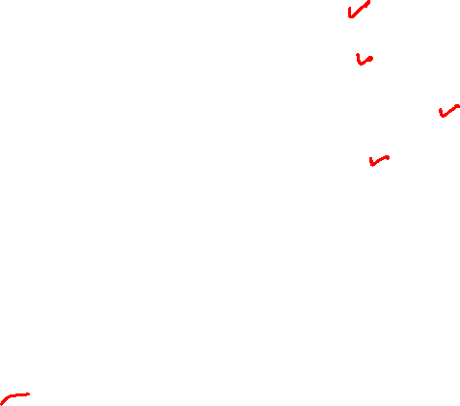
Pseudo header
struct pseudo_hdr {
__be32 src_ip_addr;
__be32 dst_ip_addr;
__u8 zero; // always zero
__u8 protocol; // 17
__be16 total_len; // size of UDP segment (UDP header + data)
// same as the UDP header len field
};

Slide 38
UDP checksum
The pseudo-header is prepended to the UDP segment (UDP header + data) for computing the checksum
The pseudo-header is not included in the actual packet. It’s used just for the checksum computation.
If the length (in bytes) of the data is not even, a byte with zero value is padded to the data during the checksum computation
The check field in the UDP header is set to zero during the computation of the checksum

Slide 39
Example
In Little-endian format
Source port: 0x64
Destination port: 0x1234
Length: 0x0B
Data: 0x10, 0x34, 0x51
Source IP address: 10.5.7.3 (in decimal format)
Destination IP address: 20.8.15.9 (in decimal format)
Protocol: 0x11
What would be the value of the checksum?

Slide 40
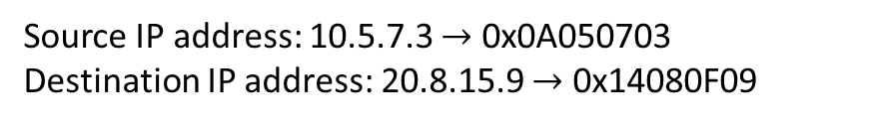
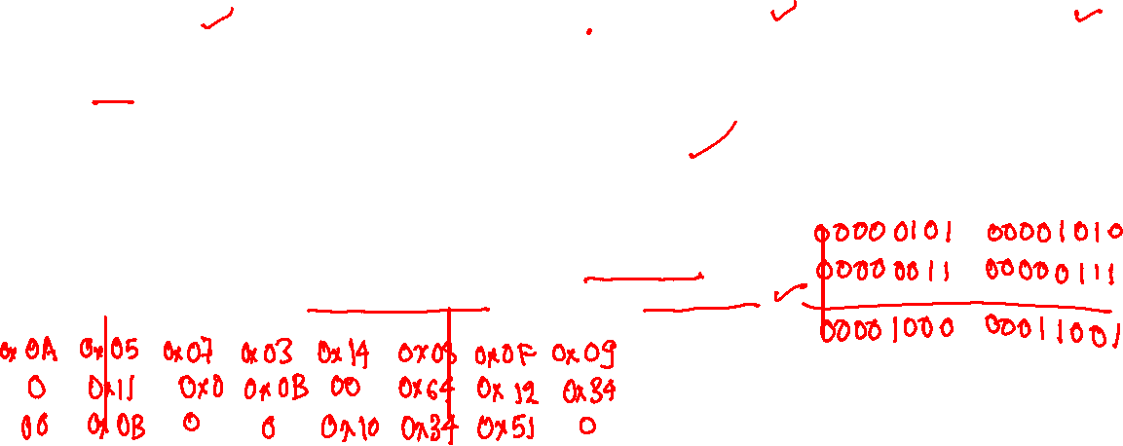
UDP packet
struct pseudo_hdr {
__be32 src_ip_addr;
__be32 dst_ip_addr;
__u8 zero; // always zero
__u8 protocol;
__be16 total_len;
};
struct udphdr { __be16 source; __be16 dest;
__be16 len;
__sum16 check;
};
In Little-endian format
Source port: 0x64
Destination port: 0x1234
Length: 0x0B
Data: 0x10, 0x34, 0x51
Source IP address: 10.5.7.3 (in decimal format)
Destination IP address: 20.8.15.9 (in decimal format)
Protocol: 0x11
Source IP address: 10.5.7.3 $→$ 0x0A050703
Destination IP address: 20.8.15.9 $→$ 0x14080F09

Slide 41
Checksum
0A | 05 | 07 | 03 | 0x14 | 08 | 0F | 09
00 | 0x11 | 00 | 0B | 00 | 0x64 | 0x12 | 0x34
00 | 0B | 00 | 00 | 0x10 | 0x34 | 0x51 | 00

Slide 42
Checksum
0A | 05 | 07 | 03 | 0x14 | 08 | 0F | 09
00 | 0x11 | 00 | 0B | 00 | 0x64 | 0x12 | 0x34
00 | 0B | 00 | 00 | 0x10 | 0x34 | 0x51 | 00

Slide 43
UDP packet
struct pseudo_hdr {
__be32 src_ip_addr;
__be32 dst_ip_addr;
__u8 zero; // always zero
__u8 protocol;
__be16 total_len;
};
struct udphdr { __be16 source; __be16 dest;
__be16 len;
__sum16 check;
};
In Little-endian format
Source port: 0x64
Destination port: 0x1234
Length: 0x0B
Data: 0x10, 0x34, 0x51
Source IP address: 10.5.7.3 (in decimal format)
Destination IP address: 20.8.15.9 (in decimal format)
Protocol: 0x11
Source IP address: 10.5.7.3 $→$ 0x0A050703
Destination IP address: 20.8.15.9 $→$ 0x14080F09
0A | 05 | 07 | 03 | 0x14 | 08 | 0F | 09
00 | 0x11 | 00 | 0B | 00 | 0x64 | 0x12 | 0x34
00 | 0B | 00 | 00 | 0x10 | 0x34 | 0x51 | 00

Slide 44
UDP packet
1101 1000 0100 0110
0000 0000 0000 0000
-------------------------------
1101 1000 0100 0110
0011 0100 0001 0000
-------------------------------
1 0000 1100 0101 0110
---------------------------------
0000 1100 0101 0110
1
---------------------------------
0000 1100 0101 0111
0000 0000 0101 0001
---------------------------------
0000 1100 1010 1000
---------------------------------
1’s complement
1111 0011 0101 0111
Final checksum:
0xF357
0A | 05 | 07 | 03 | 0x14 | 08 | 0F | 09
00 | 0x11 | 00 | 0B | 00 | 0x64 | 0x12 | 0x34
00 | 0B | 00 | 00 | 0x10 | 0x34 | 0x51 | 00
0000 0101 0000 1010
0000 0011 0000 0111
------------------------------
0000 1000 0001 0001
0000 1000 0001 0100
------------------------------
0001 0000 0010 0101
0000 1001 0000 1111
------------------------------
0001 1001 0011 0100
0001 0001 0000 0000
------------------------------
0010 1010 0011 0100
0010 1010 0011 0100
0000 1011 0000 0000
------------------------------
0011 0101 0011 0100
0110 0100 0000 0000
------------------------------
1001 1001 0011 0100
0011 0100 0001 0010
------------------------------
1100 1101 0100 0110
0000 1011 0000 0000
------------------------------
1101 1000 0100 0110

Slide 45
Assignment-2
Convert a UDP packet to an ICMP echo request in the send path of the E1000 driver
Convert an ICMP echo reply to a UDP packet in the receive path of the E1000 driver
ICMP echo request is used to test the reachability of an end host and to compute the round-trip time between two communicating hosts
The ping command uses ICMP echo request/reply

Slide 46
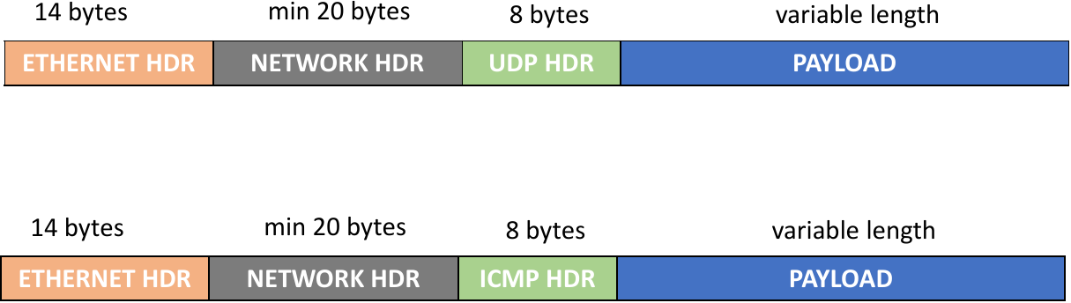
Internet Control Message Protocol (ICMP)
ICMP is a network layer protocol
It’s neither UDP nor TCP
ICMP packet looks very similar to the UDP packet

Slide 47

ICMP packet header
ICMP packet has an eight-byte header
The value of type is eight for ICMP echo request and zero for ICMP echo reply
The code is zero for both request and reply
id is set to a value that is used by the kernel to identify the target application for an ICMP echo reply
sequence is used by the application to correlate a reply with a request
checksum contains the checksum of the ICMP header and payload
struct icmphdr {
__u8 type;
__u8 code;
__sum16 checksum;
__be16 id;
__be16 sequence;
};

Slide 48
ICMP echo request/reply
The destination host ignores the value of the payload
The destination host simply copies the payload as it is in the ICMP echo reply message

Slide 49
udpping
udpping is an application that takes the IP address of the target host (say X) as input, creates a UDP packet with bytes of X as payload, similar to the assignment-1, and sends the UDP packet to a special IP address 100.100.100.100
In addition to the target IP address, the payload also contains a 4-byte magic number 0xDECAF, which helps the OS to identify the udpping application in the receive path

Slide 50
udpping
./udpping 192.1.23.98
192 | 1 | 23 | 98 | AF | EC | 0D | 00
UDP payload.
0xDECAF is stored in the host (Little-endian) order.

Slide 51
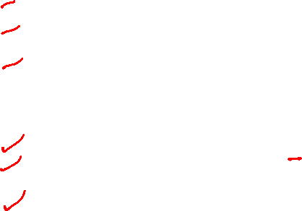
Send path
struct iphdr {
__u8 ihl:4; // length of header = ihl * 4
__u8 version:4; // 4-bit version
__u8 tos;
__be16 tot_len; // Entire packet size, header + data
__be16 id;
__be16 frag_off;
__u8 ttl; // Hop limit, decremented at each hop
__u8 protocol; // protocol ICMP=1, UDP=17
__sum16 check; // header checksum
__be32 saddr; // source IP address
__be32 daddr; // destination IP address
char options[]; // variable length
};
What changes are required in the IP header?

Slide 52
Send path
struct iphdr {
__u8 ihl:4; // length of header = ihl * 4
__u8 version:4; // 4-bit version
__u8 tos;
__be16 tot_len; // Entire packet size, header + data
__be16 id;
__be16 frag_off;
__u8 ttl; // Hop limit, decremented at each hop
__u8 protocol; // protocol ICMP=1, UDP=17
__sum16 check; // header checksum
__be32 saddr; // source IP address
__be32 daddr; // destination IP address
char options[]; // variable length
};
e1000_xmit_frame
IP header changes
Fetch the destination IP address from a UDP packet destined to 100.100.100.100
Change the destination IP address in the IP header
Change the protocol in the IP header
Update the checksum

Slide 53
Send path
struct icmphdr {
__u8 type;
__u8 code;
__sum16 checksum;
__be16 id;
__be16 sequence;
};
What will be the values of the ICMP header and the payload?

Slide 54
Send path
struct icmphdr {
__u8 type;
__u8 code;
__sum16 checksum;
__be16 id;
__be16 sequence;
};
e1000_xmit_frame
ICMP header and payload
Set type to eight and code to zero
Use a value for id and sequence
Store the source port number in the first four bytes of the payload, which will be needed during the receive
Instead of payload, you can also store the source port number in the id field of the ICMP header
Compute the checksum

Slide 55
NIC checksum computation
The Intel NIC supports fast checksum computation
Instead of computing the checksum itself, the driver can configure the NIC to compute the checksum in the UDP/IP header
What information is required to compute the checksum in the NIC?

Slide 56
NIC checksum computation
The Intel NIC supports fast checksum computation
Instead of computing the checksum itself, the driver can configure the NIC to compute the checksum in the UDP/IP header
NIC takes the start address, length of the buffer, and the offset at which the checksum needs to be stored as input
Since the checksum field and the buffer used for checksum are different for ICMP and UDP, the automatic computation will create inconsistencies unless you configure the device correctly
Better to compute the checksum yourself
Set skb→ip_summed to CHECKSUM_COMPLETE to disable the checksum computation in the NIC

Slide 57
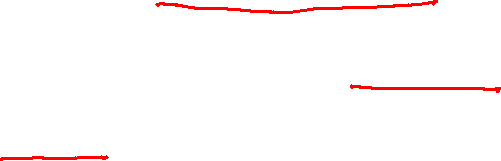
Receive path
The E1000 driver uses e1000_receive_skb to handle the packet to the network layer after receiving a packet
At this point, the various fields of the struct sk_buff might not have been initialized properly
However, skb->data points to the IP header (i.e., struct iphdr*)
Using the value of the header length, total length, and protocol in the IP header, you can compute the address of other headers and the payload

Slide 58

Receive path
How to discover the packets destined to udpping?
struct udphdr {
__be16 source; // source port
__be16 dest; // destination port
__be16 len; // length of UDP header + data
__sum16 check; // Checksum
};

Slide 59
Receive path
Discovering packets destined to udpping
Look for ICMP echo replies (using the protocol in the IP header and type in the ICMP header)
If the payload contains the magic number, it needs to be delivered to udpping
struct udphdr {
__be16 source; // source port
__be16 dest; // destination port
__be16 len; // length of UDP header + data
__sum16 check; // Checksum
};

Slide 60
Receive path
What would be the values in the UDP header?
struct udphdr {
__be16 source; // source port
__be16 dest; // destination port
__be16 len; // length of UDP header + data
__sum16 check; // Checksum
};

Slide 61
Receive path
UDP header
Fetch the destination port number from the payload or the id field in the ICMP header
Length can be computed using the information available in the IP header
Checksum?
struct udphdr {
__be16 source; // source port
__be16 dest; // destination port
__be16 len; // length of UDP header + data
__sum16 check; // Checksum
};

Slide 62

Receive path
struct udphdr {
__be16 source; // source port
__be16 dest; // destination port
__be16 len; // length of UDP header + data
__sum16 check; // Checksum
};
struct pseudo_header {
__be32 saddr; // source IP address
__be32 daddr; // destination IP address
__u8 zero; // always zero
__u8 protocol; // 17 for UDP
__be16 total_len; // same as len in udphdr
};
Checksum computation
For checksum computation, you need to prepend the pseudo IP header before the UDP packet
The pseudo IP header can be computed using the values in the IP header

Slide 63
Receive path
struct iphdr {
__u8 ihl:4; // length of header = ihl * 4
__u8 version:4; // 4-bit version
__u8 tos;
__be16 tot_len; // Entire packet size, header + data
__be16 id;
__be16 frag_off;
__u8 ttl; // Hop limit, decremented at each hop
__u8 protocol; // protocol ICMP=1, UDP=17
__sum16 check; // header checksum
__be32 saddr; // source IP address
__be32 daddr; // destination IP address
char options[]; // variable length
};
What changes are required in the IP header?

Slide 64
Receive path
struct iphdr {
__u8 ihl:4; // length of header = ihl * 4
__u8 version:4; // 4-bit version
__u8 tos;
__be16 tot_len; // Entire packet size, header + data
__be16 id;
__be16 frag_off;
__u8 ttl; // Hop limit, decremented at each hop
__u8 protocol; // protocol ICMP=1, UDP=17
__sum16 check; // header checksum
__be32 saddr; // source IP address
__be32 daddr; // destination IP address
char options[]; // variable length
};
IP header changes
You need to update the protocol field in the IP header
Recompute the checksum after this change

Slide 65
Source code
git clone https://github.com/Systems-IIITD/udpping
Run make in udpping to compile the applications
You can run udpping using:
./udpping 142.251.43.100
where 142.251.43.100 is the IP address of the destination host
Another application is cping
Run using: sudo ./cping 142.251.43.100
cping creates an ICMP packet and sends it to the destination host
You can use it for debugging

Slide 66
Debugging
I suggest working on two machines, A and B
Suppose A is the system on which you want to run udpping
Monitor ICMP messages using Wireshark on B
Set a filter in Wireshark to display only ICMP packets
Ping B from A using ping or cping
You should be able to see ICMP echo requests and replies in B’s Wireshark
After you have successfully converted a UDP packet to an ICMP packet, you can see your packet in Wireshark, too!

Slide 67
Compiling
You can compile and use the E1000 module in the same way as you did for assignment-1

Slide 68

Experiment
Ping Google using
ping www.google.com
make sure it works
Let’s say the IP address of Google is 142.251.43.100
Ping it again using: ./udpping 142.251.43.100
If it works, you’ll see the following message
UDP echo: 142.251.43.100
Congrats: test passed
Make sure normal ping works after you use udpping

