Slide 2
Method in Dafny
Specification
Precondition: A formula that must be true on entry
Free variables in the formula only include the parameters
Postcondition: A formula that must be true on exit
Free variables in the formula only include the parameters and a variable that stores the return value
Implementation
Method body

Slide 3
Method
method LinearSearch(a: array<int>, lo: int, hi: int, v: int) returns (r: bool)
requires 0 <= lo <= hi < a.Length // precondition
ensures r <==> exists i :: lo <= i <= hi && a[i] == v // postcondition
{
var i := lo;
while i <= hi
{
if (a[i] == v) {
r := true;
return;
}
i := i + 1;
}
r := false;
}

Slide 4
Method in Dafny
Specification
Return variable: returns (r: bool)
Precondition: requires 0 <= lo <= hi < a.Length
Postcondition: ensures r <==> exists i :: lo <= i <= hi && a[i] == v
Dafny verifies that if the preconditions hold on the entry of the function, then the program terminates, and the postconditions hold upon exit

Slide 5
Trusted and untrusted
The program specification is trusted, i.e., if there is any bug in the specification, then the software may not behave as expected
The implementation is not trusted. If there is any bug in the implementation, it will be caught by Dafny. Dafny ensures that the implementation is correct with respect to the specification.

Slide 6
Loop invariant
A loop invariant is a formula that is inserted just before the loop condition, and it holds every time the loop condition executes, i.e., before and after every loop iteration
Dafny requires programmers to write loop invariants to help it generate the proof of correctness
Loop invariants are not trusted, i.e., Dafny verifies that the loop invariants always hold

Slide 7
Loop invariant
method LinearSearch(a: array<int>, lo: int, hi: int, v: int) returns (r: bool)
requires 0 <= lo <= hi < a.Length // precondition
ensures r <==> exists i :: lo <= i <= hi && a[i] == v // postcondition
{
var i := lo;
while i <= hi
invariant lo <= i <= hi+1 // loop invariant
invariant forall k :: lo <= k < i ==> a[k] != v // loop invariant
{
if (a[i] == v) {
r := true;
return;
}
i := i + 1;
}
r := false;
}

Slide 8
Loop invariant
The loop invariant lo <= i <= hi+1 always holds before the loop condition is executed.
i = lo is true on entry
i = hi + 1 is true on exit
lo <= i <= hi is true every time the loop body is executed
The invariant forall k :: lo <= k < i ==> a[k] != v
holds on entry because i = lo, and lo <= k < lo is false.
holds after first iteration because i = lo+1 and a[lo] != v
holds after second iteration because i = lo+2 and a[lo] != v, a[lo+1] != v
holds after kth iteration because i = lo + k and a[lo] != v, ..., a[lo+k-1] != v
holds after the loop terminates, because i = hi + 1 and a[lo]!-v, ..., a[hi]!=v

Slide 9
Loop invariant
During the actual code generation, the loop invariants are removed because they are guaranteed to hold (can be checked statically) and thus don’t need to be checked explicitly at runtime
In other words, loop invariants are not trusted. If the loop invariant is incorrect, we can detect it at the compile time.

Slide 10
Assertions
The programmers can also write assertions in Dafny. An assertion is a predicate that must hold at a given program point. Assertions are not trusted. Dafny verifies that the assertions must hold for all possible inputs. During the actual code generation, the assertions are removed because they are statically proven to be true.

Slide 11
Assertions
method LinearSearch(a: array<int>, lo: int, hi: int, v: int) returns (r: bool)
requires 0 <= lo <= hi < a.Length // precondition
ensures r <==> exists i :: lo <= i <= hi && a[i] == v // postcondition
{
var i := lo;
while i <= hi
invariant lo <= i <= hi+1 // loop invariant
invariant i <= hi+1 ==> forall k :: lo <= k < i ==> a[k] != v // loop invariant
{
if (a[i] == v) {
r := true;
return;
}
i := i + 1;
}
assert(i == hi + 1); // assertion
r := false;
}

Slide 12
Program state
The program state at a given program point consists of the values of all live variables at that point (assuming no dynamic allocation)
method test(x: int) returns (r: int)
requires 0 < x < 1000
ensures r != 200
{
if (x < 100) {
r := x + x;
}
else {
r := 3 * x;
}
}

Slide 13
Program state
Let’s say x = 20 at Line-4.
What is the program state before Line-6?
What is the program state after Line-6?
What is the program state before Line-9?
What is the program state before Line-9?
What is the program state before Line-11?
method test(x: int) returns (r: int)
requires 0 < x < 1000
ensures r != 200
{
if (x < 100) {
r := x + x;
}
else {
r := 3 * x;
}
}

Slide 14
Program state
Let’s say x = 20 at Line-4.
What is the program state before Line-6?
x = 20, r =_
What is the program state after Line-6?
x = 20, r = 40
What is the program state before Line-9?
Not reachable
What is the program state before Line-9?
Not reachable
What is the program state before Line-11?
x = 20, r = 40
method test(x: int) returns (r: int)
requires 0 < x < 1000
ensures r != 200
{
if (x < 100) {
r := x + x;
}
else {
r := 3 * x;
}
}

Slide 15
Program state
Let’s say x = 100 at Line-4.
What is the program state before Line-6?
What is the program state after Line-6?
What is the program state before Line-9?
What is the program state before Line-9?
What is the program state before Line-11?
method test(x: int) returns (r: int)
requires 0 < x < 1000
ensures r != 200
{
if (x < 100) {
r := x + x;
}
else {
r := 3 * x;
}
}

Slide 16
Program state
Let’s say x = 100 at Line-4.
What is the program state before Line-6?
Not reachable
What is the program state after Line-6?
Not reachable
What is the program state before Line-9?
x = 100, r = _
What is the program state before Line-9?
x = 100, r = 300
What is the program state before Line-11?
x = 100, r = 300
method test(x: int) returns (r: int)
requires 0 < x < 1000
ensures r != 200
{
if (x < 100) {
r := x + x;
}
else {
r := 3 * x;
}
}

Slide 17
Program state
We can remove uninitialized variables from the program state. Accessing an uninitialized variable is illegal and can be detected at compile time using a different static analysis
We can assume that the program doesn’t access uninitialized variables in our future discussions

Slide 18
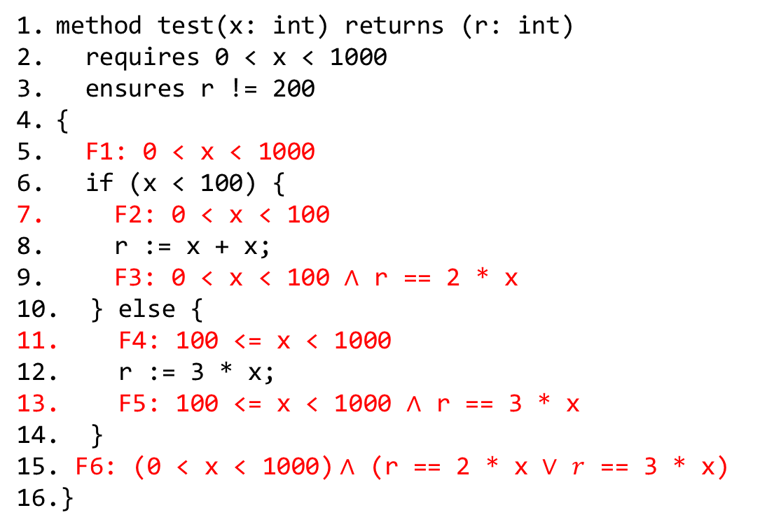
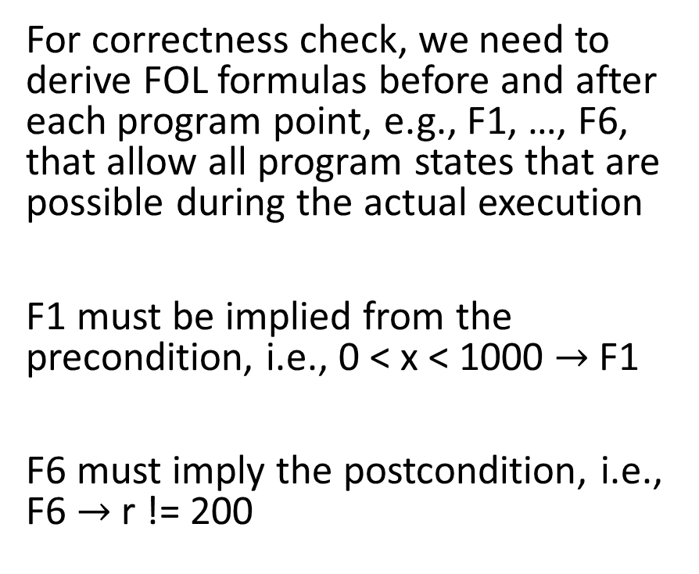
Correctness
For correctness check, we need to derive FOL formulas before and after each program point, e.g., F1, …, F6, that allow all program states that are possible during the actual execution
F1 must be implied from the precondition, i.e., 0 < x < 1000 $→$ F1
F6 must imply the postcondition, i.e., F6 $→$ r != 200
method test(x: int) returns (r: int)
requires 0 < x < 1000
ensures r != 200
{
F1: 0 < x < 1000
if (x < 100) {
F2: 0 < x < 100
r := x + x;
F3: 0 < x < 100 $∧$ r == 2 * x
} else {
F4: 100 <= x < 1000
r := 3 * x;
F5: 100 <= x < 1000 $∧$ r == 3 * x
}
F6: (0 < x < 1000)$∧$ (r == 2 * x $∨$ $r$ == 3 * x)
}

Slide 19
Correctness
Do F1, …, F6 correctly summarize all possible states at their respective points?
method test(x: int) returns (r: int)
requires 0 < x < 1000
ensures r != 200
{
F1: 0 < x < 1000
if (x < 100) {
F2: 0 < x < 100
r := x + x;
F3: 0 < x < 100 $∧$ r == 2 * x
} else {
F4: 100 <= x < 1000
r := 3 * x;
F5: 100 <= x < 1000 $∧$ r == 3 * x
}
F6: (0 < x < 1000)$∧$ (r == 2 * x $∨$ $r$ == 3 * x)
}

Slide 20
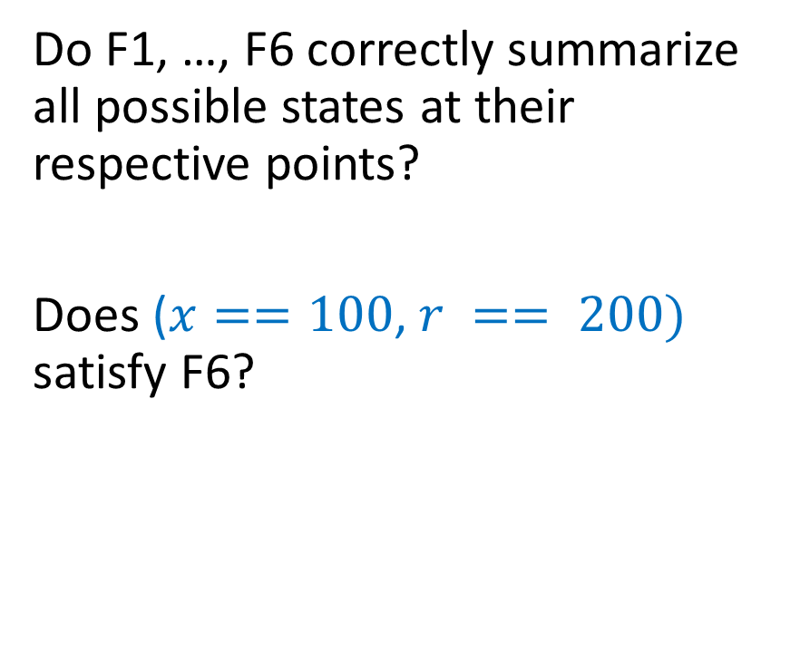
Correctness
Do F1, …, F6 correctly summarize all possible states at their respective points?
Does ($x==100$, $r == 200)$ satisfy F6?
method test(x: int) returns (r: int)
requires 0 < x < 1000
ensures r != 200
{
F1: 0 < x < 1000
if (x < 100) {
F2: 0 < x < 100
r := x + x;
F3: 0 < x < 100 $∧$ r == 2 * x
} else {
F4: 100 <= x < 1000
r := 3 * x;
F5: 100 <= x < 1000 $∧$ r == 3 * x
}
F6: (0 < x < 1000)$∧$ (r == 2 * x $∨$ $r$ == 3 * x)
}

Slide 21

Correctness
Do F1, …, F6 correctly summarize all possible states at their respective points?
Does ($x==100$, $r == 200)$ satisfy F6?
Yes.
method test(x: int) returns (r: int)
requires 0 < x < 1000
ensures r != 200
{
F1: 0 < x < 1000
if (x < 100) {
F2: 0 < x < 100
r := x + x;
F3: 0 < x < 100 $∧$ r == 2 * x
} else {
F4: 100 <= x < 1000
r := 3 * x;
F5: 100 <= x < 1000 $∧$ r == 3 * x
}
F6: (0 < x < 1000)$∧$ (r == 2 * x $∨$ $r$ == 3 * x)
}

Slide 22
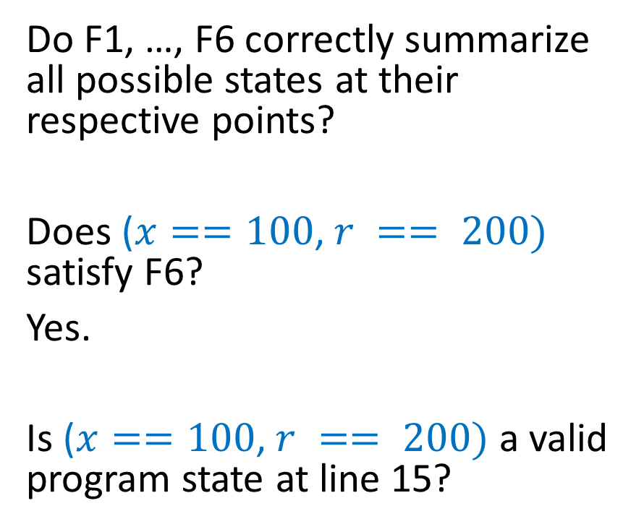
Correctness
Do F1, …, F6 correctly summarize all possible states at their respective points?
Does ($x==100$, $r == 200)$ satisfy F6?
Yes.
Is ($x==100$, $r == 200)$ a valid program state at line 15?
method test(x: int) returns (r: int)
requires 0 < x < 1000
ensures r != 200
{
F1: 0 < x < 1000
if (x < 100) {
F2: 0 < x < 100
r := x + x;
F3: 0 < x < 100 $∧$ r == 2 * x
} else {
F4: 100 <= x < 1000
r := 3 * x;
F5: 100 <= x < 1000 $∧$ r == 3 * x
}
F6: (0 < x < 1000)$∧$ (r == 2 * x $∨$ $r$ == 3 * x)
}

Slide 23
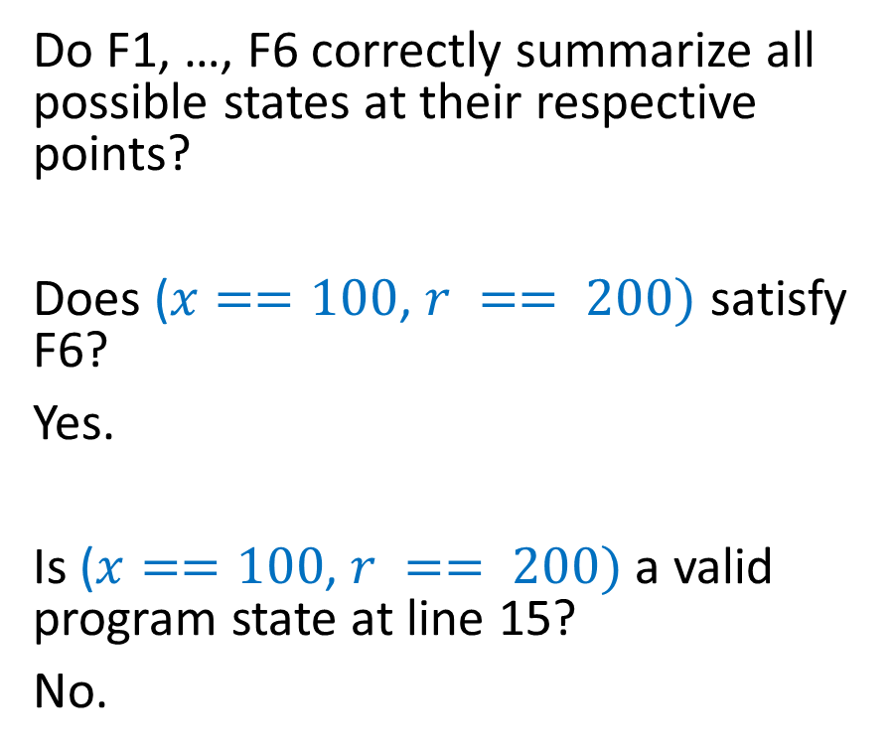
Correctness
Do F1, …, F6 correctly summarize all possible states at their respective points?
Does ($x==100$, $r == 200)$ satisfy F6?
Yes.
Is ($x==100$, $r == 200)$ a valid program state at line 15?
No.
method test(x: int) returns (r: int)
requires 0 < x < 1000
ensures r != 200
{
F1: 0 < x < 1000
if (x < 100) {
F2: 0 < x < 100
r := x + x;
F3: 0 < x < 100 $∧$ r == 2 * x
} else {
F4: 100 <= x < 1000
r := 3 * x;
F5: 100 <= x < 1000 $∧$ r == 3 * x
}
F6: (0 < x < 1000)$∧$ (r == 2 * x $∨$ $r$ == 3 * x)
}

Slide 24
Correctness
F1, ..., F6 should not allow a program state that is not feasible at their respective program points during execution.
What are the valid candidates for F1, …, F6 that allow only those program states that are feasible during execution?
method test(x: int) returns (r: int)
requires 0 < x < 1000
ensures r != 200
{
F1: 0 < x < 1000
if (x < 100) {
F2: 0 < x < 100
r := x + x;
F3: 0 < x < 100 $∧$ r == 2 * x
} else {
F4: 100 <= x < 1000
r := 3 * x;
F5: 100 <= x < 1000 $∧$ r == 3 * x
}
F6: (0 < x < 1000)$∧$ (r == 2 * x $∨$ $r$ == 3 * x)
}

Slide 25
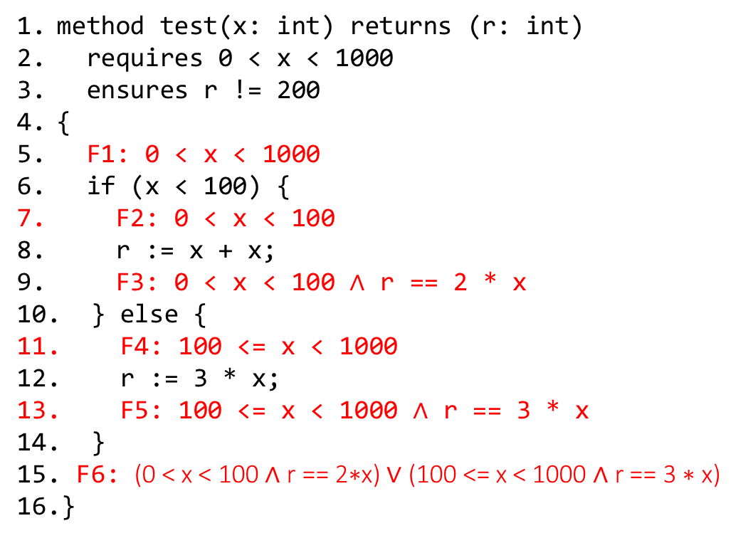
Correctness
F1, ..., F6 should not allow a program state that is not feasible at their respective program points during execution.
These are the valid candidates for F1, …, F6 that allow only those program states that are feasible during execution.
method test(x: int) returns (r: int)
requires 0 < x < 1000
ensures r != 200
{
F1: 0 < x < 1000
if (x < 100) {
F2: 0 < x < 100
r := x + x;
F3: 0 < x < 100 $∧$ r == 2 * x
} else {
F4: 100 <= x < 1000
r := 3 * x;
F5: 100 <= x < 1000 $∧$ r == 3 * x
}
F6: (0 < x < 100 ∧ r == 2∗x) ∨ (100 <= x < 1000 ∧ r == 3 ∗ x)
}

