Slide 2
Today’s lecture
Program correctness
Hoare logic

Slide 3
Program state
The program state at a given program point consists of the values of all live variables at that point (assuming no dynamic allocation)
method test(x: int) returns (r: int)
requires 0 < x < 1000
ensures r != 200
{
if (x < 100) {
r := x + x;
}
else {
r := 3 * x;
}
}

Slide 4
Program state
Let’s say x = 20 at Line-4.
What is the program state before Line-6?
What is the program state after Line-6?
What is the program state before Line-9?
What is the program state before Line-9?
What is the program state before Line-11?
method test(x: int) returns (r: int)
requires 0 < x < 1000
ensures r != 200
{
if (x < 100) {
r := x + x;
}
else {
r := 3 * x;
}
}

Slide 5
Program state
Let’s say x = 20 at Line-4.
What is the program state before Line-6?
x = 20, r =_
What is the program state after Line-6?
x = 20, r = 40
What is the program state before Line-9?
Not reachable
What is the program state before Line-9?
Not reachable
What is the program state before Line-11?
x = 20, r = 40
method test(x: int) returns (r: int)
requires 0 < x < 1000
ensures r != 200
{
if (x < 100) {
r := x + x;
}
else {
r := 3 * x;
}
}

Slide 6
Program state
Let’s say x = 100 at Line-4.
What is the program state before Line-6?
What is the program state after Line-6?
What is the program state before Line-9?
What is the program state before Line-9?
What is the program state before Line-11?
method test(x: int) returns (r: int)
requires 0 < x < 1000
ensures r != 200
{
if (x < 100) {
r := x + x;
}
else {
r := 3 * x;
}
}

Slide 7
Program state
Let’s say x = 100 at Line-4.
What is the program state before Line-6?
Not reachable
What is the program state after Line-6?
Not reachable
What is the program state before Line-9?
x = 100, r = _
What is the program state before Line-9?
x = 100, r = 300
What is the program state before Line-11?
x = 100, r = 300
method test(x: int) returns (r: int)
requires 0 < x < 1000
ensures r != 200
{
if (x < 100) {
r := x + x;
}
else {
r := 3 * x;
}
}

Slide 8
Program state
We can remove uninitialized variables from the program state. Accessing an uninitialized variable is illegal and can be detected at compile time using a different static analysis
We can assume that the program doesn’t access uninitialized variables in our future discussions

Slide 9
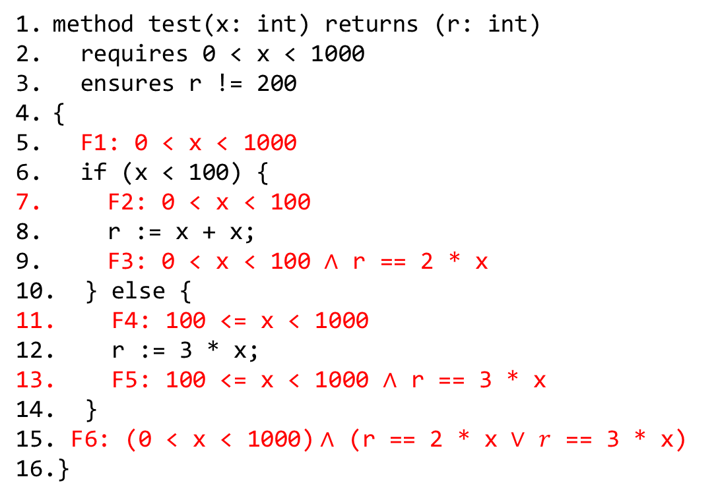
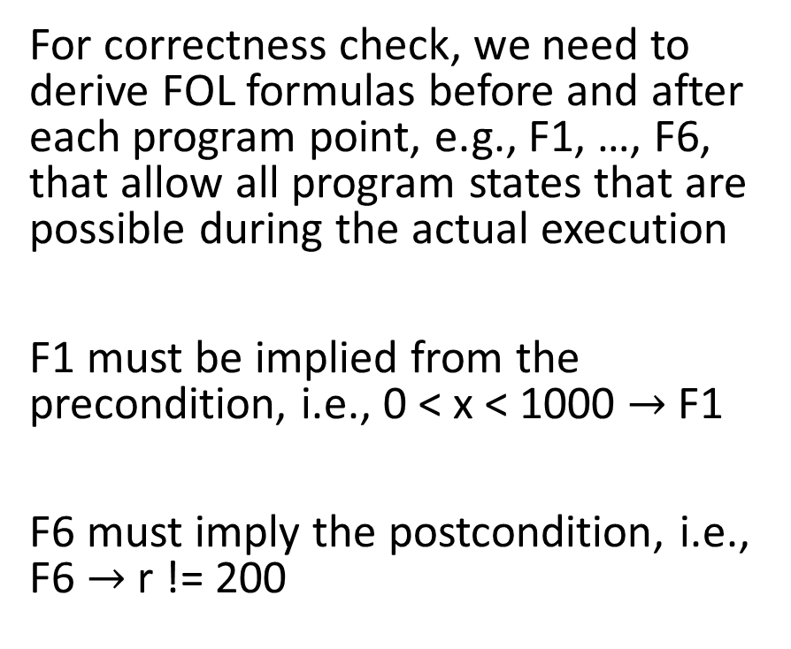
Correctness
For correctness check, we need to derive FOL formulas before and after each program point, e.g., F1, …, F6, that allow all program states that are possible during the actual execution
F1 must be implied from the precondition, i.e., 0 < x < 1000 $→$ F1
F6 must imply the postcondition, i.e., F6 $→$ r != 200
method test(x: int) returns (r: int)
requires 0 < x < 1000
ensures r != 200
{
F1: 0 < x < 1000
if (x < 100) {
F2: 0 < x < 100
r := x + x;
F3: 0 < x < 100 $∧$ r == 2 * x
} else {
F4: 100 <= x < 1000
r := 3 * x;
F5: 100 <= x < 1000 $∧$ r == 3 * x
}
F6: (0 < x < 1000)$∧$ (r == 2 * x $∨$ $r$ == 3 * x)
}

Slide 10
Correctness
Do F1, …, F6 correctly summarize all possible states at their respective points?
method test(x: int) returns (r: int)
requires 0 < x < 1000
ensures r != 200
{
F1: 0 < x < 1000
if (x < 100) {
F2: 0 < x < 100
r := x + x;
F3: 0 < x < 100 $∧$ r == 2 * x
} else {
F4: 100 <= x < 1000
r := 3 * x;
F5: 100 <= x < 1000 $∧$ r == 3 * x
}
F6: (0 < x < 1000)$∧$ (r == 2 * x $∨$ $r$ == 3 * x)
}

Slide 11
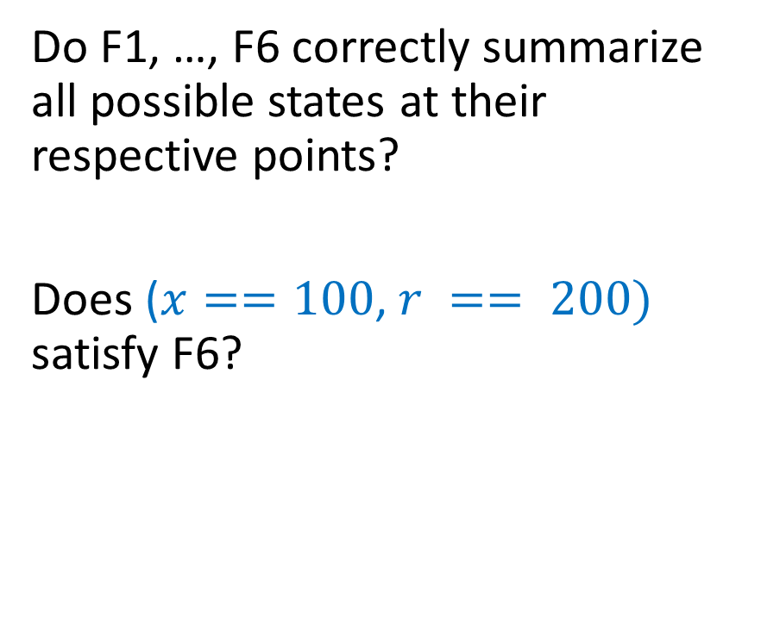
Correctness
Do F1, …, F6 correctly summarize all possible states at their respective points?
Does ($x==100$, $r == 200)$ satisfy F6?
method test(x: int) returns (r: int)
requires 0 < x < 1000
ensures r != 200
{
F1: 0 < x < 1000
if (x < 100) {
F2: 0 < x < 100
r := x + x;
F3: 0 < x < 100 $∧$ r == 2 * x
} else {
F4: 100 <= x < 1000
r := 3 * x;
F5: 100 <= x < 1000 $∧$ r == 3 * x
}
F6: (0 < x < 1000)$∧$ (r == 2 * x $∨$ $r$ == 3 * x)
}

Slide 12

Correctness
Do F1, …, F6 correctly summarize all possible states at their respective points?
Does ($x==100$, $r == 200)$ satisfy F6?
Yes.
method test(x: int) returns (r: int)
requires 0 < x < 1000
ensures r != 200
{
F1: 0 < x < 1000
if (x < 100) {
F2: 0 < x < 100
r := x + x;
F3: 0 < x < 100 $∧$ r == 2 * x
} else {
F4: 100 <= x < 1000
r := 3 * x;
F5: 100 <= x < 1000 $∧$ r == 3 * x
}
F6: (0 < x < 1000)$∧$ (r == 2 * x $∨$ $r$ == 3 * x)
}

Slide 13
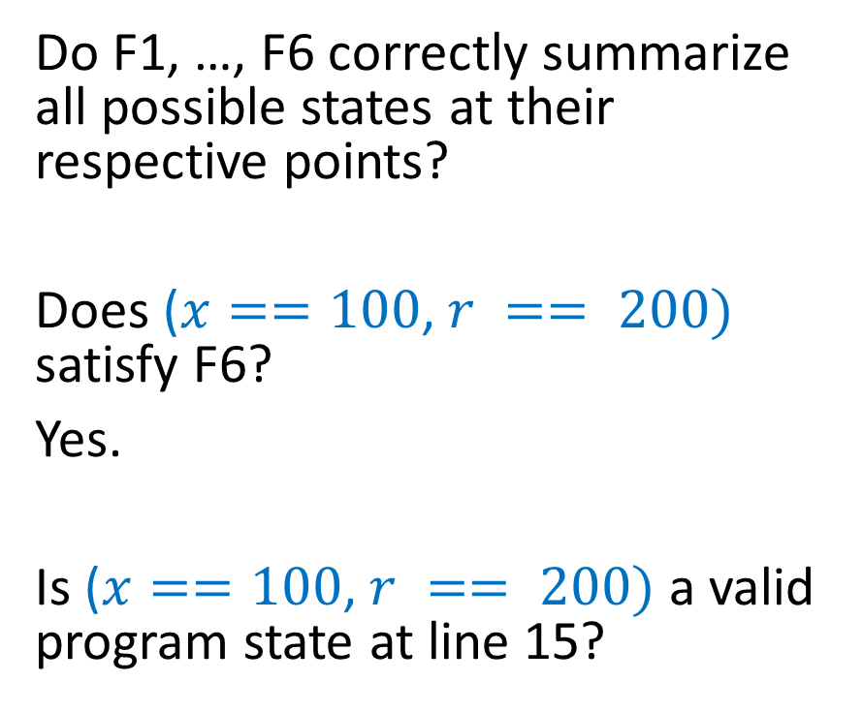
Correctness
Do F1, …, F6 correctly summarize all possible states at their respective points?
Does ($x==100$, $r == 200)$ satisfy F6?
Yes.
Is ($x==100$, $r == 200)$ a valid program state at line 15?
method test(x: int) returns (r: int)
requires 0 < x < 1000
ensures r != 200
{
F1: 0 < x < 1000
if (x < 100) {
F2: 0 < x < 100
r := x + x;
F3: 0 < x < 100 $∧$ r == 2 * x
} else {
F4: 100 <= x < 1000
r := 3 * x;
F5: 100 <= x < 1000 $∧$ r == 3 * x
}
F6: (0 < x < 1000)$∧$ (r == 2 * x $∨$ $r$ == 3 * x)
}

Slide 14
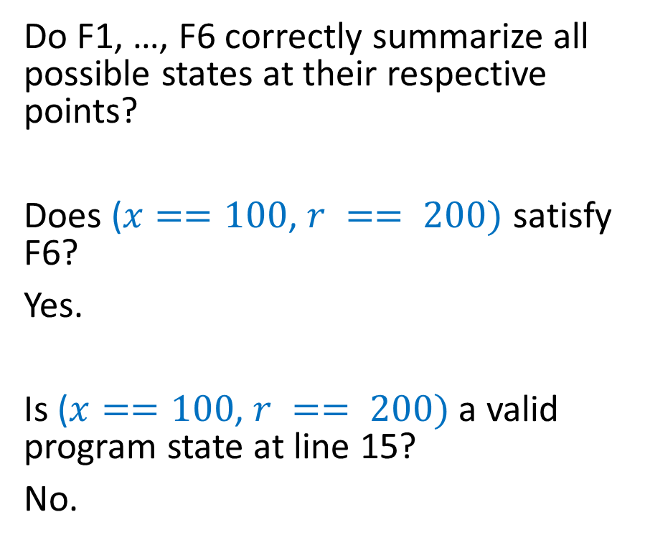
Correctness
Do F1, …, F6 correctly summarize all possible states at their respective points?
Does ($x==100$, $r == 200)$ satisfy F6?
Yes.
Is ($x==100$, $r == 200)$ a valid program state at line 15?
No.
method test(x: int) returns (r: int)
requires 0 < x < 1000
ensures r != 200
{
F1: 0 < x < 1000
if (x < 100) {
F2: 0 < x < 100
r := x + x;
F3: 0 < x < 100 $∧$ r == 2 * x
} else {
F4: 100 <= x < 1000
r := 3 * x;
F5: 100 <= x < 1000 $∧$ r == 3 * x
}
F6: (0 < x < 1000)$∧$ (r == 2 * x $∨$ $r$ == 3 * x)
}

Slide 15
Correctness
F1, ..., F6 should not allow a program state that is not feasible at their respective program points during execution.
What are the valid candidates for F1, …, F6 that allow only those program states that are feasible during execution?
method test(x: int) returns (r: int)
requires 0 < x < 1000
ensures r != 200
{
F1: 0 < x < 1000
if (x < 100) {
F2: 0 < x < 100
r := x + x;
F3: 0 < x < 100 $∧$ r == 2 * x
} else {
F4: 100 <= x < 1000
r := 3 * x;
F5: 100 <= x < 1000 $∧$ r == 3 * x
}
F6: (0 < x < 1000)$∧$ (r == 2 * x $∨$ $r$ == 3 * x)
}

Slide 16
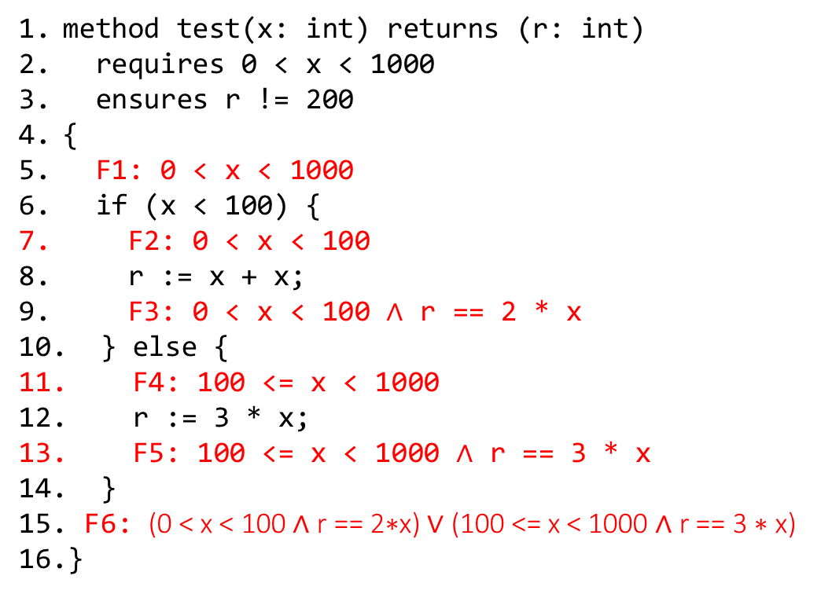
Correctness
F1, ..., F6 should not allow a program state that is not feasible at their respective program points during execution.
These are the valid candidates for F1, …, F6 that allow only those program states that are feasible during execution.
method test(x: int) returns (r: int)
requires 0 < x < 1000
ensures r != 200
{
F1: 0 < x < 1000
if (x < 100) {
F2: 0 < x < 100
r := x + x;
F3: 0 < x < 100 $∧$ r == 2 * x
} else {
F4: 100 <= x < 1000
r := 3 * x;
F5: 100 <= x < 1000 $∧$ r == 3 * x
}
F6: (0 < x < 100 ∧ r == 2∗x) ∨ (100 <= x < 1000 ∧ r == 3 ∗ x)
}

Slide 17
Correctness
F1, ..., F6 should not allow a program state that is not feasible at their respective program points during execution.
The program is correct if the FOL formula before the return, F6, implies the postcondition.
The implementation is correct if (0 < x < 100 ∧ r = 2∗x) ∨ (100 <= x < 1000 ∧ r = 3 ∗ x) → r != 200 is valid.
method test(x: int) returns (r: int)
requires 0 < x < 1000
ensures r != 200
{
F1: 0 < x < 1000
if (x < 100) {
F2: 0 < x < 100
r := x + x;
F3: 0 < x < 100 $∧$ r == 2 * x
} else {
F4: 100 <= x < 1000
r := 3 * x;
F5: 100 <= x < 1000 $∧$ r == 3 * x
}
F6: (0 < x < 100 ∧ r == 2∗x) ∨ (100 <= x < 1000 ∧ r == 3 ∗ x)
}

Slide 18
Correctness
Is (0 < x < 100 ∧ r = 2∗x) ∨ (100 <= x < 1000 ∧ r = 3 ∗ x) → r != 200 valid?

Slide 19
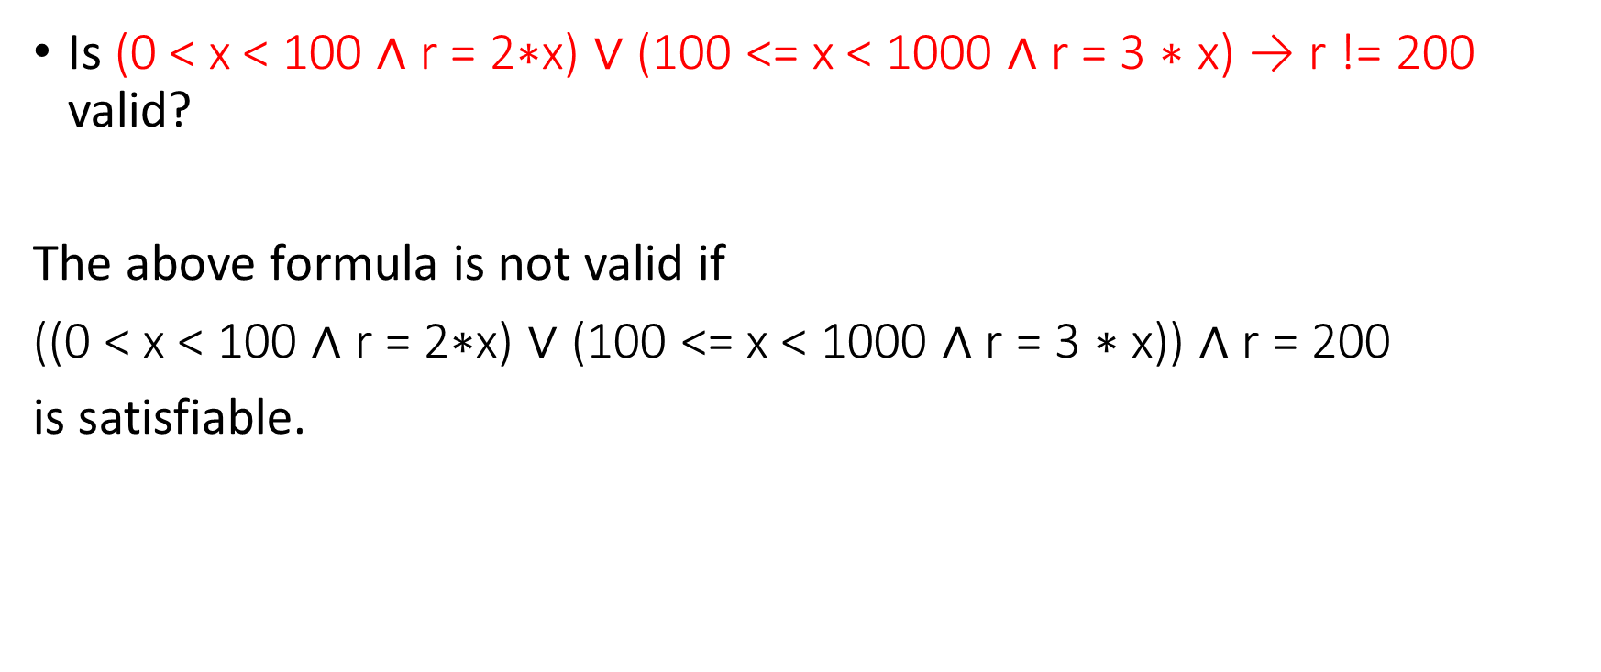
Correctness
Is (0 < x < 100 ∧ r = 2∗x) ∨ (100 <= x < 1000 ∧ r = 3 ∗ x) → r != 200 valid?
The above formula is not valid if
((0 < x < 100 ∧ r = 2∗x) ∨ (100 <= x < 1000 ∧ r = 3 ∗ x)) $∧$ r = 200
is satisfiable.

Slide 20
Correctness
Try this.
method test(x: int) returns (r: int)
requires 0 < x < 1000
ensures r != 200
{
F1:
if (x < 50) {
F2:
r := 4 * x;
F3:
} else {
F4:
r := x;
F5:
}
F6:
}

Slide 21
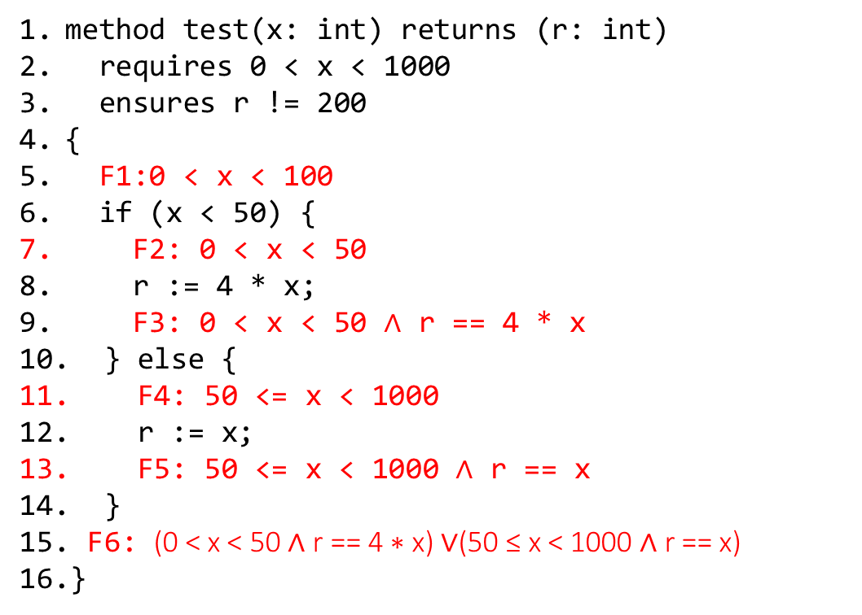
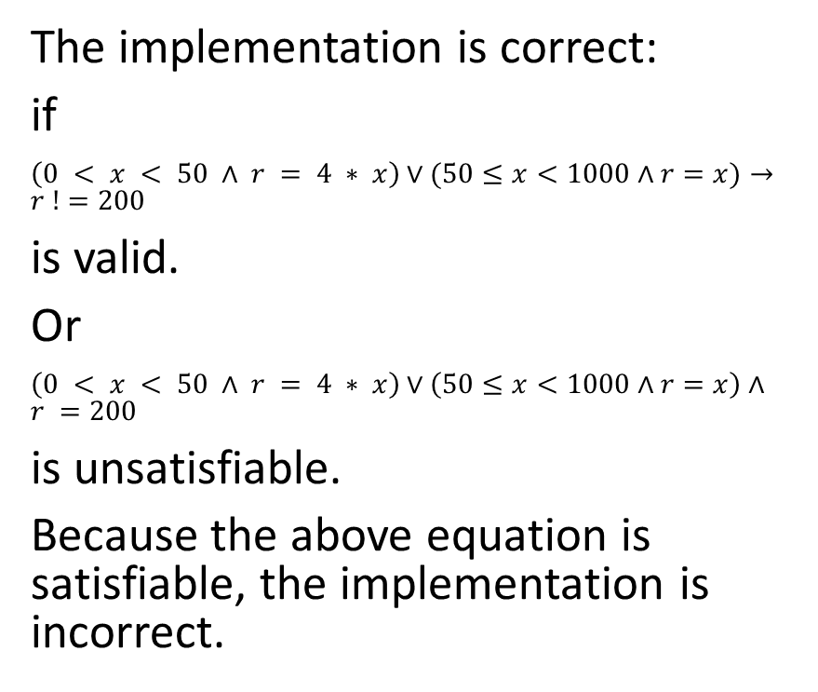
Correctness
The implementation is correct:
if
$\left(0 < x < 50 ∧ r = 4 ∗ x\right)∨(50≤x<1000∧r=x)→r !=200$
is valid.
Or
$\left(0 < x < 50 ∧ r = 4 ∗ x\right)∨\left(50≤x<1000∧r=x\right)∧r =200$
is unsatisfiable.
Because the above equation is satisfiable, the implementation is incorrect.
method test(x: int) returns (r: int)
requires 0 < x < 1000
ensures r != 200
{
F1:0 < x < 100
if (x < 50) {
F2: 0 < x < 50
r := 4 * x;
F3: 0 < x < 50 $∧$ r == 4 * x
} else {
F4: 50 <= x < 1000
r := x;
F5: 50 <= x < 1000 $∧$ r == x
}
F6: (0 < x < 50 ∧ r == 4 ∗ x) ∨(50 ≤ x < 1000 ∧ r == x)
}

Slide 22
Converting to FOL
We can compute these FOL formulas both in the forward direction and the backward direction

Slide 23
Forward direction
In this approach, we assume the precondition and generate FOL constraints in the forward direction
The question we ask is assuming that the precondition is true, what are all possible states after the successful execution of the next statement
The goal is to compute the postcondition of the next statement that will act as a precondition for the successors of the next statement
A conditional statement can have multiple successors

Slide 24
Backward direction
In this approach, we start from the postcondition and generate FOL constraints in the backward direction
The question we ask is assuming that the postcondition is true what all states are possible before the execution of the previous statement
The goal is to compute the precondition of the previous statement that will act as the postcondition of the predecessors of the previous statement
A statement can have multiple predecessors if we can reach that statement from multiple paths, e.g., the next statement after the if-else body

Slide 25
Backward direction
Do F1, …, F6 correctly summarize all possible states at their respective points?
method test(x: int) returns (r: int)
requires 0 < x < 1000
ensures 200 < r < 400
{
F1:(x < 100 ∧ 200 < x + x <400) ∨ (x ≥ 100 ∧ 200<3∗x <400)
if (x < 100) {
F2: 200 < x + x < 400
r := x + x;
F3: 200 < r < 400
} else {
F4: 200 < 3 * x < 400
r := 3 * x;
F5: 200 < r < 400
}
F6: 200 < r < 400
}

Slide 26
Backward direction
Do F1, …, F6 correctly summarize all possible states at their respective points?
No.
method test(x: int) returns (r: int)
requires 0 < x < 1000
ensures 200 < r < 400
{
F1:(x < 100 ∧ 200 < x + x <400) ∨ (x ≥ 100 ∧ 200<3∗x <400)
if (x < 100) {
F2: 200 < x + x < 400
r := x + x;
F3: 200 < r < 400
} else {
F4: 200 < 3 * x < 400
r := 3 * x;
F5: 200 < r < 400
}
F6: 200 < r < 400
}

Slide 27
Backward direction
In the backward direction, the FOL formulas don’t try to satisfy all legal states. Instead, they just satisfy only those states that are needed to prove the postcondition.
In other words, the FOL formulas assume that the postcondition holds (even though that might not be true) and allow only those states that are feasible according to the postcondition.
method test(x: int) returns (r: int)
requires 0 < x < 1000
ensures 200 < r < 400
{
F1:(x < 100 ∧ 200 < x + x <400) ∨ (x ≥ 100 ∧ 200<3∗x <400)
if (x < 100) {
F2: 200 < x + x < 400
r := x + x;
F3: 200 < r < 400
} else {
F4: 200 < 3 * x < 400
r := 3 * x;
F5: 200 < r < 400
}
F6: 200 < r < 400
}

Slide 28
Backward direction
Therefore, for different postconditions, the FOL formulas would be different, which is not the case with the forward direction that tries to prove all possible postconditions.
method test(x: int) returns (r: int)
requires 0 < x < 1000
ensures 200 < r < 400
{
F1:(x < 100 ∧ 200 < x + x <400) ∨ (x ≥ 100 ∧ 200<3∗x <400)
if (x < 100) {
F2: 200 < x + x < 400
r := x + x;
F3: 200 < r < 400
} else {
F4: 200 < 3 * x < 400
r := 3 * x;
F5: 200 < r < 400
}
F6: 200 < r < 400
}

Slide 29
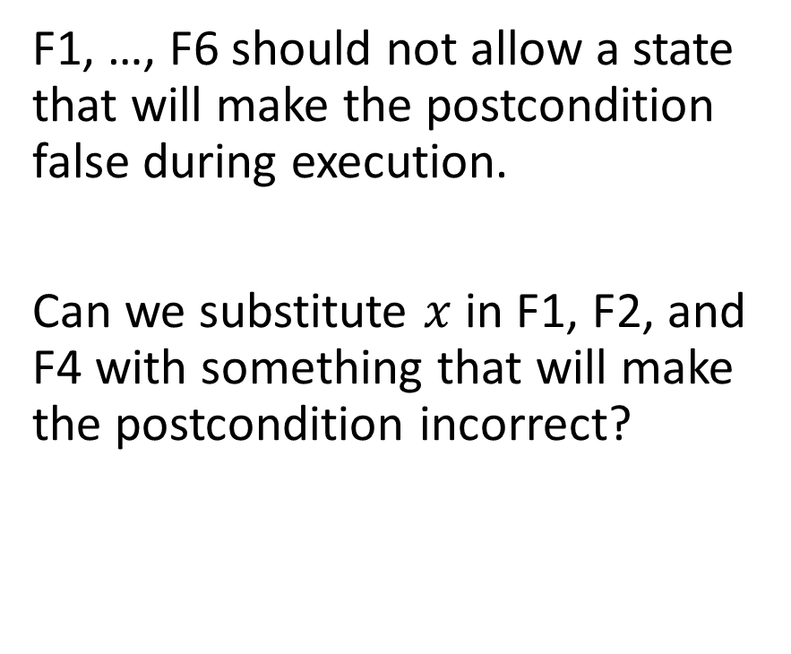
Backward direction
F1, …, F6 should not allow a state that will make the postcondition false during execution.
Can we substitute $x$ in F1, F2, and F4 with something that will make the postcondition incorrect?
method test(x: int) returns (r: int)
requires 0 < x < 1000
ensures 200 < r < 400
{
F1:(x < 100 ∧ 200 < x + x <400) ∨ (x ≥ 100 ∧ 200<3∗x <400)
if (x < 100) {
F2: 200 < x + x < 400
r := x + x;
F3: 200 < r < 400
} else {
F4: 200 < 3 * x < 400
r := 3 * x;
F5: 200 < r < 400
}
F6: 200 < r < 400
}

Slide 30
Backward direction
F1, …, F6 should not allow a state that will make the postcondition false during execution.
Can we substitute x in F1, F2, and F4 with something that will make the postcondition incorrect?
No.
method test(x: int) returns (r: int)
requires 0 < x < 1000
ensures 200 < r < 400
{
F1:(x < 100 ∧ 200 < x + x <400) ∨ (x ≥ 100 ∧ 200<3∗x <400)
if (x < 100) {
F2: 200 < x + x < 400
r := x + x;
F3: 200 < r < 400
} else {
F4: 200 < 3 * x < 400
r := 3 * x;
F5: 200 < r < 400
}
F6: 200 < r < 400
}

Slide 31
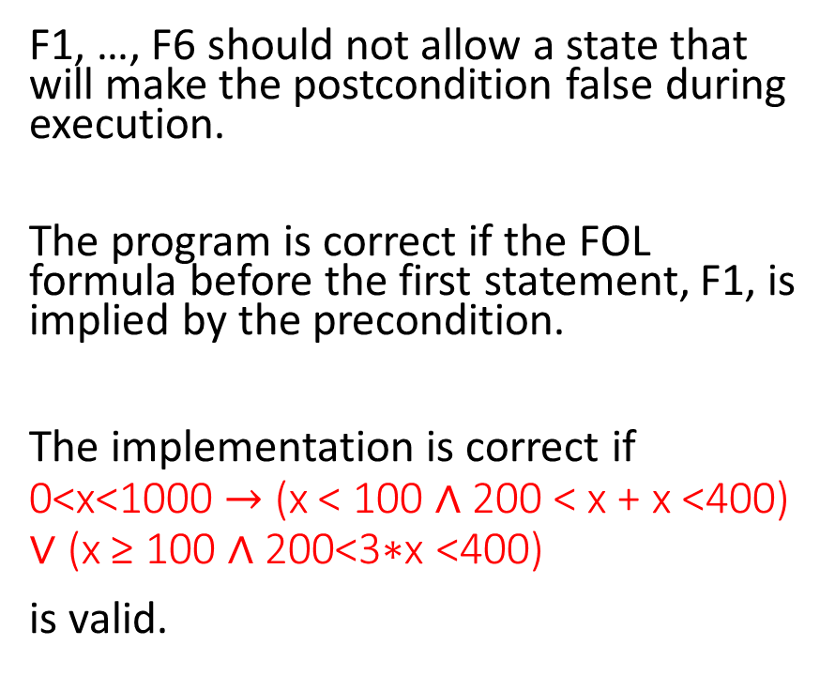
Backward direction
F1, …, F6 should not allow a state that will make the postcondition false during execution.
The program is correct if the FOL formula before the first statement, F1, is implied by the precondition.
The implementation is correct if 0<x<1000 $→$ (x < 100 ∧ 200 < x + x <400) ∨ (x ≥ 100 ∧ 200<3∗x <400)
is valid.
method test(x: int) returns (r: int)
requires 0 < x < 1000
ensures 200 < r < 400
{
F1:(x < 100 ∧ 200 < x + x <400) ∨ (x ≥ 100 ∧ 200<3∗x <400)
if (x < 100) {
F2: 200 < x + x < 400
r := x + x;
F3: 200 < r < 400
} else {
F4: 200 < 3 * x < 400
r := 3 * x;
F5: 200 < r < 400
}
F6: 200 < r < 400
}

Slide 32
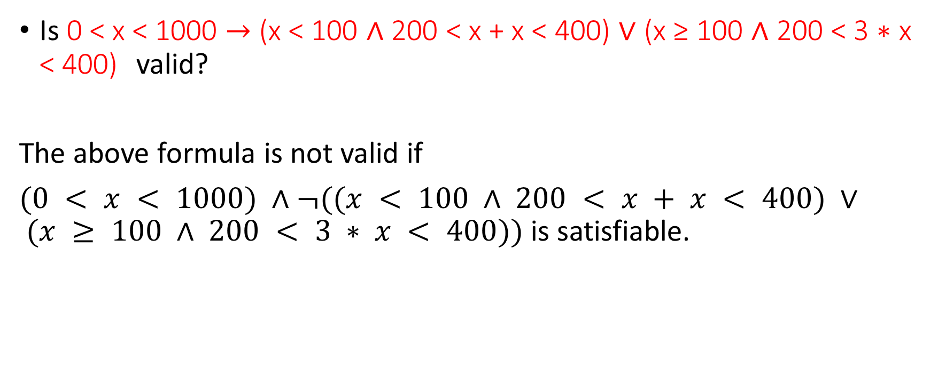
Correctness
Is 0 < x < 1000 $→$ (x < 100 ∧ 200 < x + x < 400) ∨ (x ≥ 100 ∧ 200 < 3 ∗ x < 400) valid?
The above formula is not valid if
$(0 < x < 1000) ∧¬((x < 100 ∧ 200 < x + x < 400) ∨ (x ≥ 100 ∧ 200 < 3 ∗ x < 400))$is satisfiable.

Slide 33
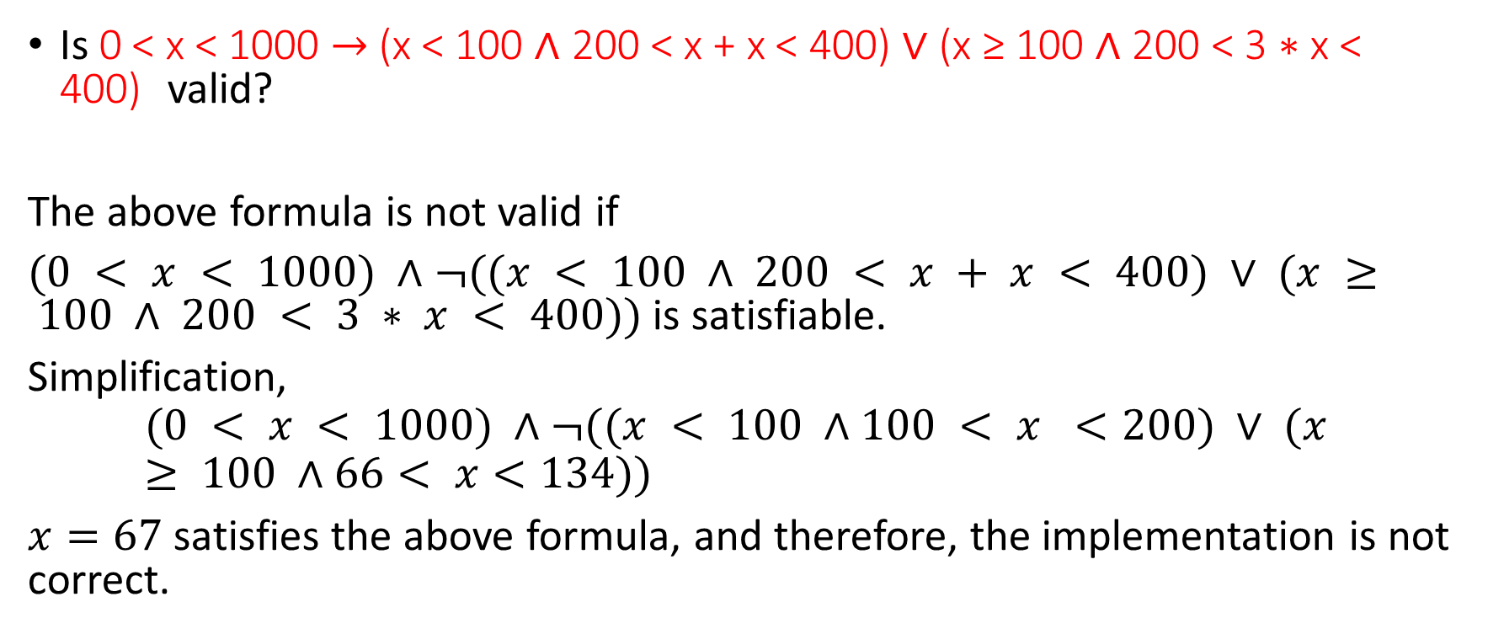
Correctness
Is 0 < x < 1000 $→$ (x < 100 ∧ 200 < x + x < 400) ∨ (x ≥ 100 ∧ 200 < 3 ∗ x < 400) valid?
The above formula is not valid if
$(0 < x < 1000) ∧¬((x < 100 ∧ 200 < x + x < 400) ∨ (x ≥ 100 ∧ 200 < 3 ∗ x < 400))$is satisfiable.
Simplification,
$$(0 < x < 1000) ∧¬((x < 100 ∧100 < x <200) ∨ (x ≥ 100 ∧66< x<134))$$
$x=67$ satisfies the above formula, and therefore, the implementation is not correct.

Slide 34
Backward direction
Try this specification.
method test(x: int) returns (r: int)
requires 0 < x < 1000
ensures r != 200
{
F1:
if (x < 100) {
F2:
r := x + x;
F3:
} else {
F4:
r := 3 * x;
F5:
}
F6: r != 200
}

Slide 35
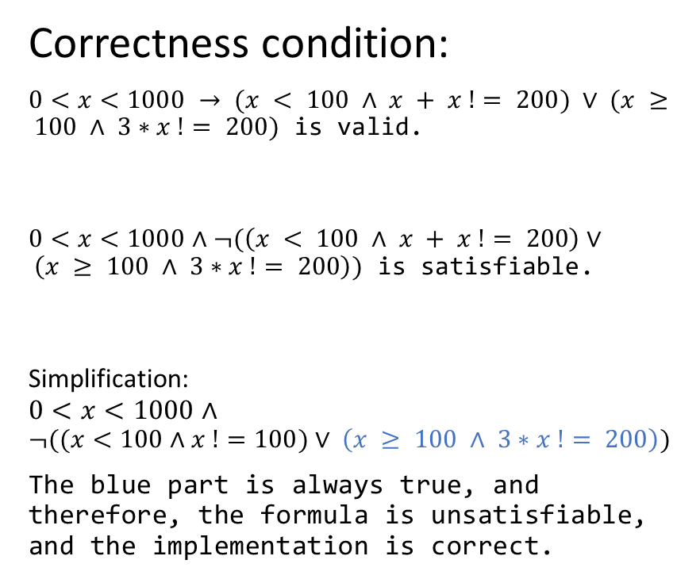
Backward direction
Correctness condition:
$0<x<1000 → (x < 100 ∧ x + x != 200) ∨ (x ≥ 100 ∧ 3∗x != 200)$ is valid.
$0<x<1000∧¬(\left(x < 100 ∧ x + x != 200\right)∨ \left(x ≥ 100 ∧ 3∗x != 200\right))$ is satisfiable.
Simplification:
$$0<x<1000∧$$
$$¬((x<100∧x !=100)∨ \left(x ≥ 100 ∧ 3∗x != 200\right))$$
The blue part is always true, and therefore, the formula is unsatisfiable, and the implementation is correct.
method test(x: int) returns (r: int)
requires 0 < x < 1000
ensures r != 200
{
F1:(x < 100 ∧ x + x != 200) ∨ (x ≥ 100 ∧ 3∗x != 200)
if (x < 100) {
F2: x + x != 200
r := x + x;
F3: r != 200
} else {
F4: 3 * x != 200
r := 3 * x;
F5: r != 200
}
F6: r != 200
}

Slide 36
Forward vs. Backward
The forward analysis tries to prove all possible postconditions and is more expensive than the backward analysis if the goal is just to prove a particular postcondition
However, forward analysis can be useful when there is no specific postcondition. E.g.,
Checking that the program can never go to a certain state
Trying to find out the meaning of the program

Slide 37
Loop
method foo() returns (r: int)
ensures r == 45
{
F1:
r := 0;
F2:
var i := 1;
F3:
while (i < 10)
F4:
{
F5:
r := r + i;
F6:
i := i + 1;
F7:
}
F8:
}
Write FOL formulas F1, …, F8 for the forward direction.
F4 is inserted just before the loop condition inside the loop.

Slide 38
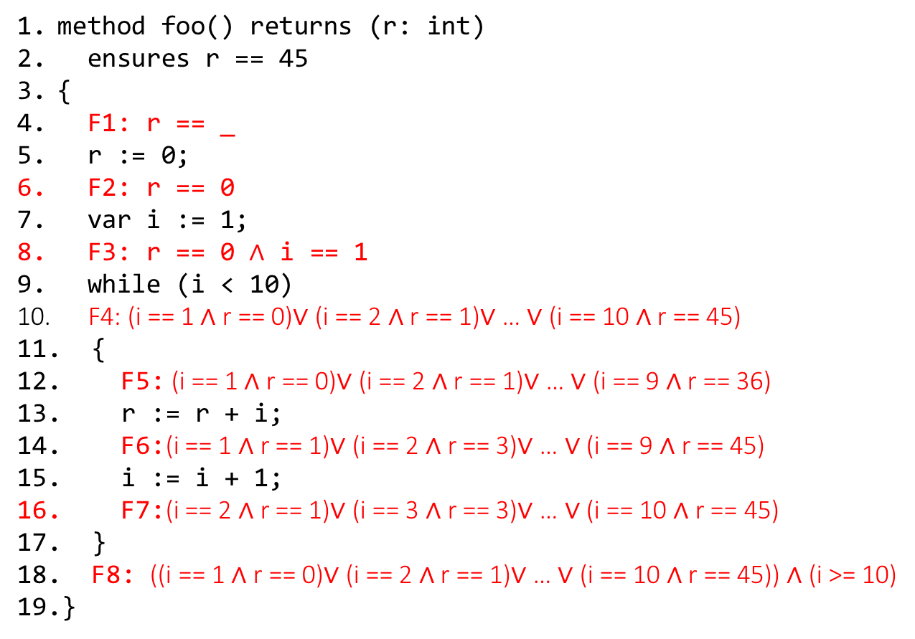
Loop
method foo() returns (r: int)
ensures r == 45
{
F1: r == _
r := 0;
F2: r == 0
var i := 1;
F3: r == 0 $∧$ i == 1
while (i < 10)
F4: (i == 1 ∧ r == 0)∨ (i == 2 ∧ r == 1)∨ … ∨ (i == 10 ∧ r == 45)
{
F5: (i == 1 ∧ r == 0)∨ (i == 2 ∧ r == 1)∨ … ∨ (i == 9 ∧ r == 36)
r := r + i;
F6:(i == 1 ∧ r == 1)∨ (i == 2 ∧ r == 3)∨ … ∨ (i == 9 ∧ r == 45)
i := i + 1;
F7:(i == 2 ∧ r == 1)∨ (i == 3 ∧ r == 3)∨ … ∨ (i == 10 ∧ r == 45)
}
F8: ((i == 1 ∧ r == 0)∨ (i == 2 ∧ r == 1)∨ … ∨ (i == 10 ∧ r == 45)) ∧ (i >= 10)
}
Write FOL formulas F1, …, F8 for the forward direction.
F4 is inserted just before the loop condition inside the loop.

Slide 39

Loop
method foo(n: int) returns (r: int)
ensures r == 45
{
F1: r == _
r := 0;
F2: r == 0
var i := 1;
F3: r == 0 $∧$ i == 1
while (i < n)
F4:
{
F5:
r := r + i;
F6:
i := i + 1;
F7:
}
F8:
}
Write FOL formulas F4, …, F8 for the forward direction.
F4 is inserted just before the loop condition inside the loop.

Slide 40

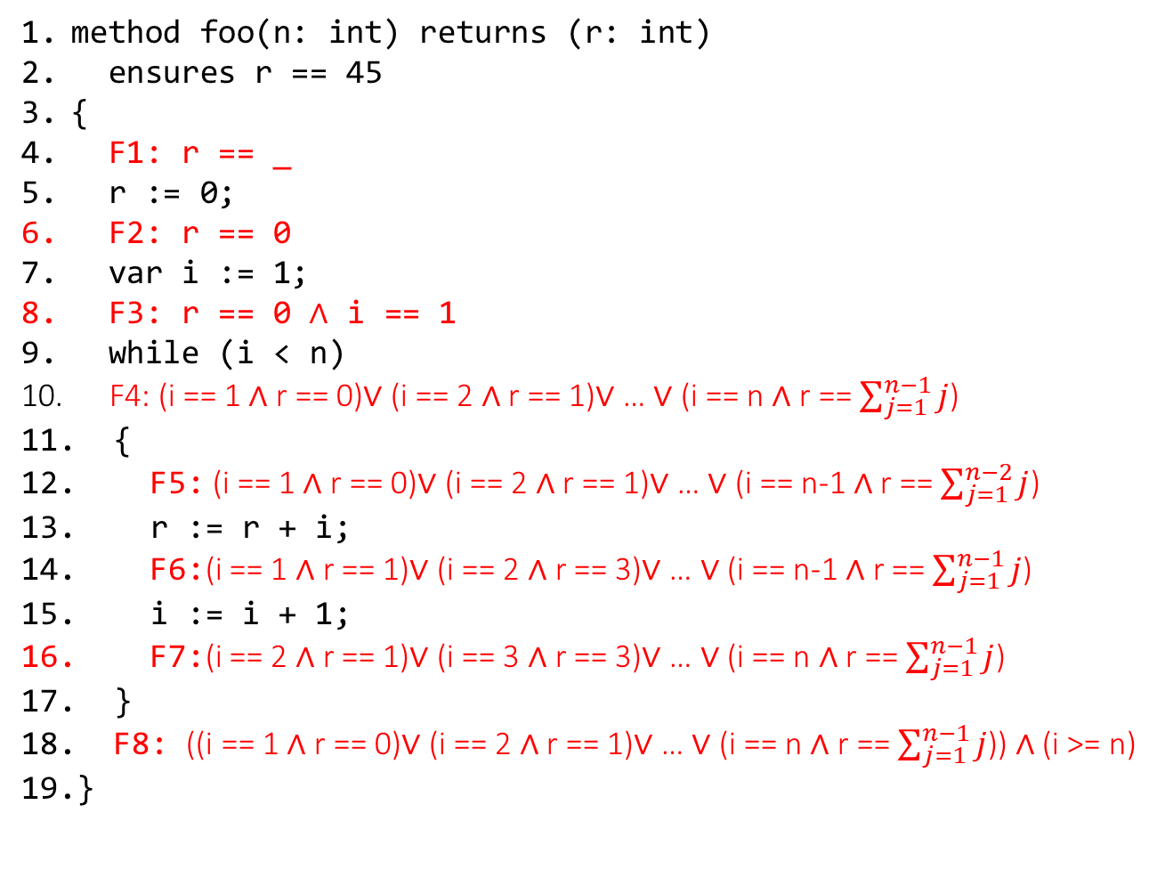
Loop
method foo(n: int) returns (r: int)
ensures r == 45
{
F1: r == _
r := 0;
F2: r == 0
var i := 1;
F3: r == 0 $∧$ i == 1
while (i < n)
F4: (i == 1 ∧ r == 0)∨ (i == 2 ∧ r == 1)∨ … ∨ (i == n ∧ r == $\sum_{j=1}^{n−1}{j}$)
{
F5: (i == 1 ∧ r == 0)∨ (i == 2 ∧ r == 1)∨ … ∨ (i == n-1 ∧ r == $\sum_{j=1}^{n−2}{j}$)
r := r + i;
F6:(i == 1 ∧ r == 1)∨ (i == 2 ∧ r == 3)∨ … ∨ (i == n-1 ∧ r == $\sum_{j=1}^{n−1}{j}$)
i := i + 1;
F7:(i == 2 ∧ r == 1)∨ (i == 3 ∧ r == 3)∨ … ∨ (i == n ∧ r == $\sum_{j=1}^{n−1}{j}$)
}
F8: ((i == 1 ∧ r == 0)∨ (i == 2 ∧ r == 1)∨ … ∨ (i == n ∧ r == $\sum_{j=1}^{n−1}{j}$)) ∧ (i >= n)
}
Write FOL formulas F1, …, F8 for the forward direction.
F4 is inserted just before the loop condition inside the loop.
The program is correct if
((i == 1 ∧ r == 0)∨ (i == 2 ∧ r == 1)∨ … ∨ (i == n ∧ r == $\sum_{j=1}^{n−1}{j}$)) ∧ (i >= n) $→$
r == 45
is valid, or
((i == 1 ∧ r == 0)∨ (i == 2 ∧ r == 1)∨ … ∨ (i == n ∧ r == $\sum_{j=1}^{n−1}{j}$)) ∧ (i >= n) $∧$
r != 45
is unsatisfiable.
Clearly, this formula is satisfiable, and thus the implementation is not correct.

Slide 41
Loop
If a statement, S, is inside a loop, multiple states are possible before and after the execution of S, depending on the loop iteration
The FOL formula for S is the disjunction of all states during individual loop iterations

Slide 42
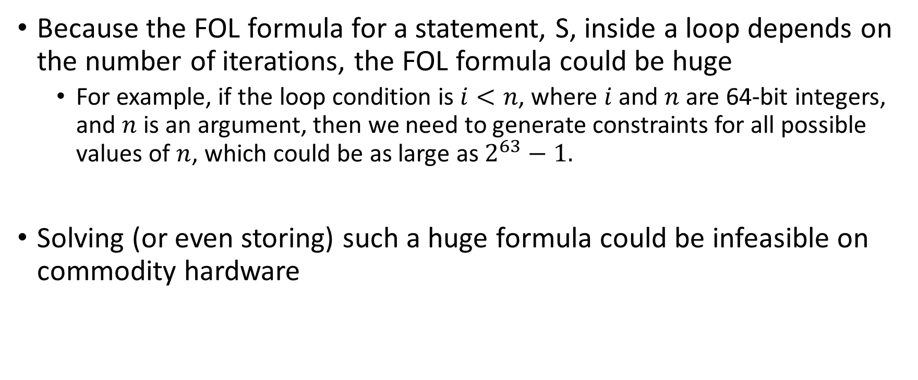
Loop
Because the FOL formula for a statement, S, inside a loop depends on the number of iterations, the FOL formula could be huge
For example, if the loop condition is $i<n$, where $i$ and $n$ are 64-bit integers, and $n$ is an argument, then we need to generate constraints for all possible values of $n$, which could be as large as $2^{63}−1.$
Solving (or even storing) such a huge formula could be infeasible on commodity hardware

Slide 43
Loop invariant
Loop invariant is a predicate (usually small) that is true before the evaluation of the loop condition regardless of the loop iteration
Thus, we can choose loop invariant as the FOL formula before the loop condition because it is the same for all the iterations
However, if the loop invariant is conservative (i.e., not strong enough to allow all possible states), we may not be able to prove some facts about the program

Slide 44
Loop invariant
On the other hand, if the loop invariant is incorrect (i.e., allows certain states that are not possible during the actual execution), we may be able to prove wrong facts
The loop invariants are not trusted. Illegal loop invariants are caught statically.
A conservative loop invariant is allowed. Even though it doesn’t convey all the facts about the loop, whatever it does is correct. Therefore, all proven facts based on the loop invariant are true.

Slide 45
Loop invariant correctness
Because the loop invariant, LI, is true at the start of the loop and also at the end of the loop, we can construct a function, F, whose body is the loop body, and both precondition and postcondition are LI
The FOL formulas for all statements in F can be derived from LI in the forward or the backward direction, as demonstrated earlier
To prove the validity of LI, we just need to prove the correctness of F

Slide 46
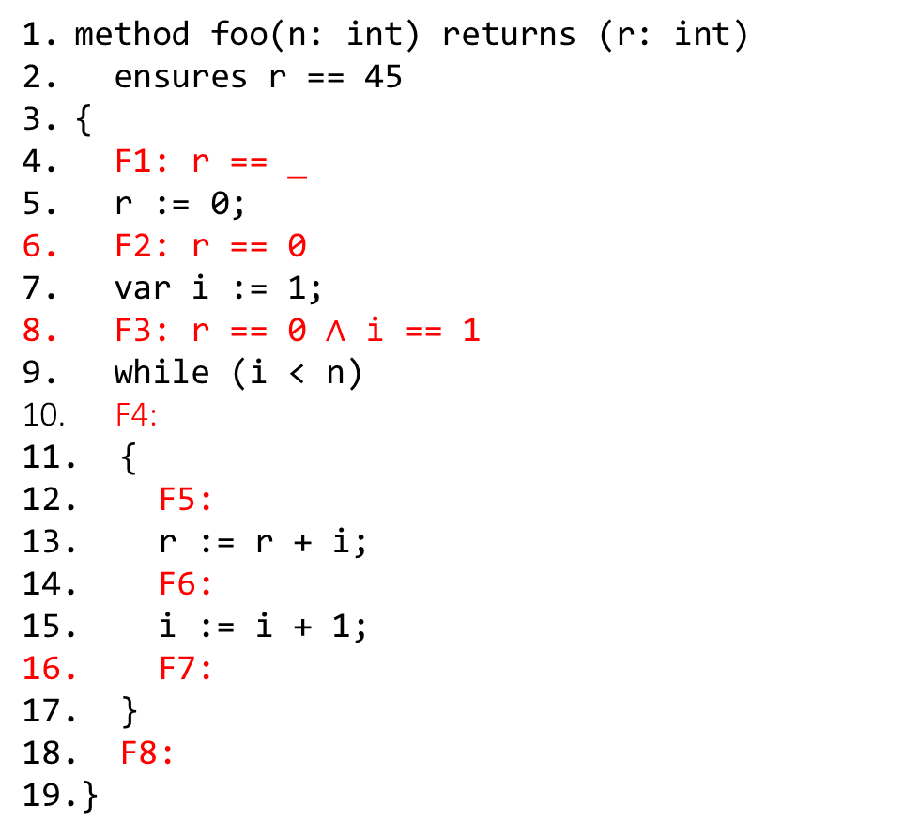
Loop invariant
method foo(n: int) returns (r: int)
ensures r == 45
{
F1: r == _
r := 0;
F2: r == 0
var i := 1;
F3: r == 0 $∧$ i == 1
while (i < n)
F4:
{
F5:
r := r + i;
F6:
i := i + 1;
F7:
}
F8:
}
Write FOL formulas F4, …, F8 for the forward direction using a loop invariant.
F4 is inserted just before the loop condition inside the loop.

Slide 47
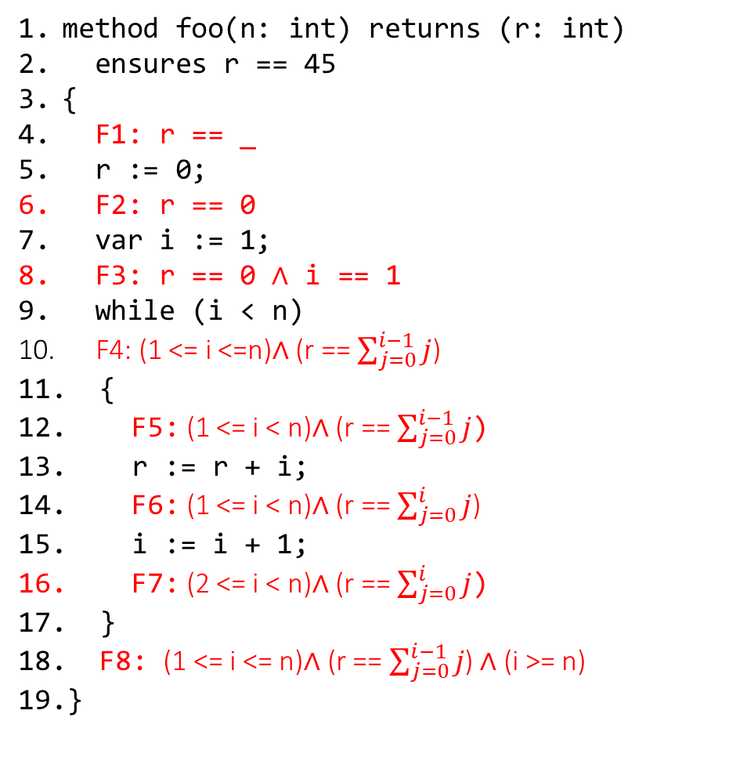
Loop invariant
method foo(n: int) returns (r: int)
ensures r == 45
{
F1: r == _
r := 0;
F2: r == 0
var i := 1;
F3: r == 0 $∧$ i == 1
while (i < n)
F4: (1 <= i <=n)$∧$ (r == $\sum_{j=0}^{i−1}{j}$)
{
F5: (1 <= i < n)$∧$ (r == $\sum_{j=0}^{i−1}{j}$)
r := r + i;
F6: (1 <= i < n)$∧$ (r == $\sum_{j=0}^{i}{j}$)
i := i + 1;
F7: (2 <= i < n)$∧$ (r == $\sum_{j=0}^{i}{j}$)
}
F8: (1 <= i <= n)$∧$ (r == $\sum_{j=0}^{i−1}{j}$) ∧ (i >= n)
}
Write FOL formulas F4, …, F8 for the forward direction using a loop invariant.
F4 is inserted just before the loop condition inside the loop.

Slide 48
Background

Slide 49
References
Chapter-2 from the Program Proofs book
Chapter-5 from the COC book
https://en.wikipedia.org/wiki/Predicate_transformer_semantics

Slide 50
Hoare triples
Hoare triples is a notation that is used to reason about correctness.
A Hoare triple {P} S {Q}, where P and Q are predicates and S is a program, is valid if the program starts in a state satisfying P and terminates in a state satisfying Q.

Slide 51
Hoare triples
Hoare triples {P} S {Q} can be used in two contexts
Partial correctness:
(Initial state of S satisfies P) ∧ (S terminates) → (Final state of S satisfies Q)
Total correctness:
(Initial state of S satisfies P) → (S terminates) ∧ (Final state of S satisfies Q)

Slide 52
Hoare triples
For now, we are going to assume partial correctness
Total correctness will be discussed later

Slide 53
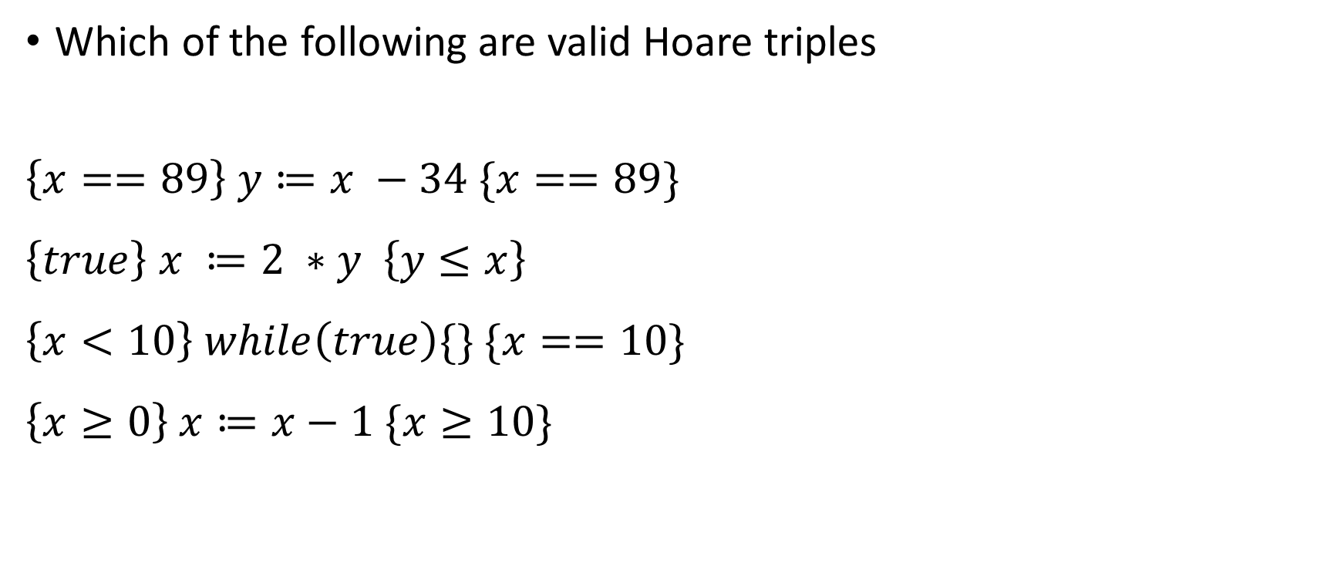
Hoare triples
Which of the following are valid Hoare triples
$$\left\{x==89\right\} y≔x −34 \{x==89\}$$
$$\left\{true\right\} x ≔2 ∗y \left\{y≤x\right\}$$
$$\left\{x<10\right\} while\left(true\right)\{\} \{x==10\}$$
$$\left\{x≥0\right\} x≔x−1 \{x≥10\}$$

Slide 54
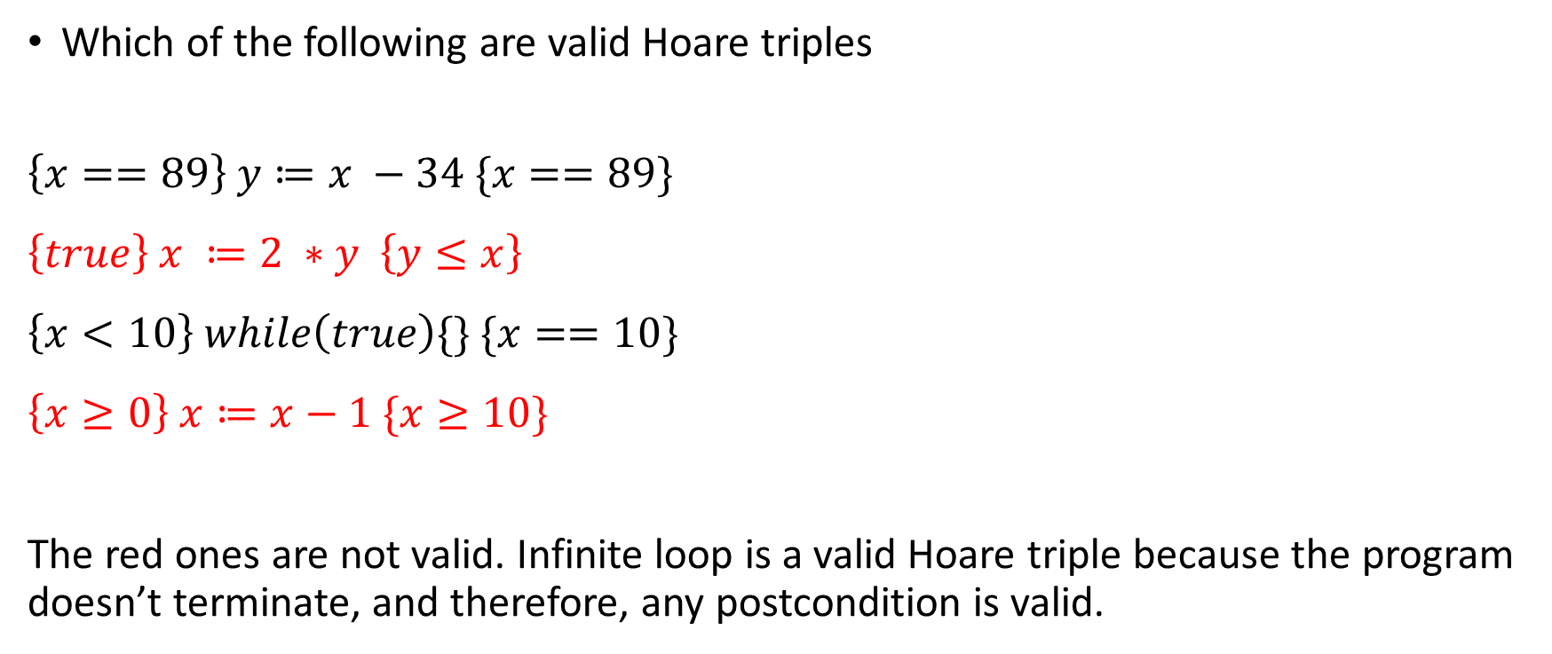
Hoare triples
Which of the following are valid Hoare triples
$$\left\{x==89\right\} y≔x −34 \{x==89\}$$
$$\left\{true\right\} x ≔2 ∗y \left\{y≤x\right\}$$
$$\left\{x<10\right\} while\left(true\right)\{\} \{x==10\}$$
$$\left\{x≥0\right\} x≔x−1 \{x≥10\}$$
The red ones are not valid. Infinite loop is a valid Hoare triple because the program doesn’t terminate, and therefore, any postcondition is valid.

