Slide 2
Today’s lecture
Hoare logic
Weakest precondition
Strongest postcondition

Slide 3
Program correctness
So far, we have discussed that we can generate FOL formulas before and after each program statement using forward or backward analysis
Now, we are going to discuss in more detail about how to do this automatically

Slide 4
References
Chapter-2 from the Program Proofs book
Chapter-5 from the COC book
https://en.wikipedia.org/wiki/Predicate_transformer_semantics

Slide 5
Hoare triples
Hoare triples is a notation that is used to reason about correctness.
A Hoare triple {P} S {Q}, where P and Q are predicates and S is a program, is valid if the program starts in a state satisfying P and terminates in a state satisfying Q.

Slide 6
Hoare triples
Hoare triples {P} S {Q} can be used in two contexts
Partial correctness:
(Initial state of S satisfies P) ∧ (S terminates) → (Final state of S satisfies Q)
Total correctness:
(Initial state of S satisfies P) → (S terminates) ∧ (Final state of S satisfies Q)

Slide 7
Hoare triples
For now, we are going to assume partial correctness
Total correctness will be discussed later

Slide 8
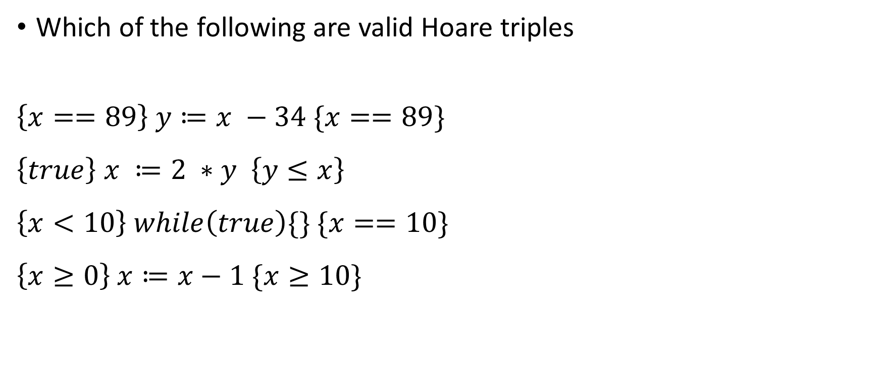
Hoare triples
Which of the following are valid Hoare triples
$$\left\{x==89\right\} y≔x −34 \{x==89\}$$
$$\left\{true\right\} x ≔2 ∗y \left\{y≤x\right\}$$
$$\left\{x<10\right\} while\left(true\right)\{\} \{x==10\}$$
$$\left\{x≥0\right\} x≔x−1 \{x≥10\}$$

Slide 9
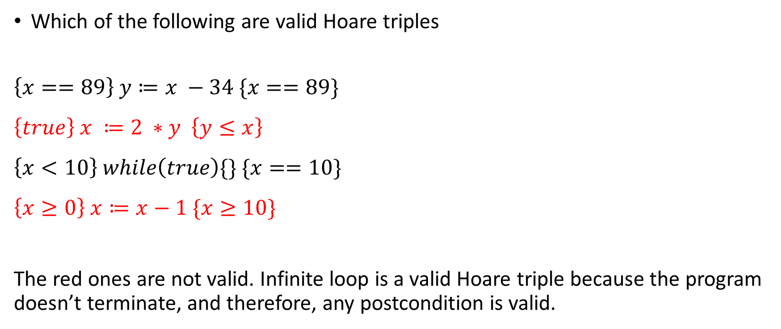
Hoare triples
Which of the following are valid Hoare triples
$$\left\{x==89\right\} y≔x −34 \{x==89\}$$
$$\left\{true\right\} x ≔2 ∗y \left\{y≤x\right\}$$
$$\left\{x<10\right\} while\left(true\right)\{\} \{x==10\}$$
$$\left\{x≥0\right\} x≔x−1 \{x≥10\}$$
The red ones are not valid. Infinite loop is a valid Hoare triple because the program doesn’t terminate, and therefore, any postcondition is valid.

Slide 10
Program correctness
The proof strategy for program correctness can be thought of as computing Hoare triples {P} S {Q} for each statement S in the program
In the forward analysis, the goal is to compute Q from P and S
In the backward analysis, the goal is to compute P from S and Q
However, a valid Hoare triple is not always sufficient for proof, as we will see next

Slide 11
Program correctness
{x >= 100} x := x + 1 {Q}
Below are some of the valid Hoare triples:
{x >= 100} x := x + 1 {x >= 101}
{x >= 100} x := x + 1 {x >= 1}
{x >= 100} x := x + 1 {x >= 100}
Which of them should we pick for Q?

Slide 12
Program correctness
{x >= 100} x := x + 1 {Q}
Below are some of the valid Hoare triples:
{x >= 100} x := x + 1 {x >= 101}
{x >= 100} x := x + 1 {x >= 1}
{x >= 100} x := x + 1 {x >= 100}
Which of them should we pick?
Among all possible Hoare triples, we should pick the one with the strongest Q.

Slide 13
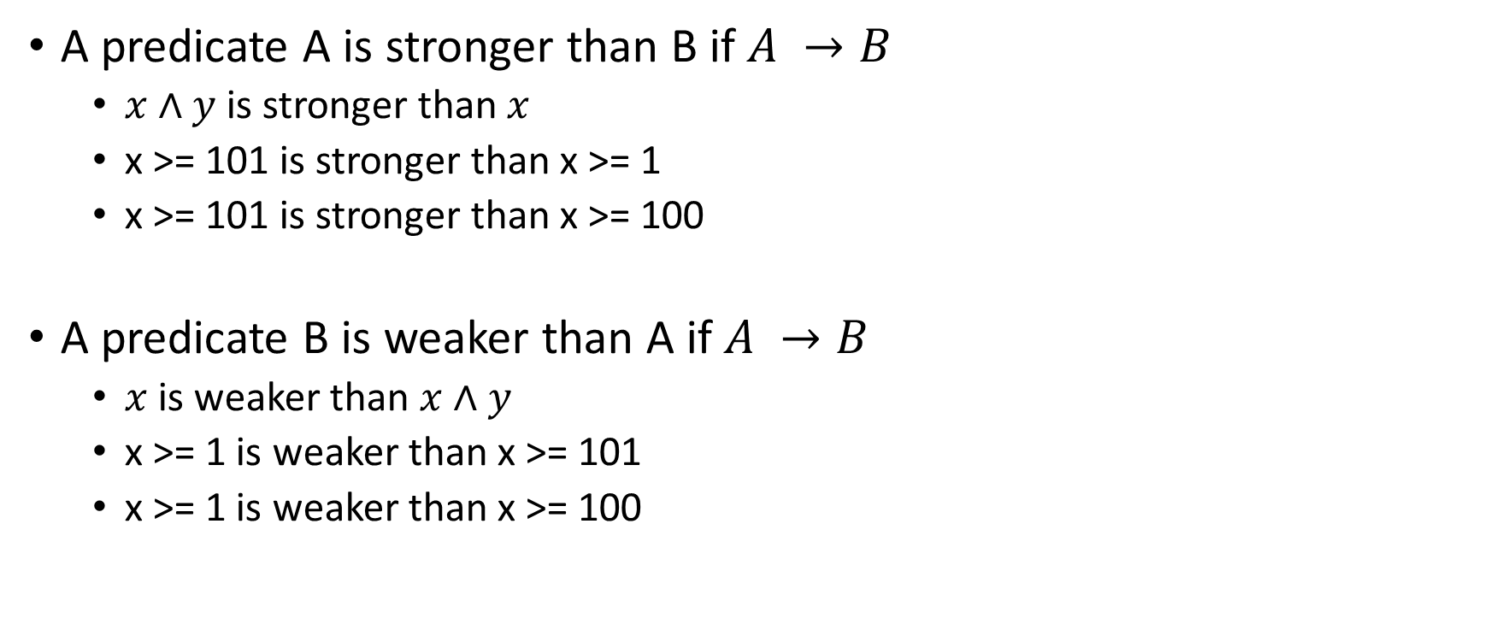
Program correctness
A predicate A is stronger than B if $A →B$
$x∧y$ is stronger than $x$
x >= 101 is stronger than x >= 1
x >= 101 is stronger than x >= 100
A predicate B is weaker than A if $A →B$
$x$ is weaker than $x∧y$
x >= 1 is weaker than x >= 101
x >= 1 is weaker than x >= 100

Slide 14
Program correctness
{x >= 100} x := x + 1 {Q}
Below are some of the valid replacements for Q:
{x >= 100} x := x + 1 {x >= 101}
{x >= 100} x := x + 1 {x >= 1}
{x >= 100} x := x + 1 {x >= 100}
Notice that valid replacements for Q, e.g., x >= 101, x >= 1, x >= 100, etc., are also a suitable postcondition of the program x := x+1. If we pick a weaker Q, say x >= 1, we won’t be able to prove a stronger postcondition, say x >= 101.

Slide 15

Program correctness
For correctness proof in the forward direction for statement S and its Hoare triple $\left\{P\right\} S \left\{Q\right\}$, we need to compute the strongest Q possible, also called the strongest postcondition

Slide 16
Program correctness
{P} x := x + 1 {x >= 11}
Some valid replacements for P are:
{x >= 100} x := x + 1 {x >= 101}
{x >= 101} x := x + 1 {x >= 101}
{x >= 501} x := x + 1 {x >= 101}
Which of them should we pick?

Slide 17
Program correctness
{P} x := x + 1 {x >= 11}
Some valid replacements for P are:
{x >= 100} x := x + 1 {x >= 101}
{x >= 101} x := x + 1 {x >= 101}
{x >= 501} x := x + 1 {x >= 101}
Which of them should we pick?
Among all possible Hoare triples, we should pick the one with the weakest P.

Slide 18
Program correctness
{P} x := x + 1 {x >= 11}
Some valid replacements for P are
{x >= 100} x := x + 1 {x >= 101}
{x >= 101} x := x + 1 {x >= 101}
{x >= 501} x := x + 1 {x >= 101}
Notice that valid replacements for P, e.g., x >= 100, x >= 101, x >= 501, etc., are also a suitable precondition of the program x := x+1. If we pick a stronger P, say x >= 501, we won’t be able to prove a weaker precondition, say x >= 101.

Slide 19

Program correctness
For correctness proof in the backward direction for statement S and its Hoare triple $\left\{P\right\} S \left\{Q\right\}$, we need to compute the weakest P possible, also called the weakest precondition

Slide 20
Assignment
Compute the weakest precondition before each statement.
wp:
x := x + 1
wp:
x := x + 5
wp:
x := x + 8
wp:
x := x + 10
Postcondition: x >= 24
What predicate, say P7, must be true at Line-7 that would make x == 24 true after the execution of Line-8 x := x + 10?
What predicate, say P5, must be true at Line-5 that would make P7 true after the execution of Line-6 x := x + 8?

Slide 21
Assignment
Compute the weakest precondition before each statement.
wp: x + 1 + 5 + 8 + 10 >= 24 or x >= 0
x := x + 1
wp: x + 5 + 8 + 10 >= 24
x := x + 5
wp: x + 8 + 10 >= 24
x := x + 8
wp: x + 10 >= 24
x := x + 10
Postcondition: x >= 24

Slide 22
Assignment
Is there any precondition weaker than x >= 0 possible at line-1 for the previous program that guarantees that the postcondition after line-8 holds?

Slide 23
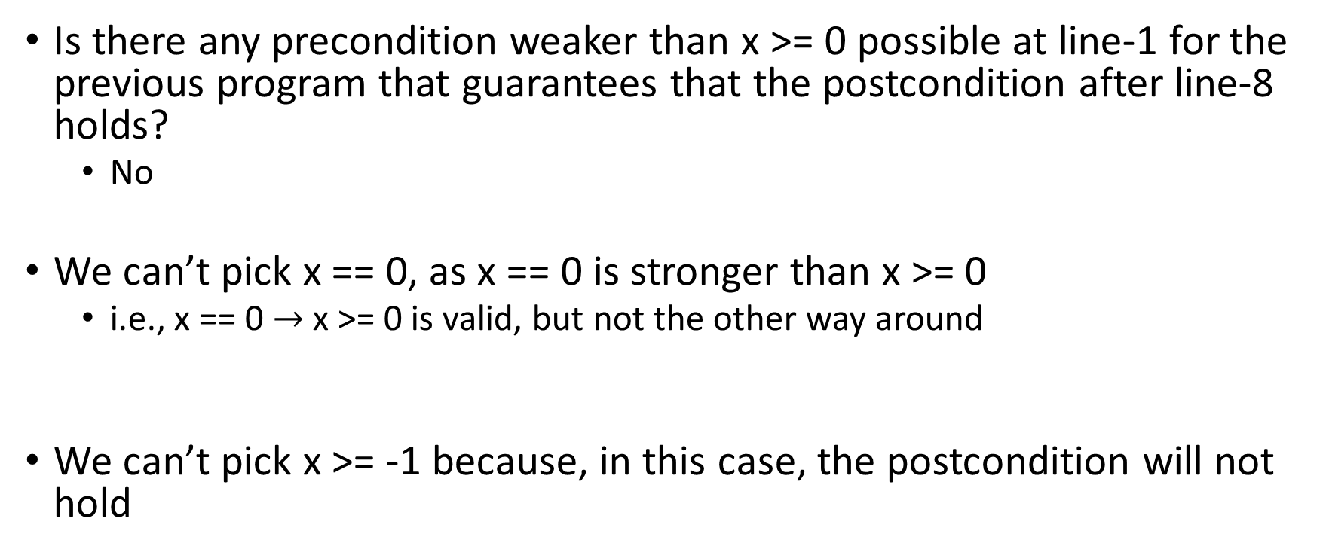
Assignment
Is there any precondition weaker than x >= 0 possible at line-1 for the previous program that guarantees that the postcondition after line-8 holds?
No
We can’t pick x == 0, as x == 0 is stronger than x >= 0
i.e., x == 0 $→$ x >= 0 is valid, but not the other way around
We can’t pick x >= -1 because, in this case, the postcondition will not hold

Slide 24
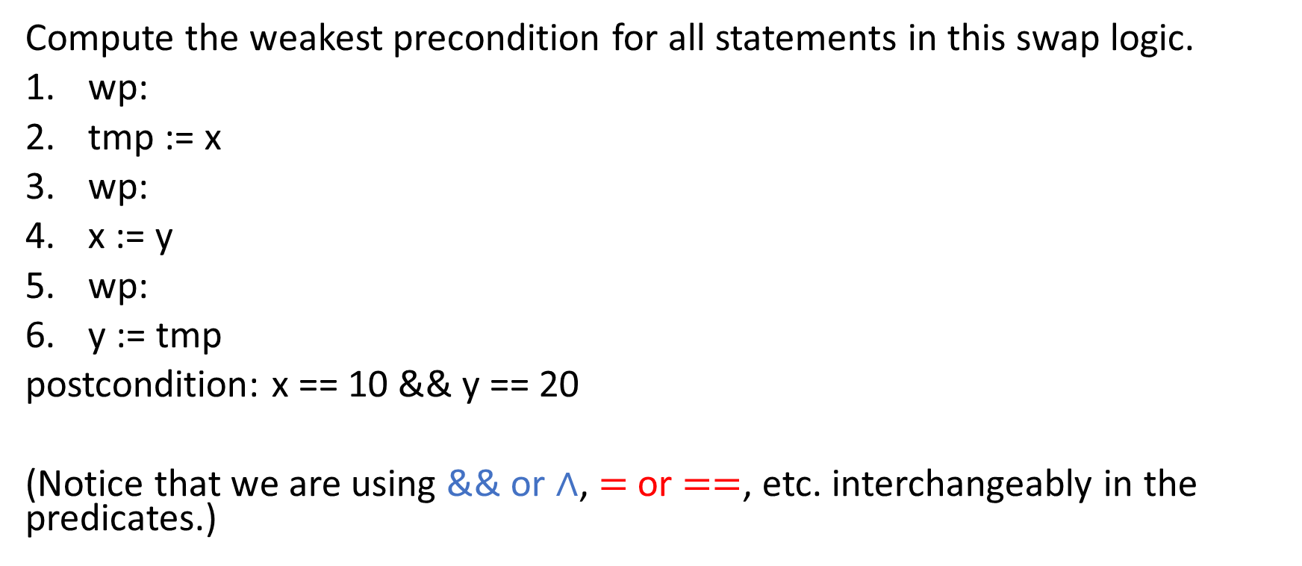
Assignment
Compute the weakest precondition for all statements in this swap logic.
wp:
tmp := x
wp:
x := y
wp:
y := tmp
postcondition: x == 10 && y == 20
(Notice that we are using && or $∧$, $=$ or $==$, etc. interchangeably in the predicates.)
What predicate, say P5, must be true at Line-5 that would make x == 10 && y == 20 true after the execution of Line-6 y := tmp?
What predicate, say P3, must be true at Line-3 that would make P5 true after the execution of Line-4 x := y?

Slide 25
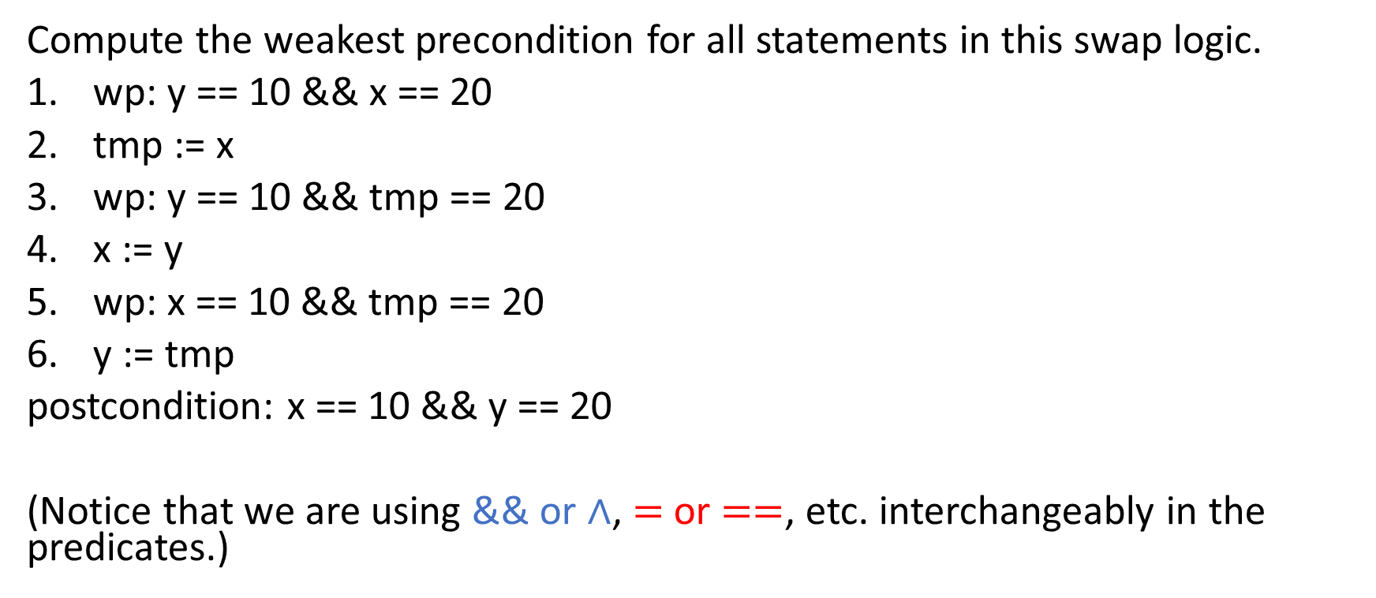
Assignment
Compute the weakest precondition for all statements in this swap logic.
wp: y == 10 && x == 20
tmp := x
wp: y == 10 && tmp == 20
x := y
wp: x == 10 && tmp == 20
y := tmp
postcondition: x == 10 && y == 20
(Notice that we are using && or $∧$, $=$ or $==$, etc. interchangeably in the predicates.)

Slide 26
Formula
Let’s define WP[S, Q] to denote the weakest precondition of S with respect to the postcondition Q.
WP[x := E, Q] = Q[x := E]
Here, Q[x := E] is the resulting predicate after replacing all free occurrences of x in Q with E.

Slide 27
if-then-else
Compute the weakest precondition for all statements
What value of wp6 makes x + y == 100 true after the execution of Line-13?
What value of wp5 makes wp6 true after the execution of Line-11?
What value of wp4 makes x + y == 100 true after the execution of Line-8?
What value of wp3 makes wp4 true after the execution of Line-6?
What value of wp2 makes wp3 true after the execution of Line-4?
What value of wp1 makes wp2 or wp5 true after the execution of Line-2?
wp1:
if x < 3 {
wp2:
x := x + 1;
wp3:
y := 10;
wp4:
}
else {
wp5:
y := x;
wp6:
}
Postcondition: x + y == 100

Slide 28

if-then-else
Compute the weakest precondition for all statements
wp1: (x < 3 $∧$ x + 1 + 10 == 100) $∨$ (x >= 3 $∧$ x + x == 100)
if x < 3 {
wp2: x + 1 + 10 == 100
x := x + 1;
wp3: x + 10 == 100
y := 10;
wp4: x + y == 100
}
else {
wp5: x + x == 100
y := x;
wp6: x + y == 100
}
Postcondition: x + y == 100

Slide 29

if-then-else
wp1: (x < 3 $→$ x + 1 + 10 == 100) $∧$ (x >= 3 $→$ x + x == 100)
if x < 3 {
wp2: x + 1 + 10 == 100
x := x + 1;
wp3: x + 10 == 100
y := 10;
wp4: x + y == 100
}
else {
wp5: x + x == 100
y := x;
wp6: x + y == 100
}
Postcondition: x + y == 100
Alternative, weakest precondition.

Slide 30

Control flow
Let’s say the postcondition of if (B) {S} else {T} is Q (i.e., the weakest precondition of the following statement, N, after the if-else body).
The postcondition of both S and T will be Q because N is the first statement executed after both S and T.
The weakest precondition of S is WP[S, Q], and T is WP[T, Q].
If B is true, WP[S, Q] is the weakest precondition; otherwise, WP[T, Q] is the weakest precondition of the following statement after the if-condition. The question we need to ask is what predicate must be true before the if-else body to ensure that WP[S, Q] is true if B is true; otherwise, WP[T, Q] is true.
PRE: (B $∧$ WP[S, Q]) $∨$ (!B $∧$ WP[T, Q])
if (B) { S } else { T }
PRE: WP[S, Q]
PRE: WP[T, Q]
S
T
POST: Q
POST: Q
PRE: Q
Next Statement N

Slide 31

Control flow
PRE: (B $→$ WP[S, Q]) $∧$ (!B $→$ WP[T, Q])
if (B) { S } else { T }
PRE: WP[S, Q]
PRE: WP[T, Q]
S
T
POST: Q
POST: Q
PRE: Q
Next Statement N
An alternative precondition for the if-else statement is shown here.

Slide 32

Formula
WP[if B { S } else { T }, Q] = (B $→$ WP[S, Q]) $∧$ (!B $→$ WP[T, Q])
WP[if B { S } else { T }, Q] = (B $∧$ WP[S, Q]) $∨$ (!B $∧$ WP[T, Q])

Slide 33
Example
wp:
if x < 8 {
wp:
if x == 5 {
wp:
y := 10;
wp:
} else {
wp:
y := 2;
wp:
}
wp:
}
else {
wp:
y := 0;
wp:
}
Postcondition: y < 10
Write the weakest preconditions of all statements.

Slide 34
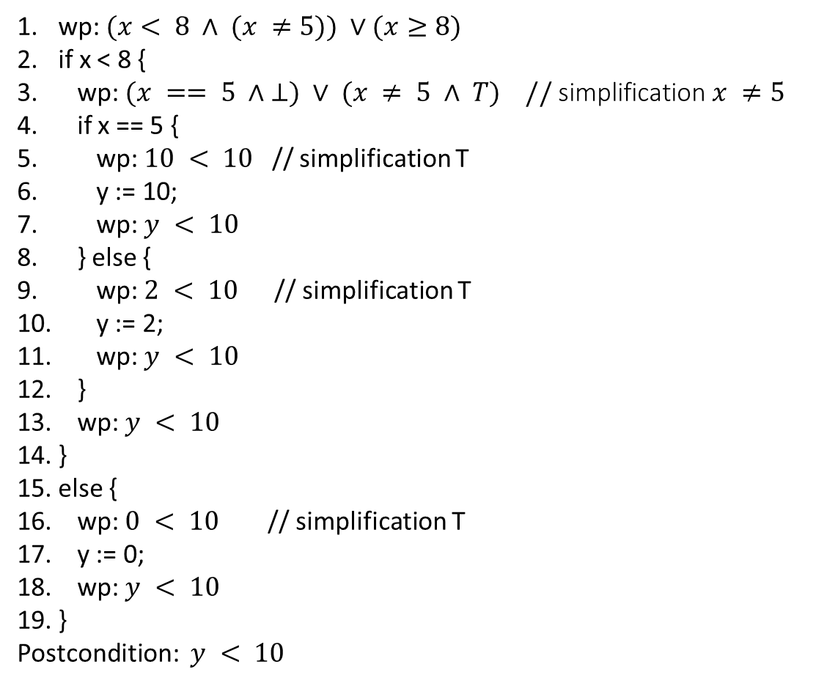
Example
wp: $(x< 8 ∧ (x ≠5)) ∨(x≥8)$
if x < 8 {
wp: $(x == 5 ∧ ⊥) ∨ (x ≠ 5 ∧ T) //$simplification$x ≠5$
if x == 5 {
wp: $10 < 10$ // simplification T
y := 10;
wp: $y < 10$
} else {
wp: $2 < 10$// simplification T
y := 2;
wp: $y < 10$
}
wp: $y < 10$
}
else {
wp: $0 < 10$// simplification T
y := 0;
wp: $y < 10$
}
Postcondition: $y < 10$

Slide 35
Sequential composition
{P} S; T {Q}
WP[S;T, Q] =
What needs to be true before S;T such that Q holds after the execution of S followed by the execution of T?

Slide 36
Sequential composition
{P} S; T {Q}
WP[S;T, Q] = WP[S, WP[T, Q]]

Slide 37
Example
WP[x := x +1; y := x + y, x + y <= 100]
=

Slide 38
Example
WP[x := x +1; y := x + y, x + y <= 100]
= WP[x := x + 1; WP[y := x + y, x + y <= 100]]
= WP[x := x + 1; x + x + y <= 100]
= x + 1 + x + 1 + y <= 100
After simplification,
2x + y <= 98

Slide 39
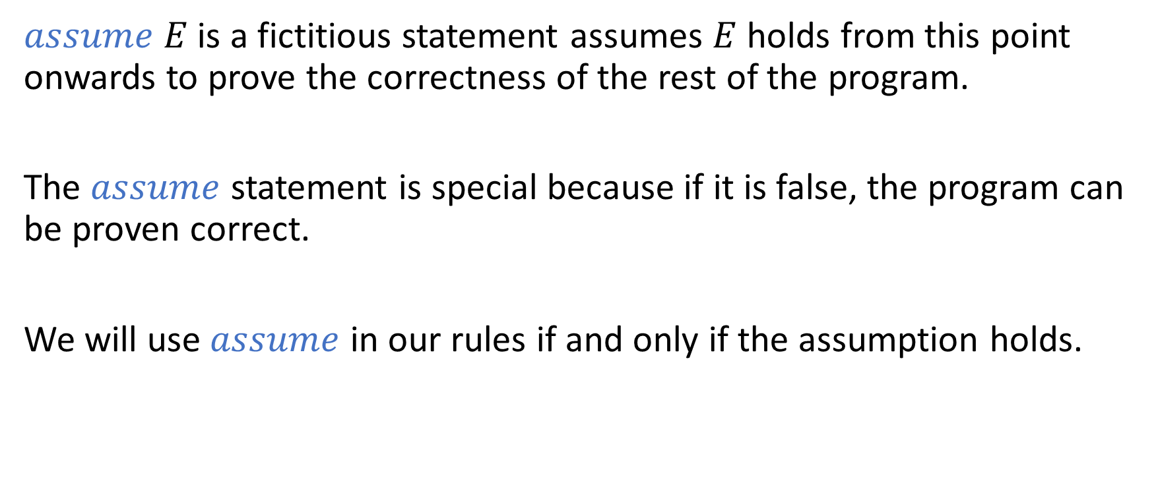
Assumption
$assume E$ is a fictitious statement assumes $E$ holds from this point onwards to prove the correctness of the rest of the program.
The $assume$ statement is special because if it is false, the program can be proven correct.
We will use $assume$ in our rules if and only if the assumption holds.

Slide 40
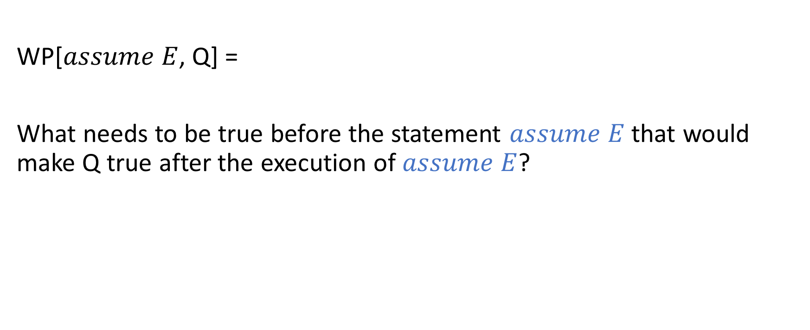
Assumption
WP[$assume E$, Q] =
What needs to be true before the statement $assume E$ that would make Q true after the execution of $assume E$?

Slide 41

Assumption
WP[$assume E$, Q] = $E →Q$

Slide 42
Assumption
wp:
x := 0
wp:
x := x + 1
wp:
assume(x == 5)
wp:
x := x + 4
Postcondition x == 10

Slide 43
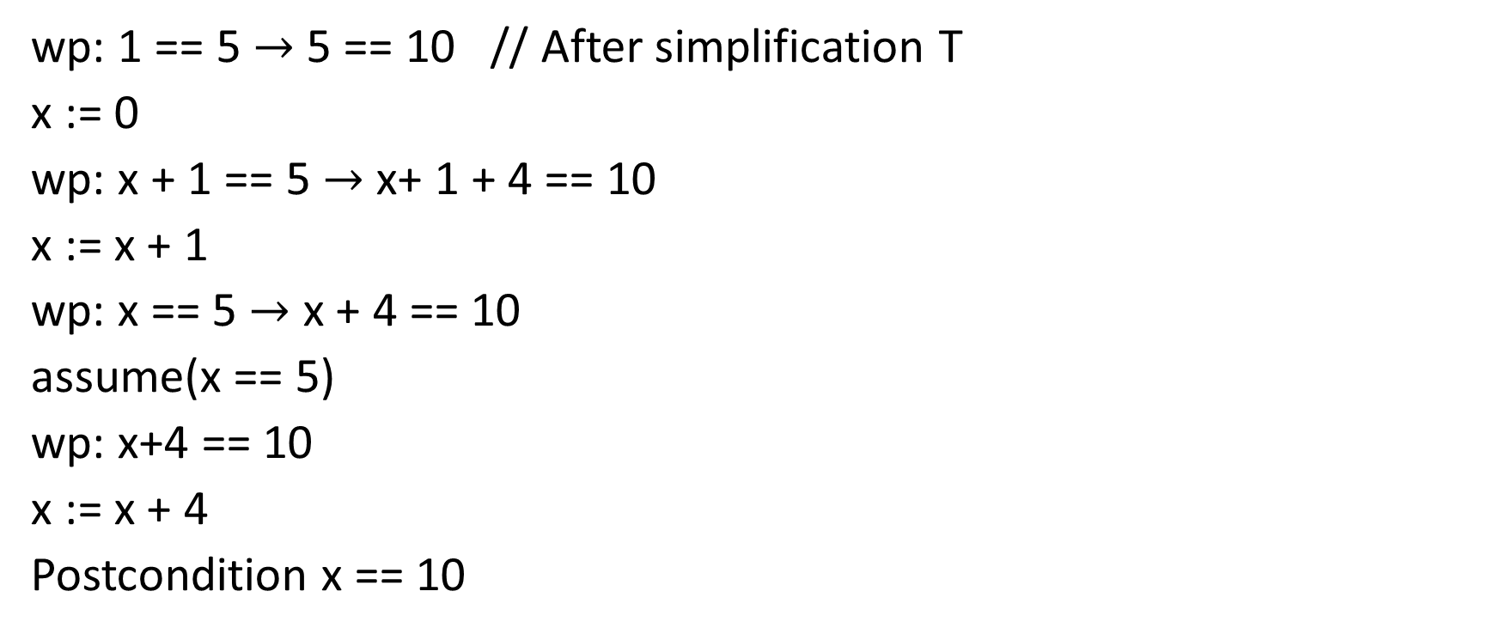
Assumption
wp: 1 == 5 $→$ 5 == 10 // After simplification T
x := 0
wp: x + 1 == 5 $→$ x+ 1 + 4 == 10
x := x + 1
wp: x == 5 $→$ x + 4 == 10
assume(x == 5)
wp: x+4 == 10
x := x + 4
Postcondition x == 10
Notice that the weakest precondition trusts the assumption. If the assumption is incorrect, an incorrect program can be proven correct.

Slide 44
Assumption
wp:
x := 0
wp:
x := x + 1
wp:
assume(x == 1)
wp:
x := x + 4
Postcondition x == 10

Slide 45
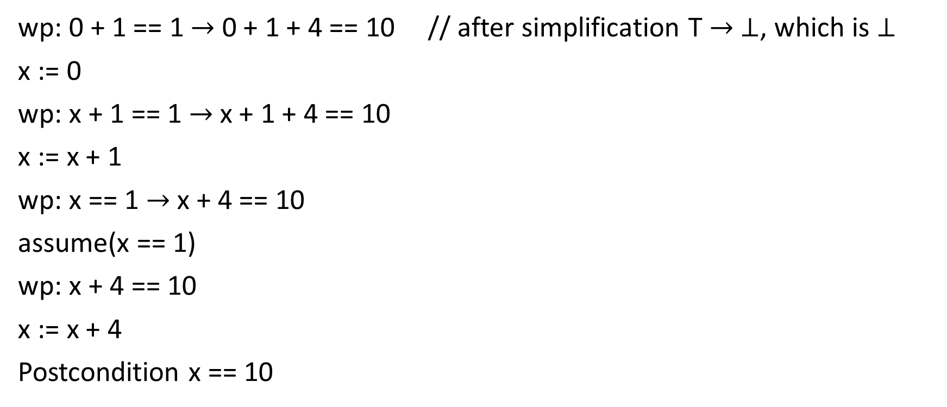
Assumption
wp: 0 + 1 == 1 $→$ 0 + 1 + 4 == 10 // after simplification T $→$ $⊥$, which is $⊥$
x := 0
wp: x + 1 == 1 $→$ x + 1 + 4 == 10
x := x + 1
wp: x == 1 $→$ x + 4 == 10
assume(x == 1)
wp: x + 4 == 10
x := x + 4
Postcondition x == 10

Slide 46
Assertion
An assertion is a predicate that must hold at a given program point
The weakest precondition is computed in such a way that the verification fails if the assertion doesn’t hold

Slide 47
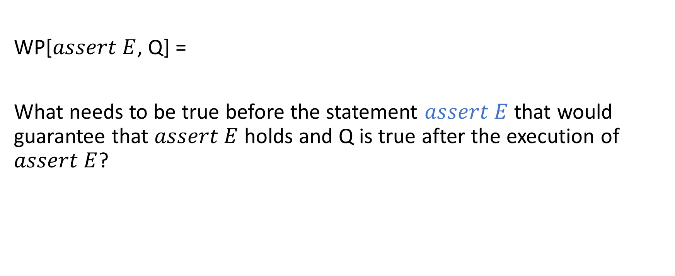
Assertion
WP[$assert E$, Q] =
What needs to be true before the statement $assert E$ that would guarantee that $assert E$ holds and Q is true after the execution of $assert E$?

Slide 48

Assertion
WP[$assert E$, Q] = $E∧Q$

Slide 49
Assertion
wp:
x := 0
wp:
x := x + 1
wp:
x := x + 1
wp:
x := x + 1
wp:
assert(x == 4)
Postcondition: T

Slide 50

Assertion
wp: 0 + 1 + 1 + 1 == 4 // after simplification $⊥$
x := 0
wp: x + 1 + 1 + 1 == 4
x := x + 1
wp: x + 1 + 1 == 4
x := x + 1
wp: x + 1 == 4
x := x + 1
wp: x == 4 $∧$ T // after simplification x == 4
assert(x == 4)
Postcondition: T
Notice that assert is a proof obligation. The weakest precondition proves that the assertion indeed holds at runtime.

Slide 51
Example
Compute the weakest precondition of all these statements with the postcondition x < 100.
assert y == 25
assert x >= 0
assert x < 200
assert x <= 100
assert 0 <= x < 100

Slide 52
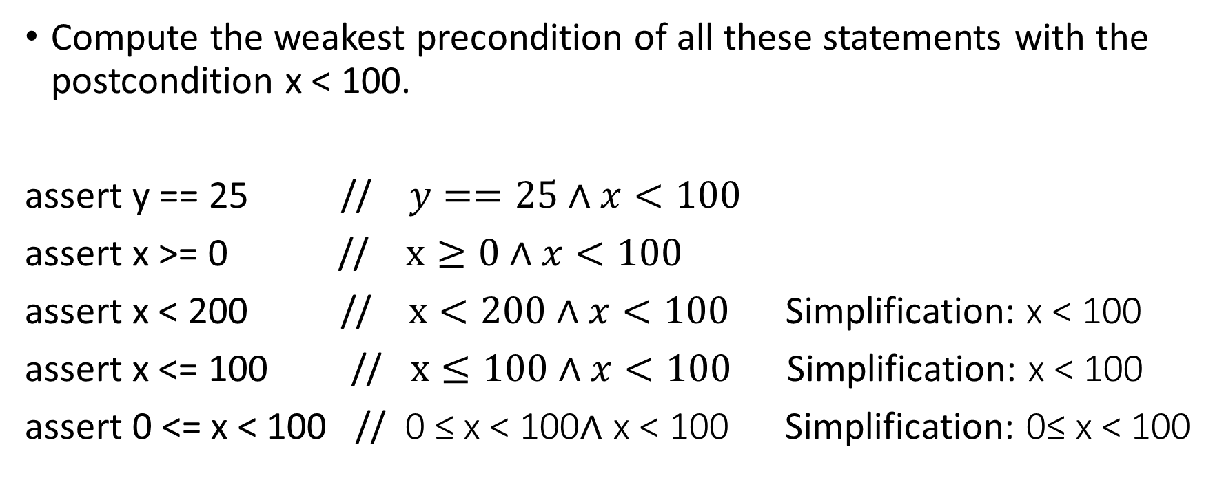
Example
Compute the weakest precondition of all these statements with the postcondition x < 100.
assert y == 25 // $y==25∧x<100$
assert x >= 0 // $x≥0∧x<100$
assert x < 200 // $x<200∧x<100$ Simplification: x < 100
assert x <= 100 // $x≤100∧x<100$ Simplification: x < 100
assert 0 <= x < 100 // 0 ≤ x < 100∧ x < 100 Simplification: 0≤ x < 100

Slide 53
Variable declaration
wp:
var x;
wp:
x = 10;
wp:
{
wp:
var x;
wp:
assert(x == 10);
wp:
}
wp: T
The weakest precondition at Line-13 is true. The precondition of the program is also true. Compute preconditions at other lines as annotated in the program snippet.
Is this program correct?

Slide 54
Variable declaration
wp: T
var x;
wp: 10 == 10
x = 10;
wp: x == 10
{
wp: x == 10
var x;
wp: x == 10
assert(x == 10);
wp: T
}
wp: T
The weakest precondition at Line-13 is true. The precondition of the program is also true. Compute preconditions at other lines as annotated in the program snippet.
Is this program correct?
If we consider variable declaration a no-op, the program is proven correct. However, this doesn't seem right because the assertion is not true.
How can we fix this problem?

Slide 55
Variable declaration
wp: T
var x;
wp: 10 == 10
x = 10;
wp: x == 10
{
wp: x == 10
var x;
wp: x == 10
assert(x == 10);
wp: T
}
wp: T
The weakest precondition at Line-13 is true. The precondition of the program is also true. Compute preconditions at other lines as annotated in the program snippet.
Is this program correct?
If we consider variable declaration a no-op, the program is proven correct. However, this doesn't seem right because the assertion is not true.
How can we fix this problem?
Ensure that all variables have a unique name.

Slide 56
Variable declaration
wp:
var y;
wp:
y = 10;
wp:
{
wp:
var x;
wp:
assert(x == 10);
wp:
}
wp: T
The weakest precondition at Line-13 is true. The precondition of the program is also true. Compute preconditions at other lines as annotated in the program snippet.
Is this program correct?
If we consider variable declaration a no-op, the program is proven correct. However, this doesn't seem right because the assertion is not true.
How can we fix this problem?
Ensure that all variables have a unique name.
Compute the weakest preconditions now.

Slide 57
Variable declaration
The weakest precondition at Line-13 is true. The precondition of the program is also true. Compute preconditions at other lines as annotated in the program snippet.
Is this program correct?
If we consider variable declaration a no-op, the program is proven correct. However, this doesn't seem right because the assertion is not true.
How can we fix this problem?
Ensure that all variables have a unique name.
Compute the weakest preconditions now.
Is this program correct?
wp: x == 10
var y;
wp: x == 10
y = 10;
wp: x == 10
{
wp: x == 10
var x;
wp: x == 10
assert(x == 10);
wp: T
}
wp: T

Slide 58

Variable declaration
The weakest precondition at Line-13 is true. The precondition of the program is also true. Compute preconditions at other lines as annotated in the program snippet.
Is this program correct?
If we consider variable declaration a no-op, the program is proven correct. However, this doesn't seem right because the assertion is not true.
How can we fix this problem?
Ensure that all variables have a unique name.
Compute the weakest preconditions now.
Is this program correct?
No, because T $→$ x == 10 is not valid.
wp: x == 10
var y;
wp: x == 10
y = 10;
wp: x == 10
{
wp: x == 10
var x;
wp: x == 10
assert(x == 10);
wp: T
}
wp: T

Slide 59
Variable declaration
wp:
var x;
wp:
x = 10;
wp:
{
wp:
var x;
wp:
assert(x == 10);
wp:
}
wp: T
Suppose we don’t want to rename variables. Can we compute the weakest precondition in a way that will work even if the variables may have the same name?

Slide 60


Variable declaration
wp: ($∀$x.$(∀$x. x == 10))
var x;
wp: ($∀$x. x == 10) // no free x to replace
x = 10;
wp: ($∀$x. x == 10)
{
wp: $∀$x. x == 10
var x;
wp: x == 10
assert(x == 10);
wp: T
}
wp: T
Suppose we don’t want to rename variables. Can we compute the weakest precondition in a way that will work even if the variables may have the same name?
Yes. Introduce quantifiers to limit the scope of variables.
Does the assertion hold?
No, because $∀$x. x == 10 is false.

Slide 61
Variable declaration
WP[var x, Q] = forall x : Q
At the time of the variable declaration, the value of the variable could be anything. Therefore, if the postcondition of var x contains x, it shouldn’t rely on any specific value of x.

Slide 62
Method call
method div(x: int, y: int) returns (r: int)
requires y != 0
ensures r * y <= x
method double(x: int, y: int) returns (r :int)
ensures r <= 2 *x
{
wp:
r := div(x + x + x + x, 2 * y);
wp:
r := r * y;
wp: r <= 2 * x
}
To compute the weakest precondition of a method call, first transform the code as shown in the next slide.

Slide 63
Method call
method div(x: int, y: int) returns (r: int)
requires y != 0
ensures r * y <= x
method double(x: int, y: int) returns (r :int)
ensures r <= 2 *x
{
wp:
x’ = x + x + x + x
y’ = 2 * y;
assert(y’ != 0);
assume(r’ * y’ <= x’);
r := r’;
wp:
r := r * y;
wp: r <= 2 * x
}
Remove the function call.
Create fresh variables for arguments and the return values for the function call, i.e., x’, y’, and r’ in this example.
Write preconditions and postconditions in terms of fresh variables x’, y’, and r’.
Assert that the precondition holds.
Assume that the postcondition holds.
The return value of the function is r’.

Slide 64
Method call
method div(x: int, y: int) returns (r: int)
requires y != 0
ensures r * y <= x
method double(x: int, y: int) returns (r :int)
ensures r <= 2 *x
{
wp:
x’ = x + x + x + x
wp:
y’ = 2 * y;
wp:
assert(y’ != 0);
wp:
assume(r’ * y’ <= x’);
wp:
r := r’;
wp:
r := r * y;
wp: r <= 2 * x
}
Compute the weakest preconditions at each program point.

Slide 65
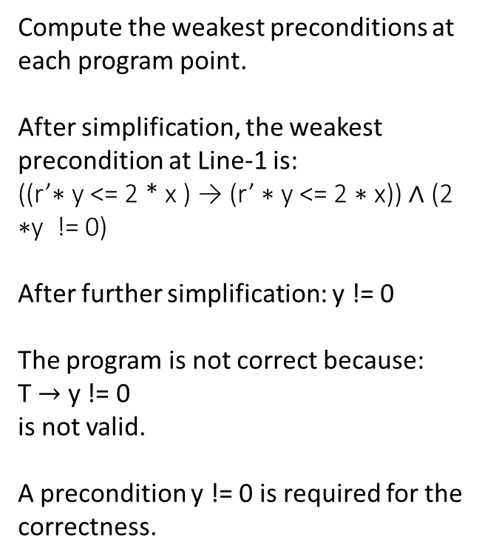
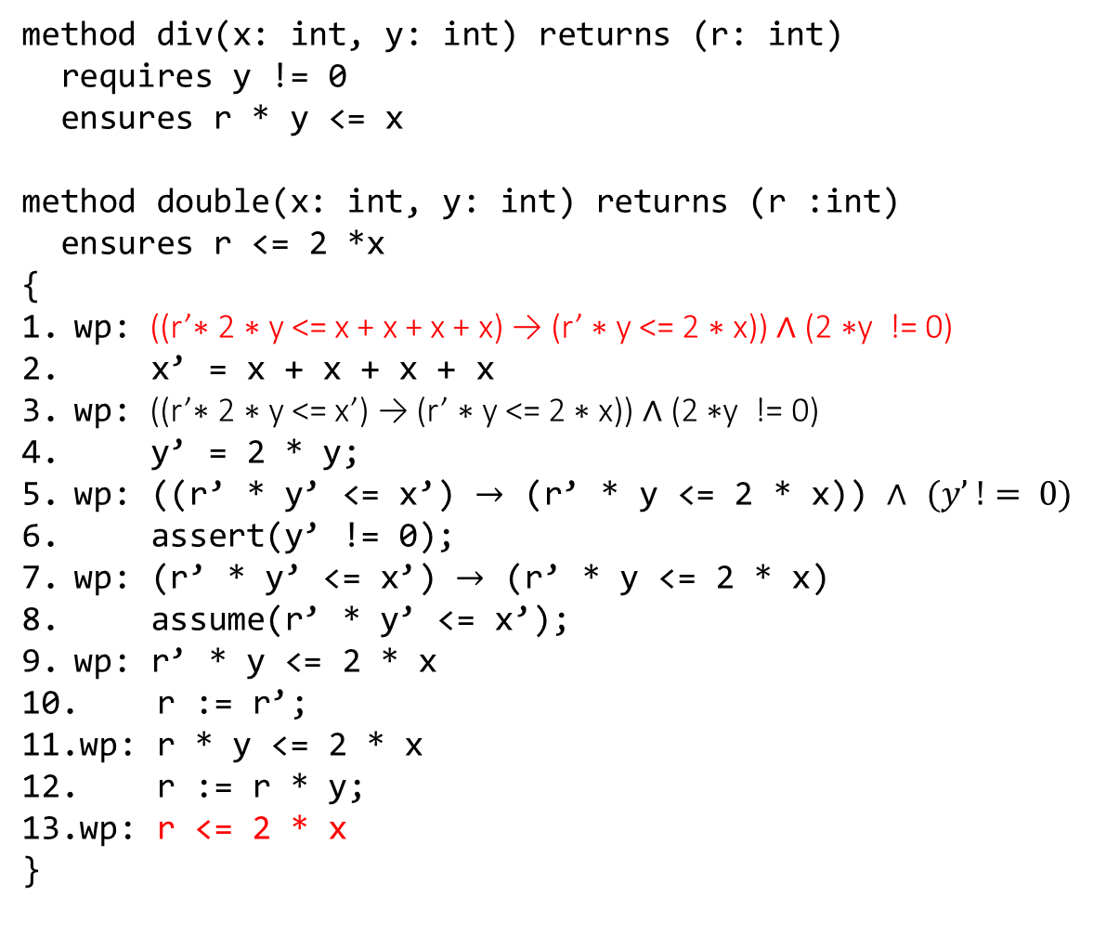
Method call
method div(x: int, y: int) returns (r: int)
requires y != 0
ensures r * y <= x
method double(x: int, y: int) returns (r :int)
ensures r <= 2 *x
{
wp: ((r’∗ 2 ∗ y <= x + x + x + x) → (r’ ∗ y <= 2 ∗ x)) ∧ (2 ∗y != 0)
x’ = x + x + x + x
wp: ((r’∗ 2 ∗ y <= x’) → (r’ ∗ y <= 2 ∗ x)) ∧ (2 ∗y != 0)
y’ = 2 * y;
wp: ((r’ * y’ <= x’) $→$ (r’ * y <= 2 * x)) $∧$ $(y’ != 0)$
assert(y’ != 0);
wp: (r’ * y’ <= x’) $→$ (r’ * y <= 2 * x)
assume(r’ * y’ <= x’);
wp: r’ * y <= 2 * x
r := r’;
wp: r * y <= 2 * x
r := r * y;
wp: r <= 2 * x
}
Compute the weakest preconditions at each program point.
After simplification, the weakest precondition at Line-1 is:
((r’∗ y <= 2 * x ) → (r’ ∗ y <= 2 ∗ x)) ∧ (2 ∗y != 0)
After further simplification: y != 0
The program is not correct because:
T $→$ y != 0
is not valid.
A precondition y != 0 is required for the correctness.

Slide 66
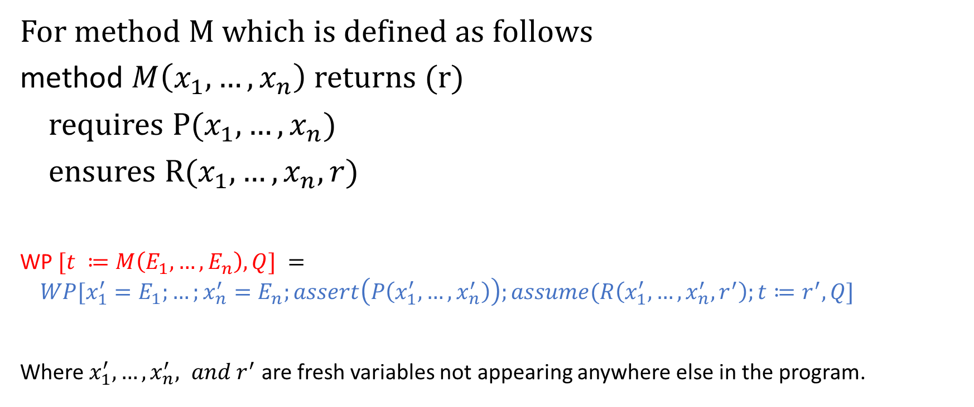
Method call
For method M which is defined as follows
method $M\left(x_{1}, …, x_{n}\right)$ returns (r)
requires P($x_{1}, …, x_{n}$)
ensures R($x_{1},…, x_{n}, r$)
WP $[t ≔M\left(E_{1},…,E_{n}\right), Q] =$
$$WP[x_{1}^{′}=E_{1};…;x_{n}^{′}=E_{n};assert\left(P\left(x_{1}^{′},…,x_{n}^{′}\right)\right);assume(R\left(x_{1}^{′},…,x_{n}^{′}, r^{′}\right);t≔r^{′},Q]$$
Where $x_{1}^{′},…,x_{n}^{′}, and r^{′}$ are fresh variables not appearing anywhere else in the program.

Slide 67
Method call
In the method call, we are assuming that the postcondition of the callee is true; isn’t it incorrect

Slide 68
Method call
In the method call, we are assuming that the postcondition of the callee is true; isn’t it incorrect
No. Because it is checked when we verify the callee. If the postcondition doesn’t hold, the verification of the callee will fail.

