Slide 2
Today’s topics
Array property fragment

Slide 3
References
Chapter-11 form the COC book
Chapter-7 from the DP book

Slide 4
Array property fragment

Slide 5
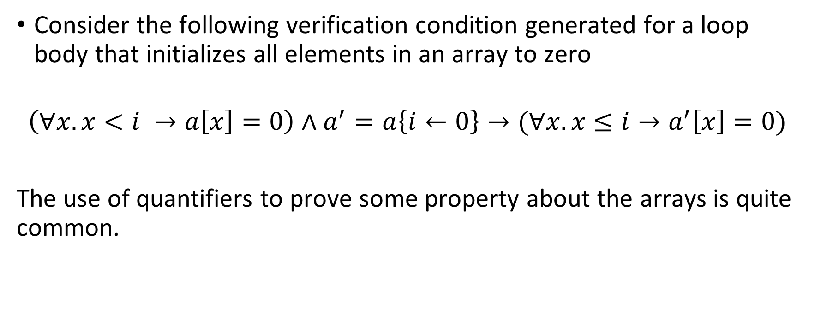
Motivation
Consider the following verification condition generated for a loop body that initializes all elements in an array to zero
$$\left(∀x. x<i →a\left[x\right]=0\right)∧a^{′}=a\left\{i←0\right\}→(∀x. x≤i→a^{′}\left[x\right]=0)$$
The use of quantifiers to prove some property about the arrays is quite common.

Slide 6
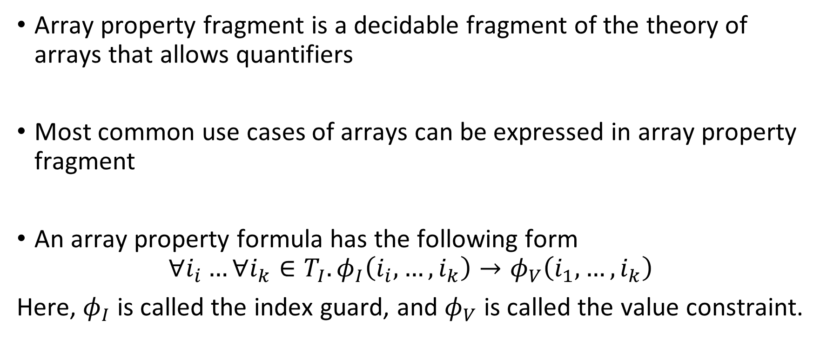
Array property fragment
Array property fragment is a decidable fragment of the theory of arrays that allows quantifiers
Most common use cases of arrays can be expressed in array property fragment
An array property formula has the following form
$$∀i_{i}…∀i_{k}∈T_{I}. φ_{I}\left(i_{i},…,i_{k}\right)→φ_{V}\left(i_{1},…,i_{k}\right)$$
Here, $φ_{I}$ is called the index guard, and $φ_{V}$ is called the value constraint.

Slide 7
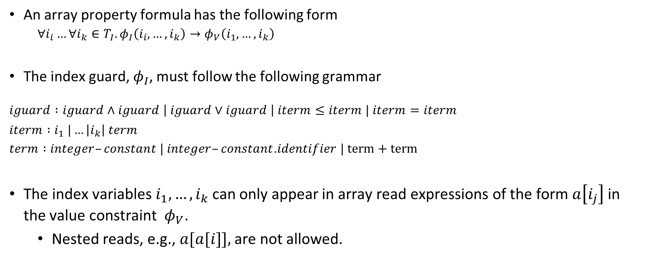
Array property fragment
An array property formula has the following form
$$∀i_{i}…∀i_{k}∈T_{I}. φ_{I}\left(i_{i},…,i_{k}\right)→φ_{V}\left(i_{1},…,i_{k}\right)$$
The index guard, $φ_{I}$, must follow the following grammar
$$iguard :iguard∧iguard \left| iguard∨iguard \right| iterm≤iterm | iterm=iterm$$
$iterm :i_{1} |…\left|i_{k}\right| term$
$term :integer–constant | integer–constant$.$identifier | term+term$
The index variables $i_{1},…,i_{k}$ can only appear in array read expressions of the form $a\left[i_{j}\right]$ in the value constraint $φ_{V}$.
Nested reads, e.g.,$a[a[i]],$are not allowed.

Slide 8
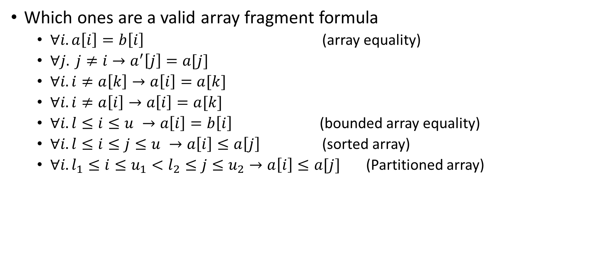
Array property fragment
Which ones are a valid array fragment formula
$∀i. a\left[i\right]=b\left[i\right]$ (array equality)
$∀j. j≠i→a^{′}\left[j\right]=a[j]$
$∀i. i≠a\left[k\right]→a\left[i\right]=a[k]$
$∀i. i≠a\left[i\right]→a\left[i\right]=a[k]$
$∀i. l≤i≤u →a\left[i\right]=b\left[i\right]$ (bounded array equality)
$∀i. l≤i≤j≤u →a\left[i\right]≤a\left[j\right]$ (sorted array)
$∀i. l_{1}≤i≤u_{1}<l_{2}≤j≤u_{2}→a\left[i\right]≤a[j]$ (Partitioned array)

Slide 9
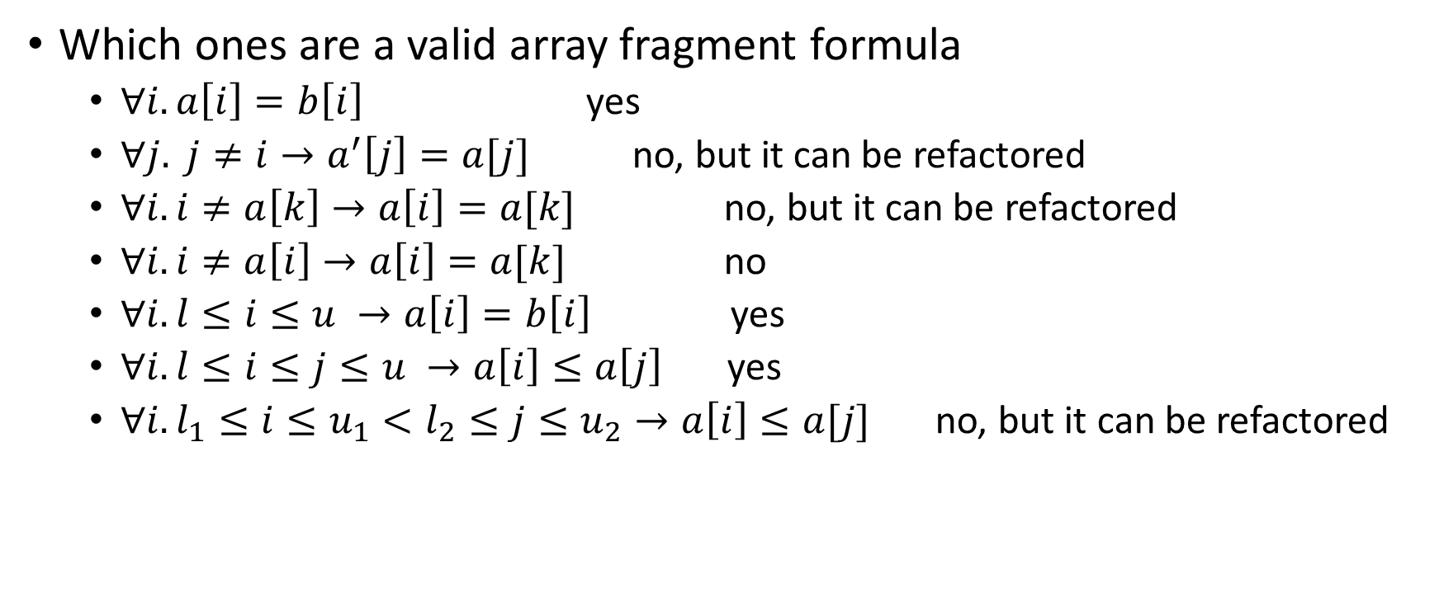
Array property fragment
Which ones are a valid array fragment formula
$∀i. a\left[i\right]=b\left[i\right]$ yes
$∀j. j≠i→a^{′}\left[j\right]=a[j]$ no, but it can be refactored
$∀i. i≠a\left[k\right]→a\left[i\right]=a[k]$ no, but it can be refactored
$∀i. i≠a\left[i\right]→a\left[i\right]=a[k]$ no
$∀i. l≤i≤u →a\left[i\right]=b\left[i\right]$ yes
$∀i. l≤i≤j≤u →a\left[i\right]≤a\left[j\right]$ yes
$∀i. l_{1}≤i≤u_{1}<l_{2}≤j≤u_{2}→a\left[i\right]≤a[j]$ no, but it can be refactored

Slide 10

Array property formula
Express $a^{′}=a\{i←0\}$ using the array property.

Slide 11
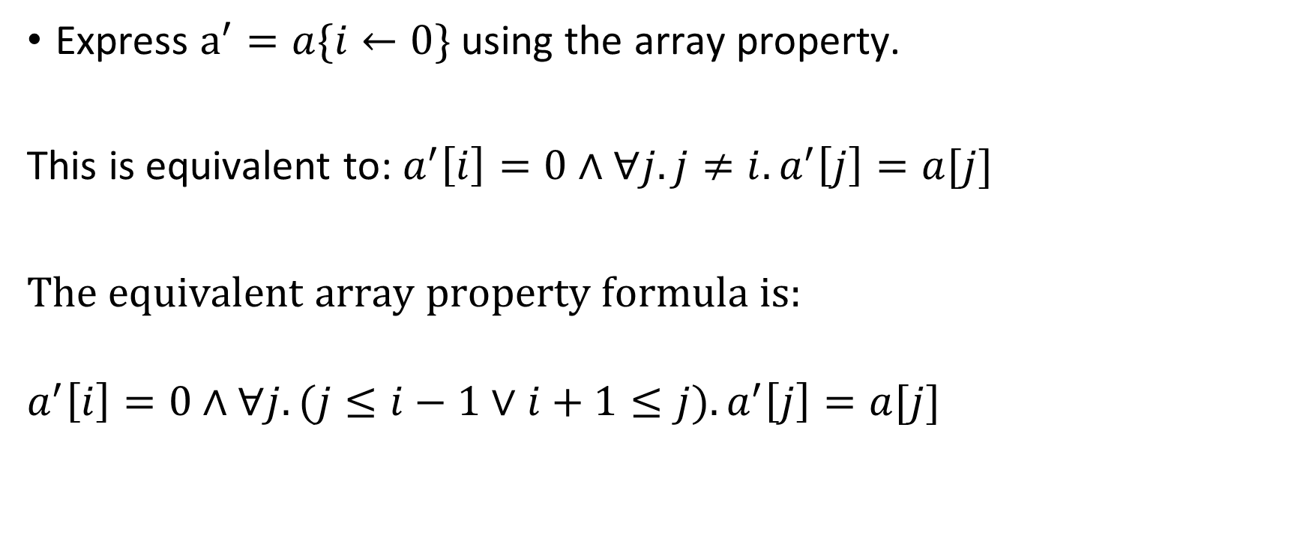
Array property formula
Express $a^{′}=a\{i←0\}$ using the array property.
This is equivalent to: $a^{′}\left[i\right]=0∧∀j. j≠i. a^{′}\left[j\right]=a[j]$
The equivalent array property formula is:
$$a^{′}\left[i\right]=0∧∀j. (j≤i−1∨i+1≤j).a^{′}\left[j\right]=a[j]$$

Slide 12

Array property formula
Can we express $∀i. i≠a\left[k\right]→a\left[i\right]=a[k]$ using the array property?

Slide 13
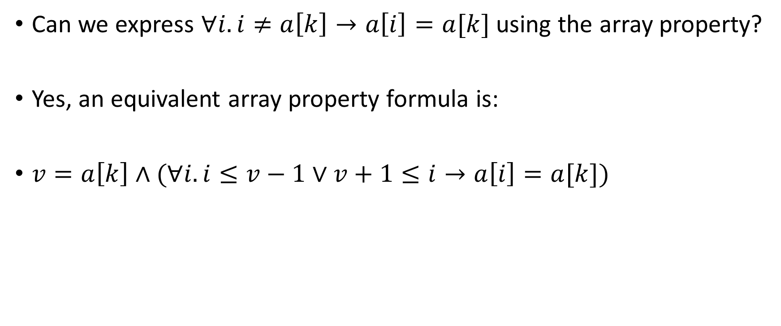
Array property formula
Can we express $∀i. i≠a\left[k\right]→a\left[i\right]=a[k]$ using the array property?
Yes, an equivalent array property formula is:
$v=a\left[k\right]∧(∀i. i≤v−1∨v+1≤i→a\left[i\right]=a[k])$

Slide 14

Array property formula
Can we express $∀i. i≠a\left[i\right]→a\left[i\right]=a[k]$ using the array property?

Slide 15

Array property formula
Can we express $∀i. i≠a\left[i\right]→a\left[i\right]=a[k]$ using the array property?
No.

Slide 16
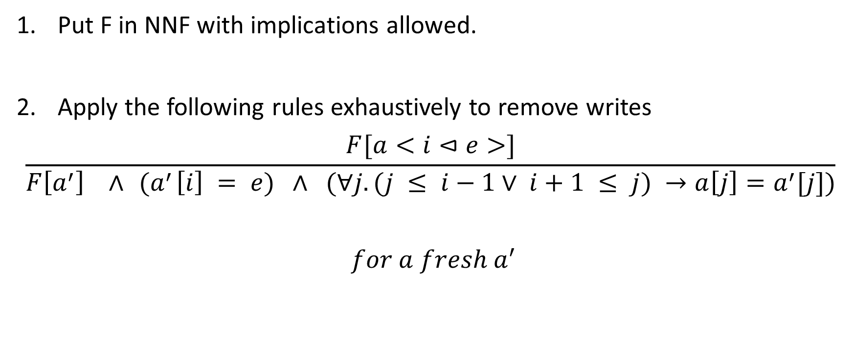
Decision procedure
Put F in NNF with implications allowed.
Apply the following rules exhaustively to remove writes
$$\frac{F[a<i⊲e>]}{F\left[a^{′}\right] ∧{ (a}^{′}\left[i\right] = e) ∧ (∀j. (j ≤ i−1∨ i+1 ≤ j) →a\left[j\right]=a^{′}[j])}$$
$$for a fresh a^{′}$$

Slide 17
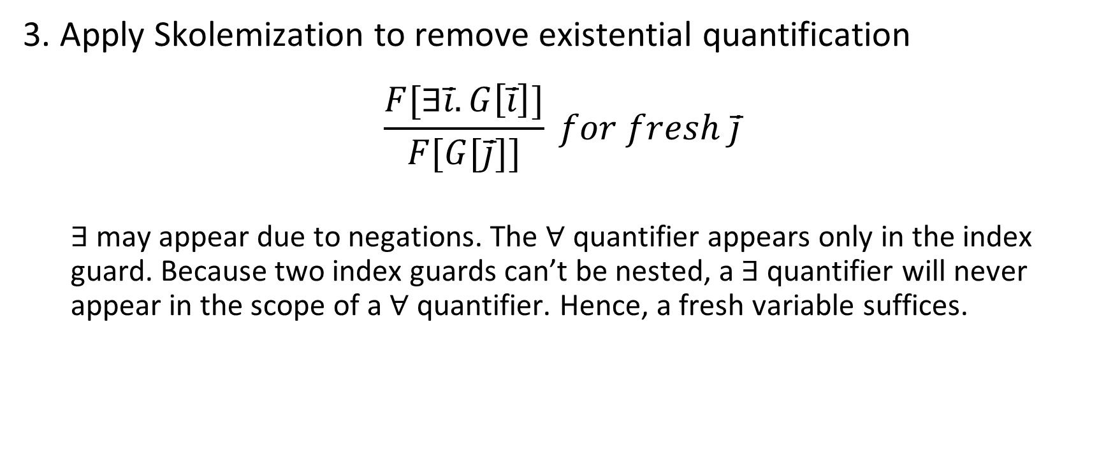
Decision procedure
3. Apply Skolemization to remove existential quantification
$$\frac{F[∃i̅.G\left[i̅\right]]}{F[G[j̅]]} for fresh j̅$$
$∃$ may appear due to negations. The $∀$ quantifier appears only in the index guard. Because two index guards can’t be nested, a $∃$ quantifier will never appear in the scope of a $∀$ quantifier. Hence, a fresh variable suffices.

Slide 18
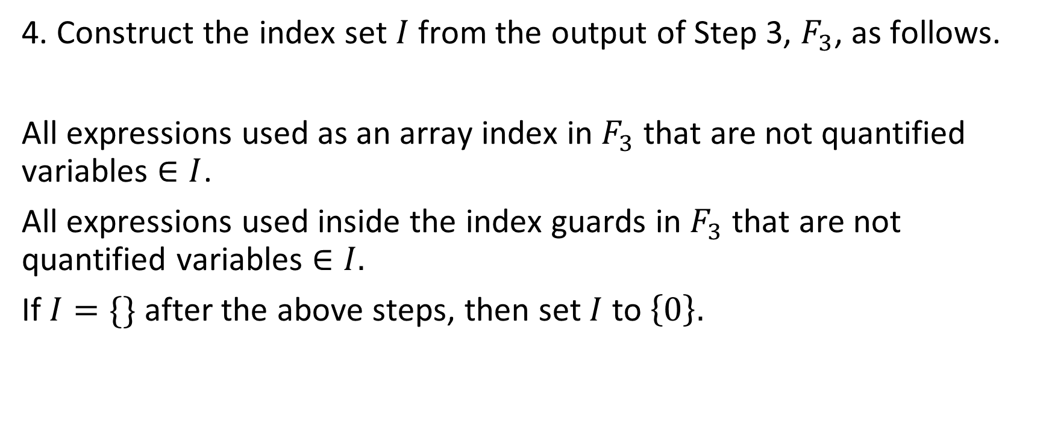
Decision procedure
4. Construct the index set $I$ from the output of Step 3, $F_{3}$, as follows.
All expressions used as an array index in $F_{3}$ that are not quantified variables $∈I$.
All expressions used inside the index guards in $F_{3}$ that are not quantified variables $∈I.$
If $I=\{\}$ after the above steps, then set $I$ to $\left\{0\right\}.$

Slide 19

Decision procedure
5. Apply the following rule exhaustively to remove universal quantification.
$$\frac{H[∀\overline{i}.F\left[\overline{i}\right]→G[i̅]]}{H[\bigwedge_{\overline{ i} ∈ I}{(F\left[\overline{i}\right]→G[i̅])}]}$$

Slide 20

Decision procedure
6. The output of Step 5, $F_{5}$, is quantifier-free. Decide the ${(T}_{A}∪T_{ℤ})$ satisfiability of the resulting formula.

Slide 21

Example
$F:\left(∀i.l≤i≤u→a\left[i\right]=b\left[i\right]\right)∧¬(∀i. l≤i≤u+1→a$<$u+1⊲b[u+1]$>$\left[i\right]=b[i])$

Slide 22
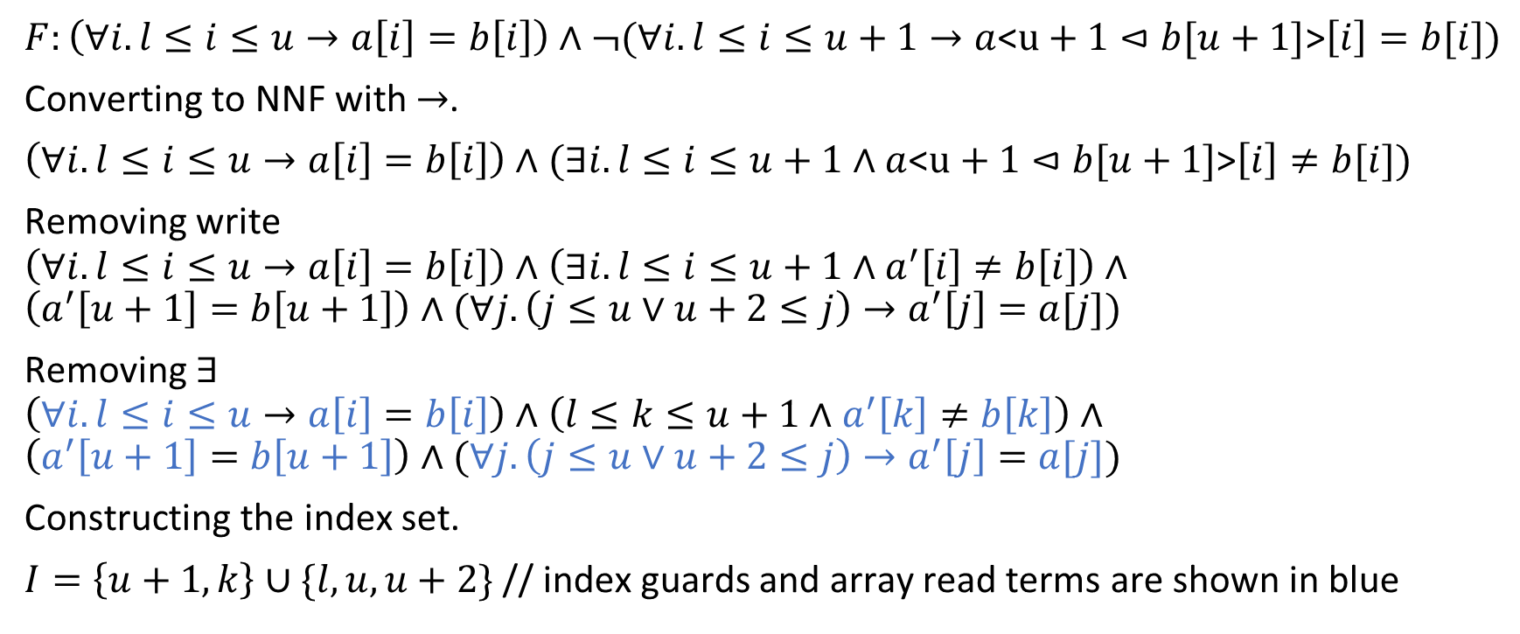
Example
$F:\left(∀i.l≤i≤u→a\left[i\right]=b\left[i\right]\right)∧¬(∀i. l≤i≤u+1→a$<$u+1⊲b[u+1]$>$\left[i\right]=b[i])$
Converting to NNF with $→$.
$\left(∀i.l≤i≤u→a\left[i\right]=b\left[i\right]\right)∧(∃i. l≤i≤u+1∧a$<$u+1⊲b[u+1]$>$\left[i\right]≠b[i])$
Removing write
$$\left(∀i.l≤i≤u→a\left[i\right]=b\left[i\right]\right)∧\left(∃i. l≤i≤u+1∧a^{′}\left[i\right]≠b\left[i\right]\right)∧$$
$$\left(a^{′}\left[u+1\right]=b\left[u+1\right]\right)∧(∀j.\left(j≤u∨u+2≤j\right)→a^{′}\left[j\right]=a[j])$$
Removing $∃$
$$\left(∀i.l≤i≤u→a\left[i\right]=b\left[i\right]\right)∧\left(l≤k≤u+1∧a^{′}\left[k\right]≠b\left[k\right]\right)∧$$
$$\left(a^{′}\left[u+1\right]=b\left[u+1\right]\right)∧(∀j.\left(j≤u∨u+2≤j\right)→a^{′}\left[j\right]=a[j])$$
Constructing the index set.
$I=\left\{u+1,k\right\}∪\{l,u,u+2\}$ // index guards and array read terms are shown in blue

Slide 23
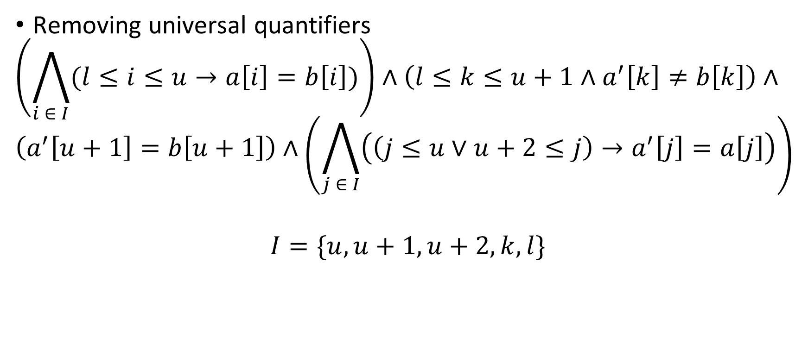
Example
Removing universal quantifiers
$$\left(\bigwedge_{i ∈ I}{(l≤i≤u→a\left[i\right]=b\left[i\right])}\right)∧\left(l≤k≤u+1∧a^{′}\left[k\right]≠b\left[k\right]\right)∧$$
$$\left(a^{′}\left[u+1\right]=b\left[u+1\right]\right)∧\left(\bigwedge_{j ∈ I}{\left(\left(j≤u∨u+2≤j\right)→a^{′}\left[j\right]=a\left[j\right]\right)}\right)$$
$$I=\{u,u+1,u+2,k,l\}$$

Slide 24
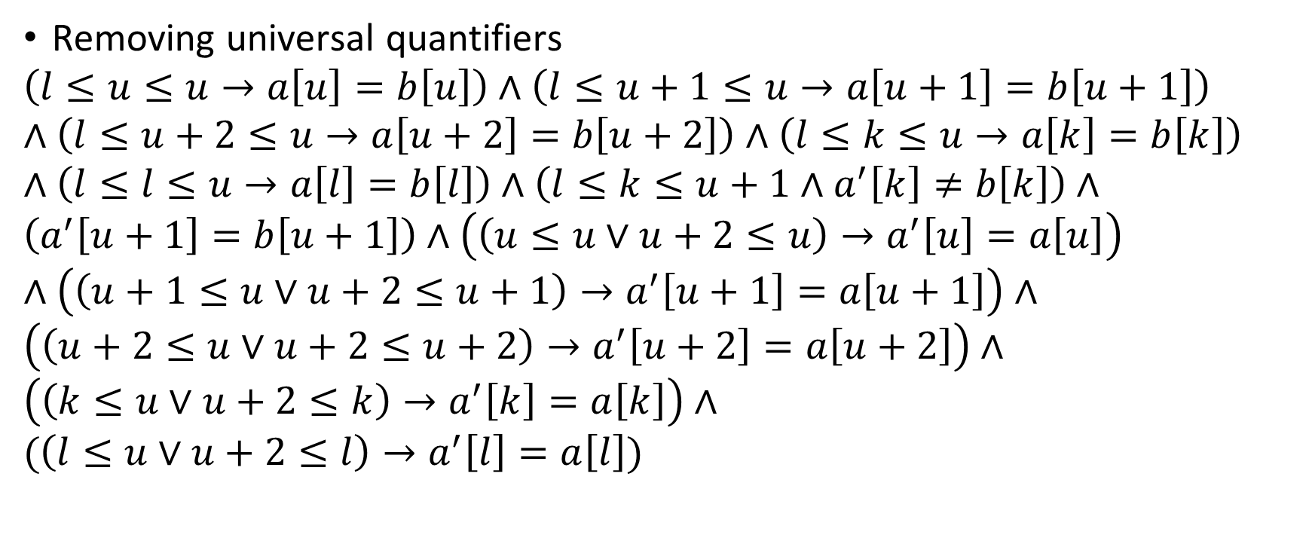
Example
Removing universal quantifiers
$$\left(l≤u≤u→a\left[u\right]=b\left[u\right]\right)∧\left(l≤u+1≤u→a\left[u+1\right]=b\left[u+1\right]\right)∧\left(l≤u+2≤u→a\left[u+2\right]=b\left[u+2\right]\right)∧\left(l≤k≤u→a\left[k\right]=b\left[k\right]\right)∧\left(l≤l≤u→a\left[l\right]=b\left[l\right]\right)∧\left(l≤k≤u+1∧a^{′}\left[k\right]≠b\left[k\right]\right)∧$$
$$\left(a^{′}\left[u+1\right]=b\left[u+1\right]\right)∧\left(\left(u≤u∨u+2≤u\right)→a^{′}\left[u\right]=a\left[u\right]\right)∧\left(\left(u+1≤u∨u+2≤u+1\right)→a^{′}\left[u+1\right]=a\left[u+1\right]\right)∧$$
$$\left(\left(u+2≤u∨u+2≤u+2\right)→a^{′}\left[u+2\right]=a\left[u+2\right]\right)∧$$
$$\left(\left(k≤u∨u+2≤k\right)→a^{′}\left[k\right]=a\left[k\right]\right)∧$$
$$(\left(l≤u∨u+2≤l\right)→a^{′}\left[l\right]=a\left[l\right])$$

Slide 25
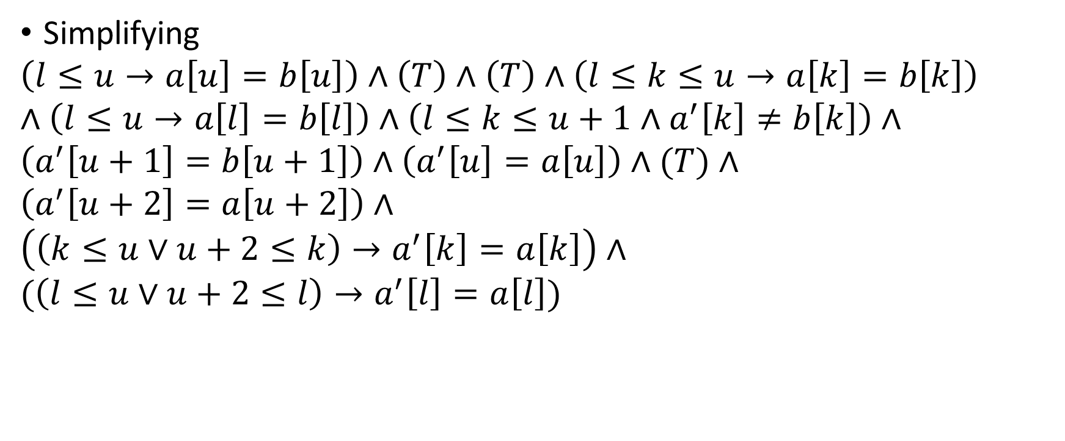
Example
Simplifying
$$\left(l≤u→a\left[u\right]=b\left[u\right]\right)∧\left(T\right)∧\left(T\right)∧\left(l≤k≤u→a\left[k\right]=b\left[k\right]\right)∧\left(l≤u→a\left[l\right]=b\left[l\right]\right)∧\left(l≤k≤u+1∧a^{′}\left[k\right]≠b\left[k\right]\right)∧$$
$$\left(a^{′}\left[u+1\right]=b\left[u+1\right]\right)∧\left(a^{′}\left[u\right]=a\left[u\right]\right)∧(T)∧$$
$$\left(a^{′}\left[u+2\right]=a\left[u+2\right]\right)∧$$
$$\left(\left(k≤u∨u+2≤k\right)→a^{′}\left[k\right]=a\left[k\right]\right)∧$$
$$(\left(l≤u∨u+2≤l\right)→a^{′}\left[l\right]=a\left[l\right])$$

Slide 26
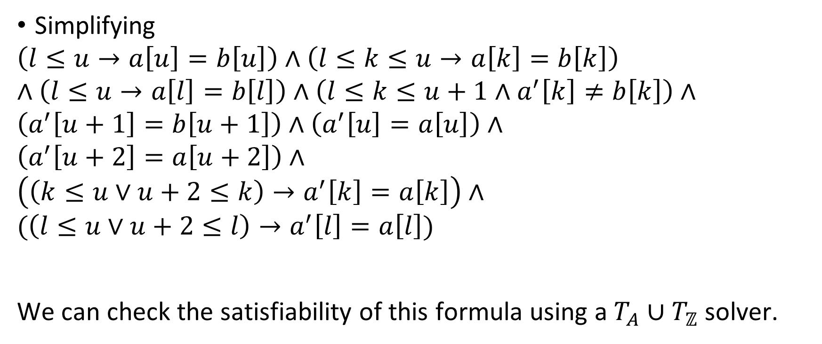
Example
Simplifying
$$\left(l≤u→a\left[u\right]=b\left[u\right]\right)∧\left(l≤k≤u→a\left[k\right]=b\left[k\right]\right)∧\left(l≤u→a\left[l\right]=b\left[l\right]\right)∧\left(l≤k≤u+1∧a^{′}\left[k\right]≠b\left[k\right]\right)∧$$
$$\left(a^{′}\left[u+1\right]=b\left[u+1\right]\right)∧\left(a^{′}\left[u\right]=a\left[u\right]\right)∧$$
$$\left(a^{′}\left[u+2\right]=a\left[u+2\right]\right)∧$$
$$\left(\left(k≤u∨u+2≤k\right)→a^{′}\left[k\right]=a\left[k\right]\right)∧$$
$$(\left(l≤u∨u+2≤l\right)→a^{′}\left[l\right]=a\left[l\right])$$
We can check the satisfiability of this formula using a $T_{A}∪T_{ℤ}$ solver.

Slide 27

Example
$$F:\left(∀x. x≤i−1→a\left[x\right]=0\right)∧a^{′}=a\left\{i←0\right\}∧¬(∀x. x≤i→a^{′}\left[x\right]=0)$$

Slide 28
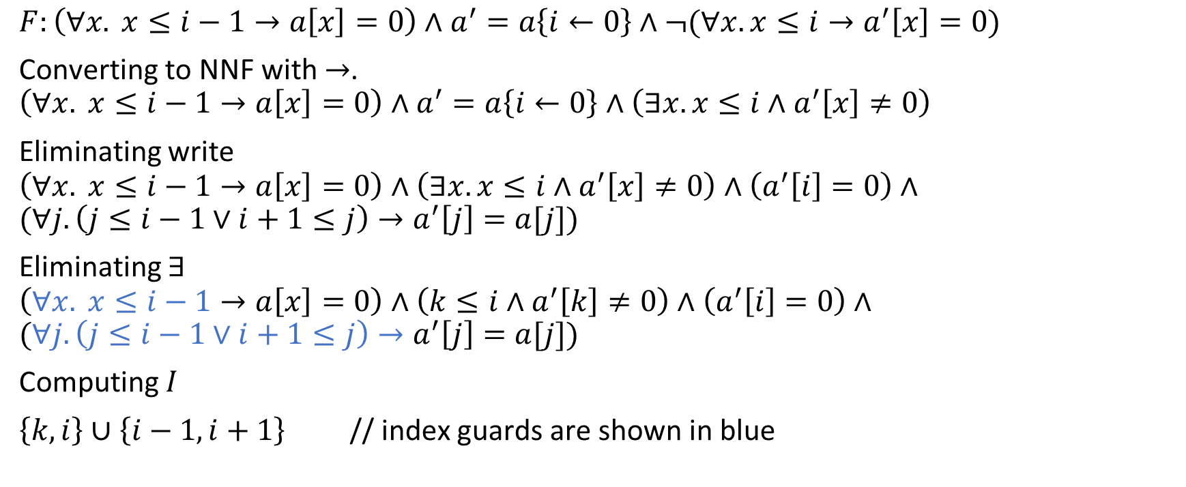
Example
$$F:\left(∀x. x≤i−1→a\left[x\right]=0\right)∧a^{′}=a\left\{i←0\right\}∧¬(∀x. x≤i→a^{′}\left[x\right]=0)$$
Converting to NNF with $→$.
$$\left(∀x. x≤i−1→a\left[x\right]=0\right)∧a^{′}=a\left\{i←0\right\}∧\left(∃x. x≤i∧a^{′}\left[x\right]≠0\right)$$
Eliminating write
$$\left(∀x. x≤i−1→a\left[x\right]=0\right)∧\left(∃x. x≤i∧a^{′}\left[x\right]≠0\right)∧\left(a^{′}\left[i\right]=0\right)∧$$
$$(∀j. \left(j≤i−1∨i+1≤j\right)→a^{′}\left[j\right]=a[j])$$
Eliminating $∃$
$$\left(∀x. x≤i−1→a\left[x\right]=0\right)∧\left(k≤i∧a^{′}\left[k\right]≠0\right)∧\left(a^{′}\left[i\right]=0\right)∧$$
$$(∀j. \left(j≤i−1∨i+1≤j\right)→a^{′}\left[j\right]=a[j])$$
Computing $I$
$\left\{k,i\right\}∪\left\{i−1,i+1\right\}$ // index guards are shown in blue

Slide 29

Example
Removing universal quantifiers
$$\left(\bigwedge_{x∈I}{(x≤i−1→a\left[x\right]=0)}\right)∧\left(k≤i∧a^{′}\left[k\right]≠0\right)∧\left(a^{′}\left[i\right]=0\right)∧$$
$$\left(\bigwedge_{j∈I}{(\left(j≤i−1∨i+1≤j\right)→a^{′}\left[j\right]=a\left[j\right])}\right)$$
Where $I=\left\{k,i−1,i,i+1\right\}$

Slide 30
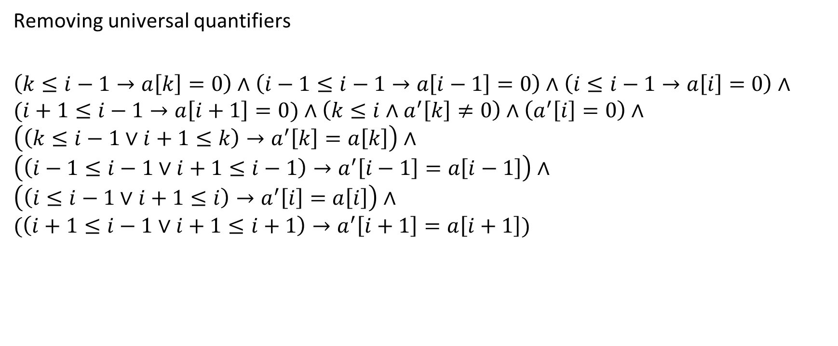
Example
Removing universal quantifiers
$$\left(k≤i−1→a\left[k\right]=0\right)∧\left(i−1≤i−1→a\left[i−1\right]=0\right)∧\left(i≤i−1→a\left[i\right]=0\right)∧$$
$$(i+1≤i−1→a\left[i+1\right]=0)∧\left(k≤i∧a^{′}\left[k\right]≠0\right)∧\left(a^{′}\left[i\right]=0\right)∧$$
$$\left(\left(k≤i−1∨i+1≤k\right)→a^{′}\left[k\right]=a\left[k\right]\right)∧$$
$$\left(\left(i−1≤i−1∨i+1≤i−1\right)→a^{′}\left[i−1\right]=a\left[i−1\right]\right)∧$$
$$\left(\left(i≤i−1∨i+1≤i\right)→a^{′}\left[i\right]=a\left[i\right]\right)∧$$
$$(\left(i+1≤i−1∨i+1≤i+1\right)→a^{′}\left[i+1\right]=a\left[i+1\right])$$

Slide 31

Example
Simplification
$$\left(k≤i−1→a\left[k\right]=0\right)∧\left(a\left[i−1\right]=0\right)∧\left(T\right)∧$$
$$(T)∧\left(k≤i∧a^{′}\left[k\right]≠0\right)∧\left(a^{′}\left[i\right]=0\right)∧$$
$$\left(\left(k≤i−1∨i+1≤k\right)→a^{′}\left[k\right]=a\left[k\right]\right)∧$$
$$\left(a^{′}\left[i−1\right]=a\left[i−1\right]\right)∧$$
$$(T)∧$$
$$(a^{′}\left[i+1\right]=a\left[i+1\right])$$

Slide 32
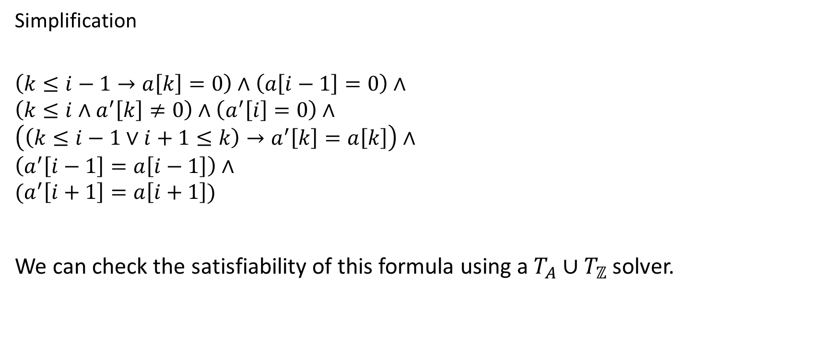
Example
Simplification
$$\left(k≤i−1→a\left[k\right]=0\right)∧\left(a\left[i−1\right]=0\right)∧$$
$$\left(k≤i∧a^{′}\left[k\right]≠0\right)∧\left(a^{′}\left[i\right]=0\right)∧$$
$$\left(\left(k≤i−1∨i+1≤k\right)→a^{′}\left[k\right]=a\left[k\right]\right)∧$$
$$\left(a^{′}\left[i−1\right]=a\left[i−1\right]\right)∧$$
$$(a^{′}\left[i+1\right]=a\left[i+1\right])$$
We can check the satisfiability of this formula using a $T_{A}∪T_{ℤ}$ solver.

Slide 33
Correctness
Read “What’s Decidable About Arrays, Bradley et al.”

Slide 34

Correctness
What do we mean by the following formula is satisfiable?
$∀i . 0≤i≤n →a\left[i\right]=b[j]$
Is it possible that the above formula is satisfiable?

Slide 35
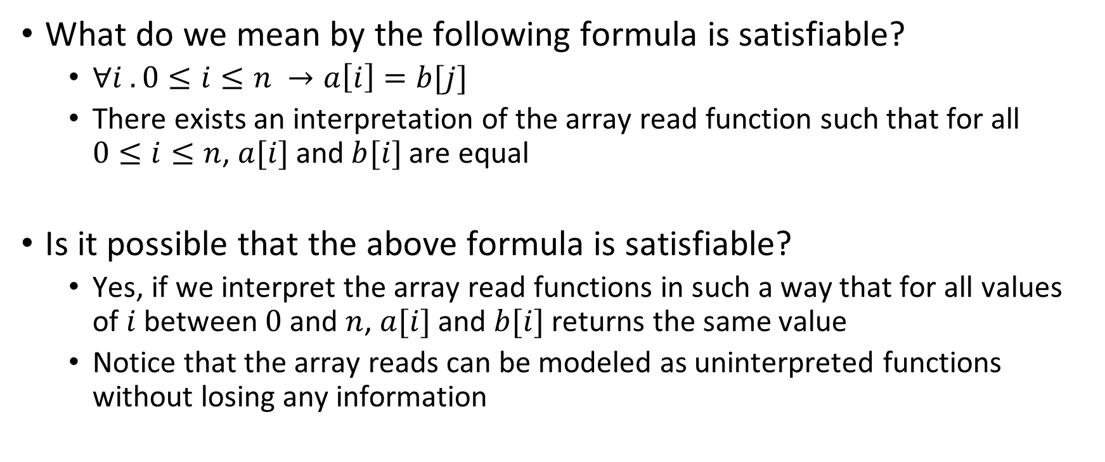
Correctness
What do we mean by the following formula is satisfiable?
$∀i . 0≤i≤n →a\left[i\right]=b[j]$
There exists an interpretation of the array read function such that for all $0≤i≤n$, $a[i]$and $b[i]$are equal
Is it possible that the above formula is satisfiable?
Yes, if we interpret the array read functions in such a way that for all values of $i$ between $0$ and $n$, $a[i]$and $b[i]$returns the same value
Notice that the array reads can be modeled as uninterpreted functions without losing any information

Slide 36
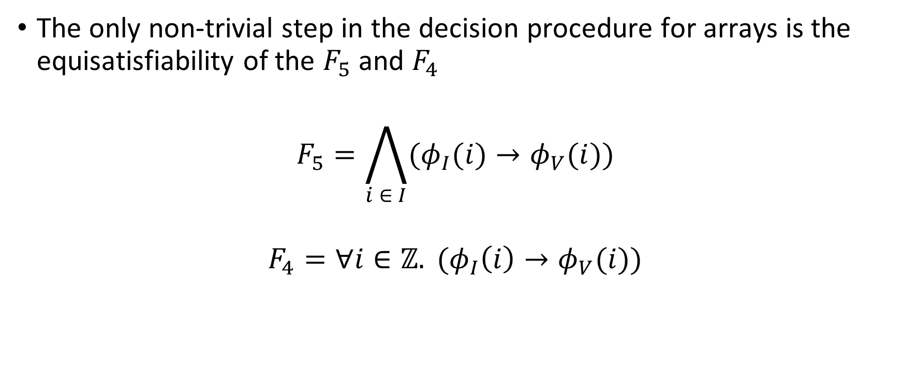
Correctness
The only non-trivial step in the decision procedure for arrays is the equisatisfiability of the $F_{5}$ and $F_{4}$
$$F_{5}=\bigwedge_{i ∈ I}{(φ_{I}(i)→φ_{V}(i))}$$
$$F_{4}=∀i∈ℤ. (φ_{I}\left(i\right)→φ_{V}(i))$$

Slide 37

Correctness
Let’s define an interpretation $J$ such that all array reads
$$a\left[i\right]=a[proj(i)]$$
Where $proj$ is a function

Slide 38
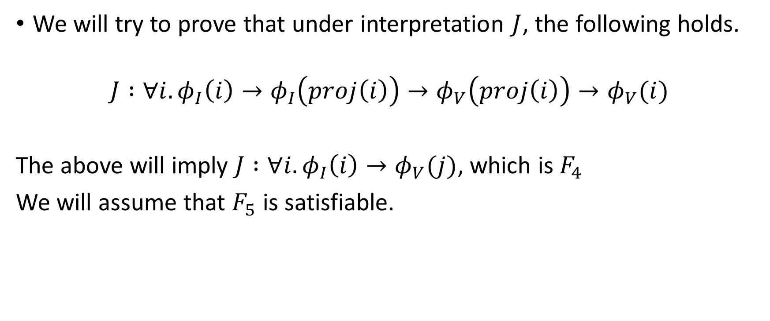
Correctness
We will try to prove that under interpretation $J$, the following holds.
$$J :∀i. φ_{I}\left(i\right)→φ_{I}\left(proj\left(i\right)\right)→φ_{V}\left(proj\left(i\right)\right)→φ_{V}(i)$$
The above will imply $J :∀i. φ_{I}\left(i\right)→φ_{V}(j)$, which is $F_{4}$
We will assume that $F_{5}$ is satisfiable.

Slide 39














Correctness
Let’s define the projection function as follows:
$$proj\left(z\right)=t, such that t∈I, z∈ℤ$$
$$t≤z∧\left(∀s∈I. s≤t∨s>z\right)$$
$or$
$$t>z∧(∀s∈I.s≥t)$$
$$z(t_{1})$$
$$t_{2}(t_{2})$$
$$z(t_{3})$$
$$z(t_{6})$$
$$−∞$$
$$t_{1}$$
$$t_{2}$$
$$t_{3}$$
$$t_{4}$$
$$t_{5}$$
$$t_{6}$$
$$∞$$
$$\left\{t_{1},…, t_{6}\right\}∈I$$

Slide 40





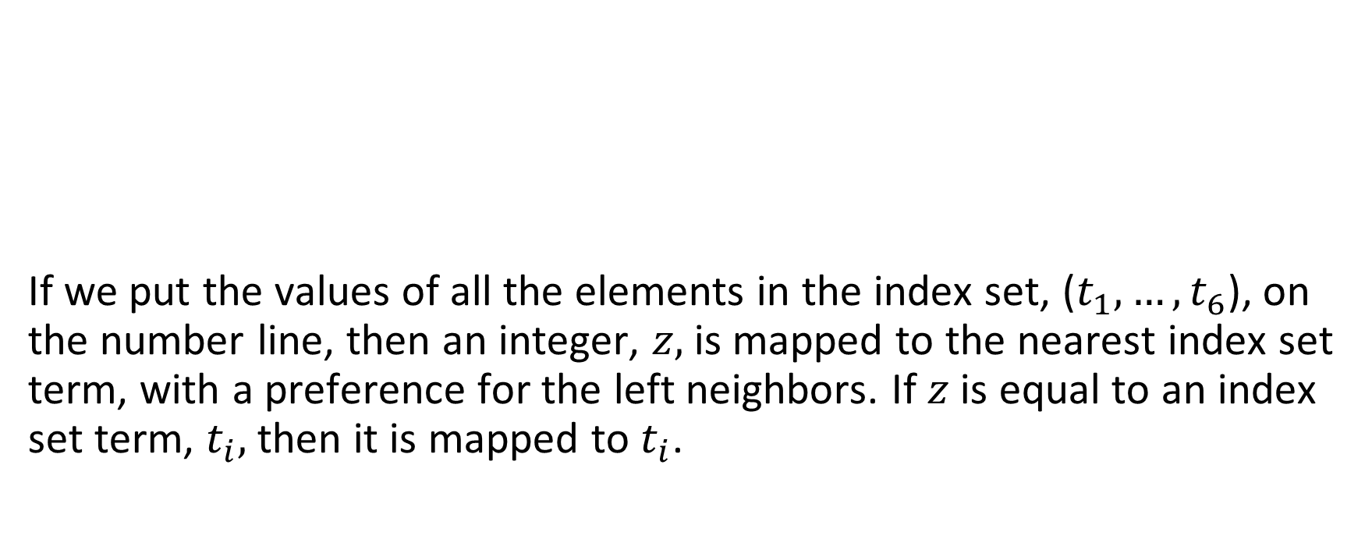








Correctness
If we put the values of all the elements in the index set, ($t_{1},…,t_{6}$), on the number line, then an integer, $z,$ is mapped to the nearest index set term, with a preference for the left neighbors. If $z$ is equal to an index set term, $t_{i},$ then it is mapped to $t_{i}$.
$$z(t_{1})$$
$$t_{2}(t_{2})$$
$$z(t_{3})$$
$$z(t_{6})$$
$$−∞$$
$$t_{1}$$
$$t_{2}$$
$$t_{3}$$
$$t_{4}$$
$$t_{5}$$
$$t_{6}$$
$$∞$$
$$\left\{t_{1},…, t_{6}\right\}∈I$$

Slide 41
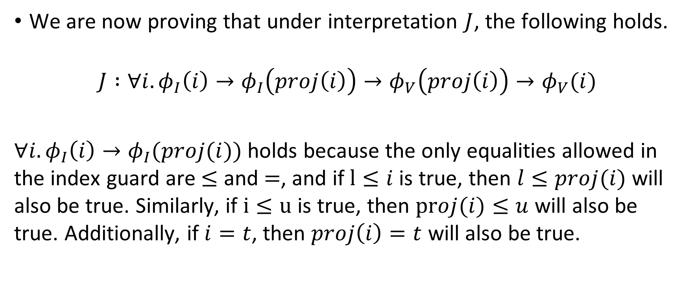
Correctness
We are now proving that under interpretation $J$, the following holds.
$$J :∀i. φ_{I}\left(i\right)→φ_{I}\left(proj\left(i\right)\right)→φ_{V}\left(proj\left(i\right)\right)→φ_{V}(i)$$
$∀i. φ_{I}\left(i\right)→φ_{I}(proj(i))$ holds because the only equalities allowed in the index guard are $≤$ and $=$, and if $l≤i$ is true, then $l≤proj(i)$ will also be true. Similarly, if $i≤u$ is true, then $proj(i)≤u$ will also be true. Additionally, if $i=t$, then $proj\left(i\right)=t$ will also be true.

Slide 42
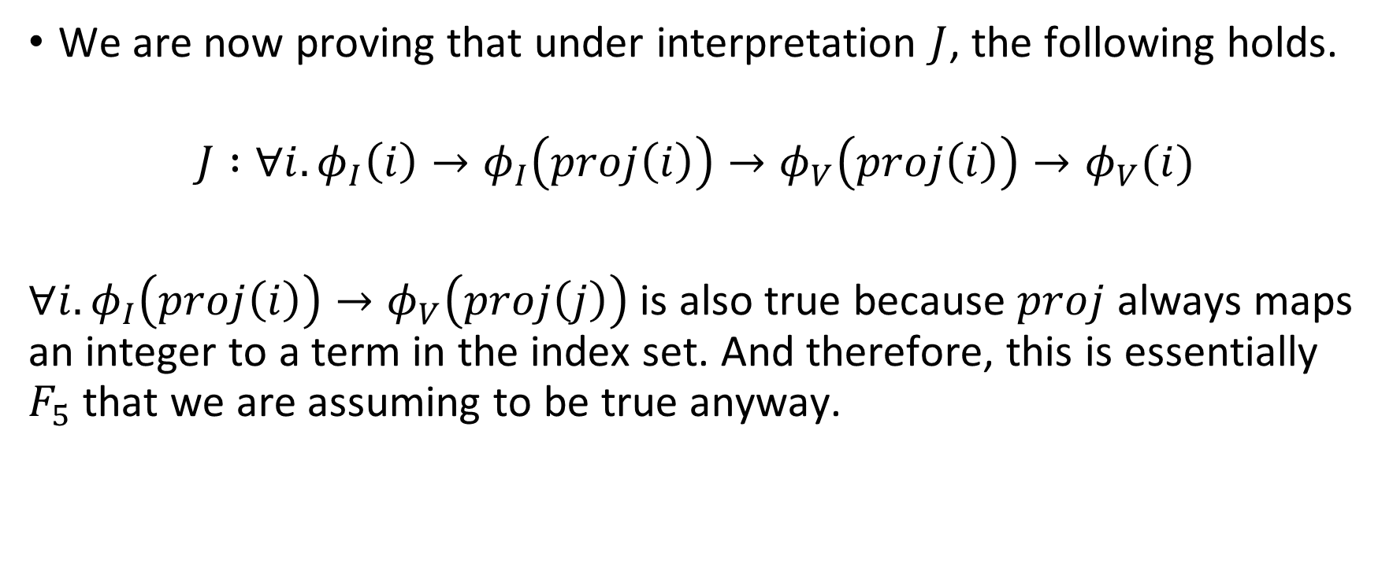
Correctness
We are now proving that under interpretation $J$, the following holds.
$$J :∀i. φ_{I}\left(i\right)→φ_{I}\left(proj\left(i\right)\right)→φ_{V}\left(proj\left(i\right)\right)→φ_{V}(i)$$
$∀i.φ_{I}\left(proj\left(i\right)\right)→φ_{V}\left(proj\left(j\right)\right)$ is also true because $proj$ always maps an integer to a term in the index set. And therefore, this is essentially $F_{5}$ that we are assuming to be true anyway.

Slide 43
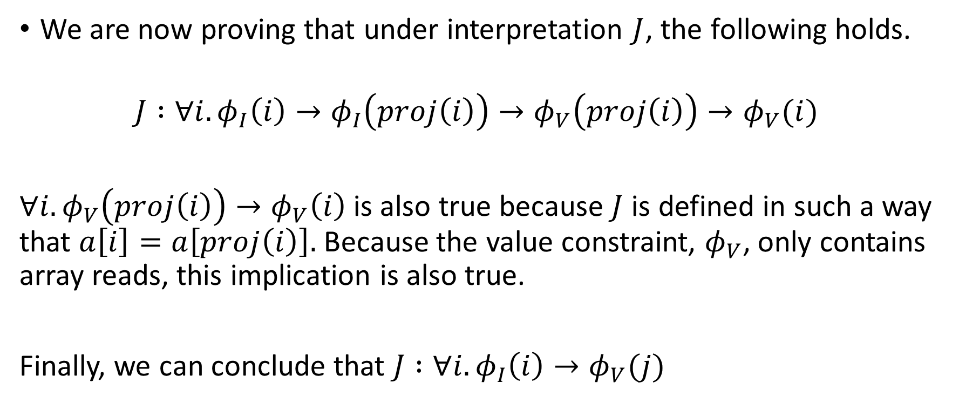
Correctness
We are now proving that under interpretation $J$, the following holds.
$$J :∀i. φ_{I}\left(i\right)→φ_{I}\left(proj\left(i\right)\right)→φ_{V}\left(proj\left(i\right)\right)→φ_{V}(i)$$
${∀i. φ}_{V}\left(proj\left(i\right)\right)→φ_{V}\left(i\right)$is also true because $J$ is defined in such a way that $a\left[i\right]=a\left[proj\left(i\right)\right].$ Because the value constraint, $φ_{V}$, only contains array reads, this implication is also true.
Finally, we can conclude that $J :∀i. φ_{I}\left(i\right)→φ_{V}(j)$

