Slide 1
Power System Fault Detection and Classification USING MACHINE LEARNING
CAPSTONE PROJECT
Presented By:
1. Piyush Sharma-UEM Jaipur-CSE

Slide 2
OUTLINE
Problem Statement (Should not include solution)
Proposed System/Solution
System Development Approach (Technology Used)
Algorithm & Deployment
Result (Output Image)
Conclusion
Future Scope
References

Slide 3
Problem Statement
Design a machine learning model to detect and classify different types of faults in a power distribution system. Using electrical measurement data (e.g., voltage and current phasors), the model should be able to distinguish between normal operating conditions and various fault conditions (such as line-to-ground, line-to-line, or three-phase faults). The objective is to enable rapid and accurate fault identification, which is crucial for maintaining power grid stability and reliability.

Slide 4
Proposed Solution
Develop a machine learning model that classifies power system faults using the dataset provideThe model will process electrical measurements to identify the type of fault rapidly and accurately. This classification will help automate fault detection and assist in quicker recovery actions, ensuring system reliability.
Key components:
Data Collection: Use the Kaggle dataset on power system faults.
Preprocessing: Clean and normalize the dataset.
Model Training: Train a classification model (e.g., Decision Tree, Random Forest, or SVM).
Evaluation: Validate the model using accuracy, precision, recall, and F1-score.

Slide 5
System Approach
The "System Approach" section outlines the overall strategy and methodology for developing and
implementing the power system fault detection and classification. Here's a suggested structure for
this section:
System requirements:
IBM Cloud (mandatory)
IBM Watson Studio for model development and deployment
IBM Cloud Object Storage for dataset handling

Slide 6
Algorithm & Deployment
Algorithm Selection: Random Forest Classifier (or SVM based on performance)
Data Input: Voltage, current, and phasor measurements from the dataset
Training Process: Supervised learning using labeled fault types
Prediction Process: Model deployed on IBM Watson Studio with API endpoint for real-time predictions

Slide 7
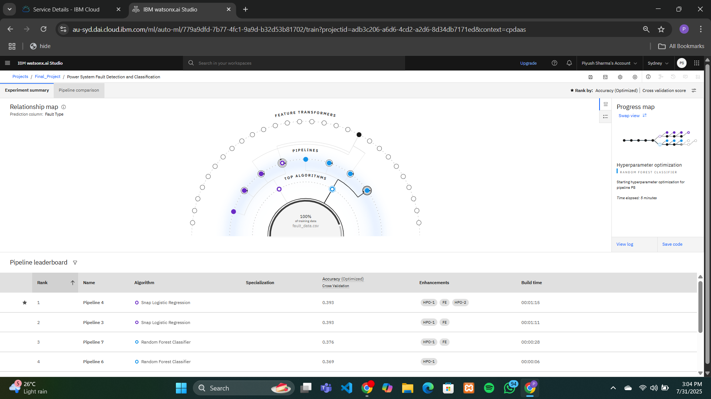
Result

Slide 8
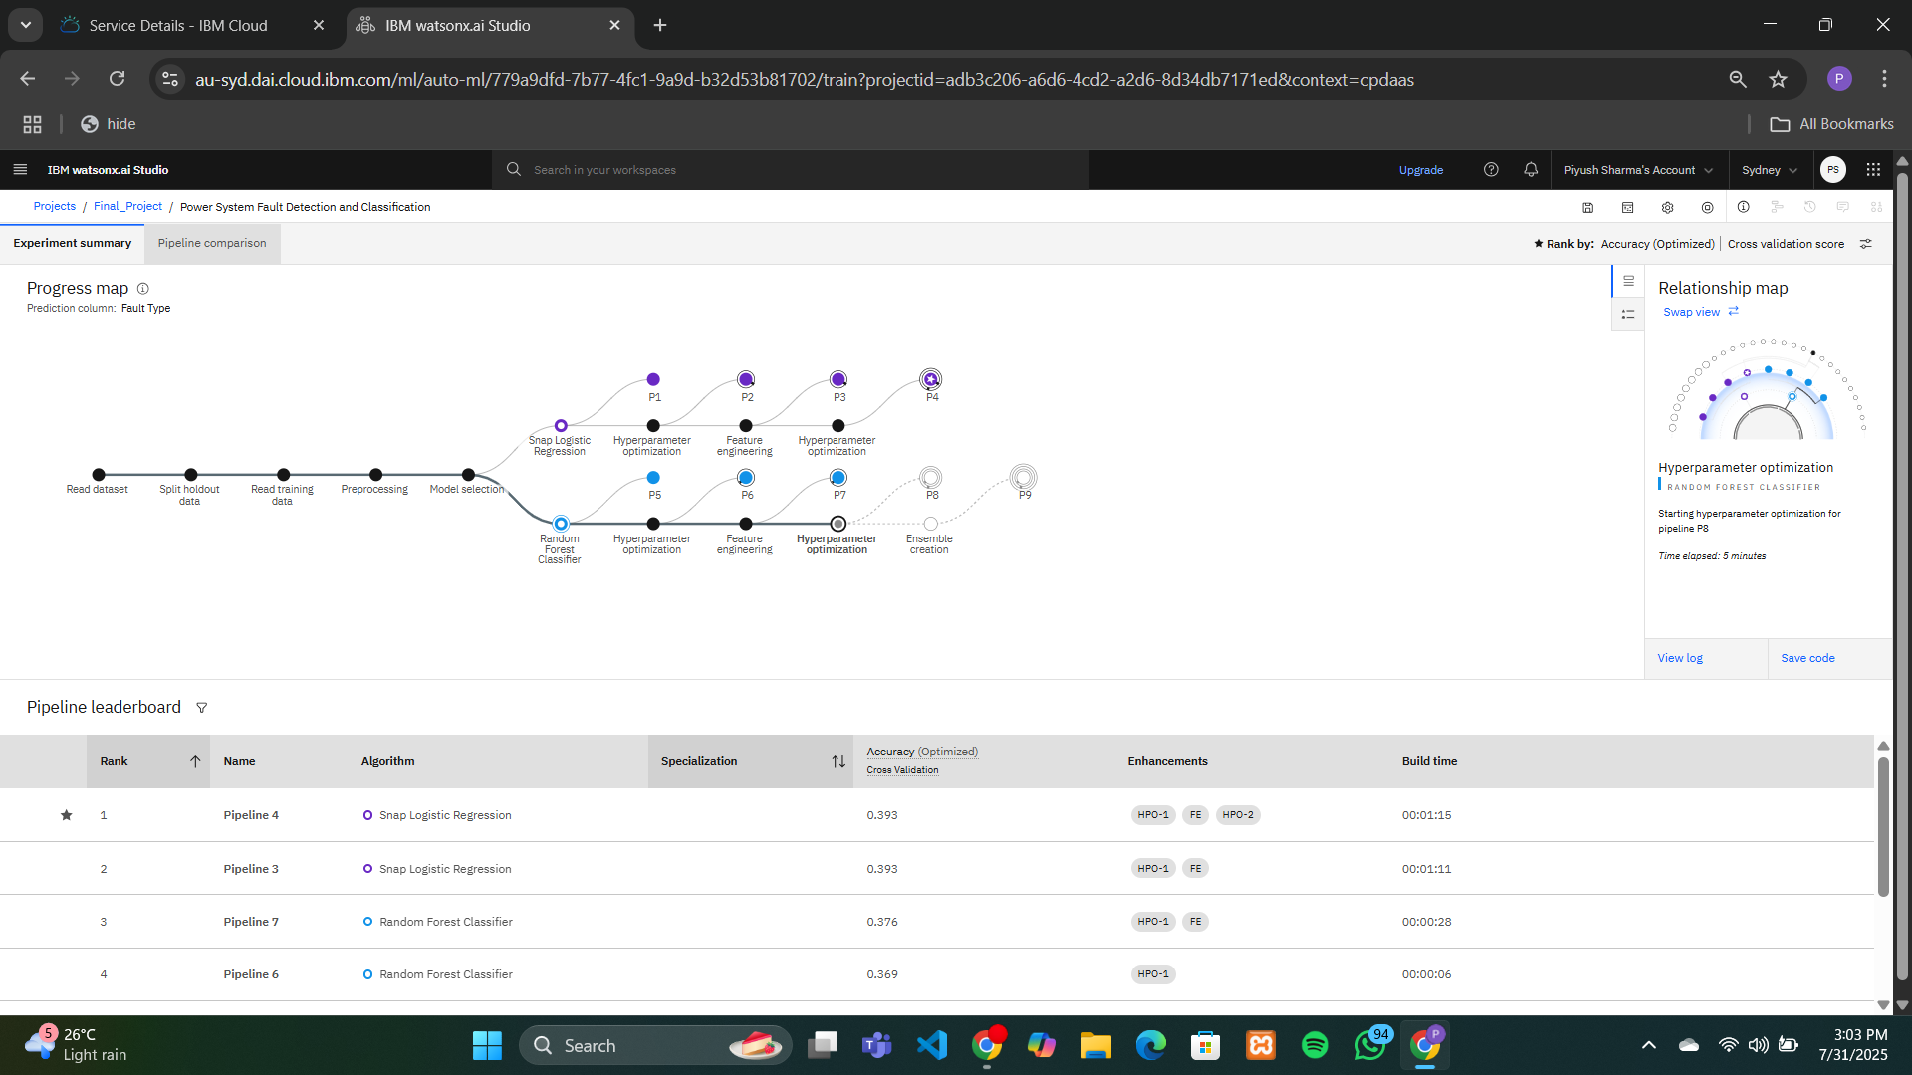
Result

Slide 9
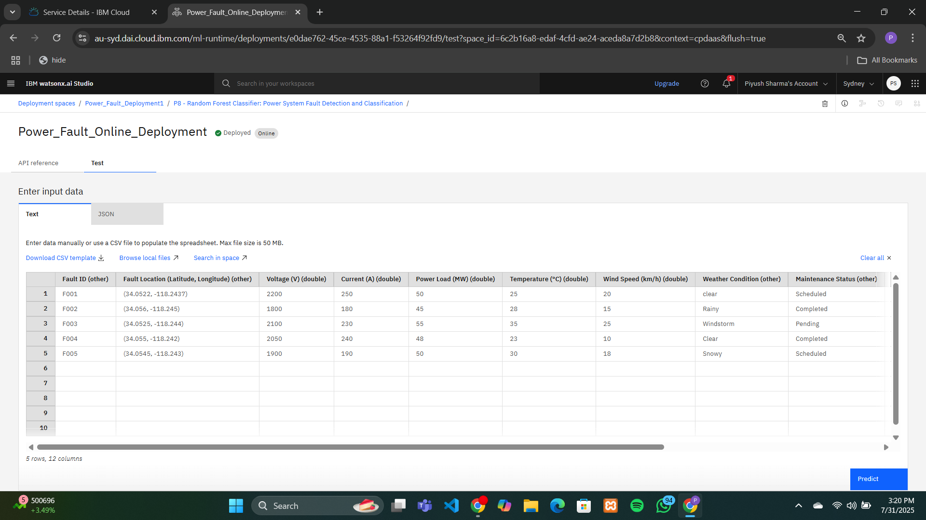
Result

Slide 10
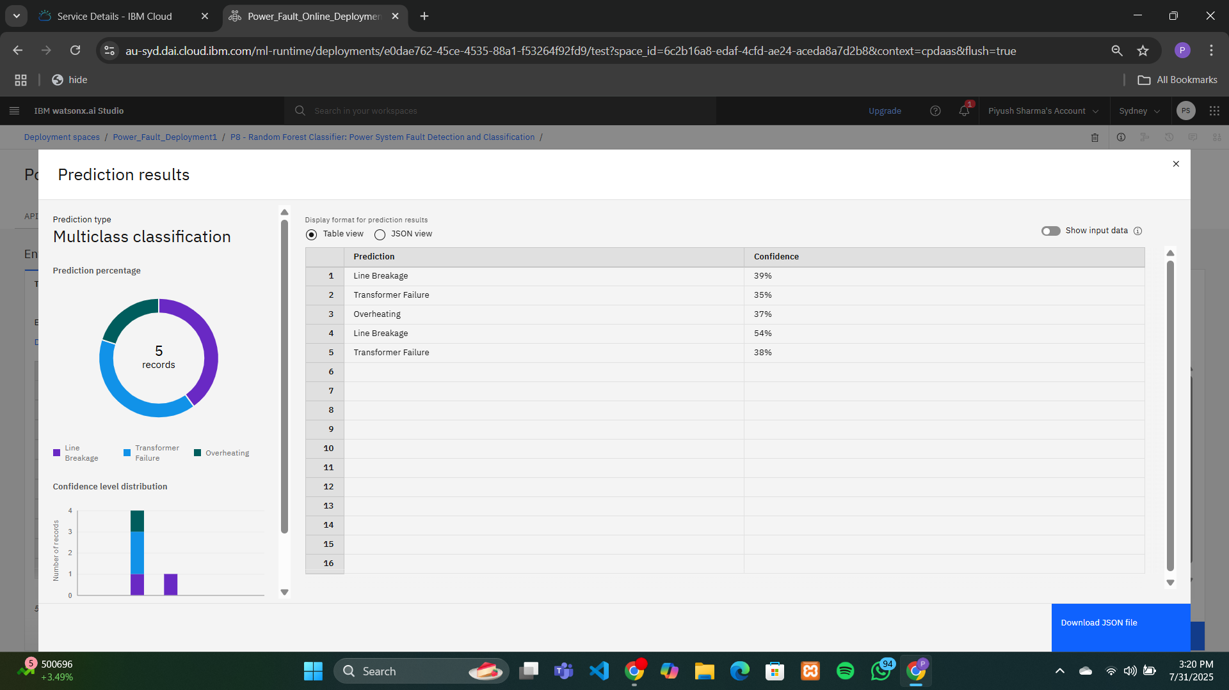
Result

Slide 11
Conclusion
This project showcases how machine learning can be effectively used to detect and classify power system faults. By using algorithms like Random Forest and deploying the model through IBM Watson Studio, we achieved fast and reliable fault prediction. The system processes real-time voltage, current, and phasor data to identify fault types accurately. With IBM Cloud support for model training and data handling, the solution is scalable and practical. Overall, the project highlights the potential of AI in improving power system efficiency, automation, and quick fault recovery.

Slide 12
Future scope
In the future, this project can be enhanced by integrating the machine learning model with real-time power grid monitoring systems to enable immediate fault detection and automated alerts. More advanced algorithms such as deep learning models (e.g., LSTM or CNN) can be explored to improve accuracy, especially for time-series data. The system can also be extended to handle multi-class fault classification and assess fault severity. Additionally, deploying the model on edge devices can offer faster processing with reduced latency. A user-friendly dashboard can be developed to visualize predictions, trends, and historical data. Incorporating cybersecurity features like anomaly detection would further enhance the reliability and robustness of the system in practical applications.

Slide 13
References
Kaggle Dataset: Power System Fault Detection Dataset – https://www.kaggle.com/datasets/ziya07/power-system-faults-dataset?resource=download
IBM Cloud & Watson Studio: IBM Cloud Documentation – https://cloud.ibm.com/docs

Slide 14

IBM Certifications

Slide 15

IBM Certifications

Slide 16
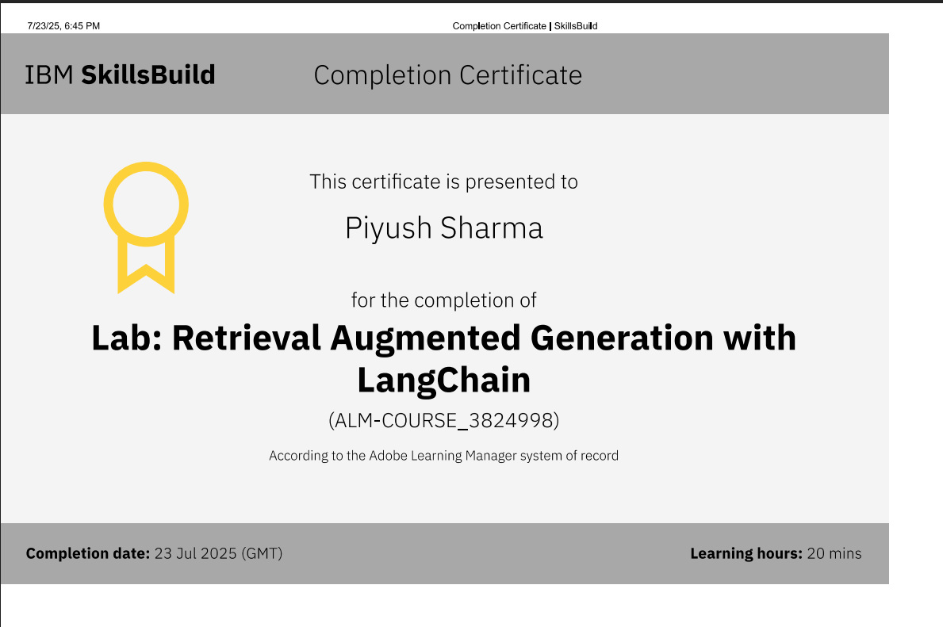
IBM Certifications

Slide 17
THANK YOU

