Slide 1
AI101 Mini-Project | Team 7
Team and roles
Calories Burnt Prediction
Member | Entry no. | Role
Piyush Tiwari | 2026ESB1487 | Documentation lead
Devansh Singh Vardhan | 2026EEB1342 | Execution lead
Avinash | 2026AIB1025 | PPT lead
Sunnam Jagadeesh | 2026MCB1575 | Video lead
Predicting how many calories you burn in a workout, using duration, heart rate, body temperature and age

Slide 2
Problem and data
What and why
Dataset
Goal: predict calories burned from duration, heart rate, body temperature and age
Why: gym machines and smartwatches only give rough estimates, so we let a model learn from real workout records
Type: regression, since the answer is a number
Kaggle: Calories Burnt Prediction (Ruchika Kumbhar)
500
9
rows
columns
Columns: User_ID, Gender, Age, Height, Weight, Duration, Heart_Rate, Body_Temp, Calories (target)

Slide 3
Approach
1 Data
2 Clean
3 Model
4 Output
Load the CSV from the data folder
Check for missing values and look at the data with some plots
Train on 80% of the data and test on the other 20%
Get the predicted calories, accuracy and plots
Libraries used
pandas
numpy
matplotlib
scikit-learn
Model we used : Linear Regression

Slide 4
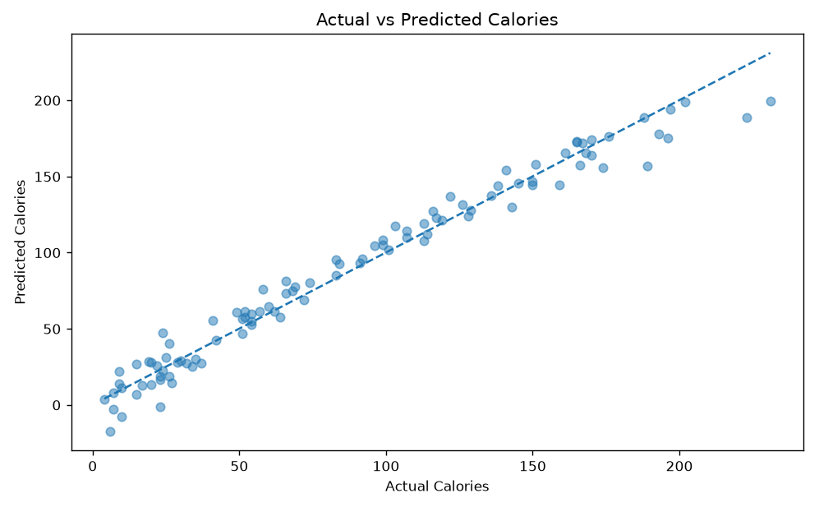
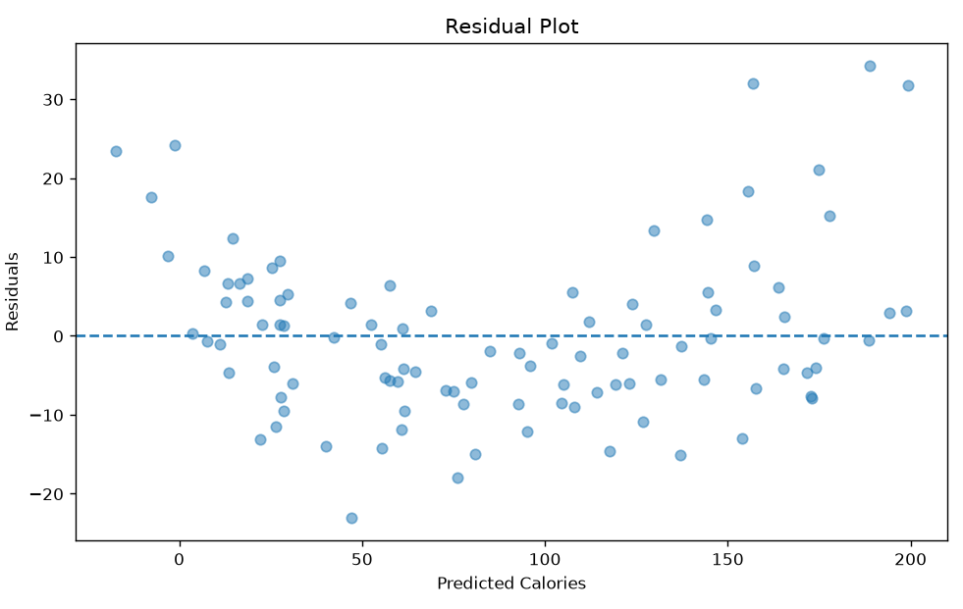
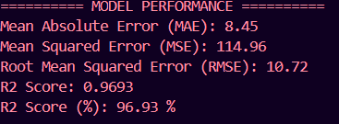
Results
0.969
8.45
10.72
Paste demo screenshot here
(terminal output)
R² score
MAE
RMSE

Slide 5
Conclusion & Project Details
What worked
Who did what
Duration and heart rate gave the strongest predictions
Splitting into train and test showed us the real accuracy
Linear Regression scored R² = 0.969
Documentation: Piyush
Execution: Devansh
PPT: Avinash
Video: Jagadeesh
All four wrote and committed code
Repository: https://github.com/piyush-esb1487/Athlete-calorie-counter

