Slide 1


A FLEXIBLE AND INVESTIGATION APPROACH FOR ENCRYPTED FEATURES SPACE USING NEURAL NETWORK
SRM Institute of Science and Technology,
Ramapuram Campus, Chennai-89
DEPARTMENT OF COMPUTER SCIENCE AND ENGINEERING
Batch No:13
Presented by:
Piyush Raj Shrivastava - RA1811032020006
Sheetal Binod Kumar Prasad - RA1811032020026
Guided by:
Mrs. Archana T
Assistant Professor
CSE Department

Slide 2
OBJECTIVE
Minimise end-device latency.
Maintaining neural network accuracy and data privacy.
Build a set of safe interaction protocols.
Use of two separate edge servers and a trusted third party.

Slide 3
SCOPE
Our design makes use of two separate edge servers and a trusted third party.
In the offline phase, the trusted third party is in charge of producing random values.
During the online phase, the two edge servers use a series of secure interaction protocols to extract CNN features from the incoming encrypted pictures.
The CNN characteristics may be obtained by the user from the encrypted results provided by the two edge servers.

Slide 4
ABSTRACT
We present an access control mechanism for object detection models in this research.
The usage of encrypted pictures or encrypted feature maps has been shown to be successful in preventing unwanted access to models.
The approach's efficiency has only been verified in image classification models and semantic segmentation models, not in object recognition models.
For the first time, encrypted feature maps are proved to be successful in access control of object detection models in this study.
(continued…)

Slide 5
In this research, we present a safe and efficient technique based on completely homomorphic encryption and demonstrate its usefulness for a variety of real data.
The suggested technique is the first to directly replicate an algorithm on ciphertext, which is one of the best performers on the plaintext feature selection problem.
Furthermore, the suggested protocol is simply extensible to the scenario of more than three data owners.

Slide 6
INTRODUCTION
The spread of various mobile devices with cameras leads to an exponential increase in the number of photos. Recent improvements in deep learning with convolutional neural networks (CNN) have made CNN feature extraction a viable method for processing these photos.
However, deploying the CNN model on mobile sensors, which are often resource-constrained in terms of storage space, computational capability, and battery life, remains a difficult issue.
Despite the fact that cloud computing has become a popular option, data security and response latency remain critical challenges.
(continued…)

Slide 7
It is difficult to fulfil the three requirements of privacy, accuracy, and efficiency when creating a privacy-preserving CNN feature extraction strategy for mobile sensing.
The privacy-preserving CNN feature extraction might take place at the network's edge.
This is done by generating a random communication overhead between the end devices and the edge servers.
Through theoretical analysis and empirical experiments, demonstration of the security, effectiveness, and efficiency of the scheme is done.

Slide 8
LITERATURE SURVEY PAPER 1
•Title : Scale Effect on Fusing Remote Sensing and Human Sensing to Portray Urban Functions
•Author : Wei Tu , Yatao Zhang , Qingquan Li , Ke Mai and Jinzhou Cao
•Year : 2021
•Methodology Used: Fusion of remote sensing images and human sensing data.
•Advantages: Offer increased flexibility,Enhance correlation strength with finer and more compact information,Streamlined and decoupled services.
•Disadvantages: Cannot meet current network business demands,Difficulties to obtain better performance,Solutions have been proved ineffective.

Slide 9
LITERATURE SURVEY PAPER 2
•Title : AMACS: Automated Mobile Application Content Sensing
•Author : Zexun Jiang , Hao Yin , Yan Luo and Jiaying Gong
•Year : 2020
•Methodology Used: (AMACS) framework
•Advantages: Streamlined and decoupled services,Relatively simple and computationally inexpensive method,Computational Complexity is significantly reduced.
•Disadvantages: Difficult to be used in large-scale parallel computing.Have not been investigated thoroughly.Cannot be implemented real time.

Slide 10
LITERATURE SURVEY PAPER 3
•Title : Extraction of Street Pole-Like Objects Based on Plane Filtering From Mobile LiDAR Data
•Author : Jingmin Tu , Jian Yao , Li Li , Wenjie Zhao and Binbin Xiang
•Year : 2021
•Methodology Used: Light Detection and Ranging (LiDAR) data
•Advantages: Capable of further reducing the required level of human effort.
It's not difficult to see what is Impacted.Increased efficiency and speed.
•Disadvantages: Difficult to be used in large-scale parallel computing.Maximizes the complexity of the problem.Difficult and Less Commonly used

Slide 11
LITERATURE SURVEY PAPER 4
•Title : Dynamic Participant Selection for Large-Scale Mobile Crowd Sensing
•Author : Hanshang Li , Ting Li , Weichao Wang and Yu Wang
•Year : 2019
•Methodology Used: mobile crowd sensing (MCS)
•Advantages: Effectiveness for distributed optimization
Improve the operational efficiency.Eliminating the huge workload of traditional methods.
•Disadvantages: Cannot be implemented real time.Big payloads and Tedious message updating.

Slide 12
LITERATURE SURVEY PAPER 5
•Title : High-Throughput Semi-Honest Secure Three-Party Computation with an Honest Majority
•Author : T. Araki, J. Furukawa, Y. Lindell, A. Nof, and K. Ohara
•Year : 2016
•Methodology Used: XOR and AND gate in the ci
•Advantages: outperform secret-sharing based protocols and simple operations making them fast.
•Disadvantages: privacy and security issue.

Slide 13
LITERATURE SURVEY PAPER 6
•Title : CNN Features off-the-shelf: an Astounding Baseline for Recognition
•Author : Ali Sharif Razavian, Hossein Azizpour ,Josephine Sullivan ,Stefan Carlsson
•Year : 2014
•Methodology Used: Deep Learning And CNN
•Advantages: huge potential for both commercial and cataloging applications.good test of whether a generic representation can capture these subtle details.
•Disadvantages: only extract one feature from the bounding box around the person.

Slide 14
LITERATURE SURVEY PAPER 7
•Title : DenseCap: Fully Convolutional Localization Networks for Dense Captioning
•Author : Justin Johnson,Andrej Karpathy, Li Fei-Fei
•Year : 2016
•Methodology Used: Fully Convolutional Localization Network
•Advantages: supports end-to-end training and efficient
test-time performance.
•Disadvantages: Discrepancy between region and image level statistics.

Slide 15
LITERATURE SURVEY PAPER 8
•Title : Understanding Image Representations by Measuring Their
Equivariance and Equivalence
•Author : Karel Lenc, Andrea Vedaldi
•Year : 2018
•Methodology Used: deep Convolutional Neural
Networks
•Advantages: it dramatically reduces the number of parameters to learn and it can be implemented efficiently as an additional layer of a CNN.
•Disadvantages: focuses on predicting a small array of 5 × 5 of HOG cells.

Slide 16
ISSUE
Cannot be implemented real time
High complexity of installing and maintaining
It is not an easy-to-use method
Big payloads
Narrowly specialized knowledge
Difficult and Less Commonly used

Slide 17
PROPOSED METHODOLOGY
Image modification using a secret key allows us to safeguard visual information on plain photos while simultaneously embedding distinctive elements controlled by a key into images.
A variety of encryption algorithms can provide encrypted pictures that are compressible and learnable by machine learning. Using these qualities, several applications of such transformations have been devised.
A type of picture modification known as learnable image encryption, which is useful for privacy-preserving machine learning and adversarially resilient defence.
We can use learnable encryption to directly apply encrypted data to a model as training and testing data.
Because encrypted photos contain little visual information compared to plain images in general, privacy-preserving learning may be accomplished by utilising visually protected images.

Slide 18
EXPECTED OUTCOME
Fast and economical, yet also as accurate as cutting-edge algorithms.
Improving time efficiency entails both computation and communication time.
Getting rid of the massive burden associated with existing approaches.

Slide 19
ALGORITHM USED
Fully Convolutional One-Stage
FCOS is an anchor-box free, proposal free, single-stage object detection model. By eliminating the predefined set of anchor boxes, FCOS avoids computation related to anchor boxes such as calculating overlapping during training. It also avoids all hyper-parameters related to anchor boxes, which are often very sensitive to the final detection performance.

Slide 20
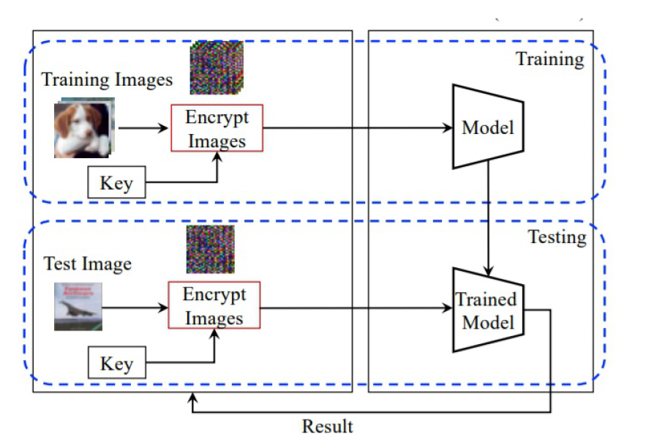
ARCHITECTURE DIAGRAM

Slide 21
SYSTEM REQUIRED SPECIFICATION
Hardware Requirements
Processor: Minimum i3 Dual Core
Ethernet connection (LAN) OR a wireless adapter (Wi-Fi)
Hard Drive: Minimum 100 GB; Recommended 200 GB or more
Memory (RAM): Minimum 8 GB; Recommended 32 GB or above
Software Requirements
Python
Anaconda
Jupyter Notebook
TensorFlow

Slide 22
MODULE EXPLANATION
Module 1 : Image Preprocessing
Processing can help you improve the quality of your image or extract essential information from it.
The complexity, inaccuracy, and insufficiency of a downloaded picture collection are all common. As a result, before constructing a computer vision model, we will preprocess the picture dataset (cleaning and converting it to the correct format) to get the intended outcomes.
Picture processing's main goal is to enhance image data (features) by minimising undesired aberrations and/or augmentation of certain critical picture attributes so that machine learning and deep learning models may operate with this upgraded data.

Slide 23
MODULE EXPLANATION
Module 2 : Image Transformation
A pixel-wise transformation approach that employs negative-positive transformation and colour component shuffling was suggested. It enables us to not only do data augmentation in the encrypted domain, but also to train and test models using separate keys. Furthermore, no adaption layer is required before to the classifier with this pixel-wise translation.
Another sort of learnable picture transformation is network-based transformation, which generates visually protected images using generative models. A generative model creating protected pictures is trained using network-based approaches by taking into account both classification accuracy for a classifier and perceptual loss based on a model.
As a result, the generative model is tuned to eliminate visual information from simple photos while keeping a high level of classification accuracy.

Slide 24
MODULE EXPLANATION
Module 3 : Image Feature Encryption Training
A model is trained using training data (pictures) encrypted with a common key, and the learned model is then applied to test images encrypted with the key. The qualities of photos and the properties allow us to execute privacy-preserving machine learning without sacrificing efficiency. Transformed photos with no visual information are delivered to a cloud server for training and testing a model, and the cloud server's network classifies the images without any visual information.

Slide 25
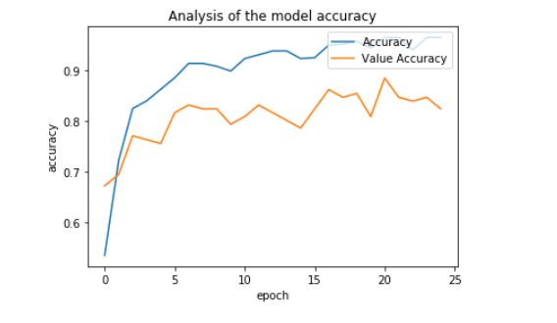
RESULT AND OUTPUT
We use the model to predict the answer on the evaluation dataset (held out data) and then compare the predicted target to the actual answer (ground truth). A number of metrics are used in ML to measure the predictive accuracy of a model.
Accuracy:The accuracy is a measure of the degree of closeness of a measured or calculated value to its actual value.
Value Accuracy: How the model is able to classify the images with the validation dataset.

Slide 26
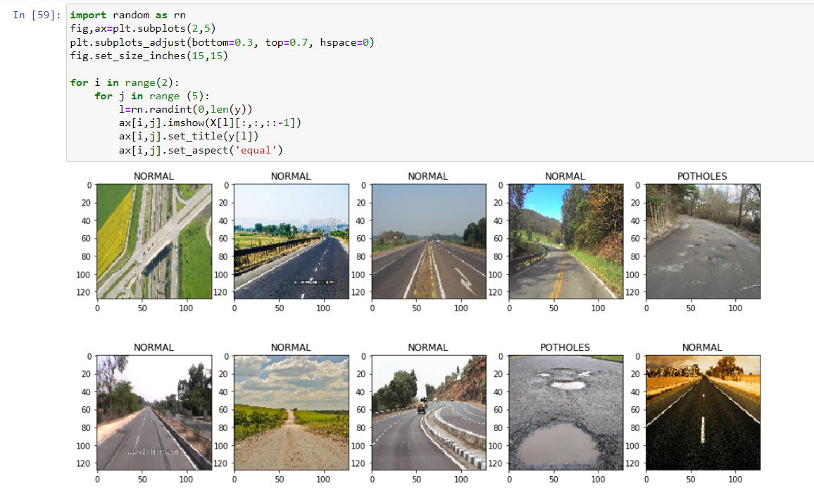
RESULT AND OUTPUT

Slide 27
CONCLUSION AND FUTURE WORK
The primary goal of our plan is to safeguard the security of the photos.
During the CNN characteristic modification procedure, the perimeter servers or slashers should be prohibited from teaching any material from the pictures or retrieved characteristics.
Because cellphone sensors are often resource-constrained, our plan must account for the processing overhead on mobile devices.
Meantime, we should drastically minimize the transmission cost among cellphone devices and perimeter servers, resulting in lower response latency.

Slide 28
REFERENCES
[1] Kai Huang, Ximeng Liu, Shaojing Fu,, Deke Guo and Ming Xu, “A Lightweight Privacy-Preserving CNN Feature Extraction Framework for Mobile Sensing ,” in Proceedings of the IEEE conference on Transactions of Dependable Computing 2018.
[2]A. Sharif Razavian, H. Azizpour, J. Sullivan, and S. Carlsson, “Cnn features off-the-shelf: an astounding baseline for recognition,” in Proceedings of the IEEE conference on computer vision and pattern recognition workshops, 2014, pp. 806–813.
[3] J. Johnson, A. Karpathy, and L. Fei-Fei, “Densecap: Fully convolutional localization networks for dense captioning,” in Proceedings of the IEEE Conference on Computer Vision and Pattern Recognition, 2016, pp. 4565–4574.
[4]Z. Xia, X. Wang, L. Zhang, Z. Qin, X. Sun, and K. Ren, “A privacy preserving and copy-deterrence content-based image retrieval scheme in cloud computing,” IEEE Transactions on Information Forensics & Security, vol. 11, no. 11, pp. 2594–2608, 2017.
[5] Q. Wang, J. Wang, S. Hu, Q. Zou, and K. Ren, “Sechog: Privacy Preserving outsourcing computation of histogram of oriented gradients in the cloud,” in Proceedings of the 11th ACM on Asia Conference on Computer and Communications Security. ACM, 2016, pp. 257–268.

