Slide 1
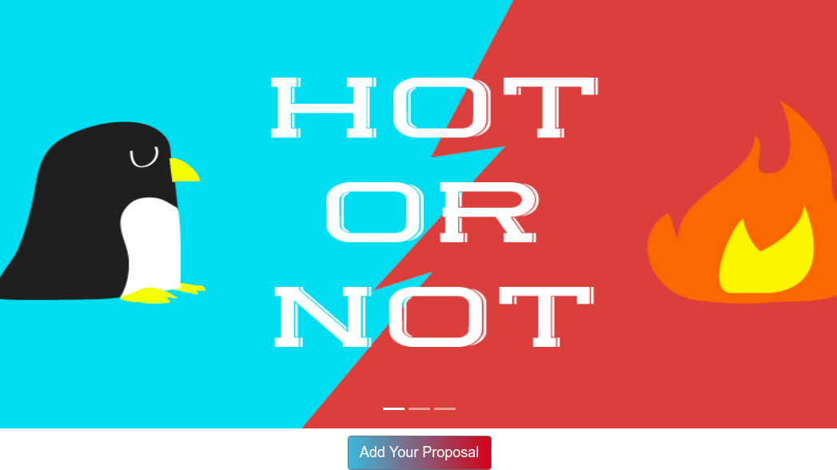
HOT OR NOT
Team Name : Lojackers
Project Name :Hot or Not
Category : Blockchain
An Ethereum based decentralised application where a particular issue or idea gets promoted globally.

Slide 2
Motivation
Free and fair elections where the leader pays and you get paid!
Raising public issues without government intervention or censor!
Advertising yourself and/or your ideas.

Slide 3
What’s new?
Proposers pay (with dynamic value 'charges' to initiate proposals).
Voters get paid (with dynamic value 'reward' to usher in voters).

Slide 4
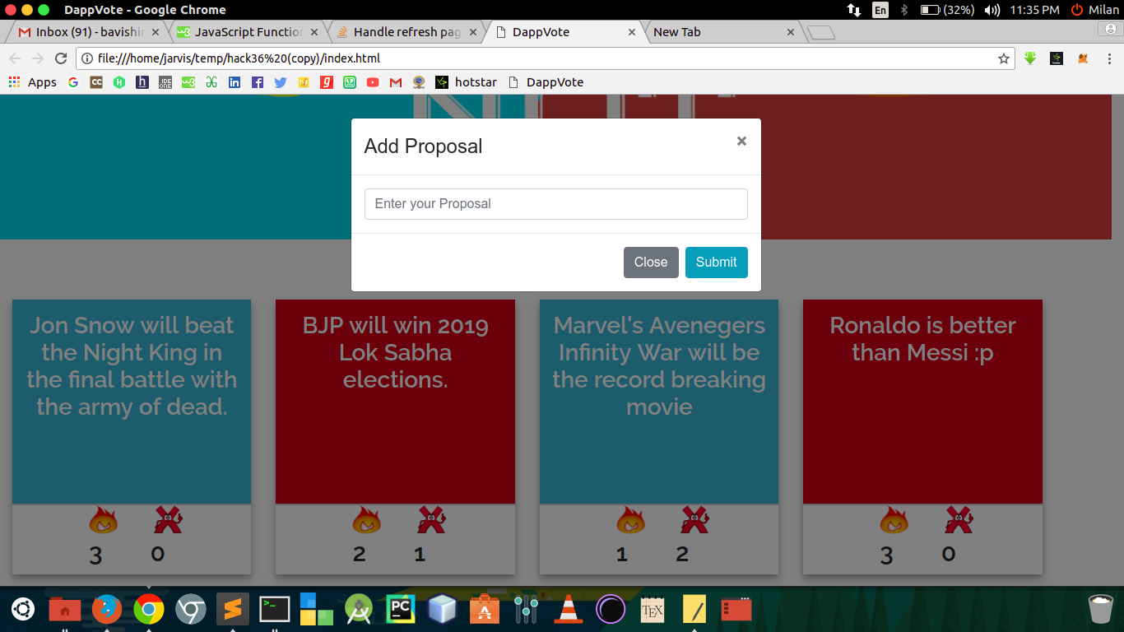
Screenshot

Slide 5
You can…
Add Your Proposal.
Any one can Upvote or Downvote (once).
Once voted the decision can’t be changed.
4 Proposal with maximum upvotes rises to the top.

Slide 6
Features
You may insert images(low res) as well!
You earn from your votes!
Everything is immutable!

Slide 7
Tools
Languages Used
JavaScript / JQuery
Solidity
Node.js
HTML / CSS / Bootstrap
Built With
Remix online IDE
Metamask(Browser Extension)
npm packages (ganache-cli, testrpc, web3, solc

Slide 8
THANK YOU!
Tuhin Subhra Patra - Backend - armag-pro
Bavishi Milan - Frontend - jarvis-dev
Jugta Ram - Backend - jugtaram
Piyush Trigun - Frontend - piyush-trigun

