Slide 1
Agile Wrapper
Nov 2018

Slide 2
5: Failure Modes & Guidance
Agile may be simple, but still it takes time to evolve the maturity to self manage. Often, organizations fail to adopt agile methods and the reasons could be cultural or process and tools related attributes. These failure points can be categorized at implementation level(ie., Sprint) and Governance level(Release/Project/Program level)
Failure Points@ Sprint level
Outcome | Failure Modes | Patterns for Identification | Prevention mode
Outcome #1: User stories not delivered as per Sprint plan | Failure Mode #1: Poor estimation | Sprint burndown chart showing an unusual fast/slow burn rate | Follow Standard Estimation method like Planning Poker or Tshirt Sizing Incorporate estimation related experience from retrospective to subsequent planning
 | Failure Mode #2: Requirements not elaborated: not meeting Definition of Ready (DOR) | Unresolved queries on requirements with PO | Prototype development as applicable Follow structured format of requirements writing Plan for frequent backlog grooming meeting during initial phases of the project
 | Failure Mode #3: Dependencies not managed | Incomplete tasks in Sprint backlog/tracker Delayed outcomes | Scrum master to identify dependencies ahead and factor it in the sprint planning meeting

Slide 3
5: Failure Modes
Outcome | Failure Modes | Patterns for Identification | Prevention mode
Outcome #2: Poor Quality of user stories delivered | Failure Mode #1: Right requirements not captured | Acceptance criteria not met/Rejection of deliverables | Involve only product owner and not proxy Business analyst for requirements capturing Early alert to steering committee on frequent rejection of 'agreed' functionalities
 | Failure Mode #2: Lack of testing within Sprint | All testing scenarios not captured/executed Time for testing not factored in the sprint | Test lead to maintain testing traceability with the user stories Enable test completion status in tracking tools Continuous integration and testing best practices to be followed Scrum master and team to ensure that all levels of testing(Unit, INT, SYS etc) are planned within the sprint
 | Failure Mode #3: Development standards not followed | Code related defects from Unit testing/ peer review and previous UATs or related incidents reported for maintenance support | Team needs to establish dev standards in sprint 0 and Project manager to ensure team awareness on the standards. Code review tool be configured or manual reviews to be planned in the sprint
 | Failure Mode #4: Business view of the product/Complete architecture view not known to team members | Unable to identify related dependencies leading to frequent rejections of functionalities | Business and Architecture overview to be given to whole team at sprint 0 maintain induction material with the relevant details.

Slide 4
5: Failure Modes
Outcome | Failure Modes | Patterns for Identification | Prevention mode
Outcome #3: Under committing/overcommitting user stories for sprint | Failure Mode #1: Apprehensiveness on the Agile way of working | Less participation in meetings retain traditional practices and use only scrum nomenclatures | Improve Agile awareness in the team by training and coaching Qualified scrum masters to be part of the team End to end Agile transformation plan for team members including senior management) for mindset change
 | Failure Mode #2: Not considering Team's capacity | Sprint burndown chart showing a fast/slow burn rate | Consider Team's capacity excluding leave plan, rework etc in the Sprint planning session
 | Failure Mode #3: Unrealistic targets from stakeholders | Acceptance of ambiguous requirement during the course of sprint Business urgency leading to excessive commitment in sprint planning | Frequent backlog grooming involving all stakeholders(eg: users) to capture and elaborate the right requirements Scrum master to ensure the right commitment is given based on team capacity thus resulting on no effort overrun while planning PO to have prioritized backlog and at least x% of the backlog items are in lesser priority.
Outcome #4: Client feedback not accounted into the delivery of features. | Failure Mode #4 Demo and Sprint review not done consistently | Definition of done not met | Scrum master to plan for demo and sprint review in sprint backlog

Slide 5
5: Failure Modes
Outcome | Failure Modes | Patterns for Identification | Prevention mode
 | Failure Mode #2: Rework not factored within sprint | Definition of done not met | Scrum master to plan the Demos as and when user stories get completed or atleast 2 days prior to sprint completion so as to factor the rework effort
Outcome #5: Under performance of team | Failure Mode #1: Agile principles not followed | Low confidence and morale Business outcome not met | Train and coach the team members Conduct Maturity assessments and plan for transformation
 | Failure Mode #2: Lack of collaboration within and amongst the teams | Lack of transparency on progress and reduced interactions | Distributed Agile best practices to be implemented(eg: Face to face interaction during Program increment workshops to improve collaboration) Scrum master to ensure availability of collaboration tools and environment
 | Failure Mode#3: Tool support not adequate | Tools not available Increased efforts for manual tracking Increase in mail Communications | Project manager to ensure availability of Agile supportive tools for planing, tracking and collaboration Train teams on tools like Jira version one etc Enable Standard configuration on tools for deliverables and status tracking

Slide 6
5: Failure Modes
Failure Points@ Release Level/Program Governance
Outcome | Failure Modes | Patterns for Identification | Prevention
Outcome#1: Business value not delivered to customer | Failure Mode#1: Business view of the product/Complete architecture view not known to team members | Unable to identify related dependencies leading to frequent rejections of functionalities | Business and Architecture overview to be given to whole team at sprint 0 maintain induction material with the relevant details.
Outcome#2: Delay in Go-Live impacting Business | Failure Mode#2: Lack of sustenance/improvement of velocity | Reduction in functionalities delivered to customer Release burn down depicting less than the ideal trend within the sprints | 1: Traceability between product backlog and release plan to be frequently aligned 2:Scrum master to Monitor Velocity and take corrective actions at the end of every sprint
 | Failure Mode#3: High defects in the functionality delivered | UAT defects or related incidents reported for maintenance support | 1: Hardening sprints to be planned before the release to accommodate integration/performance/load testing as required
Outcome#3: Attrition | 1: Low morale and excessive workload | Low confidence and reduced communication Business outcome not met | 1: Scrum master to ensure that planning is done as per the team's capacity 2: Train and coach the team members/product owner on Agile practices 3: Conduct Maturity assessments and plan for transformation

Slide 7
5: Failure Modes
Outcome | Failure Modes | Patterns for Identification | Prevention mode
Outcome#4: Poor customer satisfaction | Failure Mode #1: Lack of proactiveness | Improvement in velocity not evident Lack of reduction in requirements clarification efforts | Design thinking workshop/Business requirement fulfillment planning workshops to be conducted for the team
Outcome#5:Cost overrun | Failure Mode #1: Change management | Significant increase in product backlog | Proper definition of change and defect to be discussed and agreed with the stakeholders during sprint 0.
 | Failure Mode #2: All other failure modes listed earlier will result in Cost overrun directly/indirectly | Refer to previous failure modes

Slide 8
6: Control points
Initiation/Prepare
Build
Release/Deploy
Involve only product owner and not proxy Business analyst for requirements capturing
Follow structured format for requirements writing and ensure Acceptance criteria of the user stories is clearly documented
Follow Standard Estimation method like Planning Poker or Tshirt Sizing
Scrum master to identify dependencies ahead and factor it in the sprint planning meeting of every sprint
Team needs to establish development standards in sprint 0 and Project manager has to ensure team awareness on the standards.
Code review tool be configured or manual reviews to be planned in the sprint
Team to undergo mandatory agile training and plan for Agile coach who can mentor and guide the team. Train teams on tools like Jira, version one etc
Consider Team's capacity excluding leave plan, rework etc in the Sprint planning session
Scrum master to ensure the right commitment is given based on team capacity thus resulting on no effort overrun while planning
Project manager to ensure availability of Agile supportive tools for planning, tracking and collaboration
Incorporate estimation related experience from retrospective to subsequent planning
Plan for Frequent backlog grooming sessions involving all stakeholders(eg: users) to capture and elaborate the right requirements
Product owner has to always maintain prioritized backlog and to ensure that at least x% of the backlog items are in lesser priority
Plan for Prototype development as applicable
Scrum master and team have to ensure that all levels of testing(Unit, INT, SYS etc) are planned within the sprint
Test lead has to maintain testing traceability with the user stories
Enable test completion status in tracking tools
Continuous integration and testing best practices to be followed
Scrum master to plan for demo and sprint review in sprint backlog
Early alert to steering committee on frequent rejection of 'agreed' functionalities
Hardening sprints to be planned before the release to accommodate integration/performance/load testing as required
Sprint 1..N

Slide 9
6: Control points
Initiation
Execution
Closure
Always plan for Qualified scrum masters to be part of the team
Design thinking workshop/Business requirement planning workshops to be conducted for the team
Business and Architecture overview to be given to whole team at sprint 0
Distributed Agile best practices to be implemented(eg: Face to face interaction during Program increment workshops to improve collaboration)
Definition of Done and Definition of Ready to be discussed and agreed with all stakeholders
Proper definition of change and defect to be discussed and agreed with the stakeholders during sprint 0.
Train and coach the team members/product owner on Agile practices
Conduct Maturity assessments and plan for transformation
Ensure End to end Agile transformation plan for team members including senior management) for mindset change
Enable Standard configuration on tools for deliverables and status tracking
Maintain documentation on Business and architecture overview for new members joining the team
Traceability between product backlog and release plan to be frequently aligned
Conduct Maturity assessments and plan for transformation
Scrum master to Monitor Velocity and take corrective actions at the end of every sprint
Hardening sprints to be planned before the release to accommodate integration/performance/load testing as required
Release/
Program Governance

Slide 10
7: Agile Support by QA
Quality Assurance team lends extensive support for Agile projects from RFP/Initiation phase till Closure in various mechanisms.
Agile Profiling
Agile Maturity Assessments
Agile Coaching
Agile compliance and Tool support
Agile+DevOps Support
Agile RFP support
RFP support of appropriate responses to questions and proposals as per the client requirements
Agile Readiness checks for new engagements transitioning to Agile
Establishing sustainable Agile transformation covering process and culture
Inspire, Mentor and Coach individuals and Team along the Agile journey
Process Compliance Support to Delivery teams by SQA
* To Extend the Agile support to include DevOps and Continuous delivery in terms of process alignment and tools usage
For more details, reach out to the
QA BU partner...

Slide 11
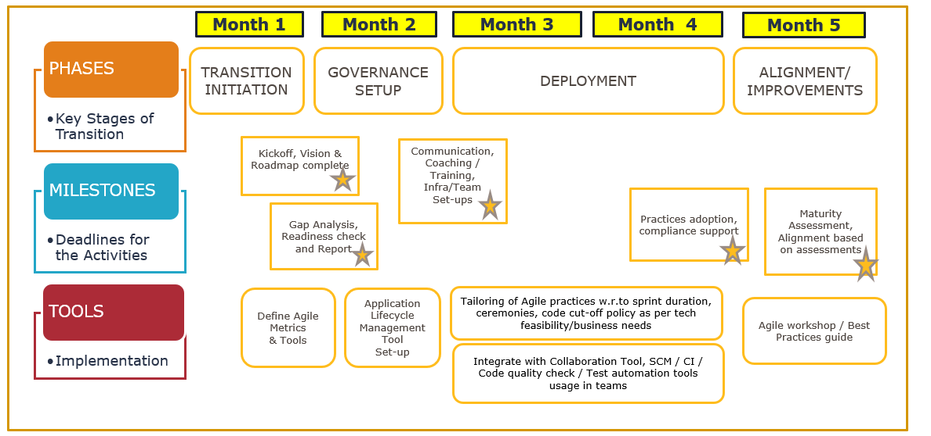
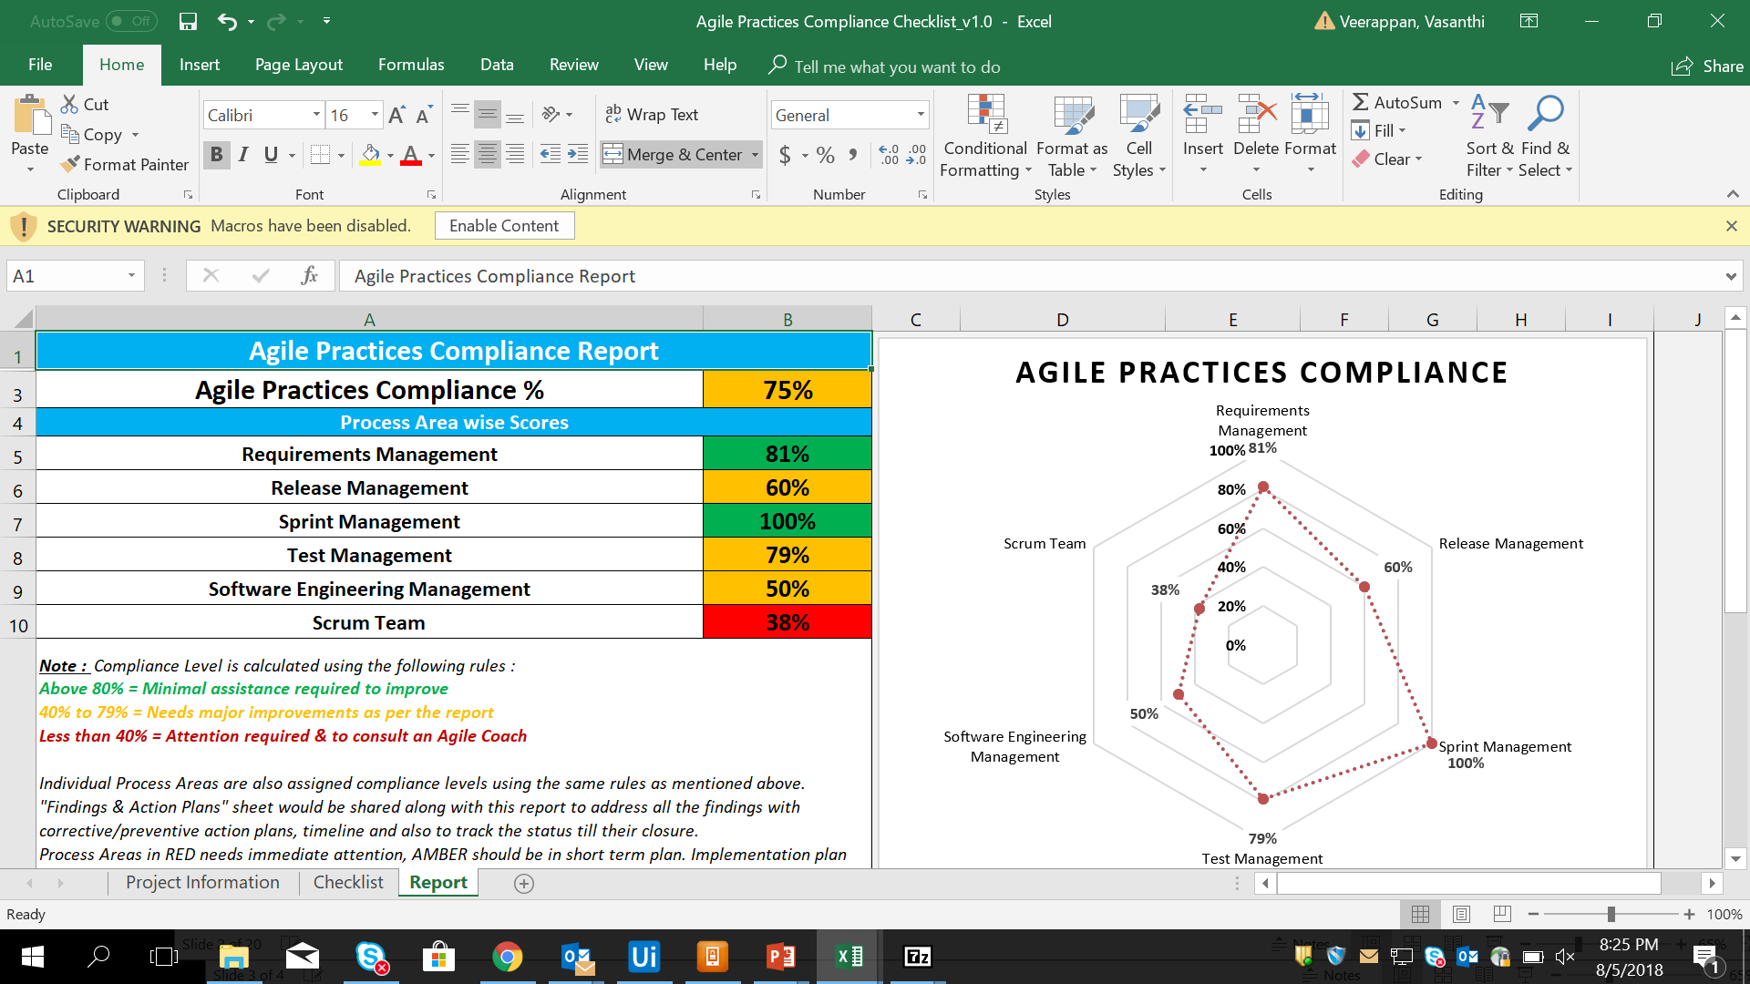
9. Accelerators and best practices
At Capgemini, we have various accelerators and best practices from projects which have implemented Agile. Some of them may be reference materials, knowledge sharing artifacts based on lessons learnt or toolkits which help in transformation.
1: Sample Agile Transformation Plan- You can contact QA team for further information
2: Agile Maturity Assessment report
3: KM Portal: Agile World contains various samples, guidances, training material and tool support articles in the portal
You can access Agile Catalyst QA-India for reference
4: External support/reference information
Scaled Agile framework
Notes:
Profiler,
Maturity assessment
Transformation plan
Training material
Jira support
Template sQMS
Agile baseline
KM portal
Nexus, Safe external links

Slide 13
Agile Wrapper across Project Lifecycle
Engagement Start up phase
Sprint Initiation
Agile Delivery and Sprint Implementation phase
Prepare
Sprint initiation
Agile tooling
Distributed model/Scaling Agile
Build & Govern
Release Planning & Sprint Planning
Readiness Check
Agile Process Set up
Case Studies & best practices
Governance & metrics
Agile Lifecycle Management & Compliance checks
Maturity Assessments
DevOps and tooling
Agile
Contracting
Project Kick off
Continual Improvement
Notes:
Fixar a posicao do titulo – sempre do lado esquerdo.
Sempre que tiver muito texto o coluna deve sempre ser “ narrowed” , se nao fica dificil de ler. Colocar paragrafos no texto.
Linha vertical deve ser mais fina e as pontas NUNCA devem ser arredondadas.

