Slide 1





FINVASIA INNOVATION HACKATHON 2026
Leveraging Emerging Trends and Technologies for
Financial Innovation
Team Name: Hackops
Problem Statement: AI Behavioral Finance Protection Layer
Team Lead: Piyush Prajapati
Team Member: Prachi Bhardwaj

Slide 2
Problem Statement
Current System Limitations: Existing trading platforms are built only for execution speed, lacking any psychological safeguards to prevent impulsive actions.
User Pain Points :.
Technical or Operational Challenges: Traditional brokers execute harmful orders with "Zero Friction," making it too easy for emotionally compromised traders to wipe out their accounts.
Why This Problem Matters Now:
90% of retail traders lose money
Not due to lack of knowledge
But due to emotions like FOMO & panic
Trading platforms do not prevent this
Rising participation in F&O trading in India
Increased risk of retail investor losses
Losses reduce user trust & retention
Affects long-term platform growth

Slide 3
Proposed Solution
Core Idea / Concept: AI "Psychological Wrapper" for Shoonya to stop emotional trading in real-time.
Key Features:
How it Addresses the Challenges: Injects "Healthy Friction" by forcing pauses and reflection before risky trades.
USP : “DON’T BLOCK TRADES — GIVE TRADERS A MIRROR”
Real-time psychological feedback
Helps users rethink decisions
Maintains freedom + adds safety
Why this Solution is Better: It focuses on trader survival and long-term retention rather than just execution speed.
AI detects 7 emotional trading patterns
Real-time risk scoring system
Cooldown circuit breakers
NLP-based misinformation detection

Slide 4
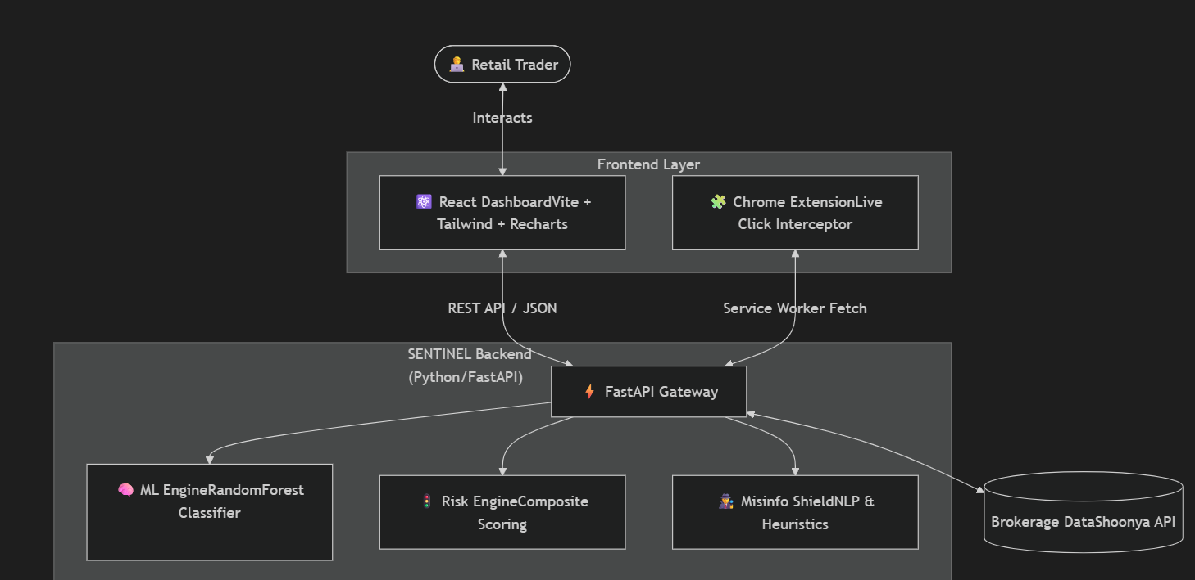
Feature 1 (

Slide 5
Key Features + Tech Stack
Feature 1 (AI-based): Behavioral ML Model trained to detect 7 emotional trading patterns (revenge trading, FOMO, panic selling).
Feature 2 (automation / prediction): Real-time Psychological Circuit Breakers and Live Risk Scoring that automatically intercept dangerous trades.
Feature 3 (user benefit): Protects retail traders from massive capital destruction during emotional tilts without permanently blocking their access to the market.
Tech stack:
AI/ML | Scikit-Learn, Pandas, NumPy, OpenAI API (gpt-4o-mini)
Backend | Python 3.11, FastAPI, Uvicorn
Frontend | React 18, Vite, TailwindCSS,
API’S | Shoonya Brokerage Data API, REST APIs for Frontend-to-Backend communication

Slide 6
Impact & Benefits
Impact on Users: Extends trader "lifespan" by reducing capital destruction caused by emotional and behavioral biases.
Benefits:
Speed: Delivers sub-second real-time behavioral analysis using a high-concurrency FastAPI gateway.
Accuracy: Utilizes a Random Forest Classifier to identify specific patterns like Revenge Trading with high precision
Cost Reduction: Eliminates financial losses from overtrading and impulsive orders, preserving retail capital for better oppertunities
Real-world Application: Acts as a native "safety layer" via a Chrome Extension that works directly on live brokerage platforms like Shoonya.

Slide 7
Challenges + Feasibility
Challenge 1 → Solution: Real-time analysis latency is solved by using a high-performance FastAPI
backend and Service Worker for sub-second trade interception.
Challenge 2 → Fix: User resistance to trade blocking is fixed by our "Mirror" philosophy—using
CoolDown Cards to force reflection rather than outright blocking.
Technical Feasibility: Built using industry-standard Python and React stacks, making it easy to integrate
with Shoonya’s existing API infrastructure.
Scalability: The microservices-based architecture and lightweight Chrome Extension allow SENTINEL to
scale across millions of retail users with minimal overhead.

Slide 8
Future Scope
Future improvement Developing deep-learning models to adapt to individual trader personalities for hyper-personalized behavioral coaching.
Scaling plan: Moving from a browser extension to a native mobile integration for the Shoonya app, ensuring protection across all devices.
Integration with real systems: Directly connecting the Portfolio Stress Tester to live exchange feeds for real-time automated hedging suggestions.
Business potential: Offering SENTINEL as a B2B "Responsible Trading" compliance layer for other financial institutions and brokerages.

