Slide 1

SENSEintelligence
Customer support ChatBOT

Slide 2
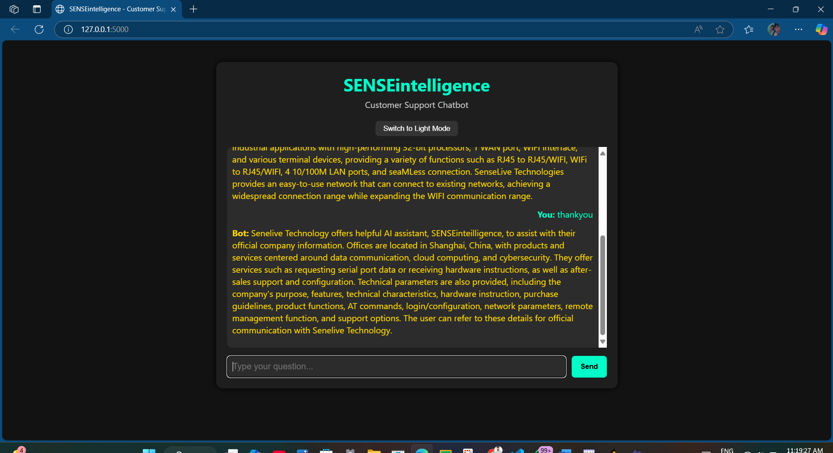
TABLE OF CONTENTS
01
02
AI MODELs
WORK FLOW
03
04
FUTURE SCOPE
CONCLUSION

Slide 3
01
AI MODELs

Slide 4
MODELS
Extractive AI
Extract existing information
Exact data from input data
Generative AI
Create New Content
Original text from input
Learns patterns and generate from search

Slide 5
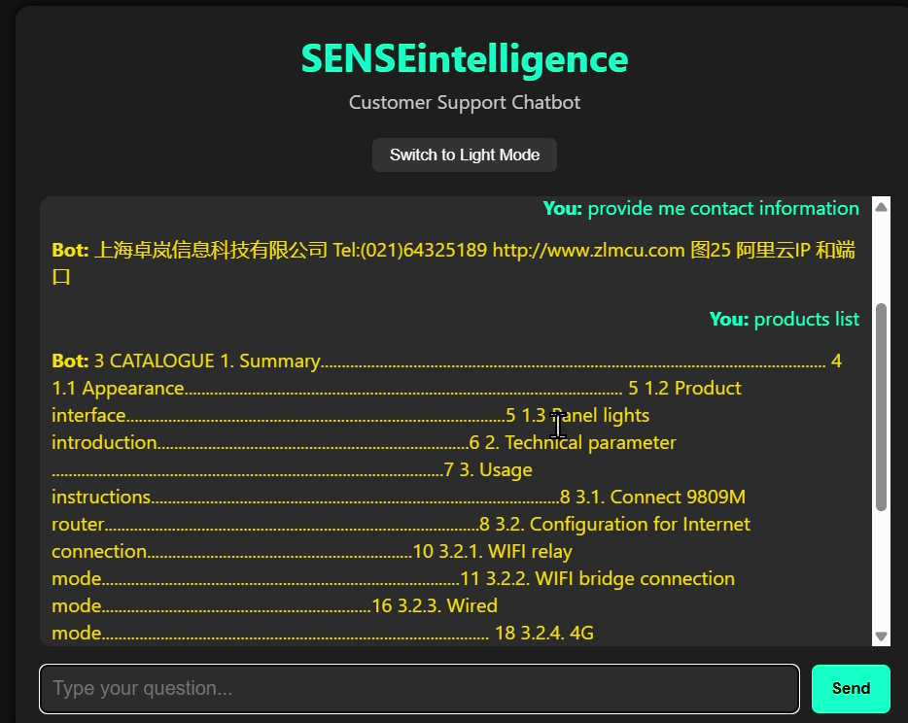
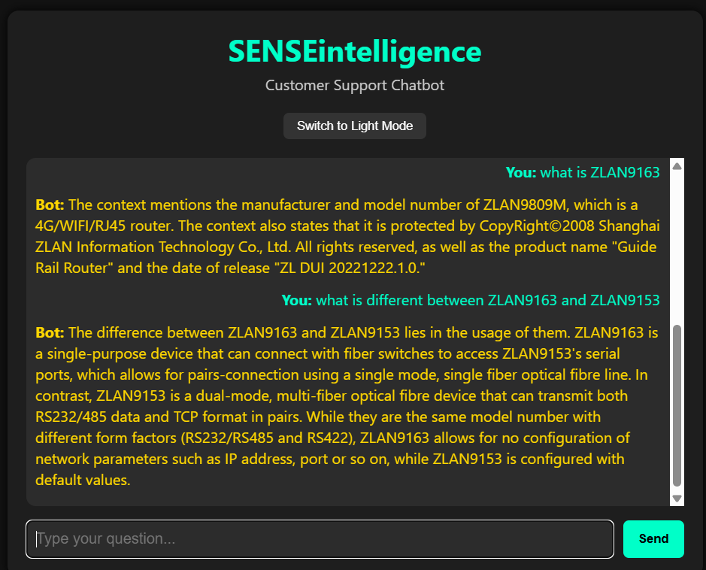
SENSEintelligence
Extractive AI
Generative AI

Slide 6
02
WORK FLOW

Slide 7
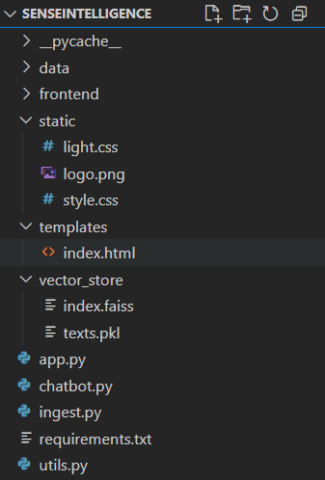
All the PDFs
FrontEnd UI (HTML + CSS)
Chuncs File (.faiss & .pkl)
BackEnd UI (PYTHON)

Slide 8
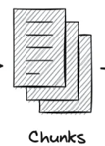
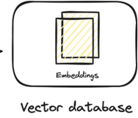


Ingest.py
.pdfs
Pdf to text
N number of chunks
Index.faiss
Texts.pkl

Slide 9
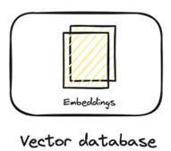
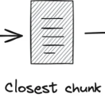
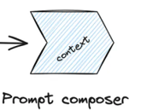





Chatbot.py
tinyllama
As a model of ollema used for the ChatBOT

Slide 10
03 & 04
FUTURE SCOPE & CONCLUSION

Slide 11
GENERATIVE AI MODEL LIST WHICH WE CAN USE
PAID AI
GPT
OpenAI
FREE AI
Gemma
Gemini 1.5
Jasper AI
Runway ML
Mistral
Ollama
Bark
LlaMa
⚠️ Limitations of Free AI Models
1. Most advanced AI models are paid and often expensive for regular or commercial use.
2. While there are free and open-source AI models, they usually require high-end hardware or powerful local configurations to run effectively.
3. However, once PDFs are embedded and vectorized, replacing a small model like TinyLlama with another model becomes straightforward, offering flexibility in experimentation and upgrades.

Slide 12
UPDATION IN THE CONTENT OF PDFs
🔄 Dynamic PDF Content Updates
Enable real-time or scheduled re-indexing of updated PDFs.
Automatically reflect changes in policy documents, product manuals, or FAQs.
Reduces manual re-training and keeps responses current.

Slide 13
Thank-YOU
DO YOU HAVE ANY QUESTION?
piyushjharariya11@gmail.com
+91 94216 86591
piyush-portfolio-alpha-olive.vercel.app
www.linkedin.com/in/piyush110920
https://github.com/piyush110920

