Slide 1
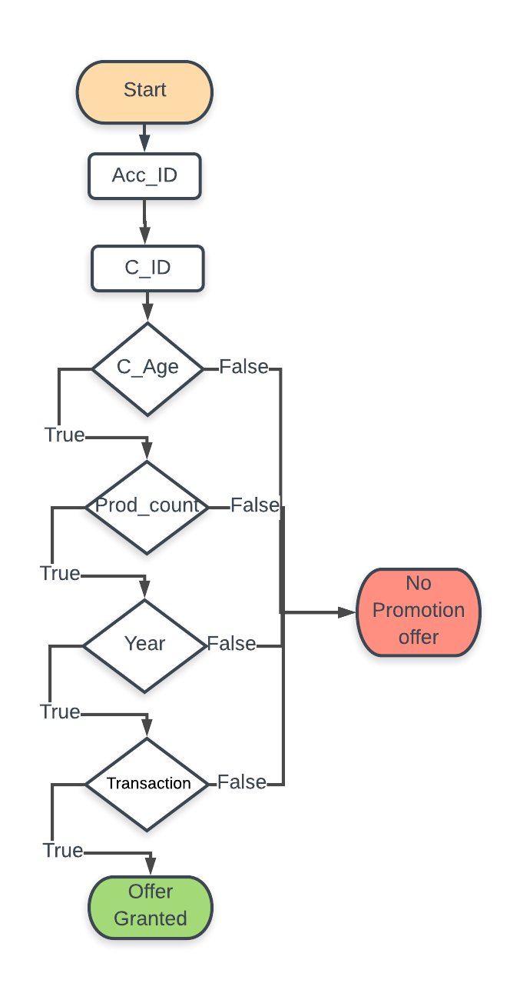
C_ID: C101 Prom_ID: P1 Count: null
C_ID: C101 Prom_ID: P2 Count: null
If condition (C_Age) follows count will be 1
else 0 as per offer condition
If condition (Pro_count) follows count will be 1 else 0 as per offer condition
If condition (Pro_Year) follows count will be 1 else 0 as per offer condition
If condition (Transaction) follows count will be 1 else 0 as per offer condition
Fetch all information for C_ID: C101 from Acc_ID
Count:1 for Prom_ID: P1
Count:0 for Prom_ID: P2
Count:11 for Prom_ID: P1
Count:0 for Prom_ID: P2
Count:111 for Prom_ID: P1
Count:0 for Prom_ID: P2
Count:1111 for Prom_ID: P1
Count:0 for Prom_ID: P2
If Count is 1111 then offer will be granted for the respective Prom_ID as P1 will get in my case.
Notes:
Initially Customer1 is eligible for all the offers let in my case Prom_ID P1, P2. In starting of the system will fetch information from various table and follow to the various condition like Age, Transaction, Product, Activate form last. As shown in the slide the Customer 1 age is 47 so for C_Age condition will be false for package 1(Blue), but will True for package 2 (Gray). So, for each true condition we will add count with 1. At last after if offer Granted condition have count 1111 then offer will be given to the customer for Prom_ID.

