Slide 1
Introduction to D3.js
Professional-looking, dynamic charts with JavaScript
September 19, 2016

Slide 2

Introduction of trainers
Onkar Deshpande
Professional training consultant since last 10 years
Java, Python, C#, JS
AngularJS, D3, NodeJS
MongoDB,Redis

Slide 3
Prerequisites for this session
JSON
JavaScript
Basics of HTML and CSS

Slide 4
History of D3.js
Developer & team
Mike Bostock, Jeffrey Heer, Vadim Ogievetsky
Initial release
18 February 2011
Stable release
30 July 2016 – Version 4.2.0
License
BSD licenses - https://en.wikipedia.org/wiki/BSD_licenses

Slide 5

Concept (Data Visualizations)
What is data visualizations?
Presentation of data in graphical format.
High-level understanding of all kinds of data
Understand patterns which is not possible without data visualizations.
More analytics data can be collected by end user in shorter time.

Slide 6
How D3.js will help for web visualizations
Now we know what is data visualizations and what is importance of it.
So lets learn how can we do this in web.
It can be used with many JavaScript libraries
D3.js works in browsers without any extra plugins. Licensed under BSD
Highcharts its good but paid script.
Prefuse and flare – fail because they don’t work without plugin
D3.js has open source community with lots of code samples available.
As its widely used for charting so its hirable skill – check here
Lets see some advantages of D3.js

Slide 7
Advantages of D3.js
Advantages over other charting libraries
Open Source
Powerful Visualization
Interaction techniques
DOM manipulation
Freedom to design the right visual interface
Works without any plugin like other libraries
D3.js helps you bring data to life using SVG, Canvas and HTML
You can also integrate transitions of different SVG elements very easily
Let’s start learning the best one

Slide 8
Installing / Including D3.js
Node
npm install d3
Direct download link
https://github.com/d3/d3/releases/
CDN –
<script src="https://d3js.org/d3.v4.js"></script>
minified - <script src="https://d3js.org/d3.v4.min.js"></script>

Slide 9

Installing / Including D3.js – CDN way
D3 allows us to bind arbitrary data to a Document Object Model (DOM), and then apply data-driven transformations to the document. For example, you can use D3 to generate an HTML table from an array of numbers. Or, use the same data to create an interactive SVG bar chart with smooth transitions and interaction.
Setup and include library – Create folder for d3js projects and create new file install.html. Include D3.js library from CDN.
<!DOCTYPE html>
<html>
<head>
<script type="text/javascript" src=" https://cdnjs.cloudflare.com/ajax/libs/d3/3.5.17/d3.js"></script>
</head>
<body>
<p> D3.js </p>
</body>
</html>

Slide 10
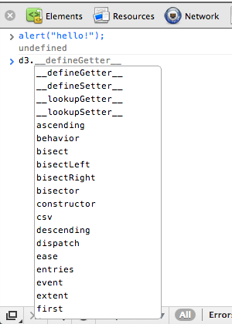
Test installation
JavaScript console setup test
– Lets go to console from web inspector to check if d3 library is loaded or not. We can simply type d3. and check for something similar to following image on your screen or not. If you can see this then your library is loaded.

Slide 11
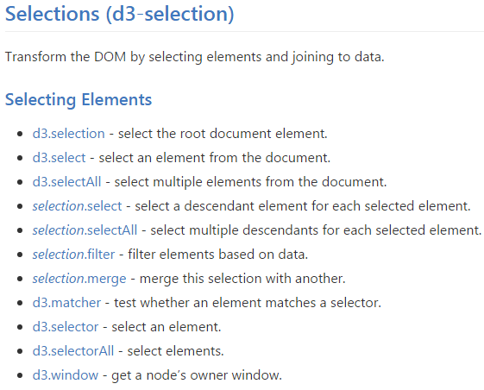
Learning some important API
Lets add simple DOM element to our document
d3.select("body")
.append(“div")
.text(“my first DOM element with D3.js");
Above example is self explanatory but point to remember is the API.
Select – This API is used to select any element from document. This method uses CSS3 Selectors.
Append – This appends a new element as the last child of the selected element.
List of all the selection API is here, Selection API are very important and we will need them in any type of chart.

Slide 12
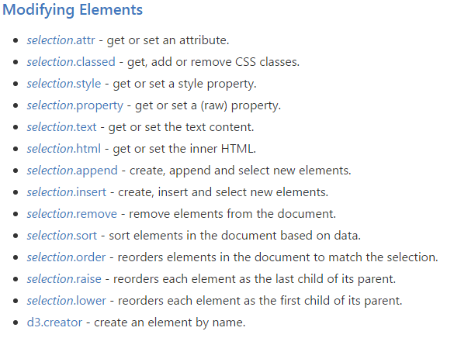
Learning API
Some important API use to
modify DOM
- d3.select("body")
.append(“div")
.text(“my first DOM element with D3.js");
- d3.select(“div")
.attr(“width“, 50)
.attr(“height“, 50);
- d3.select(“svg")
.append(“circle“)
.style(“stroke“, “gray”)
.style(“fill“, “red”);

Slide 13
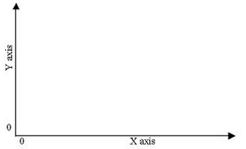

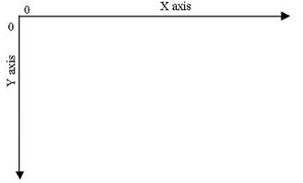
What is SVG?
SVG stands for Scalable Vector Graphics
SVG is used to create different shapes that can be used in HTML or independently as graphics.
Using SVG we can draw shapes like circle, rectangles, curved lines, animations etc.
The most important part about using SVG is that it is scalable.
If we scale images, they can become pixelated or too sharp.
In case of SVG, the graphics scale well therefore making it a good choice for graphs for screens with varying dimensions.
Let’s see some simple examples using SVG.

Slide 14
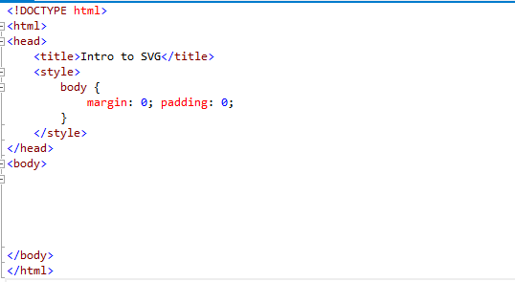
SVG example
In this example, we have
Empty HTML document

Slide 15
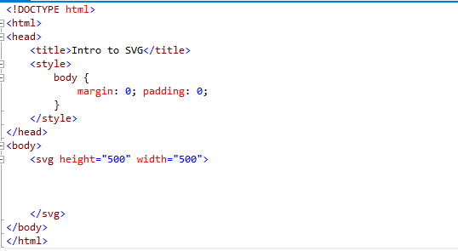
SVG example
In this example, we have
Empty HTML document
Add SVG element and give it height and width

Slide 16
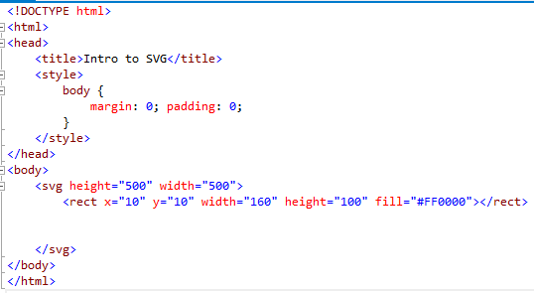
SVG example
In this example, we have
Empty HTML document
Add SVG element and give it height and width
Add a rectangle giving it `x`, `y`, ` width ` ,`height` and `fill`

Slide 17
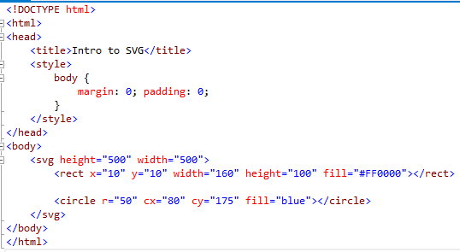
SVG example
In this example, we have
Empty HTML document
Add SVG element and give it height and width
Add a rectangle giving it `x`, `y`, ` width ` ,`height` and `fill`
Add a circle giving it `r`, `cx`, `cy` and `fill`

Slide 18
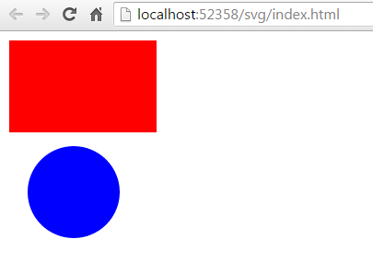
SVG output
Some points to note
x starts from left corner and goes to the right.
So x=10 means 10 pixels to the right of the left edge
And x=-10 will mean 10 pixels to the left of the left edge.
y starts from the top and goes downwards.
So y=10 means 10 pixels below the top edge
And y=-10 will mean 10 pixels above the top edge

Slide 19

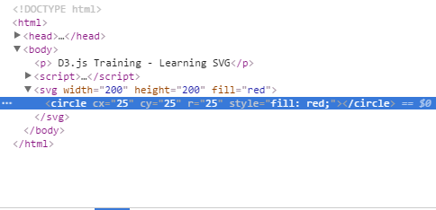
Learning API
Lets start using SVG and render some graphic elements
Recall the SVG circle we have created in earlier slide and try to
understand how can we created the same using d3.js
d3.select(“body")
.append(“svg“)
.attr(“id“, “mySvg”)
.attr(“width“, “50”)
.attr(“height“, “50”)
.append(“circle“)
.attr(“cx“, “25”)
.attr(“cy“, “25”)
.attr(“r“, “25”)
.style(“fill“, “purple”);
Hit 12 and check the rendered HTML
Congratulations - you've added an SVG element to the DOM using D3.js!

Slide 20
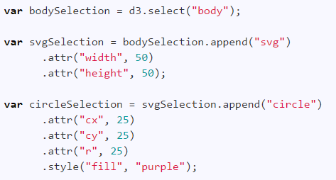
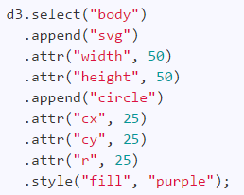
Skeleton of D3.js code for data visualizations
Which code looks better?

Slide 21
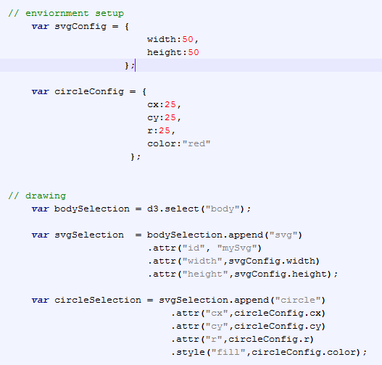
Skeleton of D3.js code for data visualizations
Environment setup
Configurations of SVG
Configurations for SVG elements etc
Drawing
We can assign selections to JS variables.
Write simple code blocks for each element you want in your DOM

Slide 22
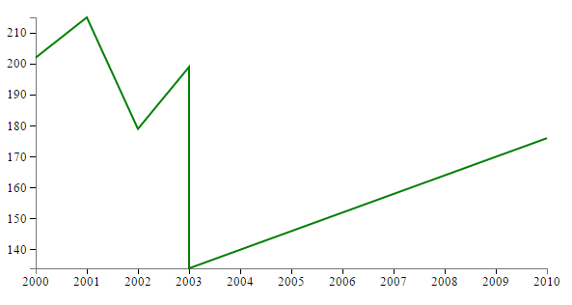
Demo 1
Simple line chart using D3.js

Slide 23
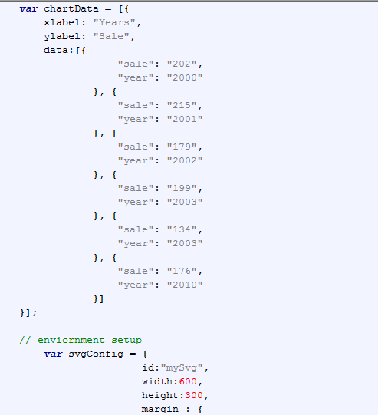
Simple line chart using D3.js
High level overview for drawing line chart
Prepare chart data in JSON
Prepare Environment configurations
Append SVG element
Create X and Y scales
Create axis using scales
Append axis to SVG
Draw line using available JSON data
API required
d3.scale.linear() - Quantitative Scale
d3.svg.axis()
D3.svg.line()

Slide 24
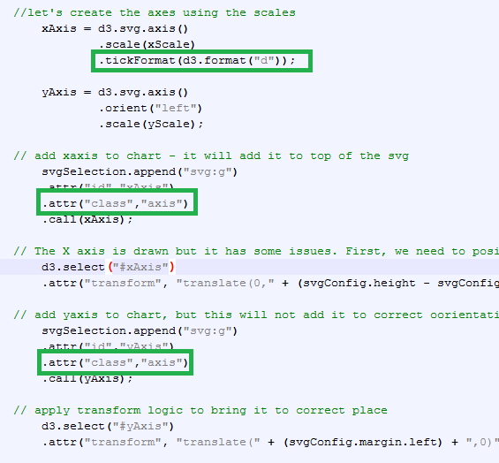
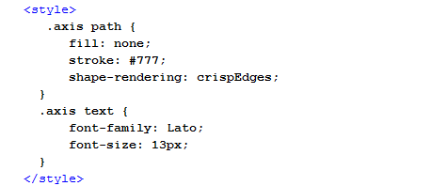
Applying styles to SVG elements
Add following styles and add class to element

Slide 25
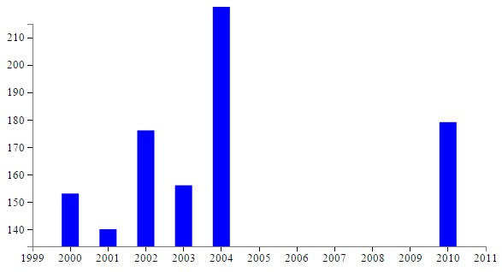
Demo 2
Bar chart using D3.js

Slide 26
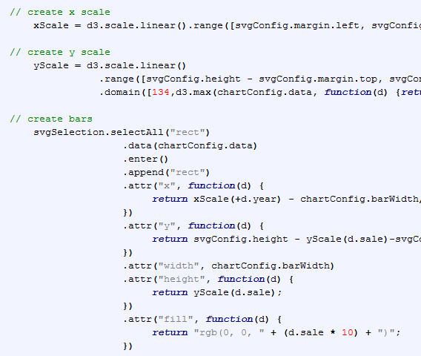
Bar chart using D3.js
High level overview for drawing bar chart
Prepare chart data in JSON
Prepare Environment configurations
Append SVG element
Create X and Y scales
Create axis using scales
Append axis to SVG
Draw line using available JSON data
API required
d3.scale.linear() - Quantitative Scale
d3.max() - Compute the maximum value in an array
d3.selectAll - select multiple elements from the document.

Slide 27
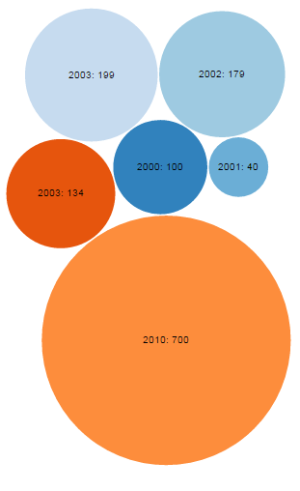
Demo 3
Bubble chart using D3.js

Slide 28
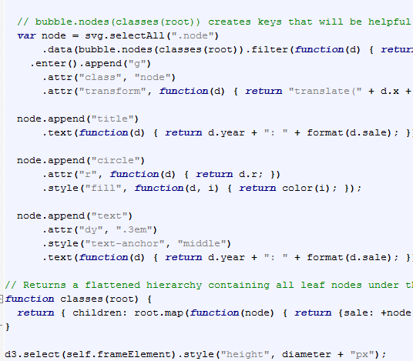
Bubble chart using D3.js
High level overview for drawing Bubble chart
Prepare chart data in JSON
Prepare Environment configurations
Append SVG element
Create X and Y scales
Create axis using scales
Append axis to SVG
Draw line using available JSON data
API required
d3.layout.pack()

Slide 29
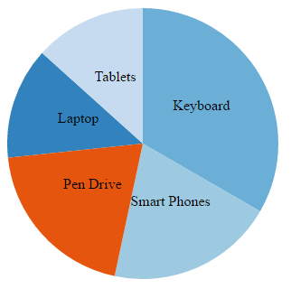
Demo 4
Pie chart using D3.js

Slide 30
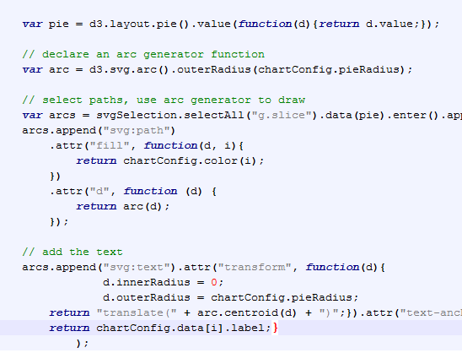
Pie chart using D3.js
High level overview for drawing Pie chart
Prepare chart data in JSON
Prepare Environment configurations
Append SVG element
Create X and Y scales
Create axis using scales
Append axis to SVG
Draw line using available JSON data
API required
d3.layout.pie()
d3.svg.arc

Slide 31
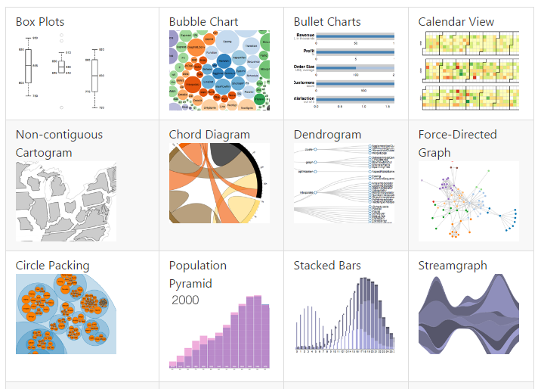
Other charts we can prepare with D3.js

Slide 32

Confident Enough?
Lets take a small test.

Slide 33

Thank You!
Name
Designation
Mobile: +1 XXX
Desk: +1 XXX
email@xoriant.com
www.xoriant.com
India
Mumbai
4th Floor, Nomura
Powai , Mumbai 400 076
Pune
5th Floor, Amar Paradigm
Baner, Pune 411 045
Kolkata
2B, 12th Floor, Tower ‘C’
Rajarhat, Kolkata 700 156
US – Corporate Headquarters
1248 Reamwood Avenue,
Sunnyvale, CA 94089
Phone: (408) 743 4400
343 Thornall St 720
Edison, NJ 08837
Phone: (732) 395 6900
UK
20 Broadwick Street
Soho, London
W1F 8HT, UK
89 Worship Street
Shoreditch,
London EC2A 2BF, UK
Phone: (44) 2079 938 955
Bangalore
4th Floor, Kabra Excelsior,
80 Feet Main Road, Koramangala 1st Block,
Bengaluru (Bangalore) 560034
Gurgaon
A/373rd Floor, Sigma Center
Gurgaon, Haryana 122 011s

