Slide 1
CAPSTONE PROJECT: BATTLE OF THE NEIGHBORHOODS
Final Assignment: Capstone Project: Battle of Neighborhoods
Singapore Visitors and Expatriates Venue Recommendation
INTRODUCTION
Singapore is a small country and one of the most visited countries in Asia. There are a lot of websites where travelers can check and retrieve recommendations of places to stay or visit. However, most of these websites provides recommendation simply based on usual tourist attractions or key residential areas that are mostly expensive or already known for travelers based on certain keywords like "Hotel", or "Backpackers" etc. The intention on this project is to collect and provide a data driven recommendation that can supplement the recommendation with statistical data. This will also be utilizing data retrieved from Singapore open data sources and FourSquare API venue recommendations.
The sample recommender in this notebook will provide the following use case scenario:
A person planning to visit Singapore as a Tourist or an Expat and looking for a reasonable accommodation.
The user wants to receive venue recommendation where he can stay or rent an HDB apartment with close proximity to places of interest or search category option.
The recommendation should not only present the most viable option, but also present a comparison table of all possible town venues.
For this demonstration, this notebook will make use of the following data:

Slide 2
Final Assignment: Capstone Project: Battle of Neighborhoods
Singapore Median Rental Prices by town.
Popular Food venues in the vicinity. (Sample category selection)
Note: While this demo makes use of Food Venue Category, Other possible categories can also be used for the same implementation such as checking categories like:
Outdoors and Recreation
Nightlife
Nearby Schools, etc.
II. DATA ACQUISITION
This demonstration will make use of the following data sources:
Singapore Towns and median residential rental prices.
Data will retrieved from Singapore open dataset from median rent by town and flattype from https://data.gov.sg website.
The original data source contains median rental prices of Singapore HDB units from 2005 up to 2nd quarter of 2018. I will retrieve rental the most recent recorded rental prices from this data source (Q2 2018) being the most relevant price available at this time. For this demonstration, I will simplify the analysis by using the average rental prices of all available flat type.
Singapore Towns location data retrieved using Google maps API.
Data coordinates of Town Venues will be retrieved using google API. I also make use of MRT stations coordinate as a more important center of for all towns included in venue recommendations.

Slide 3
Final Assignment: Capstone Project: Battle of Neighborhoods
Singapore Top Venue Recommendations from FourSquare API
(FourSquare website: www.foursquare.com)
I will be using the FourSquare API to explore neighborhoods in selected towns in Singapore. The Foursquare explore function will be used to get the most common venue categories in each neighborhood, and then use this feature to group the neighborhoods into clusters. The following information are retrieved on the first query:
Venue ID
Venue Name
Coordinates : Latitude and Longitude
Category Name
Another venue query will be performed to retrieve venue ratings for each location. Note that rating information is a paid service from FourSquare and we are limited to only 50 queries per day. With this constraint, we limit the category analysis with only one type for this demo. I will try to retrieve as many ratings as possible for each retrieved venue ID.
METHODOLOGY
Singapore Towns List with median residential rental prices.
The source data contains median rental prices of Singapore HDB units from 2005 up to 2nd quarter of 2018. I will retrieve the most recent recorded rental prices from this data source (Q2 2018) being the most relevant price available at this time. For this demonstration, I will simplify the analysis by using the average rental prices of all available flat type.
Data Cleanup and re-grouping. The retrieved table contains some un-wanted entries and needs some cleanup.
The following tasks will be performed:
Drop/ignore cells with missing data.
Use most current data record.

Slide 4
Final Assignment: Capstone Project: Battle of Neighborhoods
Fix data types. Post Processed Singapore towns list with and median residential rental prices
Adding geographical coordinates of each town location.
2. Retrieve town coordinates.
Google API was used to retrieve the coordinates (latitude and longitude of each town centers. For this exercise, I just used the MRT stations as the center points of each evaluated towns. The town coordinates will be used in retrieval of Foursquare API location data.
singapore_average_rental_prices_by_town['Latitude'] = 0.0
singapore_average_rental_prices_by_town['Longitude'] = 0.0
for idx,town in singapore_average_rental_prices_by_town['Town'].iteritems(): address = town + " MRT station, Singapore" ; # I prefer to use MRT stations as
more important central location of each town url =
'https://maps.googleapis.com/maps/api/geocode/json?address={}&key={}'.format(address, google_key)
lat = requests.get(url).json()["results"][0]["geometry"]["location"]['lat']
lng = requests.get(url).json()["results"][0]["geometry"]["location"]['lng'] singapore_average_rental_prices_by_town.loc[idx,'Latitude'] = lat singapore_average_rental_prices_by_town.loc[idx,'Longitude'] = lng
Segmenting and Clustering Towns in Singapore
Retrieving FourSquare Places of interest.
Using the Foursquare API, the explore API function was be used to get the most common venue categories in each neighborhood, and then used this feature to group the neighborhoods into clusters. The k-means clustering algorithm was used for the analysis. Fnally, the Folium library is used to visualize the recommended neighborhoods and their emerging clusters.
In the ipynb notebook, the function getNearbyVenues extracts the following information for the dataframe it generates:
Venue ID
Venue Name

Slide 5

Final Assignment: Capstone Project: Battle of Neighborhoods
Coordinates : Latitude and Longitude
Category Name
The function getVenuesByCategory performs the following:
1. Category based venue search to simulate user venue searches based on certain places of interest. This search extracts the following information:
Venue ID
Venue Name
Coordinates : Latitude and Longitude
Category Name
2. For each retrieved venueID, retrieve the venues category rating.
The generated data frame in the second function contains the following column:
Search Venues with recommendations on : Food Venues (Restaurants,Fastfoods, etc.)
To demonstrate user selection of places of interest, We will use this Food Venues category in our further analysis.
This Foursquare search is expected to collect venues in the following category:
category
Food Courts
Coffee Shops
Restaurants
Cafés
Other food venues
List of my FourSquare Data collection saved in Github can be found in the following location:
https://github.com/piyush2021/Coursera_Capstone/tree/master/FinalProject/DataSources
I used the FourSquare API to retrieve venue scores of locations.

Slide 6
Final Assignment: Capstone Project: Battle of Neighborhoods
Data cleanup un-needed entries
Eliminate possible venue duplicates.
Improve the quality of our venue selection by removing venues with no ratings or 0.0
Column Name | Description
Town | Town Name
Town Latitude | Towns MRT station Latitude
Town Longitude | Town MRT station Latitude
VenueID | FourSquare Venue ID
VenueName | Venue Name
score | FourSquare Venue user rating
category | Category group name
catID | Category ID
latitude | Venue Location - latitude
longitude | Venue Location - longitude
Results: Town Venue Recommendation Counts:
Town | Venue Categoy
 | Counts
ANG MO KIO | 34
BEDOK | 29
BISHAN | 36
BUKIT BATOK | 22
BUKIT MERAH | 9
BUKIT PANJANG | 15
CENTRAL | 46
CHOA CHU KANG | 27
CLEMENTI | 34
GEYLANG | 25
HOUGANG | 26
JURONG EAST | 39
JURONG WEST | 31
 | Town | Venue Categoy
 |  | Counts
 | KALLANG/WHAMPOA | 15
 | MARINE PARADE | 21
 | PASIR RIS | 17
 | PUNGGOL | 25
 | QUEENSTOWN | 8
 | SEMBAWANG | 18
 | SENGKANG | 17
 | SERANGOON | 42
 | TAMPINES | 25
 | TOA PAYOH | 34
 | WOODLANDS | 31
YISHUN |  | 18

Slide 7
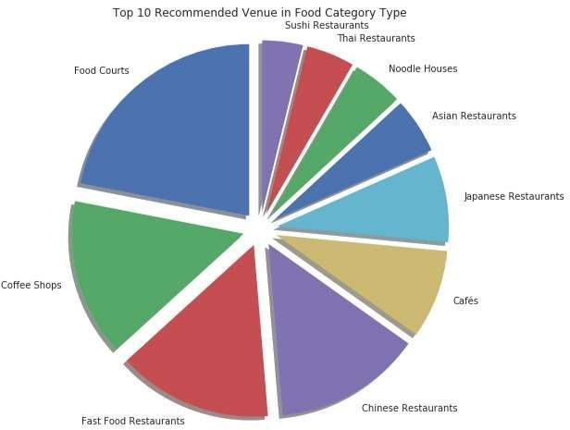
Final Assignment: Capstone Project: Battle of Neighborhoods
RESULTS: How many unique categories can be curated from all the returned venues?
* There are 67 uniques categories.
What are the top 20 most common venue types?

Slide 8
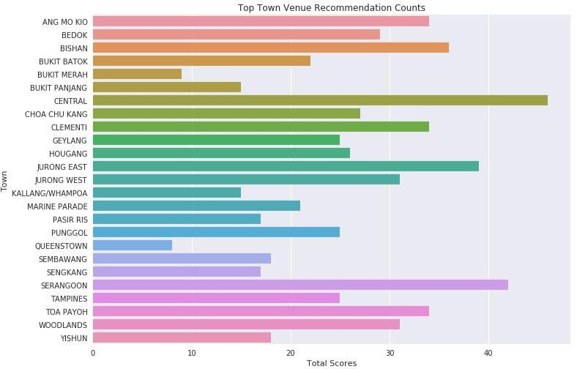
Final Assignment: Capstone Project: Battle of Neighborhoods
What are the top 10 Venue Recommendation Scores?

Slide 9
Final Assignment: Capstone Project: Battle of Neighborhoods
Analyze Each Singapore Town nearby recommended venues
Technique : One Hot Encoding
# one hot encoding
sg_onehot = pd.get_dummies(singapore_town_venues[['category']], prefix="", prefix_sep="")
# add Town column back to dataframe sg_onehot['Town'] = singapore_town_venues['Town']
# move neighborhood column to the first column
fixed_columns = [sg_onehot.columns[-1]] + list(sg_onehot.columns[:-1]) sg_onehot = sg_onehot[fixed_columns]
# Check returned one hot encoding data:
print('One hot encoding returned "{}" rows.'.format(sg_onehot.shape[0]))
# Regroup rows by town and mean of frequency occurrence per category. sg_grouped = sg_onehot.groupby('Town').mean().reset_index()
print('One hot encoding re-group returned "{}" rows.'.format(sg_grouped.shape[0]))
sg_grouped.head()
One hot encoding returned "644" rows.
One hot encoding re-group returned "25" rows.

Slide 10
Final Assignment: Capstone Project: Battle of Neighborhoods
Analysis of Singapore Town most visited venues
# Town=< ANG MO KIO > venue freq |  |  | 6 7 | Bubble Tea Shops 0.06 American Restaurants 0.03
0 Food Courts | 0.18 |  | 8 | Sandwich Places | 0.03
1 Fast Food Restaurants | 0.12 |  | 9 | Italian Restaurants | 0.03
2 Japanese Restaurants | 0.06
3 Dessert Shops | 0.06
4 Sushi Restaurants | 0.06
5 Cafés | 0.06
6 Snack Places | 0.03
7 Noodle Houses | 0.03 |  | # | Town=< BUKIT BATOK >
8 Ramen Restaurants | 0.03 |  |  | venue | freq
9 Restaurants | 0.03 |  | 0 | Food Courts | 0.27
 |  |  | 1 | Coffee Shops | 0.14
 |  |  | 2 | Chinese Restaurants | 0.14
 |  |  | 3 | Fast Food Restaurants | 0.14
 |  |  | 4 | Japanese Restaurants | 0.05
 |  |  | 5 | Sandwich Places | 0.05
 |  |  | 6 | Ice Cream Shops | 0.05
# Town=< BEDOK > venue freq |  |  | 7 8 | Italian Restaurants 0.05 Thai Restaurants 0.05
0 Coffee Shops | 0.21 |  | 9 | Asian Restaurants | 0.05
1 Food Courts | 0.10
2 Sushi Restaurants | 0.07
3 Japanese Restaurants | 0.07
4 Fast Food Restaurants | 0.07
5 American Restaurants | 0.03
6 Chinese Restaurants | 0.03 |  | # Town=< BUKIT MERAH >
7 Sandwich Places | 0.03 |  |  |  | venue | freq
8 Indonesian Restaurants | 0.03 |  | 0 | Chinese Resta | urants | 0.44
9 Indian Restaurants | 0.03 |  | 1 | Coffee | Shops | 0.22
 |  |  | 2 | Food | Courts | 0.11
 |  |  | 3 | Bistros |  | 0.11
 |  |  | 4 |  | Cafés | 0.11
# Town=< BISHAN > venue freq 0 Coffee Shops 0.14 |  |  | 5 6 7 8 9 | Malay Restaurants Noodle Houses Modern European Restaurants Miscellaneous Shops Mexican Restaurants |  | 0.00 0.00 0.00 0.00 0.00
Japanese Restaurants
Chinese Restaurants
Food Courts
Fast Food Restaurants
Cafés
0.11
0.11
0.08
0.08
0.08

Slide 11
Final Assignment: Capstone Project: Battle of Neighborhoods
# Town=< BUKIT PANJANG > venue freq |  |  | # | Town=< CLEMENTI > venue freq
0 Chinese Restaurants | 0.20 |  | 0 | Food Courts | 0.24
1 Indian Restaurants | 0.13 |  | 1 | Fast Food Restaurants | 0.09
2 Thai Restaurants | 0.13 |  | 2 | Coffee Shops | 0.09
3 Food Courts | 0.13 |  | 3 | Dim Sum Restaurants | 0.06
4 Burger Joints | 0.07 |  | 4 | Japanese Restaurants | 0.06
5 Seafood Restaurants | 0.07 |  | 5 | Thai Restaurants | 0.06
6 Vietnamese Restaurants | 0.07 |  | 6 | Asian Restaurants | 0.06
7 Asian Restaurants | 0.07 |  | 7 | Chinese Restaurants | 0.06
8 Noodle Houses | 0.07 |  | 8 | Fried Chicken Joints | 0.06
9 Cafés | 0.07 |  | 9 | Cafés | 0.03
# 0 | Town=< CENTRAL > venue Cafés | freq 0.09 |  | # Town=< 0 |  | GEYLANG > venue Chinese Restaurants | freq 0.24
1 | Chinese Restaurants | 0.09 |  | 1 |  | Dim Sum Restaurants | 0.12
2 | Coffee Shops | 0.07 |  | 2 |  | Food Courts | 0.08
3 | Ramen Restaurants | 0.07 |  | 3 | Vegetarian / Vegan Restaurants |  | 0.08
4 | Food Courts | 0.07 |  | 4 |  | Coffee Shops | 0.08
5 | Diners | 0.04 |  | 5 |  | Noodle Houses | 0.08
6 | Japanese Restaurants | 0.04 |  | 6 |  | Seafood Restaurants | 0.08
7 | Hotpot Restaurants | 0.04 |  | 7 |  | BBQ Joints | 0.04
8 | Noodle Houses | 0.04 |  | 8 |  | Fast Food Restaurants | 0.04
9 | Fast Food Restaurants | 0.04 |  | 9 |  | Asian Restaurants | 0.04
# | Town=< CHOA CHU KANG > |  | # | Town=< HOUGANG >
 | venue freq |  |  | venue freq
0 | Fast Food Restaurants 0.15 |  | 0 | Food Courts 0.19
1 | Food Courts 0.11 |  | 1 | Fast Food Restaurants 0.15
2 | Coffee Shops 0.11 |  | 2 | Coffee Shops 0.12
3 | Noodle Houses 0.11 |  | 3 | Asian Restaurants 0.08
4 | Asian Restaurants 0.07 |  | 4 | Chinese Restaurants 0.08
5 | Dessert Shops 0.04 |  | 5 | Dessert Shops 0.04
6 | Burger Joints 0.04 |  | 6 | Cafés 0.04
7 | Portuguese Restaurants 0.04 |  | 7 | Fish & Chips Shops 0.04
8 | Sandwich Places 0.04 |  | 8 | Sandwich Places 0.04
9 | Cafés 0.04 |  | 9 | Shopping Malls 0.04

Slide 12
Final Assignment: Capstone Project: Battle of Neighborhoods
# Town=< JURONG EAST >
# Town=< MARINE PARADE >
venue freq
0
1
2
3
venue Food Courts Japanese Restaurants Chinese Restaurants
Fast Food Restaurants
freq
0.13
0.13
0.10
0.08
Noodle Houses
Chinese Restaurants
Seafood Restaurants
Asian Restaurants
BBQ Joints
Bars
Dim Sum Restaurants
Thai Restaurants
Dessert Shops
Coffee Shops
0.29
0.14
0.10
0.10
0.05
0.05
0.05
0.05
0.05
0.05
4 | Cafés | 0.08
5 | Coffee Shops | 0.05
6 | Diners | 0.03
Chinese Breakfast Places
Ramen Restaurants
Noodle Houses
0.03
0.03
0.03
# | Town=< JURONG WEST > |  | # | Town=< PASIR RIS >
 | venue freq |  |  | venue freq
0 | Fast Food Restaurants 0.16 |  | 0 | Fast Food Restaurants 0.18
1 | Chinese Restaurants 0.13 |  | 1 | Food Courts 0.18
2 | Asian Restaurants 0.10 |  | 2 | Coffee Shops 0.12
3 | Japanese Restaurants 0.10 |  | 3 | Sandwich Places 0.06
4 | Food Courts 0.10 |  | 4 | Hong Kong Restaurants 0.06
5 | Cafés 0.06 |  | 5 | Bakeries 0.06
6 | Wings Joints 0.03 |  | 6 | Asian Restaurants 0.06
7 | Sandwich Places 0.03 |  | 7 | Italian Restaurants 0.06
8 | Hong Kong Restaurants 0.03 |  | 8 | Sushi Restaurants 0.06
9 | Indonesian Restaurants 0.03 |  | 9 | Restaurants 0.06
# Town=< KALLANG/WHAMPOA > venue freq |  |  | # | Town=< PUNGGOL > venue freq
0 Food Courts | 0.20 |  | 0 | Food Courts | 0.16
1 Noodle Houses | 0.13 |  | 1 | Seafood Restaurants | 0.08
2 Snack Places | 0.13 |  | 2 | Fast Food Restaurants | 0.08
3 BBQ Joints | 0.13 |  | 3 | Cafés | 0.08
4 Chinese Restaurants | 0.13 |  | 4 | Soup Places | 0.04
5 Seafood Restaurants | 0.07 |  | 5 | Ramen Restaurants | 0.04
6 Soup Places | 0.07 |  | 6 | Sandwich Places | 0.04
7 Thai Restaurants | 0.07 |  | 7 | Comfort Food Restaurants | 0.04
8 Indian Restaurants | 0.07 |  | 8 | Coffee Shops | 0.04
9 Italian Restaurants | 0.00 |  | 9 | Chinese Restaurants | 0.04

Slide 13
Final Assignment: Capstone Project: Battle of Neighborhoods
# Town=< QUEENSTOWN >
 | venue | freq
0 | Chinese Restaurants | 0.38
1 2 3 4 5 6 7 Mode 8 9 | Food Courts Thai Restaurants Italian Restaurants Malay Restaurants American Restaurants Macanese Restaurants rn European Restaurants Miscellaneous Shops Mexican Restaurants | 0.25 0.12 0.12 0.12 0.00 0.00 0.00 0.00 0.00
# Town=< SERANGOON >
venue
freq
0.14
0.10
0.10
Fast Food Restaurants
Coffee Shops
Japanese Restaurants 3
4
5
6
7
8
9
Indian Restaurants 0.05
Cafés 0.05
Steakhouses 0.05
Sushi Restaurants 0.05
Chinese Restaurants 0.05
Food Courts 0.05
Thai Restaurants 0.05
# | Town=< SEMBAWANG > |  | # | Town=< TAMPINES >
 | venue freq |  |  | venue freq
0 | Food Courts 0.28 |  | 0 | Food Courts 0.20
1 | Coffee Shops 0.17 |  | 1 | Coffee Shops 0.16
2 | Asian Restaurants 0.11 |  | 2 | Fast Food Restaurants 0.12
3 | Fast Food Restaurants 0.11 |  | 3 | Italian Restaurants 0.08
4 | Italian Restaurants 0.06 |  | 4 | Japanese Restaurants 0.08
5 | Bistros 0.06 |  | 5 | American Restaurants 0.04
6 | Japanese Restaurants 0.06 |  | 6 | Seafood Restaurants 0.04
7 | Sushi Restaurants 0.06 |  | 7 | Fried Chicken Joints 0.04
8 | Chinese Restaurants 0.06 |  | 8 | Dumpling Restaurants 0.04
9 | Cafés 0.06 |  | 9 | Pizza Places 0.04
# | Town=< SENGKANG > venue | freq |  | # | Town=< TOA PAYOH > venue | freq
0 | Food Courts | 0.18 |  | 0 | Coffee Shops | 0.18
1 | Coffee Shops | 0.18 |  | 1 | Fast Food Restaurants | 0.12
2 | Fast Food Restaurants | 0.18 |  | 2 | Food Courts | 0.12
3 | Cafés | 0.18 |  | 3 | Chinese Restaurants | 0.12
4 | English Restaurants | 0.06 |  | 4 | Snack Places | 0.06
5 | Chinese Restaurants | 0.06 |  | 5 | Cafés | 0.06
6 | Restaurants | 0.06 |  | 6 | Burger Joints | 0.03
7 | Sushi Restaurants | 0.06 |  | 7 | Sandwich Places | 0.03
8 | Sandwich Places | 0.06 |  | 8 | Italian Restaurants | 0.03
9 | Mexican Restaurants | 0.00 |  | 9 | Asian Restaurants | 0.03

Slide 14
Final Assignment: Capstone Project: Battle of Neighborhoods
# Town=< WOODLANDS > |  |  | # Town=< YISHUN >
 | venue | freq |  |  | venue | freq
0 | Food Courts | 0.16 |  | 0 | Food Courts | 0.28
1 | Japanese Restaurants | 0.13 |  | 1 | Hainan Restaurants | 0.06
2 | Cafés | 0.10 |  | 2 | Hong Kong Restaurants | 0.06
3 | Fast Food Restaurants | 0.10 |  | 3 | Halal Restaurants | 0.06
4 | Coffee Shops | 0.10 |  | 4 | Thai Restaurants | 0.06
5 | Chinese Restaurants | 0.10 |  | 5 | Fast Food Restaurants | 0.06
6 | American Restaurants | 0.06 |  | 6 | Sushi Restaurants | 0.06
7 | Italian Restaurants | 0.03 |  | 7 | Bubble Tea Shops | 0.06
8 | Fried Chicken Joints | 0.03 |  | 8 | Fish & Chips Shops | 0.06
9 | Pizza Places | 0.03 |  | 9 | Burger Joints | 0.06

Slide 15
Final Assignment: Capstone Project: Battle of Neighborhoods
RESULTS: Categorized Result
 |  | Town |  |  | 1st Most |  | 2nd Most |  | 3rd Most |  | 4th Most |  | 5th Most |  | 6th Most |  | 7th Most |  | 8th Most
 |  |  |  |  | Common |  | Common |  | Common |  | Common |  | Common |  | Common |  | Common |  | Common
 |  |  |  |  | Venue |  | Venue |  | Venue |  | Venue |  | Venue |  | Venue |  | Venue |  | Venue
0 |  |  | ANG MO | Food Courts |  |  | Fast Food |  | Dessert |  | Japanese |  | Sushi | Cafés |  |  | Ramen |  | Hong Kong
 |  |  | KIO |  |  |  | Restaurants |  | Shops |  | Restaurants |  | Restaurants |  |  |  | Restaurants |  | Restaurants
1 |  |  | BEDOK |  | Coffee Shops |  | Food Courts |  | Sushi |  | Japanese |  | Fast Food |  | Wings Joints |  | Fried |  | Indian
 |  |  |  |  |  |  |  |  |  |  |  |  |  |  |  |  | Chicken
 |  |  |  |  |  |  |  |  | Restaurants |  | Restaurants |  | Restaurants |  |  |  |  |  | Restaurants
 |  |  |  |  |  |  |  |  |  |  |  |  |  |  |  |  | Joints
2 |  |  | BISHAN |  | Coffee Shops |  | Japanese |  | Chinese |  | Fast Food |  | Food Courts |  | Cafés |  | Bubble Tea |  | American
 |  |  |  |  |  |  | Restaurants |  | Restaurants |  | Restaurants |  |  |  |  |  | Shops |  | Restaurants
3 |  |  | BUKIT |  | Food Courts |  | Coffee Shops |  | Fast Food |  | Chinese |  | Asian |  | Thai |  | Pizza Places |  | Ice Cream
 |  |  | BATOK |  |  |  |  |  | Restaurants |  | Restaurants |  | Restaurants |  | Restaurants |  |  |  | Shops
4 |  |  | BUKIT |  | Chinese |  | Coffee Shops | Food Courts |  | Bistros |  | Cafés |  |  | Dongbei |  | Comfort Food |  | Dessert
 |  |  | MERAH |  | Restaurants |  |  |  |  |  |  |  |  |  | Restaurants |  | Restaurants |  | Shops
RESULTS : k-means Cluster Results
Clustered results for k-means to cluster with 5 clusters.
 | Town | 1st Most | 2nd Most | 3rd Most | 4th Most | 5th Most | 6th Most | 7th Most | 8th Most
 |  | Common | Common | Common | Common | Common | Common | Common | Common
 |  | Venue | Venue | Venue | Venue | Venue | Venue | Venue | Venue
0 | ANG | Food Courts | Fast Food | Dessert | Japanese | Sushi | Cafés | Ramen | Hong Kong
 | MO KIO |  | Restaurants | Shops | Restaurants | Restaurants |  | Restaurants | Restaurants

Slide 16
Final Assignment: Capstone Project: Battle of Neighborhoods
 |  | Town |  |  | 1st Most |  | 2nd Most |  | 3rd Most |  | 4th Most |  | 5th Most |  | 6th Most |  | 7th Most |  | 8th Most
 |  |  |  |  | Common |  | Common |  | Common |  | Common |  | Common |  | Common |  | Common |  | Common
 |  |  |  |  | Venue |  | Venue |  | Venue |  | Venue |  | Venue |  | Venue |  | Venue |  | Venue
1 |  |  | BEDOK |  | Coffee |  | Food Courts |  | Sushi |  | Japanese |  | Fast Food |  | Wings Joints |  | Fried |  | Indian
 |  |  |  |  |  |  |  |  |  |  |  |  |  |  |  |  | Chicken
 |  |  |  |  | Shops |  |  |  | Restaurants |  | Restaurants |  | Restaurants |  |  |  |  |  | Restaurants
 |  |  |  |  |  |  |  |  |  |  |  |  |  |  |  |  | Joints
2 |  |  | BISHAN |  | Coffee |  | Japanese |  | Chinese |  | Fast Food |  | Food Courts |  | Cafés |  | Bubble Tea |  | American
 |  |  |  |  | Shops |  | Restaurants |  | Restaurants |  | Restaurants |  |  |  |  |  | Shops |  | Restaurants
3 |  |  | BUKIT |  | Food Courts |  | Coffee |  | Fast Food |  | Chinese |  | Asian |  | Thai |  | Pizza Places |  | Ice Cream
 |  |  | BATOK |  |  |  | Shops |  | Restaurants |  | Restaurants |  | Restaurants |  | Restaurants |  |  |  | Shops
4 |  |  | BUKIT |  | Chinese |  | Coffee | Food Courts |  | Bistros |  | Cafés |  |  | Dongbei |  | Comfort |  | Dessert
 |  |  |  |  |  |  |  |  |  |  |  |  |  |  |  |  | Food
 |  |  | MERAH |  | Restaurants |  | Shops |  |  |  |  |  |  |  | Restaurants |  |  |  | Shops
 |  |  |  |  |  |  |  |  |  |  |  |  |  |  |  |  | Restaurants
RESULTS: Merged Cluster Table with rental prices.
 | median_rent |  | Latitude |  | Longitude |  |  | Cluster |  | 1st Most |  | 2nd Most |  | 3rd Most |  | 4th Most |  | 5th Mos
 |  |  |  |  |  |  |  |  |  | Common |  | Common |  | Common |  | Common |  | Commo
 |  |  |  |  |  |  |  | Labels
 |  |  |  |  |  |  |  |  |  | Venue |  | Venue |  | Venue |  | Venue |  | Venue
Town
ANG MO KIO |  | 2033.333333 |  | 1.369972 |  | 103.849588 |  | 1 |  | Food |  | Fast Food |  | Dessert |  | Japanese |  | Sushi
 |  |  |  |  |  |  |  |  |  | Courts |  | Restaurants |  | Shops |  | Restaurants |  | Restauran
BEDOK |  | 2087.500000 |  | 1.324011 |  | 103.930172 |  | 3 |  | Coffee |  | Food |  | Sushi |  | Japanese |  | Fast Food
 |  |  |  |  |  |  |  |  |  | Shops |  | Courts |  | Restaurants |  | Restaurants |  | Restauran
BISHAN |  | 2233.333333 |  | 1.351042 |  | 103.849930 |  | 3 |  | Coffee |  | Japanese |  | Chinese |  | Fast Food |  | Food Cou
 |  |  |  |  |  |  |  |  |  | Shops |  | Restaurants |  | Restaurants |  | Restaurants
BUKIT BATOK |  | 1962.500000 |  | 1.348506 |  | 103.749222 |  | 1 |  | Food |  | Coffee |  | Fast Food |  | Chinese |  | Asian
 |  |  |  |  |  |  |  |  |  | Courts |  | Shops |  | Restaurants |  | Restaurants |  | Restauran
BUKIT MERAH |  | 2162.500000 |  | 1.289642 |  | 103.816798 |  | 2 |  | Chinese |  | Coffee |  | Food | Bistros |  | Cafés
 |  |  |  |  |  |  |  |  |  | Restaurants |  | Shops |  | Courts

Slide 17
Final Assignment: Capstone Project: Battle of Neighborhoods
 | median_rent |  | Latitude |  | Longitude | Cluster |  | 1st Most |  | 2nd Most |  | 3rd Most |  | 4th Most |  | 5th Mos
 |  |  |  |  |  |  |  | Common |  | Common |  | Common |  | Common |  | Commo
 |  |  |  |  |  | Labels
 |  |  |  |  |  |  |  | Venue |  | Venue |  | Venue |  | Venue |  | Venue
Town
BUKIT PANJANG |  | 1737.500000 |  | 1.276068 | 103.791904 | 4 |  | Chinese |  | Thai |  | Food |  | Indian |  | Cafés
 |  |  |  |  |  |  |  | Restaurants |  | Restaurants |  | Courts |  | Restaurants
CENTRAL |  | 2450.000000 |  | 1.288155 | 103.846718 | 3 |  | Cafés |  | Chinese |  | Food |  | Coffee |  | Ramen
 |  |  |  |  |  |  |  |  |  | Restaurants |  | Courts |  | Shops |  | Restauran
CHOA CHU KANG |  | 1933.333333 |  | 1.385385 | 103.744337 | 1 |  | Fast Food |  | Food |  | Noodle |  | Coffee |  | Asian
 |  |  |  |  |  |  |  | Restaurants |  | Courts |  | Houses |  | Shops |  | Restauran
CLEMENTI |  | 2263.333333 |  | 1.315070 | 103.765246 | 1 |  | Food |  | Fast Food |  | Coffee |  | Fried |  | Asian
 |  |  |  |  |  |  |  |  |  |  |  |  |  | Chicken
 |  |  |  |  |  |  |  | Courts |  | Restaurants |  | Shops |  |  |  | Restauran
 |  |  |  |  |  |  |  |  |  |  |  |  |  | Joints
GEYLANG |  | 2166.666667 |  | 1.316367 | 103.882772 | 4 |  | Chinese |  | Dim Sum |  | Food |  | Noodle |  | Coffee
 |  |  |  |  |  |  |  | Restaurants |  | Restaurants |  | Courts |  | Houses |  | Shops
HOUGANG |  | 1962.500000 |  | 1.371331 | 103.892544 | 1 |  | Food |  | Fast Food |  | Coffee |  | Chinese |  | Asian
 |  |  |  |  |  |  |  | Courts |  | Restaurants |  | Shops |  | Restaurants |  | Restauran
JURONG EAST |  | 2150.000000 |  | 1.333143 | 103.742329 | 3 |  | Food |  | Japanese |  | Chinese |  | Fast Food |  | Cafés
 |  |  |  |  |  |  |  | Courts |  | Restaurants |  | Restaurants |  | Restaurants
JURONG WEST |  | 1975.000000 |  | 1.338556 | 103.705828 | 3 |  | Fast Food |  | Chinese |  | Japanese |  | Asian |  | Food Cou
 |  |  |  |  |  |  |  | Restaurants |  | Restaurants |  | Restaurants |  | Restaurants
KALLANG/WHAMPOA |  | 2300.000000 |  | 1.311478 | 103.871351 | 0 |  | Food |  | Chinese |  | BBQ Joints |  | Noodle |  | Snack
 |  |  |  |  |  |  |  | Courts |  | Restaurants |  |  |  | Houses |  | Places
MARINE PARADE |  | 1950.000000 |  | 1.308410 | 103.888814 | 0 |  | Noodle |  | Chinese |  | Asian |  | Seafood |  | Snack
 |  |  |  |  |  |  |  | Houses |  | Restaurants |  | Restaurants |  | Restaurants |  | Places
PASIR RIS |  | 2066.666667 |  | 1.373191 | 103.949353 | 1 |  | Food |  | Fast Food |  | Coffee |  | Italian |  | Asian
 |  |  |  |  |  |  |  | Courts |  | Restaurants |  | Shops |  | Restaurants |  | Restauran
PUNGGOL |  | 1825.000000 |  | 1.405170 | 103.902356 | 1 | Food |  | Seafood |  | Cafés |  | Fast Food |  | Chinese

Slide 18
Final Assignment: Capstone Project: Battle of Neighborhoods
 | median_rent |  | Latitude |  | Longitude |  |  | Cluster |  | 1st Most |  | 2nd Most |  | 3rd Most |  | 4th Most |  | 5th Mos
 |  |  |  |  |  |  |  |  |  | Common |  | Common |  | Common |  | Common |  | Commo
 |  |  |  |  |  |  |  | Labels
 |  |  |  |  |  |  |  |  |  | Venue |  | Venue |  | Venue |  | Venue |  | Venue
Town
 |  |  |  |  |  |  |  |  |  | Courts |  | Restaurants |  |  |  | Restaurants |  | Restauran
QUEENSTOWN |  | 2162.500000 |  | 1.294835 |  | 103.805902 |  | 4 |  | Chinese |  | Food |  | Malay |  | Thai |  | Italian
 |  |  |  |  |  |  |  |  |  | Restaurants |  | Courts |  | Restaurants |  | Restaurants |  | Restauran
SEMBAWANG |  | 1883.333333 |  | 1.449080 |  | 103.820058 |  | 1 |  | Food |  | Coffee |  | Asian |  | Fast Food |  | Chinese
 |  |  |  |  |  |  |  |  |  | Courts |  | Shops |  | Restaurants |  | Restaurants |  | Restauran
SENGKANG |  | 1900.000000 |  | 1.391661 |  | 103.895453 |  | 3 |  | Coffee |  | Cafés |  | Food |  | Fast Food |  | Sandwich
 |  |  |  |  |  |  |  |  |  | Shops |  |  |  | Courts |  | Restaurants |  | Places
SERANGOON |  | 2187.500000 |  | 1.349787 |  | 103.873635 |  | 3 |  | Fast Food |  | Japanese |  | Coffee |  | Food |  | Steakhous
 |  |  |  |  |  |  |  |  |  | Restaurants |  | Restaurants |  | Shops |  | Courts
TAMPINES |  | 2075.000000 |  | 1.354430 |  | 103.942760 |  | 1 |  | Food |  | Coffee |  | Fast Food |  | Japanese |  | Italian
 |  |  |  |  |  |  |  |  |  | Courts |  | Shops |  | Restaurants |  | Restaurants |  | Restauran
TOA PAYOH |  | 2210.000000 |  | 1.332330 |  | 103.847425 |  | 3 |  | Coffee |  | Chinese |  | Food |  | Fast Food |  | Cafés
 |  |  |  |  |  |  |  |  |  | Shops |  | Restaurants |  | Courts |  | Restaurants
WOODLANDS |  | 1762.500000 |  | 1.436945 |  | 103.786516 |  | 3 |  | Food |  | Japanese |  | Coffee |  | Cafés |  | Chinese
 |  |  |  |  |  |  |  |  |  | Courts |  | Restaurants |  | Shops |  |  |  | Restauran
YISHUN | 1900.000000 |  | 1.429548 |  | 103.835033 |  | 1 |  |  | Food |  | Hainan |  | Bubble Tea |  | Halal |  | Hong Kon
 |  |  |  |  |  |  |  |  |  | Courts |  | Restaurants |  | Shops |  | Restaurants |  | Restauran

Slide 19
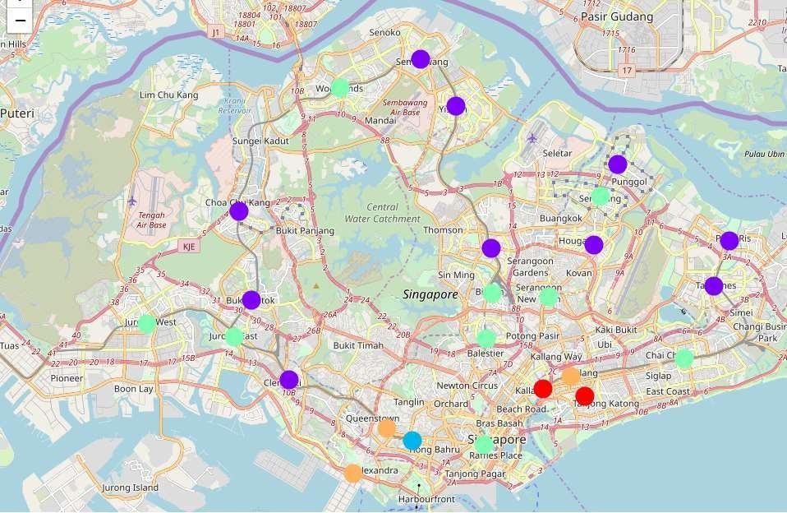
Final Assignment: Capstone Project: Battle of Neighborhoods

Slide 20
Final Assignment: Capstone Project: Battle of Neighborhoods
IV. Discussion and Conclusion
On this notebook, Analysis of best town venue recommendations based on Food venue category has been presented. Recommendations based on other user searches like available outdoor and recreation areas are also available. As singapore is a small country with a whole host of interesting venues scattered around the town, the information extracted in this notebook present on the town areas, will be a good supplement to web based recommendations for visitors to find out nearby venues of interest and be a useful aid in deciding a place to stay or where to go during their visits.
Using Foursquare API, we have collected a good amount of venue recommendations in Singapore Towns. Sourcing from the venue recommendations from FourSquare has its limitation; The list of venues is not exhaustive list of all the available venues is the area. Furthermore, not all the venues found in the the area has a stored ratings. For this reason, the number of analyzed venues is only about 50% of all the available venues initially collected. The results therefore may significantly change, when more information are collected on those with missing data.
The generated clusters from our results shows that there are very good and interesting places located in areas where the median rents are cheaper. This kind of results may be very interesting for travelers who are also on budget constraints. Our results also yielded some interesting findings. For instance, The initial assumption among websites providing recommendations is that the Central Area that have the highest median rent also have better food venues. The results however show that while Marine Parade, a cheaper location has better rated food courts. Result shows that most popular food venue among Singaporeans, residents and visitors are Food Courts, Coffee Shops and Fast Food Restaurants. The highest rated Food Courts are located in Marine Parade, and in Central Area.
Thank you.
Piyush Bhatia
email: piyushbhatia993@gmail.com

