Slide 1

Employee Attrition Prediction Using Machine Learning
Predictive Modeling for Strategic HR Management
SUBMITTED BY
COURSE
Lucky Khatik
BCA (Hons.), 2nd Semester
INSTITUTION
SUBMISSION DATE
Jiwaji University, Gwalior
30 June 2026

Slide 2

Proactive Management of Workforce Dynamics
What is Attrition?
The Impact
The Solution
Employee attrition refers to the voluntary or involuntary departure of employees from an organization, leading to workforce changes.
High attrition rates lead to loss of institutional knowledge, decreased productivity, and significant operational costs for recruitment.
This project leverages Machine Learning to identify patterns and predict potential attrition before it occurs, enabling proactive HR actions.

Slide 3

High Turnover Costs Organizations Resources
Frequent turnover disrupts team stability and project continuity.
1.5x - 2x
High recruitment and onboarding costs drain financial resources.
of an employee's annual salary is the typical cost of replacement, including hiring and training.
Loss of institutional knowledge affects long-term productivity.

Slide 4
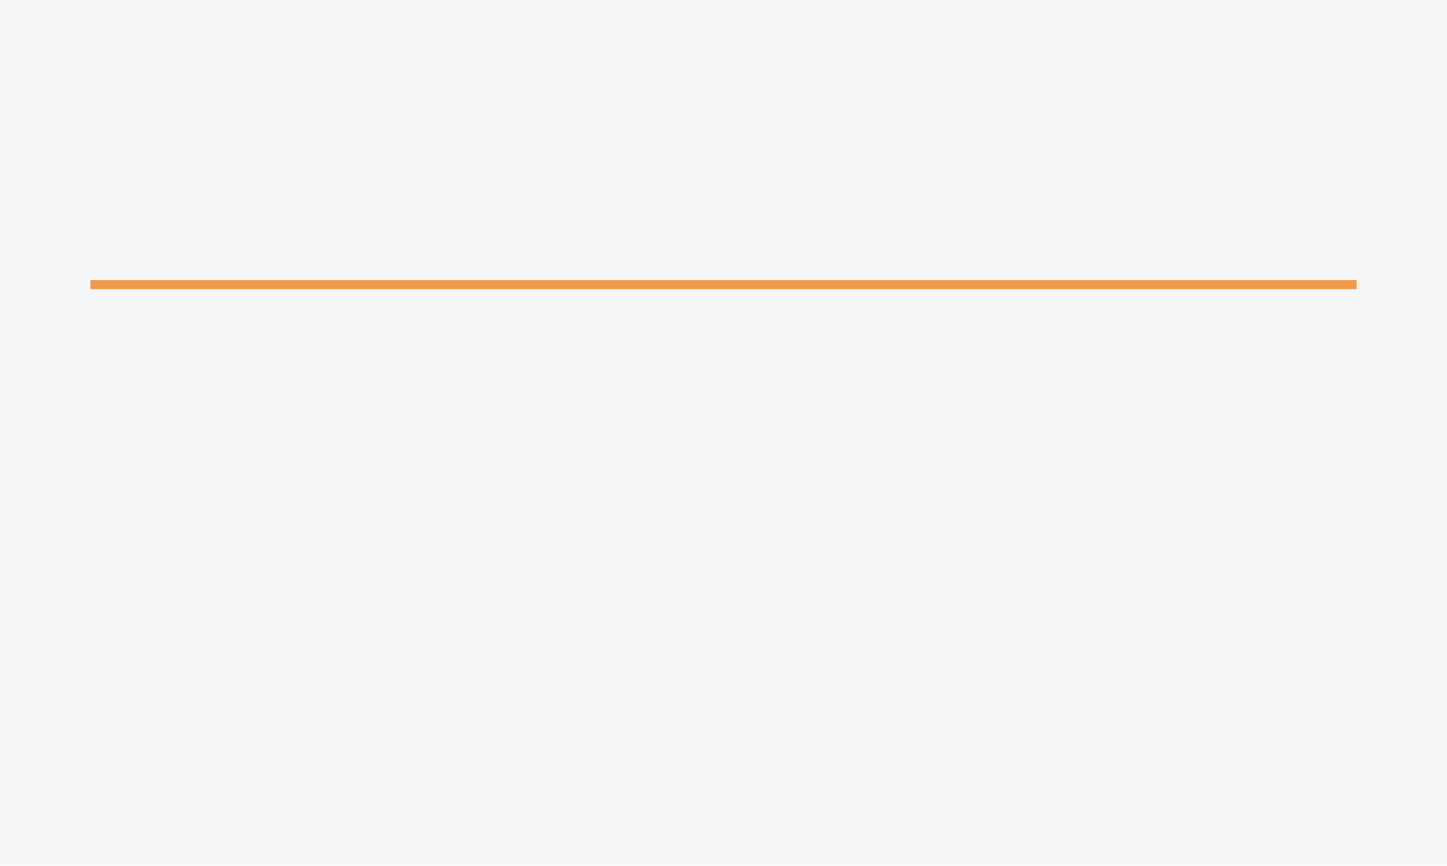



Leveraging Data Science for Strategic HR Decisions
Data Analysis
Model Development
Conduct exploratory data analysis on IBM HR employee records to uncover hidden trends and correlations.
Build a robust Machine Learning model using the Random Forest algorithm to ensure high predictive accuracy.
Attrition Prediction
Decision Support
Enable the organization to predict which employees are at high risk of leaving based on historical patterns.
Provide actionable insights to improve HR decision-making, employee satisfaction, and long-term retention.

Slide 5

Analyzing the IBM HR Analytics Dataset
1,470
Data Source
35
A comprehensive dataset created by IBM data scientists for HR analytics research and predictive modeling.
TOTAL RECORDS
FEATURES
Key Dimensions
Target Variable
Data Quality
Includes demographics, job roles, satisfaction levels, daily rates, and performance ratings.
The primary goal is to predict 'Attrition' (Yes/No), identifying employees at risk of leaving.
Clean, structured data with no missing values, ideal for training robust classification models.

Slide 6






A Modern Data Science Stack
Python
Google Colab
Pandas & NumPy
The primary language for data processing, statistical analysis, and machine learning implementation.
Cloud-based Jupyter Notebook environment for collaborative development and GPU acceleration.
Essential libraries for high-performance data manipulation and numerical computing.
Matplotlib & Seaborn
Scikit-learn
Random Forest
Powerful visualization tools for creating static, animated, and interactive statistical graphics.
Industry-standard library for predictive data analysis and machine learning algorithms.
An ensemble learning method used for classification to achieve high predictive accuracy.

Slide 7






Systematic Approach from Data to Prediction
01
02
03
Data Acquisition
Preprocessing
Feature Engineering
Loading the IBM HR Analytics dataset containing 1,470 records and 35 initial features.
Cleaning data, handling missing values, and removing non-informative columns like EmployeeID.
Encoding categorical variables and scaling numerical features for optimal model performance.
04
05
06
Model Training
Evaluation
Insights
Splitting data into 80/20 train-test sets and training the Random Forest Classifier.
Assessing performance using Accuracy, Confusion Matrix, and Classification Reports.
Extracting feature importance to identify the primary drivers of employee attrition.

Slide 8
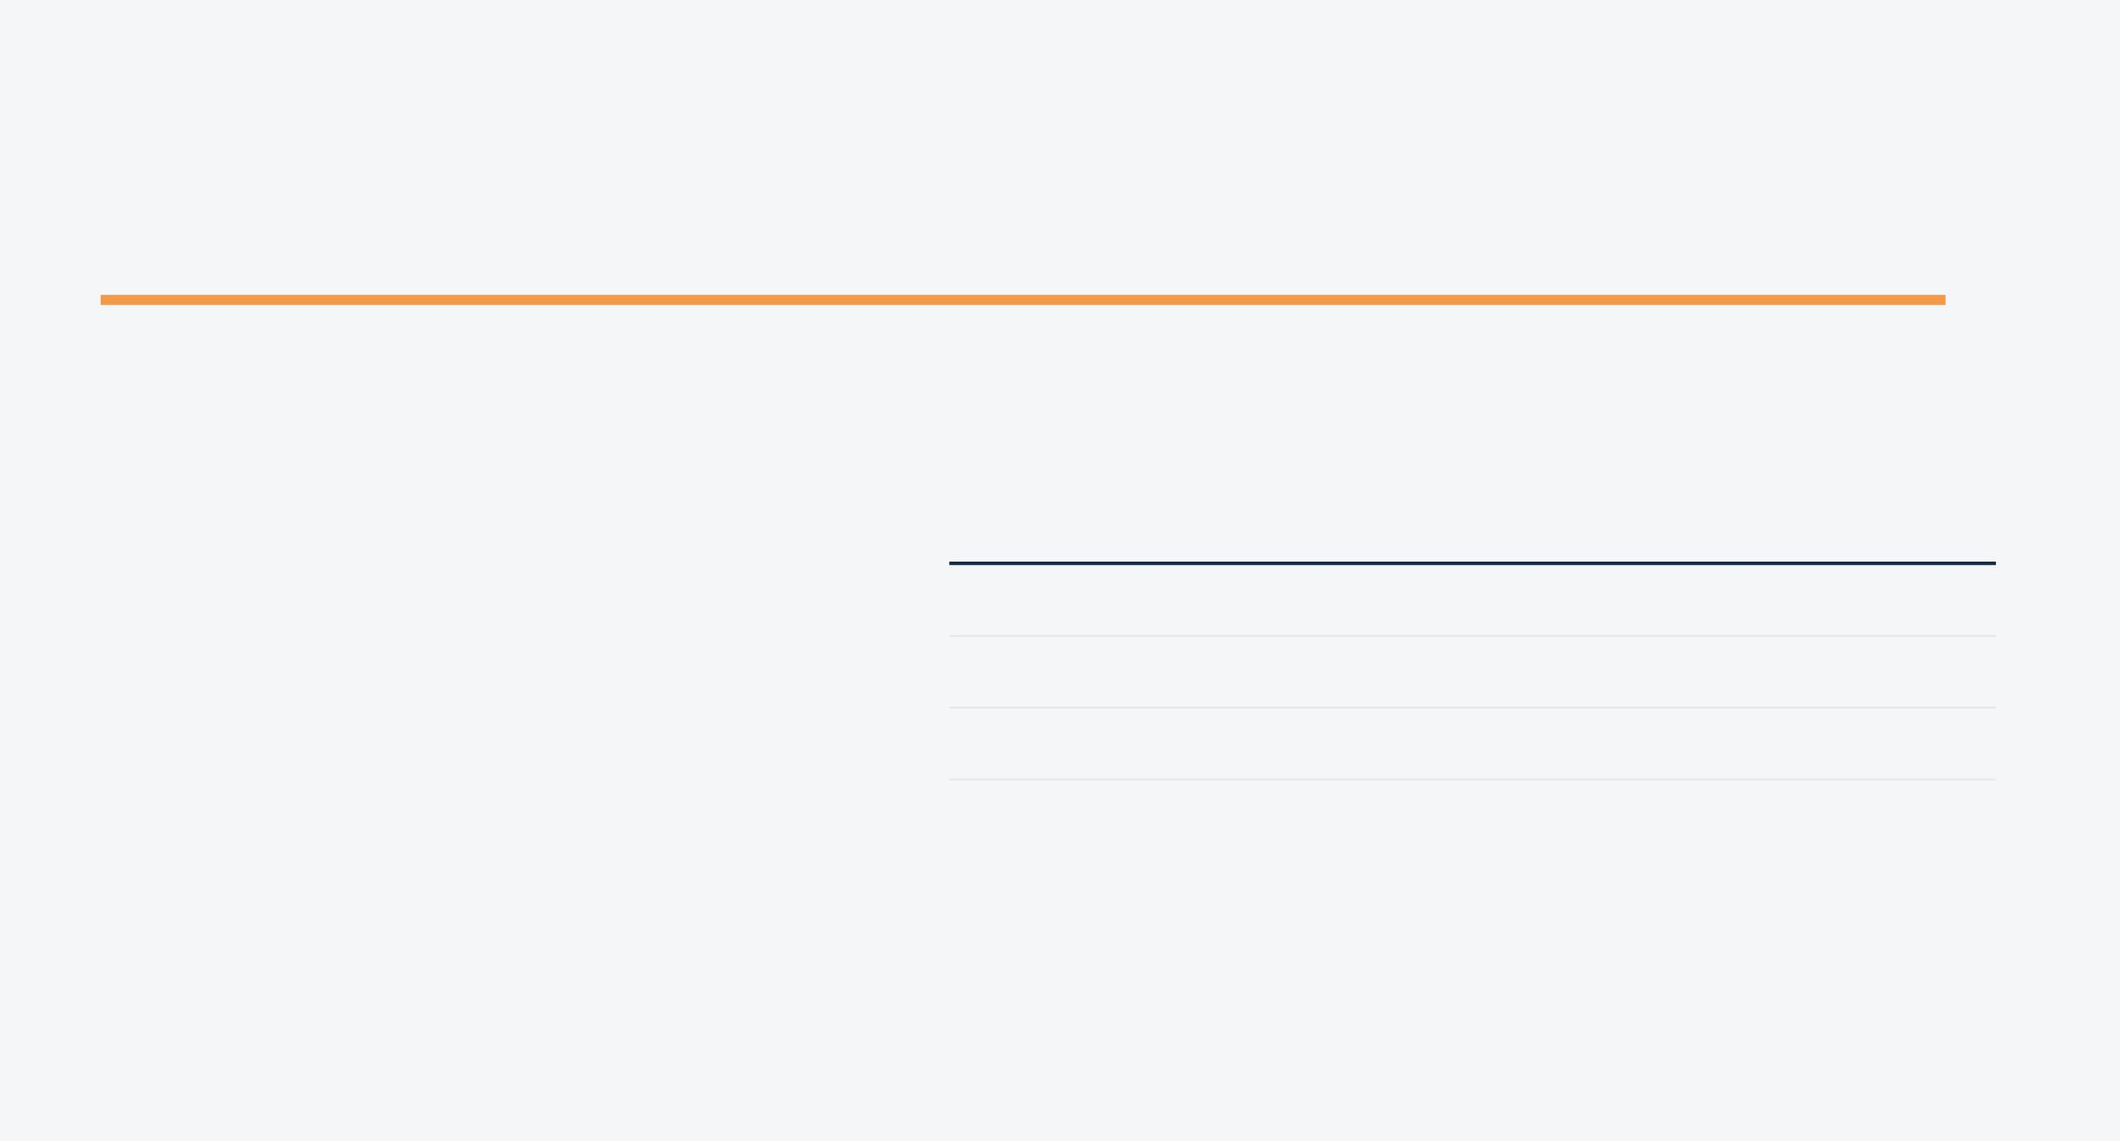
Random Forest Classifier Performance
Classification Report Summary
Metric
Class 0 (Stay)
Class 1 (Leave)
MODEL ACCURACY
88.10%
Precision
0.88
0.83
Recall
1.00
0.13
F1-Score
0.94
0.22
* The model shows
in identifying employees who will stay.
Achieved on the IBM HR Analytics test dataset
excellent precision

Slide 9

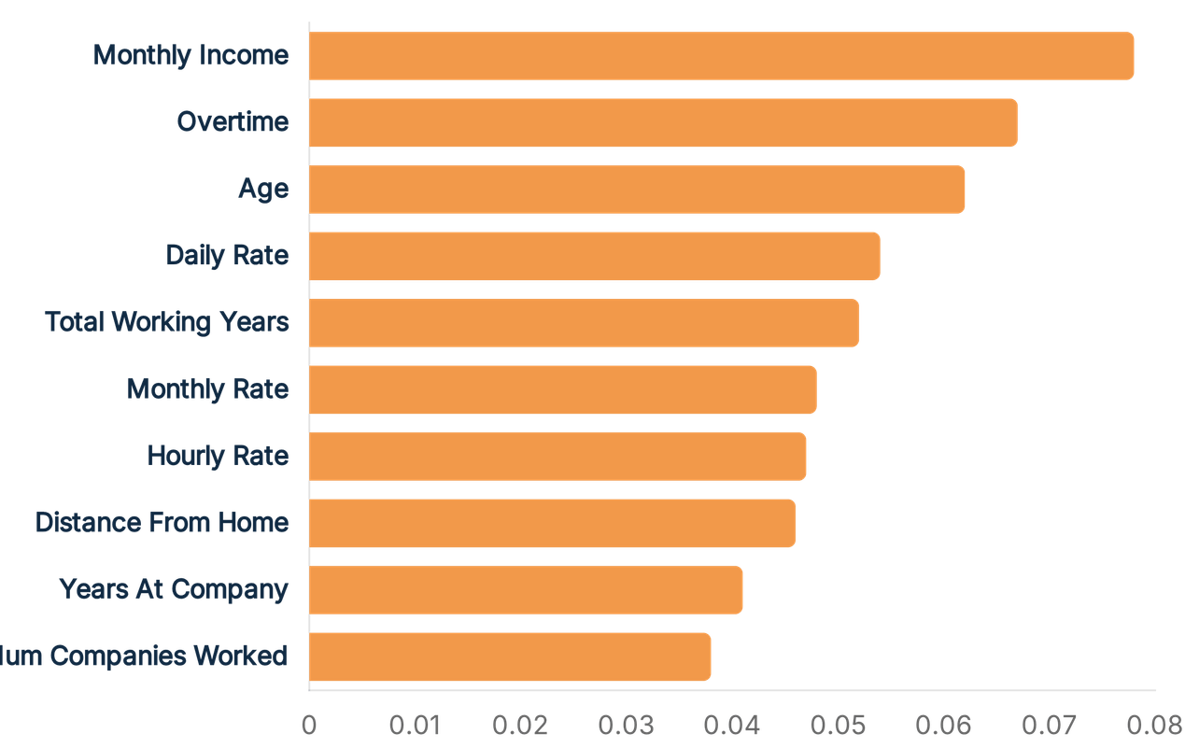
Top 10 Factors Influencing Attrition
Financial Impact
Monthly Income and Daily Rate are the strongest predictors, highlighting the role of compensation.
Work-Life Balance
Overtime is a critical driver, suggesting that workload management is key to retention.
Experience & Tenure
Age and Total Working Years significantly influence an employee's stability within the firm.

Slide 10






Data-Driven Strategies Enhance Retention
Model Reliability
Compensation Strategy
Workload Balance
Random Forest effectively predicts attrition with 88.10% accuracy, providing a reliable tool for HR departments.
Reviewing salary structures for high-risk roles can directly mitigate the primary financial drivers of turnover.
Overtime is a critical predictor; managing work hours is essential for maintaining long-term employee engagement.
Proactive Retention
Strategic Growth
Culture & Stability
Identifying at-risk employees early allows HR to implement personalized retention plans and career counseling.
Focusing on 'Total Working Years' and 'Age' helps in designing better benefits for different career stages.
Reducing attrition fosters a stable organizational culture, preserving institutional knowledge and team morale.

Slide 11




Advancing the Predictive Framework
Algorithm Optimization
Deployment
Exploring advanced boosting techniques like XGBoost and LightGBM to achieve even higher predictive accuracy and model robustness.
Creating a user-friendly web interface using Flask or Streamlit to allow HR professionals to interact with the model easily.
Real-time Analytics
Cloud Integration
Developing a live HR dashboard for continuous monitoring of workforce trends and early warning signals of attrition.
Deploying the solution to cloud platforms like AWS or Azure to ensure organizational scalability and global accessibility.

Slide 12




Thank You
Questions & Answers
PRESENTER
INSTITUTION
COURSE
Lucky Khatik
Jiwaji University, Gwalior
BCA (Hons.)

