Slide 1

Local Business Review Sentiment Analysis Using Machine Learning
Leveraging NLP for Actionable Business Intelligence
Presented by: Lucky Khatik & Sameer
Bachelor of Computer Applications (BCA) | 2nd Semester, Jiwaji University
Internship at Naviotech Solution Pvt. Ltd.
June 30, 2026

Slide 2

The Challenge of Feedback
Context
Problem Statement
Modern businesses are inundated with thousands of reviews daily. While these are critical indicators of performance, manual analysis is no longer sustainable.
Reading and analyzing each review manually is inefficient and prone to human error, leading to missed insights.
The objective is to develop a Machine Learning model that automatically predicts sentiment, enabling rapid, data-driven decisions.
Customer reviews play a vital role in understanding satisfaction, but the sheer volume makes manual processing difficult and time-consuming.

Slide 3

Project Objectives
01
Analyze and understand customer review patterns.
02
Clean and preprocess raw textual data for modeling.
03
Extract critical features using TF-IDF vectorization.
04
Train a Logistic Regression model for classification.
05
Evaluate performance using standard ML metrics.
06
Visualize results for business stakeholders.

Slide 4

Dataset Information
DATASET NAME
KEY FEATURES USED
Review Text (Primary Input)
Amazon Fine Food Reviews
Review Score (Ground Truth)
SOURCE
Review Summary (Context)
Kaggle Repository
TARGET VARIABLE
Binary Sentiment Classification
Classifying reviews into Positive and Negative categories.

Slide 5

Technology Stack
Environment & Language
Data Engineering
Python 3.x
Pandas (Data Manipulation)
Google Colab (Cloud IDE)
NumPy (Numerical Computing)
Machine Learning & NLP
Visualization
Scikit-learn (Modeling)
Matplotlib (Static Plots)
NLTK (Text Preprocessing)
Seaborn (Statistical Graphics)
TF-IDF Vectorization

Slide 6

Project Methodology
STEP 01
STEP 02
STEP 03
STEP 04
Data Collection
Preprocessing
Vectorization
Model Training
Acquisition of the Amazon Fine Food Reviews dataset from Kaggle.
Text cleaning, stopword removal, and stemming using NLTK.
Converting text to numerical features using TF-IDF Vectorization.
Training Logistic Regression on a 80/20 train-test split.
STEP 05
STEP 06
STEP 07
STEP 08
Prediction
Evaluation
Visualization
Deployment
Generating sentiment labels for the unseen test data.
Assessing performance via Accuracy, Precision, and Recall.
Creating Confusion Matrix and Sentiment Distribution plots.
Finalizing the model for business insight generation.

Slide 7

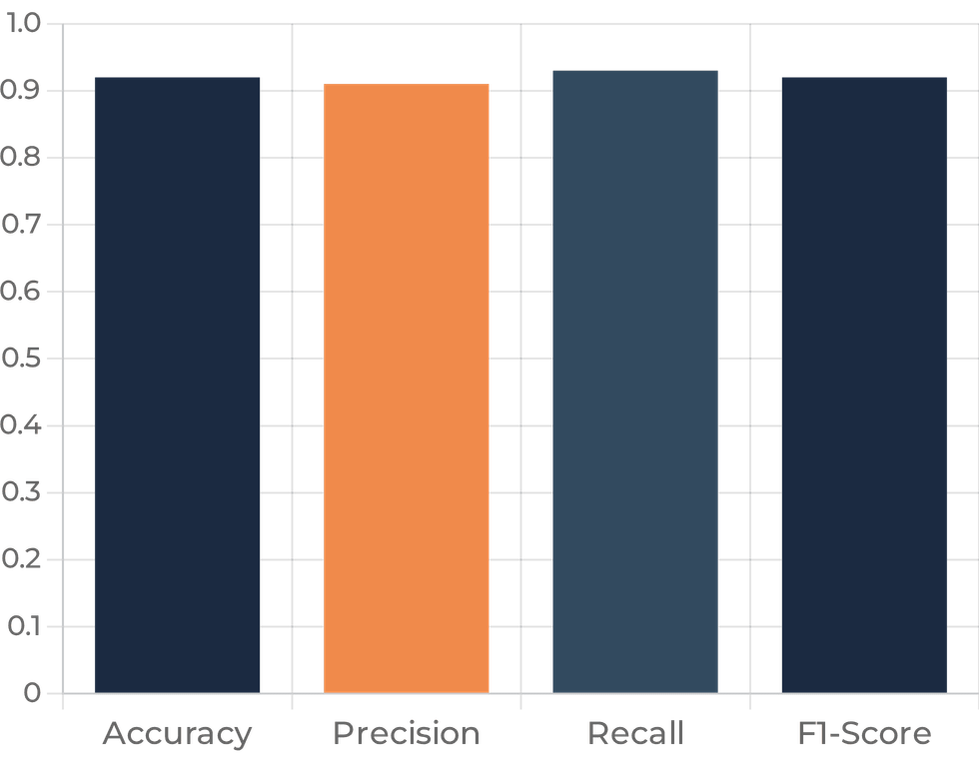
Model Performance
The trained Logistic Regression model successfully classified customer reviews into positive and negative categories with high reliability.
Performance was evaluated using a comprehensive suite of metrics to ensure the model's robustness across diverse review types.
The results demonstrate that the TF-IDF vectorization effectively captured the semantic nuances of the Amazon Fine Food dataset.

Slide 8

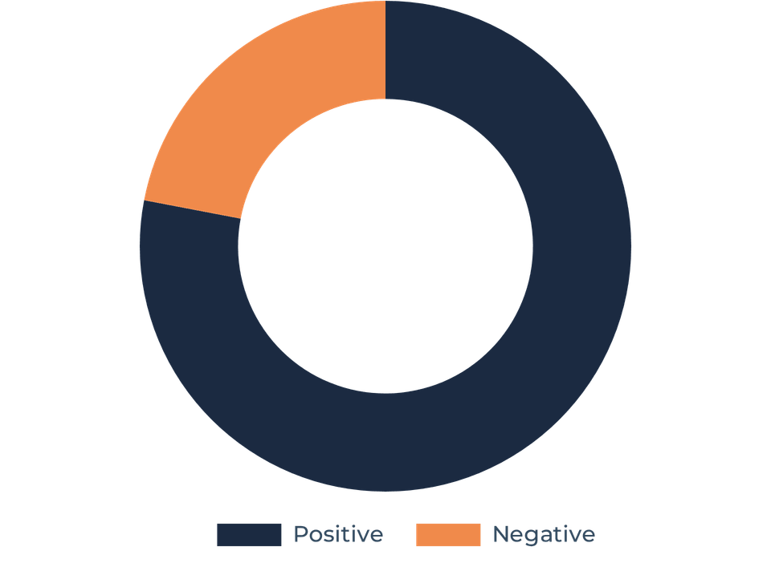
Data Visualization
Sentiment Distribution
A clear breakdown of positive versus negative reviews, highlighting the overall customer sentiment landscape.
Confusion Matrix
Detailed evaluation of model accuracy, showing true positives and negatives to validate predictive performance.
Keyword Analysis
Identification of high-frequency positive words that drive customer satisfaction and brand loyalty.
Overall Sentiment Distribution

Slide 9

Business Advantages
Operational Efficiency
Enhanced CX Insights
Significant time savings by automating the review analysis process, allowing teams to focus on high-value tasks.
Improved understanding of customer satisfaction drivers through systematic and unbiased sentiment classification.
Strategic Support
Scalability
Provides data-backed evidence for critical business decisions, product improvements, and service refinements.
Capable of handling massive datasets that would be impossible to analyze manually as the business grows.

Slide 10

Future Scope
Web & App Integration
Advanced Architectures
Developing a web-based application to provide a user-friendly interface for real-time sentiment prediction.
Integrating Deep Learning models such as LSTM or BERT for more nuanced context and sarcasm detection.
Multilingual Support
Executive Dashboards
Expanding the model's capability to analyze reviews in multiple languages for global business applicability.
Creating comprehensive business analytics dashboards for high-level executive reporting and trend tracking.

Slide 11

Conclusion
This project successfully demonstrates how Machine Learning and Natural Language Processing can be used to analyze customer reviews automatically, providing a scalable solution for modern businesses.
Accurate Insights
Operational Impact
Strategic Value
The developed model provides reliable sentiment classification, capturing the true voice of the customer.
Businesses can now understand customer opinions at scale, leading to improved products and services.
Automated analysis supports data-driven decision-making, reducing reliance on manual, subjective reviews.

Slide 12

Thank You
QUESTIONS & DISCUSSION
PRESENTED BY
Naviotech Solution Pvt. Ltd.
Lucky Khatik & Sameer
Jiwaji University, Gwalior

