Slide 1
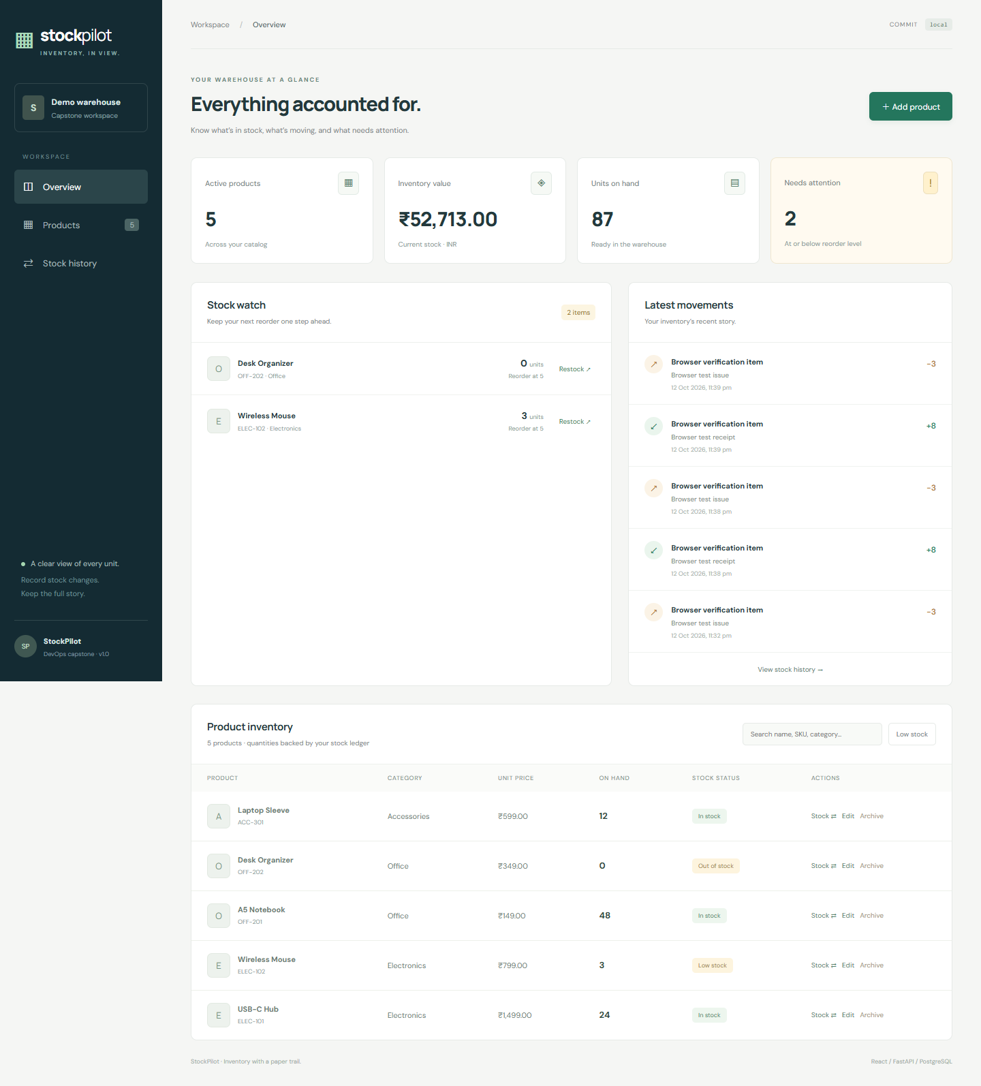
DEVOPS CAPSTONE / 2026
StockPilot
Inventory management with a traceable
DevOps delivery path
React • FastAPI • PostgreSQL • AWS EKS
A working inventory app, shipped through CI and GitOps,
with Kubernetes health and monitoring evidence.
Local seeded demo view
STOCKPILOT • DEVOPS CAPSTONE
Notes:
Introduce StockPilot as a small inventory application built to demonstrate the complete software delivery path. The dashboard image is from local seeded demo data; the deployment, CI and monitoring evidence appears later.
Evidence/source files: docs/screenshots/local-dashboard-smoke.png

Slide 2
01 / THE PRODUCT
Inventory work, made visible
A focused first release: products, stock movements, and reorder attention.
PRODUCT WORKFLOW
Keep the stock ledger trustworthy
01
Manage products
SKU, category, INR price and reorder threshold.
02
Record stock changes
Receive, issue or adjust; each change creates a movement.
03
Act on low stock
Search products and surface items below their threshold.
The figures shown are fictional local demo data, not live AWS inventory.
STOCKPILOT • DEVOPS CAPSTONE
02
Notes:
The application supports product CRUD and stock-in/out/adjust transactions. Quantity is changed through a transaction endpoint so movement history can be retained. The dashboard screenshot shows fictional seeded local data: five products, 87 units, ₹52,713 inventory value and two low-stock alerts.
Evidence/source files: docs/screenshots/local-dashboard-smoke.png, backend/app/routers/products.py, backend/app/routers/movements.py

Slide 3
02 / ARCHITECTURE
One app, two connected paths
User traffic flows through the cluster; commits flow through CI and GitOps.
RUNTIME PATH
Browser
Traefik Ingress
Application
Data + migration
React + Vite
StockPilot UI
AWS Network Load Balancer
/ → UI • /api → API
Frontend: 2 replicas
FastAPI: 2+ replicas
PostgreSQL StatefulSet
gp3 PVC • Alembic Job
Observability: Prometheus collects metrics → Grafana dashboards
RELEASE PATH
GitHub Actions
GHCR
Argo CD
AWS EKS · ap-south-1
Tests • Helm • Terraform
Build + Trivy scan
Images tagged
with commit SHA
Watches Git
Helm application
2 AZs • managed nodes • HPA
Prometheus + Grafana
Traffic uses the Ingress; release automation uses Git and registry images.
Status note: GitHub tests/build/scan passed; the optional Actions → AWS deploy job was skipped. Argo CD sync was verified separately.
STOCKPILOT • DEVOPS CAPSTONE
03
Notes:
Explain both planes. Runtime: the browser reaches a Traefik load balancer; Ingress routes root traffic to React and /api to FastAPI. FastAPI uses PostgreSQL with durable gp3 storage. A release migration Job runs Alembic before normal application operation. Delivery: GitHub Actions verifies and publishes SHA-tagged images to GHCR; Argo CD watches the repository Helm definition and reconciles the AWS EKS application. Prometheus and Grafana provide monitoring. The screenshot evidence shows successful CI and separately verified healthy Argo CD; the optional GitHub Actions AWS deployment job was skipped, so do not describe that job as successful.
Evidence/source files: helm/stockpilot, argocd/, terraform/, docs/screenshots/github_actions.png, docs/screenshots/image(1).png

Slide 4
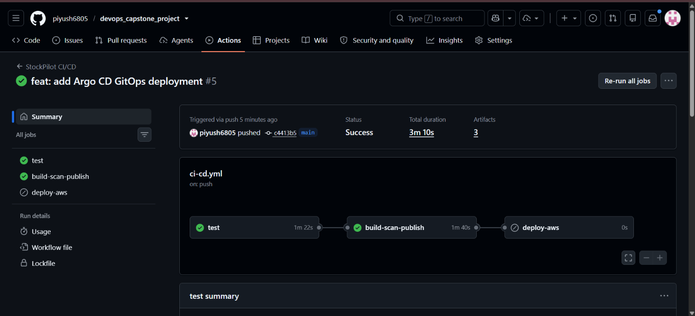
03 / CONTINUOUS DELIVERY
Every image has a commit behind it
The green checks are the gate before a release is published.
PIPELINE
1
Test
PostgreSQL-backed API tests and frontend checks
2
Build + scan
Build images; Trivy blocks high/critical findings
3
Publish
Push successful main images to GHCR with SHA tags
4
Deploy
Argo CD reconciles the matching Helm release
Evidence detail: “deploy-aws” was skipped in this run. AWS was deployed and synced through Argo CD.
STOCKPILOT • DEVOPS CAPSTONE
04
Notes:
The supplied Actions screenshot is a successful workflow: test and build-scan-publish completed successfully. The deploy-aws job is visibly skipped. Therefore present GitHub-hosted CI/image publishing as verified and AWS deployment as separately performed and verified with Argo CD. SHA-tagged images make a release traceable to a source commit.
Evidence/source files: docs/screenshots/github_actions.png, .github/workflows/

Slide 5
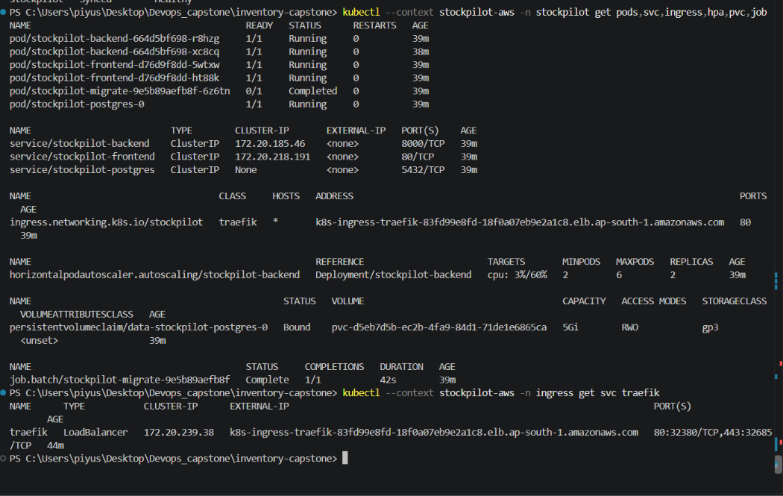
04 / KUBERNETES
A healthy release on AWS EKS
Real cluster evidence: workloads, migration, storage and ingress.
DEPLOYMENT CHECK
2 / 2
EKS worker nodes Ready
2 + 2
Backend + frontend pods Running
Bound
PostgreSQL gp3 persistent volume
Complete
Alembic migration Job
2 of 2–6
Backend HPA at minimum; ~3% CPU vs 60% target
Cluster: stockpilot-eks • Region: ap-south-1 • Ingress: Traefik NLB
STOCKPILOT • DEVOPS CAPSTONE
05
Notes:
The terminal capture shows the AWS deployment state after sync: two backend replicas and two frontend replicas are Running, PostgreSQL is Running, the migration Job completed, the gp3 PVC is Bound, and the backend HPA has minimum two, maximum six, with two replicas at roughly 3% CPU against the 60% target. This is healthy deployment evidence, not proof that autoscaling exceeded its minimum.
Evidence/source files: docs/screenshots/image(1).png, docs/screenshots/kubectlgetnodesterraform.png

Slide 6
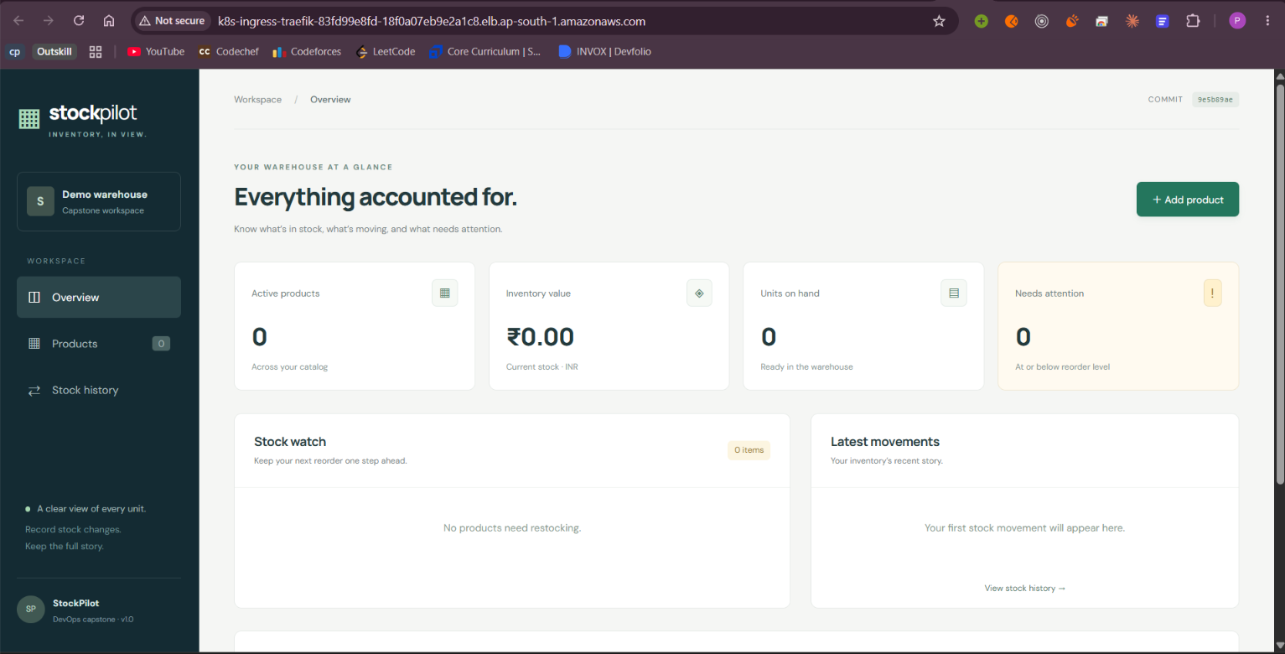
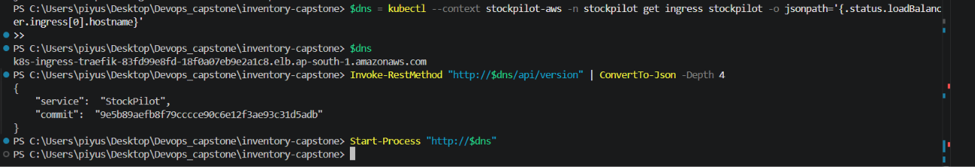
05 / VERIFIED APPLICATION
The running app identifies its release
A live endpoint ties the AWS-served application back to a source commit.
RELEASE ID
9e5b89aefb8f…
/api/version returned the StockPilot service name and deployed commit SHA.
STOCKPILOT • DEVOPS CAPSTONE
06
Notes:
Show that this was not only a successful rollout: the Ingress served the StockPilot dashboard and /api/version returned service StockPilot with commit 9e5b89aefb8f79cccce90c6e12f3ae93c31d5adb. The browser dashboard is empty because this deployed database had no demo seed records; the local demo dashboard on slide 2 shows fictional seed data.
Evidence/source files: docs/screenshots/kubernetes synced.png, docs/screenshots/image(2).png

Slide 7
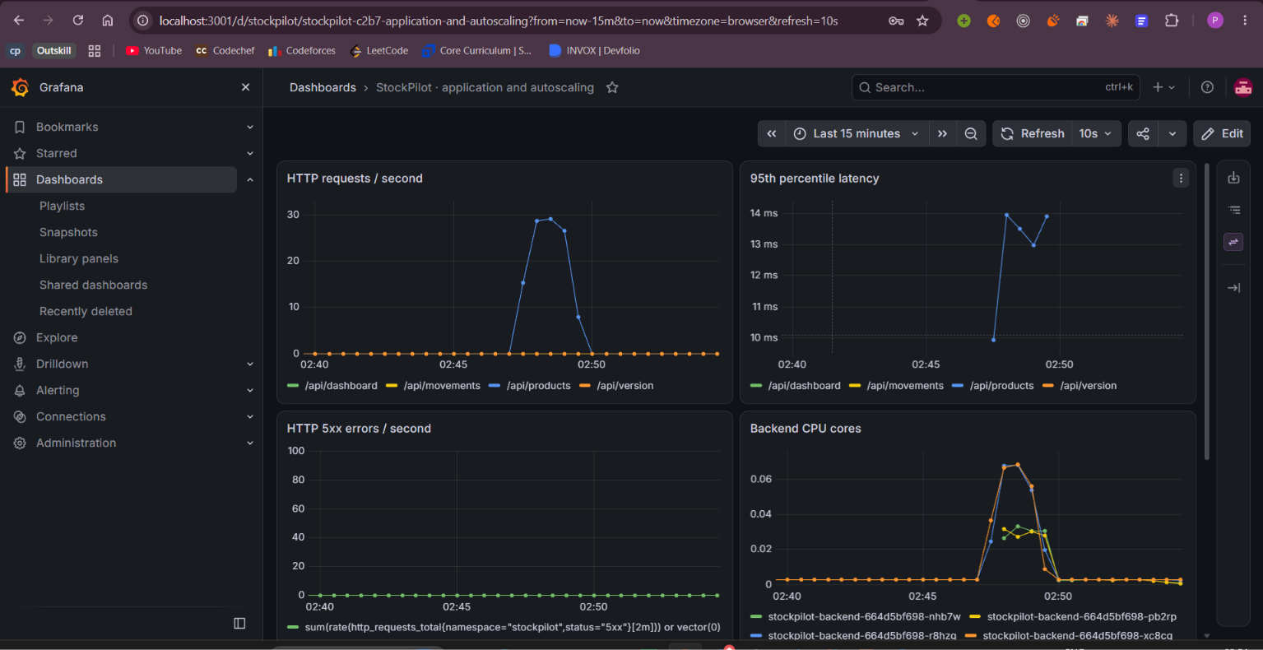
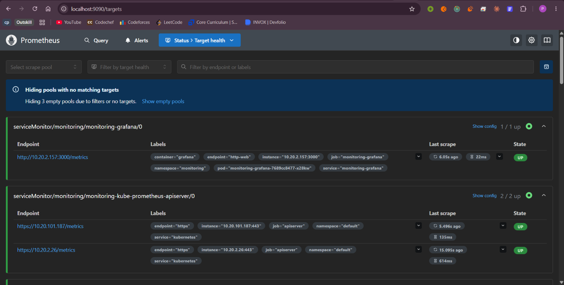
06 / OBSERVABILITY
See the service while it is under traffic
Prometheus collects metrics; Grafana makes the runtime behavior readable.
Grafana · request rate, p95 latency, errors and CPU
Prometheus · target health
STOCKPILOT • DEVOPS CAPSTONE
07
Notes:
This Grafana capture shows request-rate activity peaking around 30 requests/second, p95 latency around 14 ms at the visible peak, no visible 5xx errors, and a CPU response during generated traffic. The Prometheus capture shows targets marked UP on the visible page; it does not clearly expose the StockPilot service target in the screenshot, so describe it as Prometheus target-health evidence rather than claiming a specific target row. HPA remained at two replicas as shown earlier.
Evidence/source files: docs/screenshots/grafana.png, docs/screenshots/prometheus.png

Slide 8
07 / TAKEAWAY
A release you can follow
from commit to cluster
What the evidence says
CI test and image-scan/publish jobs passed.
StockPilot brings together an inventory workflow, automated quality gates, a GitOps-managed AWS deployment, and operational visibility.
Argo CD reports Synced and Healthy.
AWS EKS workloads and gp3 storage are healthy.
CODE
Product + stock ledger
Monitoring shows traffic and service response.
VERIFY
Tests + image scan
The Actions deploy-aws job was skipped; it is not claimed as a passing step.
PUBLISH
Commit-tagged images
RECONCILE
Argo CD → EKS
OBSERVE
Prometheus + Grafana
After screenshots and recording: destroy the temporary AWS stack, then verify the cluster, load balancer, NAT gateway and storage are gone.
STOCKPILOT • DEVOPS CAPSTONE
08
Notes:
Close with the verified story and state its boundaries accurately. CI checks and image publication passed. The GitOps application was Synced and Healthy in AWS. Kubernetes workloads and monitoring were verified. The separate deploy-aws GitHub Actions job was skipped in the screenshot. Since the AWS environment was intended to exist only for evidence capture, destroy the stack after the presentation/video and check that billable resources are removed.
Evidence/source files: docs/screenshots/github_actions.png, docs/screenshots/image(1).png, docs/screenshots/grafana.png

