Slide 1

SANJIVANI RURAL EDUCATION SOCIETY, SANJIVANI UNIVERSITY,KOPARGAON DEPARTMENT OF ARTIFICIAL INTELLIGENCE AND MACHINE LEARNING
A Presentation on
How Social Media Impacts Mental Health
Presented By:
Kotkar Piyush (2124UMLM2012)

Slide 2
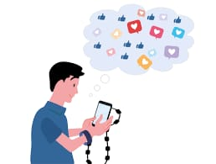
Introduction
For many of us, checking Instagram, Facebook, TikTok and other social media is a part of our normal routine. In 2023, there was an estimated 4.9 billion social media users worldwide. The average person spends 145 minutes on social media every day.
Social media use may increase feeling of anxiety and depression, specifically in teens and young adults.
FOMO (Fear of Missing Out): The use of social media increases feelings of FOMO for many people. Checking in on your friends and family through social media may make you feel that others are having more fun or living better lives than you are.

Slide 3
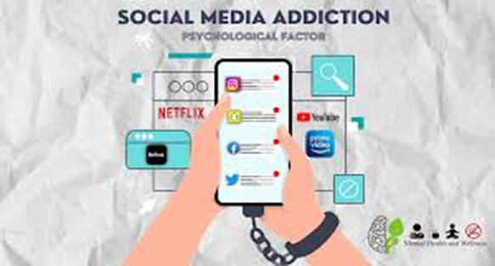
Social Media Addiction

Slide 4
Ways to safely use social media
A great way to improve your relationship with social media and help decrease the negative effects is to decrease your daily screen time. Tips to decrease screen time include:
Set time limits on social media apps within your phone settings
Designate specific hours for social media usage
Look through your friends and followers list and unfriend people whose accounts make you feel bad about yourself

Slide 5
Problem Statement
The pervasive use of social media has raised concerns about its impact on mental health, with studies indicating potential links to anxiety, depression, and low self-esteem among users. This research aims to investigate how social media interactions influence mental well-being, exploring both the positive and negative effects on individuals' psychological health.

Slide 6
Objectives
Evaluate the relationship between social media usage patterns and the prevalence of mental health issues such as anxiety and depression among different age groups.
Analyze the positive effects of social media, including community support and connection, on individuals' mental well-being.
Identify strategies for mitigating the negative impacts of social media on mental health, focusing on promoting healthy online behaviors and awareness.

Slide 7
Positive and Negative Points
Positive Points:
Connection and Support: Social media enables individuals to maintain relationships with friends and family, fostering a sense of community and belonging, which can positively impact mental well-being.
Awareness and Resources: Social media raises awareness about mental health issues and provides access to valuable resources, support groups, and information that can help individuals navigate their challenges.
Negative Points:
Comparison and Low Self-Esteem: Constant exposure to curated and idealized portrayals of others' lives can lead to unhealthy comparisons, fostering feelings of inadequacy and lowering self-esteem.
Cyberbullying and Harassment: Negative interactions on social media, such as cyberbullying, can significantly impact mental health, contributing to increased anxiety, depression, and emotional distress.

Slide 8
Conclusion
Social media has both positive and negative impacts on mental health.
It can promote connections, support, and a sense of community.
Excessive use or negative interactions may increase anxiety, depression, and lower self-esteem.
Understanding these effects is essential for developing strategies to encourage healthy social media habits.
Raising awareness and promoting responsible use can help maximize the benefits while minimizing harm to mental health.

