Slide 1
Good Cardio Fitness Business Presentation

Slide 2
Contents
The presentation consists of three Four Sections:
Background and Business Problem Overview, Analysis Approach
Data Overview and Loading, Cleaning Steps
Exploratory Data Analysis Results
Insights and Recommendations

Slide 3
Background of the Business and Problem Overview
Background
Problem Overview
Good Cardio Fitness sells treadmill products to its customers. We have data provided for customers of the retail chain across treadmill product types.
The Retail Store has customer information around products sold and various other features. The collected data does not have a timeframe but consists of customer observations
Present a customer profile (characteristics of a customer) by different product types
Perform Data Analysis and generate a set of insights and recommendations that will help in targeting new Customers

Slide 4
Data Overview
The data contains Product type, Age, Gender, Education, Marital Status, Usage, Self rated Fitness, Income of the Customer and Miles Expected to run
Data | Description
Product | Model no. of the treadmill
Age | Customer age in no of years
Gender | Customer Gender
Education | No of years of the customer
Marital Status | Of the customer
Usage | Avg. # times the customer wants to use the treadmill every week
Fitness | Self rated fitness score of the customer (5 - very fit, 1 - very unfit)
Income | Customer Income
Miles | Expected to run

Slide 5
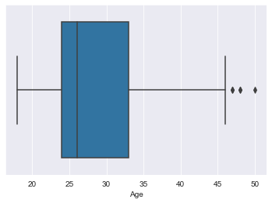
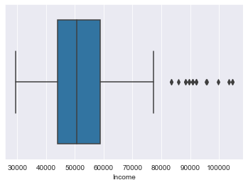
Exploratory Data Analysis
Observations on Customer Age
Customer Age graph has a long tail towards the right
Mean age of the customer is around 28.8 years
Observations on Customer Income
There are two peaks at the Income curve with 50K and 90K as the two data points
Average Income of the customers is roughly 53,720

Slide 6
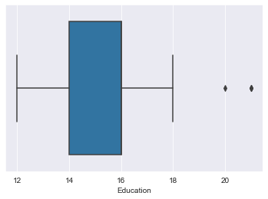
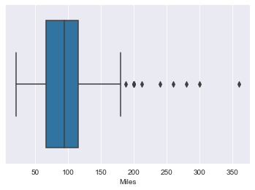
Exploratory Data Analysis Numeric Variables cont..
Observations on Customer Education
There are two peaks at the Income curve with 50K and 90K as the two data points
There are three peaks at the Income curve with 14, 16 and 18 as prominent values
Customer Miles Expected
Most of the outliers are beyond 175 Miles
Maximum value seems to go all the way upto 360 Miles
Median is around 94 Miles

Slide 7
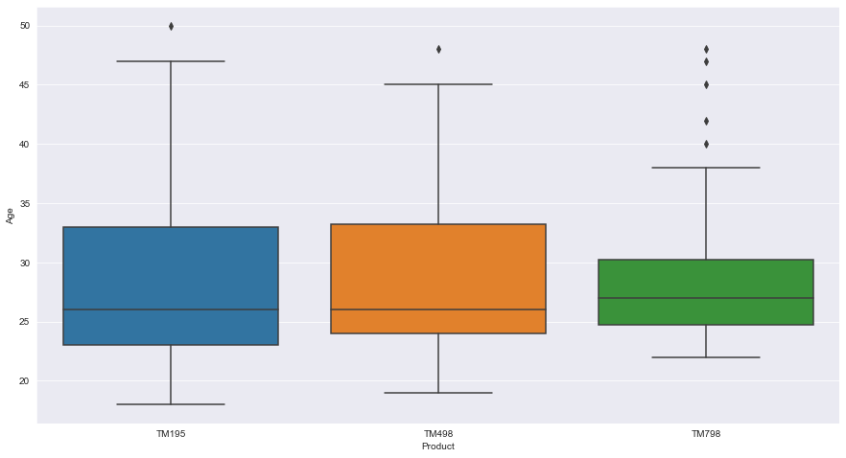
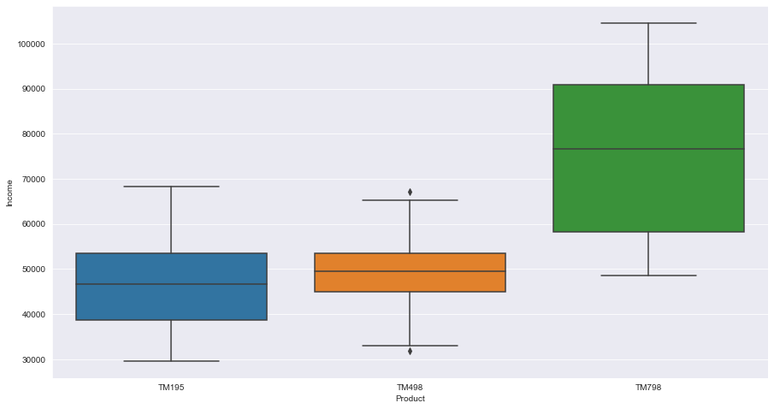
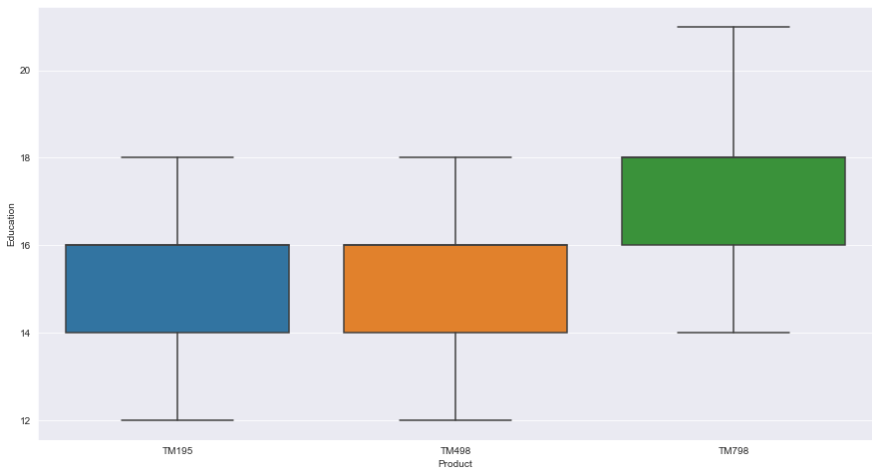
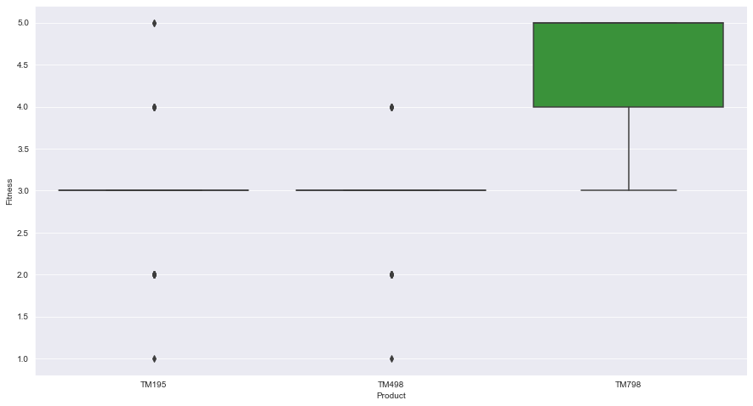
Exploratory Data Analysis - Impacting Variables
Product Type vs Age
Product Type vs Income
Product Type vs Education
Product Type vs Fitness

Slide 8
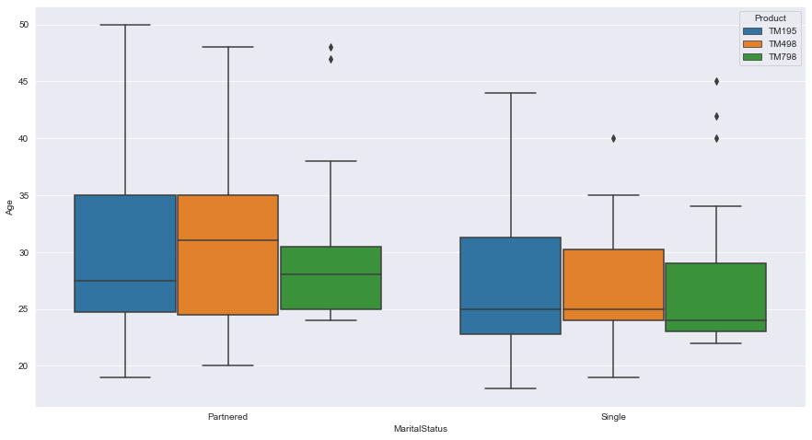
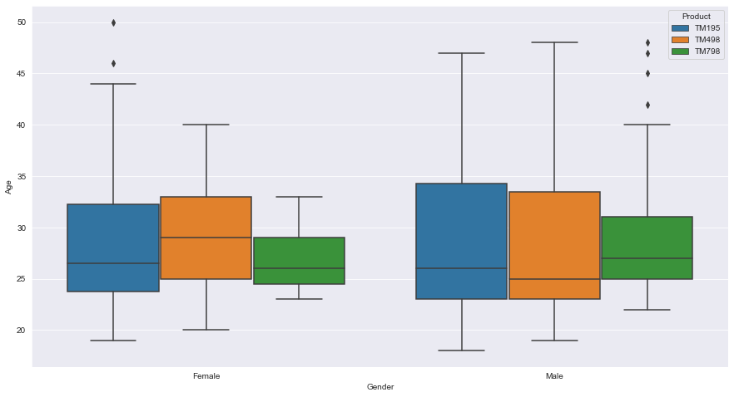
Exploratory Data Analysis - Impacting Variables
Age & Marital Status by Product Type
Age and Gender by Product Type

Slide 9
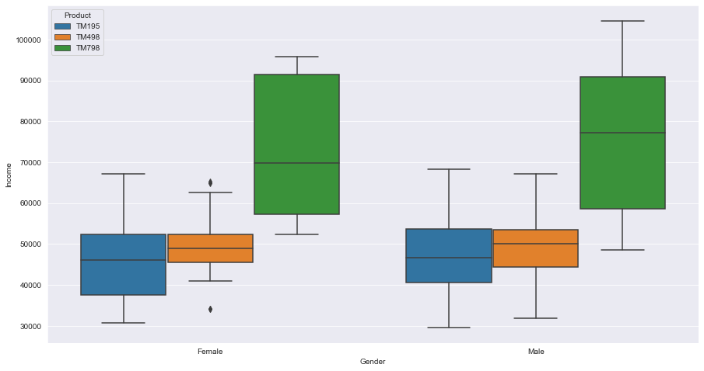
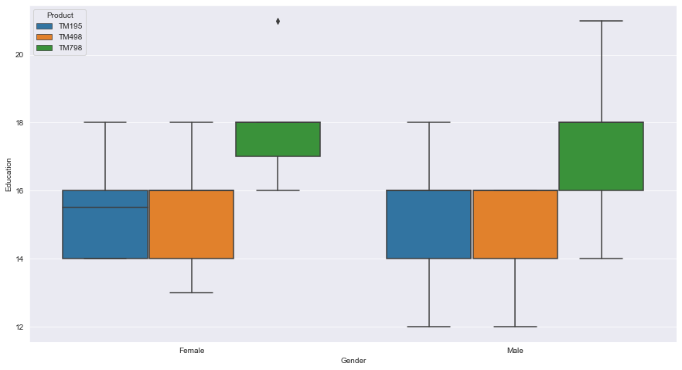
Exploratory Data Analysis - Impacting Variables
Income & Gender Status by Product Type
Education and Gender by Product Type

Slide 10
Conclusions
* Customers of TM798 have
1. Higher Income
2. Higher Fitness
3. Higher Education
* Customer base of TM798 is younger
* TM195 has a standard client base and does not have outliers by Age for Partner or Single customers
* TM798 customers age group distribution in both the gender are younger than TM195 and TM498
*TM798 product has more outliers in age for both males and females
* Education level of TM195 and TM498 customers fall betwee 14-16 years but TM798 customers education level falls between 16-18 years in the both gender catagory.
* Female customers of product TM798 are more educated than males customers
* TM798 product usage is higher among the partnered customers

Slide 11
Conclusions
* TM798 product usage is higher among the partnered customers
* TM195 product is more affordable for lower income group customers
* TM798 customer are in higher income groups across genders compared to TM195 and TM498 customers
* Average usuage of TM798 is higher than TM498 and TM195
* Male customers usage of TM195 and TM798 are higher than female customers
* Fitness and Miles Level of customer using TM978 is higher than TM498 and TM195
*Female customers miles run is higher on TM978 than male customers

