Slide 1
ReCell – Supervised Learning Business Presentation

Slide 2
Contents
The presentation consists of three Four Sections:
Background and Business Problem Overview
Data Overview
Exploratory Data Analysis
Model overview and performance summary
Key findings and insights

Slide 3
Background of the Business and Objective
Background
Objective
Used and refurbished phone market has grown considerably over the past decade.
Third-party vendors/platforms, such as Verizon, Amazon, etc., provide attractive offers to customers for refurbished smartphones.
The impact of the COVID-19 outbreak may further boost the cheaper refurbished smartphone segment, as consumers cut back on discretionary spending and buy phones only for immediate needs.
ReCell, a startup aiming to tap the potential in this market.
1. Do statistical analysis and extract actionable insights from the data
2. Analyze the data and build a linear regression model to predict the price of a used phone and identify factors that can significantly influence it.
3. To come up with a ML-based solution to develop a dynamic pricing strategy for used and refurbished smartphones.

Slide 4
Data Overview
Data | Description
brand_name | Name of manufacturing brand
os | OS on which the phone runs
screen_size | Size of the screen in cm
4g | Whether 4G is available or not
5g | Whether 5G is available or not
main_camera_mp | Resolution of the rear camera in megapixels
selfie_camera_mp | Resolution of the front camera in megapixels
int_memory | Amount of internal memory (ROM) in GB
Ram | Amount of RAM in GB
battery | Energy capacity of the phone battery in mAh
weight | Weight of the phone in grams
release_year | Year when the phone model was released
days_used | Number of days the used/refurbished phone has been used
new_price | Price of a new phone of the same model in euros
used_price | Price of the used/refurbished phone in euros
Observation | Variable
3571 | 15
Note:
1. Missing or null values in below columns main_camera_mp
selfie_camera_mp
int_memory
ram
battery
Weight
2. Missing value treatment has been done for main_camera_mp.
3. brand_name, os, 4g, 5g are objects, these are converted to categories.

Slide 5
Exploratory Data Analysis
There are 33 different brand names which comes into 125 screen sizes.
Screen size varies from 2.7 inches to 46.36 CMS.
All 33 brands released in last 8 different years.
Used price also varies between 2.51 to 1916.54 Euros.

Slide 6
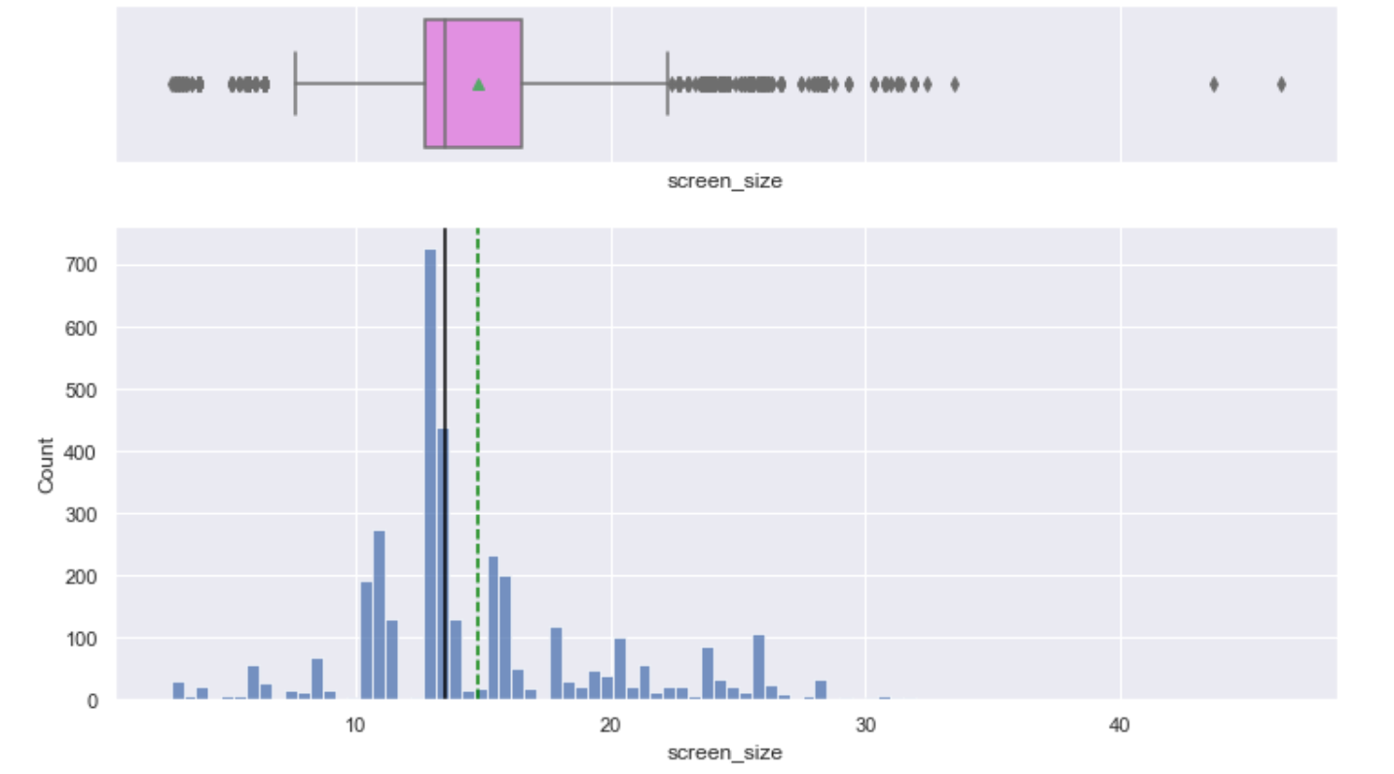
Univariate Analysis –Screen Size
Highest screen size for used smart phone are in the range of 10.16 to 13.49 cms.
There are outliers in the screen size.
Used phones with screen size 13.49 cms has the highest count.

Slide 7
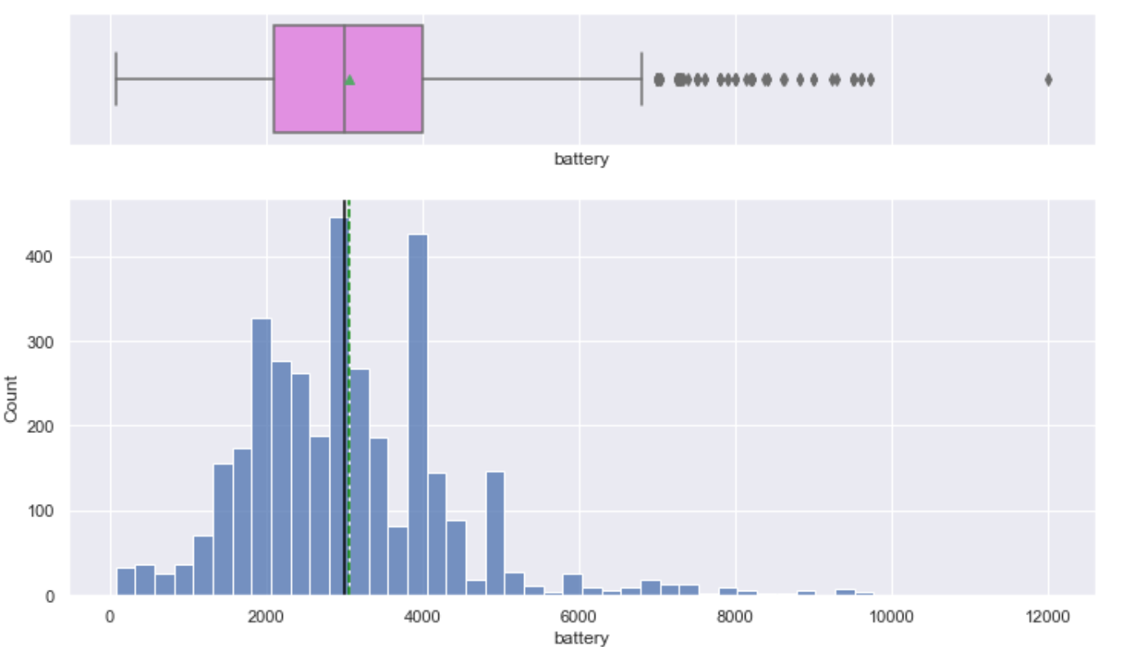
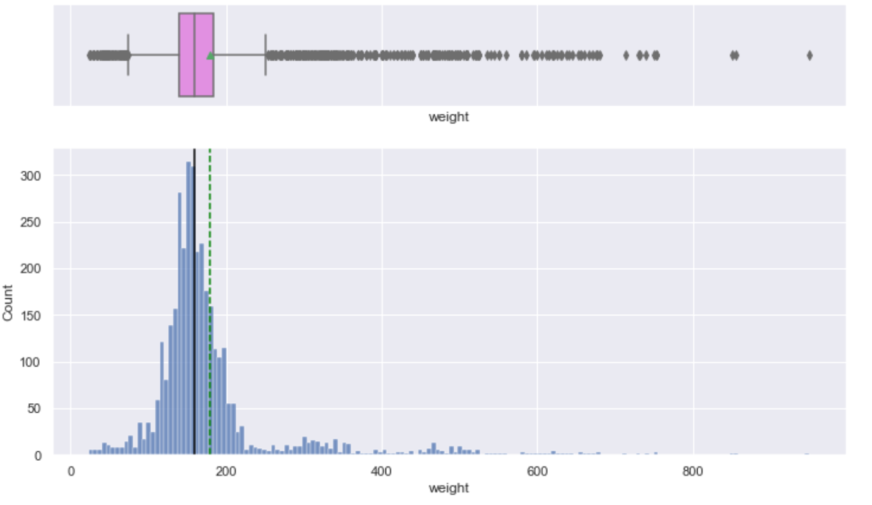
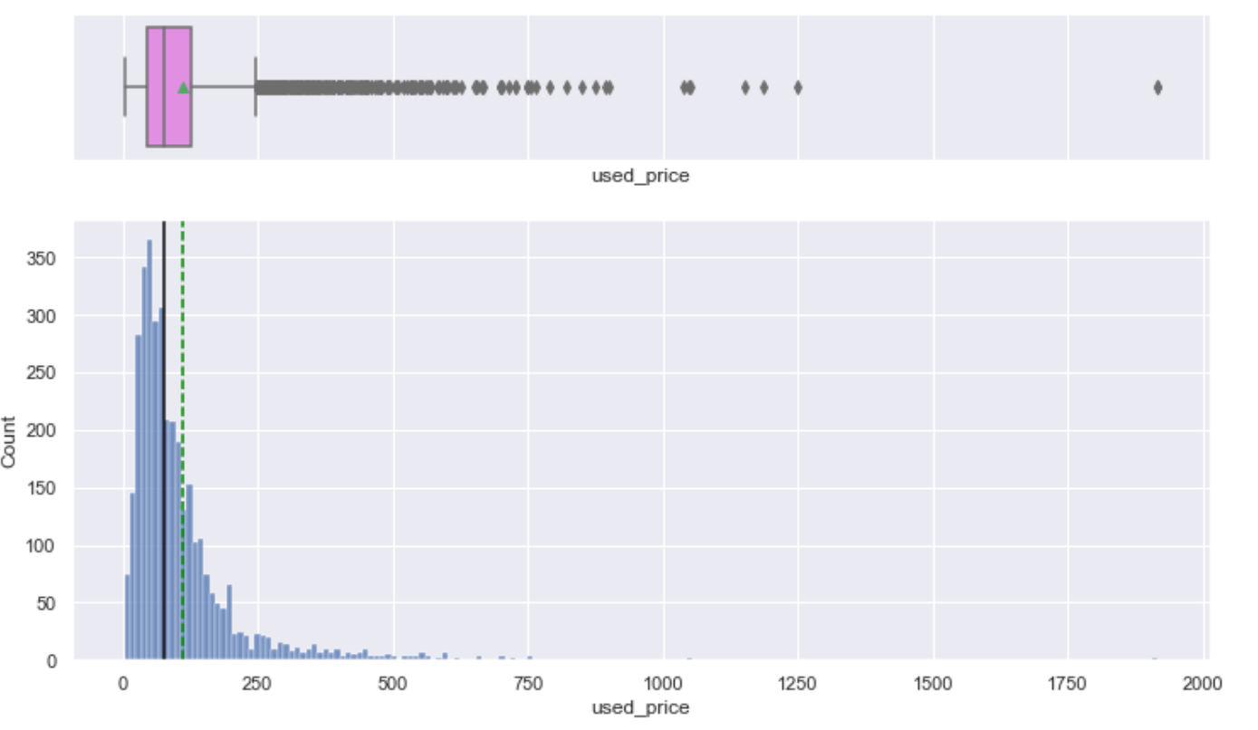
Univariate Analysis
There are outliers exists with the battery
Maxmimum used phones have a battery capicity ranged between 2000-4000 mAh.
There is no skewness in battery.
Used phones weight also has a lot of outliers but the average weight is 179 grams.
Used phones used_price has many outliers and it is right skewed.
Used phones new_price has many outlier and it is also right skewed.

Slide 8
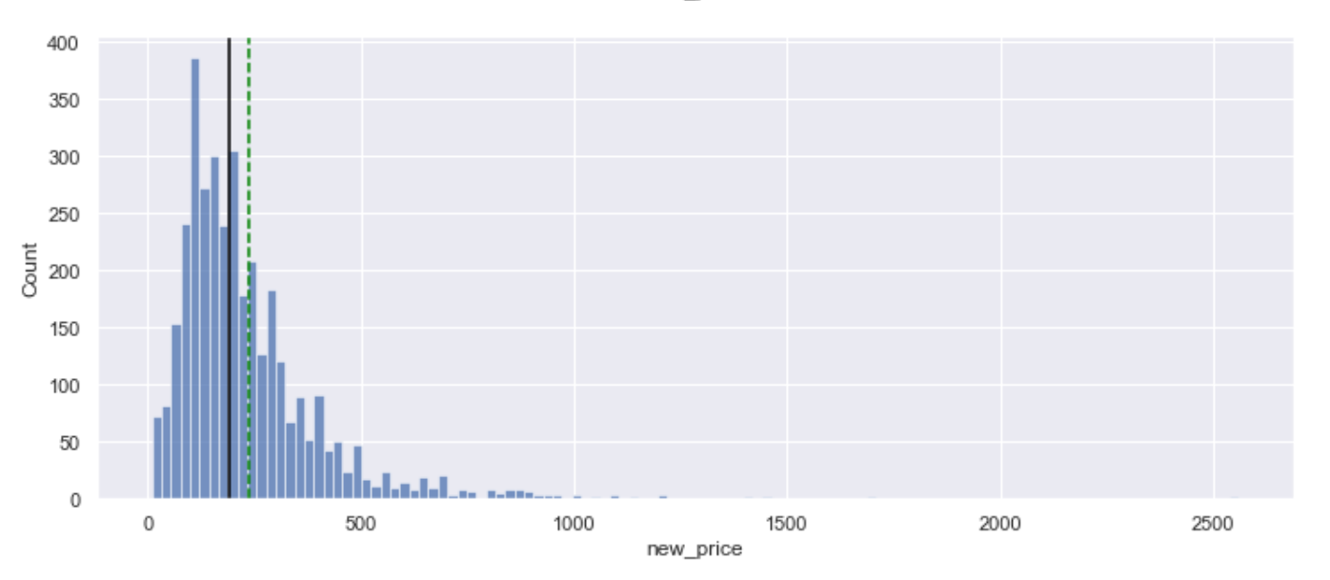
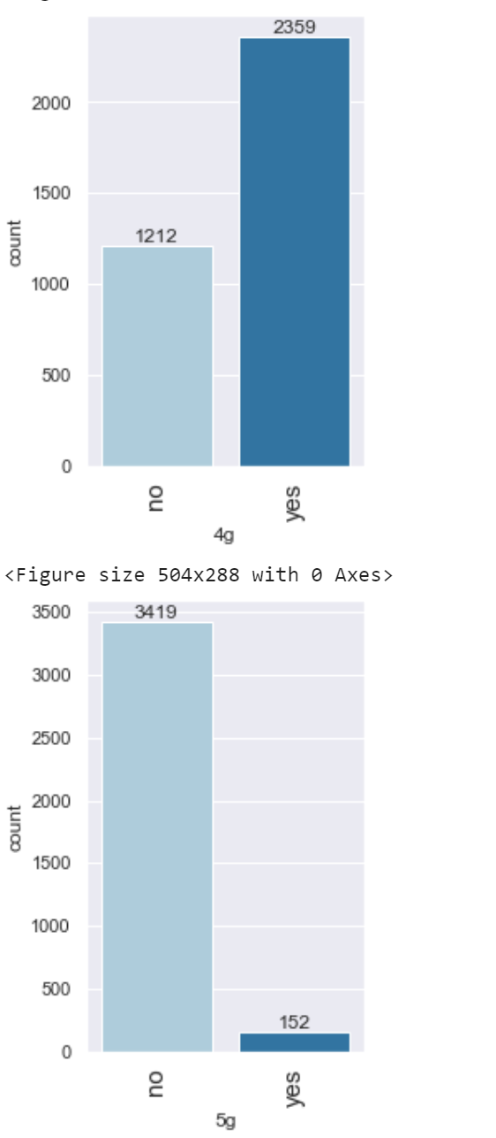
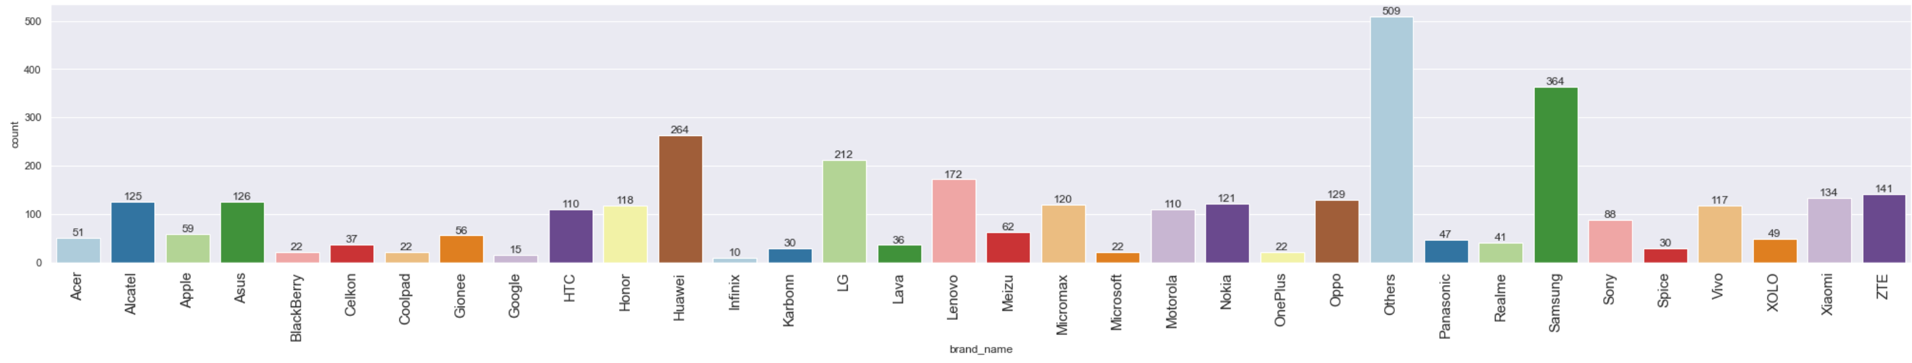
Univariate Analysis
Used phones new_price has many outlier and it is also right skewed.
Days used for used phones is left skewed.
New price for used phones is also rightly skewed.
Used price is also rightly skewed
Huawei, LG Samsung and Others are the highest available brands of cell phones.
Used phones are most popular with android OS.
Used phones mostly available in 4G spectrum.
Used phones with 5G availability is very less.

Slide 9
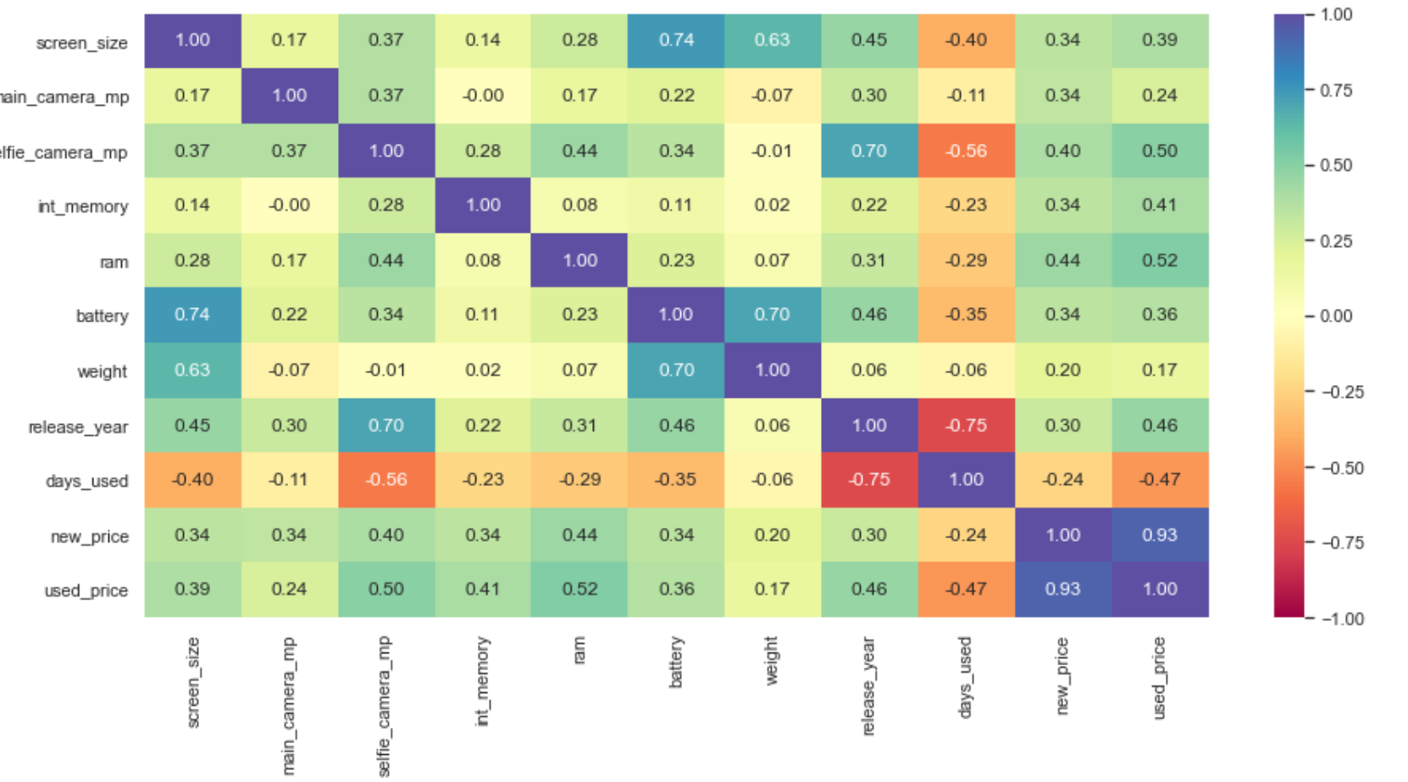
Bivariate Analysis
Screen Size with battery are positively corelated.
New price is highly positively corelated with used price.

Slide 10
Model overview and performance summary
We used regular Linear regression and Linear Regression using statsmodels to build our machine learning model.
The training 𝑅2 is 96%, indicating that the model explains 96% of the variation in the train data. So, the model is not underfitting.
MAE and RMSE on the train and test sets are comparable, which shows that the model is not overfitting.
MAE indicates that our current model is able to predict used_price within a mean error of 10.41 Euros on the test data.
MAPE on the test set suggests we can predict within 18.1% of the used_price.

Slide 11
Model overview and performance summary
brand_name_Apple,brand_name_Others, brand_name_Samsung and os_iOS have VIF greater than or equal to 5.
brand_name_Apple and os_iOS have a VIF score of much greater than 10 i.e. 23 and 22 which shows signs of high multicollinearity.
This does seem to make intuitive sense because the Apple brand and OS IOS are highly co-related.

Slide 12
Model overview and performance summary
brand_name_Apple,brand_name_Others, brand_name_Samsung and os_iOS have VIF greater than or equal to 5.
brand_name_Apple and os_iOS have a VIF score of much greater than 10 i.e. 23 and 22 which shows signs of high multicollinearity.
This does seem to make intuitive sense because the Apple brand and OS IOS are highly co-related.

Slide 13
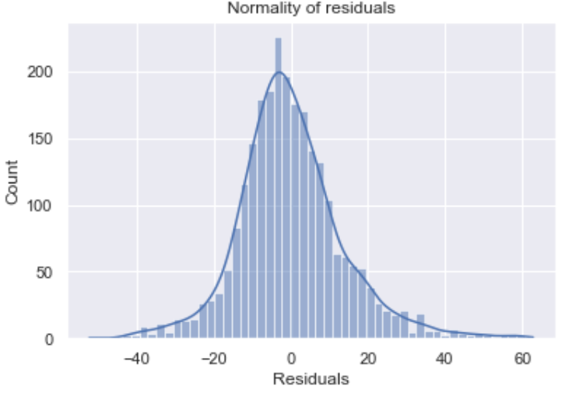
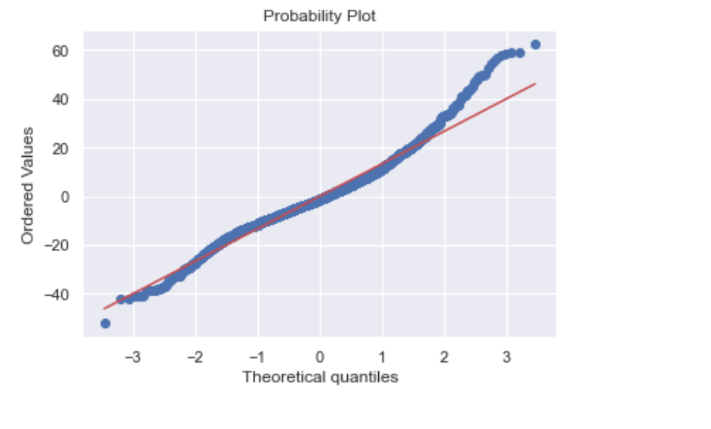
Model overview and performance summary
The residuals were more or less followed a straight line except for the head and tails.
The residual data followed normal distribution with the model we followed.
We observed that our model returned reasonable prediction results, and the actual and predicted values are slightly comparable though not fully.
The model is able to explain ~95.3% of the variation in the data, which is very good.

Slide 14
Key Findings and Insights
Used price is heavily dependent on New Price, RAM, Internal Memory, Selfie Camera Megapixel. As these increase, the total used price increases, as is visible in the positive coefficient sign.
The used price is negatively correlated with Infinix, Gionee, Lenovo, OnePlus brands, Which means that for these brands used price decreases.
Brand_name Google, Blackberry and LG are positively impacting the used phone pricing.
Phones with IOS operating systems (Apple) have highest used price in the market.
Screen Sizes have positive influence on used price with increase in screen size there is an increase in used price.

