Slide 1
Zomato Restaurant Predictor
Ayushman Bhadauria (pd16_021)
Piyush Prakash (pd16_126)
Sandeep Singh shekhawat (pd16_194)
Vaibhav Arora (pd16_235)

Slide 2
Content
Introduction
Primary goals
Challenges
Dashboard Description
Outcomes

Slide 3
INTRODUCTION
The project was made in collaboration with Masai School, and objective provided was to create a “Machine Learning model” to help the customer to select different Restaurant based on different Cuisines and Budget, Also creating an interactive dashboard to Visualize how different restaurant are preforming in different locations.

Slide 4
PRIMARY GOALS
Scrape the data from live Website.
Understand and Sanitize the data Extracted (using Python)
Design Dataset which can give useful insight (Using SQL)
Visualize data to see different trends (Using Python)
Create a Machine learning model to predict the different Requirements

Slide 5
Challenges Faced
Since the website was live, it was difficult to identify the class and different HTML element for scrapping the data.
Error Handling
Database Creation and figuring out which data columns to use to draw insight.
Deciding on machine learning model to use, as the dataset we got was small, Most of the machine learning model failed to give us the accurate Result.

Slide 6
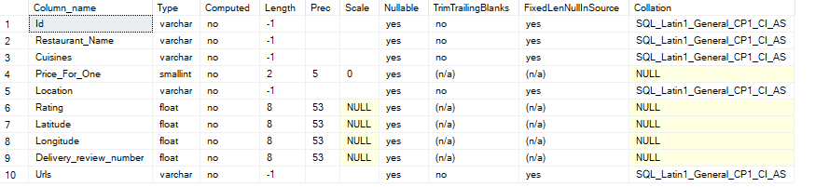
Table Attributes

Slide 7
Results
Extraction of Data
With the help of Selenium and BeautifulSoup4, we were able to extract required data from Zomato’s live website and store in a required format (which was CSV)
Analyzing the dataset
With Different tools like SQL, Excel and Python we have done the analysis and manipulation of dataset and derived different insights from it.
Building a Machine Learning Model
The most difficult stage for us was to build a machine learning model, as the dataset was small and had really a smaller number of features, which depleted accuracy of most of the Model, but finally we decide upon using random forest as it was able to provide the required result.
Creating a Dashboard
Creating Dashboard was most interesting, We used python and streamlit Library to create a Dashboard, which is not only appealing but is interactive to the user.

Slide 8
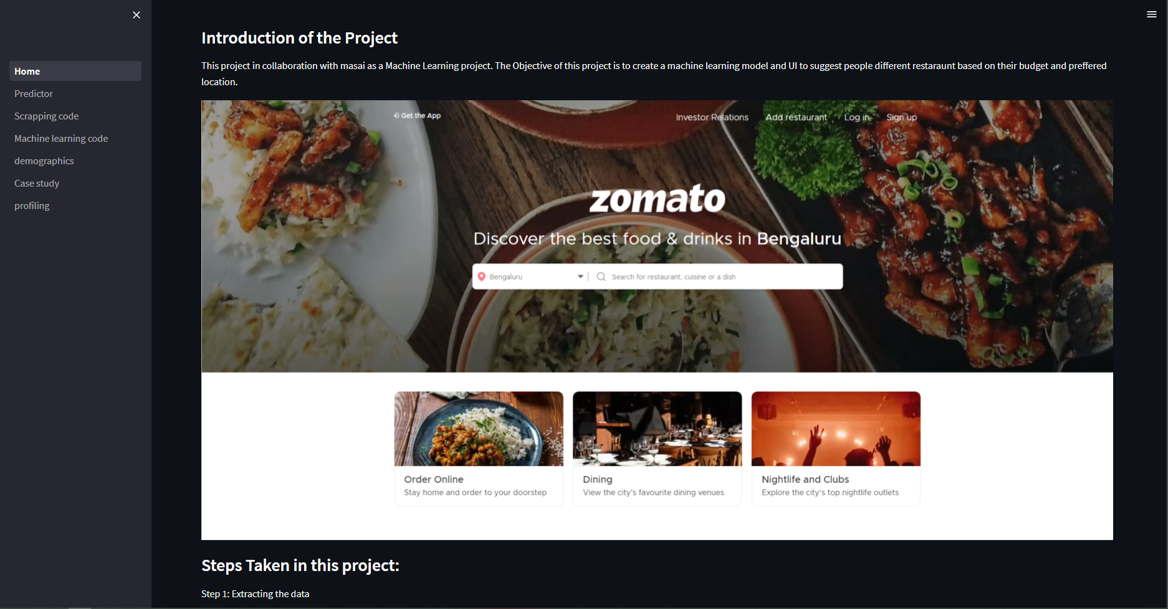
This is a small glimpse of how Our Home page looks like which includes a snapshot of website an introduction to our project, with steps taken by us to build this whole application.

Slide 9
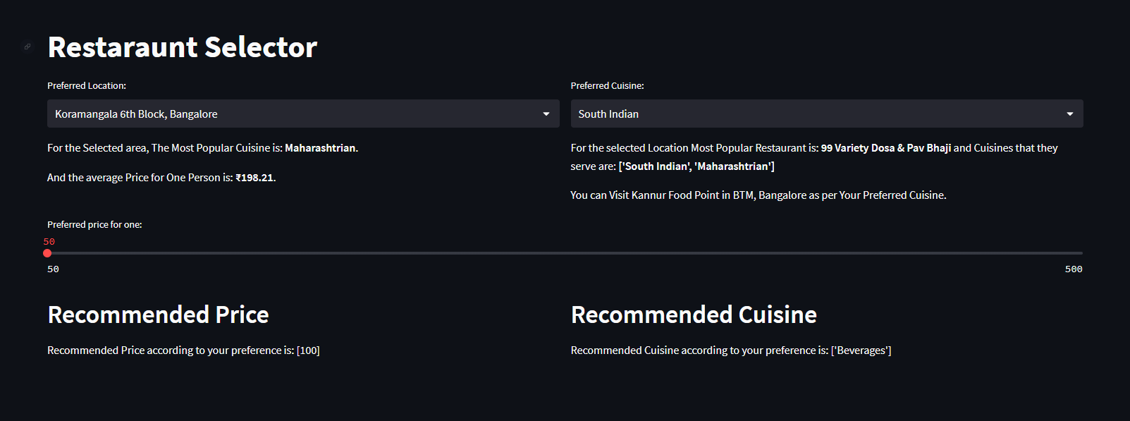
This shows the basic outline of how Our predictor page looks like with different dropdowns
Which can be used to interact with different feature input.

Slide 10
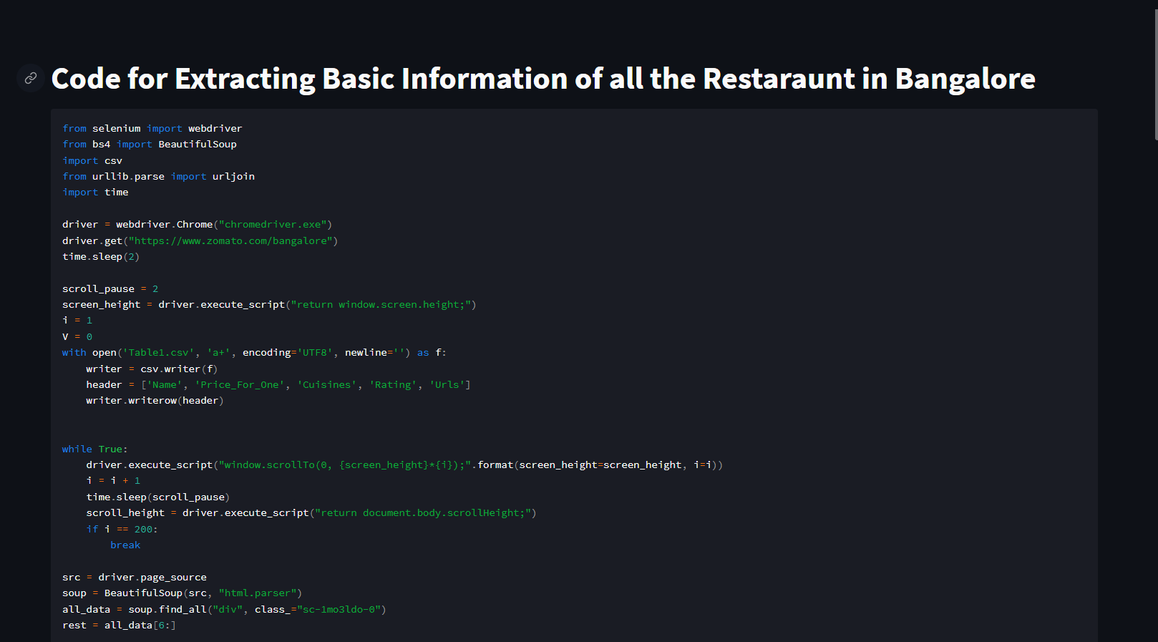
We have included 2 different pages which shows our whole source code to the machine learning model and the scrapping process.
We have made it open-source, if someone wants to improve our dataset or wants to use for other purpose, they are free to use also can be used to learn the structure of the code.

Slide 11
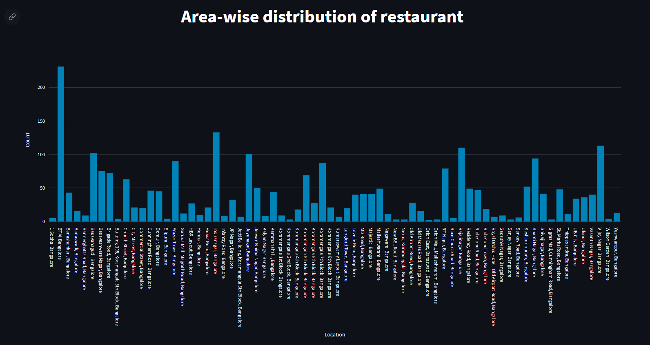

Slide 12
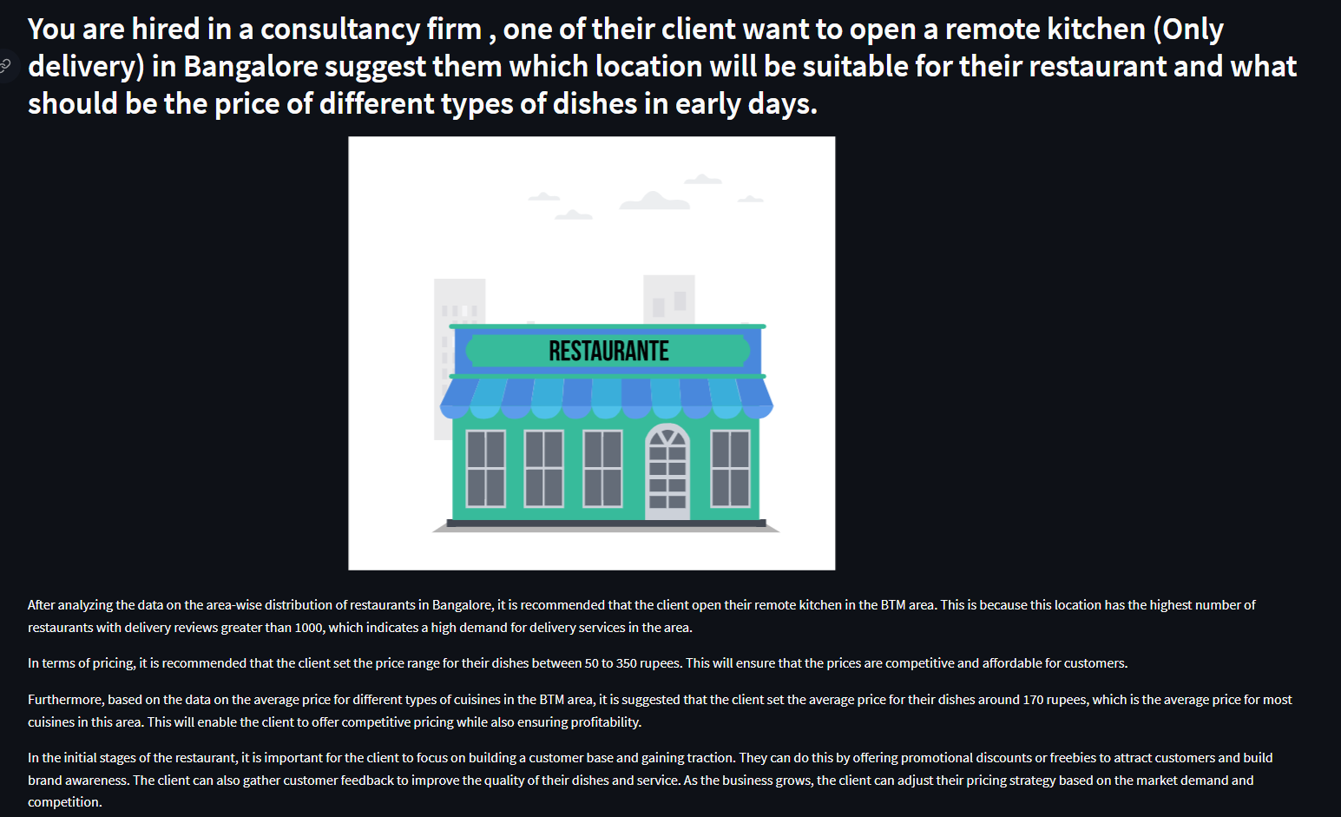

Slide 13
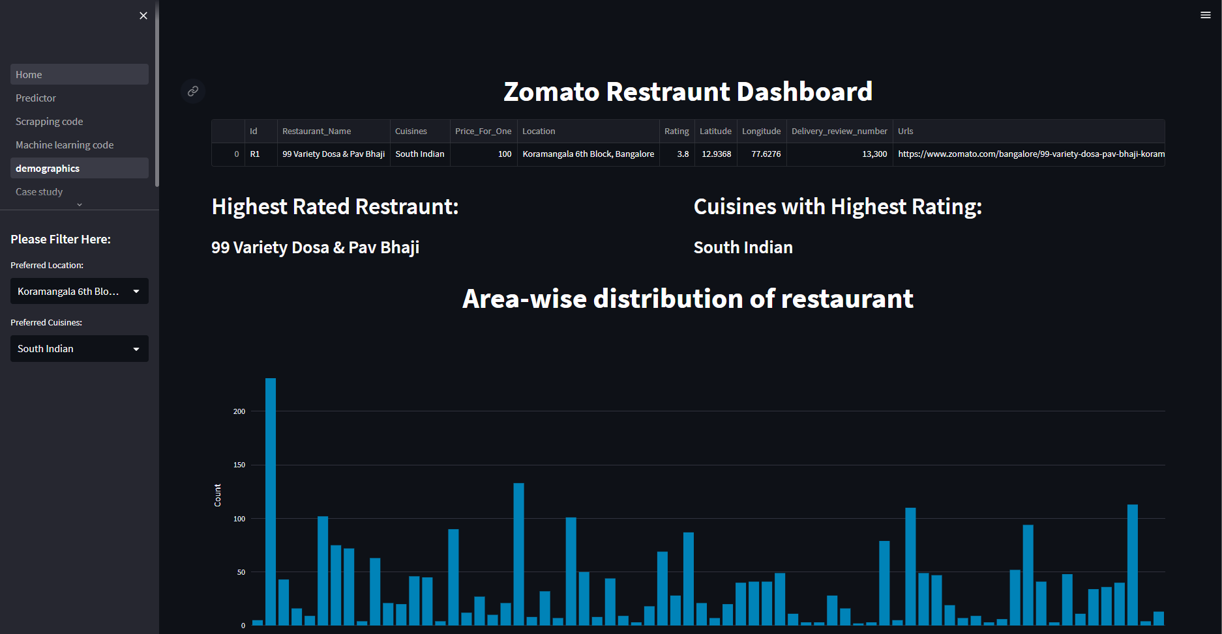

Slide 14
HOW WE GET HERE
Data Extraction and Sanitization
Data Analysis and Machine Learning.
Front-End Development
With help of different Library like Selenium and BeautifulSoup4, It was a breeze to extract the data, although we struggle a little bit in selecting correct HTML tag and HTML Class.
The Data Analysis was done using SQL, Python and slight help of Microsoft excel.
Also, python library Sklearn made it easy to implement machine learning model for us, although inability to get higher accuracy score staged us with Problem.
Front-End was created with the help of python library called as Streamlit, It made easy for us to implement different design without having to use a lot of HTML and CSS.
Although Going through the documentation and learning all the function in short duration of time was a bit hassle for us.

Slide 15
THANK YOU

