Slide 1
King County House Price Analysis
Adarsh Janapareddy, Piyush Chandra, Chirag Patel

Slide 2
Problem Selection
House Price Prediction of King county the most populous county in Washington and 13th in USA
Dataset from Kaggle
Solution: Building a price prediction system using features
Task 1: Build regression model .
Task 2: Build a clustering model using location.

Slide 3
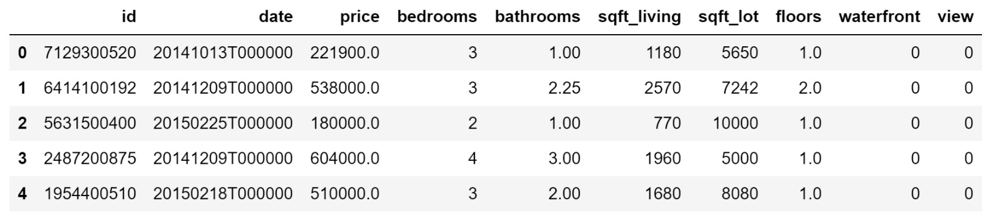
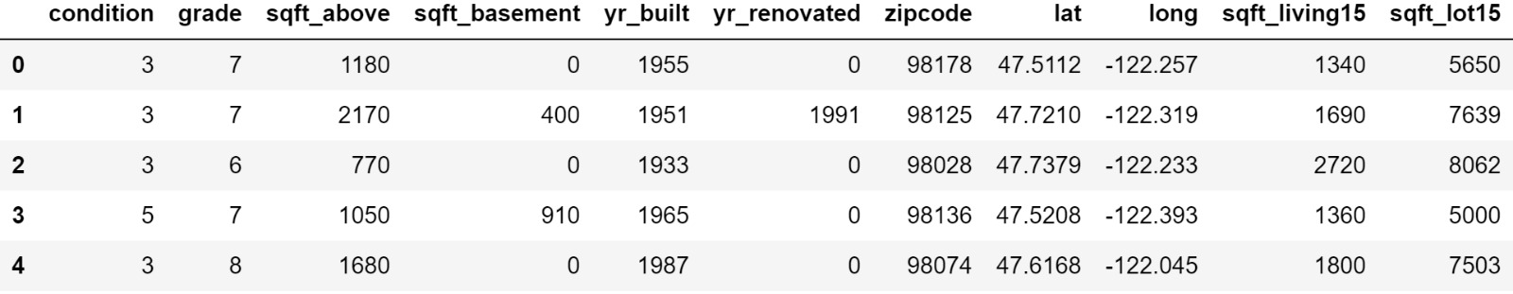
Initial Data-Frame

Slide 4
Pre-Processing
Trimmed date to year (Dirty Data)
Null values analysis (Missing Values)
Create dummy variable for date (2014->0, 2015->1)
Removed outliers.

Slide 5
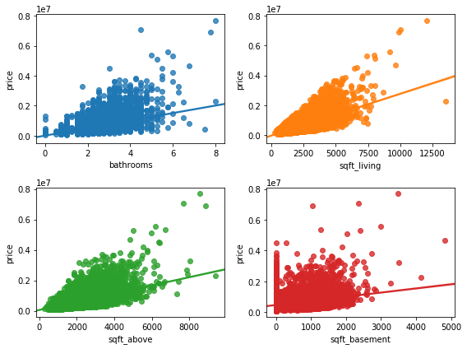
Exploratory Data Analysis

Slide 6
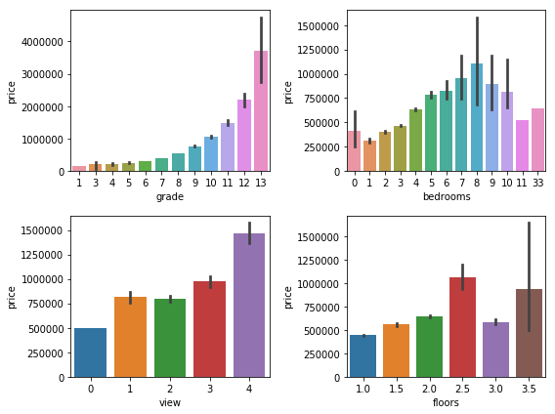
Exploratory Data Analysis Contd.

Slide 7
Regression Models
Top 12 attributes (using SelectKBest)
Train, Test and Validation Set
StandardScaler fit Training set
Transformed Train, Test and Validation set (Mean of 0 and Standard deviation of 1)

Slide 8
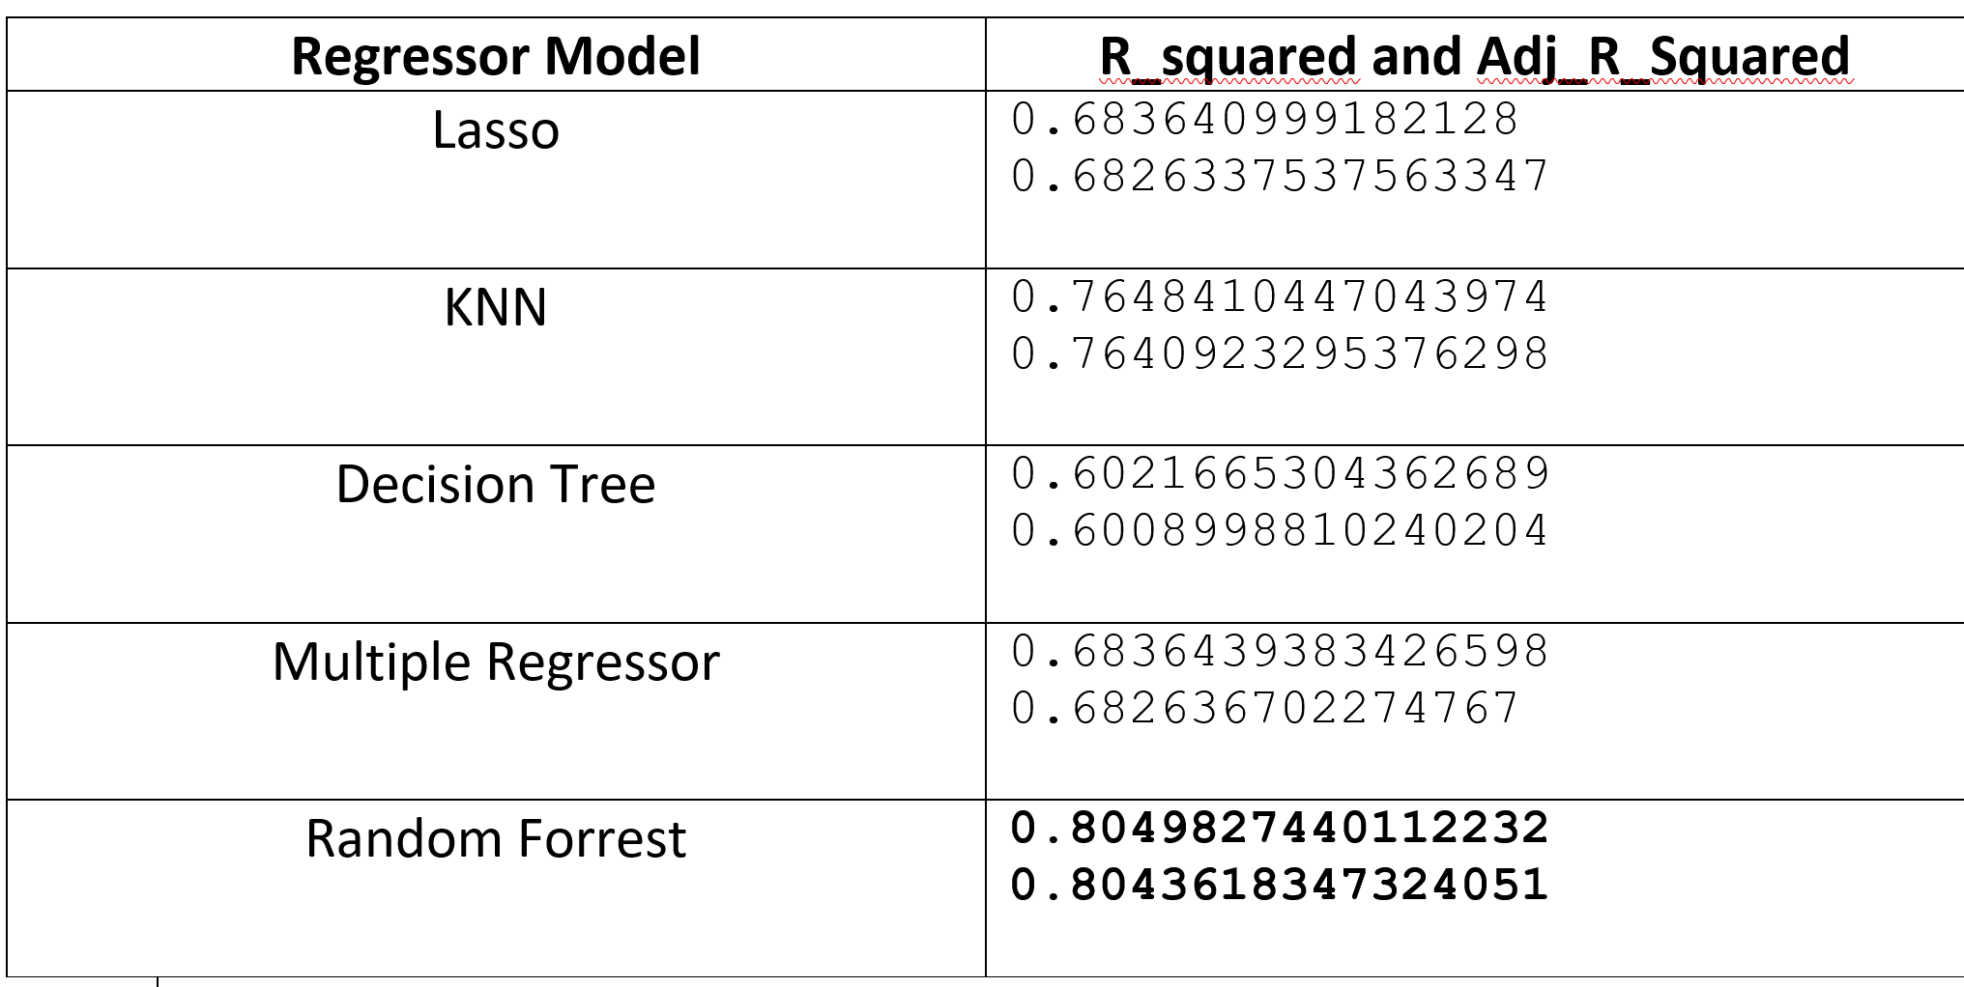
Regression Cont.

Slide 9
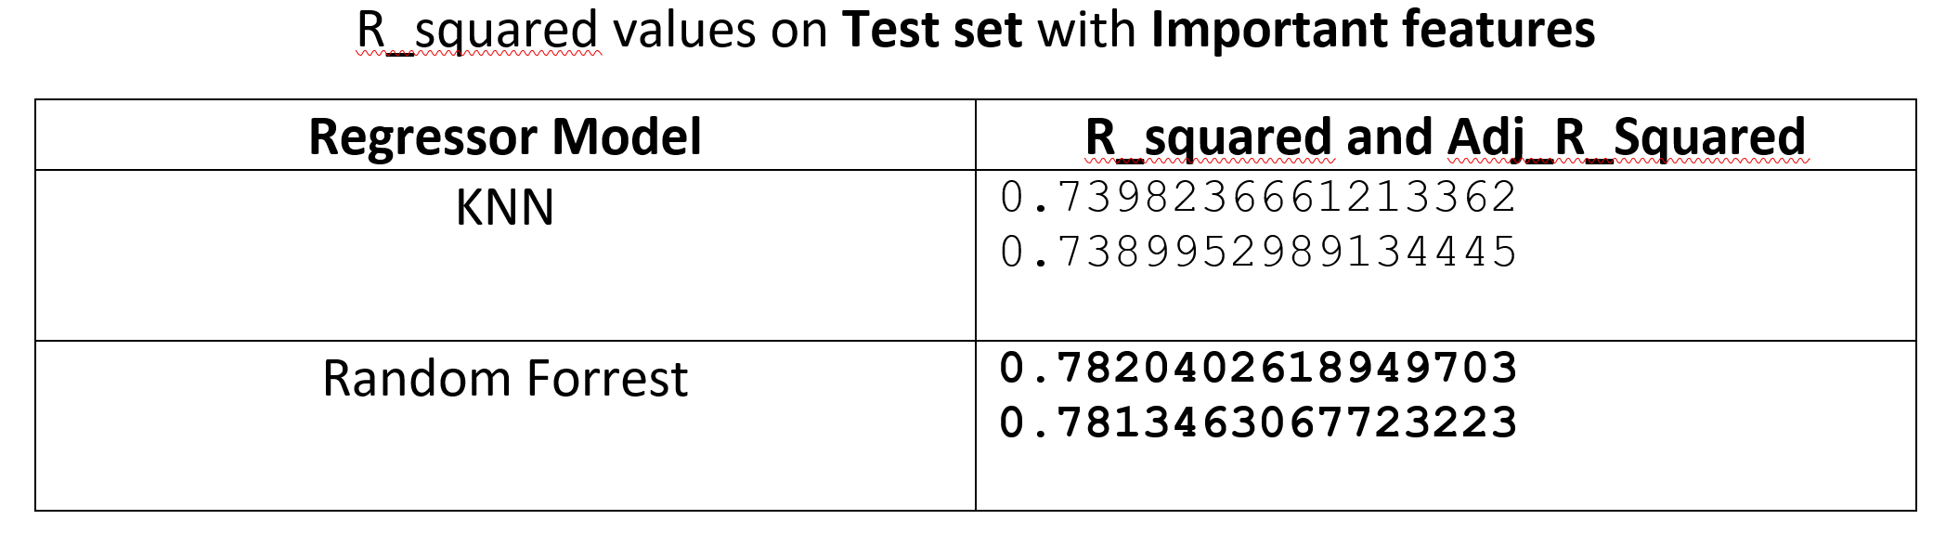
Regression Cond.

Slide 10
Clustering Models
Custom Cluster:
Price < 250000 – Light Blue
250000<price<500000 – Dark Blue
500000<price<1000000 – Green
1000000<price<3000000 – Yellow
3000000<price<5000000 – Light Red
Price>5000000 – Dark Red
K-means:
6 clusters using important features
Ward’s Linkage
6 clusters using important features

Slide 11
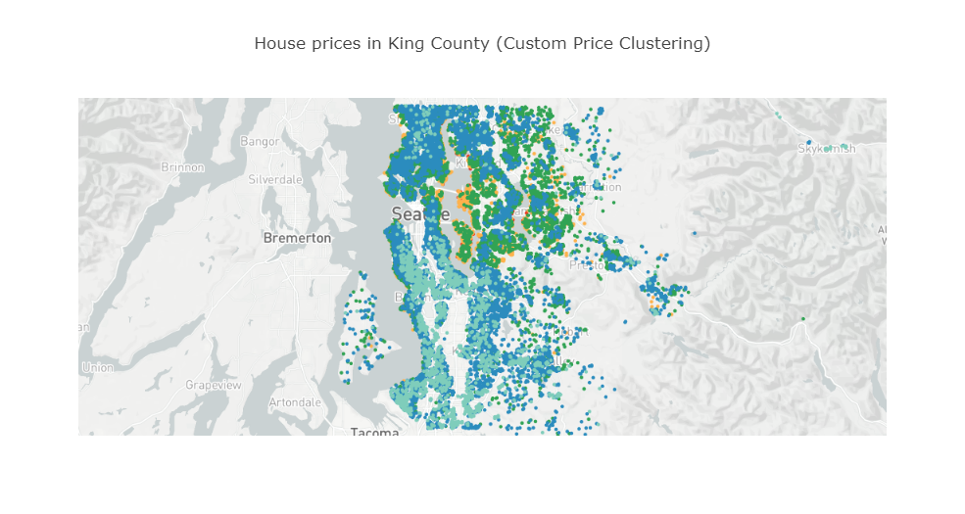

Slide 12
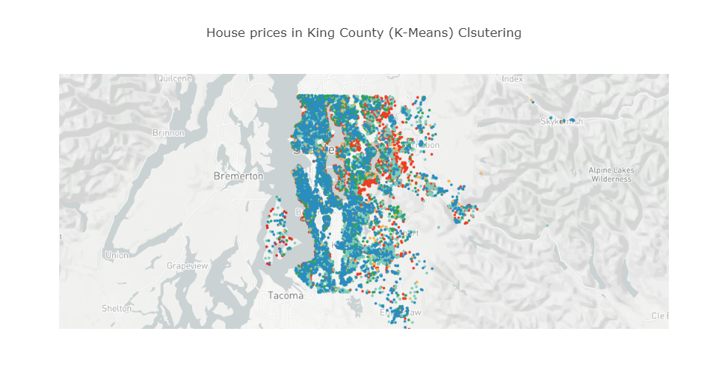

Slide 13
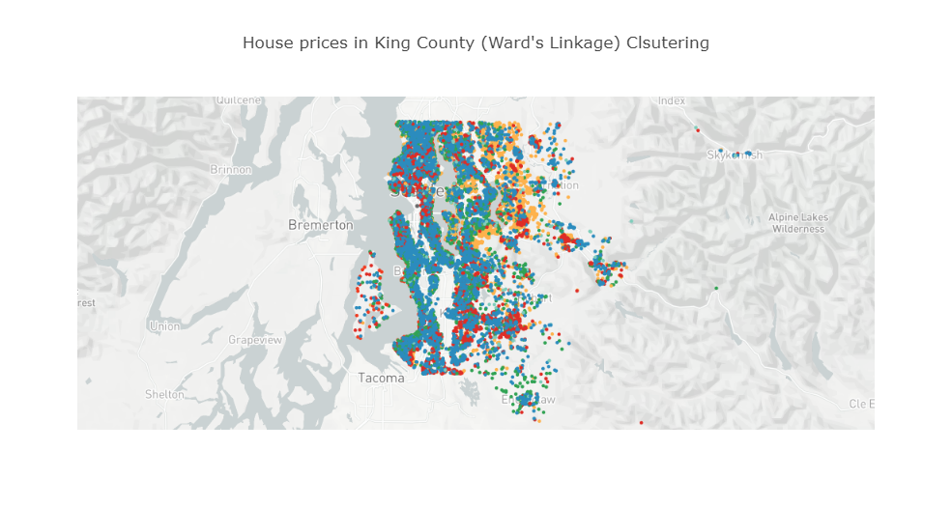

Slide 14
Conclusion
Good Regression models
Random Forest Regressor - 79% explanation is the variance of the dependent variable
Bad Clustering Models due to the no clear trend in clusters of data points.

Slide 15
Thank You

